Slide 1
Electrolyte Abnormalities
Gemma McGrory
Acute Medicine Registrar

Slide 2
Disclaimer*
Please note that QUACK is a regional teaching programme operating across GG&C, Lanarkshire and Ayrshire & Arran.
This presentation outlines general management, though local variances e.g. antibiotic prescription may vary slightly depending on your local trust
Remember to check your local guidelines

Slide 3
Learning Outcomes
Case based approach
Presentation on common electrolyte abnormalities and the practicalities of managing these

Slide 4
Case 1
85 year old man presents with confusion. His wife reports a 6 month history back pain and tiredness
Bloods
Na | 145
K | 5.2
Cl | 99
U | 16.7
Cr | 430
Ca | 3.63
Hb | 79

Slide 5
Diagnosis
Hypercalcaemia and AKI, most likely secondary to underlying myeloma

Slide 6
Wait, how did I get that diagnosis?
Back pain, anaemia and hypercalcaemia = classical triad indicating underlying myeloma, particularly in the elderly
AKI = common in hypercalcaemia due to dehydration

Slide 7
Hypercalcaemia
Primary hyperparathyroidism
  ‘Stones, bones, moans and groans’
Malignancy (most common)
  Metastases
  Myeloma (back pain / new anaemia)
Rare causes
  Sarcoid
  TB

Slide 8
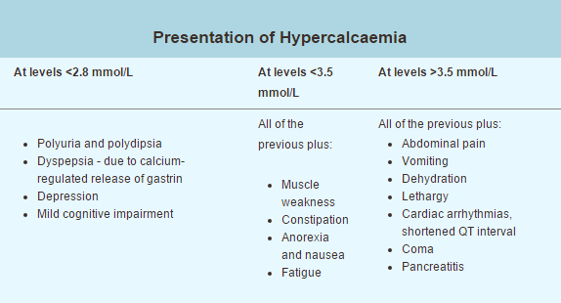
GGC Therapeutics Handbook

Slide 9
Hypercalcaemia - Ix
ECG & Cardiac monitoring
Look for underlying malignancy if suspected
Bloods:
  Serum immunoglobulins, serum free light chains, ESR, urinary Bence Jones protein
  PTH

Slide 10
Hypercalcaemia - Rx
Normal Calcium is 2.1-2.6
IV fluid rehydration 2l over 24 hours minimum
Stop precipitants
  Thiazide diuretics or calcium supplements
If no improvement after IV fluids
  Consider IV bisphosphonate
  Takes 4 – 7 days to work

Slide 11
Case 2
45 year old Asian lady presents with paraesthesia of her hands and spasms of her hands
Bloods
Na | 139
K | 3.8
Cl | 97
U | 6.1
Cr | 80
Ca | 1.97
Hb | 101

Slide 12
Diagnosis
Hypocalcaemia secondary to Vitamin D deficiency

Slide 13
Hypocalcaemia
Vitamin D deficiency
Chronic renal failure
    Secondary hyperparathyroidism
    Tertiary hyperparathyroidism
Hypoparathyroidism

Slide 14
Presentation
Paraesthesia
Tetany
Carpopedal spasm
Muscle cramps
Seizures
Prolonged QT
Confusion
Ca 2.00 – 2.20
Ca <1.99

Slide 15
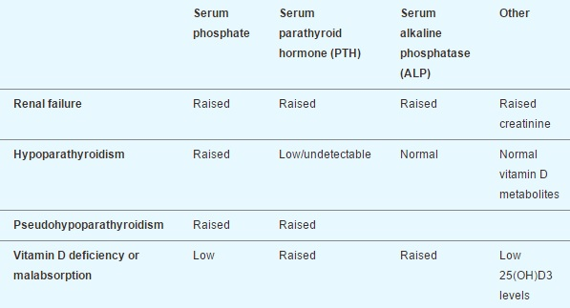
Hypocalcaemia - Ix
GGC Therapeutics Handbook

Slide 16
Hypocalcaemia - Rx
Oral replacement if Ca >2.00
  2 tabs Sandocal 3 times per day (total 50mmol daily dose)
IV replacement is Ca <2.00
  10mls 10% Calcium gluconate (2.2 mmol) over 10 mins then
  40mls 10% Calcium gluconate (8.8 mmol) over 24 hours in 1l saline

Slide 17
Case 3
79 year old man presents with confusion
Wife reports been seeing GP as been coughing up blood recently. Stopped smoking 3 years ago.
Bloods
Na | 116
K | 3.9
Cl | 101
U | 8.2
Cr | 106
Ca | 2.23
Hb | 99

Slide 18
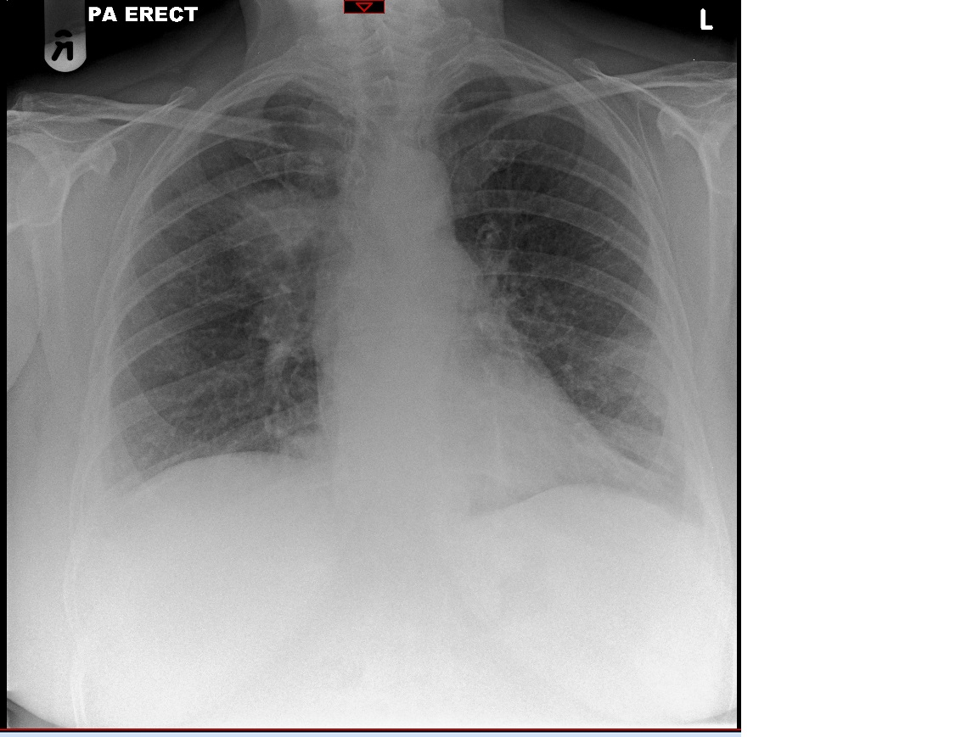
Diagnosis
Hyponatraemia secondary to SIADH due to underlying lung cancer

Slide 19
Presentation
Mild - anorexia, headache, nausea, vomiting, lethargy
Moderate - personality change, muscle cramps and weakness, confusion, ataxia
Severe - drowsiness

Slide 20
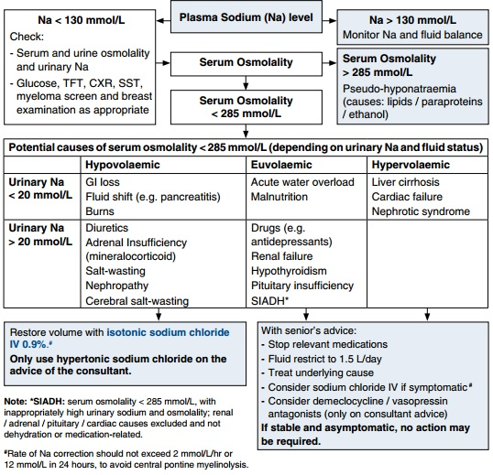
GGC Therapeutics Handbook

Slide 21
Case 4
97 year old lady with dementia brought in from nursing home with drowsiness. Been unwell with a UTI for a week and has had reduced oral intake
Bloods
Na | 168
K | 5.1
Cl | 101
U | 14.7
Cr | 357
Ca | 2.21
Hb | 117

Slide 22
Diagnosis
Hypernatraemia secondary to reduced oral intake in elderly confused patient and subsequent AKI
  Dehydration

Slide 23
Hypernatraemia
Decrease in total body water (TBW) relative to electrolyte content
  Dehydration
  Hypovolaemia
  Iatrogenic (i.e. too much saline / NG feeding)
Thirst -> CNS depression

Slide 24
Hypernatraemia - Rx
Treat any underlying disorder
Correct dehydration / hypovolaemia
  Aim to reduce serum Na by no more than 10-12mmol/l per day
  Why?

Slide 25
Case 5
You are chasing the bloods of one of your patients who has been on IV fluids
Bloods
Na | 142
K | 3.1
Cl | 110
U | 6.2
Cr | 81
Ca | 2.24
Hb | 137

Slide 26
Hypokalaemia
Mild 3.1 – 3.5
Moderate 2.5 – 3.0
Severe <2.5
Classification:
  Increased loss via the kidney (specific renal conditions or through thiazide diuretics) or gut (vomiting, diarrhoea)
  Transcellular shifts (e.g. insulin and glucose, salbutamol)
  Decreased intake of potassium (malnutrition or no IV K in IV fluids)

Slide 27
Presentation
Symptoms usually when <3.0
  Tiredness, constipation, weakness
When <2.5
  Severe weakness, paralysis respiratory failure, paraesthesia, tetany

Slide 28
Management
Replace potassium orally when 3.0 – 3.5
  Sando K, Slow K
Replace IV when <3.0
  IV KCL 40mmol in 500mls saline (no faster than over 4 hours)
  Cardiac monitoring

Slide 29
Case 6
95 year old man with known prostatic cancer presents to A&E with acute abdominal pain and is unable to pass urine
Bloods
Na | 139
K | 8.7
Cl | 108
U | 27.4
Cr | 1230
Ca | 2.24
Hb | 136

Slide 30
Diagnosis
Hyperkalaemia and Stage III AKI secondary to renal tract obstruction

Slide 31
Hyperkalaemia
Causes
  Renal Failure
  Drugs (ACE-I, K+ sparing diuretics, spironolactone)
  Potassium supplements
  Hypovolaemia
  Acidosis
  Addison’s (low Na, high K)

Slide 32
ECG Changes of Hyperkalaemia
Tall tended T waves
Flattened P waves
Prolonged PR interval
(1st degree heart block)
Progressively widened QRS
Sine wave pattern
VF
Increasing K+

Slide 33
Management
K+ 5.5 – 6.0
  Oral calcium resonium 15g tds with lactulose
K+ 6.0 or greater, or ECG changes
  10ml 10% calcium gluconate (6.8mmol Ca)
    Peak effect in minutes, lasts 1 hour
  10 units actrapid in 50mls 50% dextrose
    Peak effect 15-20 mins, last 2-4 hours
  Salbutamol nebulisers
  Sodium bicarbonate (under senior advice)

Slide 34
Summary
Case based approach
Discussed common electrolyte abnormalities and their management
  Hypercalcaemia
  Hypocalcaemia
  Hyponatraemia
  Hypernatraemia
  Hypokalaemia
  Hyperkalaemia

Slide 35
Get in touch!
Website
www.quackmeded.co.uk
Email
ggc.quackmeded@nhs.scot
Social Media
Twitter: @QUACK_ Med
Facebook: QUACK education

