Slide 1
Acute COPD & Oxygen
Gemma McGrory
Acute Medicine Registrar

Slide 2
Disclaimer*
Please note that QUACK is a regional teaching programme operating across GG&C, Lanarkshire and Ayrshire & Arran.
This presentation outlines general management, though local variances e.g. antibiotic prescription may vary slightly depending on your local trust
Remember to check your local guidelines

Slide 3
COPD
Chronic progressive fixed airflow obstruction
Smoking major cause
Elements bronchitis and emphysema
  ?

Slide 4
COPD
Bronchitis – chronic cough and sputum production for a least 3 months of two consecutive years in the absence of other causes
Emphysema – abnormal, permanent enlargement of the air spaces distal to the terminal bronchioles with destruction of their walls

Slide 5
Clinical Signs
Hyperinflated chest
Central cyanosis
Weight loss
Cor pulmonale
Flapping tremor
Pursed lip breathing
Wheeze

Slide 6
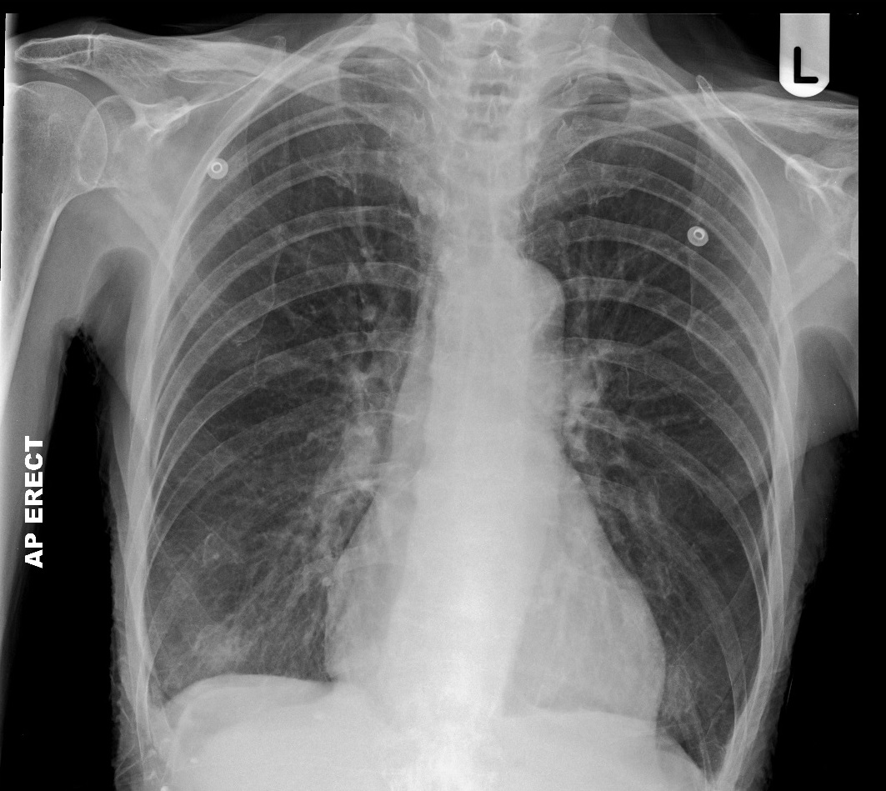

Slide 7
Symptoms
Cough
Sputum
SOB
Wheeze
Reduced exercise tolerance
Symptoms of right heart failure

Slide 8
Investigations
CXR
Sputum culture
ABG
ECG
  P pulmonale, right axis deviation, RBBB
Lung function tests (PFTs)
  Obstructive defect FEV1/FVC <70%
  If severe, can be <30%

Slide 9
Acute Management
Aims sats 94-98% unless CO2 retainer then aim for 88-92%
2.5mg Salbutamol nebs
0.5mg Iprotropium nebs
Steroids – 40mg prednisolone in non-COVID
+- Antibiotics if infective precipitant
Call for help if not improving or Type II RF
  IV Aminophylline
  NIV
  ITU

Slide 10
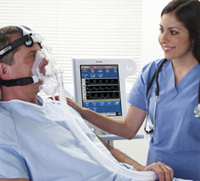
NIV
Non-Invasive Ventilation
Provides positive pressure airway support
COPD
Respiratory acidosis
Not improving after 1
hour optimal medical
therapy

Slide 11
Management
Smoking cessation
Influenza / pneumococcal vaccine
Mild disease (FEV1 <80%)
  Ipatropium and salbutamol
Moderate disease (FEV1 <50%)
  Steroid inhaler
Severe disease (FEV1 30%-50%)
  Nebuliser
  Consider LTOT

Slide 12
Lung Function Tests
Identification of certain primary lung diseases
Following the course of a specific disease over time
Quantification of severity
Assessment of a response to treatment
Exclusion of certain disease processes from diagnostic consideration

Slide 13
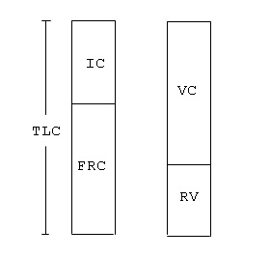
Important Points
Total lung capacity (TLC) (the total volume of gas contained in the lungs)
Functional residual capacity (FRC) (volume of gas left in the lungs at the end of expiration)
Residual volume (RV) (volume of gas left in the lungs at the end of forced expiration)
vital capacity (VC) the difference between the largest (TLC) and the smallest (RV) lung volumes which can be obtained

Slide 14
What we are interested in
FVC - represents the entire volume exhaled from the lungs in a forced breath
FEV₁ - volume of gas exhaled in the first one second of exhalation

Slide 15
Lung Function Tests
Obstructive
Restrictive
FEV1 and FVC both reduced, with FEV1 reduced more, meaning FEV1/FVC <0.7
Issue is reduction of expiratory flow
Asthma / COPD
FVC reduced along with FEV1 proportionally, meaning FEV1/FVC >0.7
Issue is reduction in total lung volume
Interstital Lung Disease

Slide 16
Complications
Respiratory failure
Recurrent exacerbations
Cor pulmonale
Polycythaemia
Pneumothorax
Lung cancer
Osteoporosis

Slide 17
Oxygen
Oxygen devices
LTOT

Slide 18
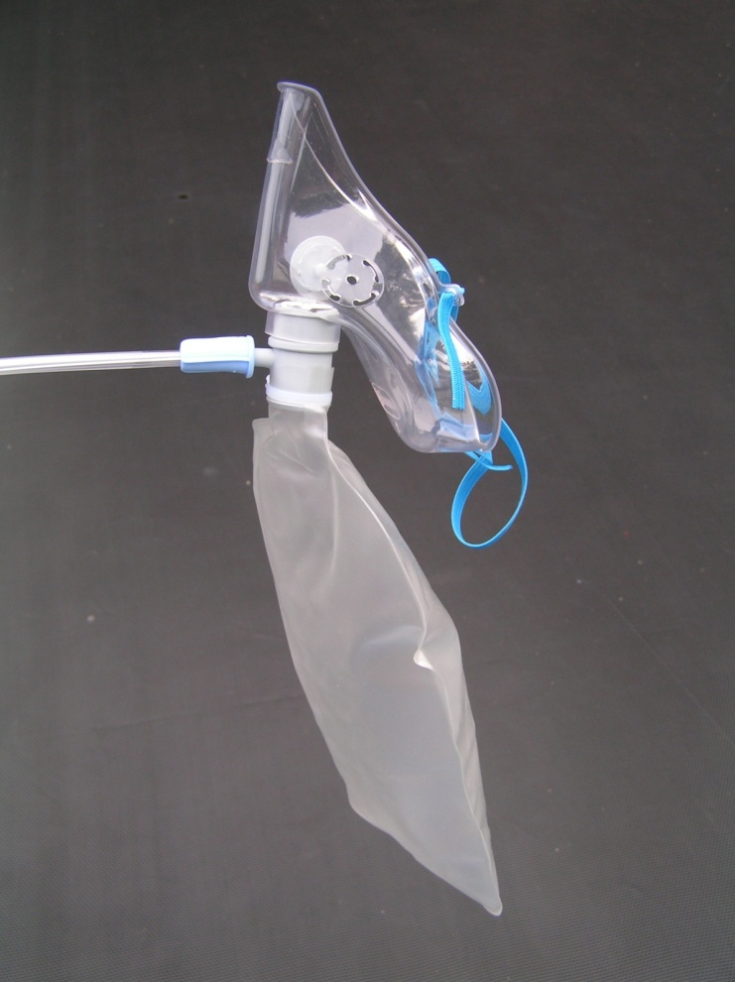
Reservoir Mask
Non re-breathing
High flow device
Delivers O₂ concentrations between 60 & 85%
Used in critical illness

Slide 19
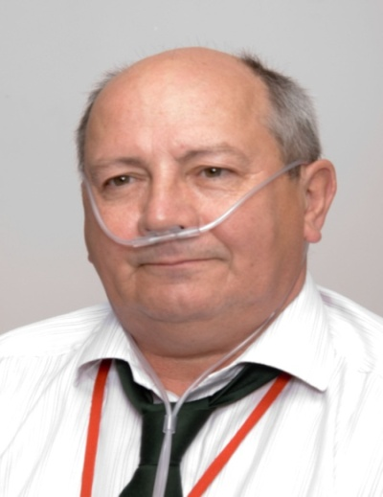
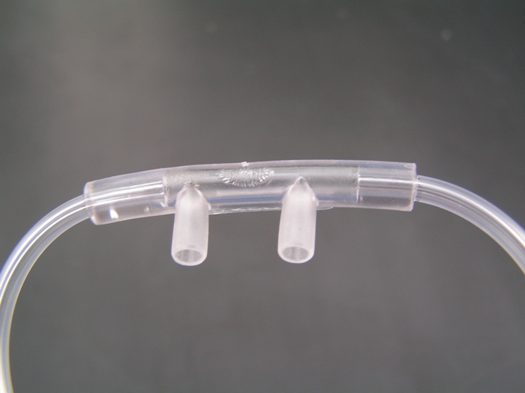
Nasal Cannulae
Low flow variable performance device
2-6L/min gives approx 24-50% FIO₂
Comfortable and easily tolerated
Can be used for Type I or Type II respiratory failure

Slide 20
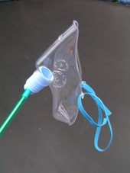
Hudson Mask
Variable performance device
Flow 5-10 L/min
Delivers variable O₂ concentration between 35% & 60%
Used for patients with type I respiratory failure.

Slide 21
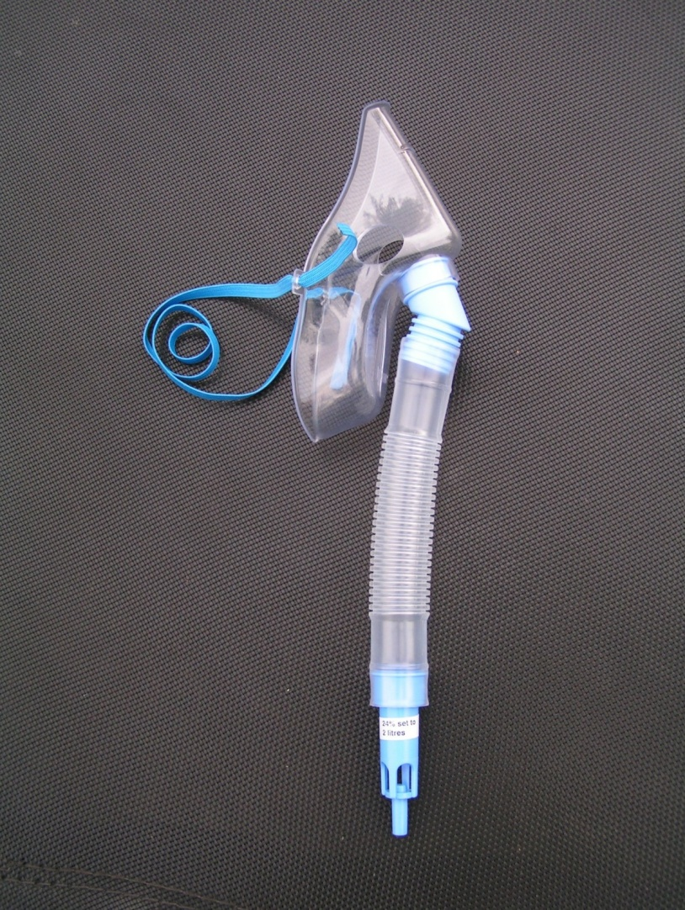
Fixed Flow Devices
Deliver constant oxygen concentration within and between breaths
Increasing flow does not increase FIO₂
Helpful for Type II RF as know exact % of O2 being delivered

Slide 22
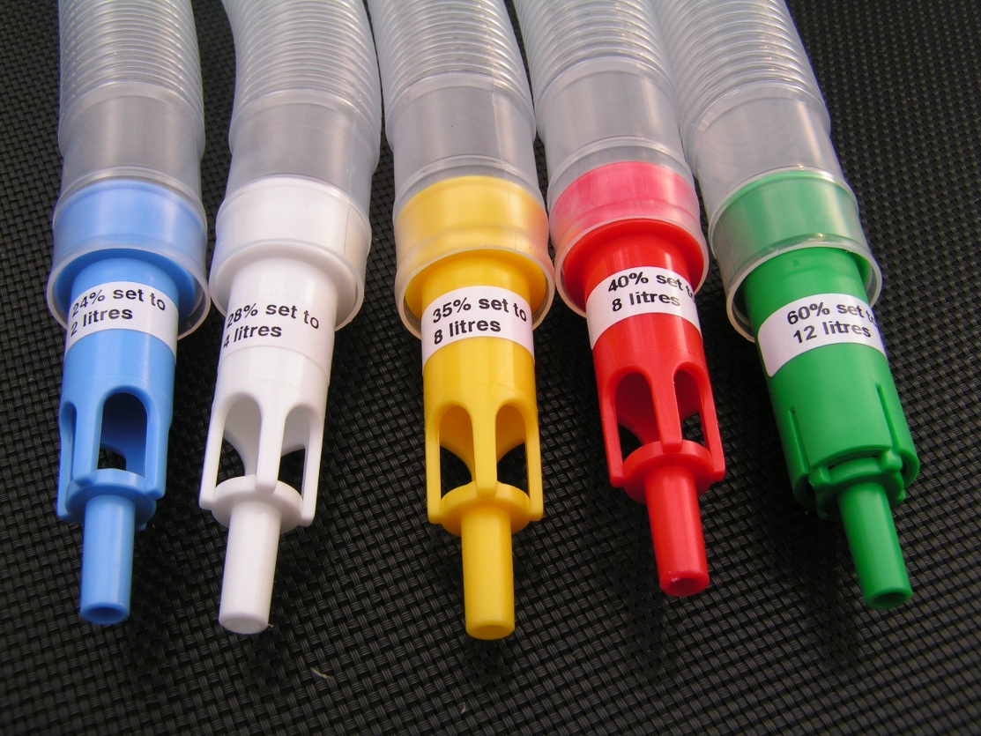
Notes:
flow rate of the gas at the face exceeds the maximum inspiratory flow rate except when the patient is very tachypnoeic

Slide 23
LTOT
Strict criteria
  NON SMOKER
  FEV1 <1.5L
  ABG x 2 3 weeks apart when well
  paO2 <7.3 (or <8.0 if cor pulmonale)
  paCO2 normal or ↑
  paO2 should ↑ >8.0 whilst on O2 with no significant ↑paCO2
Proven to ↑ 3 year survival in eligible patients
Need to ↑paO2 > 8kPa for >15 hours/day

Slide 24
Get in touch!
Website
www.quackmeded.co.uk
Email
ggc.quackmeded@nhs.scot
Social Media
Twitter: @QUACK_ Med
Facebook: QUACK education

