Slide 1
Neutropenic Sepsis
Jennifer MacDougall
Acute Oncology Nurse Specialist

Slide 2
Disclaimer*
Please note that QUACK is a regional teaching programme operating across GG&C, Lanarkshire and Ayrshire & Arran.
This presentation outlines general management, though local variances e.g. antibiotic prescription may vary slightly depending on your local trust
Remember to check your local guidelines

Slide 3
Neutropenic Sepsis
Febrile neutropenia is the most common complication of anticancer treatment, and describes the presence of fever in a person with neutropenia
Pyrexia temperature > 38◦C or Hypothermia (< 36◦C) OR > 37.5◦C on 2 occasions 30 minutes apart
Neutrophil count < 0.5 or < 1 x 109/L if recent chemotherapy or lower, or expected to fall below this level (usually within 10 days but can persist for up to 21 days)

Slide 4
Patient Journey
Prior to starting SACT patients are educated regarding potential side-effects
They are given contact details for the Cancer Treatment Helpline and advised to contact if they develop temp/side- effects
They are given chemo diary, detailing the combination of chemo Drugs they have received and any medication given to take post-chemo
Notes:
Beatson is a cold site, so if someone unwell they may be re-directed through A&E, if out of hours they will come via IAU as per agreed pathway, triage sheet is scanned onto portal.

Slide 5
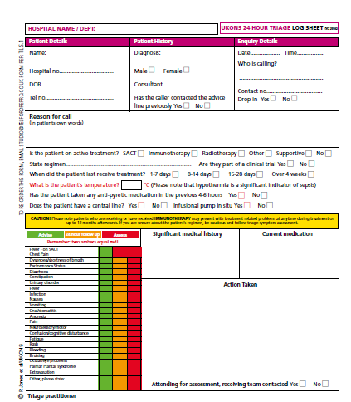
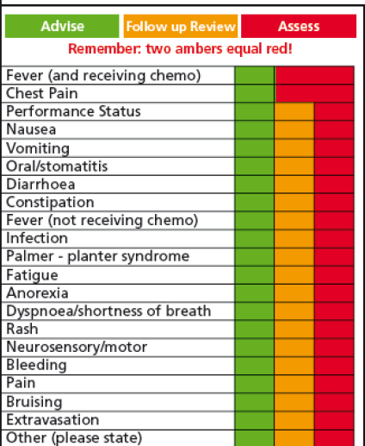
UKONS Triage Tool
CTH 24 hours helpline for patients undergoing cancer treatment
Allows rapid assessment of symptoms
Criteria sensitive to the more specific side effects of SACT
Guides Triage practitioner to most appropriate treatment pathway
The assessment sheet is scanned onto portal, under nursing assessment

Slide 6
QEUH or Beatson
Acute Oncology Assessment unit at Beatson receives patients 0800-1800
Strict admission criteria i.e., no active bleeding, chest pain etc
NEWS <5
Limited critical care at BOC- HAU
Out of hours and weekends likely to attend IAU at QEUH

Slide 7
Practice points
On arrival patient may not look unwell
Mortality rates 2-21% !!!
They may have been given or taken paracetemol prior to arriving at IAU
The ANC may be 1.2. However, it may continue to fall post-chemo.

Slide 8
Management
SEPSIS SIX
RAPID ASSESSMENT & ACTION – SAVES LIVES!!
Blood & line cultures and then Antibiotics (ABX) see local guidelines
FBC, UE, LFT, Bone, CRP, Mg, lactate & Coag. (Risk of DIC)
If pancytopenic – will need platelets
fluids & ABX within 1h (DO NOT WAIT FOR BLOOD RESULTS!)
Close monitoring – regular obs, fluid balance-don’t hesitate to escalate issues
High flow oxygen
Once stable – CXR, MSSU, Sputum culture
Notes:
Don't delay, assume patients are neutropenic

Slide 9
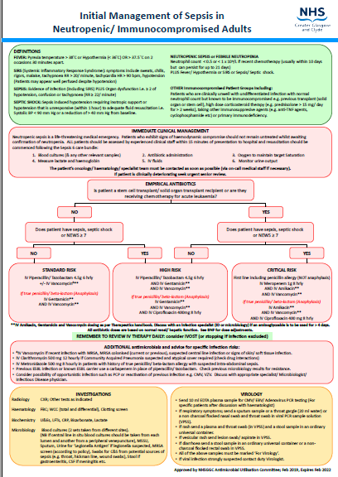

Slide 10
CVAD
Take blood cultures from line, use initial sample for blood culture
Line can be used if trained to do so and familiar with device
Signs of CVAD infection: inflamed around exit site, pyrexia/rigors post flushing, previous history of line infection, other soft tissue infection

Slide 11
GCSF
(Granulocyte Colony Stimulating Factor)
Primary Prophylaxis
  Not routinely prescribed unless specified in SACT protocol
  Only considered when SACT is being given with curative intent and dose intensity is important
  Given is SACT regimen has >20% incidence of febrile neutropenia
Therapeutic use
  Very little evidence base, no proven survival benefit
  Caution needed in thrombocytopenic patients
  Toxic medication with significant side effects

Slide 12
Multinational Association for Supportive Care in Cancer (MASCC)
Risk scoring systems such as the Multinational Association for Supportive Care in Cancer (MASCC), may be used to help risk-stratify patients
These to help determine the approach to evaluation and treatment, such as, mode of empiric antibiotic (oral vs. IV), treatment setting (inpatient vs. outpatient), and antibiotic duration
Not Commonly used in practice currently.
Carefully-selected low risk patients could receive oral or IV empiric antibiotics in a clinic or hospital setting and may be transitioned to outpatient regimens if they meet certain criteria

Slide 13
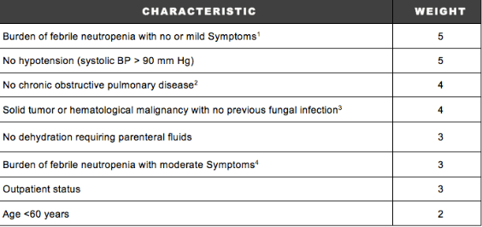
Example Score Table
A score of ≥ 21 is considered low risk and a score of < 21 as high risk
Burden of febrile neutropenia refers to general clinical status as influenced by the febrile neutropenic episode. It is evaluated in accordance with the following scale: no symptoms (5), mild symptoms (5), moderate symptoms (3), severe symptoms (0), moribund (0).

Slide 14
Challenges in IAU
Time of admission
Volume of patients
Initial triage process
AOS not available out of hours
Rapidly changing landscape of cancer treatment.

Slide 15
Future developments
AOS out of hours cover?
Using MASCC scoring systems to identify low risk patients
Pre-prescribed antibiotics-patient given prescription that could be used when admitted to IAU- IVAB/IVF

Slide 16
Thank you
Please fill out the feedback form for your certificate of learning

Slide 17
Get in touch!
Website
www.quackmeded.co.uk
Email
ggc.quackmeded@nhs.scot
Social Media
Twitter: @QUACK_ Med
Facebook: QUACK education

