Slide 1
Sepsis & SIRS
QUACK Teaching
Leonard Farrugia
ST3 Infectious Diseases/Medical Microbiology
West of SCOTLAND

Slide 2
Disclaimer*
Please note that QUACK is a regional teaching programme operating across GG&C, Lanarkshire and Ayrshire & Arran.
This presentation outlines general management, though local variances e.g. antibiotic prescription may vary slightly depending on your local trust
Remember to check your local guidelines

Slide 3
SESSION STRUCTURE & OBJECTIVES
Context: where are we and where would we like to be
Pathophysiology: sepsis as malignant intravascular inflammation
History of sepsis: Hippocrates → SIRS → SOFA
Evaluation & Management: Sepsis 6 & beyond
Case study
Prognostic factors
Conclusions & Summary

Slide 4
AREAS NOT COVERED
Paediatric & Neonatal Sepsis
Neutropaenic sepsis & Febrile neutropaenia

Slide 5
Not merely Medical, but also political

Slide 6
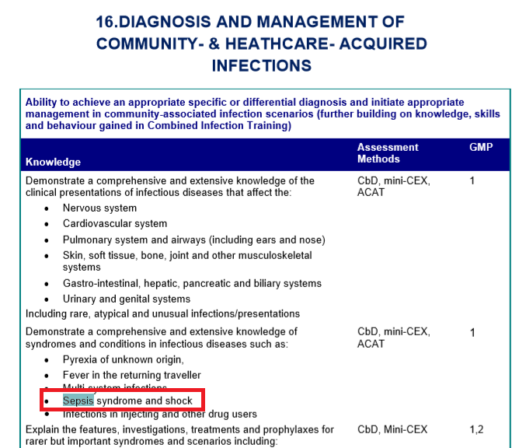
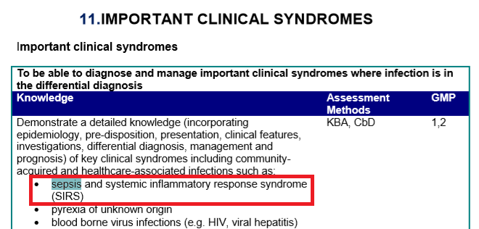
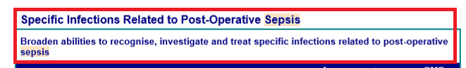
NEVER MIND THE GUARDIAN… ALSO A CORE CURRICULUM Competency

Slide 7
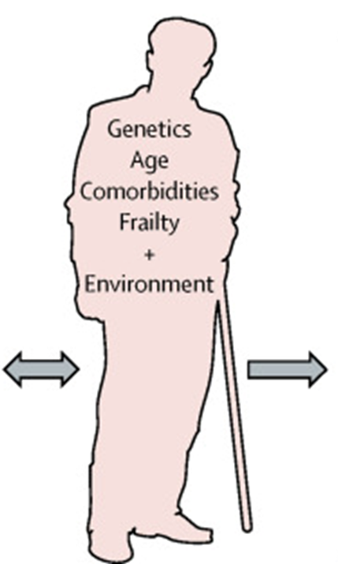
EPIDEMIOLOGY & RISK FACTORS
~250,000 cases/year in UK
Est mortality of 20-30%
~40-70,000 deaths annually in UK: more than colorectal + breast + lung + prostate cancers combined
Epidemiological Factors |  | Co-morbidities
ICU admission |  | DM
Advanced age >65 |  | Obesity
Previous hospitalization |  | Cancer
Bacteraemia |  | Immunosuppression (Asplenia, HIV/AIDS)
 |  | ESKD, CLD

Slide 8
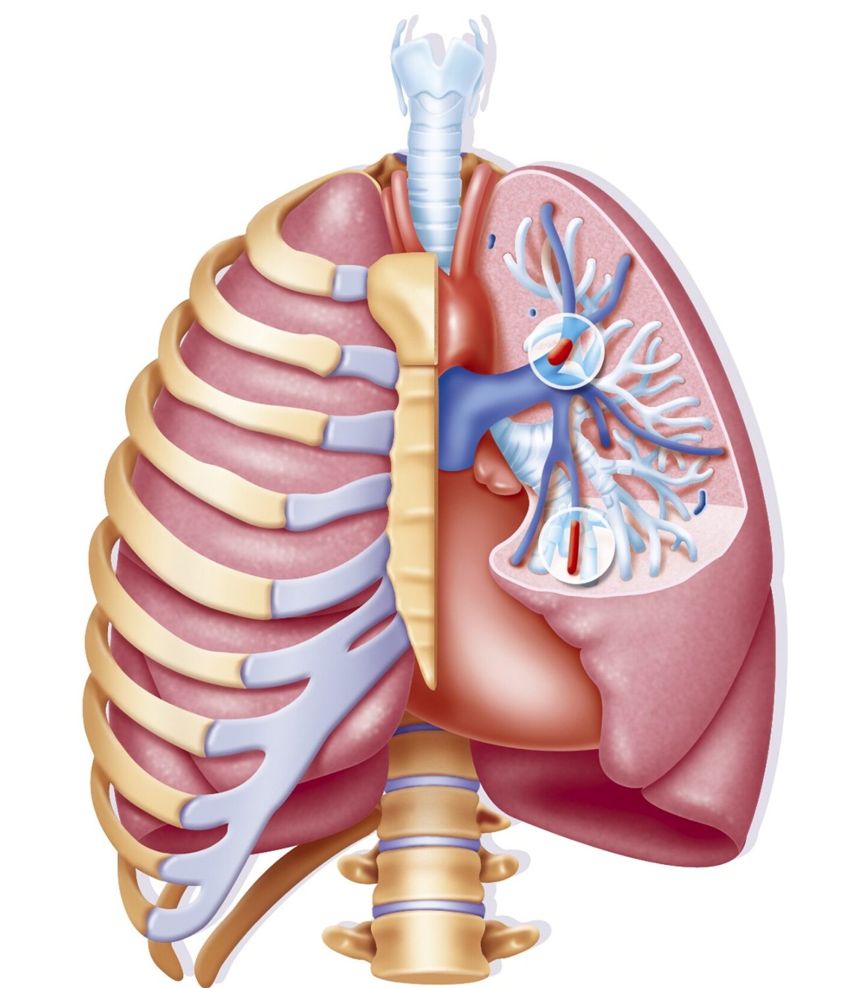

IDEAL OUTCOMES
To reliably identify the minority of patients with severe life-threatening infection
Provide care that consistently reduces morbidity and mortality from severe infection
While skirting the perils of
overtreatment (ADRs, CDI, AMR)
misdiagnosis (PE, infection mimics)

Slide 9
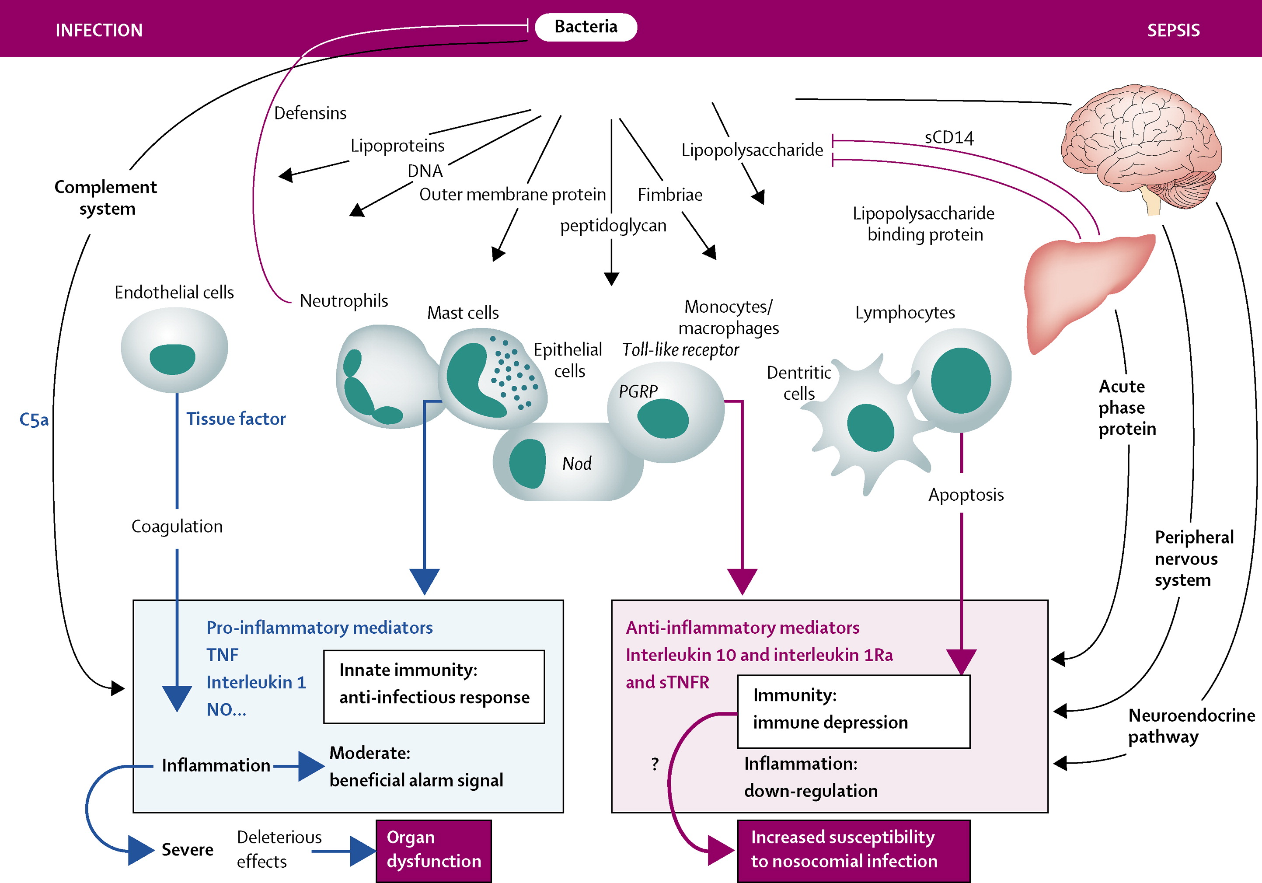
PATHOPHYSIOLOGY: cellular to tissue level
Annane D, Bellissant E, Cavaillon JM. Septic shock. Lancet. 2005;365(9453):63-78.

Slide 10
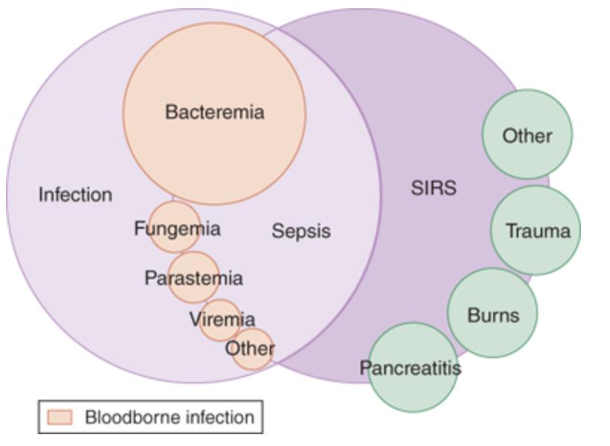
CLINICAL Sepsis AS a “LIMINAL SPACE”
Broad term covering a syndrome rather than a specific illness
No simple, unambiguous clinical criteria
No biological, imaging, or lab features which uniquely identify a septic patient.
Currently identified as a constellation of clinical signs/symptoms & physiological / biochemical derangements in a patient with suspected infection

Slide 11
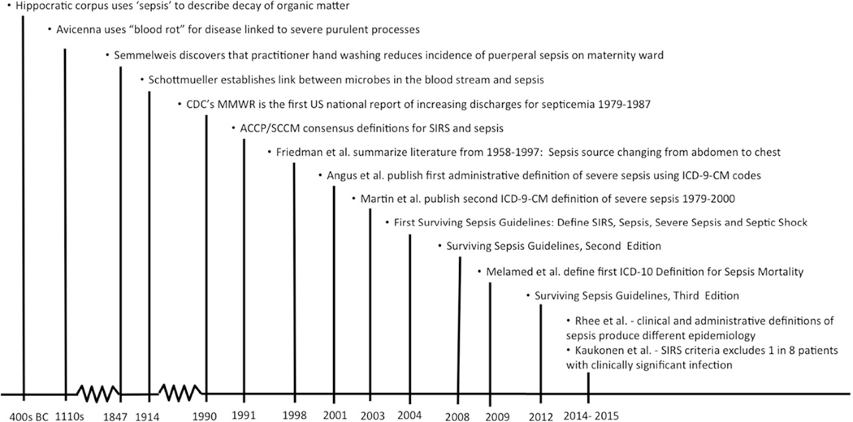
GENEALOGY OF SEPSIS AS CONCEPT

Slide 12
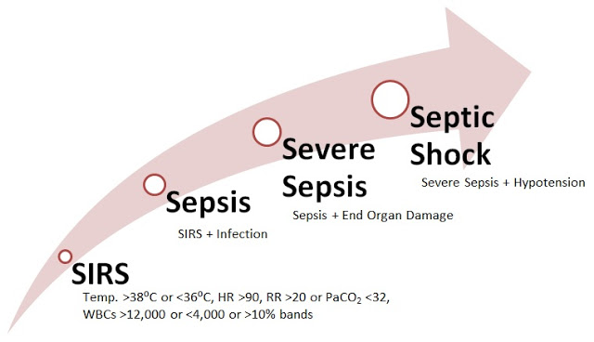
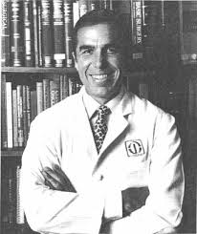
Sepsis: Defined in 1991
Roger C Bone
1941-1997
Notes:
Sepsis = result of host systemic inflammatory response:
SIRS criteria
Severe sepsis = sepsis + organ dysfunction
Septic shock = sepsis induced hypotension despite adequate fluid resuscitation

Slide 13
WHY was SIRS unsatisfactory?
Not specific – half of all screened ward patients are SIRS+ve at some point throughout their admission
Not sensitive - ~12% of ICU admissions with sepsis have an absent SIRS response (not pro-inflammatory)
Not a marker of severity - does not accurately identify patients at risk of significant morbidity and mortality
Notes:
1. pancreatitis, trauma, surgery
4. (AUS/NZ study 1 in 8 patients admitted to ICU with organ failure & infection had less than 2 SIRS criteria)

Slide 14
Sepsis: Redefined in 2016
‘life-threatening organ dysfunction caused by a dysregulated host response to infection.’
Non-homeostatic host response
Potential lethality in excess of straightforward infection
Need for urgent recognition

Slide 15
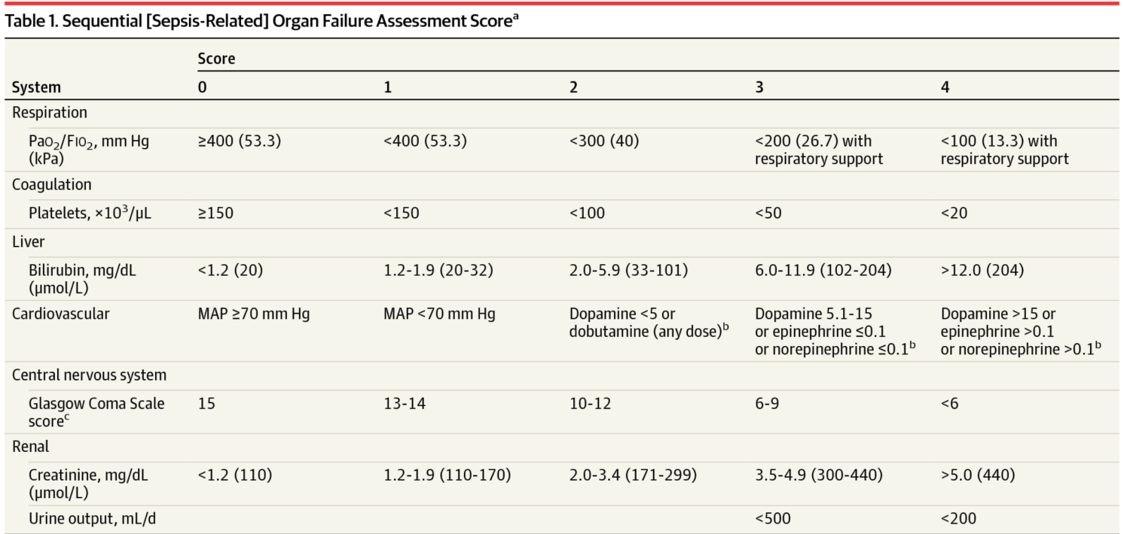
FROM SIRS TO SOFA
BUT not suitable for assessment of patients at the front door, hence qSOFA.
Notes:
APACHE
Organ dysfunction = change in baseline SOFA score of 2 or more points = overall mortality risk of 10% (greater than overall mortality risk of STEMI (8.1%)

Slide 16

qSOFA
(quick Sepsis related Organ Failure Assessment)
Presence of ≥ 2 criteria in patients with suspected infection identifies adult patients likely to have poor outcome
Altered mentation
SBP ≤100mmHg
RR≥22
Notes:
Presence of 2/3 of GCS ≤13, SBP ≤100mmHg, and RR≥22 offered similar predictive value to full SOFA score outside ICU.
In ICU full SOFA score was superior
Can be assessed quickly and repeatedly ( no lab tests needed)
InICU (?reflecting modifying effect of interventions – vasopressors, sedatives, vent)

Slide 17
qSOFA ≥2
Prompt investigation for organ dysfunction
Prompt initiation or escalation of treatment as appropriate
Prompt consideration of referral to critical care or increase frequency of monitoring
Prompt consideration of possible infection in those not previously recognised as infected.

Slide 18
Septic shock
Subset of sepsis in which underlying circulatory and cellular/metabolic abnormalities are profound enough to substantially increase mortality
Identified by patients with sepsis PLUS persisting hypotension requiring vasopressors to maintain MAP ≥ 65mmHg PLUS serum lactate ≥ 2 despite adequate fluid resus.
(definition combines a measure of cellular dysfunction (‘cryptic shock’) and cardiovascular compromise)
Septic shock → hospital mortality >40%

Slide 19

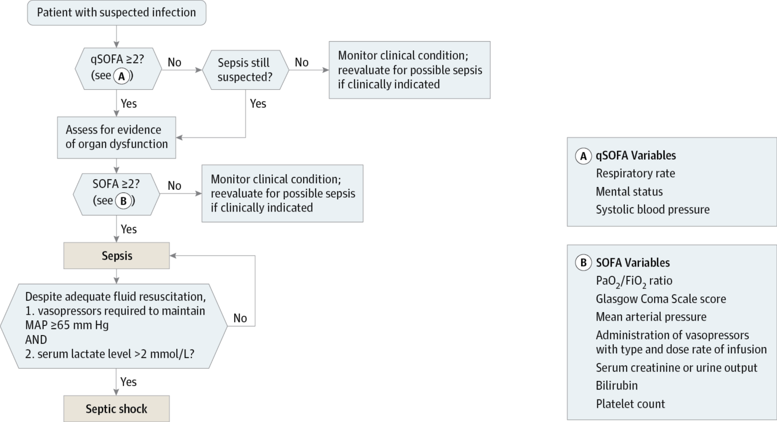
From: The Third International Consensus Definitions for Sepsis and Septic Shock (Sepsis-3)
JAMA. 2016;315(8):801-810. doi:10.1001/jama.2016.0287
Date of download: 5/12/2016
Copyright © 2016 American Medical Association. All rights reserved.

Slide 20
CASE #1
CT2 ITU on-call DGH
55yM p/w fever, abdominal pain, diarrhoea
PMH: schizophrenia / DSH / AAA under surveillance by Vascular
O/E: T 38.5C RR 33/min HR: 120/min BP: 140/90 GCS: 15 SpO2 96% RA. Cold, clammy; looks dreadful. Clear chest, tender RUQ
CXR: NAD
Med SpR refers to ICU as suspected abdominal sepsis.
Dodgy ITU consultant on-call argues against sepsis as qSOFA 1/3 –
Is this correct?

Slide 21
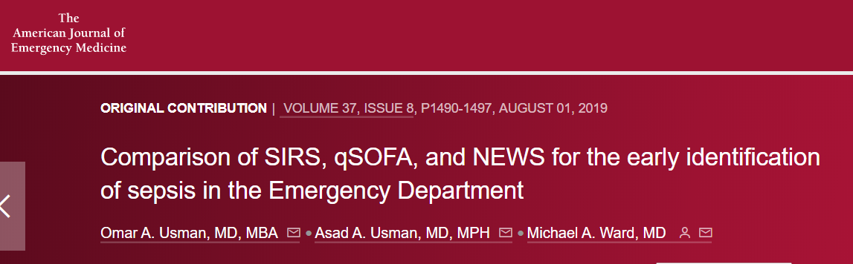
qSOFA <2 DOES NOT EXCLUDE SEPSIS
qSOFA as a microcosm of NEWS – higher specificity for sepsis defined as organ dysfunction but decreased sensitivity
SIRS > qSOFA for sepsis diagnosis, qSOFA > SIRS in predicting hospital mortality. Combining both criteria may provide a better model to initiate Rx
NEWS = SIRS > qSOFA for ED

Slide 22
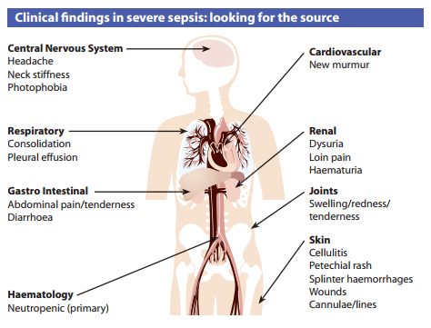
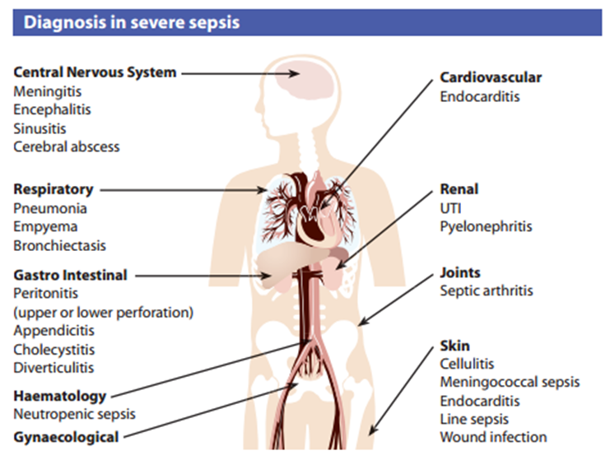
DIAGNOSIS / the art of establishing a source

Slide 23
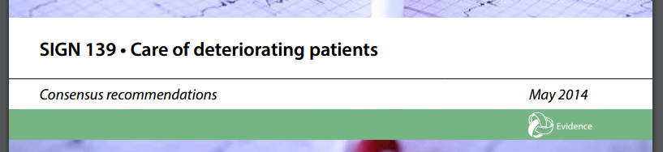
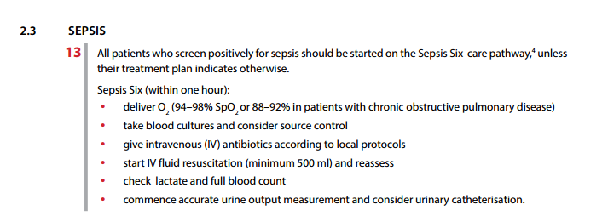
Initial Management: Sepsis 6

Slide 24
The golden hour
Kumar A, Roberts D, Wood KE, et al. Duration of hypotension before initiation of effective antimicrobial therapy is the critical determinant of survival in human septic shock. Crit Care Med. 2006;34(6):1589-1596.

Slide 25
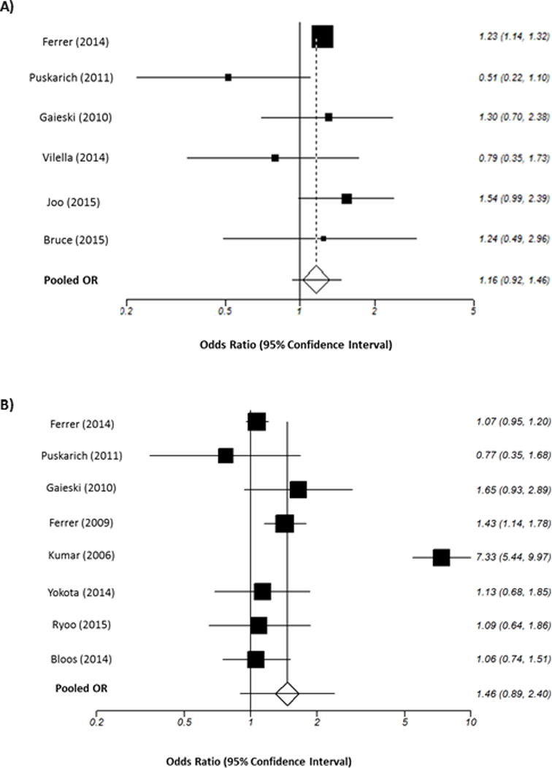

TIME-TO-ANTIBIOTIC: DOES IT MATTER?
Golden hour only appears to apply to patients in septic shock – little evidence that delays of <3-6h matter across the board.
Dutch RCT n=2698; no effect
Mortality TTA 3h
Mortality TTA 1h

Slide 26

ANTIBIOTIC CHOICE

Slide 27
IMPACT OF IN VITRO antibiotic susceptibility on outcome
697 NHS IP w/ GNB
34% of empiric Rx R in vitro
No negative impact on outcome
1702 European ICU IP w/ BSI
30% of empiric Rx R in vitro
No negative impact on outcome

Slide 28
DIAGNOSTIC MICROBIOLOGY-DRIVEN DECISION-making:
FURTHER sobering thoughts
Adapted from Llewelyn M. Towards more rational treatment of sepsis, RCPE Infectious Diseases Symposium 2019

Slide 29
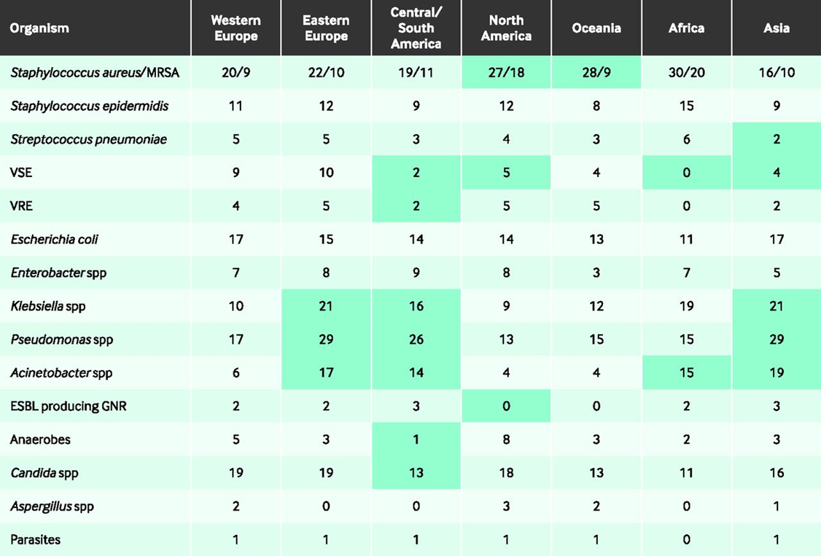
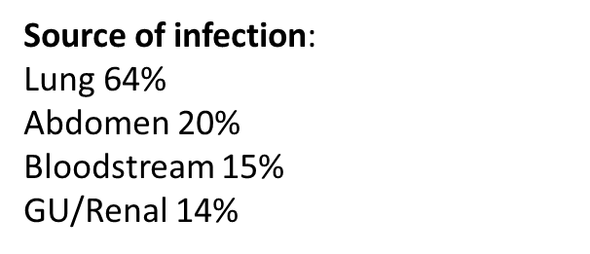
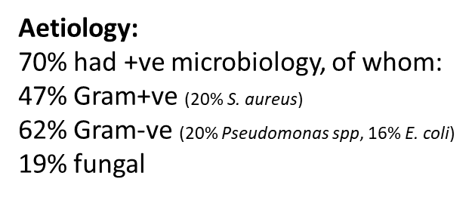
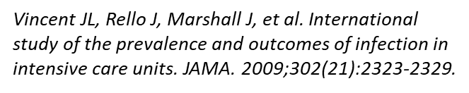
Microbiology of sepsis: EPIC II

Slide 30
SOURCE CONTROL

Slide 31
FLUIDS & VASOPRESSORS
Traditional model of sepsis as a fluid-deplete state – mostly true, but what constitutes appropriate fluid resuscitation remains under debate – 30ml/kg generally accepted.
Clinical signs of fluid status of limited use & error-prone
Transient increase in plasma volume → pathological extravascular oedema, often requiring subsequent diuresis
Increasing evidence that “less is more” – 2 trials in Africa (FEAST, Simplified Severe Sepsis Protocol Trial) + 1 in Nortern Europe (CLASSIC); CLOVERS trial ongoing

Slide 32
Early-goal directed therapy

Slide 33
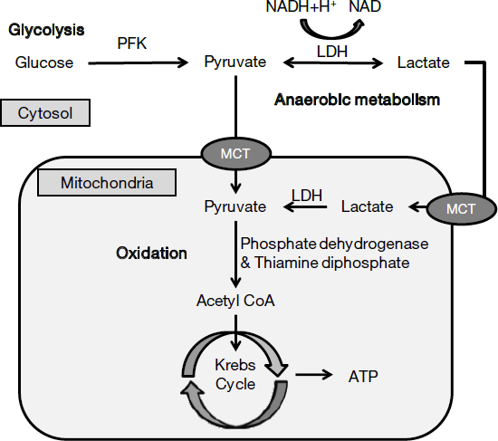
LACTate-guided resuscitation
Tissue hypoxia
Organ hypoperfusion

Slide 34
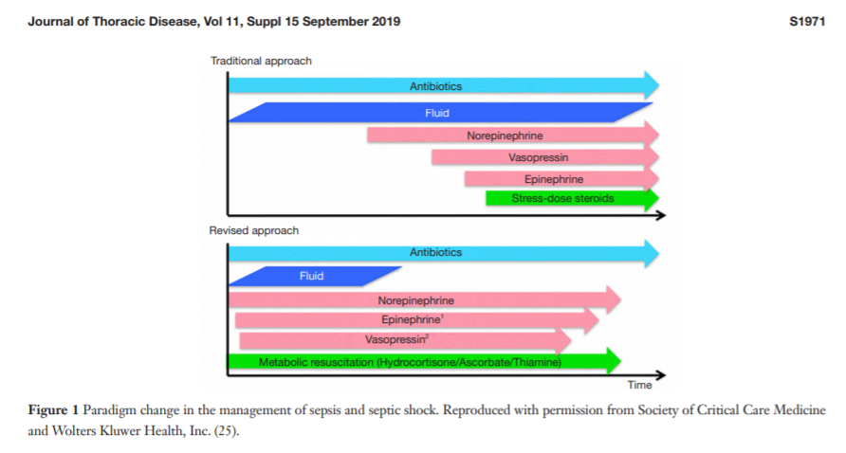
LACTATAEMIA IN SEPSIS:
IMPAIRED OXYGEN UTILIZATION
“Bioenergetic failure” – impaired energy metabolism + mitochondrial dysfunction – supported by the observation that sepsis-related AKI occurs despite maintained RBF.

Slide 35
CLOVERS

Slide 36
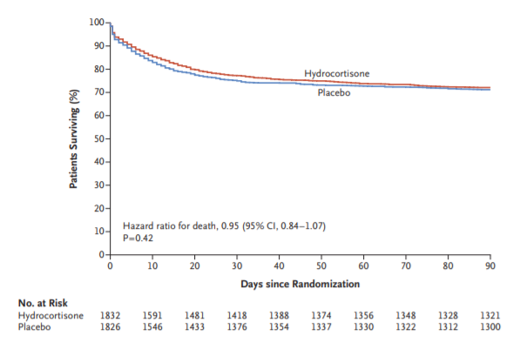
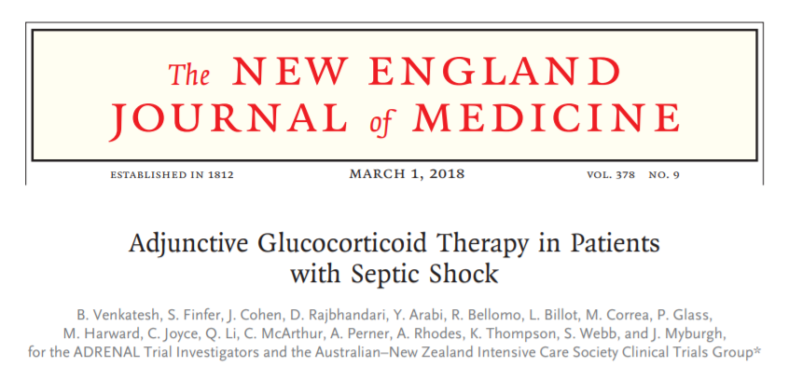
ADDITIONAL THERAPIES: STEROIDS
Relative adrenal insufficiency in septic shock
Vasopressor-sparing

Slide 37
THE MARIK PROTOCOL: A CURE FOR SEPSIS?
no improvement in organ function but incidental mortality benefit ?statistical accident.
Significant reduction in organ failure, but no improvement in septic shock

Slide 38
CASE #2
55yF journalist
Acute severe D+V, generalized weakness, confusion
O/E: T 40C, Absent peripheral pulses, BP: 65 systolic
generalized exfoliative rash
Diagnosis?

Slide 39
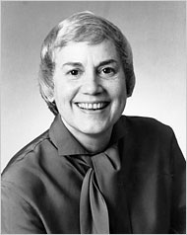
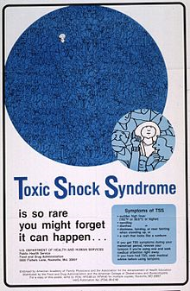
TOXIC SHOCK SYNDROME

Slide 40
MICROBIOLOGY
S. aureus – TSS – most common
S. pyogenes – TSLS
Also implicated but less common:
Group C & G Streptococci
Clostridium sordellii – CSTS (16 cases worldwide by 2018)
Yersinia pseudotuberculosis

Slide 41
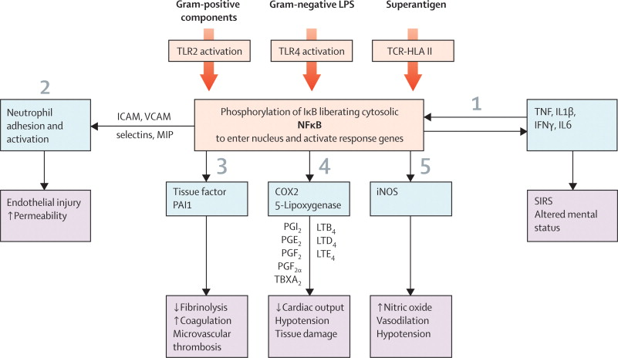
PATHOPHYSIOLOGY
Cytokine avalanche triggered by superantigens (e.g. S. aureus TSST-1, S. pyogenes M types I & III: SPEA), binding directly to TCR-HLA II
Notes:
Activation of Toll-like receptor (TLR) 2 pathways by Gram-positive components, TLR4 pathways by Gram-negative products, and superantigenic stimulation, all bring about a sequence of events that allow free NFκB to pass into the nucleus and bind to DNA. These events lead to (1) expression of inflammatory mediators and amplification of the inflammatory cascade; (2) neutrophil adhesion and activation; (3) activation of tissue factor and plasminogen activator inhibitor 1 (PAI1) to reduce fibrinolysis and enhance coagulability; (4) induction of cyclo-oxygenase 2 (COX2) and 5-lipoxygenase systems elaborating pro-inflammatory prostanoids, leukotrienes, and thromboxane A2 (TBXA2); and (5) inducible nitric oxide synthase (iNOS) acceleration with consequent vasodilatation and hypotension. Adapted from Liu et al.²⁹
ICAM=intercellular adhesion molecule. IκB=inhibitor of NFκB. IFNγ=interferon γ. IL1β=interleukin 1β. IL6=interleukin 6. LPS=lipopolysaccharide. LTB4=leukotriene B4. LTD4=leukotriene D4. LTE4=leukotriene E4. MIP=macrophage inflammatory protein. PGE2=prostaglandin E2. PGF2α=prostaglandin F2α. PGI2=prostaglandin I2. SIRS=systemic inflammatory response syndrome. TCR=T-cell receptor. TNF=tumour necrosis factor. VCAM=vascular cell adhesion molecule.

Slide 42
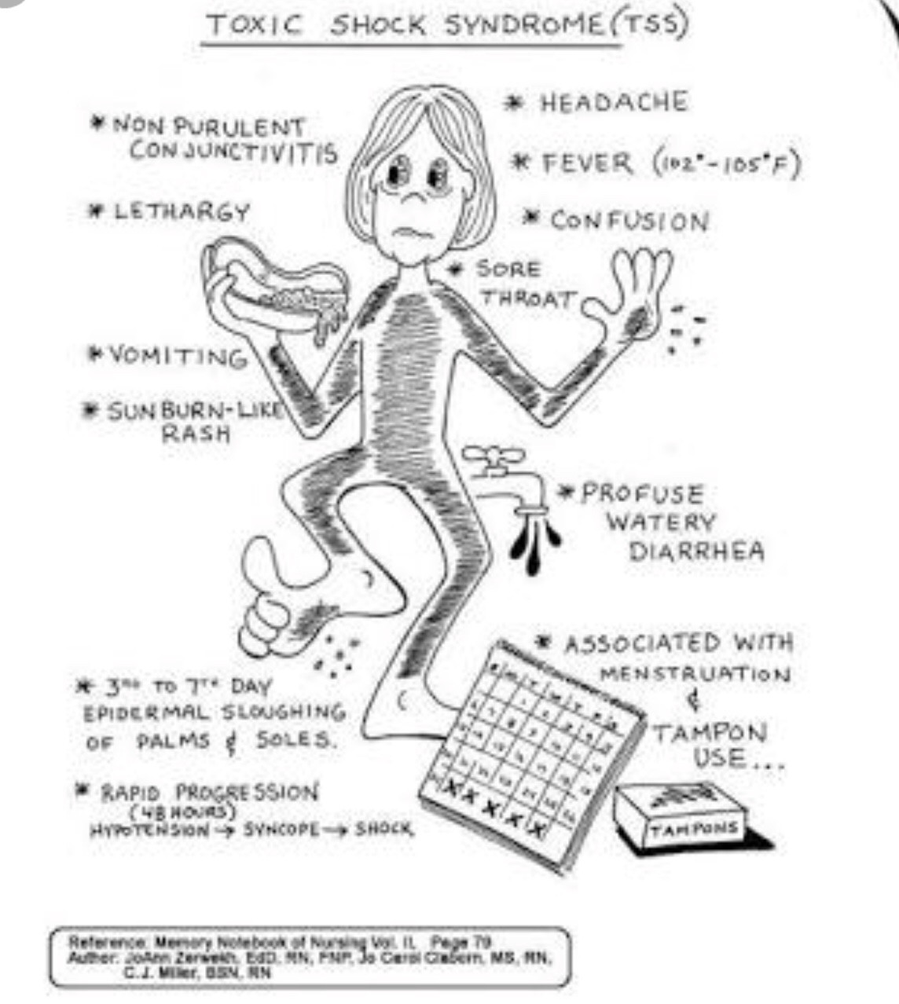
CLINICAL FEATURES
Menstrual vs Non-menstrual;
the latter include:
Surgical site infections
OBGYN (postpartum, post-abortion)
Pharyngitis
Burns
Soft tissue injuries
Focal infections

Slide 43
CASE definitions
Staph-TSS
Strep-TSLS
Isolation of GAS from:
a. normally sterile site (blood, CSF, peritoneum, tissue biopsy)
b. non-sterile site (throat, vagina, sputum)
Clinical severity markers:
a. hypotension
b. >2 of AKI, coagulopathy, hepatic, ARDS, generalized rash, soft tissue necrosis
Fever
Hypotension
Rash
Desquamation
>3 of: GI, muscular, mucous membranes, haem, renal, hepatic, CNS
-ve BC (except S. aureus), throat, CSF, RMSF, leptospirosis, measles
Probable: 1b + 2a + 2b if no other cause found
Confirmed: 1a + 2a + 2b
Probable: 4/5
Confirmed: 5/5

Slide 44
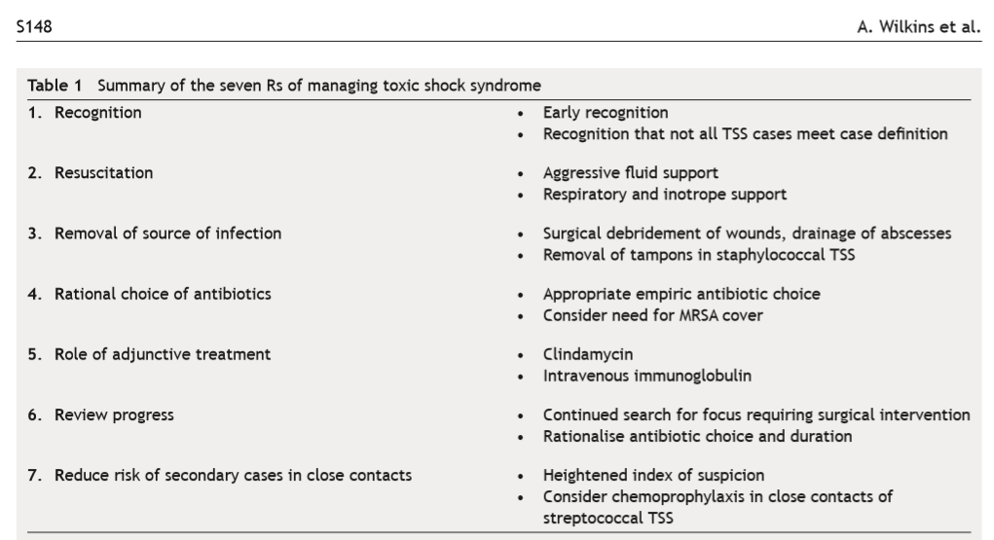
MANAGEMENT Principles
Clindamycin > Penicillin
Suppresses toxin synthesis, facilitates phagocytosis + ↓ LPS-induced TNF-α.
IVIG
↓ T-cell production of pro-inflammatory cytokines.
↑ plasma neutralising activity vs super-antigens
→ ↑ survival
Wilkins, Amanda L.; Steer, Andrew C.; Smeesters, Pierre R.; Curtis, Nigel (2017). "Toxic shock syndrome – the seven Rs of management and treatment". Journal of Infection. 74: S147–S152.

Slide 45
PROGNOSTIC FACTORS: an overview
Host-related | Infection-related | Treatment-related
Age | Nosocomial > Community-acq | Delayed Abx in septic shock
Thrombocytopaenia | MRSA | Persistent lactataemia
New-onset AF | IFI (Non-Candida > Candida) | EGDT
Absence of fever | Pseudomonas spp | Hyperchloraemia
Leucopaenia | Polymicrobial infections

Slide 46
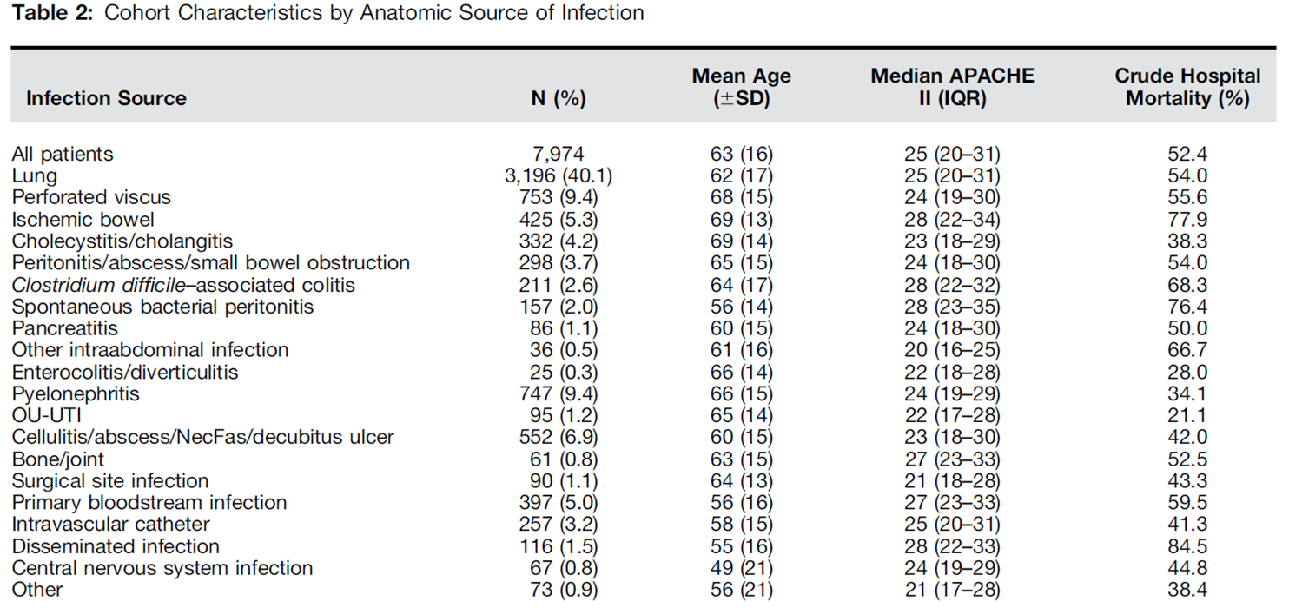





Prognostic Factors: site of infection

Slide 47
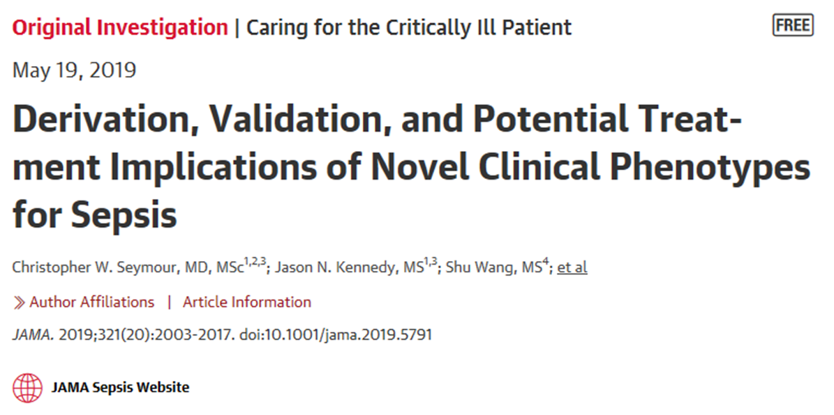
Prognostic Factors: using big data to identify CLINICAL phenotypes
Clinical phenotype | Descriptor | Est Mort
α | Lowest administration of vasopressor | 5%
β | Older patients with chronic illnesses and renal dysfunction | 13%
γ | Inflammation & pulmonary dysfunction | 24%
δ | Liver dysfunction & septic shock | 40%

Slide 48
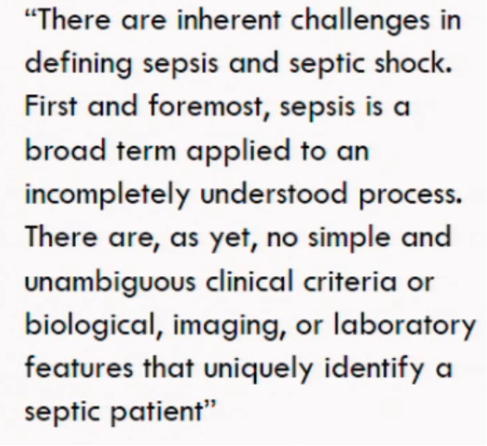
IN Conclusion
SIRS/SOFA tools useful, but caution advised.
Urgent antibiotic therapy, fluids +/- vasopressors remain cornerstone of Rx
Extension to less unwell patients to cover all possible pathogens currently not evidence-based, with risk of AMR
The quest for better diagnostics & magic bullets is ongoing, but remains elusive

Slide 49
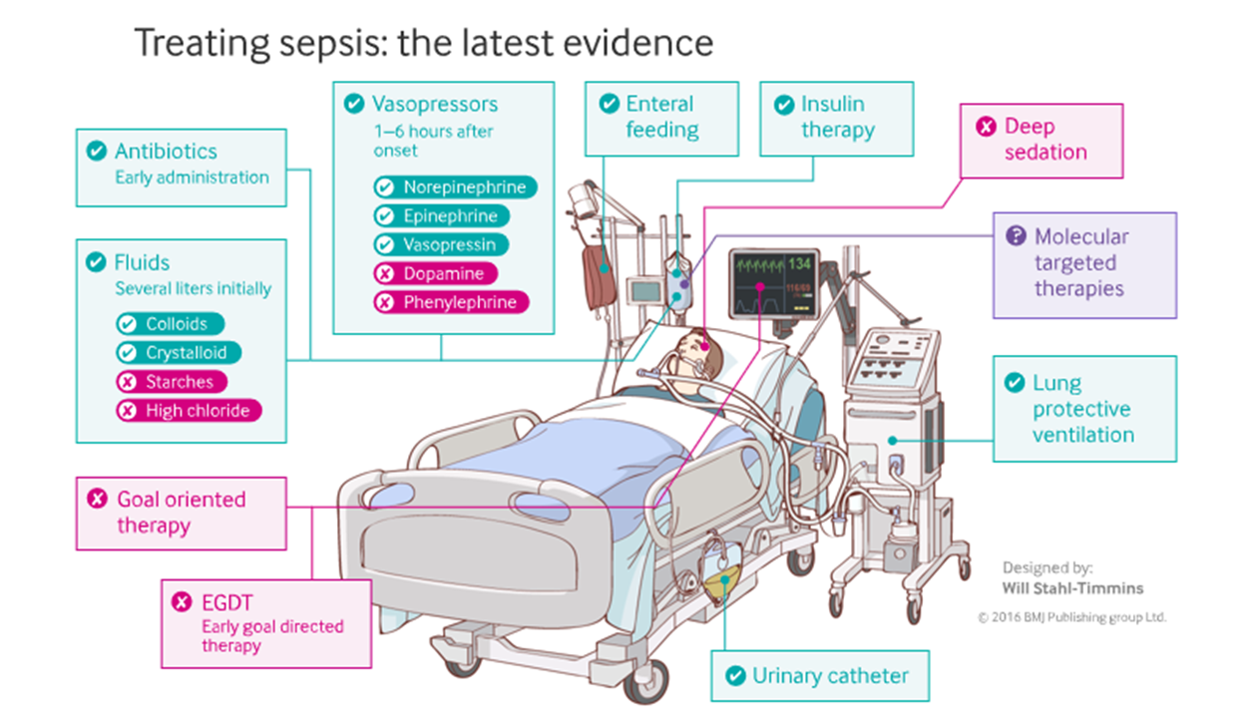
Management of sepsis: in summary

Slide 50

Thank you.
QUESTIONS?

Slide 51
Get in touch!
Website
www.quackmeded.co.uk
Email
ggc.quackmeded@nhs.scot
Social Media
Twitter: @QUACK_ Med
Facebook: QUACK education

