Slide 1
Haematology Cases: Complications of chemotherapy
Samantha Drummond
Clinical Teaching Fellow in Haematology

Slide 2
Disclaimer*
Please note that QUACK is a regional teaching programme operating across GG&C, Lanarkshire and Ayrshire & Arran.
This presentation outlines general management, though local variances e.g. antibiotic prescription may vary slightly depending on your local trust
Remember to check your local guidelines

Slide 3

Case presentation 1
Cancer treatment helpline referral
64 year old lady
Recent chemotherapy
Temperature at home

Slide 4
Case Presentation 1
On arrival to CAU
Observations
HR 116 RR 24 O₂Sats 95% OA BP 110/74 T 38.2℃
CSW performing ECG and cannulation
How do you proceed?
  Read previous history and then proceed to full history/examination
  Full history and examination
  Brief history and examination
  Prescribe antibiotics straight away

Slide 5
Case presentation 1
Presenting complaint: Fever
History of presenting complaint
  What would you like to ask?

Slide 6
Case presentation 1
History of presenting complaint
  When did the temperature start?
  Do you monitor your temperature at home?
  Any localizing symptoms?
    E.g. cough, dysuria, diarrhoea, rash
  What is the underlying cancer diagnosis?
  When was chemotherapy?
  Anybody else unwell?
  …

Slide 7
On further questions
  Has a diagnosis of AML
  Chemotherapy 7 days ago
  No localizing symptoms or unwell contacts
  Has been feeling hot/cold shivery
  NKDA

Slide 8
On examination
Looks unwell, appears sweaty
NEWS=5
A- Maintaining own
B- RR 24 O₂Sats 95% OA
Chest clear, speaking in sentences
C- HR 116 BP 110/74
HS I+II+0, no peripheral oedema, CRT 3s
D- GCS 15, Moving all 4 limbs
BM 6.2
E- T 38.2℃
Abdo SNT
No rash
Notes:
What is your differential diagnosis?
Sepsis
Drug-related
Disease-related

Slide 9
What would you do now?
  Complete a fully history and examination
  Arrange for CXR/other investigations
  Prescribe antibiotics

Slide 10
Blood results
Hb 90 g/l (133-176 g/l)
MCV 92 fl (82-98 fl)
WCC 1.2 x10⁹/l (3.9-11.1 x10⁹/l)
Neutrophils 0.4 x10⁹/l (1.5-6.5 x10⁹/l)
Platelets 54 x10⁹/l (150-400 x10⁹/l)
Urea 7.2 mmol/l (2.5-6.7 mmol/l
Sodium 140 mmol/l (135-145 mmol/l)
Potassium 5.1 mmol/l (3.5-5.0 mmol/l)
Creatinine 120 μmol/l (46-90 μmol/l)
eGFR 50
CRP 156 mg/l (2-10 mg/l)
Notes:
Comments?
What is the most concerning this for this patient?
What additional information do you need to know?
Chest X ray and urinalysis are clear
What is the most likely diagnosis for this lady now

Slide 11
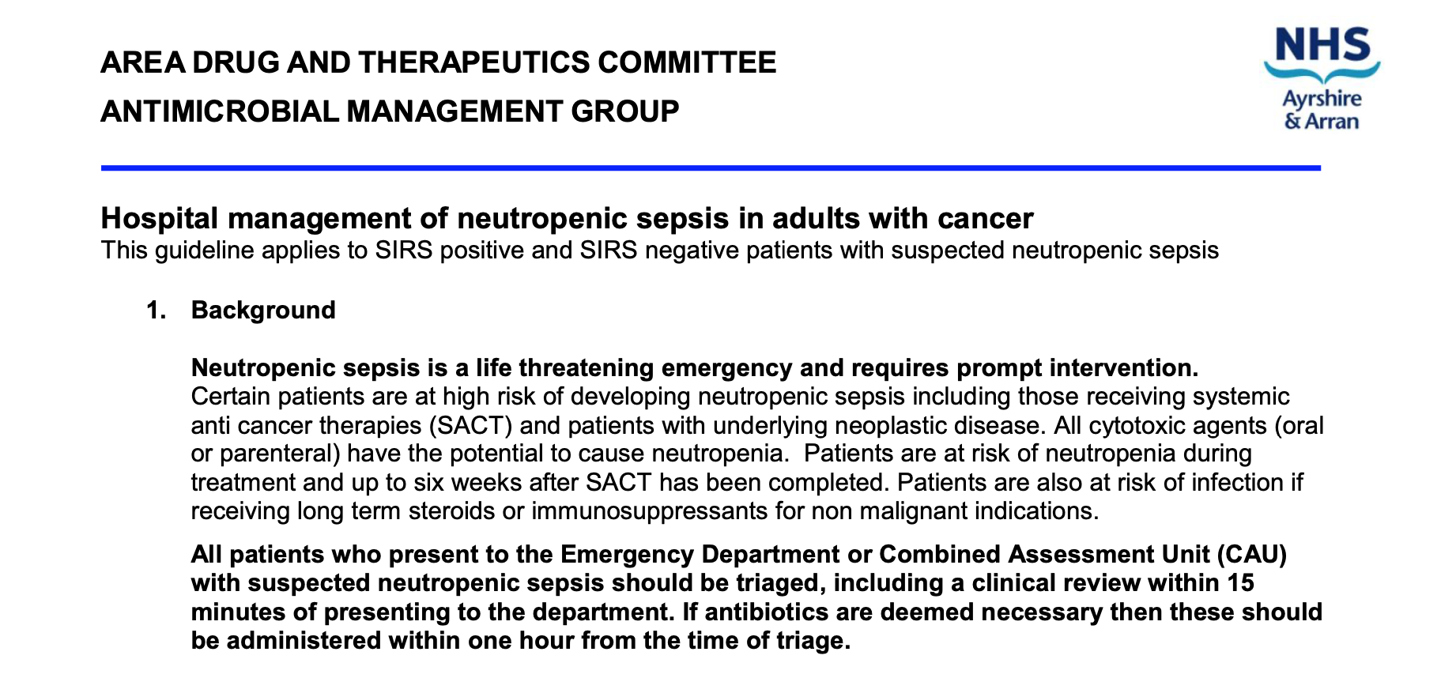

Slide 12
Neutropenic sepsis
Most common life-threatening complication of cancer therapy
More common in patients with haematological malignancies compared to those with solid organ malignancies
Most chemotherapy regimes will result in a degree of neutropenia
Risk of infection is increased if neutrophils <1
Neutropenia occurs 7-14 days after chemotherapy
Neutropenia may also be the result of an underlying haematological disorder
Notes:
Any other drugs causing neutropenia- clozapine, anti-thyroid drugs (carbimazole), sulfazalazine

Slide 13
Immediate action required if:
  Single temperature >38℃
  2 fever spikes >37.5℃ 1 hour apart
  Symptoms or signs of sepsis or infection without fever
Inability to mount inflammatory response therefore may not have localizing signs or symptoms, some patients may not even mount a fever
Notes:
Usually associated with chemotherapy
Need to have a high index of suspicion

Slide 14
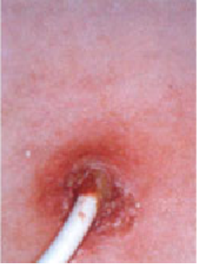
Possible sources of infection
  Chest
  Urine
  Dental
  Skin
  Line site
  GI
  …
Pathogen is only identified in about 1/3 of cases
Notes:
Especially if mucositis
This may be due to antibiotics prophylaxis and use of lines etc
Gram positive bacteria most common (about 60%), thought to be due to use of prophylactic antibiotics and increasing use of lines

Slide 15
Assessment
  Look for localizing symptoms or signs
Investigations
  FBC, U&Es, LFTS, coagulation screen, bone profile, blood glucose, lactate, CRP
  Bloods cultures (peripheral and from line if line in situ)
  Swab relevant sites e.g wounds, line exit site
  Sputum culture
  Urine culture
  Stool culture
  CXR
Give antibiotics prior to blood results!!
Notes:
Important to consider line sites as this can be a source of infection and may need to be removed
-

Slide 16
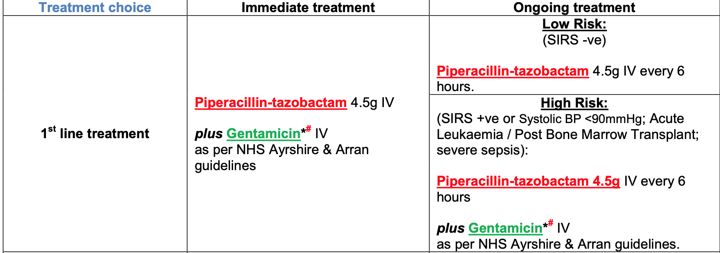
Management:
NHS A&A antimicrobial guidelines
*Check your local guidelines*

Slide 17
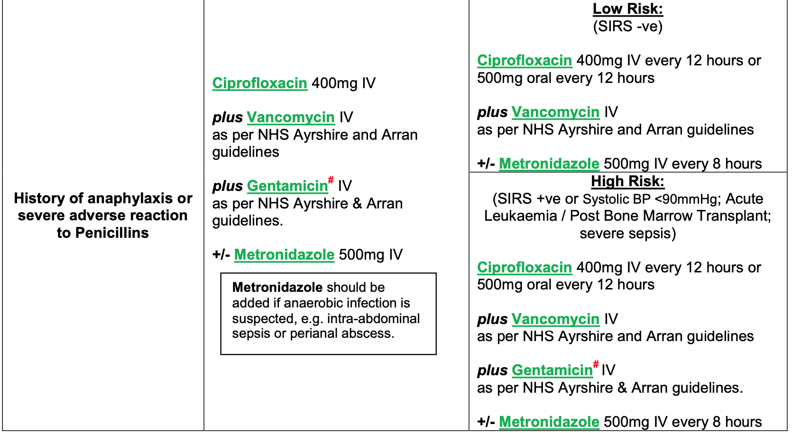

Slide 18
Management
  IV antibiotics as per guidelines
  IV fluids
  Supportive care e.g. blood products
Duration of treatment is dependent on:
  Response (e.g. is the patient now afebrile)
  Degree of neutropenia
  Blood culture results

Slide 19
If no response to antibiotics after 48 hours
  Consider altering antibiotic therapy
  CT scan to identify source
  Cover for fungal infection if considered likely
Other considerations
  Side room with reverse barrier nursing
  G-CSF
  Prophylactic antibiotics e.g. ciprofloxacin, co-trimoxazole

Slide 20
Neutropenic sepsis
If not treated in 48 hours mortality can be as high as 50%
With prompt antibiotics administration mortality is <10%
Notes:
One thing to consider is that fever can be part of the disease process e.g. in lymphoma
Fever due to tissue necrosis and inflammation

Slide 21
Case presentation 2
74 year old gentleman
Recent diagnosis of DLBCL
Started R-CHOP chemotherapy last week
Presents feeling ‘generally unwell’
What would you like to ask?

Slide 22
What would you like to ask?
  When was chemotherapy?
  When did he start to feel unwell?
  What symptoms is he experiencing:
    Nausea?
    Lethargy?
    Fever?
    Pain?
  Any other new medications?
  …

Slide 23
On further questioning
  Had chemotherapy 4 days ago
  Started to feel unwell for last two days
  Feeling tired
  Nauseated but no vomiting
  Oral intake poor
  Reduced urine output
  Muscle cramps

Slide 24
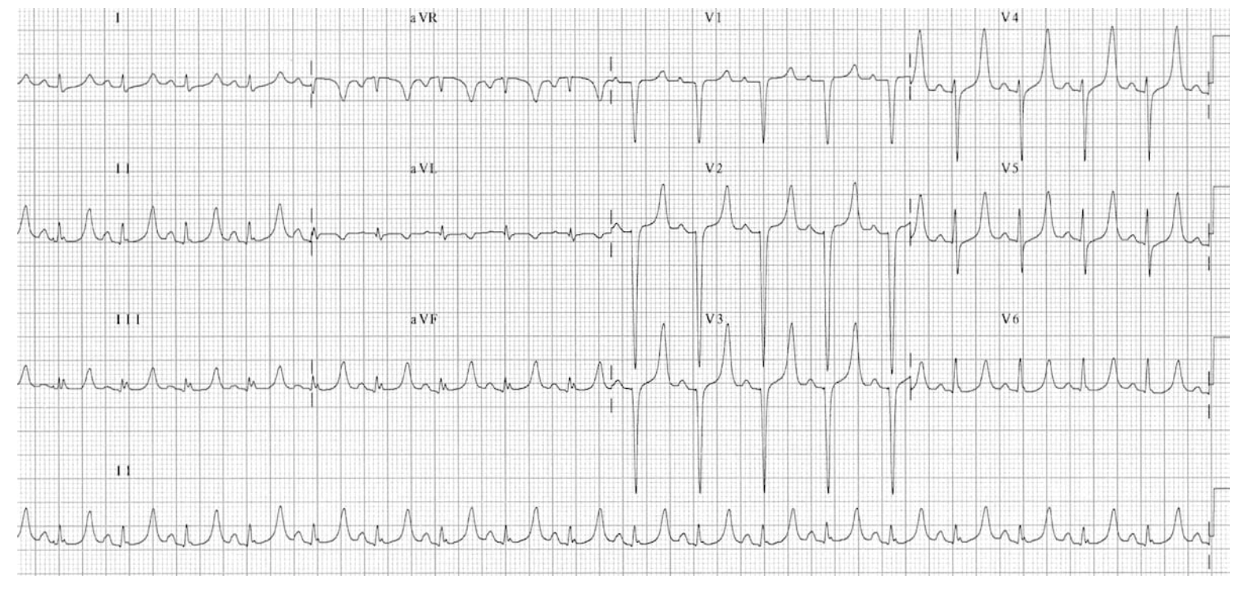
Notes:
Interrupted by CSW as ECG report says ‘abnormal ECG’
What do you think of this ECG
Peaked T waves

Slide 25
Blood results
Hb 118 g/l (133-176 g/l)
MCV 92 fl (82-98 fl)
WCC 4.3 x10⁹/l (3.9-11.1 x10⁹/l)
Platelets 224 x10⁹/l (150-400 x10⁹/l)
Urea 12.1 mmol/l (2.5-6.7 mmol/l)
Sodium 140 mmol/l (135-145 mmol/l)
Potassium 6.4 mmol/l (3.5-5.0 mmol/l)
Creatinine 226 μmol/l (46-90 μmol/l)
eGFR 32
Adj Calcium 1.82 mmol/l (2.2-2.65 mmol/l)
Albumin 32 g/l (35-55 g/l)
Phosphate 1.87 mmol/l (0.8-1.5 mmol/l)
Uric acid 500 μmol/l (200-430 μmol/l)
Notes:
Comments?
What additional information do you need to know?
Have you heard of any problems related to chemotherapy that this might be ?

Slide 26
Tumour lysis syndrome
Rapid breakdown of large number of cancer cells which release intracellular electrolytes and metabolites into the circulation
The release of large amounts of intracellular content into the bloodstream overwhelms normal homeostatic mechanisms resulting in:
  Hyperuricaemia
  Hyperphosphataemia
  Hyperkalaemia
  Hypocalcaemia
Represents an oncological emergency

Slide 27
Tumour Lysis Syndrome
Occurs with rapidly proliferating, highly chemo-sensitive tumours
For example:
  Leukaemia with high WCC (mainly AML, ALL)
  High grade NHL (particularly Burkitts lymphoma, DLBCL)
  Rarely in solid organ tumours
Can occur spontaneously but usually following chemotherapy
Notes:
Incidence is likely to increase following advances in cancer treatment
Spontaenous TLS can occur but is uncommon
Usually 3 days before or up to 7 days after chemotherapy, usually 25-72 hours after
The incidence of tumour lysis syndrome is unknown

Slide 28
Tumour lysis syndrome
  Hyperphosphataemia
    Due to rapid cell lysis
    Precipitates calcium phosphate in tissues
  Hypocalcaemia
    Secondary to hyperphosphataemia
    May cause paraesthesia, tetany, carpo-pedal spasm, altered mental state, seizures and arrhythmias
  AKI
    Predisposed by volume depletion and pre-existing dysfunction
    Due to uric acid nephropathy, acute nephrocalcinosis, and precipitation of xanthine
    Oliguria/anuria leads to volume overload and oedema
    Uraemia causes malaise, lethargy, nausea, anorexia, pruritis and pericarditis
    May require dialysis, usually reversible with prompt therapy
Notes:
AKI- precipitation of uric acid crystals, leading to renal tubular obstruction and reduced urinary output
Rasburicase transforms uric acid into allantoin, which is 5 to 10 times more soluble in urine than uric acid and consequently more easily eliminated by the kidney

Slide 29
Tumour lysis syndrome
  Hyperuricaemia
    Due to metabolism of nucleic acid purines
    May cause arthralgia and renal colic
  Hyperkalaemia
    Due to rapid cell lysis
    Often the earliest sign of TLS
    May cause paraesthesia, muscle weakness and arrythmias

Slide 30
Presentation
May be asymptomatic and on laboratory tests only
Symptoms
  Nausea and vomiting
  Anorexia
  Diarrhoea
  Muscle weakness
  Muscle cramps
  Lethargy
  Paraesthesia
  Laryngeal spasm

Slide 31
Presentation
Signs
  Acute kidney injury: hypertension, hypotension, oliguria, anuria, haematuria, peripheral oedema
  Cardiac arrhythmias: syncope, chest pain, dyspnoea
  Severe hypocalcaemia: tetany, Chvostek sign, Trousseau sign, laryngeal spasm (rare)
  Severe hypocalcaemia or hyperphosphataemia: seizures
Mild hypocalcaemia is often asymptomatic
Clinical examination is likely to reveal signs attributable to the underlying malignancy, such as palpable lymphadenopathy or splenomegaly in the case of lymphoproliferative disorders

Slide 32
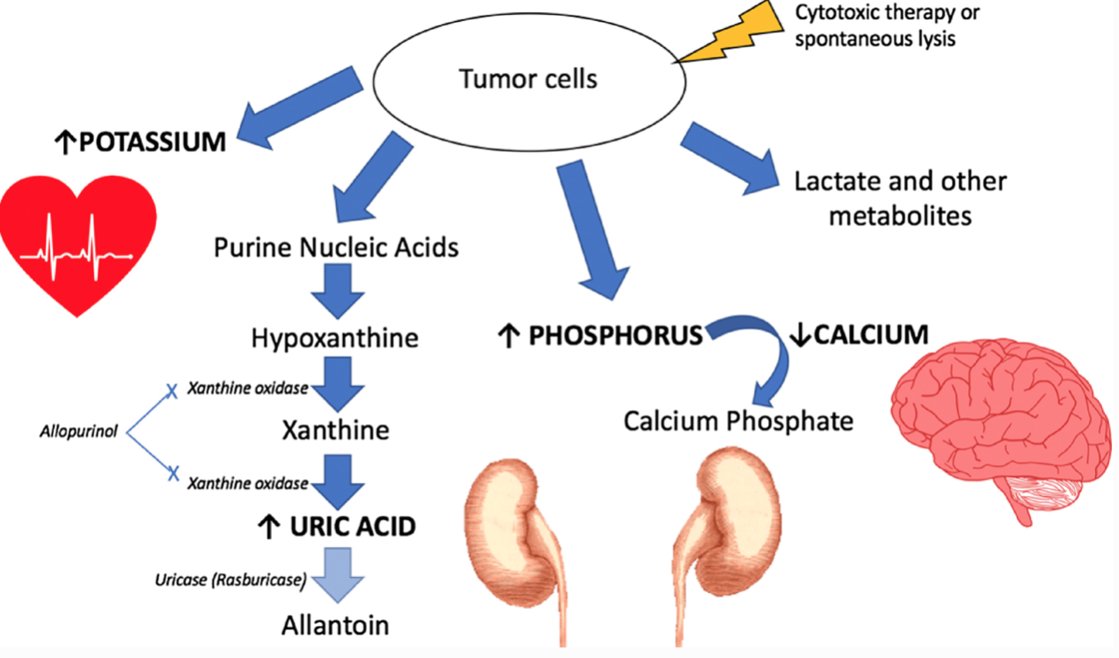

Slide 33
Risk factors
Tumour type
Large bulky tumours at presentation
Tumours with high sensitivity to chemotherapy
Recent chemotherapy
Pre-existing renal impairment
Dehydration
Use of nephrotoxic medication
Advanced age (and reduced glomerular filtration rate).
Notes:
Tumour type- most commonly in haematological malignancies
High LDH and high WCC correlate with increased tumour bulk and therefore increased risk for TLS
As per BMJ Best Practice article

Slide 34
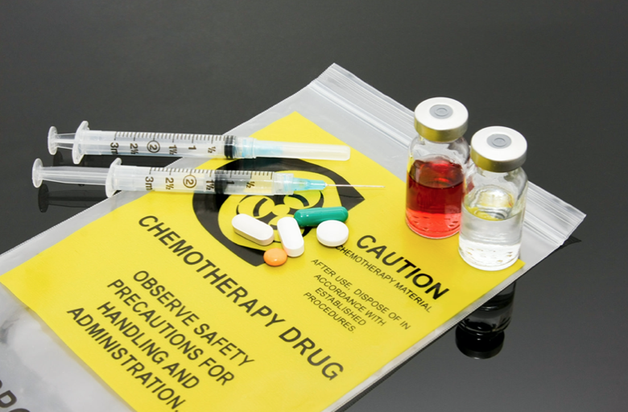




Tumour lysis syndrome
Xanthine
AKI
Uric acid
Purines
Hypocalcaemia
Phosphate
Calcium phosphate
Seizures
Cancer cells
Potassium
Arrythmias

Slide 35
Xanthine oxidase
AKI
Xanthine
Allopurinol
Uric acid
Purines
Cancer cells
Rasburicase
Allantoin
Notes:
Hyperuricaemia is a result of purine nucleic acid metabolism
Cancer cells have a high turnover rate and contain large amounts of nucleic acid products (which transform to uric acid)
Can lead to a uric acid nephropathy
Allopurinol reduces uric acid production by preventing the degradation of purine to uric acid, but it has no effect on uric acid already present.
Recombinant urate oxidase- converts uric acid to water-soluble metabolites without increasing excretion of xanthine and other purine metabolites
Very rapidly reduces uric acid levels

Slide 36
AKI
Phosphate
Calcium phosphate
Cancer cells
Notes:
Cancer cells have a high turnover rate and contain large amounts of phosphate (approximately four times the amount carried by a normal lymphocyte).
Results in precipitation of calcium phosphate in tissues and an AKI

Slide 37
AKI
Hypocalcaemia
Phosphate
Calcium phosphate
Cancer cells
Notes:
Hyperphosphataemia also results in hypocalaemia
What symptoms do you know of for hypocalcaemia?
What might this cause?
Seizures
Arrhythmias secondary to prolonged QTc

Slide 38
What are the symptoms/signs of hypocalcaemia?
  Perioral paraesthesia
  Muscle cramps
  Trosseau’s sign- carpopedal spasm
  Chvostek’s sign- facial muscle twitching
  Laryngospasm
  Altered mental state
  Seizures
  Prolonged QTc

Slide 39
AKI
Hypocalcaemia
Calcium phosphate
Phosphate
Cancer cells
Arrythmias
Seizures
Notes:
Hyperphosphataemia also results in hypocalaemia
What symptoms do you know of for hypocalcaemia?
What might this cause?
Seizures
Arrhythmias secondary to prolonged QTc

Slide 40
Potassium
Arrythmias
Cancer cells
Notes:
Often the earliest sign of TLS
May cause paraesthesia, muscle weakness and arrythmias

Slide 41
What are the ECG changes of hyperkalaemia?
  Peaked T waves (earliest sign)
  P wave flattening
  Increased PR interval
  Broad, bizarre QRS complex
  VF

Slide 42
Investigations
  Bloods
    FBC
    U&Es
    Bone profile (calcium and phosphate)
    Uric acid
    LDH
    Venous blood gas
  ECG +/- cardiac monitoring
Notes:
VBG will give rapid electrolyte results and will also give a lactate

Slide 43
Management
  Identify patients who are high risk
  Initiate preventative measures
  Monitor for both clinical and laboratory features of tumour lysis syndrome
Prevention
  Regular monitoring of bloods in patients considered high risk
  Bloods:
    U&Es, bone profile, uric acid, LDH

Slide 44
Prevention
  Ensure adequate hydration
    IV fluids to maintain urine output >100ml/hour
  Prevent hyperuricaemia
    Allopurinol
      Xanthine oxidase inhibitor, prevents uric acid formation
      Given orally
    Rasburicase
      Recombinant urate oxidase
      Converts uric acid to water-soluble metabolites without increasing excretion of xanthine and other purine metabolites
      Very rapidly reduces uric acid levels
      Given IV
Notes:
IV fluids commenced prior to starting chemotherapy
Allopurinol reduces uric acid production by preventing the degradation of purine to uric acid, but it has no effect on uric acid already present.

Slide 45
Management
  AKI
    IVF
    Consider dialysis in acute renal failure
  Hyperkalaemia
    Calcium gluconate
    IV insulin/dextrose
  Hypocalcaemia
    Only requires treatment if symptomatic
    IV calcium replacement
Notes:
Treat with rascburicase if not already on
Rasburicase has risk of haemolysis in G6PD deficiency, methaemoglobinaemia and anaphylaxis

Slide 46
Tumour lysis syndrome
Xanthine
AKI
Uric acid
Purines
Hypocalcaemia
Phosphate
Calcium phosphate
Seizures
Cancer cells
Potassium
Arrythmias

Slide 47
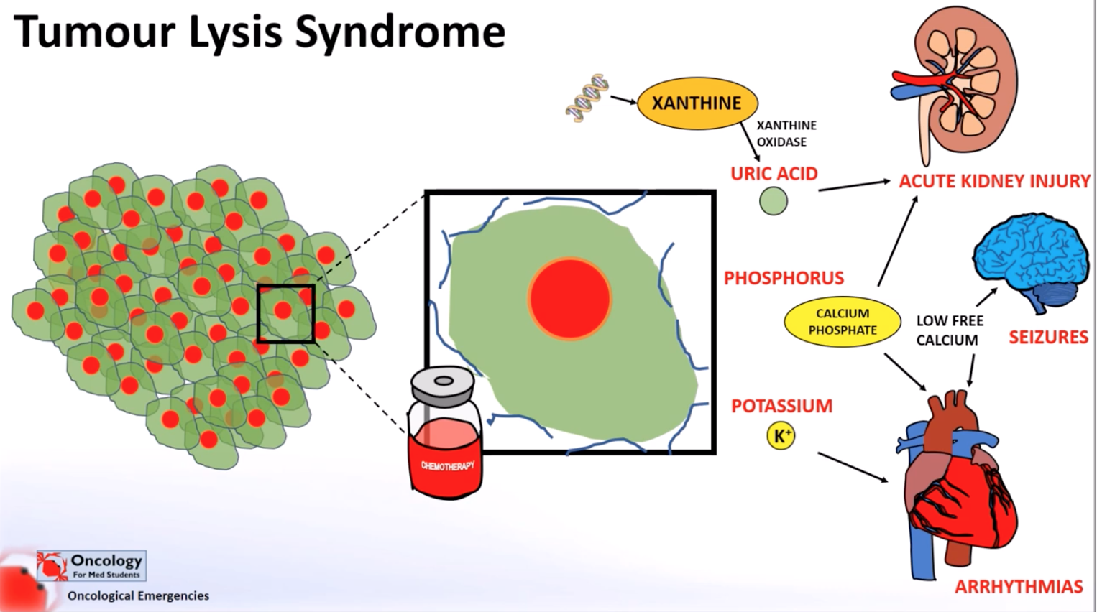
https://www.youtube.com/watch?v=v6VidGkd4XY
Notes:
https://www.youtube.com/watch?v=v6VidGkd4XY
Can also look at Cairo Bishop classification

Slide 48
Learning outcomes
By the end of this lecture you should be able to:
  Identify neutropenic sepsis as an emergency presentation
  Describe appropriate initial investigation and management of neutropenic sepsis
  Describe the laboratory and clinical features of tumour lysis syndrome
  Discuss prevention and management of tumour lysis syndrome

Slide 49
Questions ?
Email: s.drummond1@nhs.net

Slide 50
References
https://coreem.net/core/tumor-lysis-syndrome/ (TLS picture)
https://www.youtube.com/watch?v=v6VidGkd4XY (you tube video)
https://www.oncologynurseadvisor.com/home/cancer-types/general-oncology/handling-chemotherapy-premedications/ (chemotherapy pictures)
https://litfl.com/hyperkalaemia-ecg-library/ (ECG hyperkalaemia)
https://www.semanticscholar.org/paper/A-comprehensive-approach-to-the-prevention-of-of-in-Cesaro-Cavaliere/26174334943e03bfcd3d80bd9e966c49579464ed (CVC infection picture)

Slide 51
Thank you
Please fill out the feedback form for your certificate of learning

Slide 52
Get in touch!
Website
www.quackmeded.co.uk
Email
ggc.quackmeded@nhs.scot
Social Media
Twitter: @QUACK_ Med
Facebook: QUACK education

