Slide 1
Acute Hot Joint
Gareth Ingram

Slide 2
Disclaimer*
Please note that QUACK is a regional teaching programme operating across GG&C, Lanarkshire and Ayrshire & Arran.
This presentation outlines general management, though local variances e.g. antibiotic prescription may vary slightly depending on your local trust
Remember to check your local guidelines

Slide 3
Outline
General understanding and descriptive terminology
Common pathologies
Cases
  Highlighting key points
Basic management

Slide 4
Hot Joints
Spent a year in Rheumatology
Common presentation, curriculum item
Commonly see patients with swollen joints, - primarily knee
Septic arthritis parent team is hospital dependent
If prosthetic joint – speak to surgery early!
Really easy procedure to learn
Some cases

Slide 5
Description
Acute vs Chronic
Monoarthropathy
  1
Oligoarthropathy
  2-4
Polyarthropathy
  >5

Slide 6
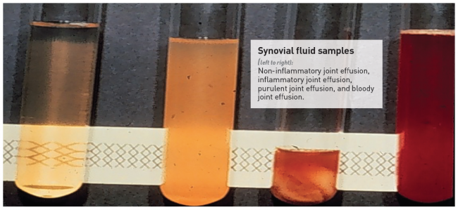
Differentials
Trauma ?haemarthrosis ?anticoagulants
Gout/crystal pathology
Inflammatory arthropathy – RA, psoriatic
OA
Reactive arthritis
Septic arthritis
  Treatment is typically flucloxacillin or vancomycin
  antibiotics, aspiration +/- washout

Slide 7
Case 1
41 year old male
?Gout ?septic arthritis
Monoarthropathy, right knee
Presented to IAU via GP
28/8/2018 13:03 (Tuesday)

Slide 8
Initial Assessment
No EMAT
Clerked in at 15:50 in ACAU

Slide 9
Just for reference…..
Urinalysis at point of admission
  +++ Protein
  ++ Blood
  + Ketones

Slide 10
Presenting Complaint
Right knee pain
Describes rigors and fever over preceding 24-48 hours
Hot to touch
Reduced range of movement

Slide 11
Past Medical History
COPD/asthma overlap
Previous DVT
Depression
HCV +ve
Cellulitis
Personality disorder
IVDU, on methadone 100mls daily

Slide 12
Systemic enquiry
Chest
  Cough, nil else
Gastro, cardiac, neuro and GU otherwise unremarkable
Feverish for 24-48 hours
No night sweats or weight loss

Slide 13
Social
Smoker, 25 per day
No alcohol use
Previous IVDU, not injected in 2 years
Lives alone
Usually mobile and independent

Slide 14
Observations
Observation | Triage | First Assessment
Temperature | 37.4 | 40.5
Heart Rate | 102 | 110
Blood pressure | 102/61 | 126/68
Respiratory rate | 20 | 22
Oxygen Saturations | 97 | 92
GCS | 15 | 14

Slide 15
Examination
General
Clammy, flushed
Drowsy, but easily rousable
Focused (right knee)
Warm to touch
Not erythematous
No obvious signs of trauma
Palpable effusion
Struggling to mobilise

Slide 16
Other
Reduced air entry globally
HS 1 +2 + O
JVP not visualised
No tender liver edge
Calves firm bilaterally but non tender,
  right > left
GCS 14 (E3)

Slide 17
Differential
Septic arthritis right knee
?Gout
??DVT

Slide 18
Initial Management
Moved to IAU
Sepsis 6
  Refused catheter
Antibiotics (IV fluclox)
Aspirate knee and blood cultures
Aggressive fluid resuscitation
Strict fluid balance
Chest and knee x-rays

Slide 19
IAU
Blood pressure remained low at mid 80’s systolic
Knee aspirated
  60ml fluid
  No comment on appearance
  Sent to cytology and microbiology
Transferred to ARU2
ID – add in clindamycin

Slide 20
Bloods
WCC 6.8
Neutrophils 4.6
MCV 90.7
Platelets 81
Coagulation Normal
CRP 242
ESR 34
Urate 330
Na 133
K 4.3
Urea 8.9
Creatinine 100
eGFR >60
Lactate 1.6

Slide 21
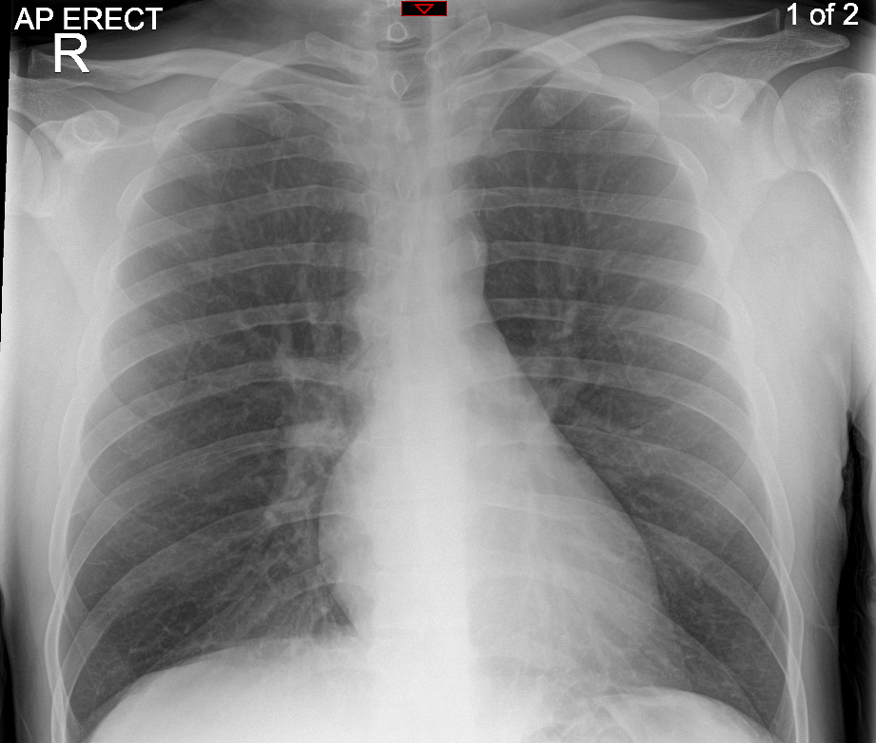

Slide 22
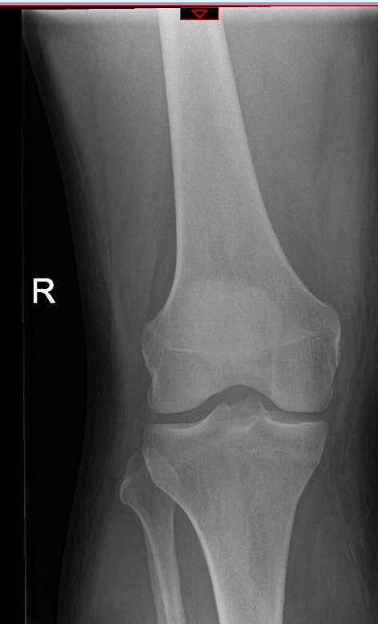
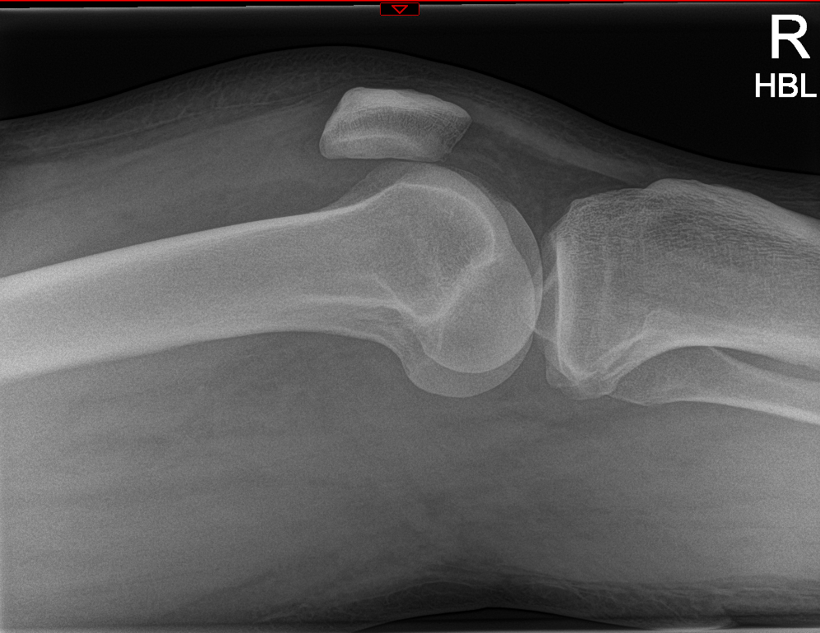

Slide 23
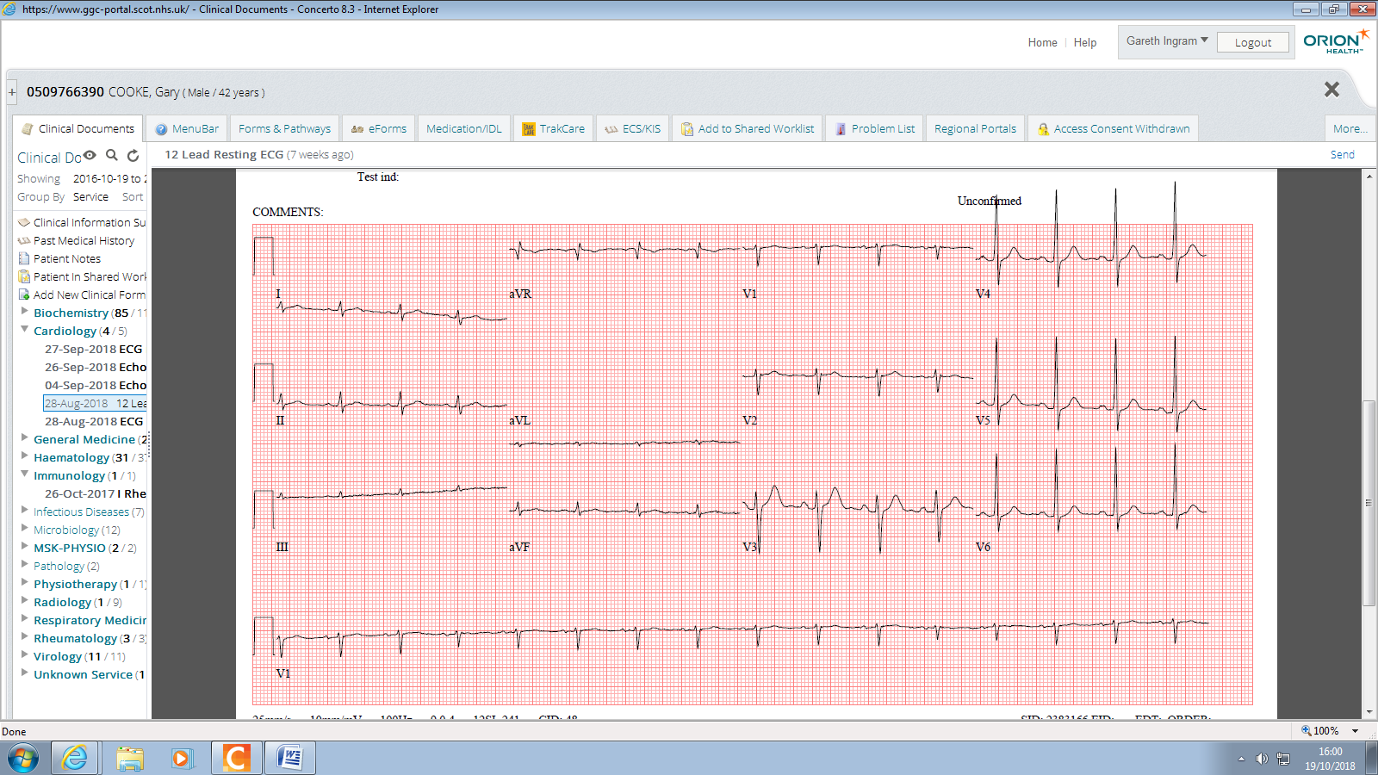

Slide 24
Night 1
Struggled to maintain BP
80-85 systolic
4.5 Litres in, 100ml out
Empty bladder on scan
Lactate 0.8
Moved to medical HDU for central line and noradrenaline
Unable to site arterial line

Slide 25
HDU
Brief 48 hour stay
BP improved to 105 systolic
Right leg noted to be swollen hot and tender
CRP fallen to 170
PO₄ replaced
Await micro results

Slide 26
Cultures
Urine
  Nil organisms or WCC
Blood
  Actinomyces turicensis
  Campylobacter ureolyticus
Knee
  WCC +++, no organisms
  Staphylococcus aureus

Slide 27
Ward
Discharged to floor 6 (Friday PM)
Rising CRP
Rising Creatinine
Clinically stable and “looks well”
Apyrexial since admission to HDU
BP 98 systolic

Slide 28
Saturday
Met for the first time
BP 105 systolic, pulse 85
Mobilising now
Knee swollen but not hot
Right leg diffusely swollen
USS doppler leg requested

Slide 29
Saturday-Sunday
NEWS goes from 2-10
Pyrexial
Abx escalated to vancomycin
Further cultures sent
CXR – patchy opacification
Seen by rheumatology reg overnight, advised reaspiration
For further aspiration
  70ml Straw, blood stained fluid, no frank pus
Further fluid challenge, aim MAP >65

Slide 30
Sunday
Discussed with ortho
  No effusion….. And good range of movement, therefore not septic arthritis
  Not for joint washout
  ?DVT
Patient continues to deteriorate
  Increasing oxygen requirement
?Septic DVT
?IE

Slide 31
Management
Phone call from micro
  “Growing everything”
  Give the rapidly spreading SSTI therapy (x5 abx)
D/W CT – CT with contrast
D/W Cardio – for echo
Transferred to Medical HDU again

Slide 32
Results
CRP approaching 300
WCC now 18, Hb 99
CT scan
  There are bilateral cavitating lung lesions present with gas and clot demonstrated within the right common femoral vein. Findings are felt most likely to represent septic emboli
Bedside echo (V scan)
  No obvious vegetation
  Normal LV function
  Cannot exclude IE on TTE

Slide 33
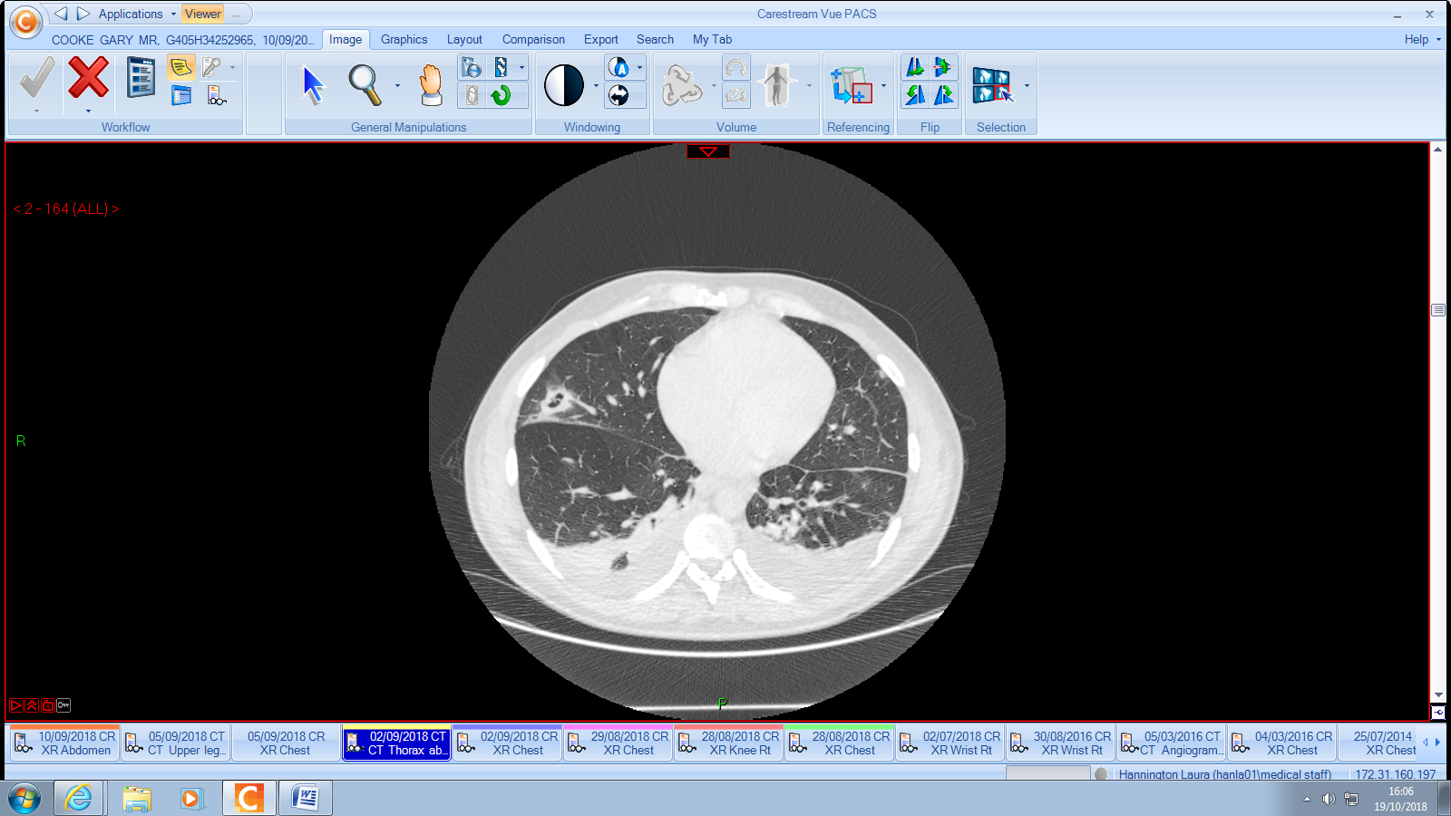

Slide 34
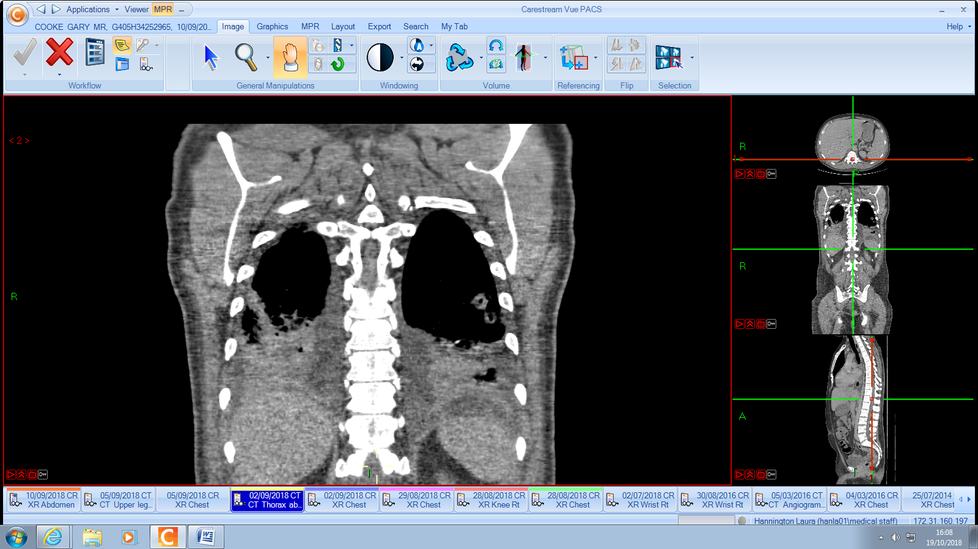

Slide 35
Medical HDU
Admits probable recent injection
Mild AKI
ID rationalised abx
  Flucloxacillin
  Clindamycin
  Benzylpenillin
Treatment dose dalteparin

Slide 36
ID
Step down to ID ward
Got PICC line, no further positive cultures
Issues with nausea secondary to Fluxcloxacillin
Leg swelling reducing
Inflammatory markers improving
Mobile structure on mitral valve leaflet
Further 2-3 weeks IV then repeat echo
6 weeks total abx duration for IE
4 weeks IV therapy

Slide 37
Final changes
Abx changed to vancomycin following nausea
Struggled with renal function
Then switched to daptomycin and tazocin
Repeat echo
  Vegetation no longer there
  IVOST to ciprofloxacin and clindamycin
Apixaban for 6 months
ID follow up in due course

Slide 38
Issues of case
Documentation of procedures
Polymicrobial infections
  Early ID and microbiology input
  IVDU patients
Friday step downs
Infection may be in more than one place!
Notes:
IVDU patients highly likely for multi-organism cultures. Often bugs like strep oralis, from licking the needle “clean”

Slide 39
Case 2
74 year old female
  Previous septic arthritis right knee
  Connective tissue disease
  Hypertension
Due to attend rheumatology clinic as OP
Struggling due to pain, reduced mobility
BIBA to A&E

Slide 40
Initial assessment
Feeling “rubbish” for 48 hours
Increasing pain in right knee, struggling to weight bare
Pain in left shoulder – known bursitis and tear on MRI previous month
Noted to be on mycophenolate and pred
WCC 16, CRP 24
?septic arthritis due to severity of pain, immunocompromised and prev septic joint

Slide 41
Transferred to ARU2
A&E phoned me directly!
Able to discuss case
Antibiotics not given, NEWS of 2, tachycardic
Mild cough recently, non-productive
Reviewed on ARU 2 – main complaint was knee
Aspirated by FY1, 40mls straw colour fluid
  Blood culture bottles
  Micro
  Cytology

Slide 42
Following Events
Given topical analgesia
Developed a temperature 38.4 - treat
Paracetamol, blood cultures
Given IV fluclox initially
All cultures negative
24-48 hours developed productive cough and new CXR changes – treated for CAP

Slide 43
Highlights
Good communication from A&E – alerted ARU2
Cultures – both knee and blood before antibiotics
Other source of investigation investigated appropriately

Slide 44
Case 3
54 year old
T8 tetraplegia (fall from a window)
Concerns re district nursing re pressure wounds
Brought in to Majors
Temp 37, low sats, tachypnoeic and borderline BP
Swollen hot left knee, chronic skin changes

Slide 45
First 24 hours
CRP >300, WCC 20
Referred to ortho
Aspirated frank pus from knee in A&E
  Started on fluclox
  Not keen for washout
Further aspiration in ARU2
  15ml thick, blood stained pus
  White needle
  No anaesthetic required!

Slide 46
Following events
Positive for gram positive cocci on gram stain
Grew Staph and Strep via cultures
Deteriorated secondary to septic shock and t/f to HDU for inotropes
Further deterioration re respiratory system
Intubated and t/f to ITU

Slide 47
Management
Reviewed by rheumatology
Given combination of illness severity and t8 tetraplegia
  Left above knee amputation
Turbulent post op period
Had a 2 month critical care admission due to O2 requirement and tracheostomy
Further surgical procedures for debridement of pressure sores

Slide 48
Case 4
54 year old male
PMH osteoarthritis
7 day history of non-specifically unwell
Presented to A&E
Swollen left lower limb
?DVT
Referred to ambulatory care DVT pathway
Dalteparin S/C
CRP 354, WCC 20

Slide 49
Ambulatory care
USS Doppler, no DVT
Walked in to examination room
  On 2 sticks!
History revisited
  Pyrexial events at home
  No trauma
  Keen runner (ultra running)
  Recent injection 10 days ago by private ortho consultant
  States not warned regarding risk of septic arthritis

Slide 50
Ongoing management
Aspirated 40ml turbid, frank pus
Gram positive cocci on gram stain
Commenced on IV fluclox
Difficult patient to manage
  Needed to go to Dubai ($$$)
Changed to Darbovancin and OPAT

Slide 51
96 hours later
Represented to Medical HDU!
GP OOH - ?MERS
No clinical evidence of MERS
  Mild cough post flight
  CXR – NAD
  Other symptoms were consistent with septic arthritis (temp)

Slide 52
Highlights and key points
Aseptic technique
No touch approach when aspirating and injecting
1/10,000 risk
  It’s small – but significant
  Co-morbidity and mortality link
  2/52 IV therapy + 4/52 oral therapy
  Warn the patient when consenting!

Slide 53
Case 5
77 year old woman
Presenting complaint – left knee pain
Gradual onset over a few days
Systemically well, no fever

Slide 54
Case 5 PMH and Examination
Prosthetic MVR
  INR target 3.5 (3-4)
Gout (no previous aspirations)
Warfarin levels been within therapeutic range
O/E
  Bilateral knee changes
  Moderate effusions
Bloods
  CRP 30
  Urate 200

Slide 55
Would you aspirate?
Therapeutic INR is not a contraindication to aspiration
Generally speaking knee is safe to aspirate
Guidance is to withhold for 24hrs with DOACs
Aspirate
  Haemarthrosis
  Likely recurrent events
  Negative for crystals
What do you do about the warfarin??
Notes:
Ended up advising aim target INR 3.0-3,5

Slide 56
Case 6
89 year old female
Recent discharge from medical ward <72 hours
Carers found ?confusion, reduced mobility
Clerked in by FY1
  Can’t move left shoulder
  Nil focal examination
  ?UTI
Old case notes reviewed
  Pseudogout right shoulder

Slide 57
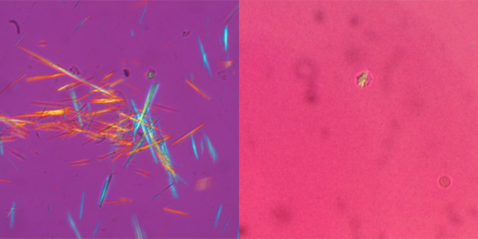
Case 6 continued
Came onto nightshift
D/W son (NoK)
Presentation identical to last admission
  CRP <5, WCC normal, urinalysis NAD
Aspirated thick yellow viscous fluid
Back to baseline AM
Discharged at 48hr following negative culture and positive cytology for CPPD

Slide 58
Treatment options
NSAIDs
Colchicine
Steroids

Slide 59
Highlights
Full systemic examination/enquiry
Collateral incredibly helpful

Slide 60
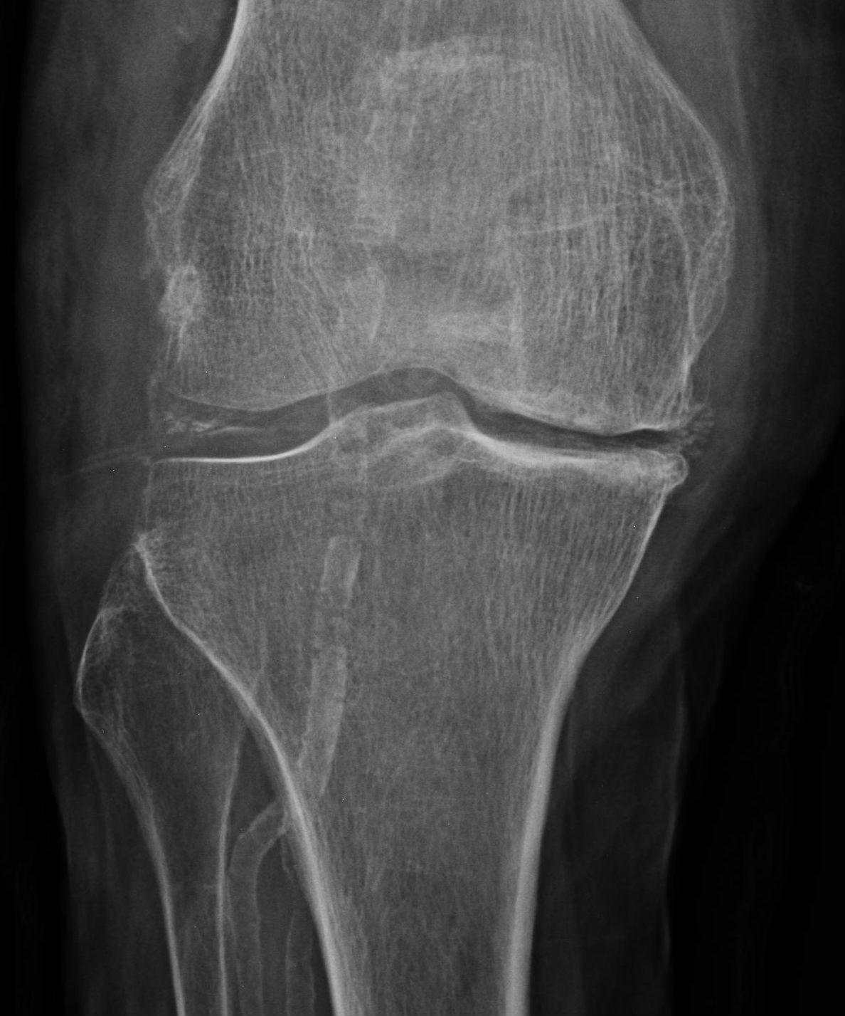
Notes:
Diagnosis??
Pseudogout
Based on chondrocalcinosis on knee Xray

Slide 61
References
Calcium Pyrophsphate Deposition. BMJ Best Practice, accessed at https://bestpractice.bmj.com/topics/en-gb/370/treatment-algorithm (accessed on 14/09/2020)
Gout. BMJ Best Practice, accessed at https://bestpractice.bmj.com/topics/en-gb/13 (accessed on 14/09/2020)
Goldenberg, D. Guide to Laboratory Testing in Patients With Suspected Rheumatic Disease, accessed at https://www.practicalpainmanagement.com/resources/diagnostic-tests/guide-laboratory-testing-patients-suspected-rheumatic-disease
Last updated September 2017 (accessed on 14/09/2020)
Rad Rounds, accessed at https://radrounds.com/photo/chondrocalcinosis-pseudogout?context=user (accessed on 14/09/2020)
Coakley G et al, BSR & BHPR, BOA, RCGP and BSAC guidelines for management of the hot swollen joint in adults accessed at https://academic.oup.com/rheumatology/article/45/8/1039/1784962 (accessed on 14/09/2020)

Slide 62
Thank you
Please fill out the feedback form for your certificate of learning

Slide 63
Get in touch!
Website
www.quackmeded.co.uk
Email
gg-uhb.quackmeded@nhs.net
Social Media
Twitter: @QUACK_ Med
Facebook: QUACK education

