Slide 1

Management of
Acute Respiratory Emergencies
Dr Manish Patel
Respiratory Consultant
University Hospital Wishaw

Slide 2
Disclaimer*
Please note that QUACK is a regional teaching programme operating across GG&C, Lanarkshire and Ayrshire & Arran.
This presentation outlines general management, though local variances e.g. antibiotic prescription may vary slightly depending on your local trust
Remember to check your local guidelines

Slide 3
Learning Outcomes
Differential diagnosis of acute breathlessness
Acute breathlessness history & examination
Investigations
Case based approach

Slide 4
Acute Breathlessness: Causes
Asthma
COPD
Pulmonary oedema
Pneumonia
Pneumothorax
Pulmonary embolus
Pleural effusion
Cardiac tamponade
Smoke inhalation
Obstruction
  Laryngeal oedema
  Foreign body
  Bronchial carcinoma

Slide 5
Acute Breathlessness: History
Chest pain
Wheeze
Sputum volume / colour / blood
Palpitations
PMH respiratory / cardiac disease
Smoking
Usual exercise capacity
Risk factors for DVT

Slide 6
Acute Breathlessness: Examination
Airway
  Stridor / deviated trachea / foreign body
Breathing
  Sats / RR / auscultation / percussion
Circulation
  Pulse / BP / oedema / JVP / HS / murmurs
Other
  Abdo / fluid balance / temperature / DVT

Slide 7
Acute Breathlessness: Urgent Ix
CXR
ABG / pH
ECG
Other
  Peak flow
  ECHO
  VQ / CTPA

Slide 8
Case 1: History
4am. Called by PRHO.
65 yr old man on respiratory ward
Admitted with haemoptysis and weight loss
CT guided lung biopsy yesterday
Suddenly SOB, with Right chest discomfort
Looks “really ill”

Slide 9
Case 1: Assessment
Airway – maintaining own
Breathing
  Sats 90% air (98% admission) RR 30
  Decreased AE Right side
  Hyper-resonant Right side
Circulation
  Pulse 130 reg
  BP 80/40
  Clammy

Slide 10
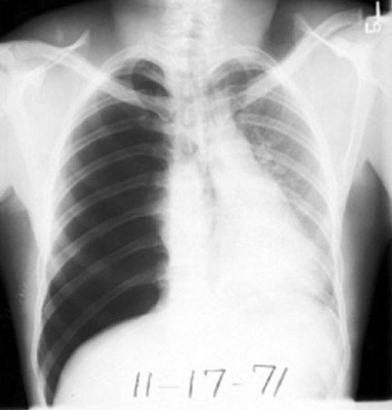
Case 1: Diagnosis?

Slide 11
Case 1: Diagnosis
Right Tension Pneumothorax

Slide 12
Tension pneumothorax : Actions
High flow oxygen
Insert wide bore cannula
    2nd intercostal space
    Midclavicular line
Chest X-ray
Insert chest drain

Slide 13
Other causes of tension pneumothorax
Spontaneous
  Tall, thin, smoking, male
  Asthma / COPD / CF / ILD
Mechanical ventilation / NIV
Blocked chest drain
Cardiopulmonary resuscitation
Iatrogenic
  Pleural tap / biopsy
  CT guided lung biopsy

Slide 14
Case 2: History
GP referral
46 yr old woman
Long history of asthma. Normal PEFR 400.
Several days cough and green sputum
Now very wheezy
Salbutamol inhaler not helping much

Slide 15
Case 2: Assessment
Wheezy
Sats 94% on air
Temp 38°C
Resp – RR 20, widespread wheeze,
PEFR 200
CVS – Pulse 100, BP 130/90

Slide 16
Case 2: Diagnosis?
Infective exacerbation of asthma

Slide 17
Acute asthma: actions
Investigations
  UE, FBC, glucose, ABG
  CXR
  ECG
Treatment
  Oxygen
  Salbutamol nebuliser +/- ipratropium
  IV augmentin +/- clarithromycin
  IV hydrocortisone 200mg

Slide 18
Acute asthma: contd
You are stuck in A&E
FY1 calls you to ward
“You know that lady with the asthma. She’s finding it harder to breathe and her sats are dropping.”
You go to the ward

Slide 19
Acute asthma: Further assessment
Airway – OK
Breathing
  Sats 85% on 40% Oxygen
  RR 30
  Quiet bilateral wheeze
Circulation
  Pulse 130, BP 130/90
ABG: PO2 8.0, PCO2 6.9, H+ 49

Slide 20
What’s happening?

Slide 21
What’s happening?
Life threatening Asthma

Slide 22
Life threatening asthma: Actions
Maximum flow oxygen
Nebulised salbutamol and ipratropium
IV salbutamol if very poor AE
  5-20 micrograms/minute
IV magnesium sulphate
  1.2-2g IV over 20 minutes
Call anaesthetist and senior cover
Consider IV aminophylline
Notes:
Aminophylline 5mg/kg over 20 mins then 0.5mg/kg/hr, adjusted according to plasma conc

Slide 23
Case 3: History
Called to Ortho ward
62 yr old woman
7 days post left knee replacement
Sudden onset SOB
Sharp Left chest pain

Slide 24
Case 3: Assessment
Sats 90% on air
Temp 37.4°C
Resp – RR 34, Chest clear
CVS – Pulse 130 reg, JVP 4cm, BP 110/60
Swollen left leg
CXR normal
ECG sinus tachycardia
ABG PO2 8.0, PCO2 3.5

Slide 25
Case 3: Diagnosis?

Slide 26
Case 3: Diagnosis
Pulmonary Embolus

Slide 27
Pulmonary Embolus: Actions
Oxygen
Analgesia – NSAID / opiate
LMWH heparin – tinzaparin 175 U/kg
D-dimers
VQ / CTPA
Doppler US left leg
ECHO
Warfarin if confirmed
Consider thrombolysis / interventional radiology if deteriorates – call for help!

Slide 28
Case 4: History
GP referral
65 yr old man
Smoker
History of COPD, inhalers only
3 week history of cough, green sputum and increasing SOB and wheeze
Not improving with steroids and antibiotics

Slide 29
Case 4: Assessment
Cachectic
Sats 88% on air
Resp – RR 28, wheezy bilaterally, cyanosed, pursed lip breathing
CVS – Pulse 90 reg, BP 130/90
ECG normal
CXR hyperinflated

Slide 30
Case 4: Diagnosis?

Slide 31
Case 4: Diagnosis
Infective exacerbation COPD

Slide 32
COPD: Actions
Controlled Oxygen
Check ABG ASAP
Nebulised salbutamol and ipratropium
IV augmentin +/- clarithromycin
IV hydrocortisone 200mg IV
Physiotherapy

Slide 33
COPD: contd
Initial ABGs on 40% Oxygen
PO2 7.5
PCO2 7.9
H+ 48
HCO3 35
Sats continue to drop
Becoming drowsy

Slide 34
COPD: contd
Recheck ABG on 40%:
PO2 7.1
PCO2 10.5
H+ 67
HCO3 28
What do you do?

Slide 35
COPD: contd
Turn down oxygen to 28%
Consider
  Aminophylline
  NIV
  ITU referral

Slide 36
Case 5: History
Called to HDU
72 yr old man 3 days post left BKA
Complaining of chest tightness and SOB
Smoker
NIDDM
Angina

Slide 37
Case 5: Assessment
Clammy and cold
Sats 90% on air
Resp – RR 28, Bilateral basal creps
CVS – Pulse 110 reg, BP 110/80, JVP 2cm
HS I+II gallop rhythm, sacral oedema

Slide 38
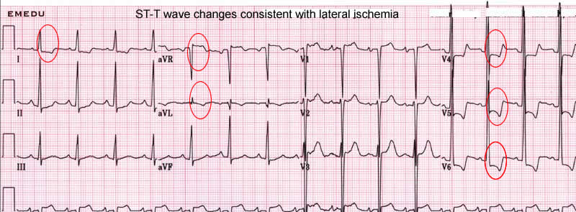
Case 5: Investigations
ECG

Slide 39
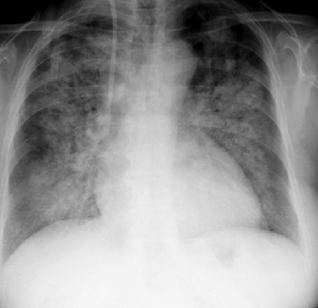
Case 5: Investigations
CXR

Slide 40
Case 5: Diagnosis?

Slide 41
Case 5: Diagnosis
Acute LVF 2° to myocardial ischaemia

Slide 42
LVF: Actions
Oxygen
Fusosemide – 50-100mg IV bolus
Morphine – 2.5-5mg IV
GTN infusion
Check ABG
Recheck ECG

Slide 43
Acute Breathlessness
Asthma
COPD
Pulmonary oedema
Pneumonia
Pneumothorax
Pulmonary embolus
Pleural effusion
Cardiac tamponade
Smoke inhalation
Obstruction
  Laryngeal oedema
  Foreign body
  Bronchial carcinoma

Slide 44
Thank you
Please fill out the online survey to obtain a certificate

Slide 45
Get in touch!
Website
www.quackmeded.co.uk
Email
ggc.quackmeded@nhs.scot
Social Media
Twitter: @QUACK_ Med
Facebook: QUACK education

