Slide 1
Connective Tissue Disease
Nick Holt
Clinical Teaching Fellow
NHS Lanarkshire

Slide 2
Disclaimer*
Please note that QUACK is a regional teaching programme operating across GG&C, Lanarkshire and Ayrshire & Arran.
This presentation outlines general management, though local variances e.g. antibiotic prescription may vary slightly depending on your local trust
Remember to check your local guidelines

Slide 3
Aims
Case based approach to some common (and less common) connective tissue presentations in hospital

Slide 4
Not covering!
Primary vasculitides, e.g., Polyangiitis with granuloma, churg strauss, polyarteritis nodosa
Mixed connective tissue disease (MCTD)
Undifferentiated connective tissue disease (UCTD)
Behcet's disease

Slide 5
Case 1
A 38-year-old Caucasian woman presents to ED
  24 hours of dyspnoea and pleuritic chest pain
  No haemoptysis
  No infective symptoms

Slide 6
Case 1
  On further questioning 3-year history of Raynaud's disease, polyarthralgia, facial rash, and intermittent migraine
  Physical examination reveals hypoxia, tachycardia, and normal blood pressure only
  What investigations would you like in the acute setting?
  What differentials are you thinking of?

Slide 7
Case 1
CXR
ECG
Bloods
What are you ruling in / out with these tests?

Slide 8
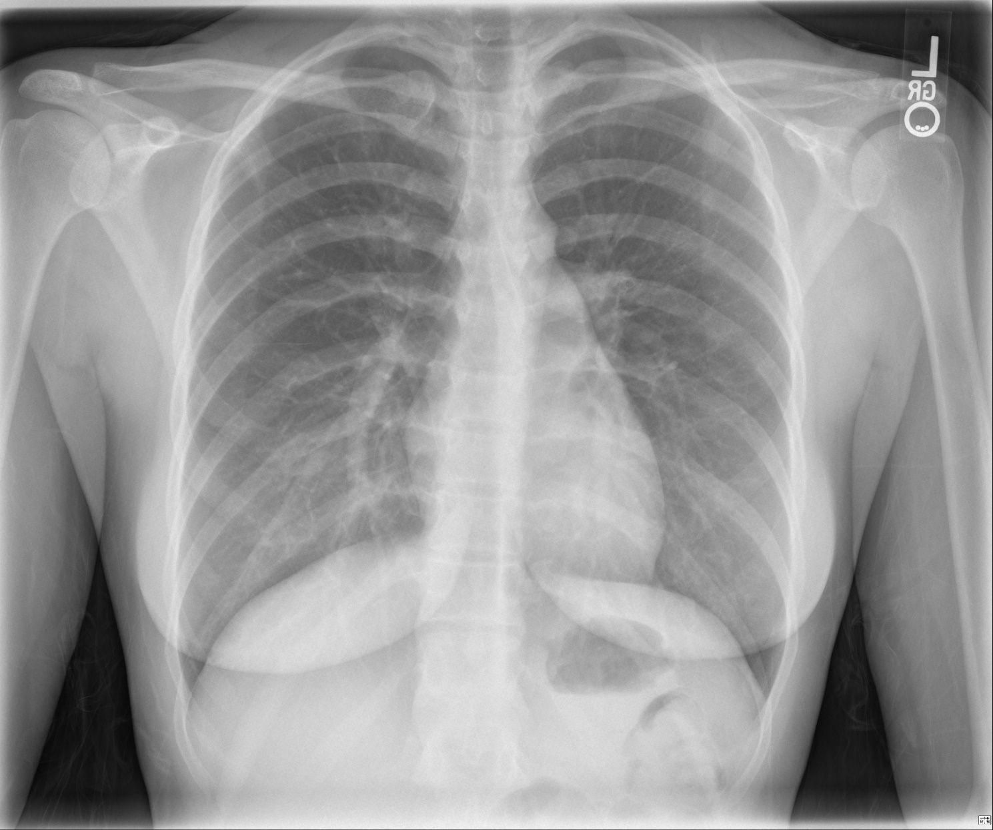

Slide 9
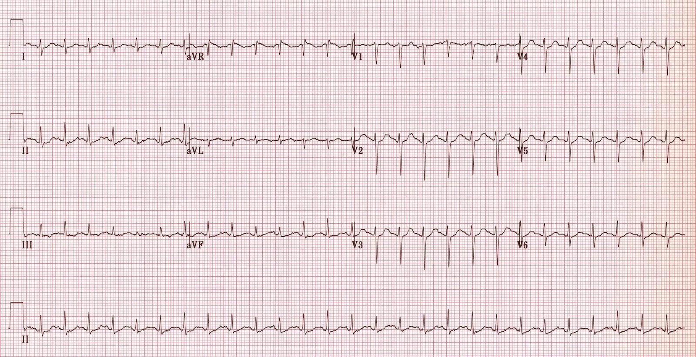

Slide 10
Bloods
Urea 8.1
Cr 167
Hb 110
CRP 46
ESR 94
D- dimer 1609
What investigation do you want next?

Slide 11
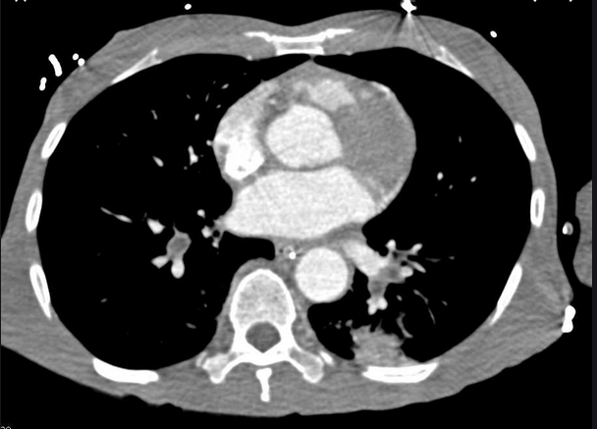
CTPA

Slide 12
Case 1
  Normal CXR
  CTPA confirms a pulmonary thromboembolism
  Diagnosed as PE and given LMWH
  Why do you think this lady has had a PTE? (think back to her PMHx!)

Slide 13
Systemic Lupus Erythematosus
Chronic Multi-system autoimmune disorder
May be drug induced
F>M; 9:1, child-bearing age
Characterised by ANA and DNA antibodies
Relapsing and remitting
Aetiology unknown – environmental trigger in genetically susceptible - ?hormonal element

Slide 14
Systemic Lupus Erythematosus
Antigen-driven immune-mediated disease
  immunoglobulin G antibodies to double-stranded DNA as well as nuclear proteins
Tolerance to self antigens in the B-cell pool is maintained
T- Helper cell dysregulation of B cells may arise - resulting in autoimmunity
  novel therapies being tested such as rituximab

Slide 15
Symptoms and Signs
Non-specific-symptoms
  Malaise
  Weight loss
  Myalgia
  Fever – (>50%)
  Fatigue – (80-100%)
  Non-tender regional lymph nodes
    Usually cervical/axillary
  Seizures/cranial nerve/depression issues in up to 75%
Specific signs
  Malar rash (40%)
  Discoid rash
    Tend to have less systemic disease
  Photosensitivity
  Renal failure 50-70%
  Arthritis
  Oral ulcers (45%)
  Serositis
Notes:
Fever may be from opportunistic infections/drugs
Malar rash can be tender, painful and pruritic and can recur after sun exposure
Renal failure is glomerulonephritis (Ds DNA ab +ve) or lupus nephritis
Can also get pericarditis and anaemia

Slide 16
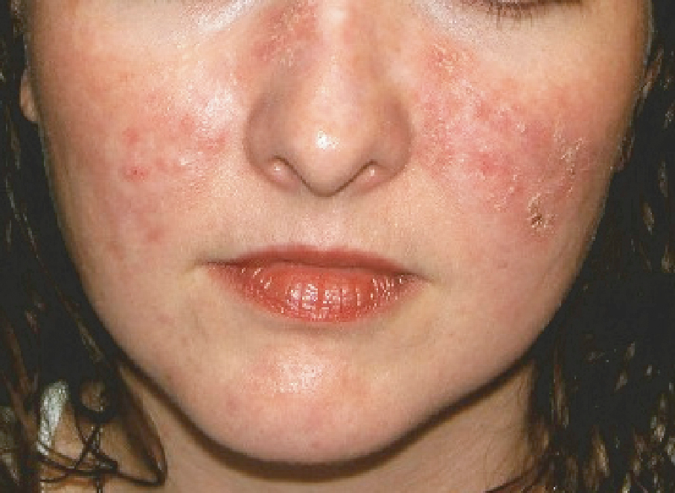

Slide 17
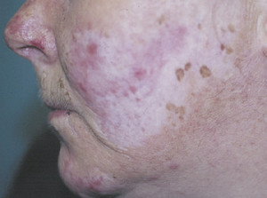

Slide 18
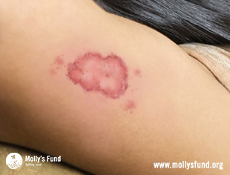

Slide 19
1997 American College of Rheumatology criteria
Malar rash
Discoid rash
Photosensitivity
Oral ulcers
Non-erosive arthritis
Pleuritis/pericarditis
Renal involvement (proteinuria)
Neurological disorder
Haematological involvement (haemolytic anaemia, leucopenia, lymphopenia, thrombocytopenia)
Immunological (anti-DNA, anti-Sm, anti-phospholipid antibodies)
Positive ANA
Need 4 of these – 95% specificity

Slide 20
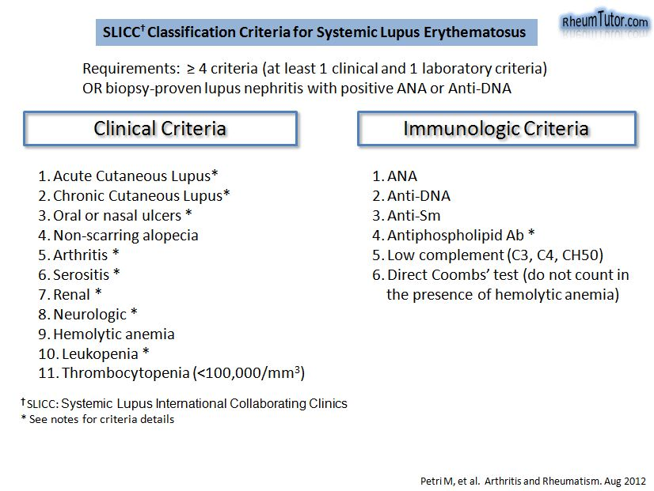

Slide 21
Diagnosis
>95% ANA +ve and criteria from American College Rheumatology
Anti Double Stranded DNA antibodies highly specific
Often associated with other autoimmune disorders
Monitoring
  Symptoms
  Anti-dsDNA antibody titres
  Complement
  ESR
  Renal function
  Prothrombin time – suggest lupus anticoagulant if prolonged
  Urinalysis for proteinuria

Slide 22
SLE Management
Acute severe flare
  Hydroxychloroquine if serositis/joint involvement
  Cyclophosphamide & high dose prednisolone if renal involvement/CNS
  NSAIDs
Maintenance
  NSAIDS
  Hydroxychloroquine
  Low dose steroids
  Azathioprine, methotrexate, mycophenolate

Slide 23
Case 2
A 35-year-old Caucasian woman presents to ED with headache, nausea and vomiting
On exam visual field deficits with left facial nerve palsy and left arm weakness 3/5
On fundoscopy she has papilloedema
Rest of exam is normal
What investigations would you like to do?

Slide 24
Case 2
Bloods initially normal
CXR normal
Urine normal
CT brain…

Slide 25
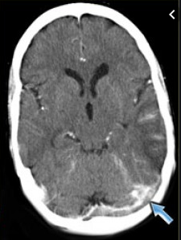
venous sinus thrombosis

Slide 26
Case 2
On speaking to patient she has a history of 3 consecutive pregnancy losses before 12 weeks of pregnancy.
She had no other known complications during the pregnancies…

Slide 27
Case 2
Further testing reveals a lupus anticoagulant, which is still present on repeat testing 12 weeks later
Anticardiolipin antibodies positive

Slide 28
Anti-Phospholipid Syndrome
Antiphospholipid syndrome
  Primary - occurs in patients without an underlying systemic autoimmune disease
  Secondary - particularly in association with systemic lupus erythematosus (SLE) or RA
The actual incidence of APS is unknown,
  probably underdiagnosed.
Prevalence of 1.0% - 6% in normal healthy populations and may increase
with age

Slide 29
Anti-Phospholipid Syndrome
Antiphospholipid Antibodies in SLE between 30% - 40%
Abs in Rheum Arthritis 10%
up to 14% of patients presenting with thrombosis have
antibodies
20% of patients presenting with recurrent pregnancy losses
have Abs
The mean age of symptom onset is approx. 34 years
  85% of patients being diagnosed between 15-50 years
98% patients caucasian

Slide 30
Anti-Phospholipid Syndrome
Antibodies to Phospholipid-binding plasma proteins on platelets
and monocytes results in the development of venous, arterial,
and microvascular thromboses, and/or pregnancy-associated
morbidity
It is unclear what leads to the development of these acquired antibodies
Diagnosed if at least 1 vascular thrombosis or pregnancy morbidity is present in association with the presence of antiphospholipid antibodies on 2 or more occasions, 12 weeks apart

Slide 31
Anti-Phospholipid Syndrome
Pregnancy morbidity is defined as:
  the loss of 3 or more embryos before the 10th week of gestation
  and/or 1 or more otherwise unexplained fetal deaths beyond the 10th week of gestation,
  and/or the premature birth of a morphologically normal neonate before the 34th week of gestation because of eclampsia, severe pre-eclampsia, or placental insufficiency

Slide 32
Anti-Phospholipid Syndrome
Investigations
  Lupus anticoagulant
  ANA and Anti-double stranded DNA abs
  Anticardiolipin Abs
  FBC may show thrombocytopenia
  Urea and Creatinine may be increased if nephropathy
  Dopplers/CTPA or MR angio
  Echo – heart valve abnormalities
    Libman-Sacks endocarditis and may relate to fibrin deposition on the valves. The mitral valve is most commonly affected

Slide 33
Anti-Phospholipid Syndrome
Treat thrombosis – LMWH and then warfarin after
If incidental finding of APL abs then watch and wait unless pregnant and need aspirin
May need immunosuppression in catastrophic flare ups

Slide 34
Case 3
A 38-year-old woman presents with Puffy hands and feet for the past 3 months.
What do want to know/do?

Slide 35
Case 3
A 38-year-old woman presents with Puffy hands and feet for the past 3 months.
She also has a history of Reflux disease and complains her hands go a “funny colour” in winter
On further questioning has occasional difficulty swallowing
What do want to know/do?

Slide 36
Case 3
Physical examination reveals telangiectasias on HER hands
She has sclerodactyly
Digital pits are present with no active ulcers
Bloods reveal high CRP/ESR only
What diagnosis are you thinking of?
What blood tests would be helpful?

Slide 37
Case 3
Further testing
  raised ANA
  Anti Scl-70 +ve

Slide 38
Systemic Sclerosis
Scleroderma
Autoimmune connective tissue disease
Multi-system
functional and structural abnormalities of small blood vessels, fibrosis of skin and internal organs with production of auto-antibodies
Aetiology and pathogenesis unknown
Variable course
Rarely spontaneously resolves

Slide 39
Types
Limited cutaneous systemic sclerosis
  CREST
  Less severe and less organ involvement
  Better prognosis
Diffuse cutaneous systemic sclerosis
  Diffuse skin involvement
  Early organ fibrosis

Slide 40
Limited Cutaneous Systemic Sclerosis
Formerly CREST
  Calcinosis
  Reynaud’s
  oEsophageal and gut dysmotility
  Sclerodactyly
  Telangectasia
Risk of pulmonary hypertension

Slide 41
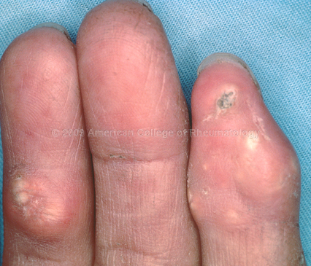
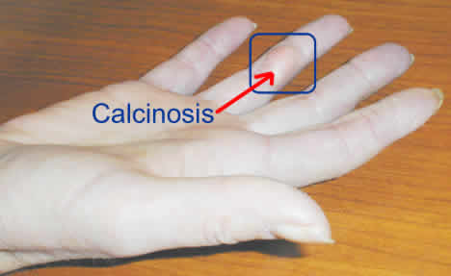

Slide 42
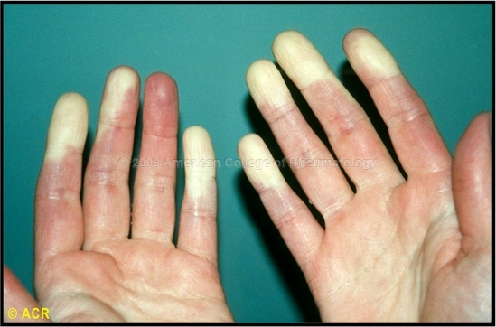
Raynaud’s

Slide 43
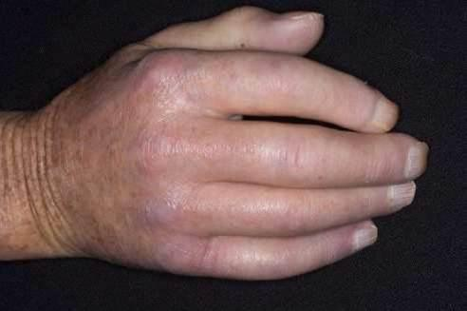

Slide 44
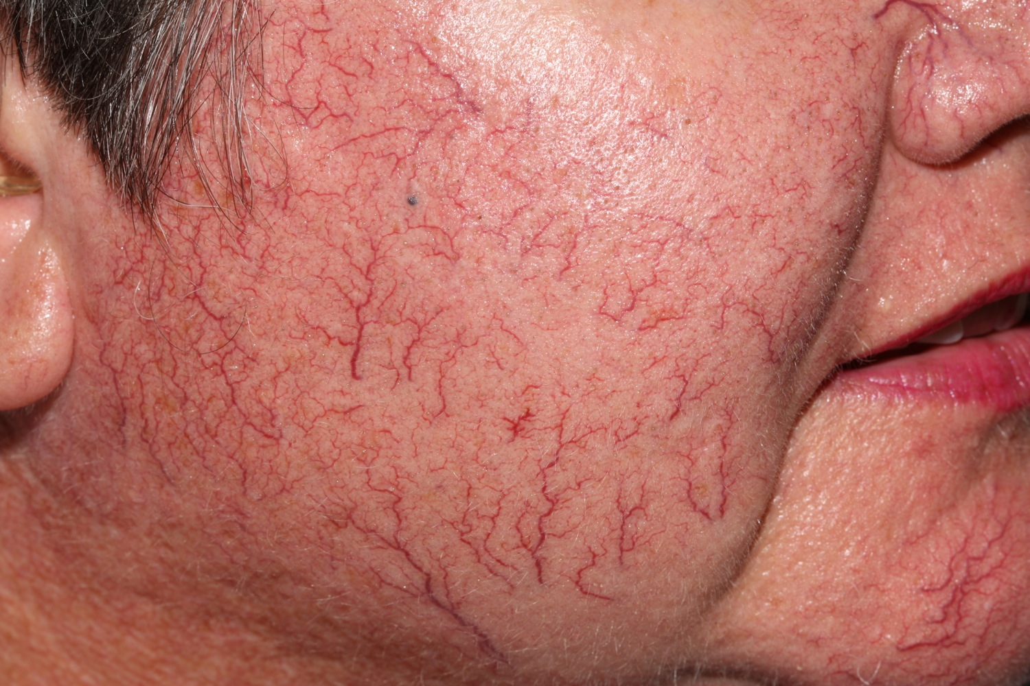

Slide 45
Vascular involvement includes
  Raynaud's phenomenon
  Ischaemic digital ulcers
  Hypertensive crisis
  Pulmonary arterial hypertension
Fibrosis can involve
  Lungs, heart, and GI tract

Slide 46
Diagnosis
Primarily clinical
Elevated ESR/CRP
May have raised ANA (>90% patients) or RhF
Anti-centromere: skin involvement and better prognosis
Anti-Scl70: worse prognosis and lung fibrosis
40% will not have known scleroderma Abs

Slide 47
Management
No cure
Immunosuppressive regimes
  Including cyclophosphamide/methotrexate
Control BP
  ACE-I or ARB
Sildenafil or calcium channel blocker
Low dose steroids
Monitor BP & renal function
Annual echo & spirometry

Slide 48
Raynaud’s
Characterised by vasospasm brought on by cold temperatures causing digits to change colour to white from lack of blood flow
Affected areas subsequently turn blue due to de-oxygenation and/or red due to reperfusion.
It can be a painful condition and can lead to complications.
Approximately 1% to 3% of the population and is more common in women

Slide 49
Raynaud’s
Can be primary or secondary
Secondary
  Associated with an underlying connective tissue disease (especially systemic sclerosis, vasculitis, malignancy, or peripheral vascular disease)
  Up-regulation of inflammatory cytokines increased in secondary
  Diffuse scleroderma have increased adrenoreceptor activity
  May pre-date connective tissue disease
Notes:
Abnormal vasospasm but also changes in NO production (especially in diffuse scleroderma) and abnormal endothelium too leading to increased spasm

Slide 50
Raynaud’s
Investigations
  If the patient has new-onset RP
  >40 years old,
  And/or has features from history or physical examination that suggest secondary causes
    ANA with titre and pattern
    FBC
    ESR
    Serum creatinine
    Urinalysis

Slide 51
Raynaud’s
Follow-up
  30% will develop a connective tissue disease within the next 5 years.
  In particular, an anti-centromere antibody and/or dilated capillaries at the
  peri-ungual region are predictive for scleroderma

Slide 52
Raynaud’s
Treated with
  Aspirin
  Statin
  Calcium Channel blockers
  May need sildenafil if severe secondary
  NSAIDs for analgesia

Slide 53
As an aside…
Other condition associated with Raynaud’s?

Slide 54
Sjogren’s
Chronic inflammatory and auto-immune disorder characterised by diminished lacrimal and salivary gland secretion (sicca complex) due to lymphocytic infiltration.
May present with fatigue and dry eyes (keratoconjunctivitis sicca) and dry mouth (xerostomia).
Diagnosed by positive ANAs, Ro and anti-La auto-antibodies, decreased saliva and tear production, lymphocytic infiltration in labial salivary gland biopsy.
Treatment mainly symptomatic – unless vasculitis/MSK involvement in which case - steroids and immunosupression
Notes:
Ro and La abs in 90% cases – indicate likelihood of developing vasculitis

Slide 55
Sjogren’s
Additional symptoms can include dryness of skin, nose, throat, vagina; arthralgias and myalgias; peripheral neuropathies; pulmonary, thyroid, and renal disorders; and lymphoma
Can be:
  Primary
  Secondary such as with lupus, rheumatoid arthritis, and systemic sclerosis

Slide 56
Case 4
A 57-year-old man presents with a 6month history of slowly worsening leg weakness
Recently had multiple falls and now experiences difficulties with fine tasks using his hands
Generalised pain
Facial rash mainly around eyes with eye lid swelling
On further questioning weight loss and reduced appetite with some difficulty swallowing

Slide 57
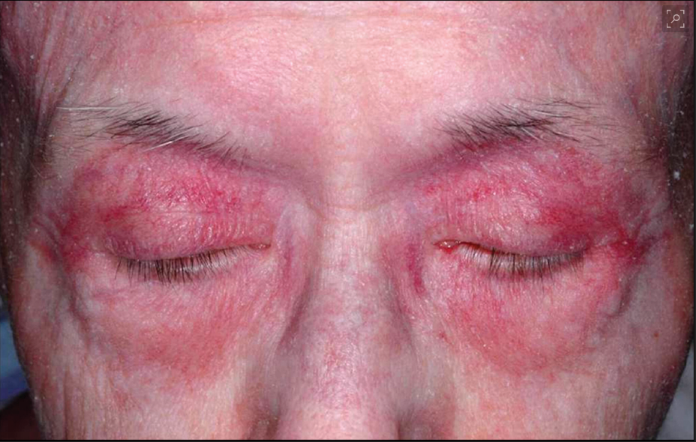
Case 4
From the JAMA network

Slide 58
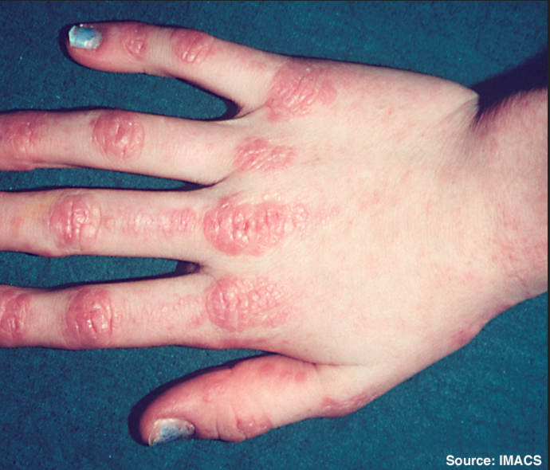
Case 4

Slide 59
Case 4
Wasting of muscles and proximal weakness in arms and legs bilaterally (power 3/5)
Can’t get out of chair
Attenuated patellar reflexes

Slide 60
Case 4
Bloods show high ALT/AST, LDH increased
High CK
Anti Jo Abs +ve
What next?

Slide 61
Case 4
Bloods show high ALT/AST, LDH increased
High CK
Anti Jo Abs +ve
What next?
Biopsy:
  Lots of inflammation and necrosis

Slide 62
Inflammatory Polymyopathies
Heterogeneous group of muscular disorders characterised by progressive muscle weakness
Presentation is sub-acute or chronic - rarely acute
Have in common the presence of moderate-to-severe proximal muscle weakness and inflammation on muscle biopsy
They are divided into 3 groups:
  Polymyositis,
  Dermatomyositis
    Polymyositis and dermatomyositis seem to have an autoimmune pathogenesis
  Inclusion body myositis – autoimmune and degenerative

Slide 63
Inflammatory Polymyopathies
Primary idiopathic polymyositis
Primary idiopathic dermatomyositis
Polymyositis or dermatomyositis with malignancy
Polymyositis or dermatomyositis associated with other connective tissue diseases
Others
  Juvenile and inclusion body

Slide 64
Inflammatory Polymyopathies
Polymyositis is seen after the second decade of life and very rarely in childhood
More common in women
1 in 30,000
Infective trigger in genetically susceptible people:
  Several viruses including coxsackievirus, influenza virus, retroviruses, cytomegalovirus, and Epstein-Barr virus (EBV) seem to be associated with these myopathies

Slide 65
Inflammatory Polymyopathies
In polymyositis,
  major histocompatibility complex-1 mediate cytotoxicity by CD8 T cells
  immunological synapses form between CD8 T cells and MHC-1 expressed on muscle fibres – inflammation and necrosis

Slide 66
Inflammatory Polymyopathies
Patients with polymyositis have double increased risk of developing cancer compared with the general population
The most frequent malignancies observed
  Non-Hodgkin's lymphoma, lung cancer, and bladder cancer

Slide 67
Inflammatory Polymyopathies
Dermatomyositis
  UV radiation intensity has been shown to be the strongest contributor to dermatomyositis
  Primary antigen target consists of components of the vascular endothelium of the larger endomysial blood vessels
  Lymphocytic response results in capillary necrosis, micro-infarction, inflammation and cell then spread into muscles

Slide 68
Inflammatory Polymyopathies
In dermatomyositis the following skin lesions are characteristic:
  Heliotrope rash with eyelid oedema
  Facial rash
  Gottron's papules, (erythema of knuckles accompanied by a raised violaceous scaly eruption)
  Erythematous rash over the knees, elbows, malleoli, and at the base of the neck and upper chest, forming a V sign
  Nail fold changes such as dilation of capillary loops of periungual area

Slide 69
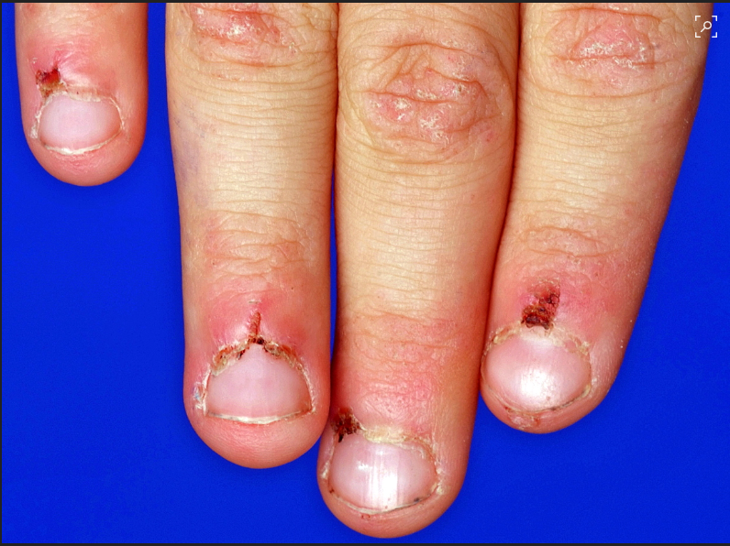

Slide 70
Inflammatory Polymyopathies
3 to 6 times increased risk of developing cancer in dermatomyositis
58% of neoplasms occurring after myositis diagnosis
Most frequent malignancies are:
  Ovarian cancer
  Pancreatic cancer
  Non-Hodgkin's lymphoma

Slide 71
Inflammatory Polymyopathies
Proximal symmetrical muscle weakness
Most commonly between the ages of 40 and 60 years
Increased difficulties in performing motor tasks predominantly requiring proximal muscles
  Getting up from a chair, climbing steps, and combing hair.
Fine motor tasks that depend on distal muscles affected:
  Sewing, knitting, or writing (late in the course of dermatomyositis and polymyositis)

Slide 72
Inflammatory Polymyopathies
Extramuscular symptoms include:
  Arthralgia
  Dysphagia
  Shortness of breath
  Palpitations
  Syncope
  Weight loss
  Fatigue
  Skin lesions
  MI symptoms
One third of patients with polymyositis have pain and muscle tenderness

Slide 73
Inflammatory Polymyopathies
Diagnosis is confirmed
  By elevated serum muscle-derived enzymes (CK)
  25% have Anti Jo Abs (identifies risk of lung fibrosis as >75% of Jo +ve will develop it)
  Typical electromyography (EMG) findings
  Inflammation and necrosis on muscle biopsy

Slide 74
Inflammatory Polymyopathies
  Lactate dehydrogenase (LDH), myoglobin, and aspartate aminotransferase (AST) and alanine aminotransferase (ALT) are part of the initial work-up and may be elevated
    Non-specific for muscle injury

Slide 75
Inflammatory Polymyopathies
Treatment
  Corticosteroids are first-line therapy (IV or Oral depending on severity of presentation)
  Intravenous immunoglobulin, methotrexate, and azathioprine are used as second-line therapy or if life threatening attacks
  Third-line therapies include cyclophosphamide, mycophenolate, ciclosporin, and tacrolimus

Slide 76
Learning Outcomes
Systemic Lupus Erythematosus (SLE)
Antiphospholipid syndrome
Systemic sclerosis (Scleroderma)
Raynaud’s phenomenon
Sjogren's syndrome
Inflammatory myopathies, e.g., polymyositis

Slide 77
Thank you
Please fill out the feedback form for your certificate of learning

Slide 78
Get in touch!
Website
www.quackmeded.co.uk
Email
ggc.quackmeded@nhs.scot
Social Media
Twitter: @QUACK_ Med
Facebook: QUACK education

