Slide 1
“I can’t walk doctor”
Dr Chris McNally
ST6 Acute and General Medicine

Slide 2
Disclaimer*
Please note that QUACK is a regional teaching programme operating across GG&C, Lanarkshire and Ayrshire & Arran.
This presentation outlines general management, though local variances e.g. antibiotic prescription may vary slightly depending on your local trust
Remember to check your local guidelines

Slide 3
Neurology in AIM/GIM
What do wee see?
Cases
“Off Legs”
Case reviews

Slide 4
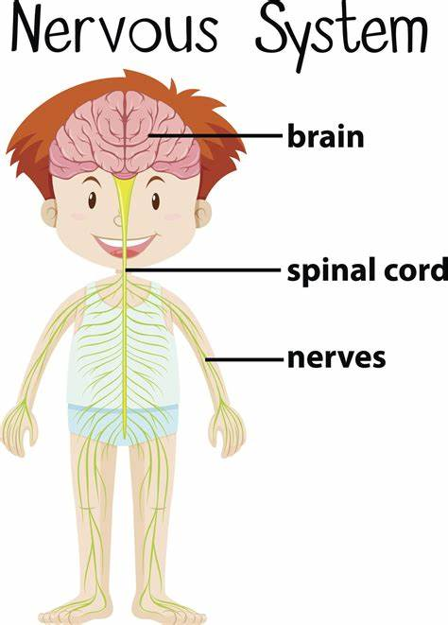
Acute Neurology in MHDU
Seizures
Delirium
Drug induced delirium and/or Psychosis
Motor Neurone Disease
NMS/Serotonin Syndrome
Acute Neuromuscular Disorders
Stroke
GBS
ACUTE BRAIN FAILURE
“ACUTE” NERVE FAILURE

Slide 5
Case 1
33M
Hiking in Skye 1/52 ago. Developed diarrhoea
Returned to parents in Glasgow
Attended GP surgery with paraesthesiae in toes and spreading to shins
O/E:
Well, haemodynamically stable and apyrexial
Power 5/5 hips, knees
Power 4/5 ankles
Absent ankle jerks
Subjective altered sensation in feet

Slide 6
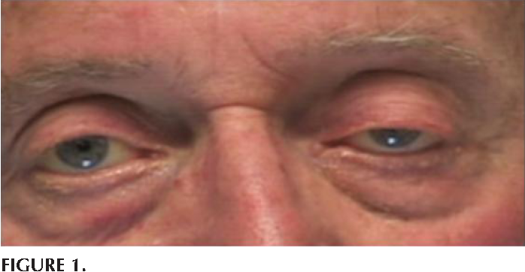
Case 2
79F. Rarely attends GP
HTN
T2DM
Ex smoker
L facial droop, ptosis and diplopia
Power 5/5 limbs
CXR – NAD
Bloods – CRP 20, WBC 8,
CT head – NAD
MRI head - NAD

Slide 7
Case 3
69M
HTN
1/52 Dysuria, fever, anal pain
No improvement with nitrofurantoin
Generally feels unwell with dizziness and feeling “unstable”
O/E
Temp 37.4 but haemodynamically stable
CV exam – NAD
No postural BP deficit
Full neuro exam including cerebellar unremarkable
Urinalysis +nitrates +leuc
Tender prostate on PR

Slide 8
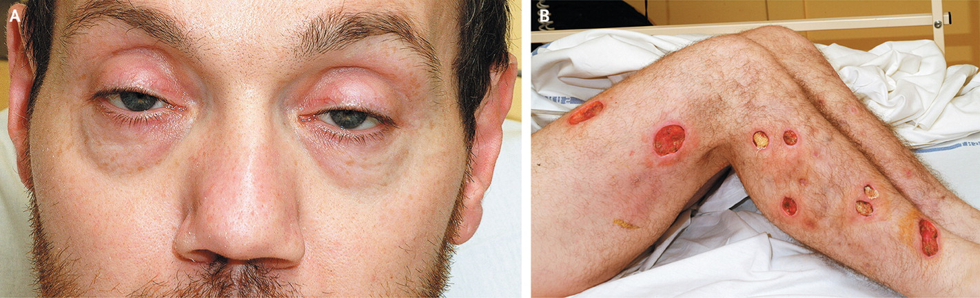
Case 4
29M
Active IVDU
1/52 swollen hot Right leg
Raised inflammatory markers and fever
USS Doppler confirms DVT
Concerns infected DVT
Increasing FiO2
T1RF on ABG
Facial paralysis and dysphasia
Drooling
Global weakness including respiratory muscles
Peri arrest
Required RSI and IPPV

Slide 9


Slide 10
Guillain-Barre Syndrome (GBS)
Most common and most severe acute inflammatory polyneuropathy
Acute neurological Emergency
20% patients remain disabled
5% mortality rate
1.11 per 100,000 person-years
2/3 of cases preceded by URTI/flu-like illness or diarrhoea

Slide 11
Guillain-Barre Syndrome
Acute Inflammatory demyelinating polyneuropathy
(AIDP)
Acute motor axonal neuropathy
(AMAN)
AM Sensory AN
Miller Fisher Syndrome

Slide 12
GBS Pathogenesis
Yuki N and Hartung HP. Guillain-Barre Syndrome. NEJM 2012; 366:2294-304

Slide 13
GBS Natural History
Willison HJ, Jacobs BC, and van Doorn PA. Guillain-Barre syndrome. Lancet 2016; 388: 717-27

Slide 14
GBS Clinical Manifestations
HISTORY
Rapidly progressive BILATERAL weakness
Ascending starting in legs
Preceding infection
EXAM
Facial weakness
Occulmotor palsies
Bulbar palsies
Areflexia in affected limbs
OTHER
Ataxia
Muscle or radicular pain
Respiratory Failure

Slide 15
Management of GBS
A CLINICAL DIAGNOSIS
CSF analysis –raised Protein, no WCC
FVC monitoring
Serum Immunoglobulins
High care area
VTE prophylaxis
Pressure sore prevention
MRI head and spinal cord
Willison HJ, Jacobs BC, and van Doorn PA. Guillain-Barre syndrome. Lancet 2016; 388: 717-27

Slide 16
GBS Treatment
IVIG
2g/kg over 5D
Plasmapheresis
5 PE sessions over 2 weeks
Supportive

Slide 17
IVIG for GBS
2g/kg split into 5 days
Will depend on pharmacy stores
Access: https://www.nsd.scot.nhs.uk/Documents/guidelines/2016ImmunoglobulinRequestForm.pdf
Given peripherally and ideally within 2 weeks of onset
Inhibits autoantibody-mediated complement activation
Risks/Adverse effects:
Similar to that of blood transfusion
Hypersensitivity and anaphylaxis
Beware IgA deficiency and renal impairment
Consult product literature – test dose

Slide 18
Supportive Therapy for GBS
VTE prophylaxis!
Pressure sore avoidance
Monitoring of HR, SaO2, BP, RR until “stable”
Monitoring of FVC – observe trend
Analgesia – NSAIDs and neuropathic agents have most evidence
Personalised physiotherapy
Holistic care
Ensure ICU aware of patient

Slide 19
When to consider referral to ICU
Major Criteria
Hypercapnic respiratory failure PaCO2 > 6.4 kPa.
PaO2 < 7.5kPa in room air
FVC < 15ml/kg or < 30% predicted
X1 major
Minor Criteria
Inefficient cough
Impaired swallowing
Developing atelectasis on CXR
X2 minor

Slide 20
Further Management and Prognosis
NCS – not essential for diagnosis but can be useful to predict outcome
10% may have relapse within 8 weeks
Clinical course is highly variable
Carries high morbidity; Cardio-respiratory complications
Poorer prognosis: higher age, degree of disability at onset, preceding diarrhoea
https://www.nhsggc.org.uk/media/248455/neuroimmunology-request-form.pdf

Slide 21
Case 1
33M
Hiking in Skye 1/52 ago. Developed diarrhoea
Returned to parents in Glasgow
Attended GP surgery with paraesthesiae in toes and spreading to shins
O/E:
Well, haemodynamically stable and apyrexial
Power 5/5 hips, knees
Power 4/5 ankles
Absent ankle jerks
Subjective altered sensation in feet

Slide 22
Case 2
79F. Rarely attends GP
HTN
T2DM
Ex smoker
L facial droop, ptosis and diplopia
Power 5/5 limbs
CXR – NAD
Bloods – CRP 20, WBC 8,
CT head – NAD
MRI head - NAD

Slide 23
Case 3
69M
HTN
1/52 Dysuria, fever, anal pain
No improvement with nitrofurantoin
Generally feels unwell with dizziness and feeling “unstable”
O/E
Temp 37.4 but haemodynamically stable
CV exam – NAD
No postural BP deficit
Full neuro exam including cerebellar unremarkable
Urinalysis +nitrates +leuc
Tender prostate on PR

Slide 24
Case 4
29M
Active IVDU
1/52 swollen hot Right leg
Raised inflammatory markers and fever
USS Doppler confirms DVT
Concerns infected DVT
Increasing FiO2
T1RF on ABG
Facial paralysis and dysphasia
Drooling
Global weakness including respiratory muscles
Peri arrest
Required RSI and IPPV

Slide 25
Botulism
Clostridium botulinium; wound and food
Symmetrical cranial nerve palsies
DESCENDING flaccid paralysis – emotionless/expressionless
Dysphagia, dysphasia, dry mouth
Respiratory Arrest
Acute medical emergency and Public Health Emergency
Need to send tissue samples to microbiology. Involve ICU and Surgeons
Rx with botulinium antitoxin. Consult pharmacy

Slide 26
References
Yuki N and Hartung HP. Guillain-Barre Syndrome. NEJM 2012; 366:2294-304
Willison HJ, Jacobs BC, and van Doorn PA. Guillain-Barre syndrome. Lancet 2016; 388: 717-27
Sobel J. Botulism. Clinical Infectious Disease 2005; 14: 1167-73

Slide 27
Take Home Messages
History of neurological examination is key
Wide differential diagnosis of “off legs”
Bilateral weakness with prior infection ?GBS
Liaise with neurology
Clinical diagnosis: CT, LP, MRI spine helpful

Slide 28
Thanks

Slide 29
Get in touch!
Website
www.quackmeded.co.uk
Email
ggc.quackmeded@nhs.scot
Social Media
Twitter: @QUACK_ Med
Facebook: QUACK education

