Slide 1
Influenza
Dr Alistair McConnachie
ID Consultant

Slide 2
Disclaimer*
Please note that QUACK is a regional teaching programme operating across GG&C, Lanarkshire and Ayrshire & Arran.
This presentation outlines general management, though local variances e.g. antibiotic prescription may vary slightly depending on your local trust
Remember to check your local guidelines

Slide 3
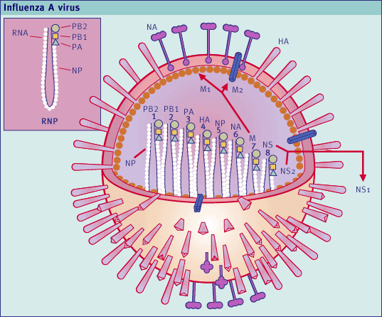
Influenza Viruses
Enveloped RNA viruses, Orthomyxoviridae
Based on core proteins
    Influenza A, B and C
Influenza A
    Antigenic surface glycoproteins
      Haemagglutinin (HA)
      Neuraminadase (NA)
    15 HA (H1-15) and 9 NA (N1-9) in aquatic birds
    H1-3 circulate in humans (host specificity)

Slide 4
Influenza - pathogenesis
Peak viral shedding at 24-48hrs
    Longer children/immunocompromised
Inhalation virus containing particles
    n.b. Fomite spread
Attachment to sialic acid residues on upper airways
Viral replication in respiratory tract

Slide 5

Clinical Features
Headache
Fever
Cough
Sore throat
Myalgia
Diarrhoea & vomiting
Older people

Slide 6
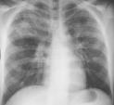
Influenza - complications
High Risk
Chronic CV/pulm/hepatic/neuro/renal disease
Diabetes
Severe immunosuppression
Obesity (BMI≥40)
Age >65
Pregnancy incl 2 weeks post partum
1ºInfluenza
Pneumonia
Mixed
Pneumonia
2° Bacterial
Pneumonia

Slide 7
Influenza - pneumonia
Primary influenza pneumonia
    Most severe, least common
    High fever, dyspnoea, cyanosis
    Elevated left atrial pressure or chronic pulmonary illness

Slide 8
Influenza – pneumonia
Secondary bacterial pneumonia
    25% all influenza deaths
    Loss of cilia, ↑ bacterial pathogenicity
    S.pneumoniae – 48%
    S.aureus – 19%
      ↑epidemic years
      ? ca MRSA
    Exacerbation fever & resp symptoms following initial improvement

Slide 9
Influenza – extra pulmonary complications
Myositis & rhabdomyolysis
    Children, unusual adults
    Extreme tenderness, more common legs
    ↑CK, myoglobinuria, renal impairment
CNS involvement
    Encephalitis, transverse myelitis, aseptic meningitis, GBS
Post influenza asthenia
    Persistent weakness, fatigability
    Lasts several weeks

Slide 10
Uncomplicated v Complicated
Uncomplicated
Influenza like illness without any features of complicated disease
Fever
Myalgia
Headache
Cough
GI symptoms
Complicated
Requires hospital admission
Symptoms and signs lower respiratory tract infection
  Dyspnoea
  Hypoxia
  Lung infiltrates
CNS involvement
Destabilisation of chronic illness

Slide 11
Neuraminadase inhibitors
Oral Oseltamavir
Inhaled Zanamivir
Nebulised Oseltamavir (off licence)
Intravenous Zanamivir (compassionate use)

Slide 12
Neuraminadase inhibitors - Efficacy
Licensing studies show reduction in illness duration by ~36hrs if started in first 48hrs of illness.
Metanalyses have suggested no reduction in risk of hospitalisation, complications or mortality if started outwith that in INFLUENZA LIKE ILLNESS (i.e. Not all ILI is Influenza)

Slide 13
Neuraminidase inhibitors - Efficacy
Observational data suggest
    Reduced complications in high risk groups
    Reduced risk of critical care admission
    Reduced mortality
Metanalysis looking at confirmed Influenza would support this¹
NIs reduce viral shedding – reduce risk nosocomial spread
1. Lancet. 2015 May 2;385(9979):1729-1737. doi: 10.1016/S0140-6736(14)62449-1.

Slide 14
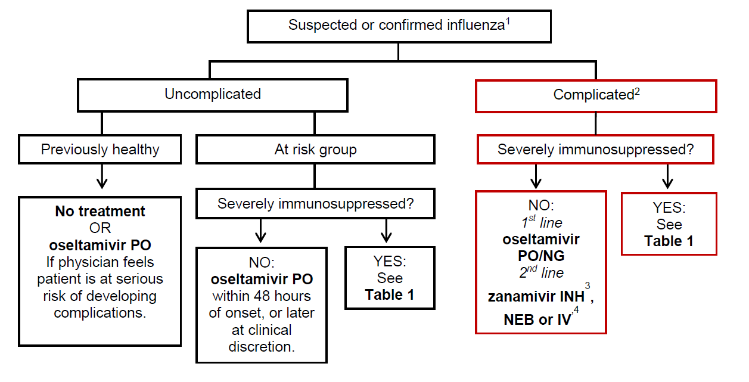
Table 1 = consider Zanamivir over Oseltamavir if H1N1 or known Oseltamavir resistance

Slide 15
Dosing and side effects
Oseltamavir – 75mg twice daily p.o. for 5 days
    CrCl 31-60 30mg bd
    CrCl 11-30 30mg od
    CrCl <10 30mg single dose
    Side effects; nausea and vomiting
Zanamivir – 10mg twice daily inh for 5 days
    Need to be able to use diskhaler
    Lack of “systemic” effect

Slide 16
Pregnancy
Pregnancy and Influenza is a bad combination
    Higher rates complications and hospitalisation
    Higher mortality
    Poor foetal outcomes including congenital malformations
No evidence of harm from Oseltamavir or Zanamavir
Oseltamavir first line treatment for
pregnant women with Influenza
Treatment does not prevent breast
feeding

Slide 17
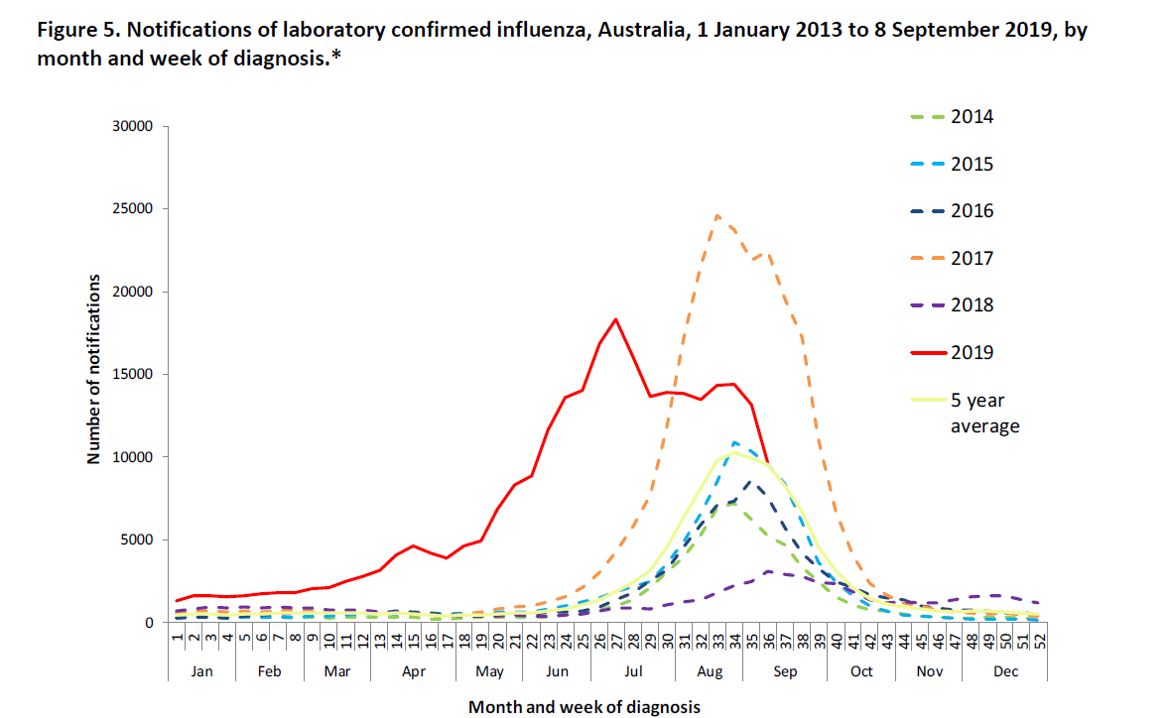
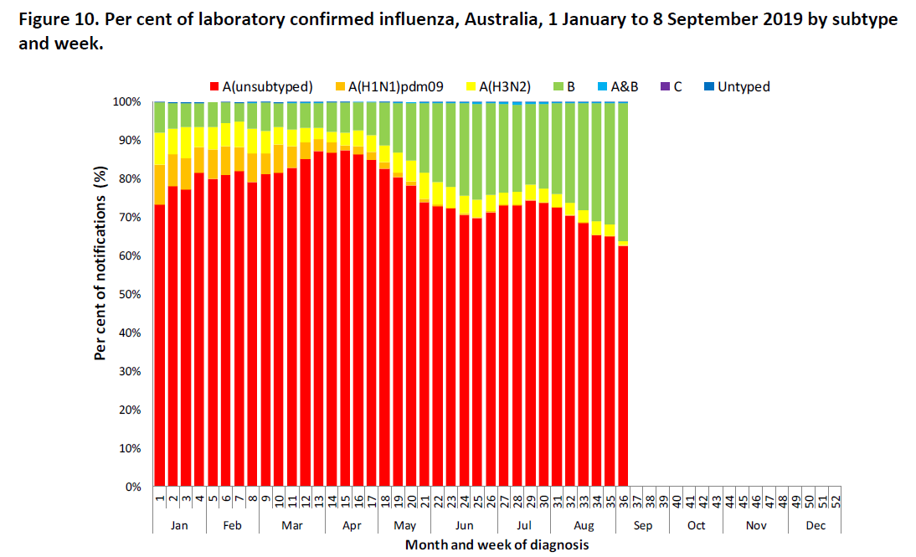

Slide 18
Summary
Think of Influenza
    Do you need to test for Influenza?
    Viral gargle – POCT has 97 to 99% sensitivity
If admitting the patient start a neuraminidase inhibitor (think carefully about need for antibiotics – most will not need)
Discharge ± neuraminidase inhibitor perfectly reasonable in absence of complicated disease (risk groups)
Beware atypical presentations in elderly and immunosupressed e.g. predominance D and V, non specific febrile illness, exacerbation COPD
Vaccination does NOT exclude Influenza

Slide 19
Get in touch!
Website
www.quackmeded.co.uk
Email
ggc.quackmeded@nhs.scot
Social Media
Twitter: @QUACK_ Med
Facebook: QUACK education

