Slide 1
Seizure
Dr Amy Davidson
StR7 Neurology

Slide 2
Disclaimer*
Please note that QUACK is a regional teaching programme operating across GG&C, Lanarkshire and Ayrshire & Arran.
This presentation outlines general management, though local variances e.g. antibiotic prescription may vary slightly depending on your local trust
Remember to check your local guidelines

Slide 3
Overview
Episodic
Definition
Recognition
Classification
When to treat
Status
Definition
Treatment

Slide 4
Definition
Seizure:
  clinical manifestation resulting from abnormal and excessive synchronised electrical discharges in a set of neurones in the brain

Slide 5
1. Background/Provoking Factors
Previous or family history
Early life risk factors
  Birth injury, febrile convulsions, meningitis, encephalitis
Brain injury: stroke, neurosurgery
Myoclonic jerks in / since teens
Provoking factors
  Change in alcohol, drugs, sleeping tablets
  Sleep deprivation
Notes:
5

Slide 6
2. Preceding symptoms
Generalised:
  Usually no warning
Focal – ‘Aura’
  Strange taste, smell
  Déjà-vu, jamais-vu
  Fear
  Ascending unusual feeling
  Sensory changes

Slide 7
3. Description of attack – (Witness!) Seizures
Focal seizures
Generalised seizures
Automatisms
  Oro-facial (lip smacking)
  Manual (picking, stroking)
Head and eye deviation
Limb stiffening/jerking
Reduced interaction or responsiveness
Duration
  Frontal lobe 10-20 seconds
  Temporal lobe 2-4 minutes
Body stiff, rigid, crashing to ground
Often letting out loud scream
From rigid to rhythmical limb jerking (not tremor)
Colour purple/ blue (as if dead)
Eyes often open (rolled back)
Lasts 1-2 minutes, then jerking slows down
Often heavy breathing, snoring

Slide 8
4. After event
Witness:
  Non-responsive for some minutes
  Often post-ictal confusion
  Dysphasia, Todd‘s paresis (if focal onset)
Patient:
  No or delayed recall
  Headache
  Achey all over (myalgia)
  Goes to sleep it off
Beware of convulsive syncope:
  If kept in upright position for too long
  Can go rigid
  May have rhythmic jerks (< 30s)
  May be incontinent
  May be briefly confused, feel rotten

Slide 9
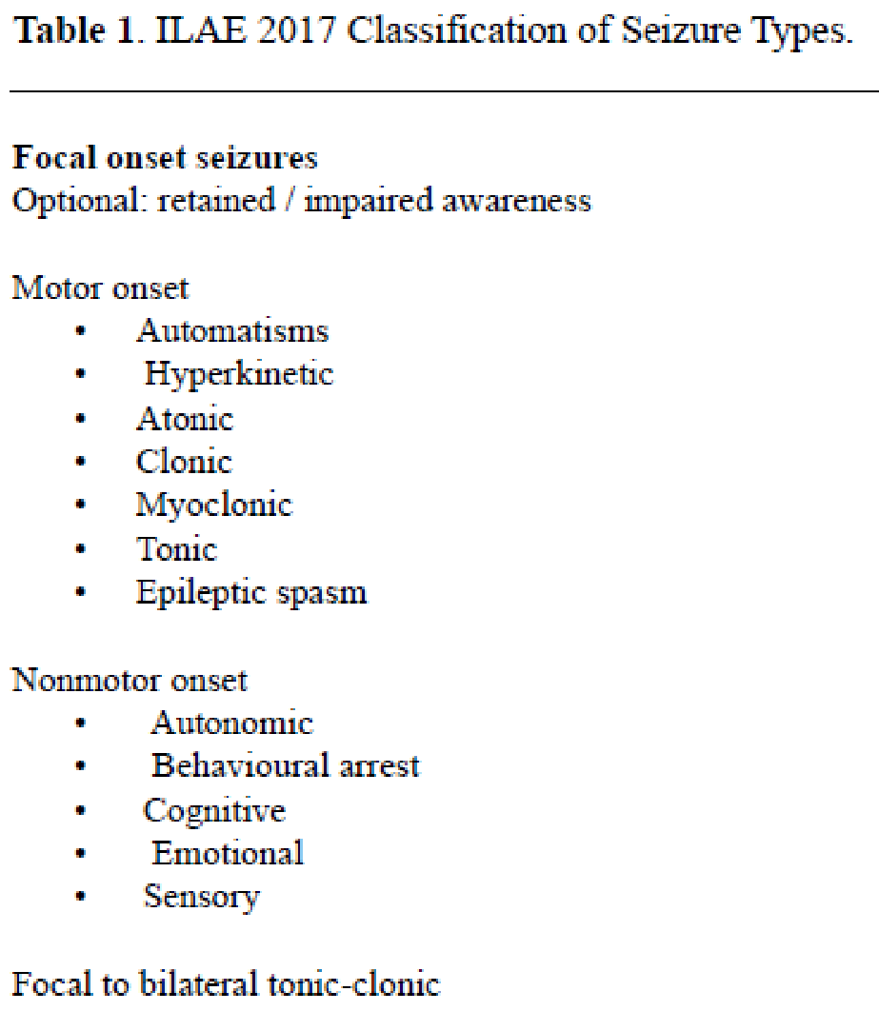
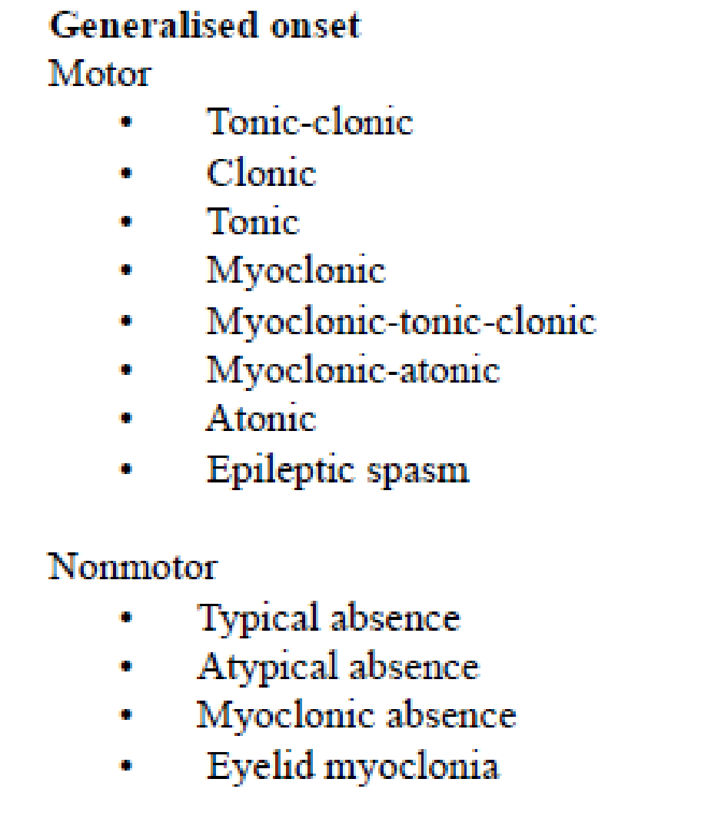
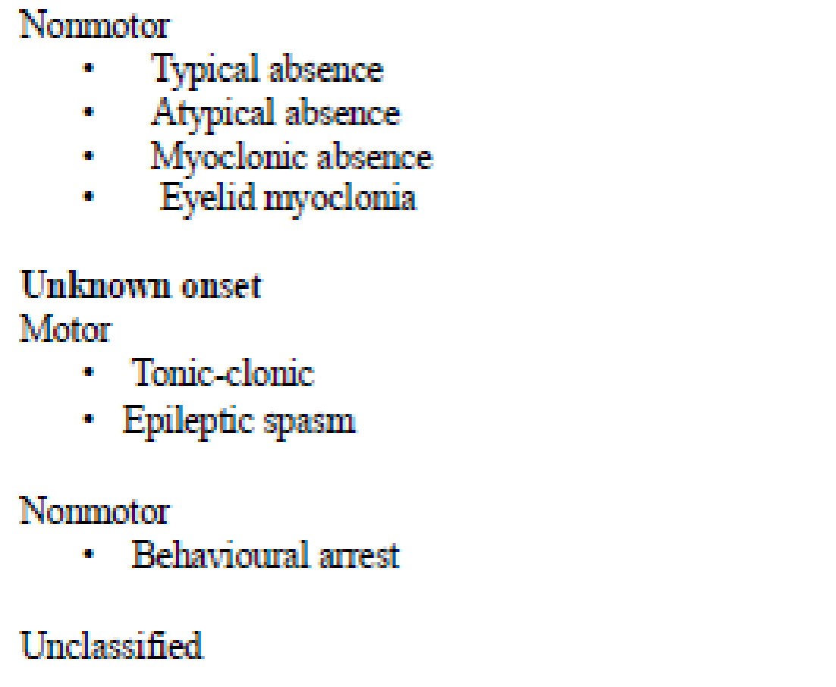
Classification of Seizures 2017

Slide 10
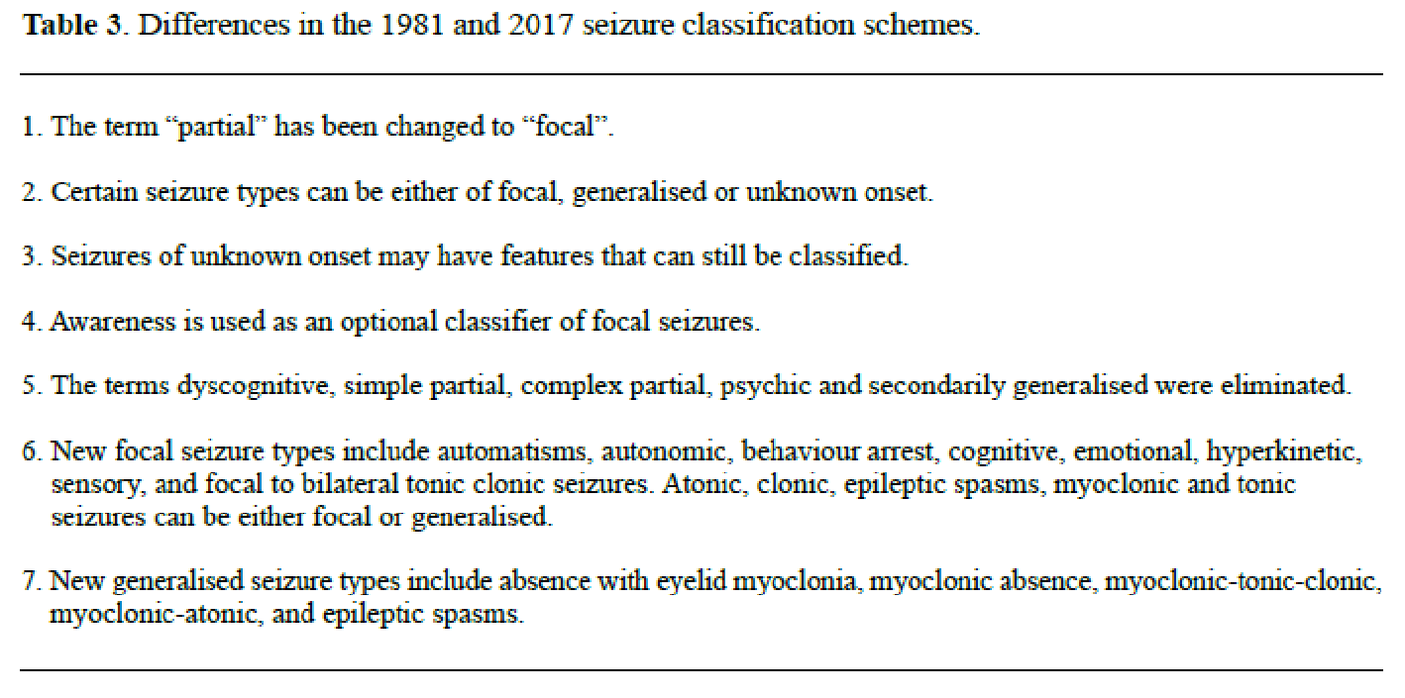
Changes from 1981 to 2017

Slide 11
Risk of seizure recurrence - untreated
FIR.S.T (First Seizure trial Group 1993)
MESS (Multicentre Epilepsy and Single Seizure study 2005)
Time after seizure | Recurrence risk
3 months | 18%
6 months | 28%
12 months | 41%
24 months | 51%
Time after seizure | Recurrence risk
6 months | 26%
2 years | 39%
5 years | 51%
8 years | 52%
Observational studies
  2 year recurrence risk in the range of 40%
Notes:
2 large scale randomised trials provide definitive estimates after an untreated first unprovoked seizure.
11

Slide 12
Risk of recurrence
There’s a 30-50% risk that a seizure will recur without intervention
The risk increased if
  You have had a previous insult to the brain (x2)
  The EEG is abnormal (x2)
  Possibly if it was a sleep seizure
If none of these risks then 10-30%
Studies show that 80-90% of seizures that recur do so within 2 years in adult

Slide 13
Driving
All patients with unexplained loss of consciousness or potential seizure activity should be informed not to drive
The onus is on the patient to inform the DVLA

Slide 14
DVLA advice
You’ve had epileptic attacks while awake and lost consciousness
Your licence will be taken away. You can reapply if you haven’t had an attack for at least a year.
If you had a seizure because your doctor changed or reduced your anti-epilepsy medicine, you can reapply when:
  the seizure was more than 6 months ago
  you’ve been back on your previous medication for 6 months
  you haven’t had another seizure in that time
You’ve had a one-off seizure while awake and lost consciousness
Your licence will be taken away. You can reapply when both the following are true:
  you haven’t had an attack for 6 months
  DVLA’s medical advisers decide there isn’t a high risk you’ll have another seizure
  Medical advisers will base their decision on information you and your doctors send them. Otherwise you can reapply after a year.
You’ve had attacks while asleep and awake
You may still qualify for a licence if the only attacks you’ve had in the past 3 years have been while you were asleep.
You’ve only had attacks while asleep
You may still qualify for a licence if it’s been 12 months or more since your first attack.
You’ve had attacks or seizures that don’t affect your consciousness or driving
You may still qualify for a licence if these are the only type of attack you’ve ever had and the first one was 12 months ago.
*caveat – changes regularly so
please check up to date advice

Slide 15
Definition of Epilepsy
Epilepsy is a disease of the brain defined by any of the following conditions:
  At least two unprovoked seizures occurring more than 24 hours apart
  One unprovoked seizure and a probability of further seizures similar to the general recurrence risk (at least 60%) after two unprovoked seizures, occurring over the next 10 years – MRI / EEG information
  Diagnosis of an epilepsy syndrome
Notes:
Epilepsydiagnosis.org

Slide 16
Unprovoked
Provoked
(25-30%)
A seizure of unknown aetiology
Pre-existing brain lesion or progressive CNS disorder (‘remote symptomatic seizure’)
‘Acute symptomatic seizure’
Acute metabolic and toxic disturbance
Drug withdrawal
  alcohol, benzos, barbiturates)
Within 7 days of an acute CNS condition
  Encephalitis, infection, head injury, cerebral infarction/haemorrhage, craniotomy
Notes:
Contentious - Most epileptics say seizures are provoked. Unprovoked seizures are difficult to define. All seizures are precipitated by particular circumstances. Unprovoked = spontaneous (?) implies that seizures are not provoked by distinct provocative factors outside physiological limits, i.e. outside situations that often occur in daily life. Such a definition make it redundant to include reflex epilepsies in the definition as reflex seizures are provoked by stimuli which is difficult to avoid in daily life.
16

Slide 17
When should you start management?
Recurrent seizures
  Provoked seizures
    Alcohol withdrawal
      Benzodiazepines
    Metabolic disturbances/drugs
      correction or withdrawal
    Following acute brain insult or neurosurgery.
      If used then AEDs should be withdrawn as no prophylactic effect
      Benzodiazepines, Levetiracetam
  Unprovoked
    Call your friendly neurologist!
Status epilepticus

Slide 18
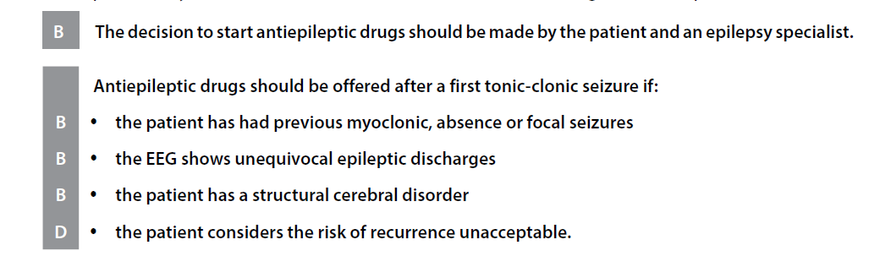
Treatment Decision
Individualised
(clinical variables)
Desires of the patient
SIGN May 2015
Notes:
Important
Serious psychosocial consequences
Loss of driving privileges
Limitations on employment
18

Slide 19
Drug choices
Considerations:
  Speed at which we require seizure control
  Method of administration
    Oral vs iv
    Tablets vs granuals vs liquid
  Age
  Co morbidities
    Renal/liver function
    Mental health
    Cardiac status

Slide 20
Drug choices
Valproate
Valproate (Epilim, Depakote and other generic brands) is associated with a significant risk of birth defects and developmental disorders in children born to women who take valproate during pregnancy.
The Medicines and Healthcare products Regulatory Agency (MHRA) states that valproate must no longer be used in any woman or girl able to have children unless she has a pregnancy prevention programme in place
https://www.gov.uk/guidance/valproate-use-by-women-and-girls

Slide 21
Drug Choices
Focal Epilepsies
Lamotrigine
Levetiracetam
Lacosamide
Carbamazepine
Topiramate
oxcarbazepine
Generalised Epilepsies
Sodium Valproate
Lamotrigine
Topiramate
WoCBA
Levetiracetam
Lamotrigine

Slide 22
Status Epilepticus
Official definitions of Status Epilepticus have varied over the years.
Definitions have depended on duration and whether there is intervening recovery of awareness

Slide 23
SE Definition 2016
Status epilepticus is a condition resulting either from:
Failure of the mechanisms responsible for seizure termination
Or
Initiation of mechanisms, which lead to abnormally prolonged seizures
It is a condition, which can have long-term consequences
Notes:
23

Slide 24
This definition is conceptual, with two operational dimensions:
first is the length of the seizure and the time point (t1 ) beyond which the seizure should be regarded as "continuous seizure activity”
The second time point (t2 ) is the time of ongoing seizure activity after which there is a risk of long-term consequences

Slide 25
t1 indicates when treatment should be initiated, with t2 signifying when long term sequelae may become an issue
Type of SE | t1 | t2
Tonic–clonic SE | 5 min | 30 min
Focal SE with impaired consciousness | 10 min | >60 min
Absence status epilepticus | 10–15 min | Unknown
Notes:
25

Slide 26
Status Epilepticus
Annual incidence rates of Generalised TC SE range 18- 36 per 100,000
  65% cases are de novo.
  9000-14000 new cases in UK each year.
5% of all adult epileptic patients will have SE at some point .
  In children this proportion is high 10-25%.
Mortality for refractory status epilepticus has been estimated to be as high as 48%

Slide 27
Management
ABCD approach
  Obs/ECG/BM
X2 wide bore IV access AEDs should be given via different lines
Routine bloods / AED levels / toxicology
Consider central imaging

Slide 28
Initial Therapy / Emergent phase therapy
BENZODIAZEPINES
Benzodiazepines can be administered via IM, rectal, nasal, or buccal routes when IV therapy is not feasible.
IV therapy = Lorazepam
IM therapy = Midazolam
PR therapy = Diazepam
Don’t give more then 40mg Diazepam
Notes:
28

Slide 29
SIGN guidelines 2015
Patients with prolonged tonic-clonic seizures that have lasted 5 minutes or more should be given:
Midazolam 10 mg buccally or intranasally, or
Lorazepam 4 mg IV if midazolam is unavailable, or
Diazepam 10 mg IV or rectally if midazolam and lorazepam are unavailable.
Establish etiology as soon as possible if any suggestion of hypoglycaemia: 50 ml of 50% glucose IV should be given.
If any suggestion of alcohol abuse or impaired nutritional status, give thiamine IV (as Pabrinex, 2 pairs of ampoules)

Slide 30
AED approach (SIGN 2015)
Within 30 minutes if seizures continue give
Sodium valproate 20–30 mg/kg IV 40 mg/min
  except in people with mitochondrial disease and liver disease
or
Phenytoin 18 mg/kg IV 50 mg/min with ECG monitoring.
Rates of phenytoin infusion may need to be reduced if hypotension or arrhythmia occur in older people or where there is renal/hepatic impairment

Slide 31
Role of LEV?
Not in first line management of status as per SIGN/local formulary
ESETT trial
  Showed non-inferiority of LEV as first line agent (BUT! At 60mg/kg)
Will often be advised 2nd / 3rd line but please discuss with neurology
  We will likely suggest a lower mg/kg regime but needs to be discussed.

Slide 32
Refractory Seizure
If seizure continues at 30 minutes (or sooner if resp compromise) then admit the patient to an ITU and administer general anaesthesia.
  Administer IV midazolam, Propofol or thiopental sodium to treat adults with refractory convulsive status epilepticus.
Refer for specialist advice!
Sedation should continue for 12-24 hrs after last clinical or electrographical seizures.
Aim for burst suppression (inter burst interval of 2-30 sec), can be guided by EEG interval monitoring

Slide 33
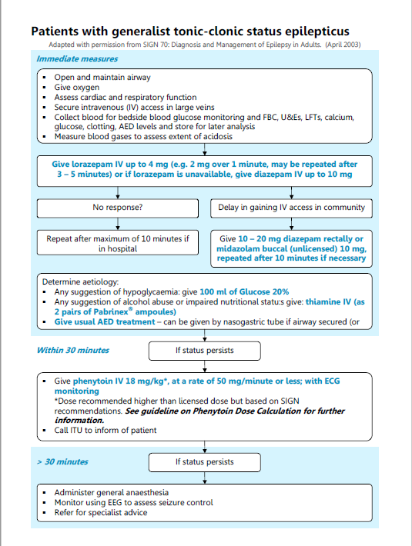
Current GGC guidance
Notes:
This is the current GGC guideline – currently under review

Slide 34
Conclusions
Recognition of seizure is important
  Witness accounts often very useful
Status epilepticus is a medical emergency
  New SIGN guidance – get familiar with it
If in doubt call the neurology team

Slide 35
Get in touch!
Website
www.quackmeded.co.uk
Email
ggc.quackmeded@nhs.scot
Social Media
Twitter: @QUACK_ Med
Facebook: QUACK education

