Slide 1
Lymphoid Malignancies
Samantha Drummond
Clinical Teaching Fellow in Haematology

Slide 2
Disclaimer*
Please note that QUACK is a regional teaching programme operating across GG&C, Lanarkshire and Ayrshire & Arran.
This presentation outlines general management, though local variances e.g. antibiotic prescription may vary slightly depending on your local trust
Remember to check your local guidelines

Slide 3
Overview
ALL
CLL
Hodgkin lymphoma
Non-Hodgkin lymphoma

Slide 4
Learning outcomes
By the end of this lecture you should be able to:
Describe the pathophysiology, epidemiology, presentation and management of:
  ALL
  CLL
  Hodgkin lymphoma
  Non-Hodgkin lymphoma

Slide 5






Red cells
Myeloid precursors
Neutrophils
Monocytes
Basophils
Eosinophils
Stem cell
Platelets
Lymphoid precursors
B lymphocytes
Plasma cells
T lymphocytes
Notes:
Most occur in B lymphocytes as the process of migration to the germinal cells and IgG arrangement is prone to error

Slide 6
Lymphoid malignancies
CLL
Lymphoma
ALL
Lymphoid precursors
B lymphocytes
Plasma cells
Stem cell
T lymphocytes

Slide 7
Lymphoid malignancies
ALL
Lymphoid precursors
B lymphocytes
Plasma cells
Stem cell
T lymphocytes
Notes:
Most commonly B cell lineage (about 85%)

Slide 8
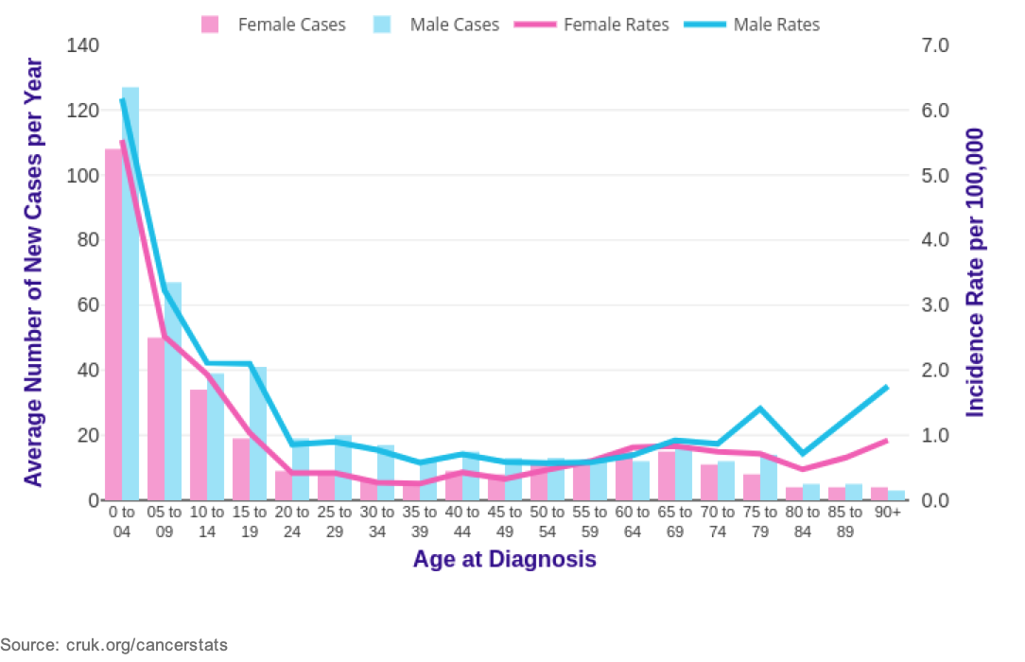
Acute lymphoblastic leukaemia
Neoplastic proliferation of lymphoid precursors
Increased proliferation but failure of differentiation
Epidemiology
  Most common malignancy in children
  Median age 3.5 years
Notes:
Majority of cases in the 2-10 age group, rare leukaemia in adults
75% of cases occur in children aged <6
85% of cases are of B cell lineage

Slide 9
Acute lymphoblastic leukaemia
Aetiology
  Unknown
  Congenital predisposition e.g. Down Syndrome
What are the presenting features of ALL?
Notes:
Congenital predisposition in Down Syndrome
Can have mediastinal involvement

Slide 10
Acute lymphoblastic leukaemia
Presentation
  Bone marrow failure
    Anaemia
    Infection
    Bleeding/bruising
  Lymphadenopathy
  Hepatosplenomegaly
  Bone/joint pain (periosteal reaction)
  CNS involvement e.g. CN palsy
Notes:
Usually presents with a short history
Lymphadenopathy is common in ALL
T cell disease can be associated with mediastinal disease which can cause compressive symptoms e.g SOB

Slide 11
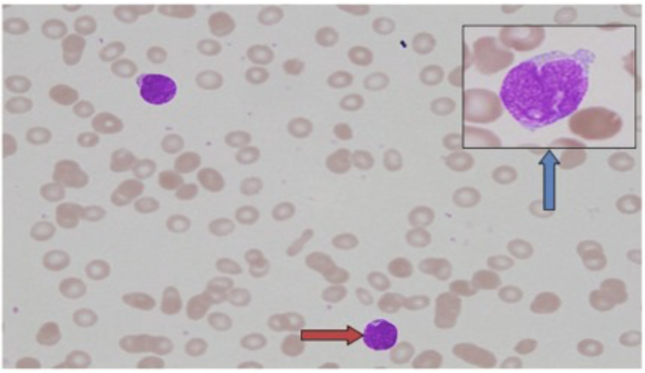
Acute lymphoblastic leukaemia
Investigations
  FBC
    Normochromic normocytic anaemia
    Leucocytosis
    Thrombocytopenia
  Blood film
    Lymphoblasts
  U&Es
  Bone profile
  Uric acid
  LDH
Notes:
FBC- Normochromic, normocytic anaemia is 80%
Despite a high WCC many patients are often neutropenic, Leucocytosis in 50%, in 25% of patients WCC is >50
Thrombocytopenia in 75%
Over 90% of patients have haematological abnormalities on FBC at presentation
Blood film has lymphoblast cells arrowed. Can see that the cytoplasm is small in these cells

Slide 12
Investigations
  Bone marrow aspiration and trephine (>25% lymphoblasts)
  Imaging
    CXR/CT for mediastinal or abdominal lymphadenopathy
  Lumbar puncture
  Cytogenetics
  Immunophenotyping
Notes:
Typically patients present with about 80% in the BM

Slide 13
Treatment
  Induction chemotherapy
  CNS directed treatment
  Consolidation therapy
  Maintenance chemotherapy
  Stem cell transplant
  Supportive therapy
    Blood products
    Prophylactic antibiotics/antifungals/antivirals
Notes:
Entered into clinical trials where possible
Induction chemo- usually in hospital for 3-4 months
Treatment lasts about 2 and a half years
T cell ALL associated with higher incidence of CNS disease
Standard induction therapy for ALL includes prednisolone (or dexamethasone), vincristine, anthracyclines, and/or L-asparaginase (crisantaspase in the UK).
vincristine, dexamethasone, daunorubicin and asparagi-nase) and intrathecal methotrexate.
APA (American Psychological Assoc.)
Smith, G. (2010). Problem solving in haematology: Vol. 1st ed. Clinical Publishing.
Maintenance e.g. mercaptopuring orally

Slide 14
Prognosis
  Poor prognostic factors
    Age >60 or <1 or >10
    High WCC
    Immunophenotype
    Cytogenetics/molecular genetics
    Slow or poor response to treatment
Prognosis in children is much better than in adults
Notes:
Prognosis is much poorer in adults compared to children with ALL
Certain cytogenetic abnormalities are associated with poor prognosis and this includes the Philadelphia chromosome
Common sites of recurrence include CNS, testes and bone marrow
Less than 30% of adults are cured

Slide 15
Case presentation
A 62 year old gentleman attends the surgical ward for an elective hernia repair
He has been feeling well in himself
Routine bloods are performed prior to surgery
Bloods
  Hb 134 g/l (133-176 g/l)
  WCC 17.6 x10⁹/l (3.9-11.1 x10⁹/l)
  Neutrophils 4.1 x10⁹/l (1.8-7.4 x10⁹/l)
  Lymphocytes 12.3 x10⁹/l (1.3-3.5 x10⁹/l)
  Platelets 170 x10⁹/l (150-400 x10⁹/l)
Notes:
What abnormality is present?
What would your differential diagnosis be?
Differential diagnosis
Reactive lymphocytosis e.g. viral infection
CLL
Lymphoma
Chronic infection e.g. TB, hepatitis

Slide 16
Lymphoid malignancies
CLL
Lymphoid precursors
B lymphocytes
Plasma cells
Stem cell
T lymphocytes

Slide 17
Chronic lymphocytic leukaemia
Lymphoproliferative disorder with progressive accumulation of B lymphocytes predominantly in the peripheral blood
Epidemiology
  25-30% of all leukaemias, most common leukaemia in Western adults
  Median age at diagnosis is 65
  Males more commonly affected, 2:1
Aetiology
  Unknown
  Familial
Notes:
Progressive accumulation of mature-appearing functionally incompetent B lymphocytes in peripheral blood, BM, lymph nodes, spleen, liver and sometimes other organs
If these cancer cells are found predominantly in lymph nodes, the disorder is called small lymphocytic lymphoma.
90% of patients >50 years old
The exact cause of CLL is unclear, but it is thought to develop as a result of an accumulation of multiple genetic events affecting oncogenes and tumour suppressor genes, which leads to increased cell survival and resistance to apoptosis
Seems to be a small increased risk in first degree relatives

Slide 18
Chronic lymphocytic leukaemia
Presentation
  Often asymptomatic
  Lymphadenopathy
  Splenomegaly
  Hepatomegaly
  Fever
  Night sweats
  Weight loss
  Can ultimately lead to BM failure
    Anaemia, neutropenia and thrombocytopenia
  Recurrent infection
Associated findings
Autoimmune haemolytic anaemia
Autoimmune thrombocytopenia
Hypogammaglobulinaemia
Notes:
70-80% are asymptomatic- picked up on routine bloods
Splenomegaly in 30% with hepatomegaly being less common
Fever and sweats occur in less than 25% (about 10%)
Recurrent infections due to dysfunctional lymphocytes and subsequent Ig deficiency
AIHA in up to 25%, ITP up to 5%

Slide 19
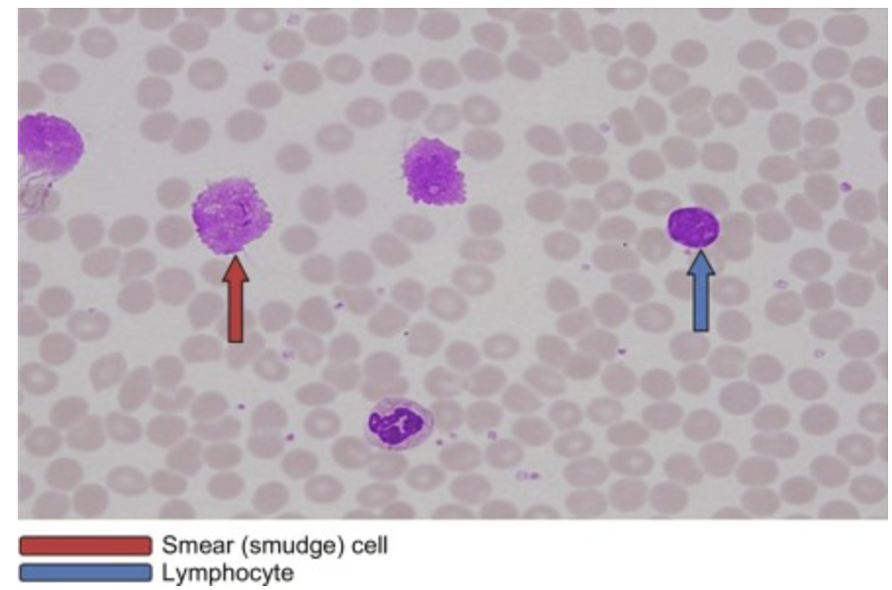
Investigations
  FBC
    Lymphocytosis
  Blood film
    ‘Smear cells’
  Immunoglobulins
  Immunophenotyping
  Cytogenetics
  Bone marrow aspirate and trephine
  Lymph node biopsy
Notes:
See a lymphocytosis, lymphocytes >5
May also see anaemia which is usually a normocytic anaemia, plus thrombocytopenia and possible neutropenia
Smear cells are a result of artefactual damage in film preparation
Bone marrow aspiration and trephine is not usually required for diagnosis- >30% ‘mature lymphocytes’
immunophenotyping and cytogenetics can be performed on peripheral blood
Lymph node biopsy also not essential

Slide 20
Binet staging
Stage A
  Hb ≥100 and platelets ≥ 100, <3 lymphoid regions enlarged
  Median survival 12 years
  60% of patients
Stage B
  Hb ≥ 100 and platelets ≥100, ≥ 3 lymphoid regions enlarged
  Median survival 5 years
  30% of patients
Stage C
  Hb ≤ 100 and/or platelets ≤ 100 and any number of enlarged area
  Median survival 2 years
  10% of patients

Slide 21
Management is based on
  Age, performance status and comorbidities
  Clinical stage, presence of symptoms, disease activity and prognostic factors
Indications for starting treatment
  B symptoms/constitutional symptoms
  Progressive bone marrow failure
    Development of or worsening anaemia and/or thrombocytopenia
  Autoimmune thrombocytopenia or haemolytic anaemia unresponsive to steroids
  Massive or progressive splenomegaly
  Massive (>10cm clusters) or progressive lymphadenopathy
  Progressive lymphocytosis with increase in >50% in 2 months or anticipated doubling time of <6 months

Slide 22
Treatment
  Chlorambucil
  R-FC (rituximab, fludarabine, cyclophosphamide)
  Monoclonal antibodies e.g. alemtuzumab
  Bruton’s tyrosine kinase inhibitors (ibrutinib)
Stem cell transplant
Notes:
Chloarmbucil has a role in older, frailer patients- risk of myelosuppression and secondary MDS/leukaemia
R-FC standard treatment for young fit patients
Alemtuzumab monoclonal antibody against CD52
?ibrutinib

Slide 23
Prognosis
Poor prognostic factors
  Male
  Advanced clinical stage
  High initial lymphocyte count (>50)
  >5% prolymphocytes on blood film
  Blood lymphocyte doubling time <12 months
  Cytogenetic abnormalities
  Poor response to therapy
Notes:
Most patients with early stage asymptomatic CLL die of other unrelated causes
Infection is a major cause of morbidity and mortality in symptomatic patients
Advanced stage patients eventually develop refractory disease and bone marrow failure
Complete remission rates of 25% to 50% can be achieved with first-line treatment. However, relapse rates are high, with a majority of patients needing further treatment after 2 to 3 years. Epidemiological studies show improved survival and remission rates with the availability of immunotherapies,[59] but improvements in overall survival have not yet been demonstrated for newer targeted therapies.

Slide 24
Largely incurable as few appropriate for stem cell transplant
Most patients with early stage CLL die of unrelated causes
Infection is a major cause of morbidity and mortality
Richter’s syndrome
  Occurs in <10%
  Transformation to lymphoma

Slide 25
Lymphoid malignancies
Lymphoma
Lymphoid precursors
B lymphocytes
Plasma cells
Stem cell
T lymphocytes

Slide 26
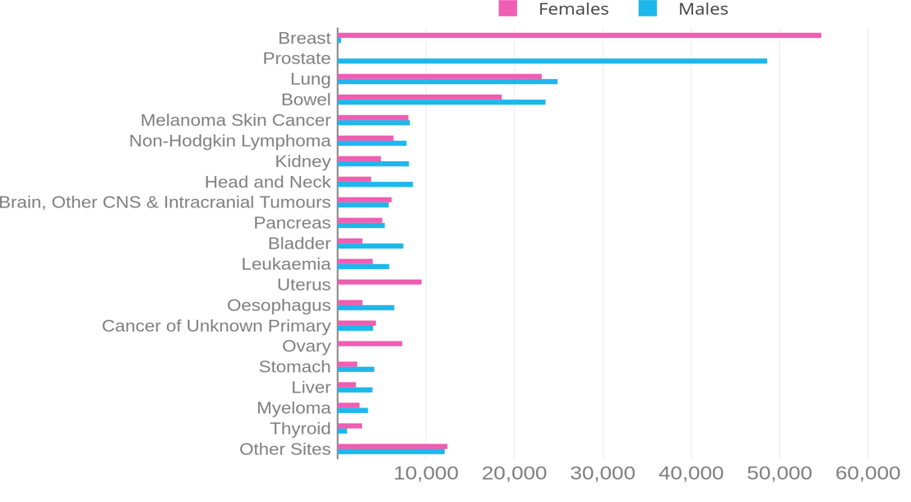
Lymphoma
Most common haematological cancer
Accounts for 5% of all cancers
Incidence increases with age
Cancer Research UK
Notes:
Most lymphomas are of B cell origin (about 85%)
Rearrangement and mutation of Ig genes that occur in B cell differentiation and the response to antigen offers an opportunity for genetic accidents such as mutations and translocatiosn involving Ig gene loci
Cancer Research UK, https://www.cancerresearchuk.org/health-professional/cancer-statistics/incidence/common-cancers-compared#heading-Zero

Slide 27
Lymphoma
Non-Hodgkin
Hodgkin

Slide 28

Presentation
Lymphadenopathy
Splenomegaly
B symptoms
  Fever >38.0
  Weight loss (>10% in 6 months)
  Night sweats
Bone marrow involvement
Notes:
Itch
Alcohol intolerance in HL

Slide 29
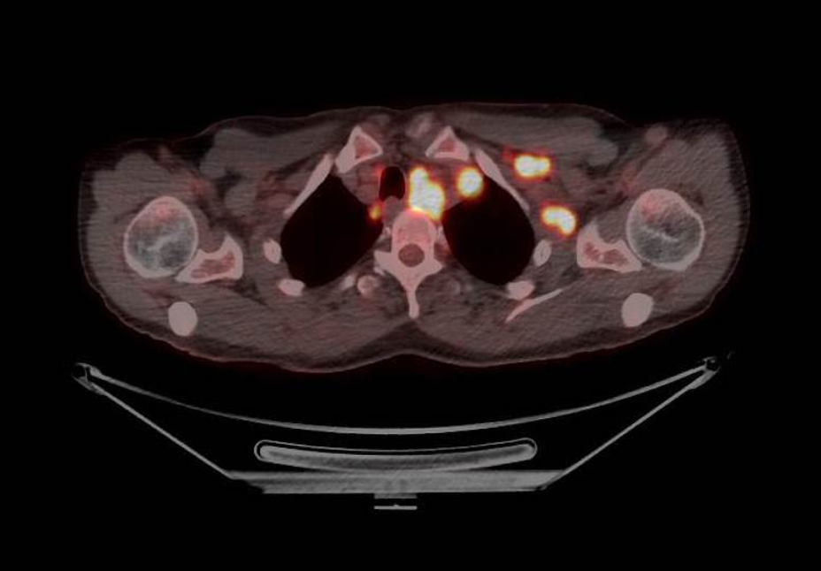
Investigations
FBC
Blood film
U&Es
LDH
Uric acid
Lymph node excision biopsy
BM aspirate and trephine
CXR
Imaging: CT or PET CT
Lumbar puncture
Notes:
PET CT has more of a role in Hodgkin lymphoma
Important that it is a lymph node biopsy and not an FNA as this can be normal in lymphoproliferative conditions

Slide 30
Staging of lymphoma- Ann Arbor classification
A- Absence of constitutional symptoms
B- Fever >38℃, weight loss >10% in 6 months or drenching night sweats
Stage | Description
I | Involvement of single lymph node region/structure
II | Involvement of 2 or more lymph node regions on the same side of the diaphragm
III | Involvement of lymph node regions/structures on both sides of the diaphragm
IV | Diffuse involvement of extra-nodal site (e.g. liver, bone marrow)

Slide 31

Case presentation
20 year old female student presents to GP with a neck lump
What questions would you like to ask?
  Where is the lump?
  Duration?
  Painful?
  Single or multiple lumps?
  Lumps elsewhere?
  Systemically unwell? (B symptoms?)
  Change e.g. bigger/smaller/stayed the same?

Slide 32
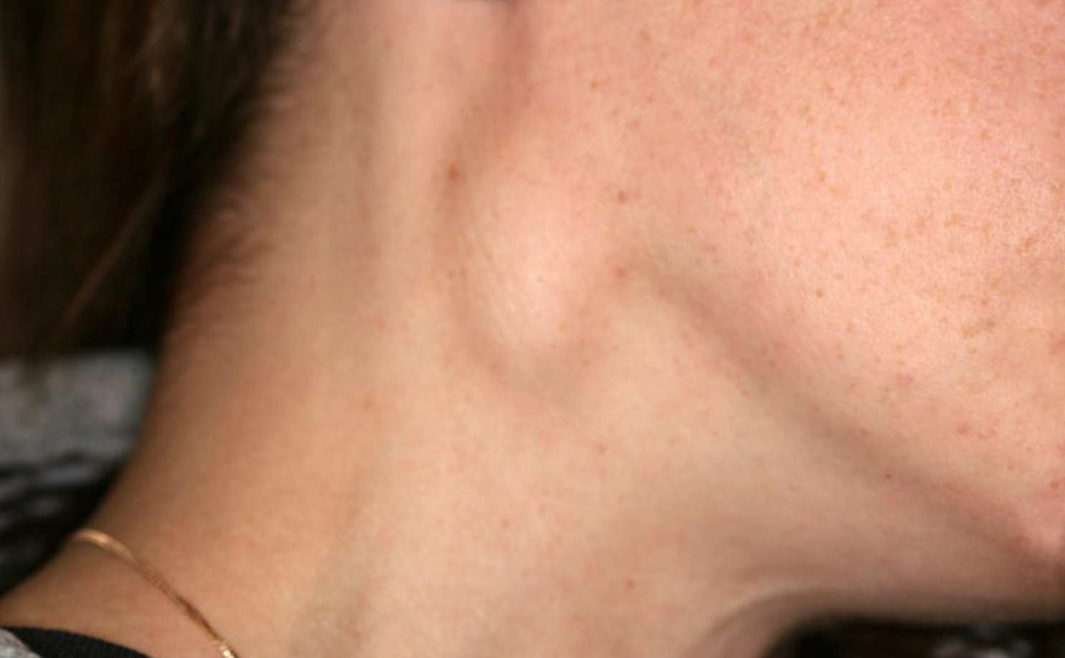
On further questioning
  Weight has been stable
  No fever or night sweats
  Lump is not painful but thinks it is getting bigger
On examination
  Cervical lymphadenopathy

Slide 33
Differential diagnosis
  Hodgkin lymphoma
  Infection
    EBV
    TB
    HIV
    Localised infection e.g. tonsilitis
  Metastatic carcinoma

Slide 34
Lymphadenopathy
Localised
Painful
  Bacterial infection
Painless
  Chronic infection (e.g. TB)
  Metastatic carcinoma
  Lymphoma
Generalised
Painful
  Viral infection (e.g. EBV, HIV)
Painless
  Lymphoma
  Leukaemia
  Sarcoidosis

Slide 35
Investigations
  FBC
  Blood film
  Lymph node biopsy
  LDH
  Virology (EBV, HIV, CMV)
  Imaging e.g. CT scan
  Bone marrow aspirate and trephine

Slide 36
Lymphoma
Non-Hodgkin
Hodgkin

Slide 37
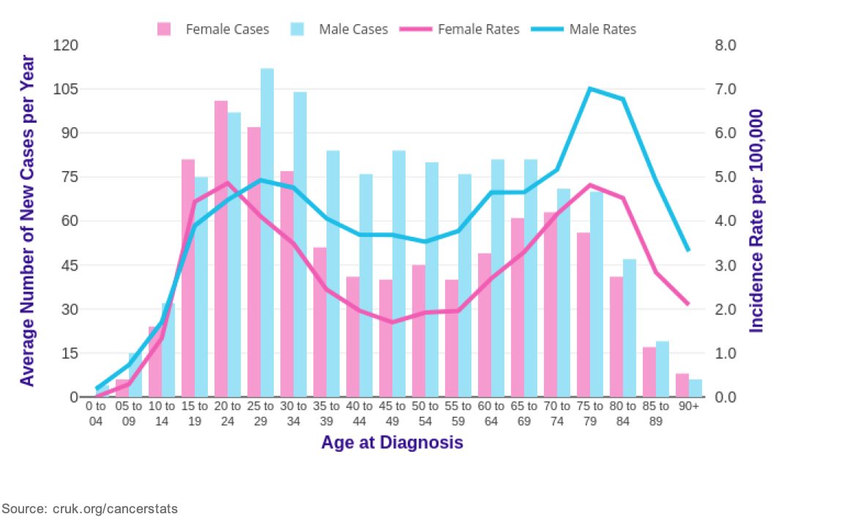
Hodgkin lymphoma
Epidemiology
  Bimodal distribution
    Peak ages 20-29 years and in elderly
  Higher incidence in males
Risk factors
  Familial
  EBV
  Higher socio-economic class
Notes:
It is less common, accounts for 10% of all lymphomas
Not conclusive that EBV is causative
With first degree relative 3 times more likely than general population
Associated with higher socio-economic class

Slide 38
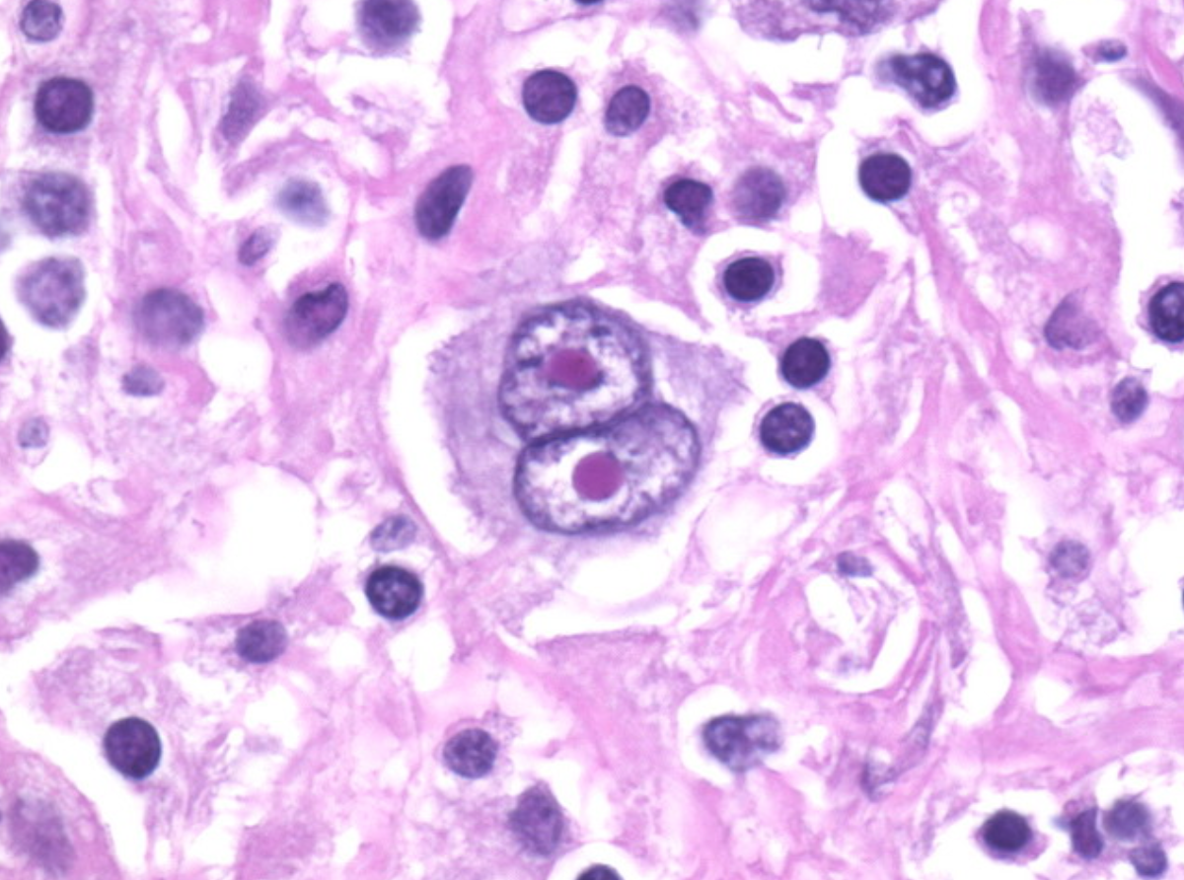
Presentation
  Lymphadenopathy
  Splenomegaly
  B symptoms
  Extra-nodal spread and BM involvement rare
Notes:
The most common presentation of HL is painless cervical and/or supraclavicular lymphadenopathy.
Asymptomatic lymphadenopathy, usually cervical
Splenomegaly in 30%
33% have 1 or more B symptoms at presentation
Can have generalized itch and alcohol induced lymph node pain
Pathological confirmation via biopsy is the only acceptable method of diagnosing HL and is essential before treatment can commence.
Bone marrow may be unnecessary in patients with limited stage diseases
Reed-Sternberg cells are transformed post germinal centre B cells
- Classical for HL, bilobed nucleus and can also be known as ‘owl eyes’- Reed- Sternberg cells

Slide 39
Types
Classical HL (95% of cases)
  Nodular sclerosis (70%)
  Mixed cellularity (25%)
  Lymphocyte-rich (5%)
  Lymphocyte-depleted (<1%)
Nodular lymphocyte-predominant HL (5% of cases).
Notes:
Lymphocyte depleted is associated with a poorer prognosis
Nodular lymphocyte predmoninant behave more like an indolent lymphoma

Slide 40
Treatment
  Chemotherapy
    Regime dependent on stage
    Can be altered depending on response
    Often ABVD (doxorubicin, bleomycin, vinblastine, dacarbazine)
  Radiotherapy
Notes:
Treatment often involved ABVD[doxorubicin, bleomycin, vinblastine, dacarbazine]
and BEACOPP (bleomycin, etoposide, doxorubicin, cyclophosphamide, vincristine, procarbazine, prednisolone), for high risk
Role of radiotherapy is in bulky disease- use is limited due to long term toxicity
Patients aged <60 have an >80% chance of cure
Other issues to consider include:
Fertility
Risk of secondary malignancy (RT)- esp breast
Pulmonary toxicity (bleomycin and radiotherapy), thyroid function
Can review chemotherapy after 2-3 cycles following PET CT to guide further treatment

Slide 41
Lymphoma
Non-Hodgkin
Hodgkin

Slide 42
Non-Hodgkin Lymphoma
Low grade
High grade

Slide 43
Non-Hodgkin lymphoma
Heterogenous group of malignancies
Epidemiology
  Increasing prevelence with age
  More common in males than in female
Notes:
Non-Hodgkin's lymphomas (NHL) are a heterogeneous group of malignancies of the lymphoid system.
Malignant lymphoid cells retain many qualities of their normal counterparts (B cells to produce immunoglobulins; T cells to travel to extranodal sites such as skin and central nervous system).
Can be further thought of as low and high grade
75% of adults present with nodal disease
25% are extra-nodal and this can involve CNS or skin presentation (skin is more common in T cell lymphomas)

Slide 44
Associations
  Infection
    Epstein-Barr virus (EBV) with Burkitt's lymphoma
    Human T-cell lymphotrophic virus type 1 with T-cell lymphoma
    Helicobacter pylori with gastric mucosa-associated lymphoid tissue (MALT)
  Immunodeficiency states
    Acquired e.g. HIV, post transplant
    Inherited immunodeficiency e.g. Wiskott- Aldrich syndrome, ataxia-telangiectasia

Slide 45
Low grade NHL
Follicular lymphoma
  Indolent
  Responds to treatment but is incurable
  Most common in middle and old age (median age 55)
Presentation
  Most commonly presents with painless lymphadenopathy
  Effects of BM infiltration
  Constitutional symptoms
70% present with stage IV disease with BM involvement
15-20% is localized stage I or II disease
Notes:
Up to 40% of cases are considered indolent lymphoma, typically slowly progressive disease
Usually considered incurable with recurrence being inevitable unless localized

Slide 46
Treatment
  Watch and wait if asymptomatic
  Radiotherapy (localized disease)
  Chemotherapy
    R-CHOP/R-CVP
  Stem cell transplant
Median survival is 10 years
About 25% transform to high grade DLBCL
Indications for treatment
B symptoms
Cytopenia
Bulky disease
Steady progression or threatened organ function
Evidence of transformation
Notes:
After initial chemotherapy can continue on rituximab maintenance
R – rituximab
C – cyclophosphamide
V – vincristine
P – prednisolone (a steroid)
Prognostic factors
Age >60
Disseminated disease
Extranodal disease
Bulky disease (>10cm)
Raised serum LDH
Raised serum B2 microglobulin
High grade transformation from low grade NHL

Slide 47
High grade NHL
Diffuse large B cell lymphoma
  Most common lymphoma worldwide,30% of lymphomas
  Male predominance
  Increases with age
50% present with stage I or II disease
Constitutional symptoms in one third
Management
  Treat with R-CHOP chemotherapy +/- radiotherapy
  CNS directed therapy
Notes:
DLBCL most common lymphoma wordwide, about 30% of all lymphomas
!st line is generally R- CHOP if the patient is fit enough CHOP (cyclophosphamide, adriamycin[doxorubicin], vincristine and prednisolone
APA (American Psychological Assoc.)
Smith, G. (2010). Problem solving in haematology: Vol. 1st ed. Clinical Publishing.
Can also receive radiotherapy
Many need to consider CNS prophylaxis if testicular, BM or epidural involvement
Repeat PET scan to assess response

Slide 48
Questions ?
Email: s.drummond1@nhs.net

Slide 49
References (lymphoid malignancy)
ALL and CLL films (Haematology Case Studies with Blood Cell Morphology and Pathophysiology)
Female patient (https://www.docwirenews.com/docwire-pick/home-page-picks/young-patients-doctors-sensitive-topics/)
Cervical lymphadenopathy (https://www.medicalnewstoday.com/articles/327203#treatments)
HL film https://www.webpathology.com/image.asp?case=388&n=5
PET CT https://radiopaedia.org/cases/lymphoma-deauville-2-fdg-pet-ct-1?lang=gb

Slide 50
Thank you
Please fill out the feedback form for your certificate of learning

Slide 51
Get in touch!
Website
www.quackmeded.co.uk
Email
ggc.quackmeded@nhs.scot
Social Media
Twitter: @QUACK_ Med
Facebook: QUACK education

