Slide 1
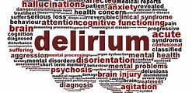
Delirium
Dr Nicola Waddell

Slide 2
Disclaimer*
Please note that QUACK is a regional teaching programme operating across GG&C, Lanarkshire and Ayrshire & Arran.
This presentation outlines general management, though local variances e.g. antibiotic prescription may vary slightly depending on your local trust
Remember to check your local guidelines

Slide 3
Intended Learning Outcomes
Definition of Delirium
How to Recognise Delirium
Investigations to Consider
Management of Delirium
Adults with Incapacity
Managing Delirium in Covid-19 Patients

Slide 4
Why is Delirium Important?
Delirium is among the most common of medical emergencies
A UK study found a prevalence of 20% in adult acute general medical patients
The prevalence is higher in particular clinical groups, such as patients in intensive care units (ICU). It affects up to 50% who have hip fracture and up to 75% in intensive care
Several predisposing factors increase the risk of delirium, including older age, dementia, frailty, the presence of multiple comorbidities, male sex, sensory impairments, a history of depression, a history of delirium, and alcohol misuse – therefore accounting for a large number of our patients
It is underdiagnosed which can lead to deficiencies in care

Slide 5
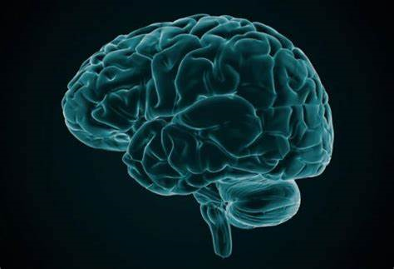
A Definition of Delirium
The International Classification of Diseases, version 10 (ICD-10) defines delirium as, “An aetiologically nonspecific organic cerebral syndrome characterized by concurrent disturbances of consciousness and attention, perception, thinking, memory, psychomotor behaviour, emotion, and the sleep-wake schedule. The duration is variable and the degree of severity ranges from mild to very severe”
Essentially “Brain Failure”
Delirium presents variably but its main characteristics are rapid onset (hours, days) of acute mental status deterioration
Patients may present with cognitive impairment, but drowsiness to the point that the patient is not speaking, severe agitation, or psychotic features such as hallucinations or delusions may be the most prominent features
Delirium is sometimes described using hyperactive, hypoactive or mixed labels depending on the level of arousal
Most delirium has a duration of a small number of days, but in around 20% of cases, it can persist for weeks or months

Slide 6
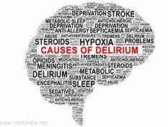
Causes of Delirium
Infection
Polypharmacy
Drugs
Electrolyte Imbalance
Hypoxia
New Environment
Malignancy
Alcohol Withdrawal
Epilepsy
Malnutrition
Retention (urinary/ faecal)
Metabolic

Slide 7

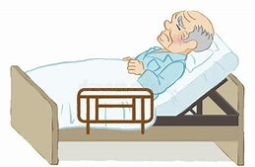
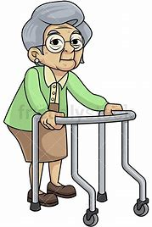

Meet the Patients….
Patient 1 – 78 year old female. Background of hypothyroidism. Presents with urinary symptoms
Patient 2 – 88 year old gentleman with Parkinson’s disease and Lewy Body Dementia presents with fever and shortness of breath
Patient 3 – 60 year old gentleman with a background of alcohol excess presents following a fall
Patient 4 – 90 year old female presents with confusion on a background of Alzheimer’s dementia

Slide 8

Patient 1… Mrs M
78 year old female
Past Medical History: Hypothyroidism
Presents with urinary symptoms and fever
On arrival found to be hypotensive and tachycardic
Bruises on face and trunk
Elevated inflammatory markers and AKI on bloods
Noted by nursing staff to have 4AT of 6
Collateral history from family confirms worsening confusion over a few days
Couple of falls at home over few days
Usually very well and independent

Slide 9
Patient 1… Mrs M
Diagnosis: Delirium secondary to Urosepsis
Differentials to Consider – other than infection
Cognitive Impairment
Subdural Haematoma
Psychiatric Conditions
New Medications
Investigations:
Bloods including lactate and blood cultures
CXR
Urinalysis
CT Brain (given recent falls and evidence of injury)

Slide 10
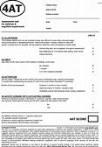
Recognising Delirium
Can Be Difficult
SIGN recommend the use of 4AT in acute settings
4AT is evidence based and practical to implement
4AT takes less than 2 minutes and can be used for all patients
Focuses on Alertness/ AMT4/ Attention/ Fluctuating Course
Score of 4 or above indicative of delirium +/- cognitive impairment
Should be performed at least 48 hourly to assess delirium
Recognise those most at risk of delirium and monitor

Slide 11

Patient 2… Mr F
88 year old gentleman presents with fever and shortness of breath
Past Medical History: Parkinson’s Disease and Parkinson’s Related Dementia
Recent history of impaired swallowing and receiving SLT in the community
Lives with his wife in a bungalow. Needs help with all ADLs and has POC OD for showering. Cannot leave the house unaided
His wife reports recurrent chest infections, each one more severe than the last
On review, he is drowsy (GCS 12 E3M5V4) and hypotensive
WCC is 25 and CRP is 350

Slide 12
Patient 2 …Mr F
Diagnosis:
  Aspiration Pneumonia Secondary to Parkinson’s Disease
  Delirium Secondary to Infection Superimposed on Dementia
Over the next 48 hours, nursing staff notice Mr F had become very confused – he believes he is in a train station waiting for the train home
He remains intermittently drowsy
His wife is very concerned that he is more confused than normal and would like to know how we will treat this

Slide 13

Managing Delirium
Treat underlying cause – infection/ electrolyte disturbance/ dehydration/ pain
Talk calmly to patient
Nurse in a quiet, well lit room and orientate regularly
Ensure patient is wearing glasses/ hearing aid
Allow patient to mobilise if safe to do so
Consider 1:1 nursing/ supervision if falls risk
“Getting to Know Me Document”
Consider involving family members but be mindful!
Avoid unnecessary moves

Slide 14

Patient 3… Mr D
60 year old gentleman presents following a fall
Found by his wife at 9am in the morning having last been seen at 6pm the night before
Past Medical History: Alcohol Excess – drinks bottle of whisky/ day
Lives with his wife who works shifts. Unemployed – previously worked as taxi driver
On admission, found to be tachycardic and anuric
Alert and Orientated
AKI – creatinine 600/ CK 20000
Admitted for IV fluid resuscitation and Pabrinex

Slide 15
Patient 3… Mr D
Day 2 of Admission
AKI slowly improving with IV fluids
On call FY1 called at 2am as patient becoming ‘aggressive’
On arrival – Mr D is throwing bedside tables at nursing staff
When you ask what is wrong he continues to shout and swear and tries to leave the ward. He is VERY unsteady on his feet
Security called to help with situation
FY1 calls medical registrar to attend – they agree but advise to prescribe some ‘sedation’ meanwhile

Slide 16
Managing Delirium
This should only be used when non-pharmacological management is unsuccessful and symptoms are causing significant distress to the patient, or symptoms threaten the safety of the patient or others (including their ability to accept necessary medical or nursing care)
Always use the oral route whenever possible
Start at the lowest clinically appropriate dose, titrate cautiously according to symptoms and review at least every 24 hours
Emergency sedation can be given under common law. More routine sedation however requires consideration of the patient’s capacity to consent
If patient is attempting to leave the hospital or requiring physical or chemical restraint then detention under the Mental Health act may be required. Psychiatry can advise on the use of legislation in this regard
Before prescribing familiarise yourself with contraindications and dose administration advice (take into account frailty when considering total daily dose). Ensure patients are closely monitored following administration of sedative medication. Emergency sedation should always be discussed with a registrar or consultant

Slide 17
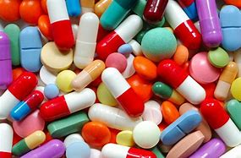
Pharmacological Management
Antipsychotics – Haloperidol/ Risperidone
  Contraindicated in Long QT Interval/ Parkinson’s Disease
  Start with lowest possible dose
  500microgram- 1mg orally. Can repeat dose after 1 hour if no response
  500microgram IM – max dose 2mg in 24 hours
  If haloperidol contraindicated then risperidone can be used
  250-500 microgram orally of Risperidone (max 2mg for elderly patients)
Benzodiazepines – Lorazepam/ Midazolam
  Can be helpful in Parkinson’s Disease patients
  Lorazepam 500microgram – 1mg (max 2mg/24 hours)
  Only in exceptional circumstances 2mg IM Midazolam (max 6mg/24 hours)
  Ensure to wait a minimum of 1 hour between doses

Slide 18

Patient 4… Mrs D
90 year old female presents with confusion
Past Medical History: Alzheimer’s Dementia
Lives home alone but needing increasing support
Now has POC QID but has been found wandering outside many times by carers
Now also turning night into day
On admission – the patient has no clue why she has come to hospital but is ‘pleasantly confused’
There is nothing to find on examination other than the patient looks frail and slightly dehydrated
Bloods reveal a urea of 13.2 but otherwise unremarkable
The patient has no family for collateral history, her NOK is a neighbour who described that Mrs D has been wandering outside very early in the morning and is looking slightly more dishevelled than normal

Slide 19
Patient 4… Mrs D
Diagnosis: Unclear…. Potential Delirium or Worsening Alzheimer’s Dementia
Reasonable to Perform
  Bloods
  CXR
  ECG
  Urinalysis
No indication currently for CT brain but could consider in due course if concerns
Day 2 of admission, nursing staff call as patient wandering in and out of patient’s rooms and keeping them awake
Nursing staff request sedation so Mrs D can get a sleep and stops disturbing other patients
What do you do/ say?

Slide 20

The Dilemma Patient
Diagnosis currently unclear
Dementia or Delirium?
Nursing staff request sedation….
Non-pharmacological management should be implemented
Ensure patient is mobilising safely and with walking aids
Ask nursing staff politely if someone could walk with patient
Restoring circadian rhythm can be helpful in delirium/ dementia BUT this patient is very high risk of falls
This is a very common scenario – it is very important that you do not prescribe sedation for patients if you feel uncomfortable or if you disagree with the request

Slide 21
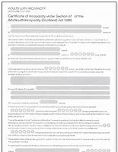
Adults with Incapacity
Section 47 – AWI should be considered in all patients with delirium – although not all patients will require one
Should be filled out by doctor FY2 or above – but you should still be mindful and think whether a patient should have one
Can be put in place for short durations or for specific procedures
Should be reviewed based on timeframe documented
Should always be discussed with POA/ NOK and this should be documented
Ensure to detail exactly what the patient is incapable of….for example all decisions around medical care/ discharge planning

Slide 22
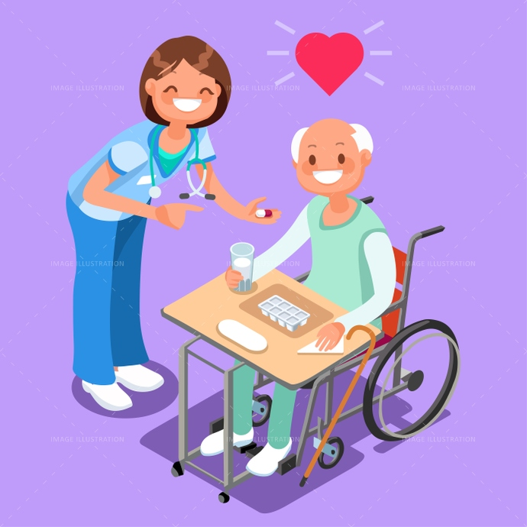
Communication with Patient and Families
Most important part of managing
Some patients will have insight into delirium, others will not
It is important to re-orientate our patients and communicate in a way they understand
Speaking openly about the delirium can be helpful
Information leaflets given to families can help them with patient communication – it can be difficult and frustrating for patients and carers

Slide 23

Managing Delirium with Covid-19
Delirium (specifically hyperactive delirium) will pose additional threats to patients and staff
The British Geriatrics Society have released guidance on how we should approach this
The standard non-pharmacological approach may not be appropriate and an isolated environment may worsen delirium itself
Aim to carry out screening/ 4AT early and detect delirium faster
Correct any clear triggers or causes such as urinary retention
If the above methods are not successful then pharmacological management may need to be implemented faster than would normally be recommended
Be sure to measure vital signs and monitor for side effects regularly

Slide 24

Key Points
Recognising delirium
Be aware that it is not only geriatric patients affected
Know the basics of how to manage delirium
Caution with pharmacological management
Basic understanding of section 47 (Adults with Incapacity)
Be sure to communicate
Common sense when dealing with delirious covid-19 patients
Prevention is better than cure

Slide 25
Thank you
Please fill out the feedback form for your certificate of learning

Slide 26
Get in touch!
Website
www.quackmeded.co.uk
Email
gg-uhb.quackmeded@nhs.net
Social Media
Twitter: @QUACK_ Med
Facebook: QUACK education

