Slide 1
Decompensated Liver Disease
‘Master Class’
Roisín Donnelly
Gastroenterology Registrar

Slide 2
Disclaimer*
Please note that QUACK is a regional teaching programme operating across GG&C, Lanarkshire and Ayrshire & Arran.
This presentation outlines general management, though local variances e.g. antibiotic prescription may vary slightly depending on your local trust
Remember to check your local guidelines

Slide 3
Learning Objectives
To be comfortable with the initial assessment of patient’s presenting with Decompensated Chronic Liver Disease
To be aware of the common precipitants to Decompensated LD in order to initiate appropriate investigations at the front door
To commence appropriate initial management
To make the BASL bundle your new best friend!

Slide 4
You are the SHO/F1 working in ARU3 and you are ready to admit a new patient...

Slide 5
Mr. Wilson
55M
PC: Confusion, reduced mobility, abdominal pain + swelling
PMH: Alcohol excess, Child’s B Cirrhosis, Oesophageal varices, Angina, Hypertension
DH: Carvedilol, Spironolactone, Thiamine, Aspirin, GTN, NKDA
SH: Smoker 20/day, last documented clinic letter 3M ago states was drinking 20+ units a day but had stopped
What else would you like to know as part of history?
Notes:
Causes of Decompensation:
Ongoing acute alcohol intoxication
Infection: SBP, Other causes of sepsis
UGIB
Constipation
Subdural - FALLS, any other neurology
Ecephalopathy – BO, laxatives,

Slide 6
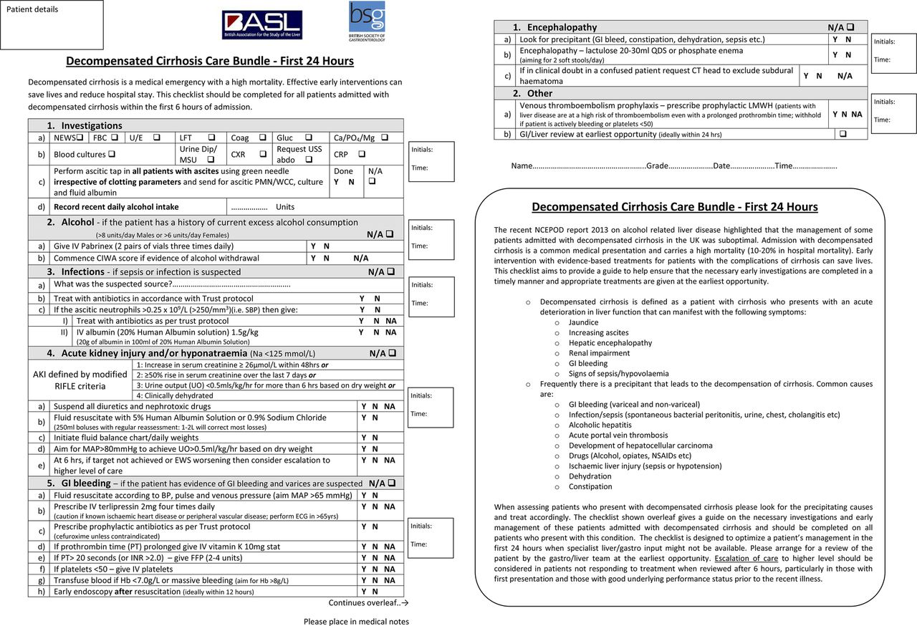

Slide 7
History
Confused
Reduced Mobility
Increasing abdominal swelling and Pain
Notes:
Identify Precipitants :
Confusion: Falls (Subdural), Bowels
Infection screen (reduced mobility), Other sources of infection – chest, urine, SBP
Any symptoms of UGIB
Bowels/Encephalopathy
ALCOHOL INTAKE IS HE WITHDRAWING

Slide 8
Decompensation in Chronic Liver Disease
An acute deterioration in liver function that can manifest with the following:
Jaundice
Increasing Ascites
Hepatic Encephalopathy
Renal Impairment
GI Bleeding
Signs Sepsis/Hypovolaemia

Slide 9
Decompensation in Chronic Liver Disease
Common precipitants to decompensation include:
GI Bleeding (Variceal and non-variceal)
Infection/Sepsis (SBP, Chest, Urine, Other)
Alcoholic Hepatitis
Acute portal vein thrombosis
Development of HCC
Ischaemic liver injury
Dehydration
Constipation
Drugs (Alcohol, Opiates, NSAIDs)

Slide 11
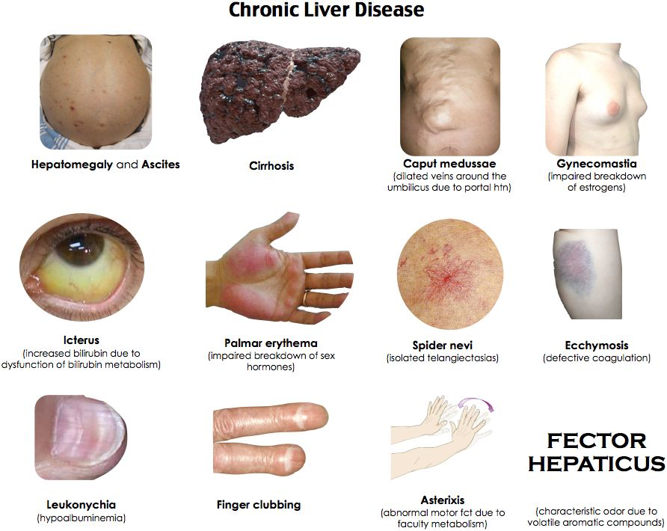
On Examination
GCS 12/15 (E3 V4 M6)
Stigmata chronic liver disease
Tense abdominal ascites, Tender to palpation
Peripheral oedema and reduced AE bilaterally
RR 18 Sats: 96% on 3L
BP 95/65 HR 90bpm
Temp 38.0
Notes:
What would you like to do

Slide 12
Investigations
Bloods: FBP, U&E, CRP, LFT, Glucose, Coag, BP, Mg + Cultures
ECG/CXR (Exclude infection, ? Overload)
Urine dip (Exclude infection)
ASCITIC TAP (Regardless of Coagulation screen)
AUSS (Exclude portal vein thrombosis, screen HCC w AFP)
Consider OGD
Consider CTB

Slide 14
Results
Hb 85
WCC 14.5
PLT 78
PT 24
APTT 48
Na 132
K 4.5
Ur 10.8
Cr 145
Bil 120
ALT 60
AST 160
ALP 135
Alb 29

Slide 15
Results
CXR: Nil Acute
ECG: No ischaemia
AUSS: Cirrhosis. No signs PV thrombus
Ascitic Tap: WCC: 800, No bacteria seen

Slide 16
SBP
C/O Antibiotics as per local protocol
IV HAS 1.5g/kg D1
IV HAS 1g/Kg D3
Remember Prophylaxis once treatment complete
(1st line Co-Trimoxazole, 2nd Norfloxacin)
Notes:
IV Amoxicillin and IV Temocillin
If mild/oral continuation therapy – Co-amoxiclav oral
Prophylaxis for:
One episode proven SBP (previously or currently) once acute treated
Total Ascitic protein <10

Slide 17
Management of Ascites
Daily Weights – R/V Daily
Low Salt Diet
Spironolactone 100-400mg each day – titrate to weights and renal function, consider adding Furosemide
Aim reduction in weight no more than 1kg/day
Notes:
If hyperkalaemic/renal impairment contact senior staff

Slide 18
Management of Alcohol Withdrawal
Pabrinex
GMAWS
Addictions Liaison
Remember GAHS score
Notes:
Pabrinex
Lorazepam
Addictions liaison
GAHS score and consider PRED

Slide 19
Management of Renal Impairment
Catheterise
DOCUMENT INPUT:OUTPUT
Review/Stop diuretics/other nephrotoxics
IVF based on Hydration status
Consider renal tract USS
Notes:
If dehydrated – IV Saline
If ascites/peripheral oedema: IV HAS 100ML 20% BD and consider terlipressin and titrate
C/O at 0.5mg QDS
NB: IHD, Arrhytmias, PVD

Slide 20
Management of Encephalopathy
Look for precipitating factors: Sepsis/infection, renal failure, constipation, medication and investigate accordingly
Stop sedatives
Lactulose 20ml TDS and titrate
Notes:
Titrate to 3x bowel motions daily
Consider Rifaxamin
+/- Phosphate enema

Slide 21
During your ward round Mr. Wilson then develops malaena...

Slide 22
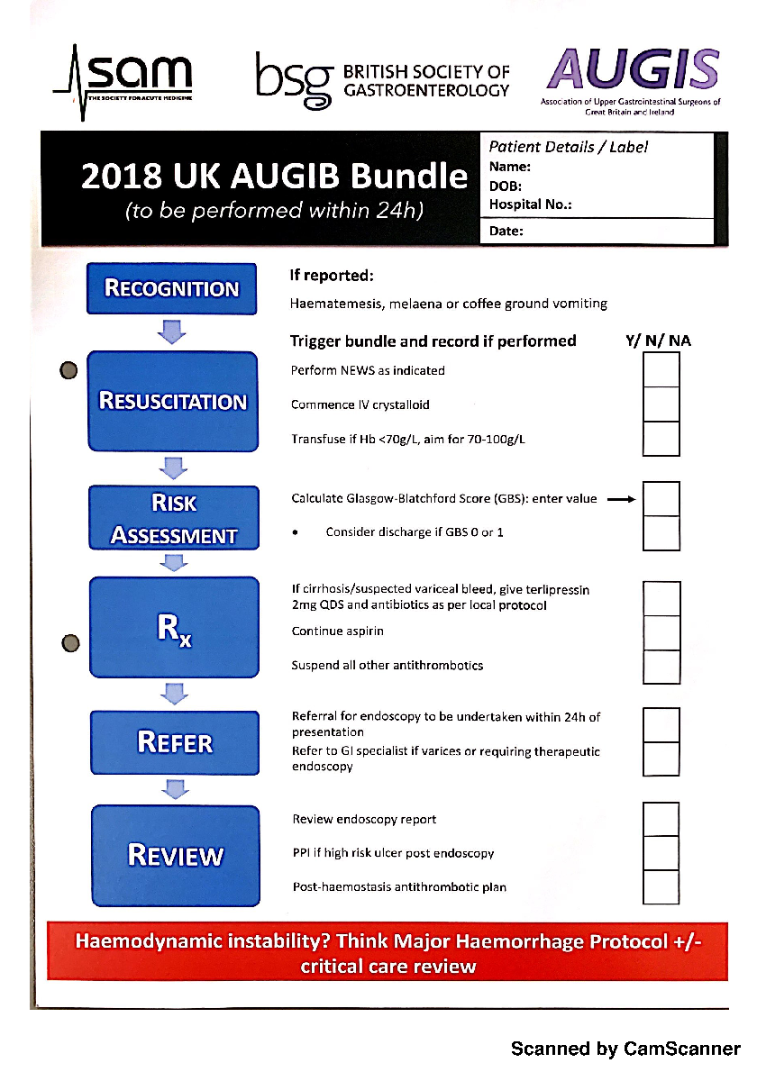

Slide 24
Get in touch!
Website
www.quackmeded.co.uk
Email
ggc.quackmeded@nhs.scot
Social Media
Twitter: @QUACK_ Med
Facebook: QUACK education

