Slide 1
Case Presentation
23/10/2018
Gareth Ingram

Slide 2
Patient X
41 year old male
?Gout ?septic arthritis
Monoarthropathy, right knee
Presented to IAU via GP
28/8/2018 13:03 (Tuesday)

Slide 3
Initial Assessment
No EMAT
Clerked in at 15:50 in CDU

Slide 4
Urinalysis at point of admission
  +++ Protein
  ++ Blood
  + Ketones

Slide 5
Presenting Complaint
Right knee pain
Describes rigors and fever over preceding 24-48 hours
Hot to touch
Reduced range of movement

Slide 6
Past Medical History
COPD/asthma overlap
Previous DVT
Depression
HCV +ve
Cellulitis
Personality disorder
IVDU, on methadone

Slide 7
Systemic enquiry
Respiratory
  Cough, nil else
Cardiac, Gastro, GU, neuro
  Nil

Slide 8
Medication
Naproxen 500mg BD
Diazepam 4mg QDS
Fostair 200/6, 2 puffs BD
Tiotropium OD
Gabapentin 300mg nocte
Quetiapine 300mg BD
Dihydrocodeine MR 60mg BD
Mirtazepine 45mg nocte
Salbutamol PRN
Omeprazle 20mg OD
Methadone 100mls daily
No known allergies

Slide 9
Social
Smoker, 25 per day
No alcohol use
Previous IVDU, not injected in 2 years
Lives alone
Usually mobile and independent

Slide 10
Observations
Observation | Triage | First Assessment
Temperature | 37.4 | 40.5
Heart Rate | 102 | 110
Blood pressure | 102/61 | 126/68
Respiratory rate | 20 | 22
Oxygen Saturations | 97 | 92
GCS | 15 | 14

Slide 11
General Examination
General
Clammy, flushed
Drowsy, but easily rouseable
Focused right knee
Warm to touch
Not erythematous
No obvious signs of trauma
Palpable effusion

Slide 12
Focused Examination
Tender over his right knee
Right knee > left
Struggling to mobilise on leg
Effusion palpable
Hot to touch, reduced mobility

Slide 13
Other Examination Findings
Chest
Reduced air entry globally
HS 1 + 2 + 0, pulse regular
Abdomen soft and non tender, palpable liver edge
No tremor or flap
Drowsy but rousable

Slide 14
Initial Management
Moved from CDU to IAU
Sepsis 6 management including fluid balance, catheter refused
BP 81/32 prior to fluid resuscitation
IV antibiotics fluclox + clindamycin (ID), knee aspiration, aggressive fluid resuscitation and transfer to ARU2
Aspirate
  60mls aspirated (no comment on appearance)
  Sent for culture and crystals
Imaging: Chest and knee x-rays

Slide 15
Bloods
WCC 7.8
Neutrophils 4.8
Hb 129
MCV 90.7
Platelets 77
Coagulation: Normal
Lactate
ESR 34
CRP 242
Lactate 0.8
Na 137
K 4.6
Urea 9.4
Creatinine 89
eGFR >60
CRP
AST 111
ALT 43
Albumin 31
Urate

Slide 16
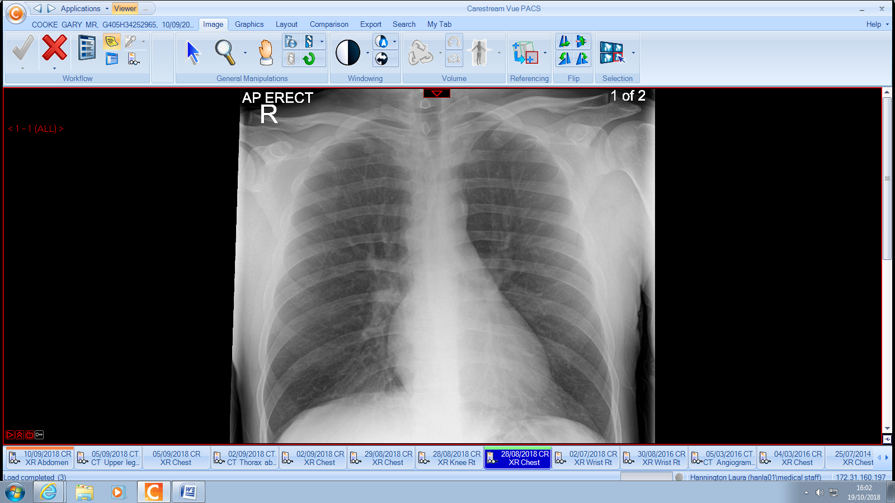

Slide 17
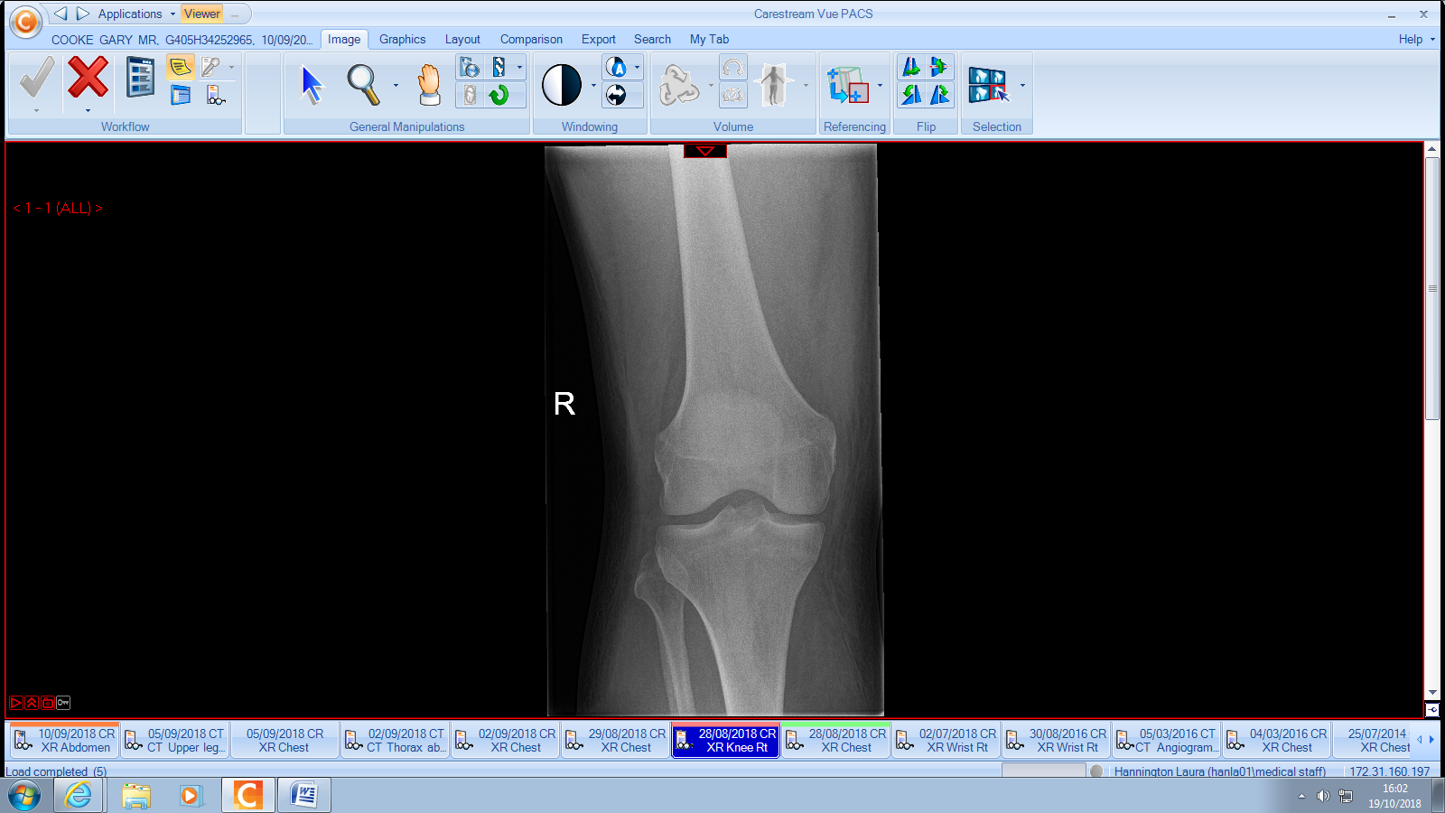
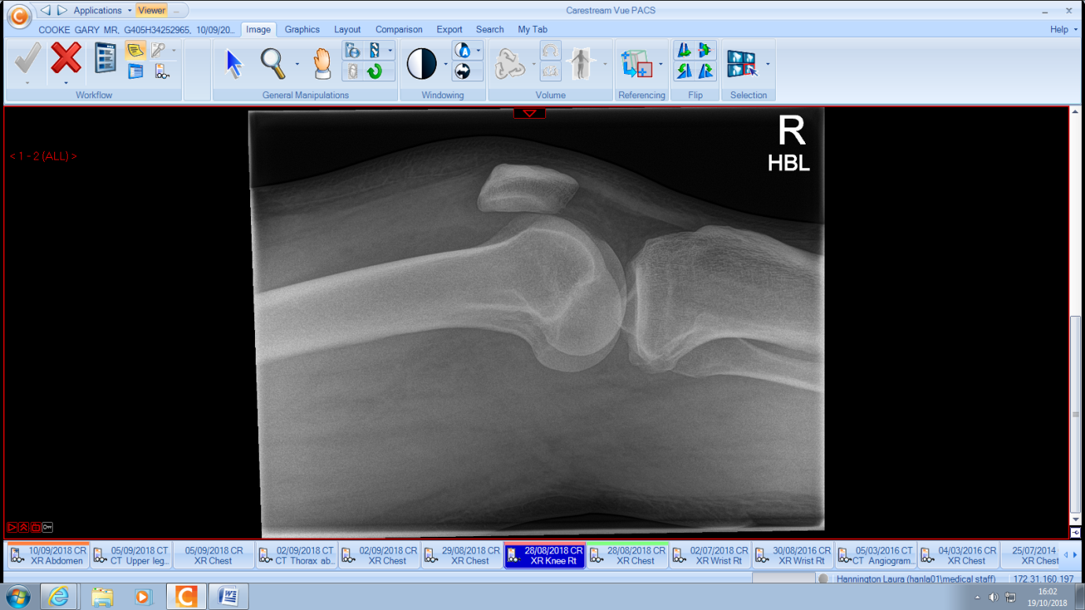

Slide 18
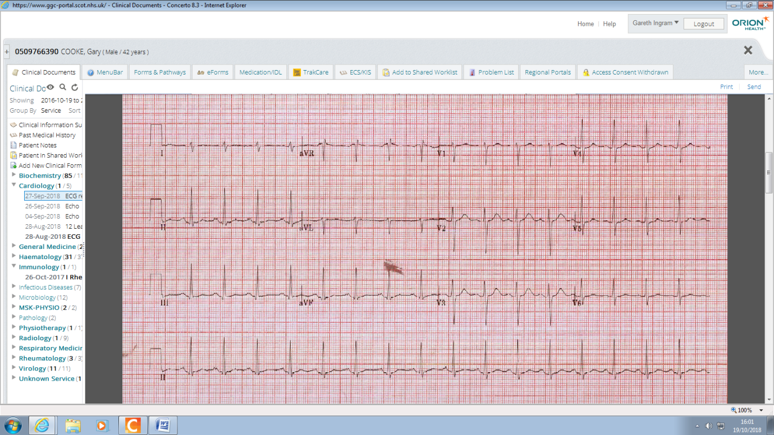

Slide 19
Night one
Remained hypotensive, 86 systolic
4.5 Litres
100ml out, empty bladder on USS
Transferred to Medical HDU for central access and noradrenaline
Unable to get radial arterial access
48 hour period in HDU
Step down to 6th floor

Slide 20
Positive cultures
  Blood
    Actinomyces turicensis
    Campylobacter ureolytics
  Joint
    Staphylococcus aurea

