Slide 1
Glomerulonephritis
Work-up and management in acute medicine
Kaitlin Mayne
ST3 Renal/GIM

Slide 2
Disclaimer*
Please note that QUACK is a regional teaching programme operating across GG&C, Lanarkshire and Ayrshire & Arran.
This presentation outlines general management, though local variances e.g. antibiotic prescription may vary slightly depending on your local trust
Remember to check your local guidelines

Slide 3
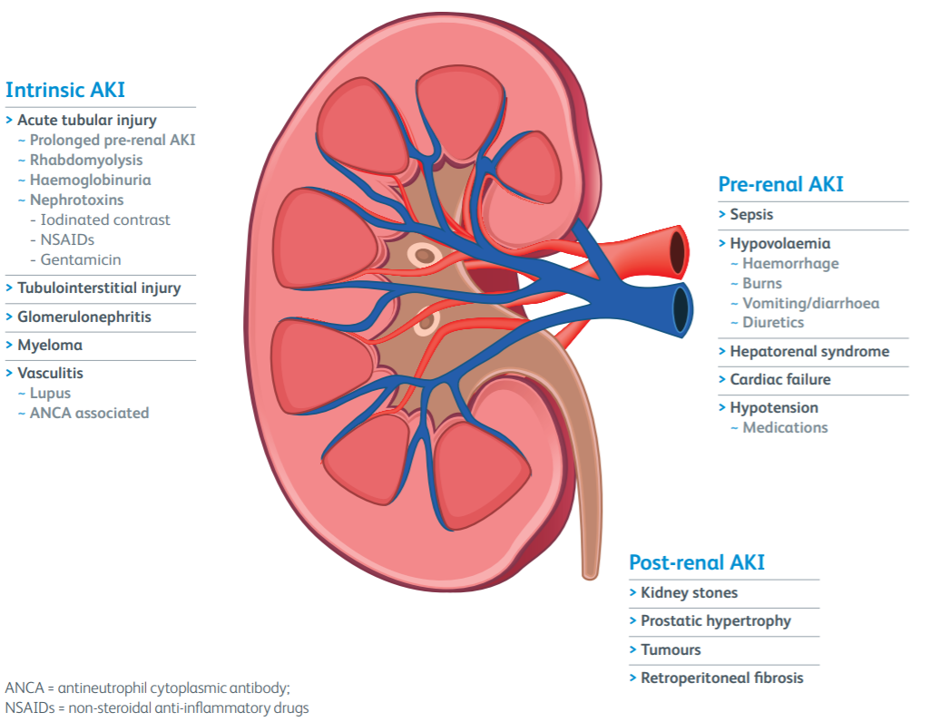

Causes of AKI
80% of all AKI
Often multifactorial
Urology
Renal USS ?hydronephrosis
Royal College of Physicians: Acute care toolkit 12 Acute kidney injury and intravenous fluid therapy

Slide 4
Introduction to glomerulonephritis
Set of diseases due to injury to renal glomeruli, occurs by either:
  Deposition of immune/non-immune (diabetes, amyloid) material
  Direct immune attack (anti-GBM)
Important cause of AKI/CKD/end stage renal disease (15% of ESRD)
Can be either:
Primary
  Eg. IgA nephropathy, minimal change disease
Secondary
  Systemic conditions with injury to glomeruli - vasculitis, amyloidosis, diabetes

Slide 5
Classification: Nephritic vs nephrotic
Nephrotic syndrome
Triad of:
Heavy proteinuria >3.5g/day
  uPCR >300mg/mmol
Oedema
Hypoalbuminaemia
AKI less common
Nephritic syndrome
Haematuria
Proteinuria (degree of)
Oliguria
Hypertension
AKI common

Slide 6
Nephrotic syndrome
Non-proliferative injury to structure of glomerulus resulting in excessive leakage of key plasma molecules such as albumin
Results in heavy proteinuria and hypoalbuminaemia
Protein loss results in…
  Reduced oncotic pressure causing oedema & elevated cholesterol
  Increased risk of infection (loss of immunoglobulins)
  Increased thrombosis risk (loss of antithrombotic factors)
Oedema generally peripheral in adults, facial (periorbital) common in children
May describe frothy urine

Slide 7
Nephritic syndrome
Usually proliferative changes within glomerulus - focal or diffuse
Results in presence of blood in urine
Nephritic urinary sediment: urine microscopy showing red cell casts, leucocytes, sub-nephrotic range proteinuria and dysmorphic red cells
Inflammatory infiltrates result in reduced movement across basement membrane (↓GFR) causing oliguria
Water and sodium retention result in hypertension and a degree of oedema (less so than nephrotic syndrome)

Slide 8
Conditions associated with…
Nephrotic syndrome
Minimal change disease
  Commonest children
Membranous nephropathy
  Commonest older adults
Focal segmental glomerulosclerosis (FSGS)
  Commonest younger adults
Diabetic nephropathy
Amyloidosis
Nephritic syndrome
IgA nephropathy (commonest)
Post-streptococcal GN
Lupus nephritis
Vasculitis

Slide 9
Infection-related glomerulonephritis
Henoch-Schonlein purpura (HSP)
Overlap with IgA nephropathy
Mainly children
Purpuric rash, abdominal pain, joint pain
Self-limiting 4-6 weeks, risk relapse
Post-streptococcal GN
  2 weeks post-infection, usually self-limiting
IgA nephropathy
  Within 5 days of URTI, often within 24-48 hours
Membranoproliferative GN
  Sometimes (not always) follows URTI
Can have immune-complex mediated GN with other (non-streptococcal bacterial infections)
Usually conservative management
Discuss with Renal team
Notes:
?draw timeline following infection

Slide 10
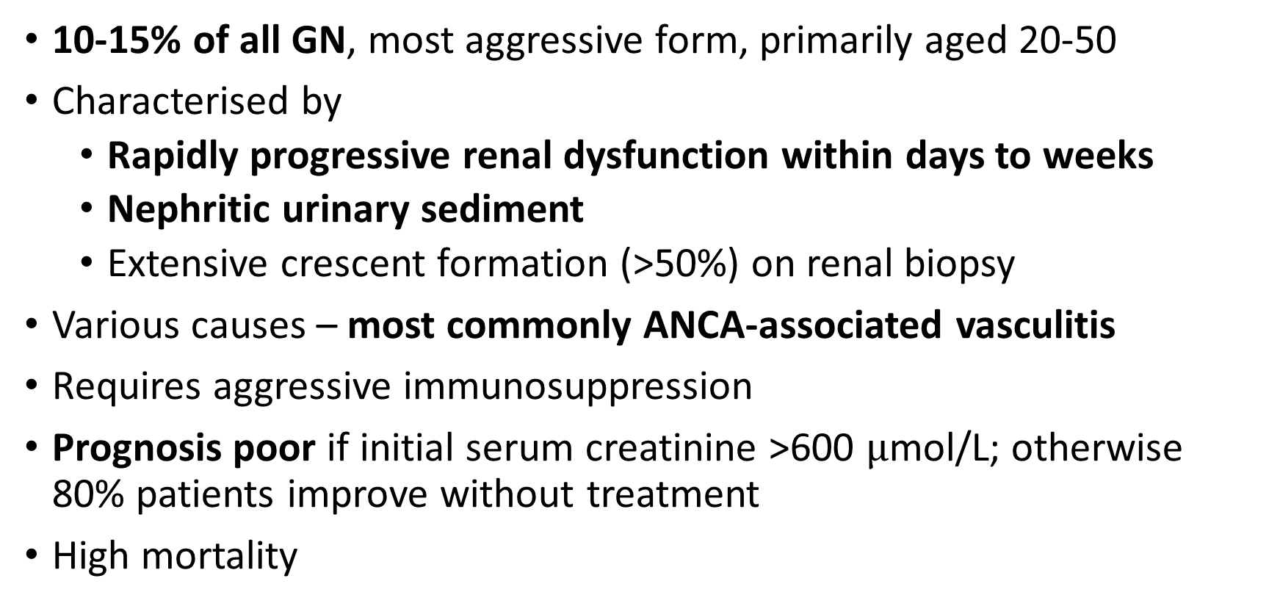
Beware: rapidly-progressive glomerulonephritis (RPGN) aka crescenteric GN
10-15% of all GN, most aggressive form, primarily aged 20-50
Characterised by
  Rapidly progressive renal dysfunction within days to weeks
  Nephritic urinary sediment
  Extensive crescent formation (>50%) on renal biopsy
Various causes – most commonly ANCA-associated vasculitis
Requires aggressive immunosuppression
Prognosis poor if initial serum creatinine >600 $μ$mol/L; otherwise 80% patients improve without treatment
High mortality

Slide 11
How does glomerulonephritis present
Upto 50% have no symptoms
Proteinuria – hallmark of glomerular disease
  May be isolated incidental finding, may have oedema
Isolated haematuria
  Not specific - can arise anywhere in urinary tract – consider urology
Nephrotic syndrome
Nephritic syndrome
Acute renal failure
  Reduced urine output
  Generally unwell – anorexia, weakness, fatigue, nausea/vomiting
Chronic renal failure
  Anorexia, weakness, fatigue, nausea/vomiting

Slide 12
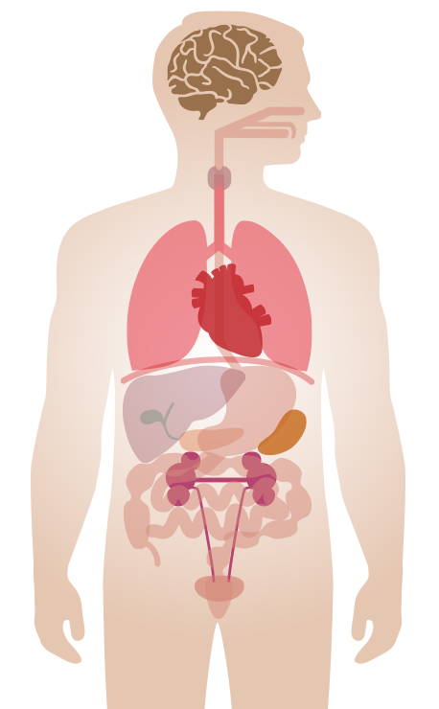

Stroke
Mononeuritis multiplex
Ask about preceding illness – recent flu-like/respiratory symptoms
Eye symptoms - uveitis
Epistaxis
Rhinitis/sinusitis/polyps
Saddle nose deformity
Haemoptysis
Pulmonary infiltrates/nodules
Pleural effusion
Asthma
Fever, malaise, weight loss
Pericarditis
Joint pain
Myalgia
Haematuria
Oedema
Rash
Purpura
Abdominal pain
PR bleeding
Suspect vasculitis in any patient with multisystem presentation NOT explained by infection/malignancy

Slide 13
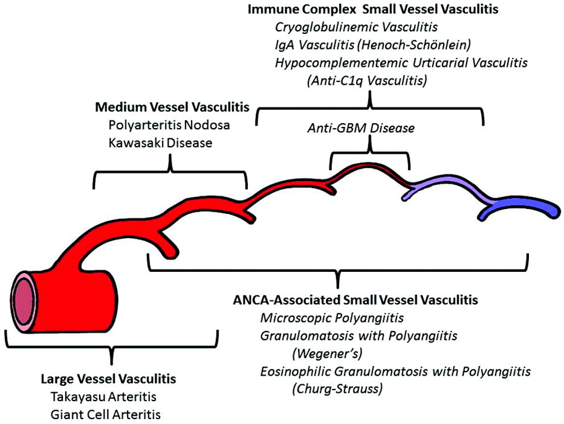
Vasculitis
https://onlinelibrary.wiley.com/doi/full/10.1002/art.37715

Slide 14
ANCA-associated vasculitis
Peak age 65-75, 85% 1 year survival with treatment
Usually slowly progressive rather than acute presentation (younger)
Cytoplasmic c-ANCA usually PR3, associated with GPA
Peri-nuclear p-ANCA usually MPO associated with MPA, also eGPA
  ANCA positivity but negative MPO/PR3 likely not significant
  p-ANCA in IBD, RA, SLE, Sjogren’s, hepatitis, cocaine use
Can have ANCA negative vasculitis with renal involvement
If known, check and compare titres – rise may reflect disease flare

Slide 15
Granulomatosis with polyangiitis (GPA) “Wegener’s” | Eosinophilic granulomatosis with polynagiitis (eGPA) “Churg-Strauss” | Microscopic polyangiitis (MPA)
c-ANCA/PR3 Small & medium vessels Upper & lower respiratory plus renal involvement Destructive nasal lesions – septal perforation, saddle deformity May have purpura | p-ANCA/MPO Small & medium vessels Eosinophilia Sinusitis, nasal polyps (non-destructive lesions) Strong asthma association Purpura more common Renal involvement less common | p-ANCA/MPO Mainly small vessel Systemic upset common May have purpura Anaemia common

Slide 16
Initial investigations for glomerulonephritis
Bloods – urea and electrolytes
Urinalysis – protein, blood
Urine protein:creatinine ratio (PCR)
Urine microscopy (red cell casts)
Renal ultrasound
CXR ?pulmonary infiltrates
Glomerulonephritis (GN) screen
Myeloma screen
What is a GN screen?
ANCA
ANA
Rheumatoid factor
Complement (C3, C4)
Anti-GBM if clinical suspicion (renal & pulmonary signs)
(Trakcare order set in GGC)

Slide 17
Investigations for secondary cause
Blood glucose (diabetic nephropathy)
Serology – ANA, anti-dsDNA; complement
Blood-borne virus screen
  Hepatitis B (membranous)
  Hepatitis C (crygoglobulinaemia, membranoproliferative GN)
  HIV (FSGS most commonly)
Cryoglobulins if clinical suspicion (associated vascular signs)
Investigation of malignancy (membranous nephropathy)

Slide 18
Basic management
Refer to Renal team – all suspected intrinsic renal disease
Address underlying cause
Blood pressure control
  Aim BP <130/80mmHg or 125/75mmHg if heavy proteinuria
ACEI or ARB (reduce proteinuria)
Fluid/salt restriction
Plan for possible renal biopsy:
  Check FBC, coagulation screen, withhold anticoagulation/Clopidogrel
  Manage hypertension – risk of post-biopsy bleeding
Immunosuppression dependent on aetiology

Slide 19
Specific to nephrotic syndrome…
If diuretic needed:
  IV Furosemide bolus (may need IV infusion)
  Needs to reach tubules to be effective – highly albumin-bound
Consider VTE prophylaxis (no RCT evidence)
No evidence for IV albumin if albumin >20 (not studied <20)
Hyperlipidaemia – no evidence for statins

Slide 20
Key points
Refer to Renal (any suspected intrinsic renal disease)
Distinguishing between nephrotic and nephritic syndrome (uPCR) is key to investigation & management
Look for systemic involvement
Ask about preceding illness (IgA nephropathy, post-strep GN)
GN can present in variety of ways and associated with wide differential diagnosis

Slide 21
Get in touch!
Website
www.quackmeded.co.uk
Email
gg-uhb.quackmeded@nhs.net
Social Media
Twitter: @QUACK_ Med
Facebook: QUACK education

