Slide 1

Shock
Dr Kirsty Crowe & Dr Nick Holt
Clinical Teaching Fellows
NHS Lanarkshire

Slide 2
Disclaimer*
Please note that QUACK is a regional teaching programme operating across GG&C, Lanarkshire and Ayrshire & Arran.
This presentation outlines general management, though local variances e.g. antibiotic prescription may vary slightly depending on your local trust
Remember to check your local guidelines

Slide 3
Learning Objectives
Define the clinical entity of shock
Classify different types of shock and clinical examples of these
Develop an approach to the shocked patient
Case based approach

Slide 4
What is shock?

Slide 5
Shock
State of cellular and tissue hypoxia
  Due to reduced oxygen delivery
  Or increased oxygen consumption
  Or inadequate oxygen utilisation
Most commonly secondary to circulatory failure
If not treated will progress to irreversible organ dysfunction → multi-organ failure → death
Serum lactate levels have been used as surrogates for hypoperfusion and tissue hypoxia
Useful risk-stratification
Notes:
Cellular hypoxia → cell membrane ion pump dysfunction, intracellular oedema, leakage of intracellular contents into extraceullar space, inadequate regulation of intraceullular pH → acidosis & endothelial dysfunction → further inflammatory and anti-inflammatory cascade; compounded by further reduction in tissue perfusion from complex humoral and microcirculatory processes that impair regional blood flow

Slide 6
Physiology
Cardiac Output(CO) = Stroke volume x Heart Rate
Mean Arterial Pressure = CO x vascular resistance (SVR)
Notes:
Common to most forms of shock is diminished cardiac output (CO) and/or systemic vascular resistance (SVR).
Some forms of shock have normal CO and SVR. As an example, patients with profound mitochondrial dysfunction (eg, inheritable mitochondrial disease, carbon monoxide, and cyanide poisoning) are shock states that occur despite normal CO, SVR, and tissue perfusion because they are due to inadequate oxygen utilization.
In general, severe hypovolemia, cardiogenic shock, and late-stage obstructive shock are characterized by a low CO and compensatory increase in the SVR to maintain perfusion to vital organs, whereas distributive shock is classically associated with reduced SVR and compensatory increase in the CO.
Occasionally, the SVR is low relative to a high CO (eg, thyrotoxicosis), which can result in poor tissue perfusion. However, the CO may be normal in the early phases of hypovolemic and obstructive shock. Similarly, in some cases of severe distributive shock (eg, sepsis and neurogenic shock) or combined shock, both CO and SVR may be reduced

Slide 7
Major Determinants of Tissue Perfusion
Preload
(capacitance)
Afterload
(resistance)
Pump
(rate / volume)
C
P
R
Notes:
Cardiac output and systemic vascular resistance
Cardiac output – heart rate and stroke volume
Systemic vascular resistance – vessel diameter & length, blood viscosity

Slide 8
Pathophysiology
The body is autoregulated to maintain perfusion and perfusion pressure
For each type of shock there exists
  An initial problem
  Circulatory consequences
  Subsequent compensatory changes

Slide 9
Pathophysiology of Shock
Pathophysiologically
  C apacitance: Inadequate volume
  P ump: Pump failure
  R esistance: Dilated circulation
These conditions can co-exist

Slide 10
Stages of Shock
Inciting event
Pre-shock – compensated shock
Shock – compensatory mechanisms overwhelmed, symptoms of organ dysfunction
  Symptomatic tachy, SOB, diaphoresis, metabolic acidosis, hypotension, oliguria, cool & clammy skin, restlessness
End-organ dysfunction
  Anuria, acute renal failure, acidaemia further depresses CO, worsening lactate, coma
Notes:
Early stages of shock more amenable to therapy

Slide 11
Classification of Shock
Distributive
Cardiogenic
Hypovolaemic
Obstructive
Combined
Undifferentiated

Slide 12
Vasodilatory (Distributive) Shock
INITIAL problem
  Severe Peripheral Vasodilation (R)
COMPENSATION
  Tachycardia
  Cardiac output rises* (P)
CLINICALLY
  Warm, dry peripheries
  Tachycardia
  Bounding pulse

Slide 13

Case 1
70 year old male
BIBA as a standby
  Tachypnoeic
  Hypotensive
  Tachycardic
  Drowsy
  Pyrexial
3/7 Hx of dysuria and right flank pain
Intermittent chills, shaking

Slide 14
PMHx: type 2 DM, rheumatoid arthritis, hypertension
Drug Hx: metformin, ramipril, methotrexate, folic acid
Normally independent with ADLs
Non-smoker, minimal ETOH

Slide 15
SIRS
What is SIRS?

Slide 16
SIRS
Robust inflammatory response
2 or more of the following
T>38ºC or <36ºC
HR >90 bpm
RR>20/min or PaCO₂ <4.3kPa
WBC >12 or less than 4.
Notes:
Some also include hyperglycaemia in the absence of DM and altered cognition
Noninfectious causes – burns, pancreatitis, hypoperfusion caused by trauma, blunt trauma/crush injury fat/air/amniotic embolism, ROSC, MI.

Slide 17
Sepsis
What is sepsis?

Slide 18
Sepsis
Dysregulated host response to infection resulting in life threatening organ dysfunction
SIRS
AND
Proven or suspected infective source

Slide 19
Severe Sepsis
What is severe sepsis?

Slide 20
Severe Sepsis
Sepsis associated with:
organ dysfunction
  E.g. renal or respiratory.
or hypoperfusion
  Lactic acidosis, oliguria, altered mental state
or hypotension
  SBP <90mmHg or a drop of 40mmHg from, baseline

Slide 21
Septic Shock
Lastly, what is septic shock?

Slide 22
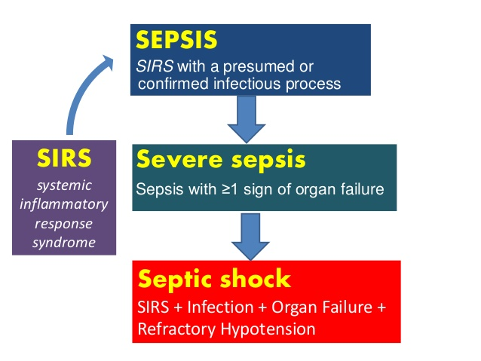
Septic Shock
Severe sepsis refractory to adequate fluid resuscitation
Mortality 40-50%

Slide 23
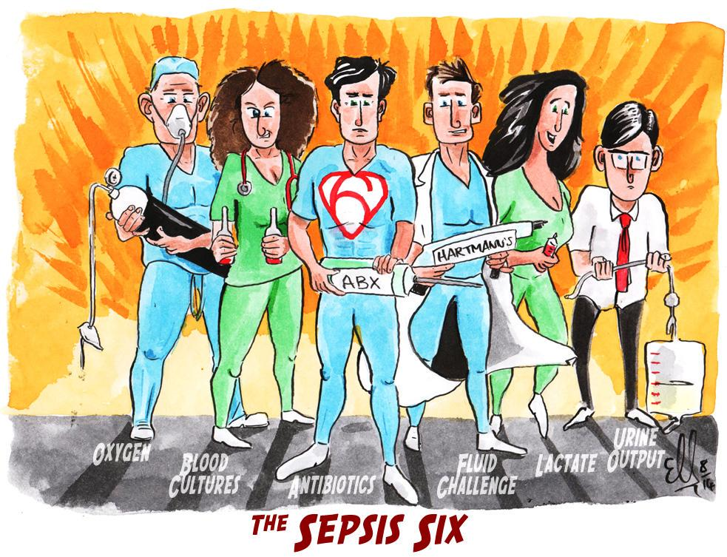

Slide 24
Why is Sepsis important?
A life-threatening medical emergency
A global health priority (WHO)
Can arise from virtually any infection
Wide variety of presentations
Can be difficult to recognise
Internal Medicine Teaching website, Sepsis 2020 slides

Slide 26
Note: Sepsis 3 Criteria (JAMA, 2017)
Sepsis should be defined as life-threatening organ dysfunction caused by a dysregulated host response to infection
Organ dysfunction can be represented by an increase in the Sequential [Sepsis-related] Organ Failure Assessment (SOFA) score of 2 points or more, which is associated with an in-hospital mortality greater than 10%.
Septic shock should be defined as a subset of sepsis in which particularly profound circulatory, cellular, and metabolic abnormalities are associated with a greater risk of mortality than with sepsis alone
  i.e. requirement for vasopressors or lactate >2 once fluid resuscitated
New bedside clinical score termed quickSOFA (qSOFA): respiratory rate of 22/min or greater, altered mentation, or systolic blood pressure of 100 mmHg or less.

Slide 27
Case 2
19 year old male
BIBA after falling from 2nd floor balcony at a flat party
Arrives in ED Resus with reduced GCS, bradycardic and hypotensive
Not moving arms or legs
T 37.9
No significant PMHx or drug history

Slide 28
Neurogenic Shock
Sometimes seen in severe traumatic brain injury and SC injury; different from spinal shock
Interruption of sympathetic autonomic pathways
  Decreased vascular resistance
  Altered vagal tone
Myocardial depression and hypovolaemia from blood loss can also contribute

Slide 29
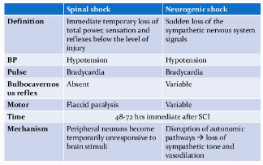

Slide 30
Case 3
2222 call to ward 8
35 year old lady became unwell whilst receiving a Tazocin infusion
Initially complained of abdominal pain and itchy skin
Lips started swelling and she felt her throat closing over

Slide 31
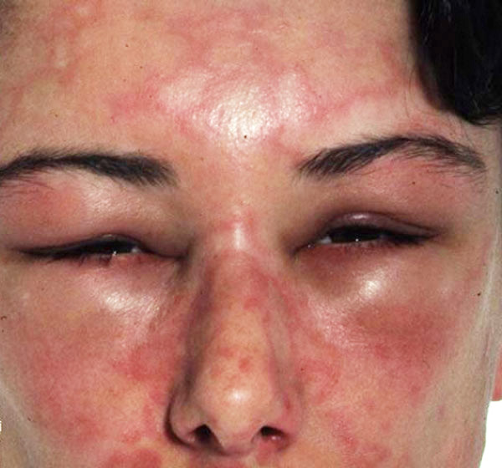
Case 3
On examination:
  Wheezy
  SpO2 85% OA, RR 40
  HR 130 bpm
  BP 80/50
  Urticarial weals over skin
  Red wrist band

Slide 32
Anaphylaxis
Severe generalised/systemic hypersensitivity reaction
Haemodynamic collapse, bronchospasm, increased airway resistance – ABC +/- skin/mucosal changes
Severe IgE mediated allergic reactions
Immunologic triggers independent of IgE (IgG, coagulation system activation)
Direct activation of mast cells and basophils

Slide 33
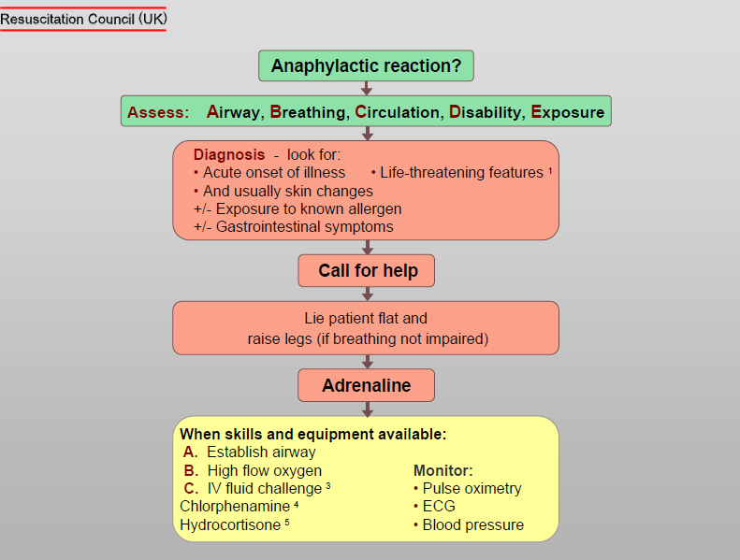
Managing Anaphylaxis

Slide 34
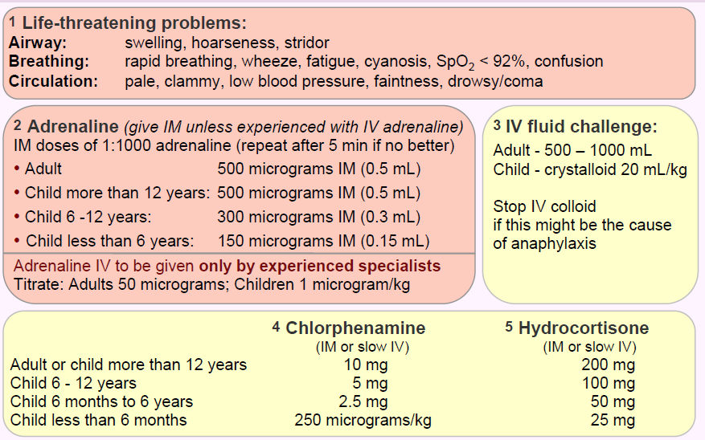
Resuscitation Council, UK

Slide 35
Mast Cell Tryptase
Baseline ASAP
1-2 hours after symptom onset
24+ after symptom onset

Slide 36
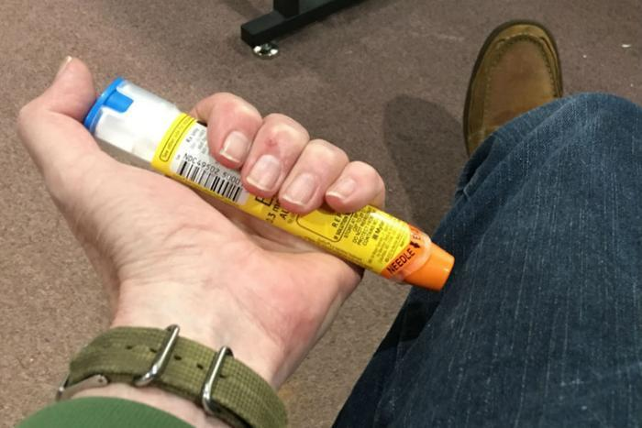
Issue auto-injector

Slide 37
Case 4 - Pump Failure
INITIAL problem
  Fall in cardiac output (P)
COMPENSATION
  Increased resistance (R)
  Tachycardia
FURTHER PROBLEM
  Increased capacitance (C) (failure of Starling’s Law)
CLINICALLY
  Cold, clammy peripheries
  Decreased capillary refill
  MAY have raised JVP

Slide 38
Case 4
55 year old male brought to the Cath Lab
1 hour history of severe crushing central chest pain radiating to jaw and down left arm

Slide 39
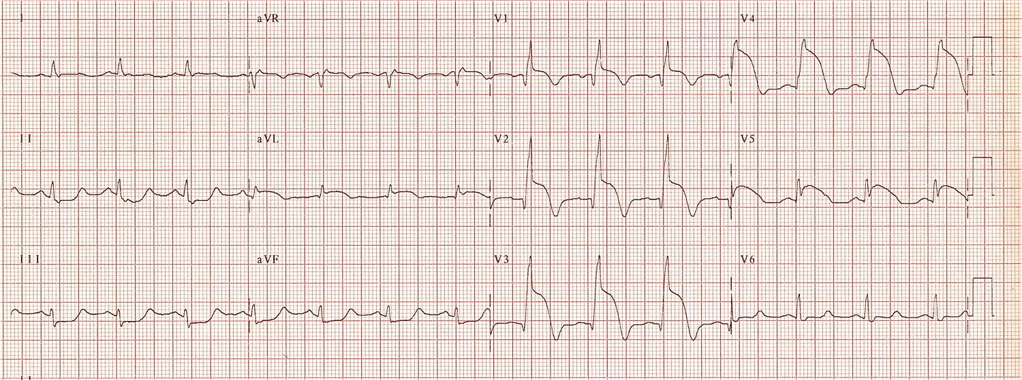

Slide 40
Case 4
As team preparing to assemble for coronary angiography patient complains of feeling dizzy and breathless
Cold to touch
Wheezy, crepitations on auscultation
BP 75/50

Slide 41
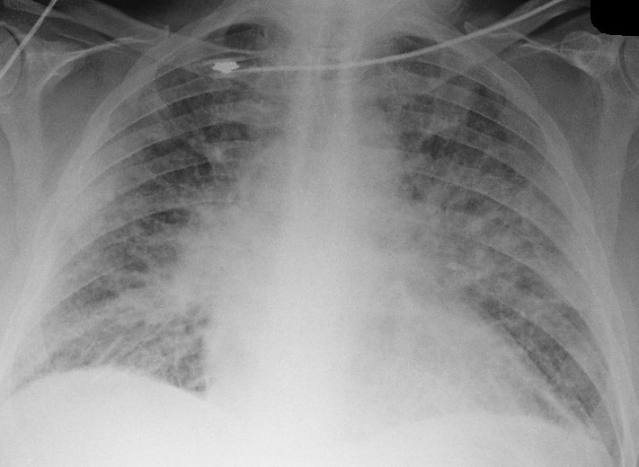

Slide 42
Management
Restore coronary artery blood flow to myocardium
  Including rate control
Inotropic support
Diuretics
Circulatory assist device

Slide 43
Case 5 - Hypovolaemic Shock
INITIAL problem
  Inadequate volume (C)
Consequences
  Fall in cardiac output (P)
  Causes hypotension
Compensation
  Increased resistance (R)
  Tachycardia, but cardiac output still falls
CLINICALLY
  Cold, Clammy
  Tachycardia
  Empty veins

Slide 44
Case 5
You are called to the gastro ward on the evening shift
A 52 year old female patient has started filling vomit bowls full of fresh blood
Known chronic liver disease
Being investigated for increasing ascites and confusion
A – patent, own
B – RR 35, SpO2 unrecordable
C – BP cuff keeps cycling, CRT 7 seconds, HS 1 + 2 + 0, cool to elbows/knees, mottled

Slide 45
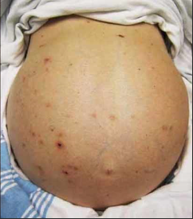
D – responsive to voice, BM 6.0
E – jaundiced, swollen abdomen

Slide 46
Controlling Haemorrhage
Direct pressure vs tourniquet vs clamping
Internal – chest, abdomen, retroperitoneum, pelvis, long bones
Pelvic stabiliser, extremity splints, chest decompression
Surgical/interventional radiological treatment
Bleeding control and replacement of intravascular volume
Avoiding worsening coagulopathy and inducing iatrogenic hypothermia

Slide 47
Classification of shock
Class | I | II | III | IV
Blood loss | <750 | 750-1500 | 1500-2000 | >2000
HR | <100 | >100 | >120 | >140
BP | Normal | Normal | Decreased | Decreased
Pulse pressure | Normal | Decreased | Decreased | Decreased
RR | 14-20 | 20-30 | 30-40 | >40
UO | >30 | 20-30 | 5-20 | Negligible
Mental Status | Slightly anxious | Mildly anxious | Anxious, confused | Lethargic
Notes:
Venous system increases resistance to increase circulating blood volume and decrease venous capacitance, this is why the diastolic pressure increases relative to systolic.
Permissive hypotension
Class 2 – HR increases to increase CO, blood diverted from extremeties and intestinal circulation
Class 3 – 30-40% change in volume, BP no longer maintained
Class 4 – moribound
Children and pregnant patients guard physiology until point of collapse, tachycardia more prominent.
Elderly may not mount tachycardic response due to medications, PPM; elderly have baseline hypertension

Slide 48
Non-haemorrhagic hypovolaemic shock
GI losses
Skin losses
Renal losses
Third space losses

Slide 49
Case 6
Trauma call BIBA
85 year old male who has fallen down the stairs
Chest pain on inspiration
Breathless, distressed
No acute neurology
OBS RR 45, SpO2 75% OA 100% on 15L, BP 82/60, HR 140, T 36.5

Slide 50
A – patent
B – SpO2 100% 15L; reduced chest expansion left side; breath sounds heard only on right; hyper-resonant sounds on left; tracheal deviation to the right
Impression?

Slide 51
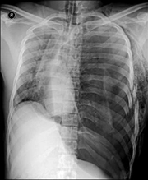
Tension Pneumothorax

Slide 52
Obstructive Shock
Mostly due to extracardic causes of pump failure
  Poor right ventricular output
PE or severe pulmonary HTN → right ventricular failure to overcome high pulmonary vascular resistance

Slide 53
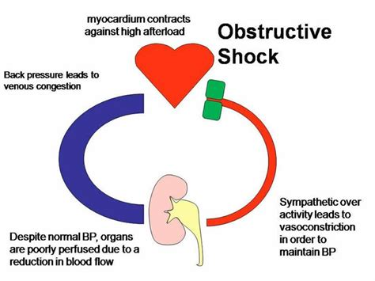

Slide 54
Thank you
Please fill out the feedback form for your certificate of learning

Slide 55
Get in touch!
Website
www.quackmeded.co.uk
Email
gg-uhb.quackmeded@nhs.net
Social Media
Twitter: @QUACK_ Med
Facebook: QUACK education

