Slide 1

Obstructive Sleep Apnoea
Dr Manish Patel
Respiratory Consultant, Wishaw

Slide 2
Learning Outcomes
Background
Clinical features
Investigations
Treatment
Summary

Slide 3
Obstructive sleep apnoea
Background
Clinical features
Investigations
Treatment
Summary

Slide 4
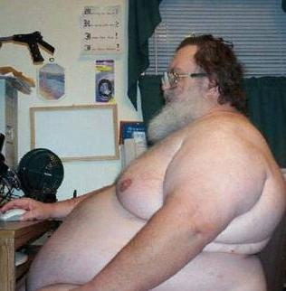
Obstructive Sleep Apnoea
Male
Obese
Snorer
Hypertensive
Diabetic

Slide 5
Definition
Recurrent episodes of partial (hypopnoea) or complete upper airway obstruction (apnoea) during sleep
AHI > 5
Excessive daytime sleepiness
2 or more of the following
  Choking or gasping during sleep
  Recurrent awakenings from sleep
  Unrefreshing sleep
  Daytime fatigue
  Impaired concentration

Slide 6
Apnoeas and hypopnoeas
Apnoea
  Reduction in airflow of >90% of baseline for at least 10 seconds
Hypopnoea
  Reduction in airflow of >50% of baseline for at least 10 seconds, associated with >4% desaturation from pre-event baseline

Slide 7
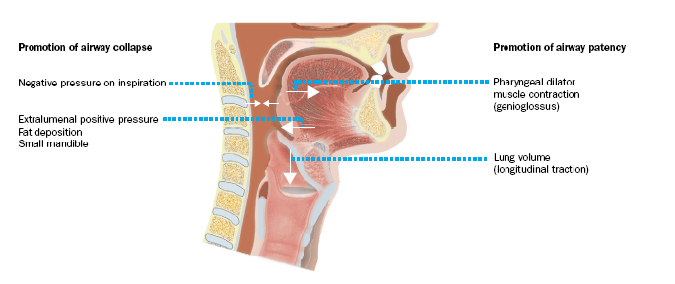
Balance of forces
Malhotra. Lancet 2002

Slide 8
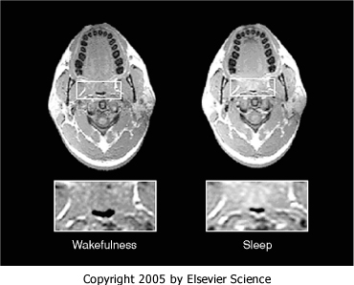
Normal subject awake and sleep

Slide 9
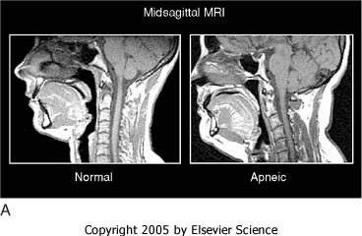
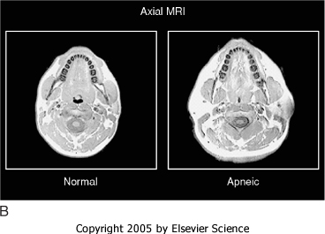

Slide 10
Mechanism of OSAHS
Sleepiness
Reduced quality of life
Sleep disruption
Negative thoracic pressure
Road accidents
Pharyngeal narrowing
Arousal
Blood pressure surge
Heart attacks
Strokes
(Douglas - Lancet 1994;334:653-5)

Slide 11
Prevalence
% Men % Women
AHI > 5 24 9
AHI>5 + daytime somnolence 4 2
75% patients undiagnosed
Middle aged men 1-2% - similar to Type 1 Diabetes

Slide 12
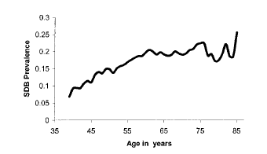
Age
SHHS

Slide 13
Risk factors
Young. AJRCCM 2002
Male Gender
Post-menopausal state
Excess body weight
Increasing age
Race
Craniofacial anatomy
Familial and genetic predisposition
Alcohol consumption
Smoking

Slide 14
Excess body weight
10% weight gain is associated with a six-fold increased risk of OSA

Slide 15
Obstructive sleep apnoea
Background
Clinical features
Investigations
Treatment
Summary

Slide 16
Symptoms and signs
Excessive Daytime Somnolence
Snoring
Impaired concentration
Witnessed apnoeas
Obesity
Hypertension
Family history
Non-restorative sleep

Slide 17
Potential causes of excessive daytime sleepiness in adults
fragmented sleep (quality of sleep)
sleep deprivation (quantity of sleep)
shift work
depression
narcolepsy
hypothyroidism
restless leg syndrome /periodic limb movement disorder
drugs
- sedatives
- stimulants (caffeine, theophyllines, amphetamines)
- beta-blockers
- selective serotonin reuptake inhibitors (SSRIs)
idiopathic hypersomnolence
excess alcohol
neurological conditions
- dystrophica myotonica
- previous encephalitis
- previous head injury
- parkinsonism

Slide 18
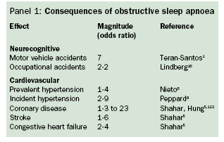

Slide 19
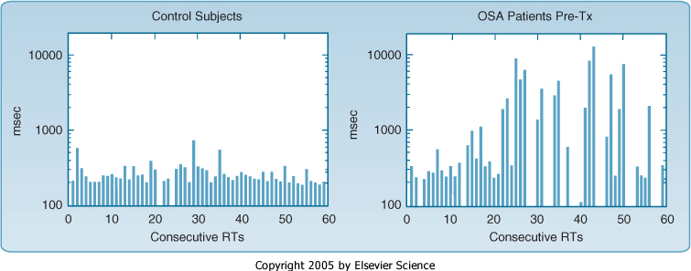
Reaction times

Slide 20
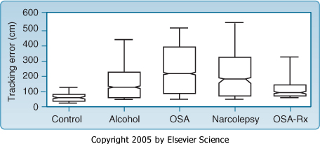
Driving simulator

Slide 21
OSA and Cardiovascular risk
Good evidence that OSAS causes BP elevation
  Animal studies
  Epidemiology
Factors such as age, obesity, alcohol consumption can make this interpretation difficult - however still an independent association

Slide 22
OSA and Cardiovascular risk
CPAP therapy can reduce BP by up to 3.3 mmHg
Should equate to reduction in cardiac and stroke risk
Claims of direct association between OSAHS and MI and stroke are yet unproven

Slide 23
Obstructive sleep apnoea
Background
Clinical features
Investigations
Treatment
Summary

Slide 24
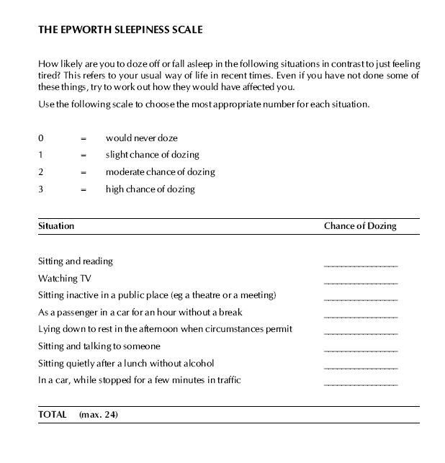
<11 – normal; 11-14 – mild; 15-18 – moderate; >18 - severe

Slide 25
Sleep studies
To confirm clinical suspicion of OSAHS and assess severity
Type 1: Full attended overnight PSG
Type 2: Full PSG (unattended)
Type 3: at least 4 channels
Type 4: one or 2 channels

Slide 26
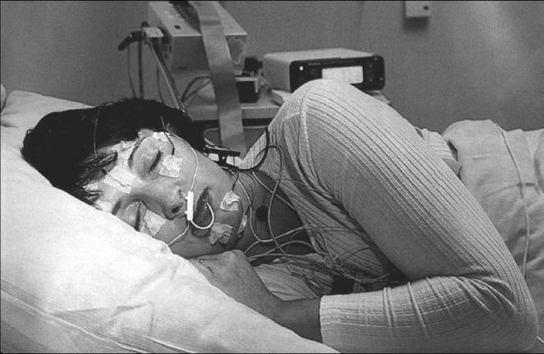

Slide 27
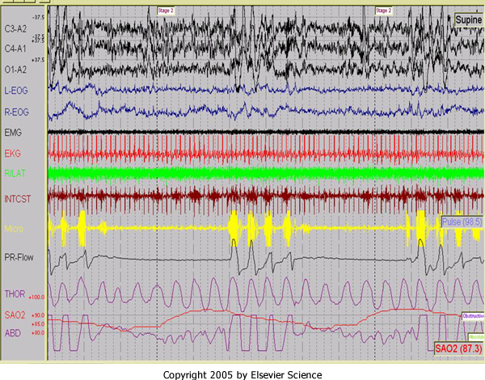
Obstructive apnoeas with arousal
Notes:
Pr – pressure related flow

Slide 28
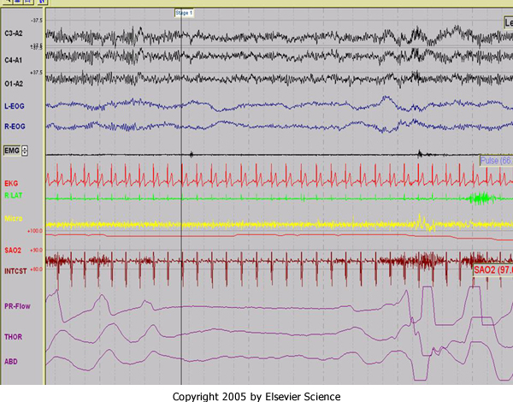
Central apnoea

Slide 29
Obstructive sleep apnoea
Background
Clinical features
Investigations
Treatment
Summary

Slide 30
Treatment of OSAS
Behavioural therapy
CPAP
Mandibular advancement splints
Surgery
Notes:
CPAP therapy indicated in sleepy patients (ESS 11 plus) and moderate to severe AHI (>15) or significant desaturations (DI >10 events an hour of 4% dip of baseline).
Some evidence in improvement in patients with mild OSA (AHI 5-14) if sleepy

Slide 31
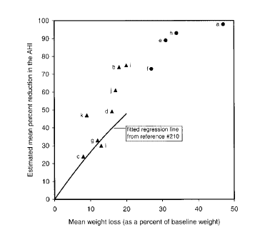
Weight reduction
Weight reduction has huge impact on OSA
  20% reduction in weight can result in almost a 50% reduction in AHI

Slide 32
Other behavioural therapies
Stop smoking (worry over weight gain)
Avoid sedatives and alcohol (decrease airway dilator function)
Non sleepy snorers – avoid sleeping on back

Slide 33
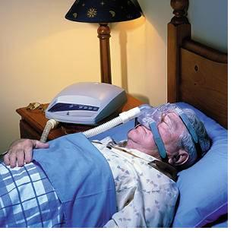
CPAP
Notes:
CPAP therapy indicated in sleepy patients (ESS 11 plus) and moderate to severe AHI (>15) or significant desaturations (DI >10 events an hour of 4% dip of baseline).
Some evidence in improvement in patients with mild OSA (AHI 5-14) if sleepy

Slide 34
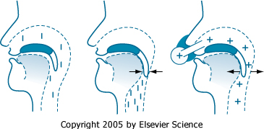

Slide 35
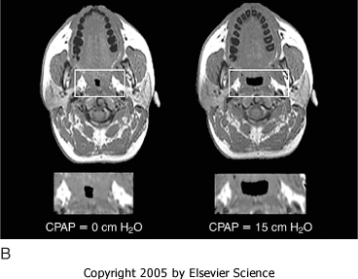
Effect of treatment

Slide 36
Benefits of CPAP
Randomised control trial evidence that CPAP improves:
  Sleepiness
  Cognition
  Health status
  Driving
  Blood pressure

Slide 37
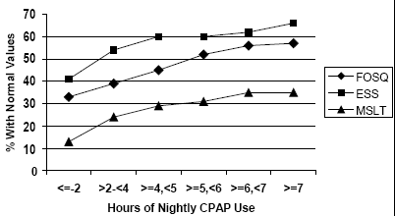
More CPAP = Less sleepiness
Weaver et al. Sleep 2007
Notes:
Functional Outcomes of Sleep Questionnaire (FOSQ)

Slide 38
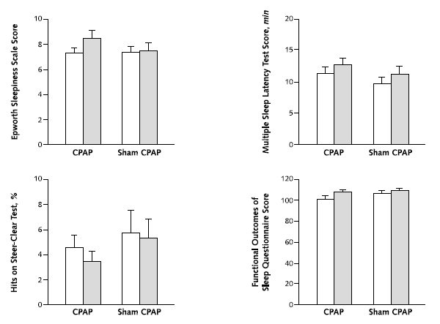
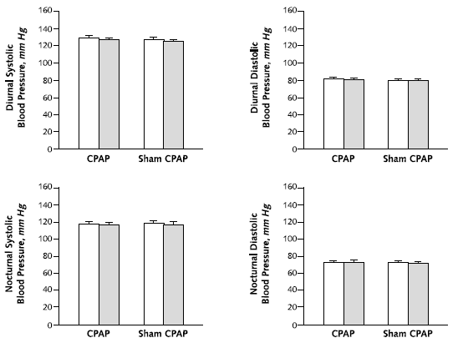
CPAP in non-sleepy OSA patients
Barbe et al. Annals Intern Medicine 2001
Notes:
38
White bars before and grey bars after treatment

Slide 39
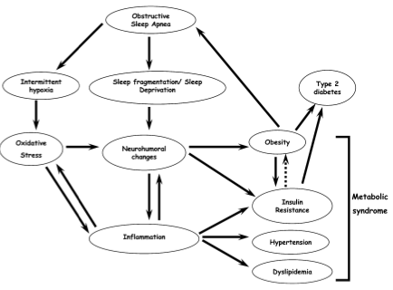

Slide 40
Effect of CPAP therapy
Improves insulin sensitivity
Reduces post-prandial glucose
Reduces HbA1c levels

Slide 41
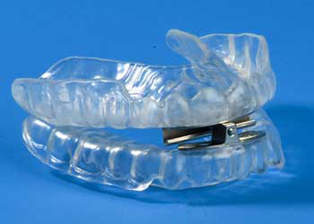
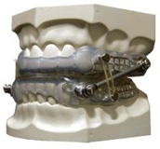
Mandibular Advancement Devices

Slide 42
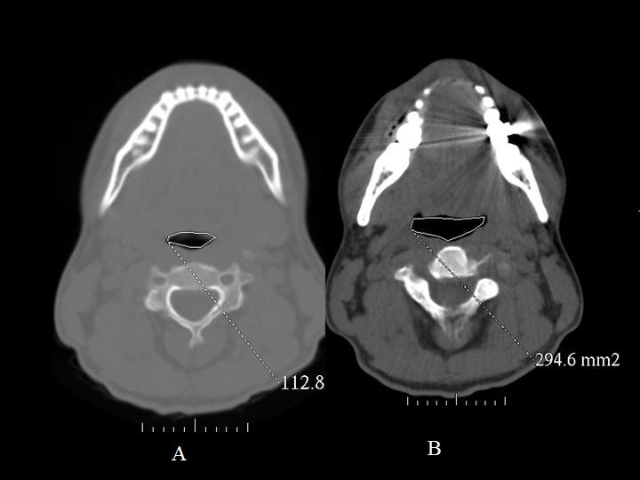
Mandibular advancement devices

Slide 43
Manibular Advancement devices Evidence
MADs do reduce AHI in those with OSA, but not as effectively as CPAP therapy
Some evidence to suggest that MADs reduce BP and reduces oxidative stress and endothelial dysfunction

Slide 44
SIGN Recommendations
Mandibular advancement devices
Intra-oral devices are an appropriate therapy for snorers and for patients with mild OSAS with normal daytime alertness
Intra-oral devices are an appropriate alternative therapy for patients who are unable to tolerate CPAP

Slide 45
Surgery
Bariatric surgery
Tracheostomy
Jaw advancement surgery
Palatal surgery
Tonsillectomy
Palatal implants
Laser

Slide 46
Bariatric surgery
Surgically induced weight loss significantly improves obesity-related OSA and parameters of sleep quality
Haines et al 2007. Surgery

Slide 47
Tracheostomy
Usually effective
Good benefits on BP
But…long-term complications of tracheostomy
Social stigma
SIGN - “Only considered when all else fails in a carefully selected patients”

Slide 48
Jaw advancement surgery
One controlled trial evidence that maxillo-mandibular advancement improves AHI to similar extent as CPAP
No RCT
Condrat et al 1998

Slide 49
Palatal surgery
Uvulopalatopharyngoplasty (UPPP) and laser-assisted uvulopalatopharyngoplasty (LAUP) for treatment of OSAHS is not recommended
Uncontrolled case series suggest, at best, a 50% improvement in 50% of patients

Slide 50
Tonsillectomy
Tonsillectomy is usually carried out in conjunction with conventional UPPP, but may in its own right improve OSAHS. Case series support this conclusion but no RCT data
The presence of large tonsils in a patient with diagnosed OSAHS should prompt referral to an ENT surgeon for consideration of tonsillectomy

Slide 51
Drugs for OSAS
There are no drugs for the primary treatment of OSAS
Modafanil (a non-amphetamine based stimulant) may have a role in the adjuvant treatment of OSAS if objective sleepiness remains after good CPAP compliance
Not approved by SMC for this use!

Slide 52
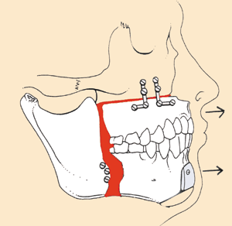
Jaw advancement surgery

Slide 53
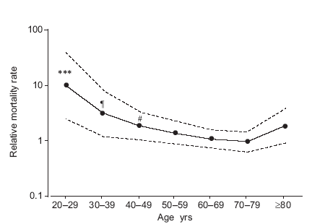
All cause mortality in OSA:
Declining mortality with age
Lavie. ERJ 2005
Notes:
?referral bias.
? If relatively more patients aged > 50 are being treated and so reduces their AHI and consequently their mortality

Slide 54
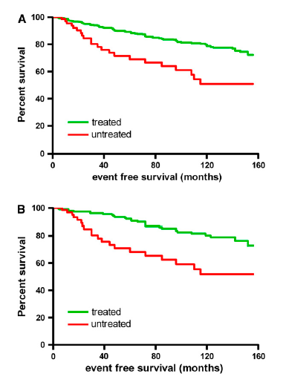
CPAP may improve CV outcomes in mild to moderate OSAS
28% overall 10 yr CV absolute risk reduction
Independent of age and pre-existing CV disease
All patients
Mild-moderate
Buchner et al. AJRCCM 2007

Slide 55
Effect of CPAP on BP
Faccenda AJRCCM 2001
Pepperell Lancet 2002
Placebo controlled trials have shown that CPAP treatment decreases mean BP in symptomatic OSAS
  4-5mmHg in patients with > 20 4% desaturations/hour
3.3mmHg reduction should be associated with 20% reduced risk of stroke and 15% reduced risk of coronary event

Slide 56
Obstructive sleep apnoea
Background
Clinical features
Investigations
Treatment
Summary

Slide 57
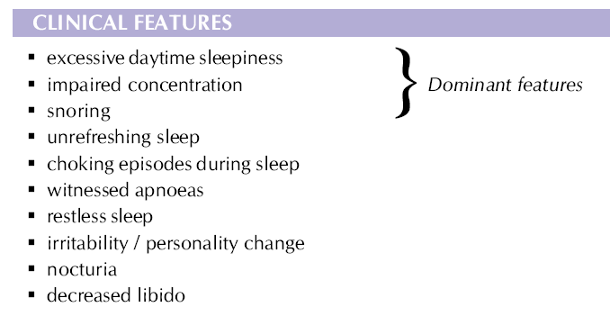
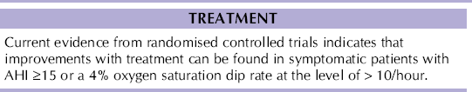
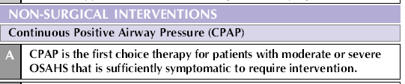
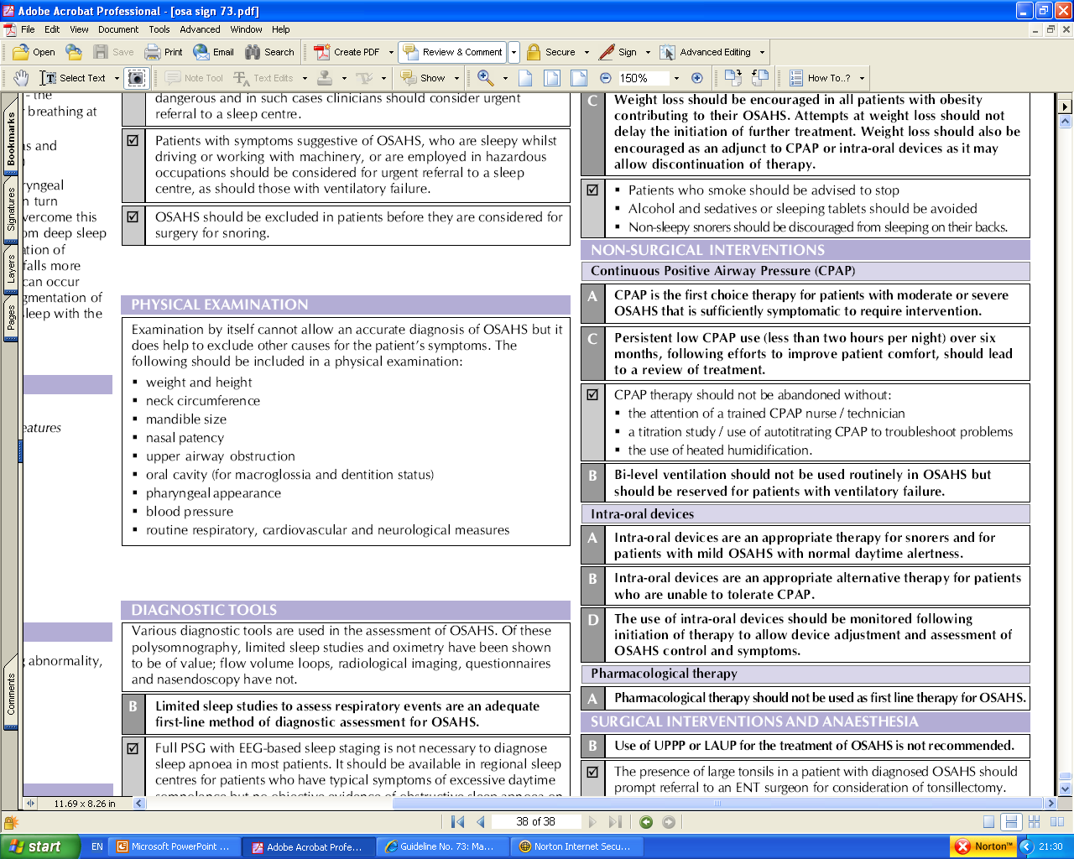
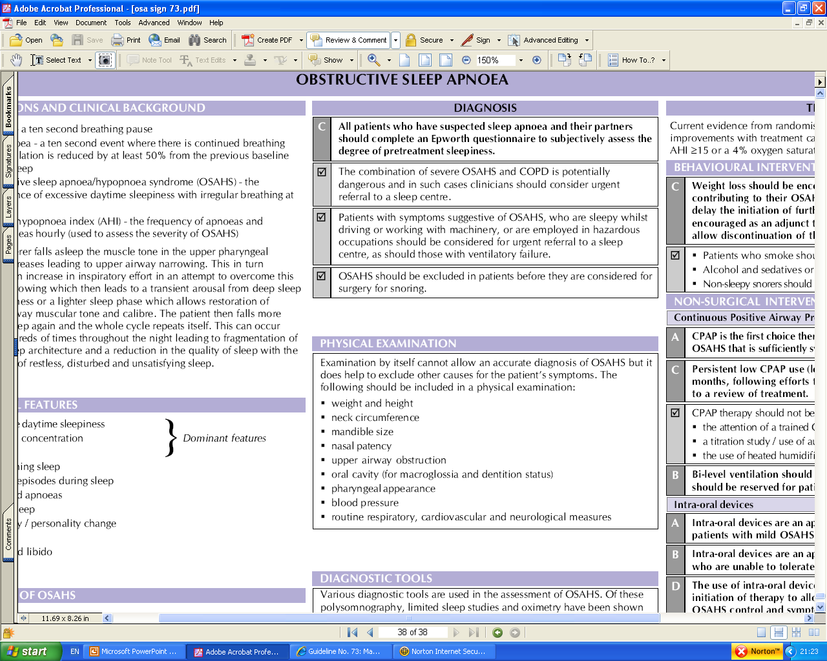
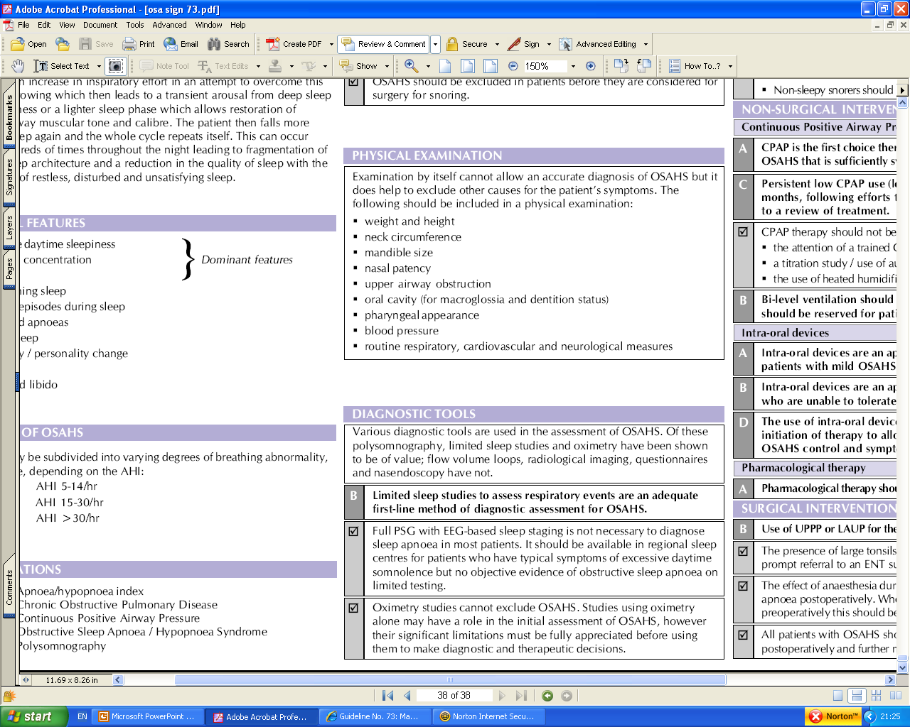
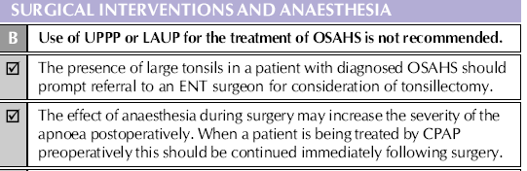
Summary

Slide 58
Thank you
Please fill out the online survey to obtain a certificate

Slide 59
Get in touch!
Website
www.quackmeded.co.uk
Email
ggc.quackmeded@nhs.scot
Social Media
Twitter: @QUACK_ Med
Facebook: QUACK education

