Slide 1
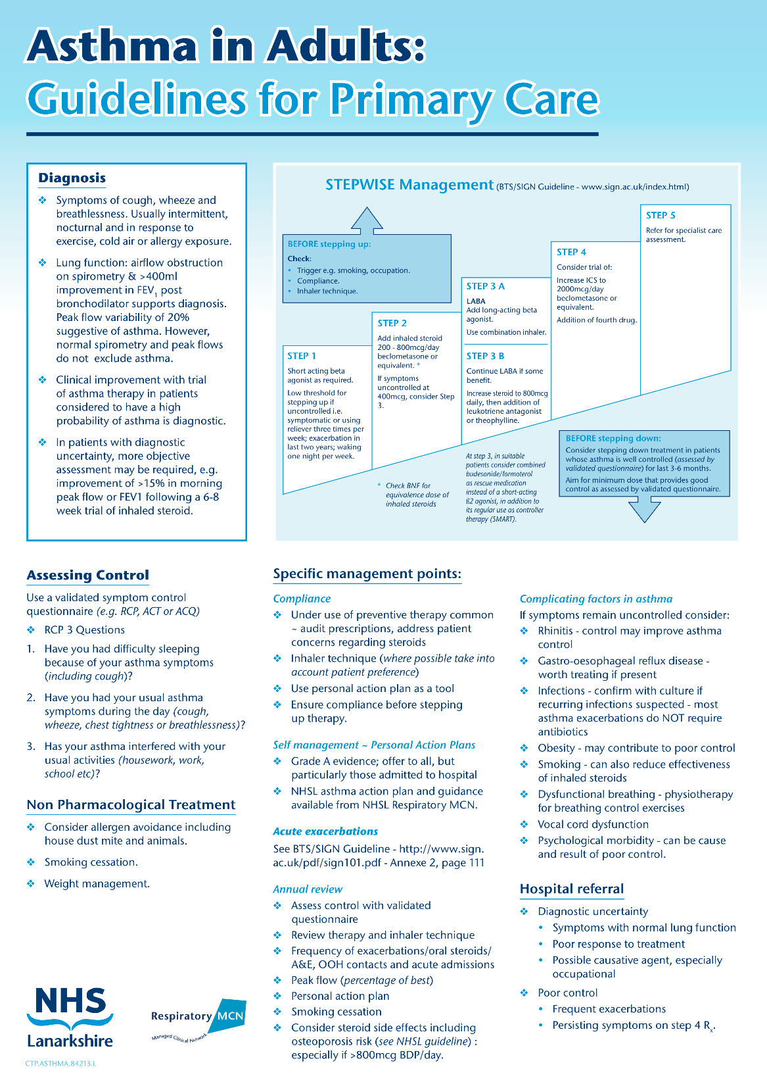
Update on Chronic Asthma Management
Dr Andrew Smith
Consultant Respiratory Physician
Wishaw General Hospital

Slide 2
Disclaimer*
Please note that QUACK is a regional teaching programme operating across GG&C, Lanarkshire and Ayrshire & Arran.
This presentation outlines general management, though local variances e.g. antibiotic prescription may vary slightly depending on your local trust
Remember to check your local guidelines

Slide 3
Outline
Diagnosis
NHSL asthma therapy guidelines
Step-down of asthma therapy
National Review of Asthma Deaths (NRAD) report interspersed

Slide 4
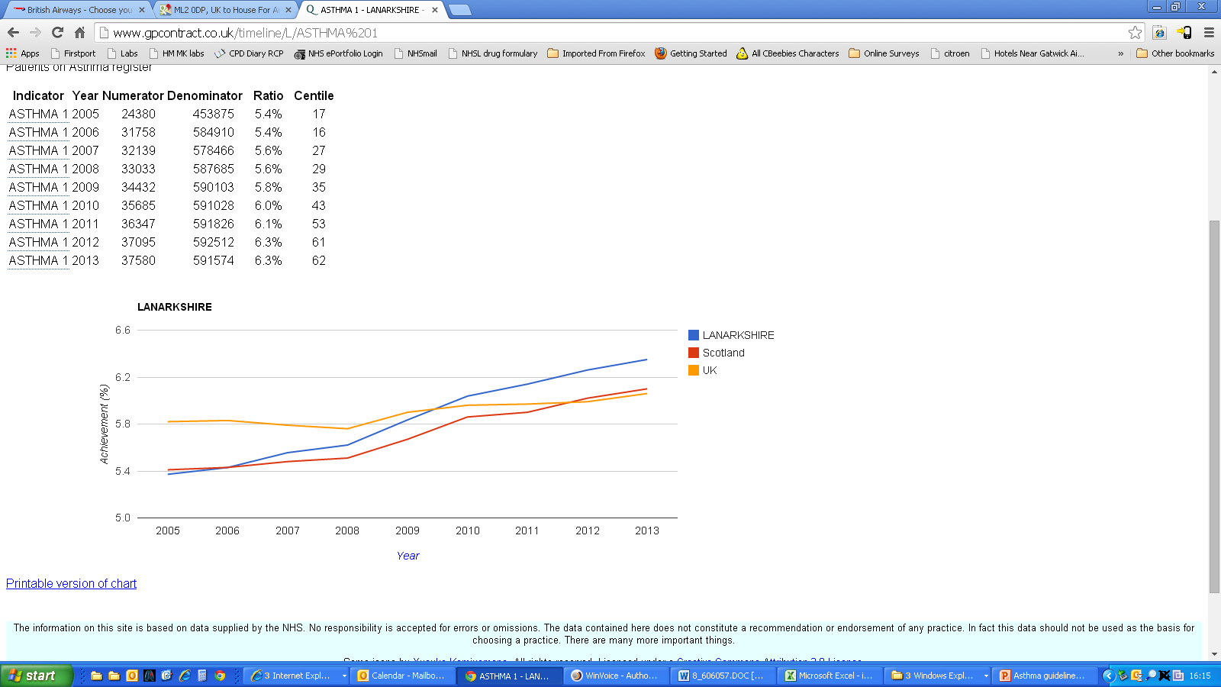
Asthma prevalence
ISD Scotland (May 2014)

Slide 5
Diagnosing asthma
… chronic inflammatory disorder of the airways …
… increase in airway hyper-responsiveness …
… recurrent episodes of respiratory symptoms …
… variable airflow obstruction …
… reversible spontaneously or with treatment.
Global Initiative for Asthma 2012
Notes:
This is the internationally accepted definition of asthma from GINA. I have highlighted only the key phrases Asthma is an INFLAMMATORY DISORDER characterised by INCREASED AIRWAY HYPER-RESPONSIVENESS resulting in VARIABLE AIRFLOW OBSTRUCTION which causes RESPIRATORY SYMPTOMS

Slide 6
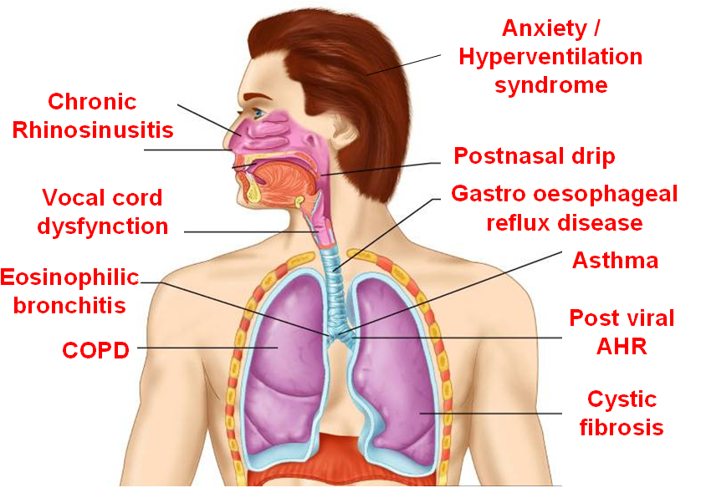
Differential diagnosis of asthma in adults
Inhaled foreign body
Bronchiectasis
Heart failure
Pulmonary fibrosis

Slide 7
Diagnosing asthma – objective measurements
Conventional lung function measurements
  Peak expiratory flows
  Spirometry
  Measurement of airway hyperresponsivess with bronchial challenge tests
Novel / future diagnostic tests
  Measurements of airway inflammation
    Induced sputum cell count
    Exhaled nitric oxide (FE_{NO})

Slide 8
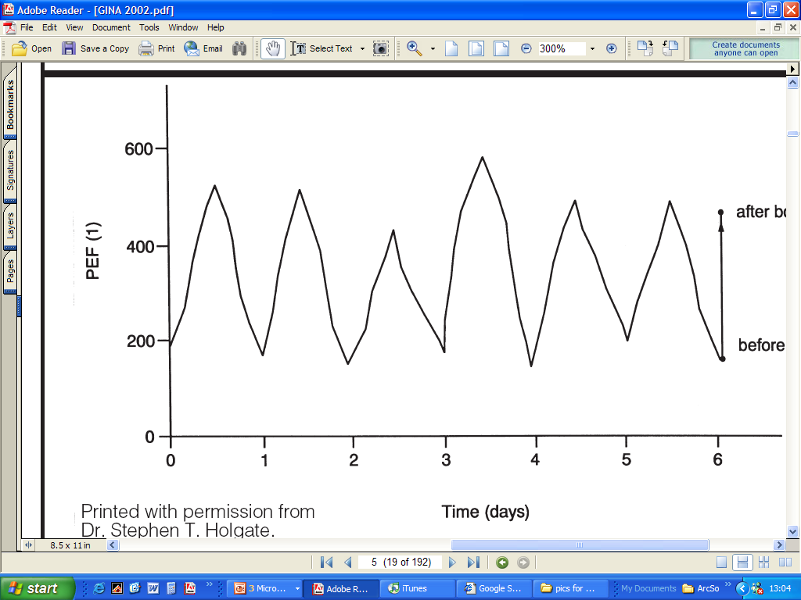
Diurnal peak flow variability
pm
pm
pm
am
am
am

Slide 9
Confirming the presence of airflow obstruction: use of spirometry
litres
NORMAL
OBSTRUCTED
FEV₁
Sensitivity = 35%
Specificity = 100%
1 2 3 4 5 6
seconds
Smith et al. AJRCCM., 2004
Notes:
But spirometry is not a sensitive test. Our data showed that the sensitivity of a low FEV1 FVC ratio was only 35%! i .e. spirometry is abnormal in less than half of all patients with asthma!

Slide 10
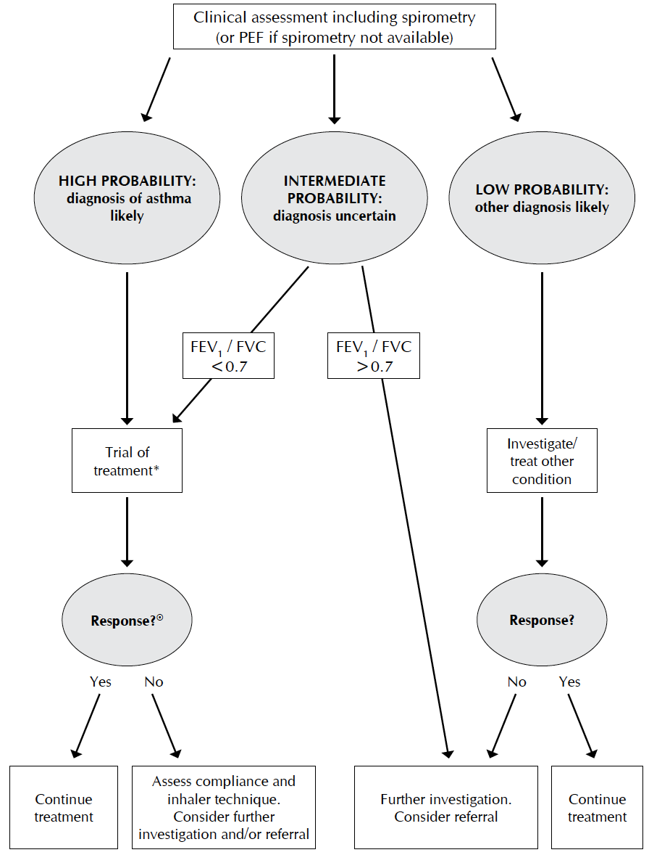
Diagnostic algorithm for adult asthma
SIGN 2012

Slide 11
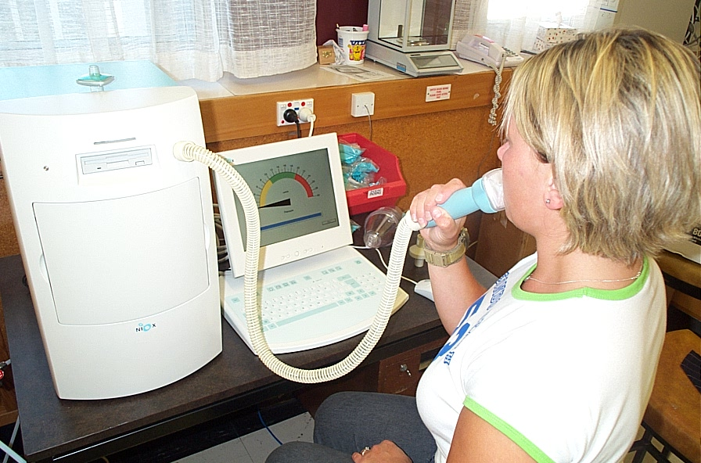

Slide 12
Combined FE_{NO} / spirometry for diagnosing asthma
Test | Sensitivity (%) | Specificity (%) | Positive predictive value (%) | Negative predictive value (%) | Accuracy
FE_{NO} > 33ppb | 69 | 93 | 85 | 84 | 84
FEV₁ < 80% predicted | 29 | 100 | 100 | 71 | 74
One or more of: FE_{NO} > 33ppb FEV₁ < 80% predicted | 94 | 93 | 88 | 96 | 93
Smith et al. Curr.Opin.Allergy Clin.Immunol., 2005

Slide 13
National Review of Asthma Deaths findings – (6,7 & 8 of 17)
Personal asthma action plans, were known to be provided to only 23% of the 195 people who died from asthma.
43% had no evidence of an asthma review in general practice in the last year before death
Exacerbating factors, or triggers, were documented in the records of almost half of patients
  including drugs, viral infections and allergy.
NRAD 2014

Slide 14
NRAD recommendations
– (7,8 & 9 of 19)
All people with asthma should receive a written personal asthma action plan (PAAP) documenting
  their own triggers
  current treatment
  when and how to seek help in an emergency
Structured review at least annually
  People at high risk of severe asthma attacks should be monitored more closely, with review and updating of at each review.
Factors that trigger or exacerbate asthma must be elicited routinely and documented in the medical records and PAAPs of all people with asthma

Slide 15
The Annual review
Symptom score (RCP 3 questions / Asthma control test)
Lung function (spirometry or peak flow)
Exacerbations, oral corticosteroid use and time off work or school since last assessment
Inhaler technique
Adherence
Bronchodilator reliance
Possession of and use of self management plan / personalised asthma action plan
Exposure to tobacco smoke
Growth (height and weight centile)

Slide 16
Self management education and personalised action plans
Structured educational program / discussion
  Nature of disease
  Nature of treatment and how to use it
  Development of self monitoring / assessment skills
  Recognition and management of acute exacerbations
  Appropriate allergen or trigger avoidance
Reinforcement with written personalised action plan
  Symptom vs peak flow triggered
  2-3 action points
  Patients may hold emergency supply of prednisolone

Slide 17
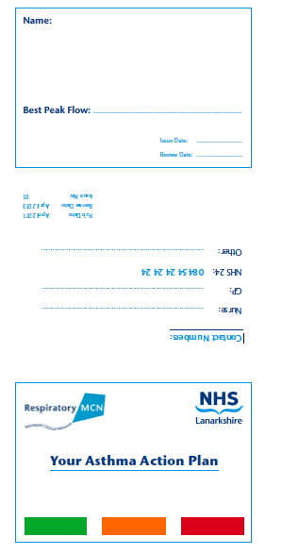
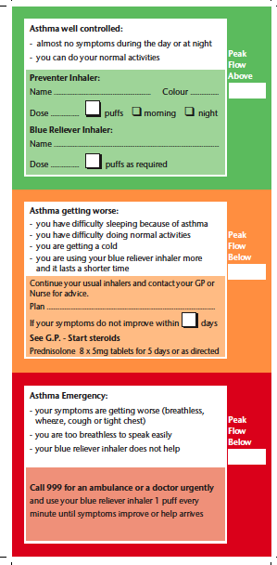

Slide 18
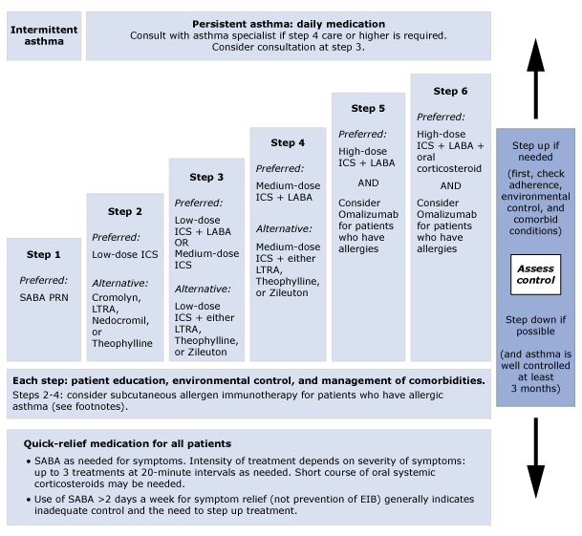

Slide 19
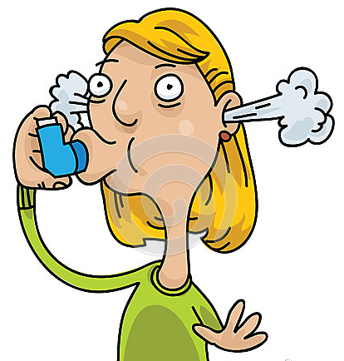

Slide 20
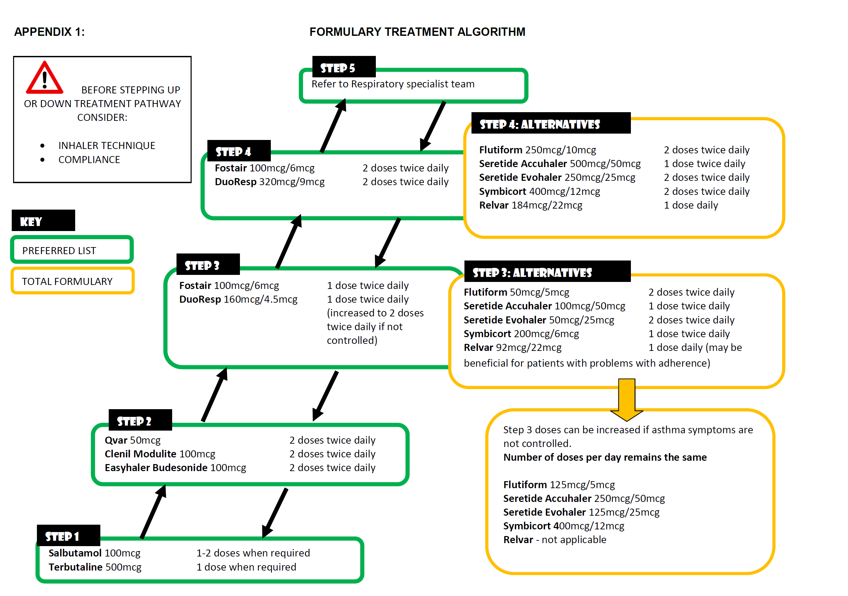
NHSL Inhaler Algorithm

Slide 21
Potential reasons for “asthma symptoms” in adults to be considered prior to increasing ICS dose
(including poor adherence)
Inhaled foreign body
Bronchiectasis
Heart failure
Pulmonary fibrosis
Notes:
So before escalating doses of inhaled steroids/combination ICS/LABA’s, consider alternative explanations for patients apparently uncontrolled asthma symptoms. This would commonly include poor adherence with therapy or poor inhaler technique, but could also be due to other conditions as listed above for example

Slide 22
National Review of Asthma Deaths findings – (11 - 13 of 17)
Excessive prescribing of reliever medication
  39% had been prescribed more than 12 short-acting reliever inhalers in the year before they died,
  4% more than 50 reliever inhalers.
Under-prescribing of preventer medication.
  80% issued with fewer than 12 preventer inhalers in the previous year
  38% were known to have been issued with fewer than four
Inappropriate prescribing of long-acting beta agonist
  14 were prescribed a single-component LABA bronchodilator at the time of death
  3% patients were on LABA monotherapy without inhaled corticosteroid preventer treatment

Slide 23
NRAD recommendations
– (12,14 & 15 of 19)
All asthma patients who have been prescribed more than 12 short-acting reliever inhalers in the previous year should be invited for urgent review.
Non-adherence to preventer inhaled corticosteroids should be continually monitored
  associated with increased risk of poor asthma control
If long acting beta agonist is required, it should always be prescribed as a single combination inhaler with inhaled corticosteroid

Slide 24
Summary
Annual review
  Use validated asthma symptom questionnaire
    ACT / (RCP 3 questions)
  Issue personalized asthma action plan
New asthma management guidelines
  Step-up
    If uncontrolled on low-moderate dose inhaled corticosteroid (ICS), switch to a combination ICS/LABA using the same equivalent dose of ICS
    Consider other reasons for uncontrolled asthma symptoms before increasing the ICS dose, given the marginal gains and greater side effect profile
  Step down
    Consider step-down of inhaled steroid dose (especially combination ICS/LABA) in well controlled asthma patients

Slide 25
Increased FE_{NO} predicts steroid responsiveness in patients with non-specific respiratory symptoms
Composite symptom score
Peak flow (percent change)
FEV₁ (percent change)
PC₂₀ AMP (doubling dose shift)
<15
15-47
Baseline FE_{NO} (ppb)
>47
<15
15-47
>47
Smith et al. AJRCCM, 2005

Slide 26
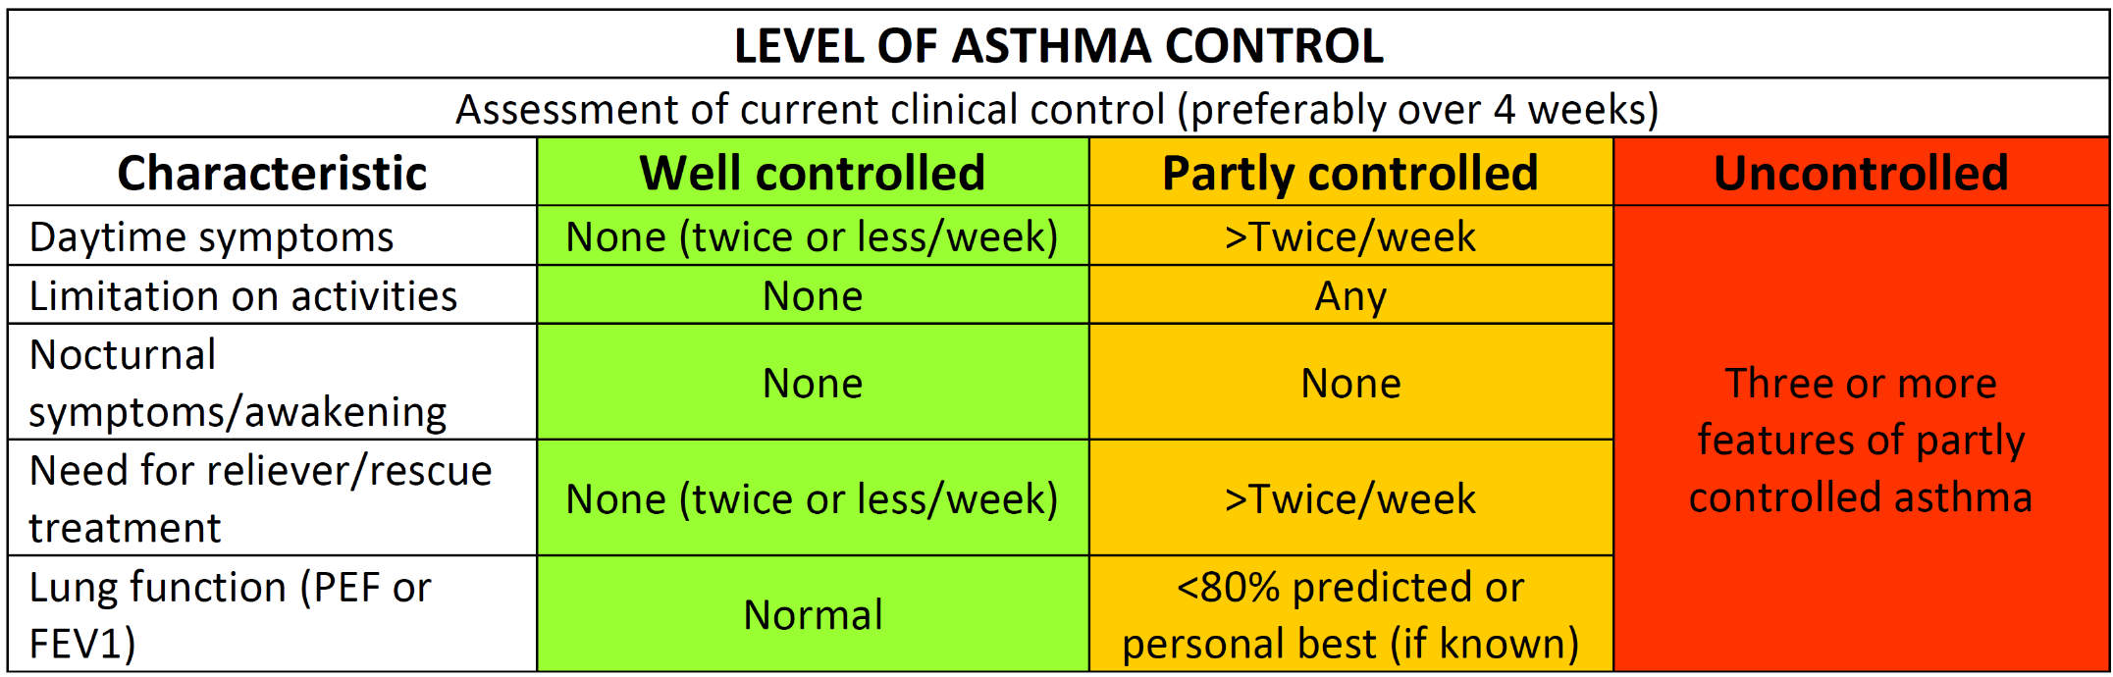

Slide 27
Stepping down combination asthma inhaler therapy: FENO project
Consider in patients who have well controlled asthma for three months or more
50% interval reductions (every 3/12) in the inhaled steroid component
If remain controlled on low dose combination - switch to inhaled steroid alone

Slide 28
Thank you
Please fill out the online survey to obtain a certificate

Slide 29

Get in touch!
Website
www.quackmeded.co.uk
Email
ggc.quackmeded@nhs.scot
Social Media
Twitter: @QUACK_ Med
Facebook: QUACK education

