Slide 1
Weil’s Disease
Gareth Ingram
Acute Medicine Clinical Fellow

Slide 2
Disclaimer*
Please note that QUACK is a regional teaching programme operating across GG&C, Lanarkshire and Ayrshire & Arran.
This presentation outlines general management, though local variances e.g. antibiotic prescription may vary slightly depending on your local trust
Remember to check your local guidelines

Slide 3
Case
28 year old male
GP referral ?Weil’s disease
Originally referred to ID – no beds at present – so directed to medical receiving

Slide 4
History of presenting complaint
Generally unwell
16 day history since events began
  Initial flu like symptoms (off work for a week)
  Started to resolve, went back to work then symptoms began to return
  Reduced oral intake for 48 hours and feverish
  Vomiting for 24 hours, no haematemesis, no bowel upset
  Productive cough of clear sputum, plus an isolated episode of haemoptysis
  Works on a recycling plant – worsening occupational advice

Slide 5
Other history information
PMH
Nasal polyps
Psychiatric history
Generally well
Systemic inquiry
No weight loss
No headaches
No rashes
No cardiac symptoms
DH
Nil regular
No known drug allergies
Social history
Home alone generally, independent
Son and uncle close contacts
Never smoked, alcohol 12 units
Goes to the gym regularly
Works on a recycling plant

Slide 6
Clinical Examination
A –patent, talking in sentences
B – No evidence of SOB, no supplementary O_{2,} left basal creps, no wheeze
C – HS I +II+0, JVP not seen, nil oedema, peripherally warm, regular pulse
D – abdomen soft, no organomegaly, dry mucous membranes
E – alert and orientated, no evidence of jaundice or icteric sclera
Neurologically intact, no gross deficit
General skin survey – no evidence of bites

Slide 7
Bloods and observations
Obs at triage:
Temperature 37.1
Pulse 85bpm
Sats 98% on air
Respiratory rate 16
BP 119/84
Hb 145
WCC 14.0
Neutrophils 11.7
Platelets 169
MCV 88.8
PT 15
APTT 27
CRP 118
Na⁺ 140
K⁺ 4.5
Cl⁻ 105
Urea 4.4
Creatinine 79
eGFR >60
Bilirubin 12
ALT 16
AST 16

Slide 8
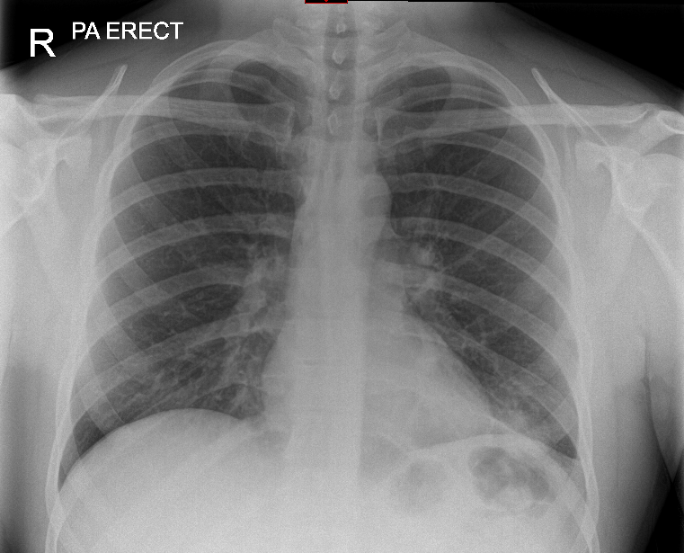
Chest X-ray

Slide 9
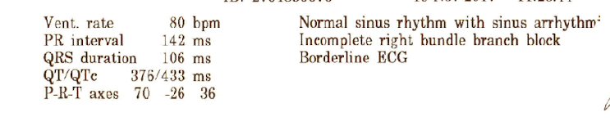

ECG

Slide 10
Initial management
Diagnosed as likely LRTI/CAP following recent viral infection but admitted to exclude leptospirosis
IV benpen and oral clarithromycin
IV fluids whilst reduced oral intake
Admitted to ID Ward

Slide 11
Progress
Day 2 of admission
  Feeling better
  IV fluids discontinued
  Neutrophilia settled, CRP peaked at 166
  Switched to oral doxycycline
  Routine HIV screening
Day 3 of admission
  Remained apyrexial throughout admission
  Discharged home to complete 7 day course of oral antibiotics
  Clinic and CXR as outpatient

Slide 12
Discharge and follow up
Leptospirosis urine antigen negative
2 sets of blood cultures – no growth
HIV negative
Formal CXR report – no evidence of consolidation
6/52 in general ID clinic

Slide 13
Weil’s disease/leptospirosis
Many different names including mud fever and sewerman’s flu
Leptospirosis is an infection caused by spirochetes of the genus Leptospira
It is originally an aquatic organism and its main host is animals including rodents, dogs and cattle
The host animal is usually asymptomatic, but will excrete leptospires in their urine
Transmitted to humans via contact with contaminated water, infected urine or infected animal tissues via abrasions in the skin or via mucous membranes

Slide 14
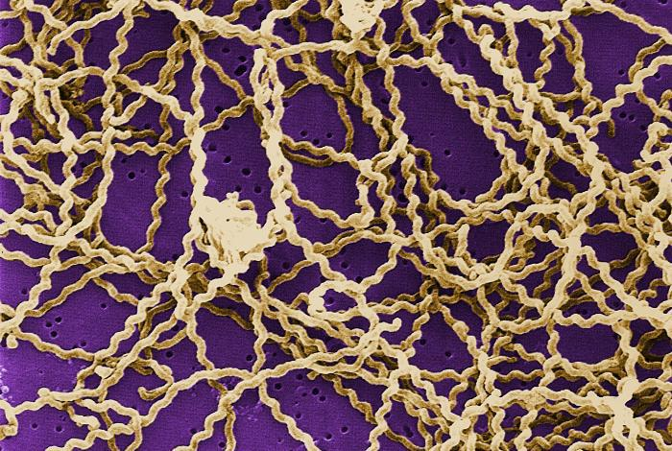
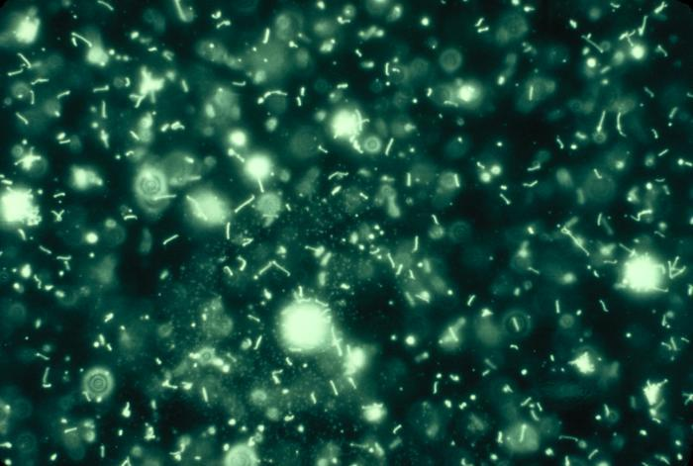
Causative organism
From the genus Leptospira – 21 species
  9 are known pathogenic – leptospira interrogans
  5 uncertain pathogenicity
  7 non-pathogenic
Spiral-shaped, highly motile aerobic spirochetes best visualised via dark field microscopy or fluorescent microscopy

Slide 15
Epidemiology and aetiology
Most widespread zoonosis in the world!
Relatively uncommon in the UK 1 case per million (England PH)
Most common in tropical regions, slums and during rainy seasons
Increasingly more common with water sports and outdoor activities
Potential occupation exposure

Slide 16
Presentation
Has a wide variety of presentations, from subclinical to life-threatening
Has an incubation period of 2-30 days
Often presents as a mild form, with viral like symptoms of malaise, dry cough muscle pain and headache
2 phases of illness
More severe disease is Weil’s which presents with jaundice and can sometimes feature with renal failure and pulmonary haemorrhage and multiorgan failure (5% mortality)

Slide 17
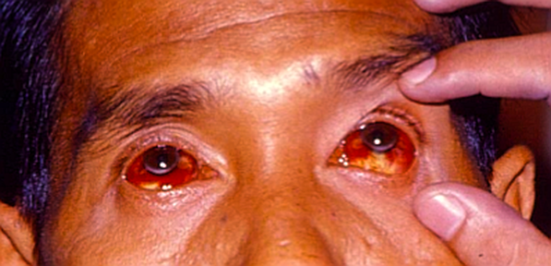
Physical examination
Skin breaks
Conjunctival suffusion 30% in Weil’s disease, often early on during illness
Neck stiffness and signs of meningism
Fever
Jaundice
Anaemia
Hepatosplenomegaly
Rarely acalculous cholecystitis

Slide 18
Diagnosis
Clinical history and examination
Risk factors
Blood cultures – though only positive during early illness
PCR – via urine and blood
  Urine appears more sensitive

Slide 19
Treatment
Supportive if multiorgan failure
Antibiotics
  Doxycylcine
  IV penicillins
    Cochrane review uncertain of clinical significant
    Started before laboratory confirmation
    Found to reduce clinical illness
Steroids
Ophthalmic drops
Brett-Major DM, Coldren R. Antibiotics for leptospirosis. Cochrane Database Syst Rev. 2012 Feb 15. 2:CD008264.

Slide 20
Prevention
Occupational hygiene and protective clothing
No licensed vaccine in the UK– current availability is usually only for a specific serovar
Use of antibiotics in those at risk of short term exposure
Guidugli F, Castro AA, Atallah AN. Antibiotics for preventing leptospirosis. Cochrane Database Syst Rev. 2000. CD001305

Slide 21
Get in touch!
Website
www.quackmeded.co.uk
Email
ggc.quackmeded@nhs.scot
Social Media
Twitter: @QUACK_ Med
Facebook: QUACK education

