Slide 1
Anaemia
Rosie Haddock
Gastro Registrar

Slide 2
Disclaimer*
Please note that QUACK is a regional teaching programme operating across GG&C, Lanarkshire and Ayrshire & Arran.
This presentation outlines general management, though local variances e.g. antibiotic prescription may vary slightly depending on your local trust
Remember to check your local guidelines

Slide 3
Learning Outcomes
Definition of anaemia and how to identify it
Describe difference in macro/normo/microcytic anaemia and causes
Describe common investigations of anaemia and investigations related to specific types of anaemia

Slide 4
Anaemia
Function of Haemoglobin?
  Carry and deliver O2 to tissues from the lung
Anaemia is simply a reduction in the haemoglobin level below the normal range for a population of the same age and sex.

Slide 5
Symptoms?
Depend on rate of fall
  Compensates
Non specific
  Fatigue
  Breathlessness
  Angina if co-existent arterial disease

Slide 6
Signs?
Pale skin/mucous membranes
Tachycardia
Iron deficiency
  Brittle nails/ Koilonychia
  Hair loss
  Angular stomatitis/ glossitis
  Pale skin/mucous membranes

Slide 7
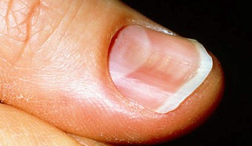

Slide 8
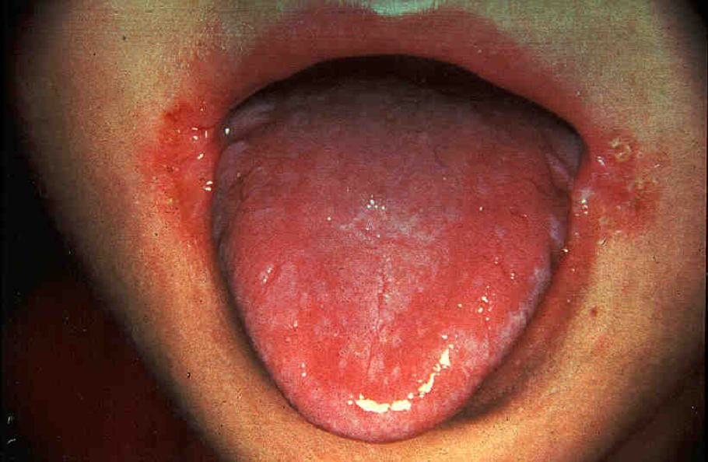

Slide 9
Mean Corpuscle Volume important clue to pathophysiology
LOW MCV - indicates that haemoglobin synthesis is impaired from a number of possible causes.- low HB content in RBC
HIGH MCV - indicates that DNA synthesis is impaired or that there is an increase in the RBC membrane.
NORMAL MCV - suggests other causes underproduction, haemolysis or acute blood loss

Slide 10
Microcytic anaemia
Small red cells (<80fl)
Iron deficiency: MOST COMMON the cause of which must always be determined.
Anaemia of chronic disease
Thalassaemia
Sideroblastic anaemia

Slide 11
Iron Deficiency
Iron absorbed in duodenum
Transported bound to transferrin
Causes?
  Blood loss – most common
    Premenopausal women!
  Reduced absorption
  Increased demands
    Growth, pregnancy, exercise
  Poor intake

Slide 12
Investigations?
FBC
  Low Hb and low MCV
Blood film- RBC hypochromic
Serum Ferritin, transferrin and transferrin saturations.
Upper and lower GI endoscopy
Coeliac
? Bone Marrow

Slide 13
Management
Treat cause
Iron replacement
  Oral – Ferrous Fumerate 210mg TDS for 3 months
  Parenteral- If not absorbed orally

Slide 14
Case 1
A 50 year old man presents with fatigue and change in bowel habit
Hb 105 MCV 78
Blood film shows hypochronic microcytic anaemia
What is your approach to history and examination?
What investigations might you undertake?

Slide 15
Red flag symptoms
FH malignancy
Chronic inflammatory diseases
PR exam
Investigations?

Slide 16
Ferritin 8 (15-200)
Transferrin - normal
Transferrin saturations 10% (20-55%)
Endoscopy/colonoscopy

Slide 17
Case 2
25 year old pregnant women who is found to have a low Hb on first antenatal visit
Hb 10.7
MCV 64
Plx 202
WCC 7.2
What diagnosis do you consider?

Slide 18
Thalassamia
Haemoglobinopathy
Normal adult Hb is made up of haem and 2 polypeptide chains – α and β
Genetic defect resulting in reduced rate of production of one of globin chain
Haemolysis/ early red cell death

Slide 19
Haemoglobin electrophoresis, increase in HbF and reduced HbA(normal haemoglobin)
Different forms depending on if homo/heterozygous
Repeated blood transfusions
  Leads to excess iron deposition

Slide 20
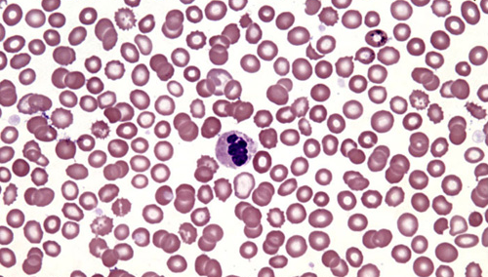

Slide 21
Normocytic anaemia
Acute blood loss
Anaemia of chronic disease
Aplastic anaemia
Haemolytic anaemia
Endocrine disorders

Slide 22
Macrocytic anaemia
Megaloblastic or non Megaloblastic
Megaloblastic- defective DNA synthesis.
Causes?
  B12
  Folate
Non megalobblastic- haemolysis, myelodysplasia, chemotherapy

Slide 23
B12 deficiency
Necessary to synthesise DNA
Binds to intrinsic factor to be absorbed in the terminal ileum.
Causes?
  Low dietary intake
  Impaired absorption
    Pernicious anaemia
    Coeliac
    Ileal disease or resection- Crohn’s disease

Slide 24
Investigations?
FBC Hb low MCV >98
Blood film- macrocytic anamia. Severe- pancytopenia
Autoantibodies
  Intrinsic factor
  Parietal cell (in stomach, secrete IF)
  Coeliac screen

Slide 25
Management
IM hydroxycobalamin 1mg alternate days for 3 weeks
Then 3 monthly after that

Slide 26
Folate deficiency
Poor intake
Malabsorption
Excess utilisation
  Pregnancy, lactation
  Dialysis
  Haematological malignancy
Drugs- Methotrexate

Slide 27
Case 3
36 year old woman with a history of tiredness and loose bowel motions.
Hb 8 g/dL MCV 110
What is most likely cause of raised MCV?
What investigations would you do?

Slide 28
Haemolytic anaemia
Increased destruction of red cells
Normal life span 120 days
Extra or intravascular
Causes?

Slide 29
Causes
Inherited
Hereditary spherocytosis
Hb abnormalities
Red cell metabolic defects
Acquired
Immune
  Autoimmune
  Transfusion reaction
  Drugs
Non immune
Infections
Drugs
Hypersplenism

Slide 30
Clinical features
Jaundice
Splenomegaly
Gallstones

Slide 31
Investigations
FBC
Haptoglobins
Unconjugated bilirubin
Coombs test
Find cause

Slide 32
Get in touch!
Website
www.quackmeded.co.uk
Email
ggc.quackmeded@nhs.scot
Social Media
Twitter: @QUACK_ Med
Facebook: QUACK education

