Slide 1



HHS
(Hyperosmolar Hyperglycaemic State)
For ADULT patients
Principles of Management
&
HHS Care Pathway
Slide-set produced by Diabetes MCN Inpatient Subgroup

Slide 2


Slide 3
Features of HHS
Usually in elderly patients with type 2 diabetes (can be first presentation of diabetes)
Can take days (or weeks) to evolve
Severe dehydration is predominant clinical presentation
Ketosis or ketoacidosis can complicate HHS
Mortality is high (15-20%) reflecting age and comorbidity, but also iatrogenic component

Slide 4
Clinical presentation
HHS v DKA
 | HHS | DKA
Age | Usually older | Usually younger
Volume depletion | 10-20% | 5-10%
Duration of onset | Days to weeks | Hours to days
Endogenous insulin | Usually present | Absent
Ketoacidosis | Absent / mild | Mild / Mod / Severe

Slide 5
Why is HHS mortality double that of DKA?
Older age and increased co-morbidity (eg cerebrovascular, coronary and chronic renal disease)
Hypercoagulable state secondary to severe dehydration
Iatrogenic cerebral oedema and central pontine myelinolysis from rapid correction of serum osmolality

Slide 6
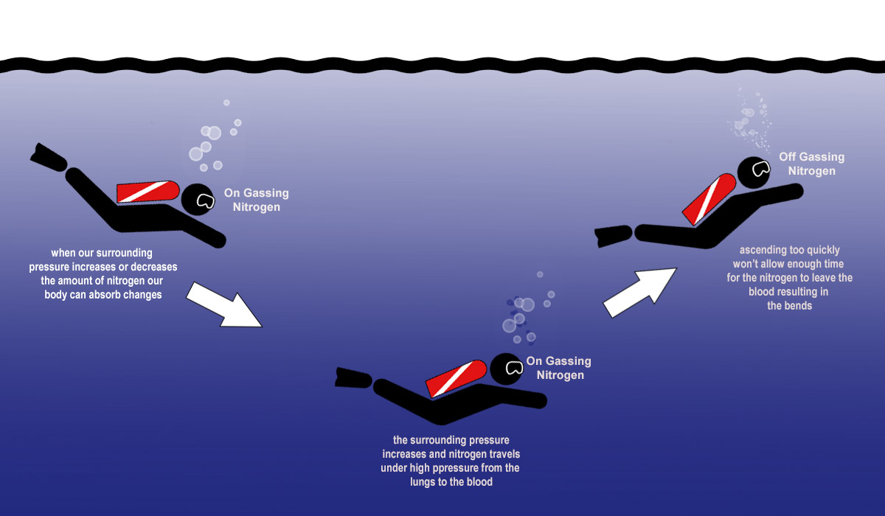
Analogy of ‘The Bends’

Slide 7
Principles of management
HHS v DKA
HHS has slower onset than DKA, usually with no urgent need to clear ketoacidosis, and occurs in patients with brains at higher risk of injury by rapid shifts in sodium and glucose
THEREFORE: HHS requires less aggressive fluid resuscitation and glucose-lowering strategies than DKA, with target rate of reduction of osmolality: 3-8 mOsm/kg/hr

Slide 8
Ideal first 24 hours for non-ketotic HHS Rx
388
Osmolality
58
Sodium
311
150
Glucose
IV 0.9% Saline
142
FRIII
22
Urea
10
9
0
hours
24

Slide 9
HHS guideline
This NHSGGC Guideline and Care Pathway has been based on the Joint British Diabetes Societies (Inpatient Care Group) Guideline (2012), available to download at: https://abcd.care/sites/abcd.care/files/resources/JBDS_IP_HHS_Adults.pdf
The complex pathophysiology and management of HHS means that level 2 care is usually most appropriate, with early input from specialist inpatient diabetes teams.

Slide 10
HEADLINE CONCEPTS 1
CORRECT DIAGNOSIS?
Differentiating HHS from DKA is more problematic in context of severe intercurrent illness due to increased ketosis (eg SGLT2i, fasting ketosis) and non-ketotic metabolic acidosis (eg AKI).
If predominant diagnosis unclear (HHS v DKA v both), then seek early specialist input to help tailor protocol to individual patient need.

Slide 11
HEADLINE CONCEPTS 2
APPROPRIATE IV FLUIDS?
Use intravenous (IV) 0.9% sodium chloride to restore circulating volume and reverse dehydration (NB total body sodium is significantly deplete).
Only switch to 0.45% sodium chloride solution if the osmolality is not declining (<3 mOsm/kg/hr)despite adequate positive fluid balance.
An initial rise in sodium is expected (reversal of relative pseudohyponatraemia in context of hyperglycaemia) and is not itself an indication for hypotonic fluids.
The rate of fall of plasma sodium should not exceed 10 mmol/L in 24 hours.
Aim for 2-3 litres positive balance in first 3-6 hours and 3-6 litres positive balance in first 6-12 hours
Consider less aggressive fluid resuscitation in context of heart failure and oliguric renal failure.

Slide 12
HEADLINE CONCEPTS 3
INSULIN – WHEN AND WHAT RATE?
The fall in blood glucose should be no more than 5 mmol/L/hr (so that serum osmolality doesn’t fall too quickly). Low dose IV insulin should only be commenced:
EITHER once the blood glucose level plateaus with IV fluids alone
OR immediately if there is significant ketosis (blood ketones > 1.5 or urine ketones greater than ‘+’
SEE APPENDIX A

Slide 13
APPENDIX A
Scenario 1 – HHS and CBK <1.5 (UK – or +)
Do not start FRIII immediately
Continue to monitor BG during IV fluid replacement (use laboratory venous BG if CBG ‘>28’ or ‘hi’)
If BG plateaus, commence FRIII at rate of 0.05 units/kg/hr (correct to nearest whole unit), aiming for target CBG 10-15

Slide 14
APPENDIX A
Scenario 2 – HHS and CBK >1.5 (UK >+) and [H⁺] <50
Start FRIII immediately at rate of 0.05 units/kg/hr (correct to nearest whole unit)
Repeat BG (use laboratory venous BG if CBG ‘>28’ or ‘hi’) and CBK at hourly intervals
If BG decreasing too quickly (> 5mmol/l/hr), reduce FRIII rate by 50%
Repeat BG and CBK regularly and, if necessary, adjust insulin rate to ensure both ketones are clearing and glucose is falling in a controlled manner, aiming for target CBG 10-15

Slide 15
APPENDIX A
Scenario 3 – HHS and CBK >1.5 (UK >+) and [H⁺] >50
Start FRIII immediately at rate of 6 units/hr (or 0.05 units/kg/hr, if weight >120kg - correct to nearest whole unit)
Continue to monitor BG, CBK and [H⁺] regularly and adjust insulin rate as required (be guided by insulin adjustment principles from the ‘DKA protocol’), aiming for target CBG 10-15

Slide 16
HEADLINE CONCEPTS 4
TREATMENT TARGETS
If IV fluids and insulin are managed as above, serum osmolality should fall within the target range of 3-8 mOsm/kg/hr. Ideally, laboratory-measured osmolality should be used, but calculated osmolality is adequate surrogate: 2(Na⁺ + K⁺) + glucose + urea.
Failure to achieve this target increases risk of neurological complications such as cerebral oedema and pontine myelinolysis.

Slide 17
HEADLINE CONCEPTS 5
OTHER ISSUES?
Remember also to:
correct other electrolyte deficiencies eg [Mg⁺⁺], [K⁺], [Ca⁺⁺], [PO₄³⁻]
prescribe prophylactic anticoagulation
investigate for and treat intercurrent illness eg sepsis
risk assess for pressure ulceration, especially in context of peripheral sensory neuropathy.

Slide 18
Ideal first 24 hours for non-ketotic HHS Rx
388
Osmolality
58
Sodium
311
150
Glucose
IV 0.9% Saline
142
FRIII
22
Urea
10
9
0
hours
24

Slide 19
HHS CHARTING - VIDEO
youtube.com/watch?v=uzt2Wzsq7tU

Slide 20


