Slide 1
CKD, AKI & Hyperkalaemia
Gemma McGrory
Clinical Teaching Fellow

Slide 2
Disclaimer*
Please note that QUACK is a regional teaching programme operating across GG&C, Lanarkshire and Ayrshire & Arran.
This presentation outlines general management, though local variances e.g. antibiotic prescription may vary slightly depending on your local trust
Remember to check your local guidelines

Slide 3
Learning Objectives
Revise kidney function
Discuss what U&Es are
Review stages of CKD
Discuss Acute Kidney Injury (AKI) using cases
Revise clinical presentation and management of hyperkalaemia
Discuss Renal Replacement Therapy (RRT) and indications for acute haemodialysis

Slide 4
Kidney Function
What do the kidneys do?

Slide 5
Kidney Function
What do the kidneys do?
  Eliminate waste products of metabolism and some drugs
  Electrolyte balance
  Acid base balance
  Fluid balance and BP control (renin, angiotensin)
  Endocrine function – EPO, Vitamin D

Slide 6
Determining Renal Function
Glomerular filtration rate
Tubular function (Na and K handling and urinary concentrating / diluting capacity)
Acid base balance (how much H+ is reabsorbed)
Endocrine function
  Renin angiotensin
  EPO production
  Vitamin D metabolism

Slide 7
U&Es
What comprises a set of U&Es?

Slide 8
U&Es
Sodium (Na+)
Potassium (K+)
Chloride (Cl-)
Urea (Ur)
Creatinine (Cr)
eGFR
+- Bicarbonate (Bic)

Slide 9
GFR
Glomerular filtrate = ultrafiltrate of plasma that crosses the glomerular barrier into urinary space
GFR measured in unit time and represents the sum of filtration of all functioning nephrons
  Creatinine / eGFR
eGFR useful for:
  Providing a consistent measure of renal function
  Monitoring progression of CKD
  Forecast the need for RRT
  Determining renal dose reduction for medication

Slide 10
Creatinine
Indirect measure GFR, convenient, cheap
Generated from non enzymatic metabolism of creatine in skeletal muscle
Production is proportional to muscle mass
Little short term variation in an individual
25% derived from dietary meat intake
Varies inversely with GFR
Problems with estimating in bodybuilders, the elderly or underweight

Slide 11
Urea
Synthesized in liver as a means of ammonia excretion
Rate of production not constant
Inverse relationship with GFR
High Urea | Low Urea
High dietary protein intake | Low protein intake
GI Bleeding | Pregnancy
Catabolic states: Haemorrhage; Trauma; Steroids | Liver Disease
Tetracycline Abx

Slide 12
Chronic Kidney Disease
What is CKD?
What are the causes of CKD?

Slide 13
Chronic Kidney Disease
What is CKD?
  Chronic renal failure of varying degrees
  Affects 1 in 10 people
  Almost half of those over 75
  Common causes
    Diabetes
    Hypertension
    Age
  Less common causes
    Glomerulonephritis
    Renal artery stenosis
    Polycystic kidney disease
    Ureteric reflux
    Repeated UTIs

Slide 14
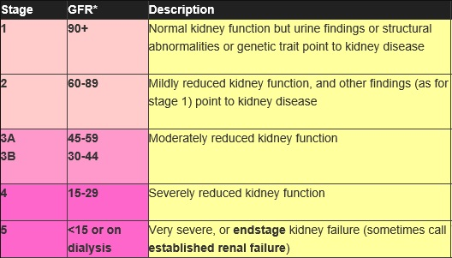

Slide 15
Clinical Signs of CKD
Often none
Picked up on routine testing
Anaemia due to reduced EPO (Stage III and later)
Secondary / tertiary hyperparathyroidism
Symptoms usually occur when Stage IV-V (pre-dialysis)
  Fluid retention
  Nausea
  Cramps
  Itch
  Weight loss / poor appetite

Slide 16
Treatment of CKD
Treat the underlying cause
Good BP control
Good diabetes control
Treat anaemia
Treat proteinuria (ACE-I)
Avoid nephrotoxins
Sometimes supportive and prepare for renal replacement therapy (more in a minute...)

Slide 17
Acute Kidney Injury
Acute Kidney Injury (AKI) is defined as “a rapid reduction in kidney function resulting in a failure to maintain fluid, electrolyte and acid-base homoeostasis”
Affects ~10% of inpatients
AKI staging
Appreciation that small rises in serum creatinine can have detrimental effects
  Increased mortality / morbidity / CKD
  Longer inpatient stay

Slide 18
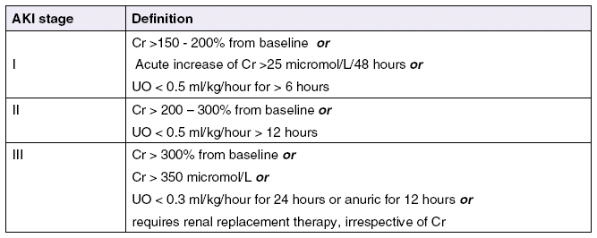
AKI Staging

Slide 19
For example
 | Patient 1 | Patient 2
Baseline | 50 | 150
AKI Stage I | 75 | 175
AKI Stage II | 100 | 300
AKI Stage III | 150 | 450

Slide 20
Causes of AKI
Pre renal
Renal
Post renal

Slide 21
Pre-renal AKI
SHOCK
  Hypotension, Hypovolaemia, Hypoperfusion, Hypoxia
Sepsis
Drugs, toxins
If sufficiently severe and/or prolonged, acute tubular necrosis (ATN) occurs – may take days to weeks to recover

Slide 22
Post Renal AKI
In the lumen
  Stones
In the wall
  Tumour
Outside the wall
  External compression

Slide 23
Renal AKI
The weird and the wonderful
  Glomerulonephritis (Glomeruli)
  Tubulointerstital nephritis (Tubules)
  Vasculitis (Blood vessels)

Slide 24
Some Cases...

Slide 25
Case 1
76 year old lady
Asked to review on ward 3 days post hemi-arthroplasty following fall at home and associated prolonged lie (>12 hours)
 | Day of Admission | Day 3
Na (135-145) | 148 | 140
K (3.5 – 5.0) | 3.6 | 3.8
Ur (<8) | 8 | 11
Cr (60 – 120) | 95 | 220
eGFR (>60) | 53 | 20

Slide 26
Questions
What else do you need to know?
What is the cause of her AKI?
What are you going to do about it?

Slide 27
What else you need to know
Is she passing urine?
Is she well?
Is her potassium safe?
Are there signs of fluid overload?
What is her CK? (prolonged lie on floor = rhabdomyolysis)

Slide 28
Question
How do you know this is AKI and not chronic kidney disease (CKD)?

Slide 29
Question
How do you know this is AKI and not chronic kidney disease (CKD)?
  Anaemia (EPO)
  Low Ca+ and high Phos suggest impaired Vitamin D metabolism
  Small kidneys on USS
  History from patient / notes
  Look back through bloods to establish accurate baseline

Slide 30
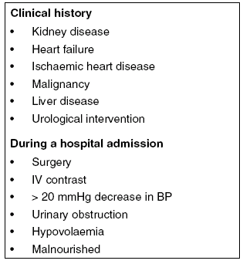
AKI Risk Factors

Slide 31
Nephrotoxins
ACE-I / ARBs
Diuretics
NSAIDs
IV Contrast
Antibiotics
  Penicillins
  Vancomycin
  Gentamicin
  Trimtheoprim

Slide 32
Investigations
U&Es, Bone profile, Bicarbonate
US Renal tract
Urine dip
uPCR and MSSU
Exclude infection
Fluid balance (CXR, catheter)
Consider the weird and the wonderful
  Proteinuria, haematuria and funny symptoms
  Glomerulonephritis, Vasculitis etc
  ANA, ANCA, Anti-GMB, C3/C4, Myeloma screen

Slide 33
Nephrotic Syndrome
Nephritic Syndrome
Proteinuria
  <3g day in urine (frothy)
Hypoalbuminaemia
  <30g/dl
Oedema
  Loss of protein oncotic effect; increased salt ad water retention
Hypercholesterolaemia
  Liver makes more cholesterol (linked to compensatory mechanism for low albumin)
Causes
  Membranous GN (idiopathic; can be related to melignancy or Hep B)
  Diabetic glomerulosclerosis
  Amyloid
Proteinuria
Haematuria
Hypertension
Oliguria
Causes
  IgA nephropathy
  Post streptococcal
  SLE nephritis

Slide 34
Case 2
A 45 year old man attends clinic
Renal deterioration noted by GP
USS showed multiple cysts on both kidneys
Sister required dialysis for renal failure
 | Baseline | Clinic
Na (135-145) | 135 | 137
K (3.5 – 5.0) | 3.6 | 4.0
Ur (<8) | 6.1 | 6.9
Cr (60 – 120) | 54 | 125
eGFR (>60) | >60 (152) | 58

Slide 35
Diagnosis?

Slide 36
APKD
Adult Polycystic Kidney Disease
Autosomal Dominant
Clinical presentation
  Abdominal pain
  Haematuria
  UTIs
  Hypertension
  Renal Failure
Associations
  Liver or pancreatic cysts
  Berry aneurysms (SAH)
  Mitral valve prolapse

Slide 37
Case 3
95 year old man with known prostatic cancer
Presents to A&E with acute abdominal pain
Unable to pass urine
Cause of AKI? What about his bloods?
 | Baseline | A&E
Na (135-145) | 138 | 139
K (3.5 – 5.0) | 3.6 | 6.3
Ur (<8) | 6.1 | 7.2
Cr (60 – 120) | 67 | 1034
eGFR (>60) | >60 (102) | 4
Bic (20 – 30) | 20 | 8

Slide 38
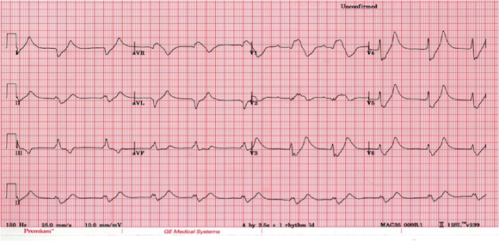

Slide 39
ECG Changes of Hyperkalaemia
Tall tended T waves
Flattened P waves
Prolonged PR interval
(1st degree heart block)
Progressively widened QRS
Sine wave pattern
VF
Increasing K+

Slide 40
Hyperkalaemia
Causes
  Renal Failure
  Drugs (ACE-I, K+ sparing diuretics, spironolactone)
  Potassium supplements
  Hypovolaemia
  Acidosis
  Addison’s (low Na, high K)

Slide 41
Management
K+ 5.5 – 6.5
  Oral calcium resonium 15g tds with lactulose
K+ 6.5 or greater, or ECG changes
  10ml 10% calcium gluconate (6.8mmol Ca) protects the heart
    Peak effect in minutes, lasts 1 hour
  10 units actrapid in 50mls 50% dextrose moves K+ into the cells
    Peak effect 15-20 mins, last 2-4 hours
  Salbutamol nebulisers (need a lot for small effect)
  Sodium bicarbonate (under senior / renal advice)

Slide 42
Our Case...
Hyperkalaemia not coming down with medical management – what next?
 | Baseline | A&E | 6 hours later
Na (135-145) | 138 | 139 | 138
K (3.5 – 5.0) | 3.6 | 6.3 | 6.5
Ur (<8) | 6.1 | 7.2 | 7.3
Cr (60 – 120) | 67 | 1034 | 1046
eGFR (>60) | >60 (102) | 4 | 4
Bic (20 – 30) | 20 | 8 | 6

Slide 43
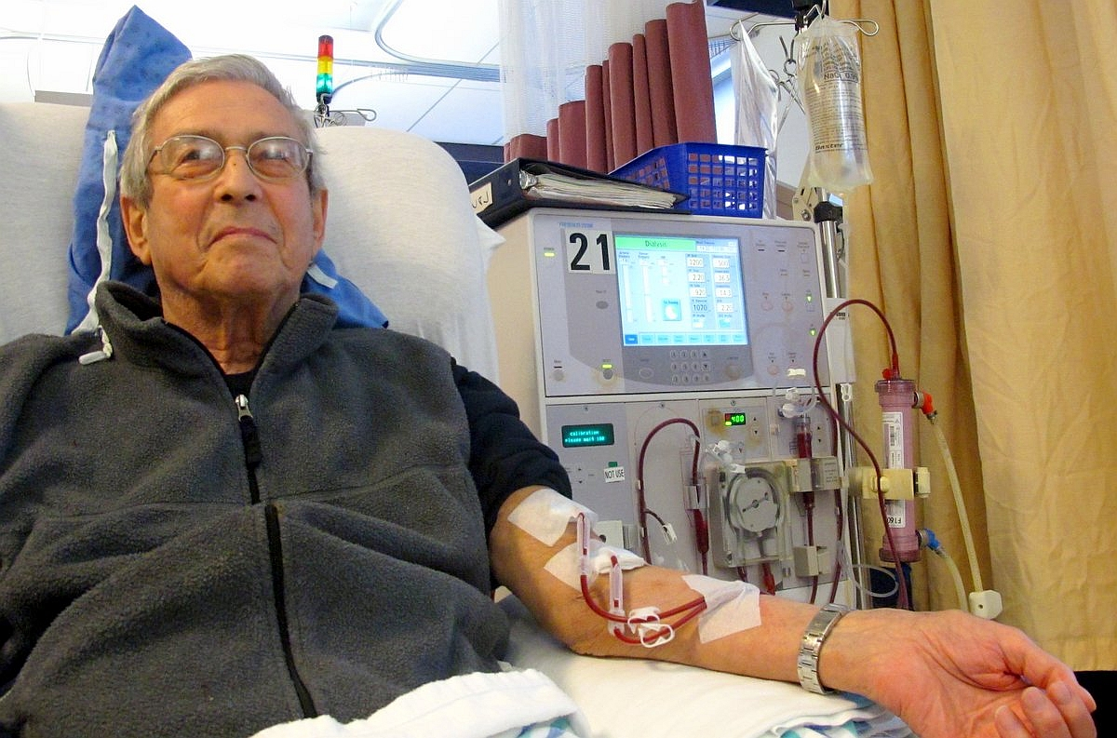
Renal Replacement Therapy
Haemodialysis
(Peritoneal dialysis)
(Renal transplantation)

Slide 44
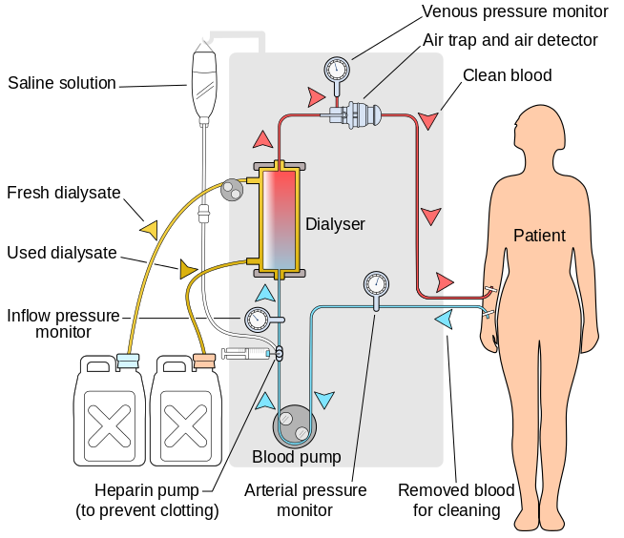

Slide 45
Indications Acute RRT
Severe hyperkalaemia
Fluid overload (pulmonary oedema)
Severe acidosis
Uraemia leading to encephalopathy or pericarditis

Slide 46
Summary
Revise kidney function
Discuss what U&Es are
Review stages of CKD
Discuss Acute Kidney Injury (AKI) using cases
Revise clinical presentation and management of hyperkalaemia
Discuss Renal Replacement Therapy (RRT) and indication for acute haemodialysis

Slide 47
Thank you
Please fill out feedback via the survey monkey link
https://www.surveymonkey.co.uk/r/XWHL5XK

Slide 48
Get in touch!
Website
www.quackmeded.co.uk
Email
ggc.quackmeded@nhs.scot
Social Media
Twitter: @QUACK_ Med
Facebook: QUACK education

