Slide 1
Management of Alcohol Withdrawal
Dr Christopher Brown
Consultant AIM

Slide 2
Disclaimer*
Please note that QUACK is a regional teaching programme operating across GG&C, Lanarkshire and Ayrshire & Arran.
This presentation outlines general management, though local variances e.g. antibiotic prescription may vary slightly depending on your local trust
Remember to check your local guidelines

Slide 3
Objectives
Describe the different types of alcohol withdrawal
Recognize the symptoms of alcohol withdrawal
Review the management of alcohol withdrawal

Slide 4
Relevance
Problem drinking associated with increased morbidity and mortality
250,000 self report features of alcohol dependence
16,000 report severe symptoms
Increased numbers of ED attendances
Widespread throughout all IP specialty wards
15% of pts in primary care have either an alcohol-related health problem or “at-risk” pattern of alcohol use
Notes:
“At-risk” drinking for men is >4drinks/sitting or14 drinks/wk. For women, >7 drinks/wk or >3/sitting. Equates to amt of alcohol that puts a person “at-risk” for health consequences related to drinking.

Slide 5
Spectrum of EtOH withdrawal
Mild withdrawal
Withdrawal-associated seizures
Alcoholic Hallucinosis
Alcohol Withdrawal Delirium (aka Delerium Tremens)

Slide 6
Alcohol Withdrawal Pathophysiology
GABA receptors have binding site for EtOH
  EtOH induces an insensitivity to GABA
  More EtOH needed to maintain inhibitory tone
EtOH inhibits glutamate-induced excitation
Withdrawal occurs w/ abrupt cessation after prolonged exposure (not a binge)
Leads to over-activity of CNS

Slide 7
Mild EtOH Withdrawal
6-8hrs after stopping drinking
Resolves in 1-2 days
CNS overactivity
  Insomnia, anxiety
  Tremulousness
  Diaphoresis
  GI upset
  Headaches

Slide 8
Withdrawal-associated Seizures
Occurs 12-48hr after last drink (can occur as soon as 2hr!)
Generalized tonic-clonic classically
Usually single seizure (but may be several clustered over short time)
Status epilepticus NOT consistent usually
If untreated, approx 30% will progress to DTs

Slide 9
Alcoholic Hallucinosis
These are the hallucinations that precede DTs
Develops >12hr after cessation
Resolves within 48hr
Hallucinations principal symptom
Usually visual (but can be tactile or auditory)
Not part of DTs in context of normal vital signs and sensorium otherwise
Often have insight

Slide 10
Alcohol Withdrawal Delirium
Symptoms
Risk factors
Timing
Prognosis

Slide 11
Diagnostic Criteria for Alcohol Withdrawal Delirium (AWD)
Disturbance of consciousness, with reduced ability to focus, sustain, or shift attention
Change in cognition or development of perceptual disturbance that is not better accounted for by pre-existing dementia
Develops in short period and tends to fluctuate throughout day
Evidence that symptoms developed during or shortly after a withdrawal syndrome

Slide 12
Symptoms of AWD
Agitation
Disorientation
Hallucinations
Autonomic instability
  Tachycardia
  HTN
  Hyperthermia
  Diaphoresis

Slide 13
Alcohol Withdrawal Delirium
Occurs in ~5% of patients who experience alcohol withdrawal
Occurs 2-4 days after last drink and lasts 1-5 days (average of 2-3 days).
Be vigilant for a concurrent illness that may precipitate DTs
  Infection (chest/urine/CNS), pancreatitis, OH hepatitis, GI bleed, cardiac ischemia…

Slide 14
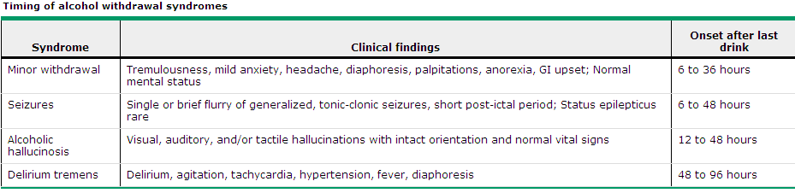
Timing of Withdrawal
UpToDate, 08/2018

Slide 15
Mortality
Mortality is ~5%
Increased by older age, coexisting lung or liver disease, and temperature >39 C
Death due to arrhythmia, complicating illness, or failure to recognize triggering illness
Notes:
Parentheses are most common causes

Slide 16
Risk Factors for AWD
History of Previous DTs
Age >30 yr
Presence of concurrent illness
Sustained drinking
Experiencing EtOH withdrawal in presence of “elevated” alcohol level
Longer period since last drink (developing withdrawal >2 days since last drink)

Slide 17
Associated Biochemistry
Dehydration (increased losses)
Hypokalemia (renal and extrarenal losses)
Hypomagnesemia (increases risk for seizures and arrhythmias)
Hypophosphatemia (increases risk for rhabdomyolysis and cardiac failure)

Slide 18
Management of EtOH Withdrawal
Evaluate for other conditions
  Bloods for metabolic causes
  Consider CTB or LP for intracranial causes
  Consider GI bleed
Supportive care
Medications

Slide 19
Supportive Care for DTs
Replace volume deficits w/ isotonic fluids
Aggressively correct abnormal K⁺, Mg²⁺, PO₄⁻, and glucose
Thiamine IV – Pabrinex
Antipyretic
Antiemetic
Analgesia

Slide 20
Overview of Treatment
Benzodiazepines are current mainstay of EtOH withdrawal treatment
  6 prospective trials comparing BZD to placebo
  Risk reduction of 7.7 in preventing seizures
  Risk reduction of 4.9 in preventing delirium
Work by stimulation GABA receptors
Treats agitation and prevents progression
Kosten TR. NEJM 2003; 348: 1786, SIGN 71

Slide 21
Benzo vs Neuroleptics
Meta-analysis based on 5 studies
Benzos more effective in reducing mortality from AWD (RR 6.6 for neuroleptics, CI 1.2-34)
Time to achieve adequate sedation was less with BZDs (1.1 vs 3 hr, p=0.02)
Arch Int Med, vol 164, 2004.
Notes:
Studies dating back to 1960s provided evidence that BZDs were effective (and more so than neuroleptics)

Slide 22
Fixed vs Symptom-triggered Dosing
Double-blind RCT
Fixed dose: received chlordiazepoxide 6 hourly (50mg x 24hrs then 25mg x 48hrs) plus as required for CIWA
Symptom-triggered: received 25-100mg 1 hourly as required for CIWA
Primary outcome: Duration of medical treatment total amount of BZD prescribed
Saitz R. JAMA 1994; 272: 519.

Slide 23
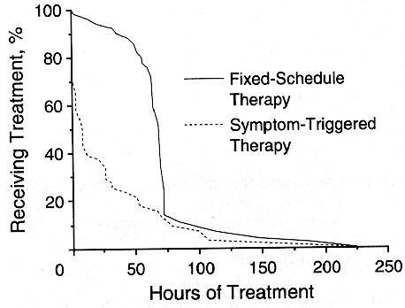
“Individualized treatment for alcohol withdrawal. A randomized double-blind controlled trial”
Figure 1 . Kaplan-Meier curves illustrate treatment times for both groups. Treatment time was shorter in the patients receiving symptom-triggered therapy (log rank test P <.001)

Slide 24
RESULTS: Fixed vs Symptom-triggered dosing
Median treatment duration was shorter in symptom-triggered group (9hr vs 68hr, p<.001)
Symptom triggered group received less BZD (100mg vs 425mg, p<.001)
No difference between groups in severity (CIWA-Ar scores), incidence of DTs, hallucinations, seizures, leaving against advice, or re-admission rates
Saitz R. JAMA 1994; 272: 519.

Slide 25
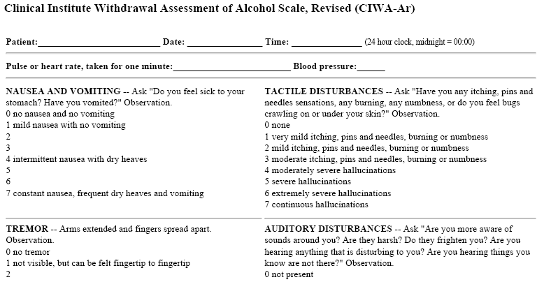
Clinical Institute Withdrawal Assessment (CIWA-Ar) scale
Maximum score of 67
Score > 8 necessitates treatment

Slide 26
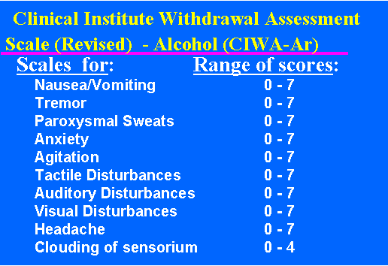

Slide 27
What Does This Actually Mean? i.e. Current Practice Guidelines (SIGN/NICE)
Benzo should be primary agent for managing AWD
  Reduce mortality
  Reduce duration of symptoms
  Less complications than neuroleptics
Initial goal is control of agitation
  Rapid, adequate control of agitation reduces adverse events
Arch Int Med, vol 164, 2004.

Slide 28
Benzodiazepines
Long-acting formulations preferred (Diazepam)
Shorter acting (Lorazepam) may be preferred in elderly or liver disease due to accumulation/metabolism
Onset of action for BZDs: 15sec – 2min
Peak action: 5-15 min

Slide 29
Examples of Medical Regimens
Diazepam 20mg PO QID Fixed
Diazepam 10-20mg PO PRN CIWA
Diazepam 10mg IV (over 2 min)
  Repeat in 10min if no effect
  If still no effect, increase dose to 20mg IV
  Important to monitor for over-sedation
Lorazepam 1-2mg PO QID Fixed
Lorazepam 1mg PO PRN CIWA
Lorazepam 1-4MG IV (over 2mins)
  Repeat in 15 min interval
  Important to monitor for over sedation
Notes:
Light somnolence defined as pt awake but falls asleep unless stimulated or is sleeping but easily aroused

Slide 30
Prophylaxis Against AWD
Often referred to as “Fixed dose” by Liaison Psych./CAT
Can be considered in patients with a history of withdrawal seizures, AWD, or prolonged, heavy alcohol use
Benefit unclear and may lead to increased BZD overall dose and longer treatment duration
Diazepam 20mg PO QID
Chlordiazepoxide 50mg PO QID
Aim to down titrate at 24hr intervals as symptoms resolve
Must still have CIWA scores charted and as required BZD prescribed

Slide 31
Adjunctive Neuroleptics
Inferior to benzodiazepines
Increased risk of side effects, including lower seizure threshold, prolonged QTc and hypotension
No studies done on “newer” atypical agents
Can be used in conjunction w/ benzodiazepines in setting of perceptual disturbances
  Haloperidol

Slide 32
Adjunctive Medications
Beta-blockers - not well studied
  Mild reduction in autonomic manifestations
  One controlled study w/ propranolol: increased incidence of delirium?
  Can be considered if persistent HTN or tachycardia
Ethyl Alcohol – not recommended
  No controlled trials, potential severe GI/neurological effects
  Difficult to titrate, not readily available in hospital!

Slide 33
Adjunctive Medications
Clonidine
  Effective for mild-moderate symptoms of withdrawal
  No studies that show decrease rate of delirium or seizures in EtOH but widely used in ICU for similar indications
Carbamazepine
  Effective for mild-moderate symptoms of withdrawal
  Limited data on preventing seizures or delirium
  Availabilty/familairity

Slide 34
Summary
Alcohol withdrawal includes a number of clinical syndromes that exists along a time and severity continuum
Benzodiazepines are the mainstay of treatment
  Admin should be guided by CIWA scores (>8)
Identification of a trigger for AWD and supportive treatment with Pabrinex, rehydration, glucose and electrolyte replacement are crucial

Slide 35
References and Reading
SIGN 71 (available online)
Best Practice (available online by subscription)
Ferguson JA, et al. Risk factors for delirium tremens development. J Gen Intern Med 1996; 11: 410.
Hack JB, et al. Thiamine before glucose to prevent Wernicke Encephalopathy: examining the conventional wisdom. JAMA 1998; 279: 583.
Kosten TR. Management of Drug and Alcohol Witdrawal. NEJM 2003; 348: 1786.
Mayo-Smith MF. Pharmacological management of alcohol withdrawal. JAMA 1997; 278: 144
Mayo-Smith MF, et al. Management of Alcohol Withdrawal Delirium. Arch Intern Med 2004; 164: 1405
Ntais C, et al. Benzodiazepines for alcohol withdrawal. Cochrane Database Syst Rev 2005.
Saitz R, et al. Individualized treatment for alcohol withdrawal. JAMA 1994; 272: 519.

Slide 36
Get in touch!
Website
www.quackmeded.co.uk
Email
ggc.quackmeded@nhs.scot
Social Media
Twitter: @QUACK_ Med
Facebook: QUACK education

