Slide 1
VASCULITIS
Dr. Sahil Jain
ST6 Rheumatology/GIM
Glasgow Royal Infirmary

Slide 2
Disclaimer*
Please note that QUACK is a regional teaching programme operating across GG&C, Lanarkshire and Ayrshire & Arran.
This presentation outlines general management, though local variances e.g. antibiotic prescription may vary slightly depending on your local trust
Remember to check your local guidelines

Slide 3
Learning objectives
What is vasculitis?
Characteristic histological features
Nomenclature NOT classification
Variable presentation/pattern recognition – diagnostic dilemma
Approach to diagnosis
Tests to consider
Large vessel vasculitis (GCA/Takayasu arteritis)
Medium vessel vasculitis (PAN)
Features of ANCA-associated vasculitis (GPA/EGPA/MPA)
Treatment of ANCA associated vasculitis

Slide 4
What is vasculitis?
Inflammation of the blood vessels
Features depend on the size and location of the affected vessels
Difficult to diagnose
Characteristic Histology
Infiltration of the vessel wall by neutrophils, mononuclear cells and/or giant cells
Fibrinoid necrosis (panmural destruction of the vessel wall)
Leukoctoclasis (dissolution of leukocytes)
All these lead to TISSUE ISCHAEMIA/INFARCTION

Slide 5
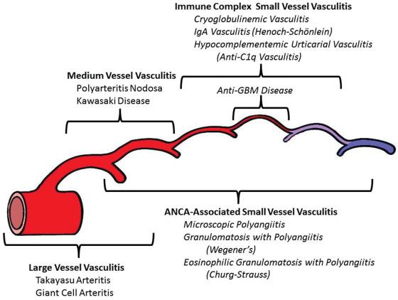
Nomenclature NOT Classification
(CHAPEL HILL CONSENSUS CONFERENENCE – 2012)

Slide 6
Large vessel vasculitis
  Takayasu arteritis
  Giant cell arteritis
Medium vessel vasculitis
  Polyarteritis nodosa
  Kawasaki disease
Small vessel vasculitis
(ANCA)–associated vasculitis
  Microscopic polyangiitis
  Granulomatosis with polyangiitis
  Eosinophilic granulomatosis with polyangiitis
Immune complex mediated
  Anti–glomerular basement membrane
  Cryoglobulinemic vasculitis
  IgA vasculitis (i.e. Henoch-Schonlein purpura)
  Hypocomplementemic urticarial vasculitis
Variable vessel vasculitis
  Behcet’s disease
  Cogan’s syndrome
Single-organ vasculitis
  Cutaneous leukocytoclastic angiitis
  Cutaneous arteritis
  Primary central nervous system vasculitis
  Isolated aortitis
  Vasculitis associated with systemic disease
  RA
  SLE
  Sarcoid
Vasculitis associated with probable infective aetiology
  Hepatitis C virus–associated cryoglobulinemic vasculitis
  Hepatitis B virus–associated vasculitis
Drug-associated immune complex vasculitis or other secondary vasculitides
  Cancer-associated vasculitis
  Others

Slide 7
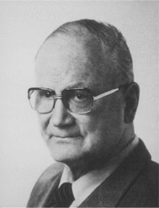


Changes to nomenclature
Temporal arteritis → Giant cell arteritis
Wegener’s granulomatosis → Granulomatosis with polyangiitis (GPA)
Churg-Strauss → eosinophilic granulomatosis with polyangiitis (EGPA)
Lotte
Strauss
Jacob
Churg
Friedrich
Wegener

Slide 8
Presentation
Immune process
Systemic features
Sweats
Fevers
Fatigue
Weight loss
Inflammatory picture on bloods (raised ESR/CRP/ platelets, low Hb, low albumin)
Vessel inflammation
Occlusion – infarct
Narrowing – ischaemia
Haemorrhage
Aneurysm
No clinical features

Slide 9
Important clues to possible vasculitis
Palpable purpura
Pulmonary infiltrates
Microscopic haematuria

Slide 10
Important clues to possible vasculitis
Limb/digit
ischaemia
Mononeuritis multiplex

Slide 11
Diagnosis
Variable presentation – NO SINGLE TYPICAL PRESENTATION OF VASCULITIS
Suspect the diagnosis (keep it in mind!)
Pattern recognition may sometimes help
The clinical manifestation may sometimes suggest the size of vessel involved:
Large vessel vasculitis – limb claudication, bruits, asymmetric blood pressure, absence of pulses
Medium vessel vasculitis – cutaneous nodules, ulcers, livedo reticularis, digital gangrene, mononeuritis multiplex
Small vessel vasculitis – palpable purpura, urticaria, glomerulonephritis, alveolar haemorrhage
Rule out vasculitis mimics!

Slide 12
Approach to diagnosis
Suspect the disease - could this be vasculitis?
Think about secondary causes of vasculitis (infections, malignancy, drugs, other rheumatological diseases)
Rule out vasculitis mimics
Pattern recognition
Define the extent of the disease
Confirm the diagnosis

Slide 13
Secondary causes of vasculitis
Infection (SBE, hepatitis B, C, parvovirus, syphilis, herpes simplex/zoster virus, CMV, EBV, HIV)
Malignancy (B-cell lymphoma, multiple myeloma, leukemia, paraneoplastic)
Drugs (cocaine, propylthiouracil, hydralazine, minocycline, allopurinol, D-penicillamine, sulfasalazine, penicillins, cephalosporins and several immunomodulating agents)
Rheumatological diseases (RA, SLE, Sjogren’s syndrome, APLA syndrome)

Slide 14
Vasculitis mimics
LARGE ARTERY INVOLVEMENT
CEREBRAL ARTERY INVOLVEMENT
Fibromuscular dysplasia
Marfan syndrome
Syphilitic aortitis
IgG4 disease
Reversible cerebral vasoconstrictive syndrome
PRES, CADASIL
Intravascular lymphoma
MEDIUM ARTERY INVOLVEMENT
MALIGNANCY
Cholesterol emboli syndrome
Fibromuscular dysplasia
Thromboembolic disease
Ehlers-Danlos syndrome
Metastatic carcinoma
Atrial myxoma
Lymphoma carcinomatosis
Leukaemia, multiple myeloma
SMALL ARTERY INVOLVEMENT
OTHERS
Infectious endocarditis
Gonococcal/meningococcal sepsis
Thrombotic thrombocytopenic purpura
Sweet syndrome
Ergotism
Radiation
Coarctation of aorta
Amyloidosis

Slide 15
Pattern recognition - does this fit with a recognized type of vasculitis ?
Elderly, headache, scalp tenderness, jaw claudication
Middle aged, ENT problems, haematuria
Worsening/late onset asthma, weight loss, fevers
Youngish woman, weight loss, upper limb claudication, absent pulses
GCA
GPA
EGPA
Takayasu’s
Middle aged male, abdominal pain, testicular pain and tenderness, hepatitis B positive
PAN

Slide 16
Tests to consider
BASELINE TESTS
VASCULITIS SCREEN
FBC, UE, LFT, Glucose, bone profile
Infl. markers - ESR, CRP
FBC, ESR, CRP
Urinalysis (blood/protein)
ANCA, MPO, PR3
ANA
Anti-GBM antibody
Complements (C3, C4)
Cryoglobulins
Urine PCR (if urine dip has protein)
MIMICS/SECONDARY CAUSES
Blood cultures
CXR, ECHO, CTCAP
Hepatitis B, C, HIV
Immunoglobulin, serum protein electrophoresis
NCS, EMG, CK
DISEASE SPECIFIC
GCA/Large vessel vasculitis – temporal artery biopsy/US, PET scan
PAN – visceral/mesenteric/renal angiogram
Small vessel vasculitis – tissue biopsy/skin biopsy/renal biopsy

Slide 17
Large vessel vasculitis

Slide 18
Giant cell arteritis (GCA)
Previously called Temporal arteritis/cranial arteritis
>50 years old patient
Raised inflammatory markers (ESR/CRP)
More common in females, smokers, less common in diabetics
CLINICAL FEATURES:
Headache (initial symptom in 33%, present in 72%); scalp tenderness
Visual symptoms (50%; unilateral visual blurring/loss, diplopia)
Neck, torso, shoulder, and pelvic girdle pain that is consistent with PMR (initial in 25%, present in 58%)
Fatigue and malaise (initial in 20%, present in 56%)
Jaw/tongue claudication (initial in 4%, present in 40%)
Fever (initial in 11%, present in 35%)

Slide 19
Giant cell arteritis (GCA)
DIAGNOSTIC INVESTIGATIONS:
Temporal artery biopsy/US
TREATMENT: if GCA suspected, may need urgent institution of steroids to prevent sight loss
With visual symptoms – IV methylprednisolone f/b PO prednisolone 60mg/day OR PO prednisolone 60mg/day
No visual symptoms - 40-60mg prednisolone/day - tapering dose (watch out for side effects) + PPI
DON’T FORGET BONE PROTECTION (VITAMIN D/ CALCIUM/ BISPHOSPHONATES)
Relapses – Methotrexate (MTX), Tocilizumab (GIACTA trial)

Slide 20
Takayasu Arteritis (TA)
Also called pulseless disease/aortic arch syndrome
More common in females (F:M = 8:1)
<50 years old patients (median age of onset = 25 years)
More common in Asian females (Japan, India, China, SE Asia)
Raised inflammatory response
CLINICAL FEATURES:
Constitutional symptoms (fever, arthralgia, weight loss)
Bruits, claudication (UL>LL) , reduced pulses, asymmetric B.P, headache, HTN, cardiac involvement, pulmonary involvement
DIAGNOSTIC INVESTIGATION:
MRA/CTA – GOLD STANDARD (vessel wall stenosis/inflammation)
TREATMENT:
High dose corticosteroids (prednisolone)
Relapses – MTX, MMF, Azathioprine, cyclophosphamide
Biologics – Infliximab, Tocilizumab, Rituximab

Slide 21
Medium vessel vasculitis

Slide 22
Polyarteritis Nodosa (PAN)
Multisystem disease characterized by necrotizing inflammation of medium and small arteries
NO GLOMERULONEPHRITIS/LUNG/ENT INVOLVEMENT
ANCA NEGATIVE
No gender difference
Median age of onset = 40 – 60 years
Raised inflammatory response
Associated with hepatitis B (10 – 50%)
CLINICAL FEATURES:
Constitutional symptoms >90% (fever, arthralgia, weight loss)
Multisystem involvement (mononeuritis multiplex, renal artery aneurysms, infarction, palpable purpura, ulcers, arthritis/arthralgia, myalgia, abdominal pain (mesenteric vasculitis), orchitis, cardiac involvement (MI, CCF), retinal haemorrhage

Slide 23
Polyarteritis Nodosa (PAN)
DIAGNOSTIC INVESTIGATIONS:
Hepatitis B serology
Tissue biopsy (accessible involved tissues – skin, sural nerve, skeletal muscle, testicle)
Visceral/mesenteric/renal angiogram (saccular microaneurysms)
ANA, ANCA, RF, Cryoglobulins NEGATIVE in classical primary PAN
TREATMENT:
High dose oral prednisolone/IV methylprednisolone
Cyclophosphamide, MMF, Azathioprine, Mtx, Infliximab

Slide 24
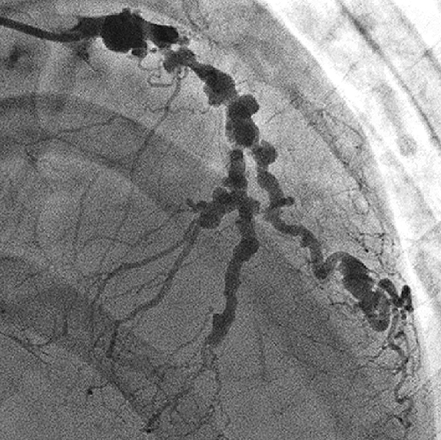

Slide 25
Small vessel vasculitis

Slide 26
ANCA-associated vasculitis
What is ANCA?
Antineutrophil cytoplasmic antibodies (ANCA)
These are antibodies directed against specific proteins in granules in the cytoplasm of neutrophils and lysosomal proteins in monocytes
Serum test in patients suspected with vasculitis
3 categories (IIF – indirect immunofluorescence testing):
Cytoplasmic (c-ANCA) – diffuse staining of the neutrophil cytoplasm
Perinuclear (p-ANCA) – perinuclear cytoplasmic staining
Atypical ANCA – pattern not clear for either c-ANCA or p-ANCA; protein not clear

Slide 27
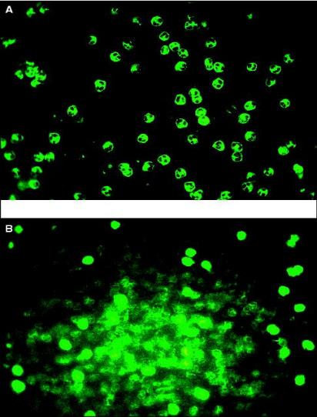
What is ANCA?
p-ANCA (peri-nuclear)
Targets myeloperoxidase (MPO)
c-ANCA (cytoplasmic)
Targets proteinase 3 (PR3)

Slide 28
Granulomatosis with Polyangiitis (GPA)
Previously called Wegener’s granulomatosis
250 cases/million people in the UK
90% of cases of Northern European descent
M:F = 1.5:1
Typically age = 35-55 years
3 MAJOR ANATOMICAL SITES (GENERALIZED GPA):
Upper respiratory tract – sinusitis, epistaxis, perforation of nasal septum, mucosal ulcerations, oral ulcers, pharyngitis, otitis media, subglottic stenosis
Lungs – cough, hemoptysis, respiratory distress, pulmonary nodules, cavitatory lung lesions, alveolar haemorrhage
Renal involvement – focal and segmental necrotizing glomerulonephritis
LOCALIZED GPA: no renal involvement
c-ANCA
(PR3)

Slide 29
Granulomatosis with Polyangiitis (GPA)
OTHER CLINICAL FEATURES:
Rapidly progressive glomerulonephritis (75%)
Rhinitis, saddle nose deformity
Hearing loss
Subglottal stenosis
Pulmonary nodules/infiltrates/haemorrhage/cavitation
Arthritis
Purpuric rash
Eye signs (50%)
Sensory neuropathy/mononeuritis multiplex
Cardiac involvement (<5%) - pericarditis
RELAPSE COMMON

Slide 30
Eosinophilic Granulomatosis with Polyangiitis (EGPA)
p-ANCA
(MPO)
Previously called Churg-Strauss syndrome OR
allergic angiitis with granulomatosis
Granulomatous vasculitis of small and medium-sized vessels, frequently involving the skin, peripheral nerves and lungs, and is associated with peripheral eosinophilia
2.5 cases per 100,000 adults per year worldwide
Slightly more common in men
Aged 15-70 years (peak age at diagnosis = 50 years)
CHARACTERISTIC LABORATORY ABNORMALITY = EOSINOPHILIA (>10% in blood)
Renal involvement UNCOMMON

Slide 31
Eosinophilic Granulomatosis with Polyangiitis (EGPA)
CLINICAL FEATURES:
Previous history of allergic manifestations (such as rhinitis, nasal polyps), paranasal sinusitis
Late onset/worsening asthma (90%)
Pulmonary infiltrates (may be transient), pulmonary nodules WITHOUT cavitation
Mononeuritis multiplex/polyneuropathy
Subcutaneous nodules, purpura
Arthralgia, arthritis
Abdominal pain, bloody diarrhea (eosinophilic gastroenteritis)
Myocarditis
TISSUE BIOPSY: histological proof of vasculitis with extravascular eosinophils

Slide 32
Microscopic Polyangiitis (MPA)
Systemic necrotizing small vessel vasculitis (clinically/histologically)
Frequently associated with focal segmental necrotizing glomerulonephritis and pulmonary capillaritis
Approximately 2 cases per 100,000 persons in the UK
Slightly more common in men
Age of onset = 30 – 50 years
Worst long term survival rate
CLINICAL FEATURES:
Similarities with GPA, but no granuloma formation
Similarities with PAN, but no microaneurysm formation
Rapidly progressive glomerulonephritis
Purpura (50%)

Slide 33
Microscopic Polyangiitis (MPA)
CLINICAL FEATURES:
Mononeuritis multiplex (57%); seizures (11%)
Arthralgia (10-50%); myalgia (40%)
Testicular pain (2%)
Ocular (1%) - Red eye, ocular pain, decreased visual acuity
Symptoms of sinusitis (1%)
DIAGNOSIS: CLINIAL PRESENTATION + RENAL BIOPSY (showing necrotizing glomerulonephritis without immune deposits)
ANCA positive (80%); p-ANCA/MPO (60%); c-ANCA/PR3 (40%)
30% RELAPSE RATE AT 1-2 YEARS

Slide 34
Treatment – ANCA Vasculitis
A. INDUCTION OF REMISSION:
1. Cyclophosphamide/Rituximab + steroids (vital organ/ life threatening involvement)
2. Plasma exchange (vital organ/ life threatening involvement + creatinine >500 Umol/L)
3. Methotrexate/MMF + steroids (less severe cases – no organ threatening involvement)
B. MAINTAINENCE THERAPY: combination of low-dose glucocorticoid therapy and either Methotrexate, MMF, Azathioprine or Leflunomide.
Cyclophosphamide side effects - hemorrhagic cystitis (Mesna), bladder cancer, lymphoproliferative disorders, myelodysplasia, infertility

Slide 35
IgA Vasculitis/Henoch Schonlein Purpura (HSP)
Characteristic IgA deposition in affected blood vessels
Primarily occurs in children between ages 2 -10 years; can occur in adults – usually more severe disease with higher frequency of renal involvement
Disease is usually self limiting
CLINICAL FEATURES:
Classical tetrad of palpable purpura, arthritis, abdominal pain and renal disease occurs in upto 80% of cases
Rash mainly involves the lower extremities and buttocks
DIAGNOSTIC INVESTIGATION: Immunofluorescence on skin/renal biopsy– GOLD STANDARD (IgA deposition)
TREATMENT: usually self limiting (6 – 16 weeks)
Mild disease – supportive treatment (NSAID’s, steroids)
Severe disease/organ threatening – high dose steroids/ IV methylpred. + cyclophosphamide

Slide 36
Summary
Vasculitis is potentially scary, complicated and difficult to diagnose - most of all it’s diverse, so keep the diagnosis in mind!
No single typical presentation with many overlapping symptoms but pattern recognition may sometimes help to diagnose certain conditions
It should be considered in patients with multi-system disease since early and accurate diagnosis is important
A structured approach (including good history and clinical examination) to assess patients can be helpful – look out for important clues that may lead to the diagnosis
Think about secondary causes of vasculitis and vasculitis mimics
If suspecting GCA – refer early to rheumatology as patient may need urgent institution of steroids (to prevent sight loss)
IF IN DOUBT – REFER TO RHEUMATOLOGY

Slide 37
Thank you
Please fill out the feedback form for your certificate of learning

Slide 38
Get in touch!
Website
www.quackmeded.co.uk
Email
ggc.quackmeded@nhs.scot
Social Media
Twitter: @QUACK_ Med
Facebook: QUACK education

