Slide 1
Myeloproliferative neoplasms
Samantha Drummond
Clinical Teaching Fellow Haematology

Slide 2
Disclaimer*
Please note that QUACK is a regional teaching programme operating across GG&C, Lanarkshire and Ayrshire & Arran.
This presentation outlines general management, though local variances e.g. antibiotic prescription may vary slightly depending on your local trust
Remember to check your local guidelines

Slide 3
Overview
Polycythaemia vera
Essential thrombocytosis
Primary myelofibrosis

Slide 4
Learning outcomes
By the end of this lecture you should be able to:
Have an understanding of the pathophysiology, presentation, investigation and management of:
  Polycythaemia vera
  Essential thrombocytosis
  Primary myelofibrosis

Slide 5
Myeloid malignancies
Acute myeloid leukaemia
Chronic myeloid leukaemia
Myelodysplastic syndromes
Myeloproliferative neoplasms

Slide 6
Myeloproliferative neoplasms
Polycythaemia vera
Essential thrombocytosis
Primary myelofibrosis

Slide 7






Red cells
Myeloid precursors
Neutrophils
Monocytes
Basophils
Eosinophils
Stem cell
Platelets
Lymphoid precursors
B lymphocytes
Plasma cells
T lymphocytes

Slide 8
Myeloproliferative neoplasm
Group of haemopoetic stem cell neoplasms with excessive proliferative of one or more of the erythroid, megakaryocytic or myeloid lineages
Relatively normal maturation resulting in increased numbers of red cells, platelet and/or granulocytes in the peripheral blood
Splenomegaly and hepatomegaly are common
Share a potential to progress to:
  Myelofibrosis
  Blastic transformation
Notes:
Common mechanism seems to through constituative tyrosine kinase activation
Unlike some of the other condition haemopoesis still occurs effectively
- Characterised by effective haemopoesis devoid of dyserythropoeisis, granulocytic dysplasia or monocytosis

Slide 9
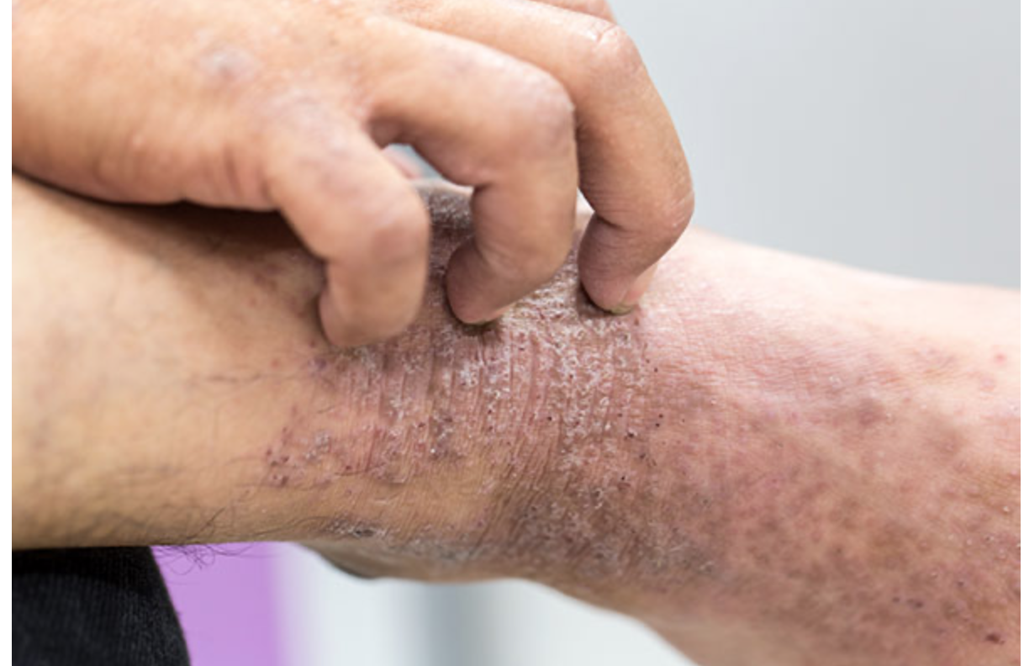
Case presentation 1
55 year old gentleman
Presenting complaint:
  Itch
History of presenting complaint:
  What would you like to ask?

Slide 10
Case presentation 1
55 year old gentleman
PC: Itch
HPC:
  How long has this been a problem?
  Obvious trigger?
  Specific area or generalized itch?
  Previous problem with itch?
  Does anything make it better/worse?
  Change in detergent/soap etc. ?
  …
Notes:
What other things might you ask?
Not specifically related to itch- B symptoms, symptoms of anaemia etc
The patients says he has had the itch for a few months, generalized problem. No obvious trigger. Worse after taking a bath.
The only other problem he can think of is that he is a bit tired

Slide 11

Case presentation 1
Past medical history
  Gout
Drug history
  No regular medications
  NKDA
Family history
  Nil of note
Social history
  What questions would this involve?

Slide 12
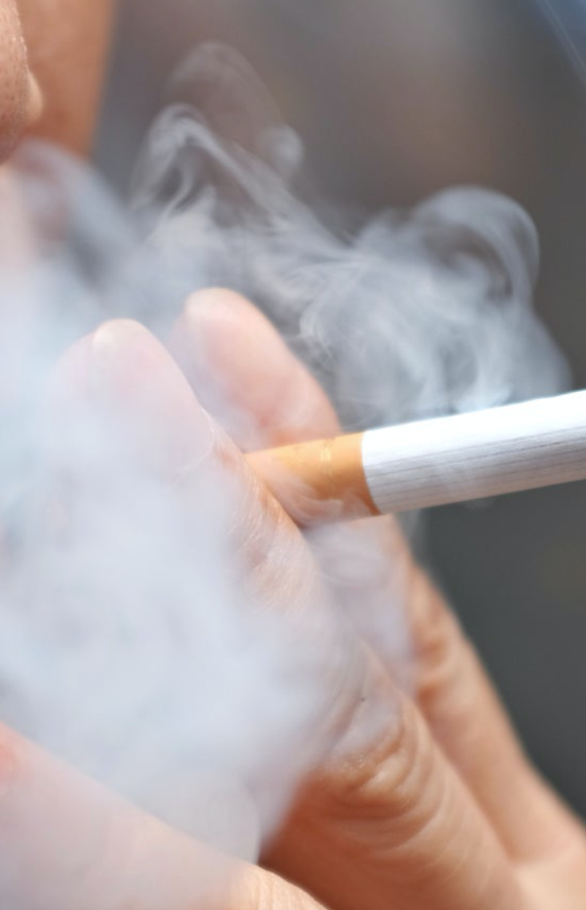

Case presentation 1
Social history
  Smoking status
  Alcohol intake
  Occupation
  Functional status
  Recent travel
Notes:
Smoker
What do you then want to ask?
Minimal alcohol intake
Works as a builder

Slide 13
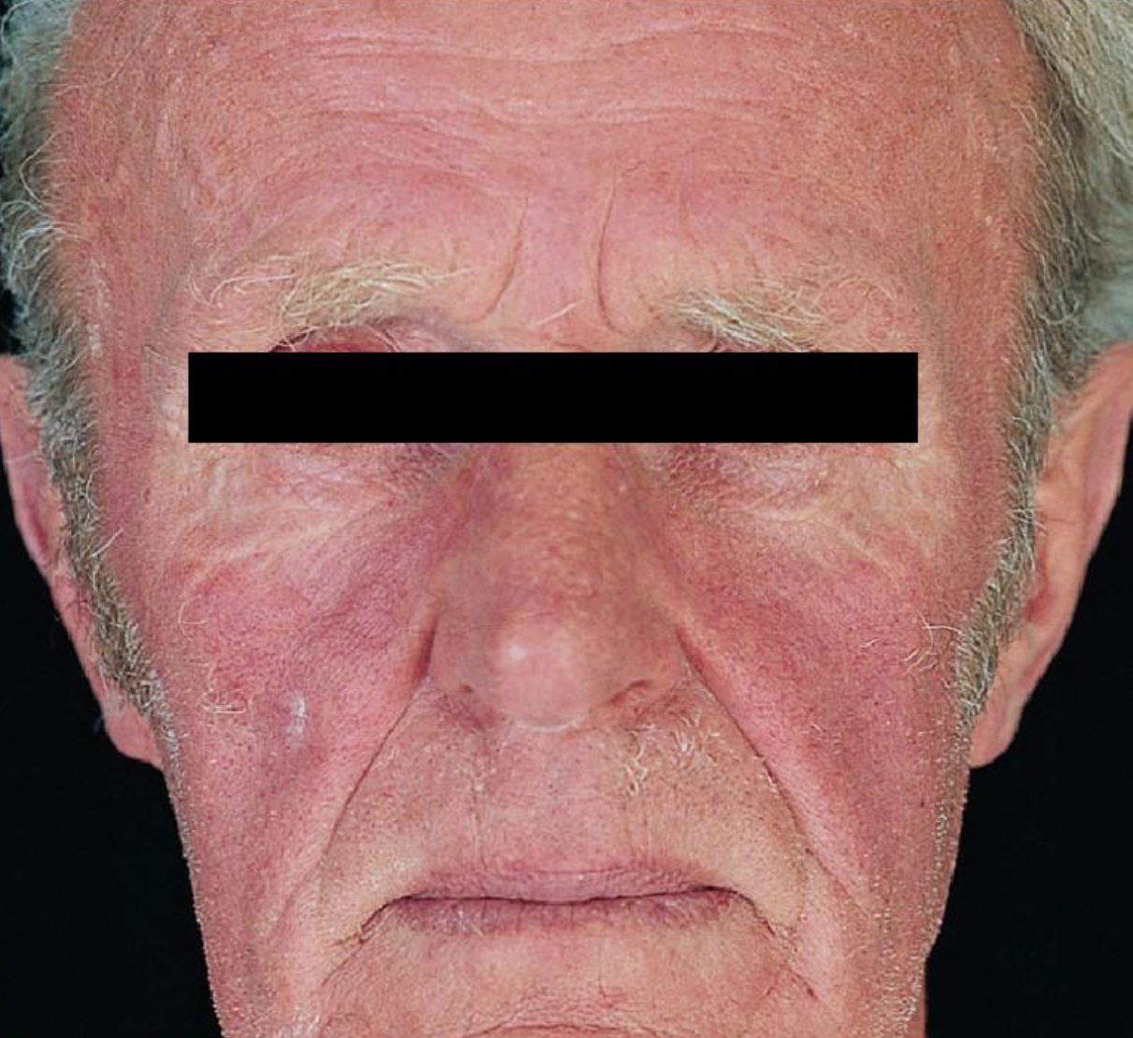
Case presentation 1
On examination
  Normal observations
  Chest clear
  ?Splenomegaly
GP takes ‘routine bloods’
Notes:
What do you think about the patient’s face?
What bloods would the GP have taken?
FBC
U&Es
LFTs
Can get itch associated with a number of issues. Can be dermatological but can also get itch due to liver problems as well as uraemia.

Slide 14
Case presentation 1
Hb 200 g/l (133-176g/l)
Hct 0.62 (0.390-0.500)
WCC 18.0 x10⁹/l (3.9-11.1 x10⁹/l )
MCV 75 fl (82-98 fl)
Platelets 850 10⁹/l (150-400 x10⁹/l)
Neutrophils 14.6 x10⁹/l (1.8-7.4 x10⁹/l)
Lymphocytes 2.0 x10⁹/l (2.2-7.7 x10⁹/l)
Monocytes 0.8 x10⁹/l (0.2-0.9 x10⁹/l)
Basophils 0.5 x10⁹/l (0-0.1 x10⁹/l)
Notes:
What do you think of those blood tests?
Normal ranges are in brackets

Slide 15
Case presentation 1
What would you do now?
  Repeat bloods
  Consider referral to Haematology
What would your differential diagnosis be?
Notes:
Erythrocytosis is defined as an increase in total red cell mass
Persistent elevation of haematocrit >0.48 in females and >0.51 in males is abnormal

Slide 16
Differential Diagnosis
Polycythaemia vera
Secondary polycythaemia
  EPO producing tumours e.g. hepatoma, cerebellar haemangioma
  Hypoxia e.g.COPD, OSAS, high altitude
  Renal disease e.g. polycystic kidney disease, renal artery stenosis
Drugs e.g. EPO abuse/doping
Chronic myeloid leukaemia
Relative eyrthrocytosis
Notes:
An elevated haematocrit can occur with a normal red cell mass if the plasma volume is reduced ’relative’ erythrocytosis

Slide 17
Relative erythrocytosis
‘Pseudo-polycythaemia’
Low plasma volume but normal red cell mass
Causes include
  Hypertension
  Obesity
  Excessive alcohol
  Dehydration or diuretic therapy

Slide 18
Case presentation 1 cont…
Persistent abnormalities on repeat FBC
Patient referred to haematology
Positive for JAK 2 mutation
What is the diagnosis now?

Slide 19
Polycythaemia vera
Neoplastic disorder of haemopoetic stem cells causing excessive proliferation of the erythroid, myeloid and megakaryocytic lineages
Affects all three cell lines
Carries risk of thrombotic complications
Epidemiology
  Most common MPN
  Incidence up to 3 per 100, 000
  Median age at diagnosis is 60 years
Notes:
Cells have an abnormal response to growth factors
Very rare below age 30

Slide 20
Polycythaemia vera
Aetiology
  Exact aetiology is unknown
95% of PV patients have JAK 2 V617F mutation
Acquired mutation
Mutations result in haemopoetic cells which are more sensitive to growth factors such as erythropoietin
No known environmental risk factors
Notes:
A unique valine to phenylalanine substitution at position 617 (V617F) in the pseudokinase JAK2 domain has been identified called JAK2V617F that leads to a permanently turned on signalling at the affected cytokine receptors[16].
Gain of function mutation
Involved in EPO receptor signalling
May not be the initiating mutation

Slide 21
Presentation
Fatigue
Headache
Erythromelalgia
Aquagenic itch
Visual disturbance
Thrombosis
Haemorrhage
Gout
Splenomegaly and hepatomegaly
Plethoric facies
Notes:
Can be asymptomatic
Erythromelagia- burning pain, with erythema and increased skin temperature affecting the hands and feet.
Itch such as our patient and this affects up to 50% of patients
Main concern is increased risk of vascular events- up to 40% present with thrombosis
Can be arterial or venous
Need to consider in patients presenting with thrombosis at unusual sites eg BCS- 10 to 15% present with arterial or venous thrombosis
Haemorrhage- up to 20%
Gout due to increased cell turnover

Slide 22
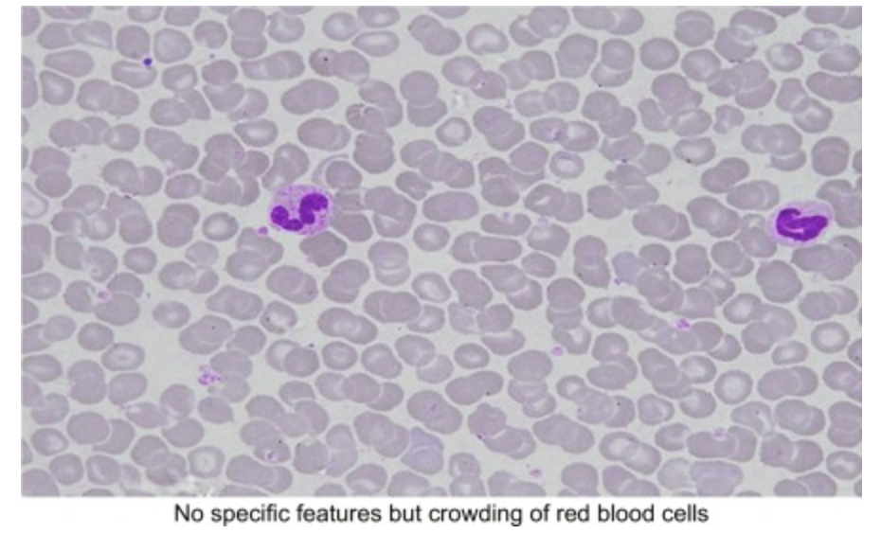
Polycythaemia vera
Investigations
  FBC
    Raised Hb and Hct
    Tendency for raised WCC and platelets
  Blood film
  Serum EPO
  Arterial oxygen saturation
    ABG or pulse oximetry
  JAK2 mutation analysis
  Bone marrow aspirate and trephine
  Uric acid level
Notes:
High EPO suggests secondary cause, would expect serum EPO to be low or can be normal
Can have a low MCV and may have iron deficiency anaemia- use up iron stores
Bone marrow →•Hyperplastic
•Erythroid and granulocytic hyperplasia
•Increased megakaryocytes
Bone marrow is not essential for diagnosis if patient is positive for mutation

Slide 23
Case presentation 1 cont…
What management options can do you know of ?
  Venesection
  Aspirin
  Cytoreductive therapy
    Hydroxycarbamide
  JAK 2 inhibitor
    Ruxolitinib
  Allopurinol

Slide 24
Management
Venesection
  Aim Hct <0.45
Aspirin
Consider allopurinol
For high risk patients
  Cytoreductive therapy e.g. Hydroxycarbamide, Interferon α
  JAK 2 inhibitor- Ruxolitinib
Require regular blood monitoring under care of haematologist
Notes:
Treatment is stratified by risk:
Low risk is <60 with no previous thrombosis
Intermediate are low risk patients but with cardiac risk factors e.g. hypertension, diabetes, smoking
High risk are those aged >60 or previous history of thrombosis
Patients who are low risk should be offered venesection and aspirin to reduce risk of thrombotic complications
Hydroxycarbemide is a cytoreductive therapy, can also use interferon alpha
Common adverse effects of interferon alpha are GI upset and flu like symptoms
For elective surgery would ideally delay until haematocrit and platelets normalized > 2 months due to risk of thrombosis and haemorrhage

Slide 25
Complications
Risk of transformation
  Secondary myelofibrosis
  Transformation to AML
Other complications include risk of vascular events e.g. thrombosis, stroke
Notes:
Untreated PV carries a significant risk of early thrombotic complications. Long term risk of transformation to myelofibrosis or less commonly to AML
Cardiovascular complications e.g. MI, stroke and VTE are the most common causes of death (41%)
Most common cause of death is cardiovascular complications and transformation to AML

Slide 26

Case presentation 2
60 year old lady attends GP for routine cardiovascular review
She has a past medical history of a TIA
On further questioning she reports
  Headache
  Intermittent light headedness
The GP performs bloods as part of check

Slide 27
Case presentation 2
Blood results
  Hb 130 g/l (122-165 g/l)
  Hct 0.40 (0.360-0.480)
  WCC 10.1 x10⁹/l (3.9-11.1 x10⁹/l)
  Plt 870 x10⁹/l (150-400 x10⁹/l)
What abnormality is present?
What would your differential diagnosis be?

Slide 28
Differential diagnosis
Essential thrombocytosis
Polycythaemia vera
Chronic myeloid leukaemia
Myelofibrosis
Myelodysplastic syndrome
Reactive
  Infection
  Post surgery
  Post splenectomy
  Malignancy
  Recent blood loss
  Inflammatory e.g. RA
  Chronic IDA
Notes:
<10% of isolated thrombocytosis is due to a primary haematological disorder
Generally reactive thrombocytosis does not require any treatment

Slide 29
Essential thrombocytosis
Clonal proliferation of megakaryocytes leading to increased platelet counts with abnormal function
Associated with bleeding and thrombosis
Epidemiology
  Median age at diagnosis 60 years
  Slightly more common in females
Aetiology
  Unknown
  50% have JAK 2 V617F mutation
  Other mutations have also been identified
Notes:
Frequently occurs <40 years, very rare less than 20
Usually affects middle aged and older people
The cause of the increase in production of platelets is unclear
Although it is not known how this mutation produces the separate phenotypes
Genetic mutations affecting Janus kinase 2 (JAK2), calreticulin (CALR), or myeloproliferative leukaemia virus oncogene (MPL) are found in the majority of patients, but their role in the pathogenesis of essential thrombocytosis is unknown

Slide 30
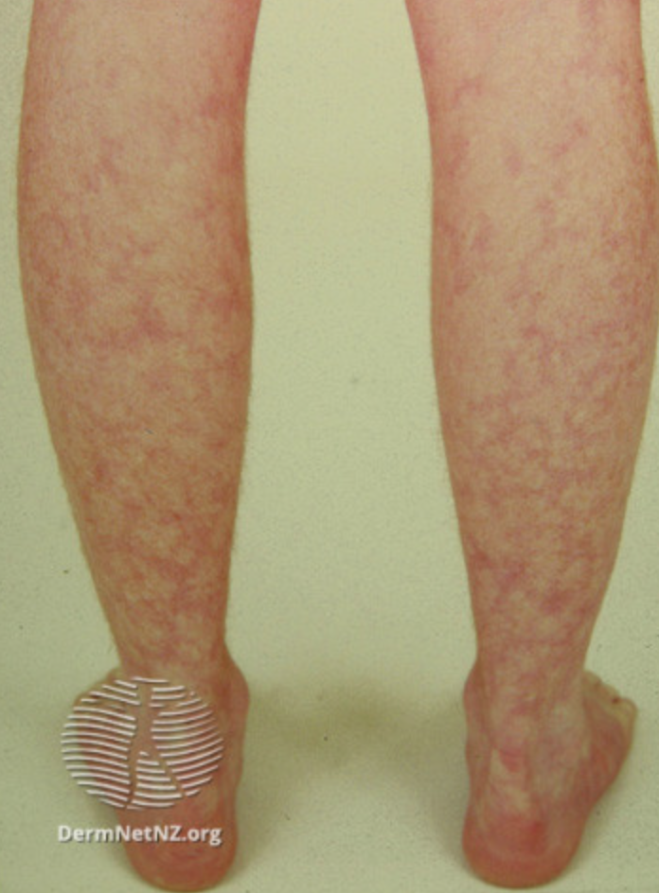
Presentation
Up to 50% are asymptomatic
Vasomotor symptoms include:
  Headache
  Light headedness
  Syncope
  Atypical chest pain
  Visual upset
  Paraesthesia
  Livedo reticularis
  Erythromelagia
Thrombosis
Haemorrhage
Splenomegaly
Notes:
Erythromelalgia, characterised by burning pain and dusky congestion of the extremities, may occur
Splenomegaly can occur in about 40%

Slide 31
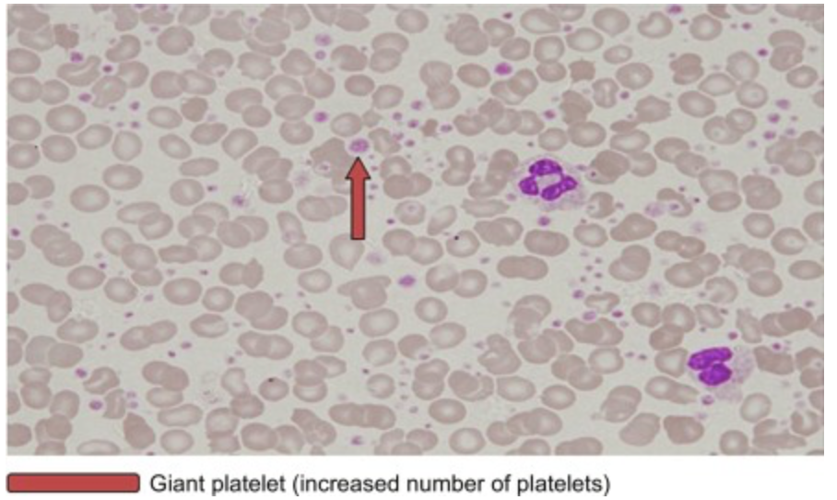
Essential thrombocytosis
Investigations
  FBC
    Platelet count >450 x10⁹/l
  Blood film
  Serum ferritin
  Inflammatory markers
  JAK 2 mutation screen
  Bone marrow aspiration and trephine
Notes:
The degree of elevation is not used to differentiate between ET and reactive
Investigations are used to exclude reactive causes of increased platelets
Hb usually normal
Ferritin to exclude IDA as a cause of reactive thrombocytosis
Can consider other molecular tests including BCR ABL to exclude CML aswell as for the other mutations in ET (CLR and MPL)
AK2, CALR, and MPL mutations are mutually exclusive mutations that may be present in patients with essential thrombocytosis. Incidence is reported to be 55%, 25%, and 3%, respectively.[9] Approximately 17% of patients are negative for all three mutations.
Bone marrow will show increased megakarycytes

Slide 32
Essential thrombocytosis
WHO diagnostic criteria
1. Persistent elevation of platelet count ≥ 450 x10⁹ /L
2. Bone marrow biopsy showing megakaryocyte proliferation with large and mature morphology; no or little granulocyte or erythroid proliferation
3. Not meeting WHO criteria for CML, PV, PMF, MDS or other myeloid neoplasm
4. Demonstration of JAK 2 V617F mutation or other clonal marker. In the absence of a clonal marker, no evidence of reactive thrombocytosis
Notes:
Diagnosis of exclusion
WHO has developed criteria

Slide 33
Essential thrombocytosis
Management
  Avoid NSAIDs due to risk of haemorrhage
  Aspirin
  Hydroxycarbamide
  Anagrelide
  Interferon α
Prognosis
  Life expectancy is near normal
  Follows a more indolent course than other MPN
  Low risk of transformation to AML or myelofibrosis
Notes:
Also based on risk
e.g. older and previous history of thrombosis or major bleeding
In low risk patients may be reasonable to observe and monitor bloods only
Risk of thrombosis is associated with previous thrombosis and age >60
Haemorrhage is associated with extreme thrombocytosis (>1500) and anti-platelet therapy
About 5% risk of transformation

Slide 34

Case presentation 3
A 69 year old gentleman presents with weight loss
What questions would you like to ask?

Slide 35
Case presentation 3
A 69 year old gentleman presents with weight loss
What questions would you like to ask?
  How much weight?
  Over how long?
  Other B symptoms- fever and night sweats?
  Smoking history
  Any blood loss?
  Symptoms of anaemia?

Slide 36
Case presentation 3
On further questioning:
  He has lost 5kg over the past 3 months
  Complains of fatigue and night sweats
  Feeling SOBOE
  Abdominal discomfort
  No overt blood loss
  Denies infective symptoms

Slide 37
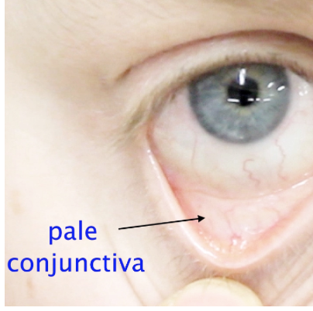
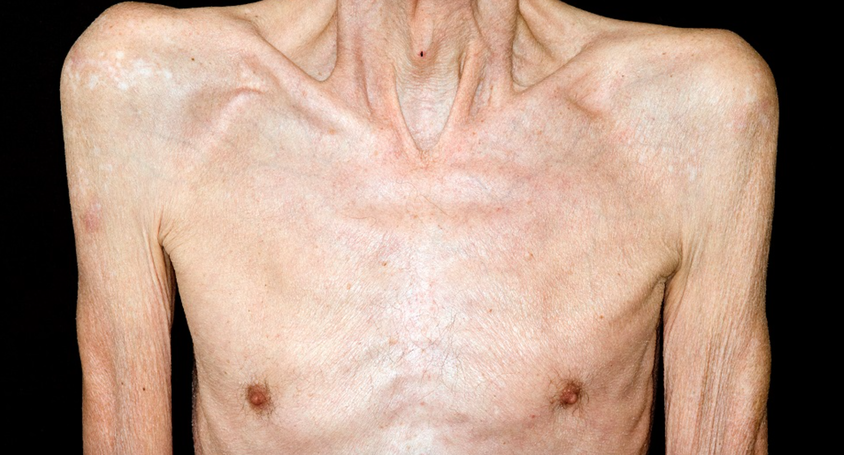
Case presentation 3
On examination
  Cachectic
  Pallor
  Moderate splenomegaly

Slide 38
Case presentation 3
Blood results
Hb 60 g/l (133-176g/l)
MCV 86 fl (82-98 fl)
Platelets 96 x 10^9/l (150-400 x10⁹/l)
WCC 6.2 x 10^9/l (3.9-11.1 x10⁹/l)
Neutrophils 2.2 x 10^9/l (1.8-7.4 x10⁹/l)
Lymphocytes 2.4 x 10^9/l (2.2-7.7 x10⁹/l)
Monocytes 0.36 x 10^9/l (0.2-0.9 x10⁹/l)
Notes:
The peripheral blood smear shows occasional teardrop-shaped red blood cells, and erythroblasts and myelocytes.

Slide 39
Primary Myelofibrosis
Chronic progressive myeloproliferative disorder arising from haematopoeitic stem cells
Results in hyperplasia of abnormal megakaryocytes and clonal monocytes that stimulate reactive fibrosis of the bone marrow
Characterised by marrow fibrosis, splenomegaly and extramedullary haematopoeisis
Incidence
  Rare
  5 cases per million per year
  Predominantly elderly patients (median age 65)
  Equal sex distribution
Notes:
primary myelofibrosis (PMF), a chronic progressive myeloproliferative disorder with its origin in a multipotent haematopoietic progenitor cell. The aetiology of PMF is unknown
The aetiology is unknown
Primary myelofibrosis is characterized by marrow fibrosis, splenomegaly, extramedullary haematopoeisis and teardrop poikliocytes and leucoerythroblastosis in the peripheral blood
Marrow fibroblasts in primary myelofibrosis (PMF), in contrast to the haematopoietic stem cells, are polyclonal, suggesting that the marrow fibrosis is a reactive process initiated by expansion of the malignant clone.
Thought there is a inappropriate release of fibrinogenic cytokines by dysfunctional megakaryocytes

Slide 40
Primary myelofibrosis
Aetiology
  Unknown
  Radiation exposure
  Exposure to industrial solvents (e.g. benzene, toluene)
  JAK 2 V617F mutation present in about half

Slide 41
Presentation
20% may be asymptomatic at diagnosis
Most diagnosed in the fibrotic stage
  Anaemia
  Bleeding/bruising
  Fatigue, night sweats, fever, weight loss
Splenomegaly present in 90%
Hepatomegaly up to 70%
Notes:
May be diagnosed due to splenomegaly or on routine FBC
Fatigue, sweats etc are result of a hypercatabolic state
Leads to extramedullary haemopoesis causing increased size of liver and spleen

Slide 42
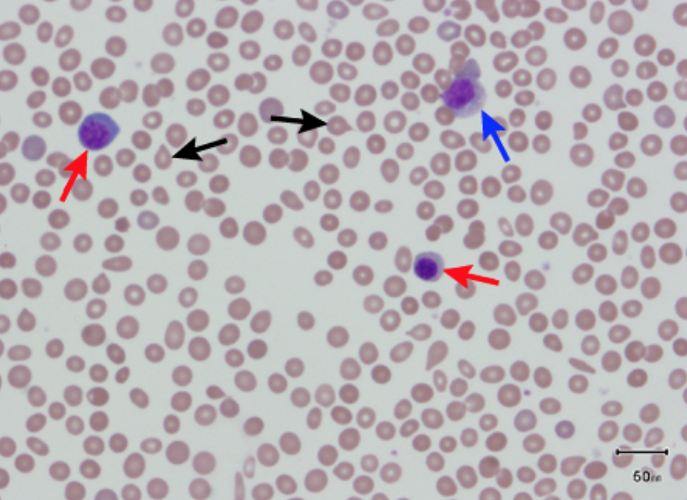
Primary myelofibrosis
Investigations
  FBC
    Hb usually normal or decreased
    WCC variable
    Platelets usually normal or reduced
  Blood film
    ‘Leucoerythroblastic film’
  BM aspirate and trephine
    ‘Dry tap’
  JAK 2 mutation analysis
  Cytogenetics
  Uric acid
Notes:
Inevitably (due to extramedullary haematopoiesis) metamyelocytes, myelocytes, promyelocytes, myeloblasts, and nucleated RBCs will be present in the circulation together with teardrop-shaped RBCs. Although this so-called leuko-erythroblastic reaction is not specific for PMF, it is a hallmark of PMF and its absence should challenge the clinical impression.
(nucleated red cells, myelocytes), with tear drop poikliocytes and polychromasia, giant platelets and megakaryocyte fragments
BM trephine shows patchy cellularity and fibrosis
A leukoerythroblastic blood film, in which immature white cell precursors (includingblasts) and nucleated red blood cells are seen, is highly indicative of an infiltrative processaffecting the bone marrow. The differential diagnosis includes malignancy (both haema-tological and secondary bone marrow involvement from non-haematological malig-nancy), infection involving the bone marrow (for example tuberculosis) andmyelofibrosis.
Peripheral blood smear showing teardrop red blood cells (black arrows), 2 nucleated red blood cells (red arrows), and a myelocyte (blue arrow)

Slide 43
Differential diagnosis
CML
Essential thrombocytosis
Polycythaemia vera
AML
MDS
Metastatic cancer

Slide 44
Management
Incurable except for SCT
  Can use scoring systems to consider SCT
No disease modifying treatment
Symptomatic treatment
  Consider EPO
  Blood product support
  Cytoreductive therapy e.g.hydroxycarbamide
  Anti-angiogenic e.g. lenalidomide
  Splenectomy
  Ruxolitinib
Notes:
Splenectomy is not without risk though can also consider splenic irradiation

Slide 45
Primary Myelofibrosis
Prognosis
  Median survival 3.5-5 years
  Up to 20% transform to AML
  Death often due to infection or haemorrhage
Adverse prognostic features
  Marked anaemia (Hb <100)
  Older age
  Constitutional symptoms
  Abnormal karyotype
  JAK 2 mutation
Notes:
Worst survival of the MPN
Generally older age, constitutional symptoms and marked anaemia

Slide 46
Myeloid malignancies
Acute myeloid leukaemia
Chronic myeloid leukaemia
Myelodysplastic syndromes
Myeloproliferative neoplasms

Slide 47
Questions ?
Email: s.drummond1@nhs.net

Slide 48
Get in touch!
Website
www.quackmeded.co.uk
Email
gg-uhb.quackmeded@nhs.net
Social Media
Twitter: @QUACK_ Med
Facebook: QUACK education

Slide 49
Thank you
Please fill out the feedback form for your certificate of learning

Slide 50
Get in touch!
Website
www.quackmeded.co.uk
Email
ggc.quackmeded@nhs.scot
Social Media
Twitter: @QUACK_ Med
Facebook: QUACK education

