Slide 1
Hot Joints
Gareth Ingram
Clinical Fellow in Acute Medicine

Slide 2
Disclaimer*
Please note that QUACK is a regional teaching programme operating across GG&C, Lanarkshire and Ayrshire & Arran.
This presentation outlines general management, though local variances e.g. antibiotic prescription may vary slightly depending on your local trust
Remember to check your local guidelines

Slide 3
Arthropathy
Monoarthopathy
  1 joint only
Oligoarthropathy
  2-4 joints
Polyarthopathy
  5 or more joints

Slide 4
Differentials
Trauma ?haemarthrosis ?anticoagulants
Gout/crystal pathology
Inflammatory arthropathy – RA, psoriatic
OA
Reactive arthritis
Septic arthritis
  Treatment is typically flucloxacillin or vancomycin
  antibiotics, aspiration +/- washout

Slide 5
Case 1
41 year old male
?Gout ?septic arthritis
Monoarthropathy, right knee
Presented to IAU via GP

Slide 6
Presenting Complaint
Right knee pain
Describes rigors and fever over preceding 24-48 hours
Hot to touch
Reduced range of movement

Slide 7
Past Medical History
COPD/asthma overlap
Previous DVT
Depression
HCV +ve
Cellulitis
Personality disorder
IVDU, on methadone 100mls daily

Slide 8
Systemic enquiry
Chest
  Cough, nil else
Gastro, cardiac, neuro and GU otherwise unremarkable
Feverish for 24-48 hours
No night sweats or weight loss

Slide 9
Social
Smoker, 25 per day
No alcohol use
Previous IVDU, not injected in 2 years
Lives alone
Usually mobile and independent

Slide 10
Observations
Observation | Triage | First Assessment
Temperature | 37.4 | 40.5
Heart Rate | 102 | 110
Blood pressure | 102/61 | 126/68
Respiratory rate | 20 | 22
Oxygen Saturations | 97 | 92
GCS | 15 | 14

Slide 11
Examination
General
Clammy, flushed
Drowsy, but easily rousable
Focused (right knee)
Warm to touch
Not erythematous
No obvious signs of trauma
Palpable effusion
Struggling to mobilise

Slide 12
Other
Reduced air entry globally
HS 1 +2 + O
JVP not visualised
No tender liver edge
Calves firm bilaterally but non tender, right > left
GCS 14 (E3)

Slide 13
Differential
Septic arthritis right knee
?Gout
??DVT

Slide 14
Initial Management
Sepsis 6
  Refused catheter
Antibiotics (IV fluclox)
Aspirate knee and blood cultures
Aggressive fluid resuscitation
Strict fluid balance
Chest and knee x-rays

Slide 15
IAU
Blood pressure remained low at mid 80’s systolic
Knee aspirated
  60ml fluid
  No comment on appearance
  Sent to cytology and microbiology
Transferred to medical ward
ID – add in clindamycin

Slide 16
Bloods
WCC 6.8
Neutrophils 4.6
MCV 90.7
Platelets 81
Coagulation Normal
CRP 242
ESR 34
Urate 330
Na 133
K 4.3
Urea 8.9
Creatinine 100
eGFR >60
Lactate 1.6

Slide 17
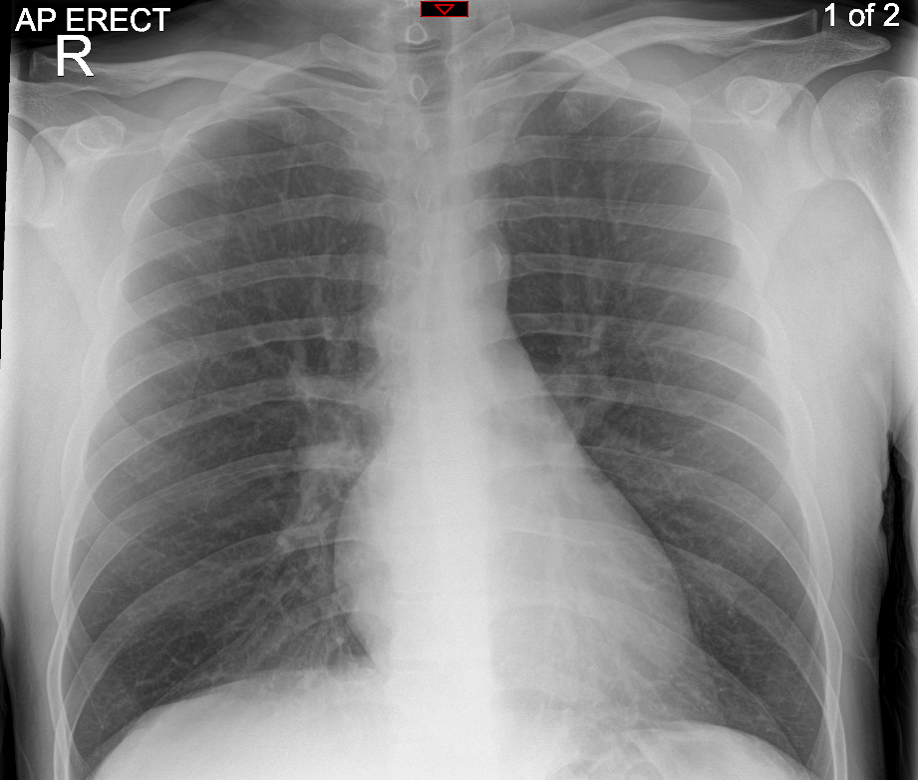

Slide 18
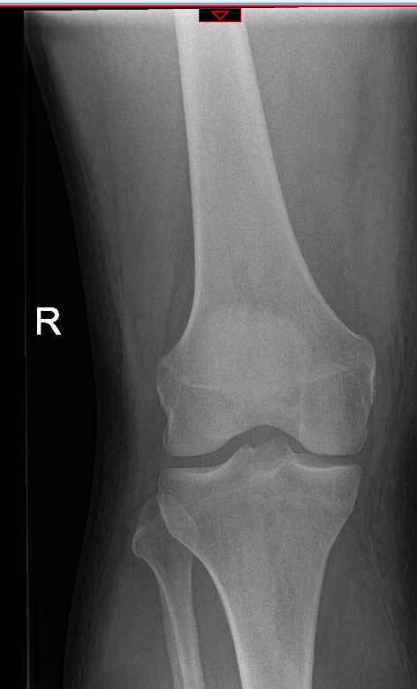
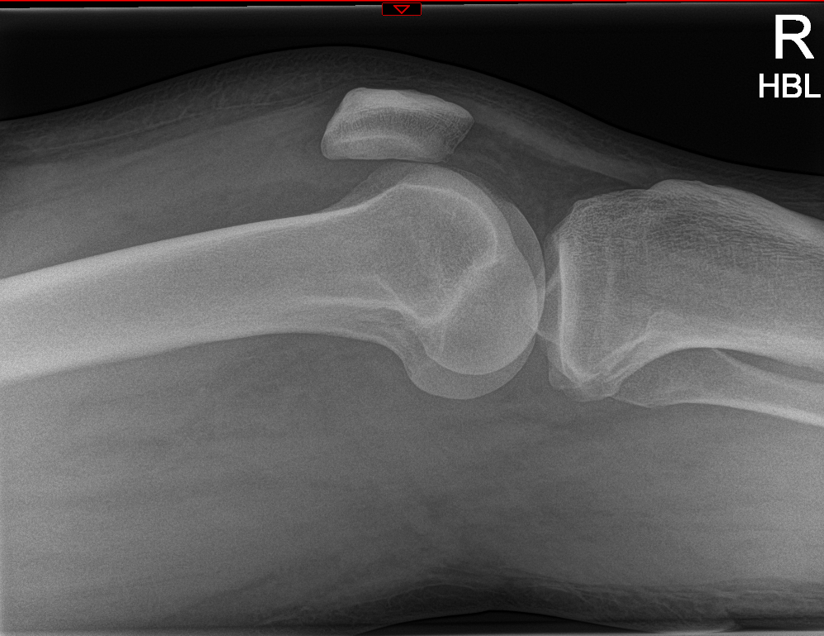

Slide 19
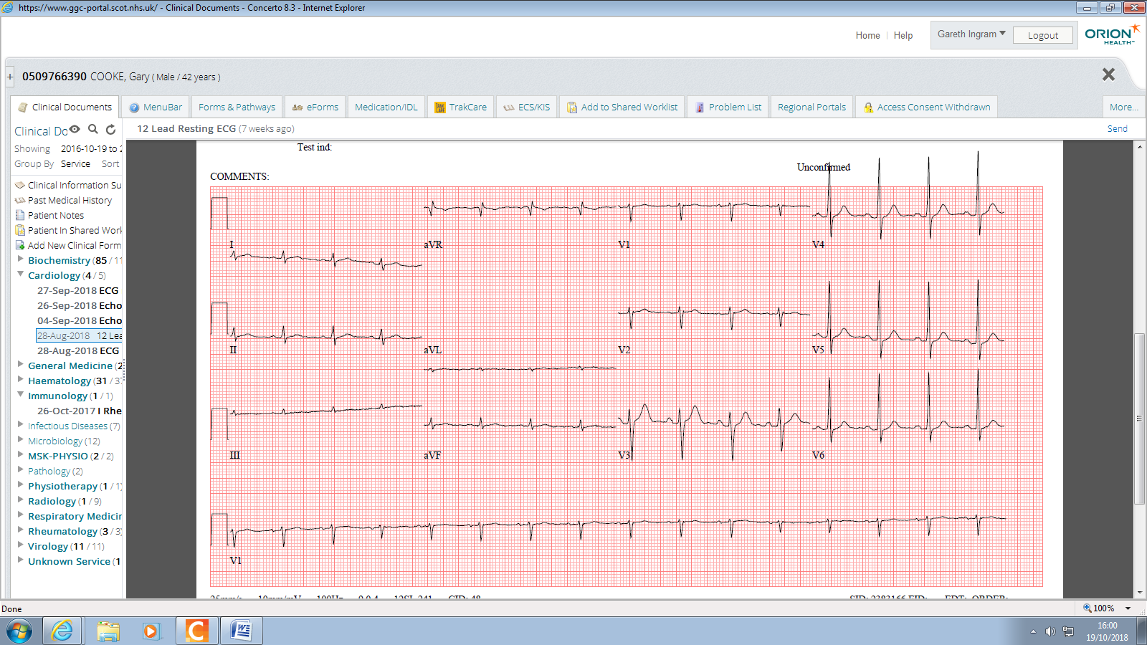

Slide 20
Night 1
Struggled to maintain BP
80-85 systolic
4.5 Litres in, 100ml out
Empty bladder on scan
Lactate 0.8
Moved to medical HDU for central line and noradrenaline
Unable to site arterial line

Slide 21
HDU
Brief 48 hour stay
BP improved to 105 systolic
Right leg noted to be swollen hot and tender
CRP fallen to 170
PO₄ replaced
Await micro results

Slide 22
Cultures
Urine
  Nil organisms or WCC
Blood
  Actinomyces turicensis
  Campylobacter ureolyticus
Knee
  WCC +++, no organisms
  Staphylococcus aureus

Slide 23
Ward
Rising CRP
Rising Creatinine
Clinically stable and “looks well”
Apyrexial since admission to HDU
BP 98 systolic

Slide 24
At the Weekend…
Met for the first time
BP 105 systolic, pulse 85
Mobilising now
Knee swollen but not hot
Right leg diffusely swollen
USS doppler leg requested

Slide 25
Next day
NEWS goes from 2-10
Pyrexial
Abx escalated to vancomycin
Further cultures sent
CXR – patchy opacification
Seen by rheumatology reg overnight
For further aspiration
  70ml Straw, blood stained fluid, no frank pus
Further fluid challenge, aim MAP >65

Slide 26
Discussed with ortho
  No effusion….. And good range of movement, therefore not septic arthritis
  Not for joint washout
  ?DVT
Patient continues to deteriorate
  Increasing oxygen requirement
?Septic DVT
?IE

Slide 27
Management
Phone call from micro
  “Growing everything”
  Give the rapidly spreading SSTI therapy (x5 abx)
D/W CT – CT with contrast
D/W Cardio – for echo
Transferred to Medical HDU again

Slide 28
Results
CRP approaching 300
WCC now 18, Hb 99
CT scan
  There are bilateral cavitating lung lesions present with gas and clot demonstrated within the right common femoral vein. Findings are felt most likely to represent septic emboli
Bedside echo (V scan)
  No obvious vegetation
  Normal LV function
  Cannot exclude IE on TTE

Slide 29
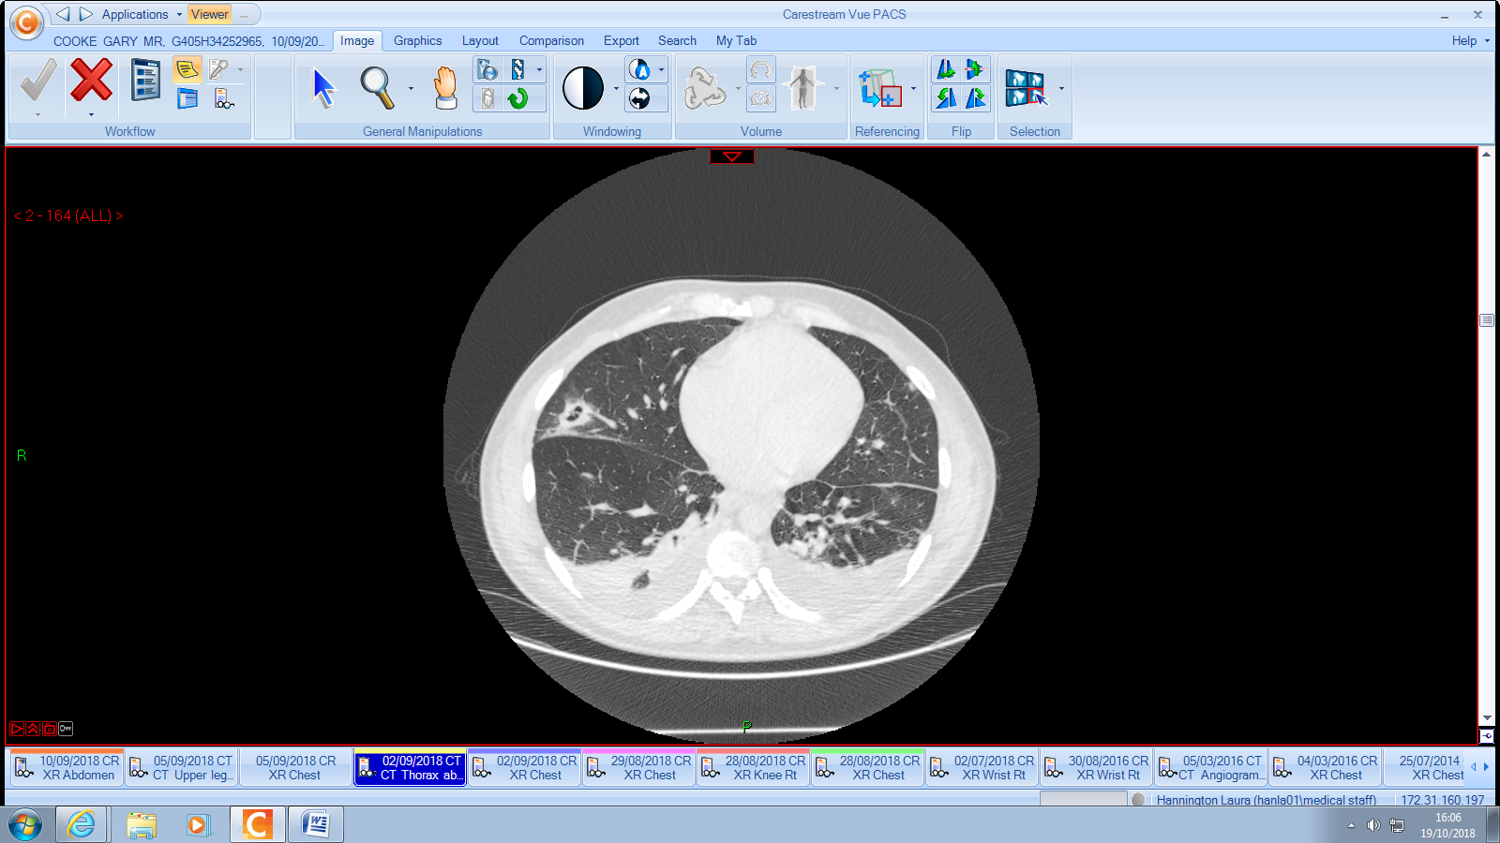

Slide 30
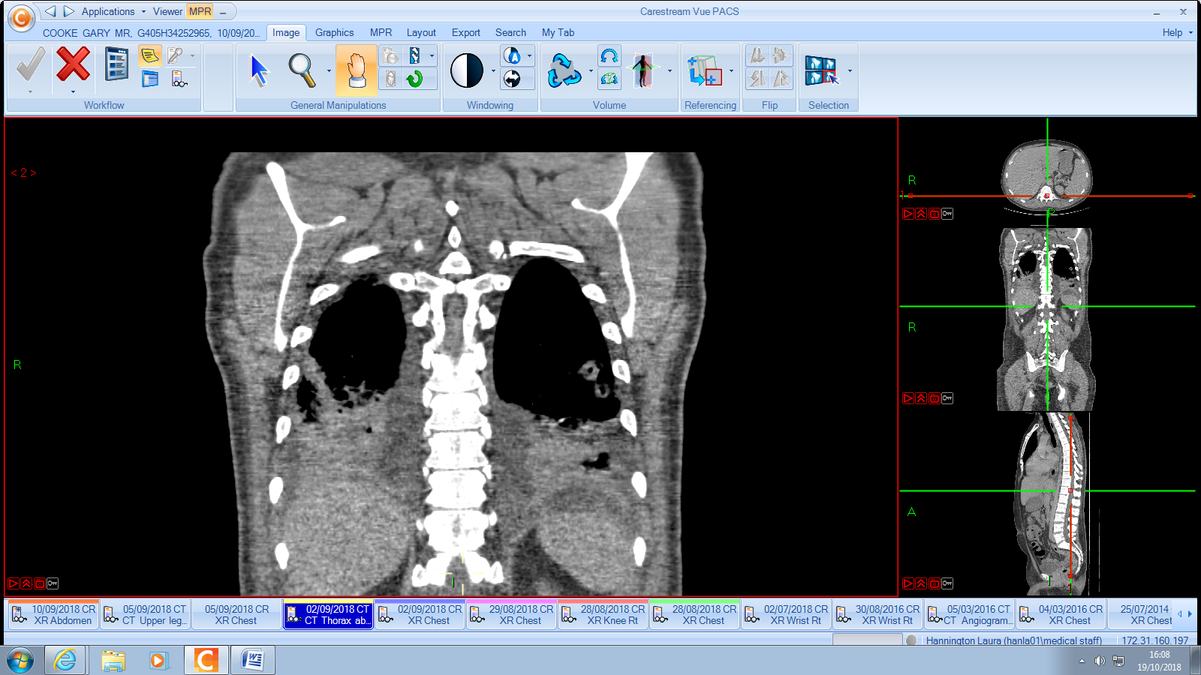

Slide 31
Medical HDU
Admits probable recent injection
Mild AKI
ID rationalised abx
  Flucloxacillin
  Clindamycin
  Benzylpenillin
Treatment dose dalteparin

Slide 32
ID
Step down to ID ward
Got PICC line, no further positive cultures
Issues with nausea secondary to Fluxcloxacillin
Leg swelling reducing
Inflammatory markers improving
Mobile structure on mitral valve leaflet
Further 2-3 weeks IV then repeat echo
6 weeks total abx duration for IE
4 weeks IV therapy

Slide 33
Final changes
Abx changed to vancomycin following nausea
Struggled with renal function
Then switched to daptomycin and tazocin
Repeat echo
  Vegetation no longer there
  IVOST to ciprofloxacin and clindamycin
Apixaban for 6 months
ID follow up in due course

Slide 34
Case 2
74 year old female
  Previous septic arthritis right knee
  Connective tissue disease
  Hypertension
Due to attend rheumatology clinic as OP
Struggling due to pain, reduced mobility
BIBA to A&E

Slide 35
Initial assessment
Feeling “rubbish” for 48 hours
Increasing pain in right knee, struggling to weight bare
Pain in left shoulder – known bursitis and tear on MRI previous month
Noted to be on mycophenolate and pred
WCC 16, CRP 24
?septic arthritis due to severity of pain, immunocompromised and prev septic joint

Slide 36
Transferred to Medical Receiving
Antibiotics not given, NEWS of 2, tachycardic
Mild cough recently, non-productive
Reviewed: main complaint was knee
Aspirated by FY1, 40mls straw colour fluid
  Blood culture bottles
  Micro
  Cytology

Slide 37
Following Events
Given topical analgesia
Developed a temperature 38.4 - treat
Paracetamol, blood cultures
Given IV fluclox initially
All cultures negative
24-48 hours developed productive cough and new CXR changes: treated for CAP

Slide 38
Case 3
54 year old
T8 tetraplegia (fall from a window)
Concerns re district nursing re pressure wounds
Brought in to Majors
Temp 37, low sats, tachypnoeic and borderline BP
Swollen hot left knee, chronic skin changes

Slide 39
First 24 hours
CRP >300, WCC 20
Referred to ortho
Aspirated frank pus from knee in A&E
  Started on fluclox
  Not keen for washout
Further aspiration
  15ml thick, blood stained pus
  White needle

Slide 40
Following events
Positive for gram positive cocci on gram stain
Grew Staph and Strep via cultures
Deteriorated secondary to septic shock and t/f to HDU for inotropes
Further deterioration re respiratory system
Intubated and t/f to ITU

Slide 41
Management
Reviewed by rheumatology consultant
Given combination of illness severity and t8 tetraplegia
  Left above knee amputation
Turbulent post op period
Remained in critical care unit due to O2 requirement tracheostomy and debridement of pressure sores
Since made full recovery

Slide 42
Get in touch!
Website
www.quackmeded.co.uk
Email
ggc.quackmeded@nhs.scot
Social Media
Twitter: @QUACK_ Med
Facebook: QUACK education

