Slide 1
Urology for Physicians
Gemma McGrory
Clinical Teaching Fellow

Slide 2
Disclaimer*
Please note that QUACK is a regional teaching programme operating across GG&C, Lanarkshire and Ayrshire & Arran.
This presentation outlines general management, though local variances e.g. antibiotic prescription may vary slightly depending on your local trust
Remember to check your local guidelines

Slide 3
Learning Outcomes
Case based approach
Discuss common urological problems, their presentation and management

Slide 4
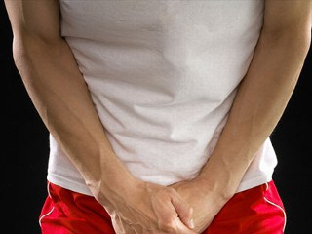
Case 1
18 year old man
Presents to ED with acute scrotal pain whilst playing football 1 hour ago
Differential diagnoses?

Slide 5
Testicular Torsion
Peak age 7 – 14, less common after 25
Sudden severe pain
Radiates to abdomen
Vomiting
Often during sport / activity
Red swollen testis
Unilateral retraction upwards

Slide 6
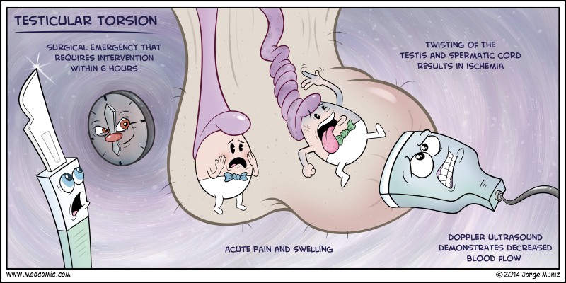

Slide 7
Case 2
18 year old from Case 1
Scrotal exploration and orchidopexy under general anaesthetic
In recovery, unable to pass urine…

Slide 8
Urinary Retention
Inability to void when bladder is full
  Sphincter unable to relax
  Proximal urethral obstruction
Acute
Chronic

Slide 9
Acute Urinary Retention
Postoperatively
  Fluids, supine, drugs, pain, embarrassment, anxiety
Clot retention
Stone
Pregnancy
Catheter acutely then TWOC

Slide 10
Chronic Urinary Retention
Thickened bladder neck
Prostatic enlargement
Spinal injuries
Gradual increase in incomplete voiding
Issues arise when volume approaches the maximum bladder capacity
  Urinary overflow
  Distended bladder

Slide 11
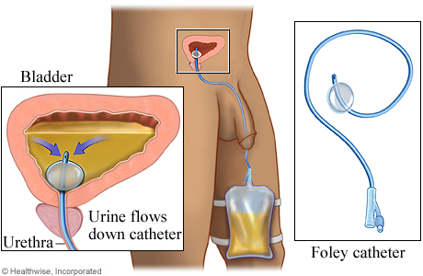
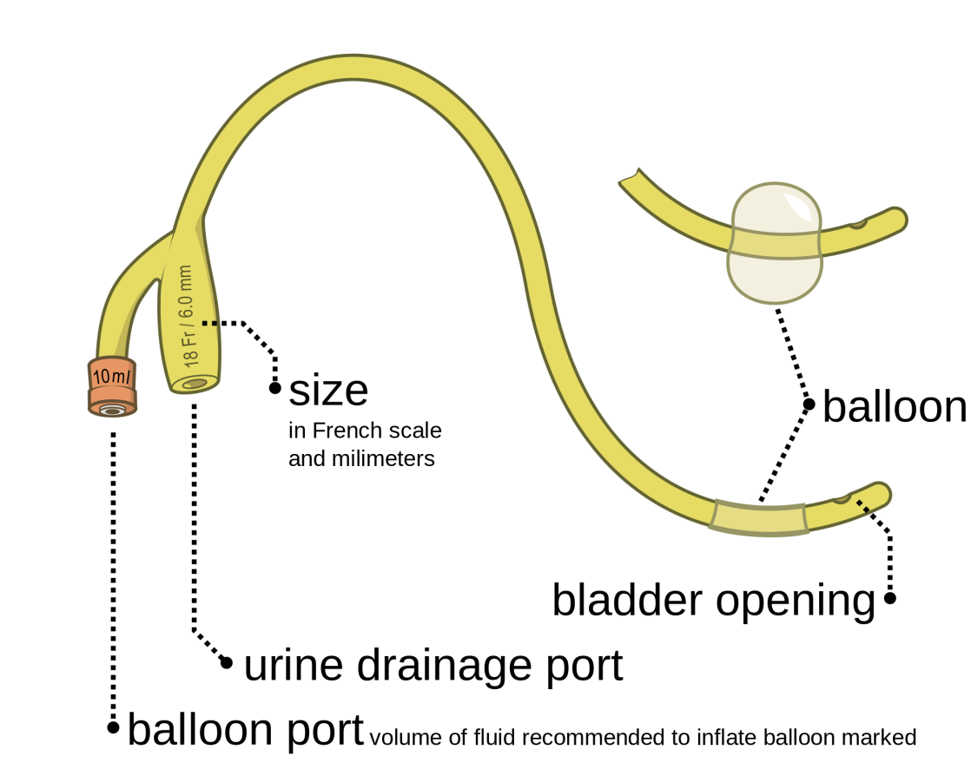

Slide 12
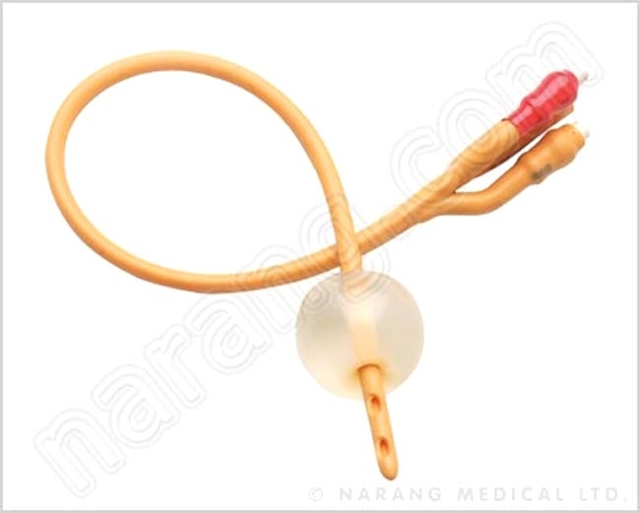
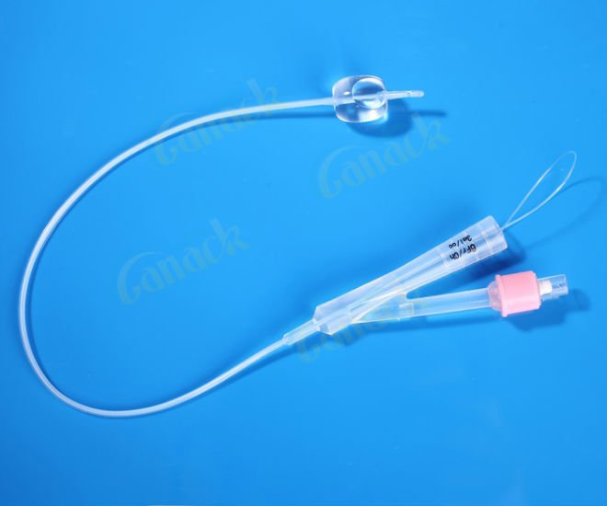

Slide 13
Case 3
78 year old man
Referred to urology clinic by GP
6 month history of increasing
  Frequency
  Nocturia
  Post micturition dribbling

Slide 14
Benign Prostatic Hypertrophy
50% >50 years
Universal at 70 years
  ~50% symptomatic enough to warrant treatment
Hyperplasia of paraurethral tissues
  Hence lots of symptoms
PSA
  Rises in correlation to prostatic mass

Slide 15
BPH Symptoms
Incomplete emptying
Frequency
Intermittent flow (stop/start)
Urgency
Weak stream
Straining
Nocturia
Hesitancy
Post-micturition dribbling
Double micturition

Slide 16
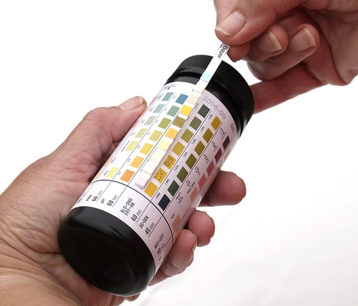
Investigations
Urine dip / MSSU
USS (TRUS)
U&Es / PSA
Cystometrometry
  Measuring urine flow rate
Cystoscopy
Notes:
TRUS – Transrectal Ultrasound Scanning

Slide 17

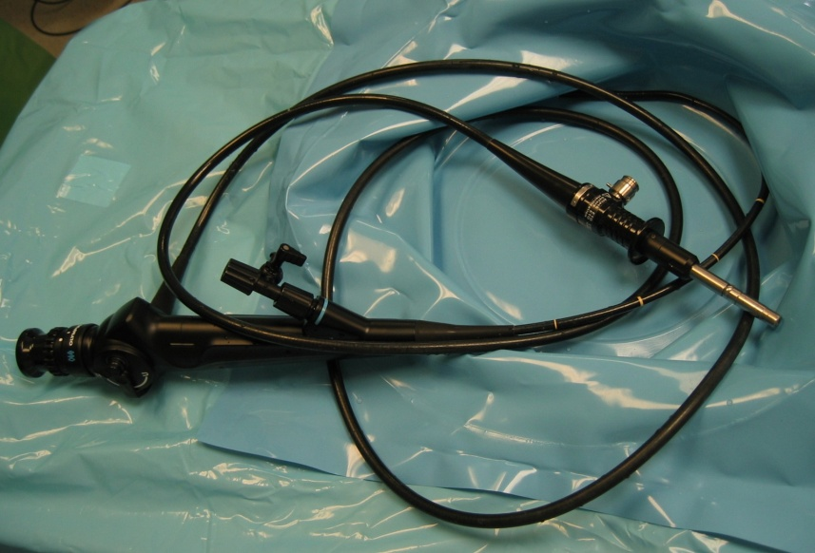
Management
Non-surgical
  Tamsulosin
  Finasteride
  Saw palmetto
  Catheter
Surgical
  TURP
Notes:
Finasteride blocks the enzyme 5-alpha reductase from coverting testosterone into dihydro-testosterone and therefore reduces the size of hyperplastic prostate glands
Tamsulosin – alpha-adrenergic A1 blockers which are present in the bladder neck and prostate
Usually combination
Saw palmetto natually contains 5-alpha reucing substances

Slide 18
Case 4
The gentleman from case 3 is discovered to have a PSA of 35
What does this mean?

Slide 19
Prostate Cancer
PSA 10-15 likely benign
  > 15 more likely to be neoplastic
Common in Western countries
Common after age 65
Usually adenocarcinoma
  Depend on testosterone for growth
  Slower to develop symptoms as develop from peripheral prostatic glands

Slide 20
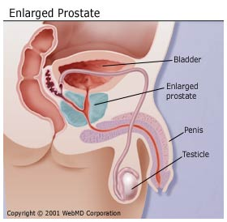

Slide 21
Further Management
Biopsy transurethrally
  If tumour <5% total cells can be managed safely conservatively
Surgery (TURP)
Chemotherapy
Radiotherapy
Chemical / surgical castration
Notes:
If low grade and not advanced, chances will die with it and not from it
If metastasis, 5 year survival 20%

Slide 22
Complications of TURP
Haematuria
Haematospermia
Retrograde ejaculation (common)
Infection / prostatitis
Impotence ~10%
• Incontinence

Slide 23
Case 5
48 year old lady with recently diagnosed hypertension presents with:
  Flank pain
  Frank haematuria
Differential Diagnoses?

Slide 24
Renal Tumours
Often found incidentally on CT
Arise from tubular epithelium
Usually renal cell carcinoma
Can reach a large size before symptoms
  Retroperitoneal
    >8cm 80% metastasised

Slide 25
Renal Tumours
Symptoms
Risk Factors
Haematuria
Loin Pain
Mass
PUO
Hypertension
Anaemia
Cannonball lesions
Smoking
Hypertension
APKD
Exposure to solvents / heavy metals
Renal transplantation
Analgesic abuse

Slide 26
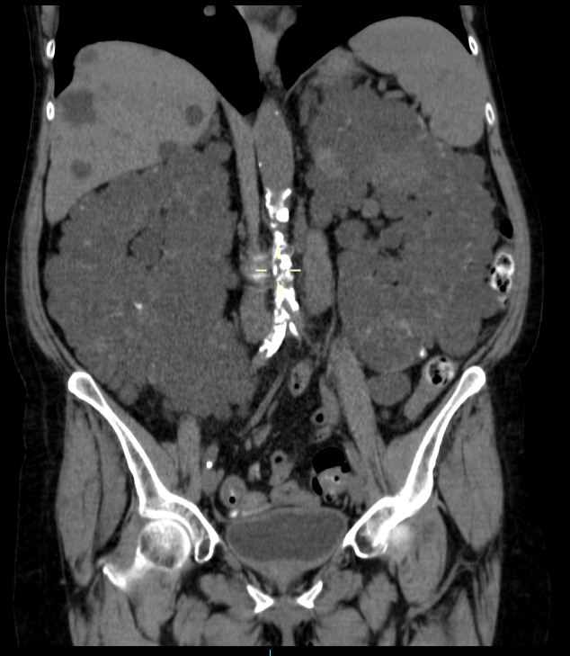
AKPD
Notes:
APKD with liver cysts

Slide 27
Case 6
85 year old man
Retired former Grangemouth worker
Smoker
Developed frank haematuria and increased micturation 2 weeks ago
Differential diagnoses?

Slide 28
Case 6
85 year old man
Retired former Grangemouth worker
Smoker
Developed frank haematuria and increased micturation 2 weeks ago
GP treated as UTI, no better
Differential diagnoses?

Slide 29
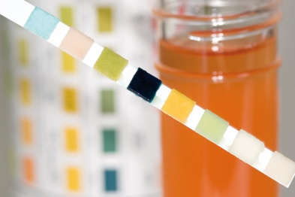
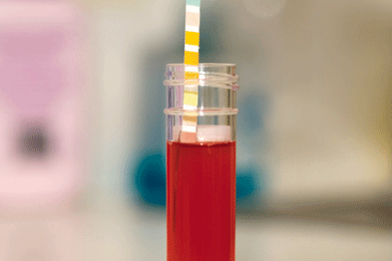
Haematuria
UTI
Urinary tract malignancy
Renal calculi
Glomerulonephritis
APKD

Slide 30
LUTS Symptoms
Frequent micturition
  Incomplete emptying
  Overactive bladder
  Bladder irritation
Nocturia
Urgency
Hesitancy
Poor urinary stream
Post micturition dribbling
Notes:
LUTS - Lower Urinary Tract Symptoms

Slide 31
Bladder Cancer
Urothelial tumours
Usually transitional cell carcinoma
Risk factors:
  Smoking
  Analgesic nephropathy
  Rubber and aniline dye exposure
  Renal calculi
  Schistosoma infection

Slide 32
Summary
Case based approach
Discuss common urological problems, their presentation and management
Testicular torsion
Urinary retention
BPH / prostate cancer
Urinary tract tumours

Slide 33
Get in touch!
Website
www.quackmeded.co.uk
Email
ggc.quackmeded@nhs.scot
Social Media
Twitter: @QUACK_ Med
Facebook: QUACK education

