Slide 1
Management of Atrial Fibrillation
Gemma McGrory
Acute Medicine Registrar

Slide 2
Disclaimer*
Please note that QUACK is a regional teaching programme operating across GG&C, Lanarkshire and Ayrshire & Arran.
This presentation outlines general management, though local variances e.g. antibiotic prescription may vary slightly depending on your local trust
Remember to check your local guidelines

Slide 3
Background
Atrial fibrillation is an arrhythmia
Results from irregular and disorganised electrical activity in the atria
Common causes:
  Idiopathic
  Alcohol
  IHD
  Hypertension
  Valvular heart disease
  Hyperthyroidism

Slide 4
ECG Features
No p waves
Irregular
Narrow QRS
May be fast or slow

Slide 5
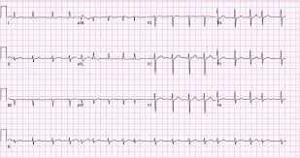

Slide 6
Symptoms
Palpitations
Syncope
Chest pain
Breathlessness
Signs and symptoms of heart failure

Slide 7
Complications of AF
Stroke and thromboembolism
Heart failure
Tachycardia-induced cardiomyopathy and critical cardiac ischaemia
Reduced quality of life

Slide 8
Stroke Risk Factors in AF
RR
Previous stroke or TIA 2.5
Diabetes 1.7
Hypertension 1.6
CAD 1.5
Increased age (per decade) 1.4
CHF 1.4

Slide 9
Definitions
First episode
Paroxysmal: self terminating
Persistent: not self terminating, terminates
with pharmacological or
electrical cardioversion
Permanent: cardioversion failed or not
attempted

Slide 10
Conclusions (NEJM, 2002)
Rate control can be considered a primary approach to therapy
Rhythm control, if used, may be abandoned early
Continuous anticoagulation warranted in all patients with AF and stroke risk factors, even when SR apparently restored

Slide 11
Echocardiography
Perform if:
Baseline echo important
Rhythm control being considered
Suspicion of underlying heart disease
Risk stratification for antithrombotic therapy needed

Slide 12
Cardioversion
Pharmacological or electrical if <48h
Electrical preferred if >48h
Flecainide if no structural heart disease
Amiodarone if structural heart disease
If concern about success of electrical cardioversion, 4 weeks prior treatment with amiodarone or sotalol
Anticoagulation needed for 6 weeks prior to elective cardioversion

Slide 13
Persistent AF

Slide 14
Persistent AF
Appropriate antithrombotic therapy irrespective of rate or rhythm control
Rate control preferred if >65y, CAD, contraindications to AADs, unsuitable for cardioversion, no CHF
Rhythm control preferred if symptomatic, younger, 1st presentation with lone AF, corrected precipitant, CHF

Slide 15
Rate Control
Standard beta blocker if structural heart disease, amiodarone 2nd line
Standard beta blocker if no structural heart disease; flecainide, propafenone or sotalol 2nd line; amiodarone 3rd line

Slide 16
Rate Control
Beta blockers or rate-limiting CCBs preferred initial monotherapy
Digoxin only where monotherapy inadequate or if elderly patient

Slide 17
Rhythm Control
Consider no treatment or ‘pill-in-the pocket’ if infrequent, few symptoms or known precipitant
Otherwise standard beta blocker 1st line
Sotalol 2nd line if CAD
Flecainide, propafenone or sotalol 2nd line if no structural heart disease
Amiodarone or non-pharmacological therapy 3rd line (2nd line if structural heart disease)

Slide 18
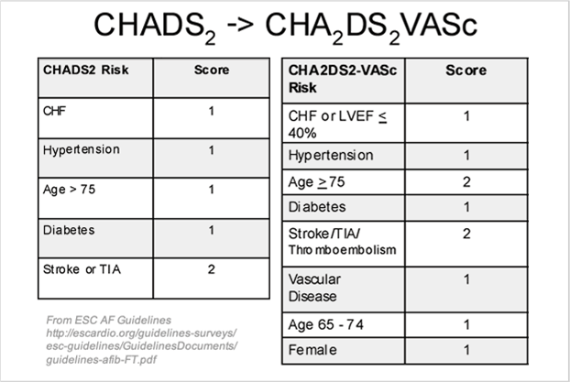
Anticoagulation
CHADSVASC2 score to assess stroke risk
If score:
  0 = low risk, no anticoagulation
  1 = medium risk, consider anticoagulation
  2 = high risk, anticoagulation advised

Slide 19
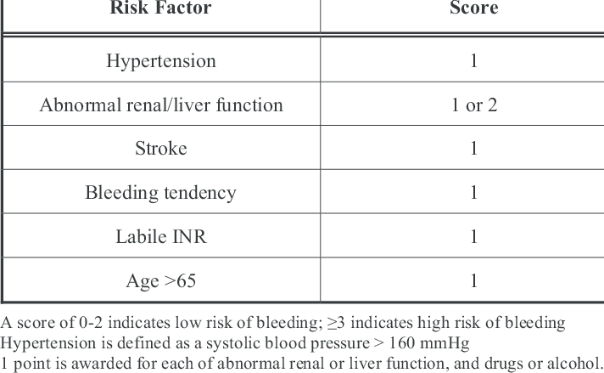
But what about bleeding risk?
HASBLED score
Score:
  0-2 low risk of bleeding
  > or equal to 3 high risk of bleeding

Slide 20
Which anticoagulant? (NICE, 2020)
Warfarin or a direct oral anticoagulant drug (DOAC; dabigatran, edoxaban, rivaroxaban, or apixaban) depending on trust guidelines
Advantages and disadvantages of warfarin and the DOACs so that they can make an informed choice about their treatment. For example, discuss the following:
  Stroke risk reduction — DOACs are non-inferior to warfarin for the prevention of stroke in people with AF [Ruff et al, 2014].
  Risks associated with treatment — DOACs are associated with a reduced risk of haemorrhagic stroke and intracerebral haemorrhage compared with warfarin.
  Adherence to treatment — adherence to anticoagulation treatment is vital, but is more important with NOACs than with warfarin. This is because DOACs have a relatively short half-life and their anticoagulant effect fades rapidly after 12 to 24 hours. With warfarin, some benefit is retained for 48 to 72 hours after missing a dose.
  Monitoring of treatment — DOACs have predictable pharmacokinetics, so coagulation control does not need to be monitored. Warfarin, on the other hand, needs regular blood tests to monitor coagulation control.
  Reversibility of effect — unlike warfarin, there are, as yet, no specific antidotes for DOACs; however, there are steps that can be taken to reverse their effect in the event of a major bleed.

Slide 21
Acute AF

Slide 22
Treatment
Emergency electrical cardioversion if life-threatening, irrespective of duration
If non-life-threatening but haemodynamically unstable, IV amiodarone if electrical cardioversion delayed
Flecainide is an alternative in WPW (avoid AV node-blocking drugs)
If instability due to poorly controlled ventricular rate beta blockers or rate limiting CCBs 1st line, amiodarone 2nd line

Slide 23
Acute Antithrombotic Therapy
Start heparin
If <48h no long term anticoagulation if SR restored within same 48h, low risk of recurrence and low stroke risk (e.g. alcohol induced)
Anticoagulation if uncertainty about timing of onset
(Always manage as per local trust guidelines)

Slide 24
Protocols

Slide 25
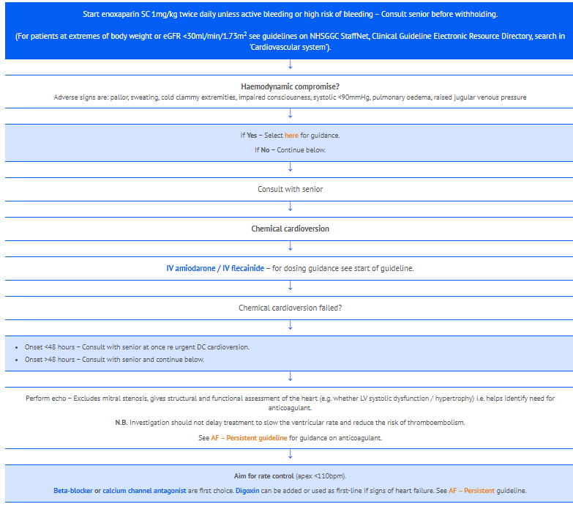
GGC Therapeutic Handbook

Slide 26
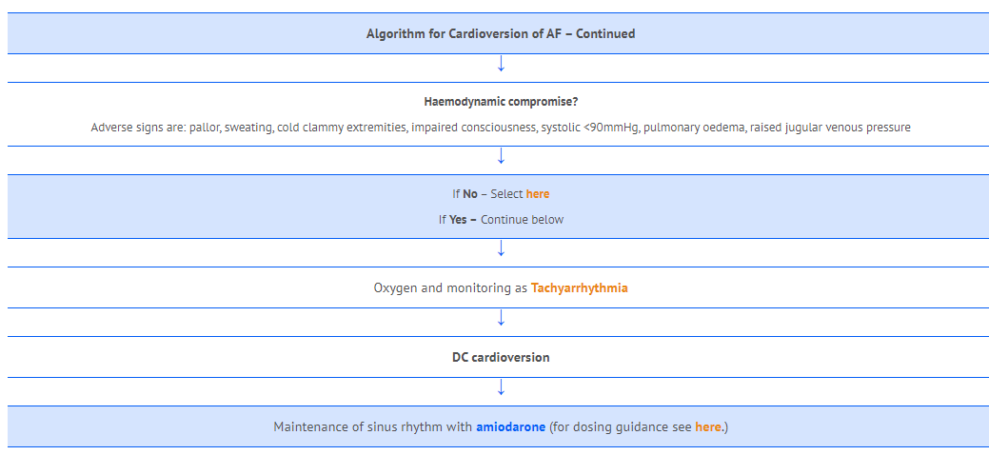
GGC Therapeutic Handbook

Slide 27
References
CHASVASC2 https://www.mdcalc.com/cha2ds2-vasc-score-atrial-fibrillation-stroke-risk
HASBLED https://www.mdcalc.com/has-bled-score-major-bleeding-risk
NICE CKS AF https://cks.nice.org.uk/topics/atrial-fibrillation/
NICE AF Guideline https://www.nice.org.uk/guidance/cg180
ECS AF guideline https://www.escardio.org/Guidelines/Clinical-Practice-Guidelines/Atrial-Fibrillation-Management
GGC Therapeutic Handbook https://handbook.ggcmedicines.org.uk/guidelines/cardiovascular-system/atrial-fibrillation-af-or-flutter-recent-onset/

Slide 28

Get in touch!
Website
www.quackmeded.co.uk
Email
gg-uhb.quackmeded@nhs.net
Social Media
Twitter: @QUACK_ Med
Facebook: QUACK education

