Slide 1
Myasthenia Gravis in the Acute Receiving Unit
Michael Lowe
ST3 LAT in Neurology

Slide 2
Disclaimer*
Please note that QUACK is a regional teaching programme operating across GG&C, Lanarkshire and Ayrshire & Arran.
This presentation outlines general management, though local variances e.g. antibiotic prescription may vary slightly depending on your local trust
Remember to check your local guidelines

Slide 3
Outline: Three Situations
New presentation of undiagnosed myasthenia gravis
  How to spot it
  Differential diagnosis/mimics
  What to do
The myasthenic patient admitted with an unrelated issue
  Things to be aware of to avoid triggering a crisis!
Acute myasthenic crisis
  When to be worried
  How to treat
  What to monitor
  When to panic (in a controlled fashion)

Slide 4
Case: A 63 year old woman with diplopia
Mrs Green is referred by her GP with intermittent double vision ?stroke/TIA:
  2 months of double vision that comes and goes
  Notices this most often when reading before bed
  Friends have also commented more recently that she is harder to hear at the end of a phone call
Background:
  Hypothyroidism – on adequate replacement
  Fit & well, independent, shopkeeper
  Social drinker, non-smoker
  No family history

Slide 5
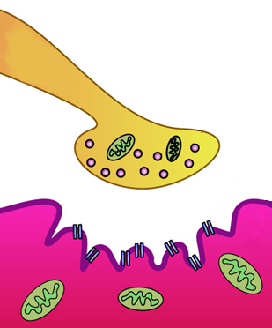
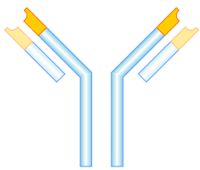
Myasthenia Gravis
Lower Motor Neuron
Autoimmune, antibody mediated condition
Affecting the neuromuscular junction
Most commonly due to auto-antibodies against the nicotinic acetylcholine receptor on the muscle end plate
Impaired neuromuscular transmission leads to weakness
Defining clinical feature is fatigable weakness (worsens with repetitive or sustained effort)
AChR-Ab
AChR
Muscle Endplate

Slide 6
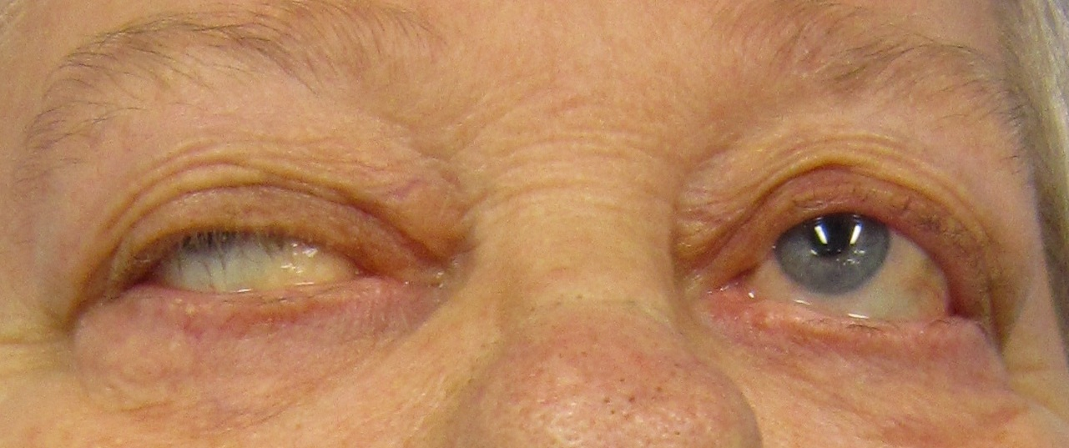
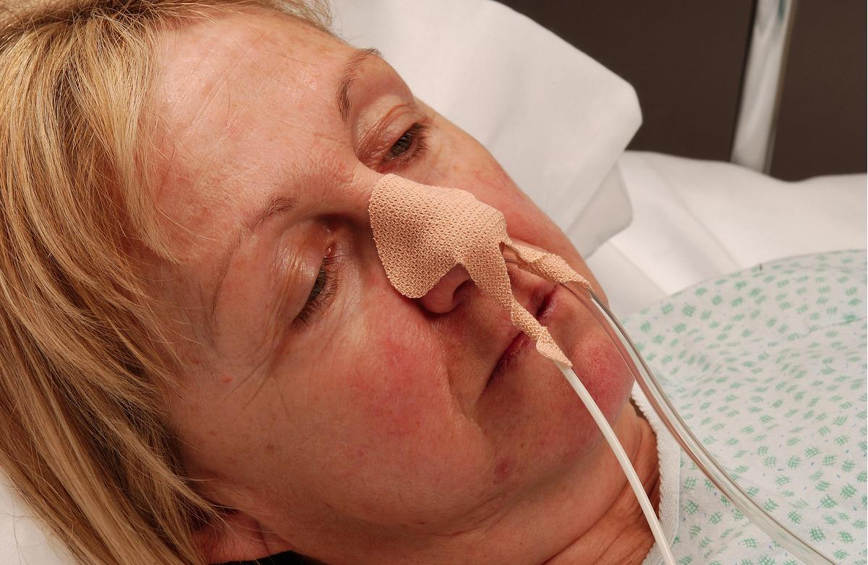
Typical Features
Ocular
  Ptosis (may be unilateral) & diplopia
  Almost all patients will have ocular involvement; presenting feature in >50%
  15-20% will have isolated ocular disease but most develop generalised features in first 1-2 years
Limbs
  Proximal weakness of legs, arms; less commonly distal weakness
Bulbar
  Dysarthria, dysphagia, facial weakness, difficulty chewing, neck weakness
Respiratory (always concerning!)
  Dyspnoea, apnoea, orthopnoea
By James Heilman, MD - Own work, CC BY-SA 3.0, https://commons.wikimedia.org/w/index.php?curid=17978809

Slide 7
What to look for in the history/examination
Evidence of fatiguability is key to the diagnosis
History | Examination
Diplopia after a period of focussing (e.g. reading/driving) | Ptosis/diplopia which is seen or exaggerated after prolonged upgaze
Dysarthria/dysphonia after a long conversation/lecture etc. | Proximal weakness which is worse after 15-20 repetitions (e.g. shoulder abduction)
Difficulty chewing/swallowing towards the end of a meal | Repeating the alphabet/counting multiple times – fatigable dysarthria
Diurnal variation in symptoms, generally worse in the evening | Neck flexion/extension weakness

Slide 8
Case: Mrs Green
Fatigable diplopia and hypophonia – ocular and bulbar involvement
Autoimmune history associated with MG
Examination
  Slight bilateral ptosis, worse on the right, otherwise cranial nerves all intact, full range of extra-ocular movements
  Normal tone, full power, symmetrical reflexes, sensation and co-ordination intact in all limbs
  After holding upgaze for 20 seconds develops diplopia and ptosis worsens
  After repeated shoulder abduction there is slight reduction in power bilaterally

Slide 9
What to do if you suspect Myasthenia Gravis
Refer to Neurology!
Look for red flags – see later section on myasthenic crisis
Significant bulbar symptoms, neck weakness, respiratory involvement will require inpatient management
Ocular involvement and only mild generalised myasthenia may be suitable for outpatient management
1st Line Tests
2nd Line Tests
If all –ve consider other Dx
AChR Antibodies
TFTs
CT thorax (?thymoma)
MuSK antibodies
Repetitive nerve stimulation/
Single fibre EMG

Slide 10
Some Potential Mimics of Myasthenia
Motor neuron disease (especially bulbar onset)
  Usually slowly progressive with little variability in symptoms
Lambert Eaton Myasthenic Syndrome
  Ocular involvement is rare; autonomic features may be present; less fatigable (may improve after exercise)
Myopathies
  Again ocular involvement is rare; less variability; inflammatory myopathies associated with pain, systemic illness
Thyroid eye disease
  Can present with complex ophthalmoplegia but not ptosis; may have proptosis
Guillain-Barre Syndrome/variants
  Typically ascending weakness; sensory signs/symptoms;
  areflexia; acute progressive onset without variability

Slide 11
Management of MG in the non-acute setting
If not controlled initially
If not controlled initially or unable to wean <15-20mg prednisolone
AChE inhibitors
Steroids
Immunosuppresion
Pyridostigmine 30mg 4/day typical starting dose
Titrated over weeks up to 90mg 5/day
Prednisolone either daily or alternate days
Titrated slowly – can worsen weakness initially
Azathioprine 1st line (check TPMT)
Others include MMF, methotrexate, ciclosporin, rituximab
Thymectomy
If there is a thymoma on CT
In young patients with seropositive MG thymectomy is evidence based even in absence of thymoma

Slide 12
Case: Mrs Green
Seen by Neurology
Suspected diagnosis of generalised myasthenia gravis
Commenced on pyridostigmine 30mg QDS
AChR antibodies sent, later come back positive
Discharged for outpatient management as only ocular and very mild bulbar symptoms
Over next few weeks titrates up pyridostigmine but symptoms persist
Prednisolone introduced and symptoms resolve, established on 10mg daily
CT thorax is normal, no thymoma

Slide 13
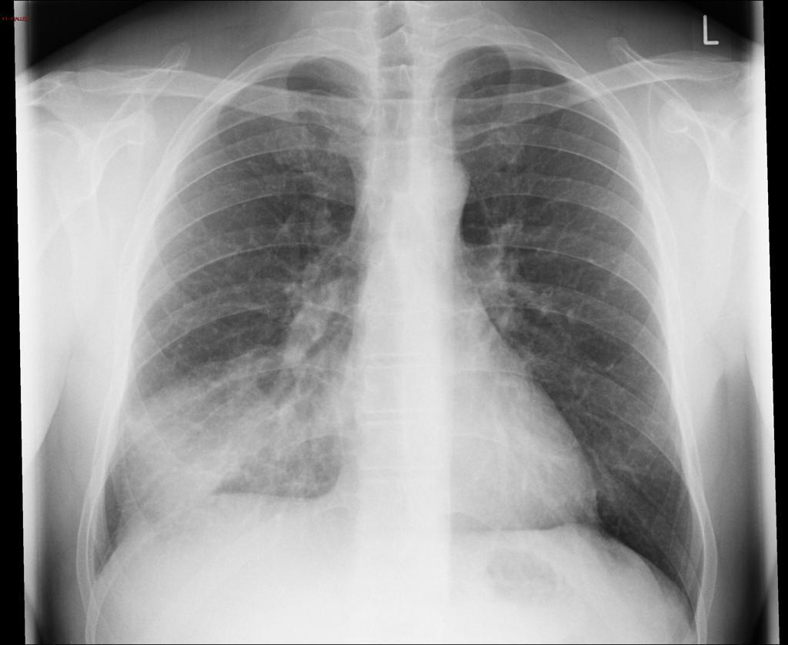
Later… Mrs Green gets a cough
Several months later attends A&E with a few day history of cough, green sputum and fever
SpO2 96% OA, RR 22, BP 141/86, HR 95, Temp 38.6
Right basal creps
Right lower zone consolidation on CXR

Slide 14
Special Considerations in Managing Patients with Myasthenia
Ensure they get their regular pyridostigmine
  If NBM – guidance available on Staffnet
  NG tube for administration preferable
  Parenteral neostigmine is an option if this is not possible
Drugs to avoid
  Many drugs can worsen myasthenia; full list on Staffnet
  Write that patient has MG in allergy section of Kardex
  Commonest high risk drugs are antibiotics, particularly aminoglycosides (gentamicin)
Not to alter steroid doses quickly
  Don’t change without Neurology advice unless urgent (e.g. adrenal crisis)
  Don’t routinely double up if unwell
Be aware of potential for deterioration

Slide 15
Case: Mrs Green’s pneumonia
Several months later attends A&E with a few day history of cough, green sputum and fever
SpO2 96% OA, RR 22, BP 141/86, HR 95, Temp 38.6
Right basal creps
Right lower zone consolidation on CXR
Admitted to medical ward
Started on amoxicillin after checking MG drugs list
Usual pyridostigmine prescribed
No change to usual steroid dose
Assessed carefully for signs/symptoms of myasthenia

Slide 16
Progress on the ward
Initial improvement with antibiotics, cough settles, no further fevers, bloods improving
However next day becomes increasingly short of breath
Can’t lie flat due to breathlessness
Speech slurred
Feels generally weak

Slide 17
The Deteriorating Myasthenic Patient
Features of impending myasthenic crisis include:
Significant bulbar symptoms
Any respiratory symptoms
Progressive deterioration despite treatment
Assessment should include:
Screen for infection (common trigger for deterioration)
Check drugs/recent changes against risk drugs list
Ensure has been taking usual treatment; check if any recent reduction
Speech and language therapy input; may need NGT
Ideally manage in Neurology ward or HDU setting

Slide 18
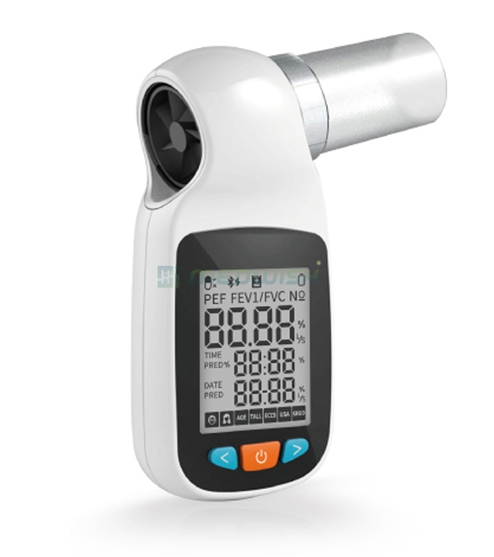
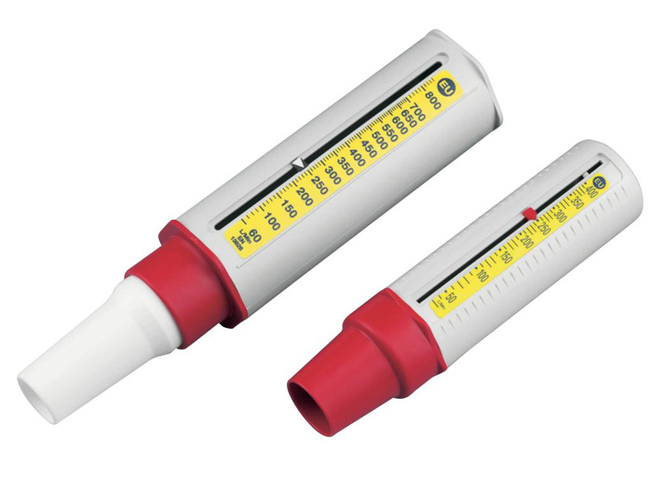
Monitoring: Vital Capacity
Most importance parameter to monitor is vital capacity
Vital capacity monitors may be available (more restricted with COVID-19)
NOT peak flow – unreliable and not a good marker of neuromuscular ventilatory failure
Reasonable proxy of VC is a single breath count
  “Take a deep breath and count up from 1 as long as you can”
  Variation in counting speed etc. makes single measure harder to interpret, trend is more helpful

Slide 19
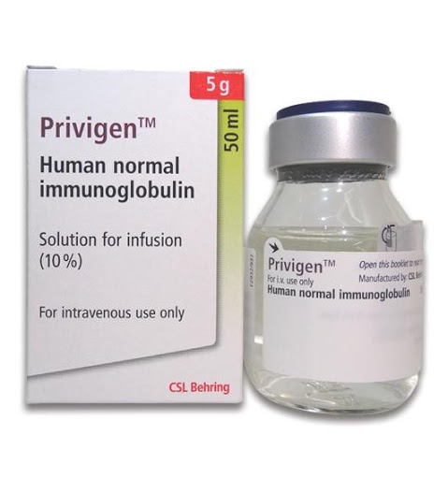
Treatment of Deteriorating Myasthenia Gravis
Treat any reversible cause of deterioration (infection, correct electrolytes etc.)
Intravenous Immunoglobulin (IVIg)
  Usually given 2g/kg over 5 days
  Can take some time to kick in
  Effect usually lasts 3-4 weeks
Plasma Exchange (PLEX)
  Alternative to IVIg if contraindicated
Addressing longer term management
  Uptitration of prednisolone to prevent relapse once IVIg
  wears off; addition of further immunosuppressant

Slide 20
Case: Mrs Green - Progress
No FVC monitor available, single breath count 18
Bilateral ptosis and dysarthria now evident, choking episodes with lunch
Update bloods and CXR show ongoing improvement in pneumonia
Management:
Discussed with local Neurology team
NG tube passed to continue regular medications
IVIg commenced
Moved to HDU for close monitoring

Slide 21
When to refer to ICU
Early review/at least make ICU aware of any deteriorating patient with MG
Low threshold for admission to ICU; can crash very rapidly with little warning
Patients should certainly be referred if:
High/rising PCO2
Hypoxaemia (if due to neuromuscular ventilatory failure this develops as a late sign and can signify impending respiratory arrest)
FVC <1L or <20ml/kg
Single breath count <15
Clinical judgement – if the patient is very fatigued and
looks unwell despite maintaining adequate ‘numbers’

Slide 22
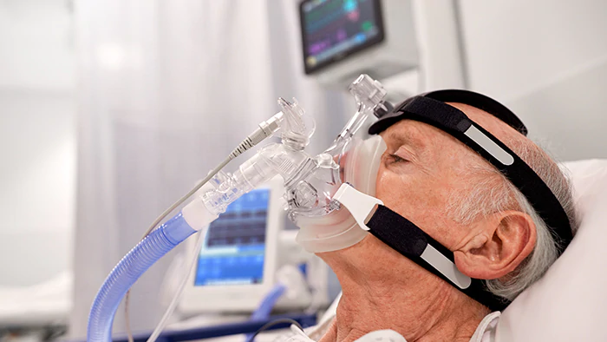
Use of NIV in Myasthenia Gravis
NIV does have a role in MG
Can be used as an interim measure to
treat type II respiratory failure whilst
treatment (usually IVIg) takes effect
Caveats:
Requires good level of consciousness; airway maintenance
Secretion/sputum clearance can be an issue
Significant bulbar weakness lessens probability of success with NIV
Must take place in a critical care environment where invasive ventilation can be quickly established if deteriorates

Slide 23
Case: Mrs Green - Progress
Continues to deteriorate
By teatime single breath count is 13
Updated ABG shows PCO2 now 8, H+ 52
Management:
Referred to ICU
Commenced on NIV pending review but requires frequent breaks for suctioning, poor cough; fails to improve
Intubated and ventilated

Slide 24
ICU Progress and Outcomes
ICU outcomes are generally good
Mortality is usually due to medical complications such as overwhelming sepsis or pneumonia
ICU mortality rates probably 5-10% in cohort studies
Duration of ICU admission in ventilated patients is typically 1-2 weeks, may be longer

Slide 25
Case: Mrs Green – Progress to Discharge
Completes course of IVIg over next 5 days whilst in ICU
Reducing oxygen requirement and pressure support
Successfully extubated on day 5 of ICU stay
Stepped down to ward to rehab
Prednisolone increased and azathioprine added
Discharged 1 week with no ongoing symptoms of myasthenia

Slide 26
Summary: Myasthenia Gravis
Fatigable ocular (most common), bulbar, limb and respiratory weakness
Positive antibody sufficient for diagnosis with typical history/exam
If admitted be aware of drugs to avoid list, ensure they get their usual treatment, don’t double steroid up
Let Neurology know early of any deteriorating MG patient
Monitor closely if significant weakness, especially bulbar – HDU – can ‘go off’ very quickly
FVC or single breath count, not PEFR!
Early ICU involvement

Slide 27
Further Reading
Sussman J, Farrugia ME, Maddison P, et al. Myasthenia gravis: Association of British Neurologists’ management guidelines. Pract Neurol 2015;15:199–206.
Spillane J, Higham E, Kullmann DM. Myasthenia gravis. BMJ. 2012 Dec 21;345:e8497.
Whittaker RG. Testing the neuromuscular junction: what neurophysiology can offer the neurologist. Pract Neurol. 2011 Oct;11(5):303-7.
Al-Bassam W, Kubicki M, Bailey M, Walker L, Young P, Pilcher DV, Bellomo R. Characteristics, incidence, and outcome of patients admitted to the intensive care unit with myasthenia gravis. J Crit Care. 2018 Jun;45:90-94.

Slide 28
Thank you
Please fill out the feedback form for your certificate of learning

Slide 29
Get in touch!
Website
www.quackmeded.co.uk
Email
ggc.quackmeded@nhs.scot
Social Media
Twitter: @QUACK_ Med
Facebook: QUACK education

