Slide 1
Pleural Effusion for Physicians
Gemma McGrory
ST6 AIM

Slide 2
Disclaimer*
Please note that QUACK is a regional teaching programme operating across GG&C, Lanarkshire and Ayrshire & Arran.
This presentation outlines general management, though local variances e.g. antibiotic prescription may vary slightly depending on your local trust
Remember to check your local guidelines

Slide 3
Pleural Effusion
What is it?
How does it present?

Slide 4
Presentation
SOB
SOBOE
Chest pain
Cough
Features of malignancy
Occupational history important
  Why?
    Different lung diseases prevalent in different occupational groups e.g. asbestosis in shipbuilders, silicosis in stoneworkers etc.

Slide 5
Light’s Criteria
Considered an exudate when:
  Pleural fluid-serum protein ration >0.5
  Pleural fluid-serum LHD ratio >0.6
  Pleural fluid LDH > 2/3 the upper limit of normal

Slide 6
Pleural Effusion
Transudate
Exudate
Cardiac failure
Cirrhosis
Low albumin
Renal failure
Hypothyroidism
FAILURE
Malignancy
Parapneumonic
TB
PE
Pancreatitis
RA / SLE
ACTIVE PROCESS

Slide 7
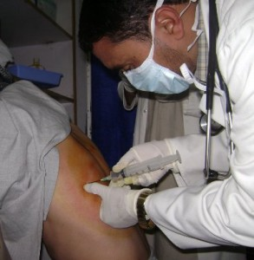
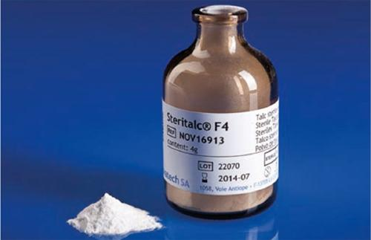
Management
CXR
CT scan
Pleural tap +- drain
+-Pleurodesis

Slide 8
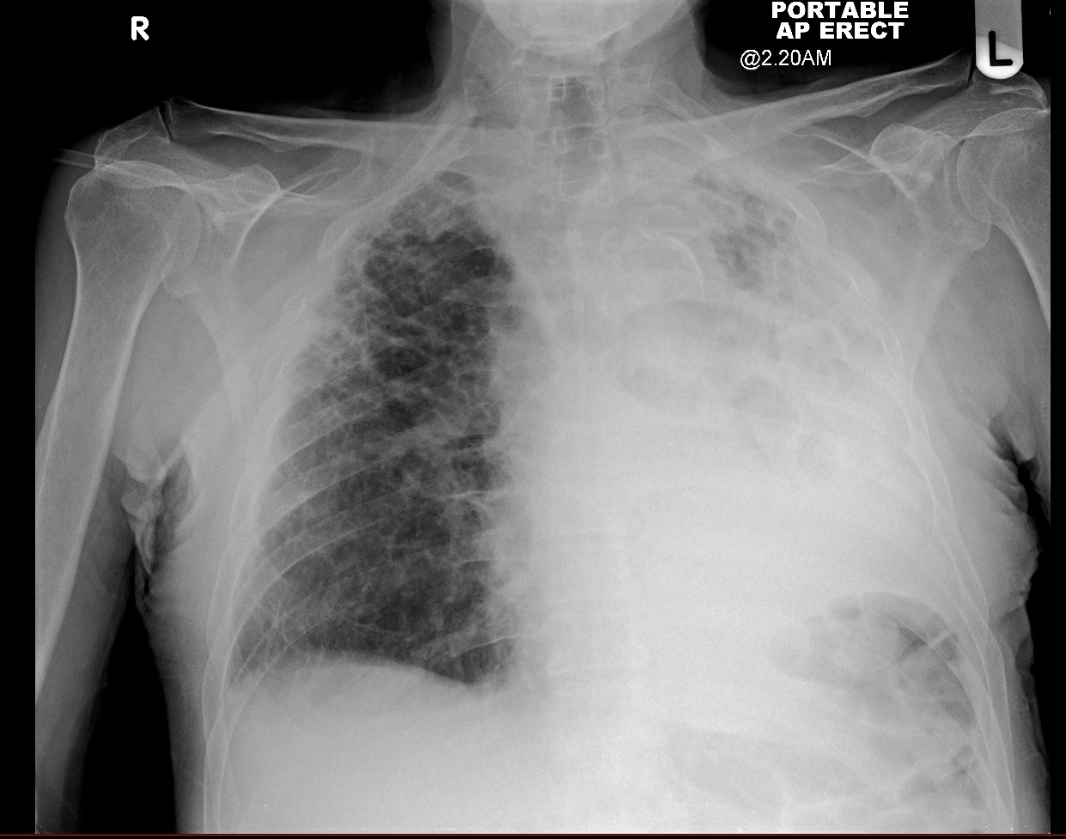
Total White Out / Pleural Effusion

Slide 9
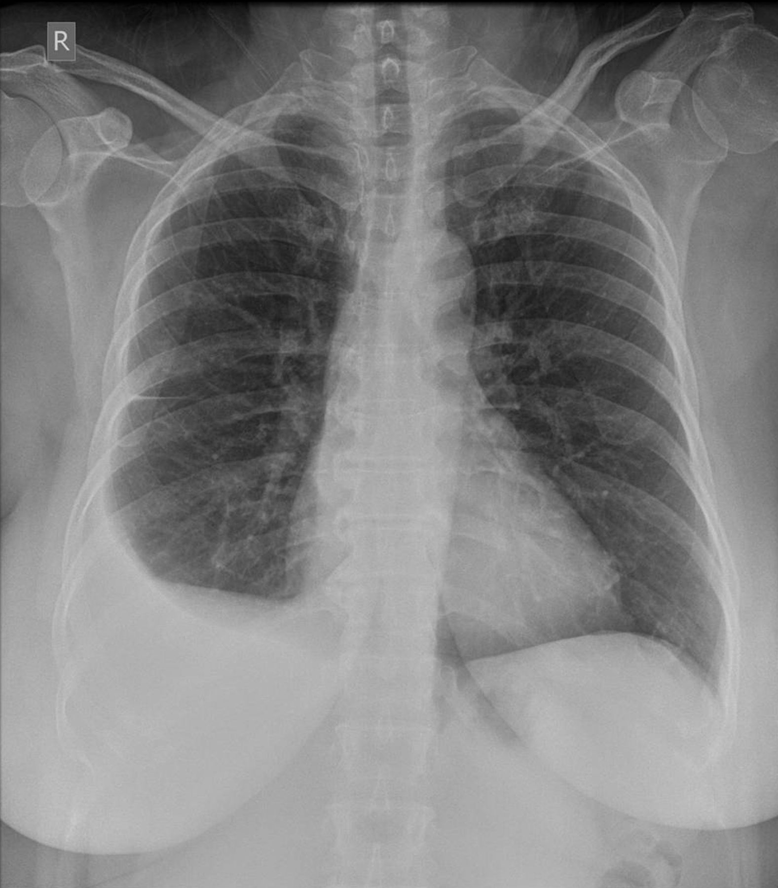
Smaller pleural effusion
Could be parapneumonic,
could be malignant

Slide 10
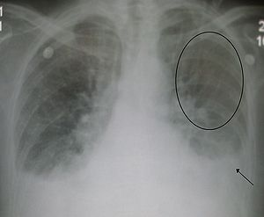
Bibasal pleural effusions
Note pulmonary oedema
here suggesting underlying
heart failure

Slide 11
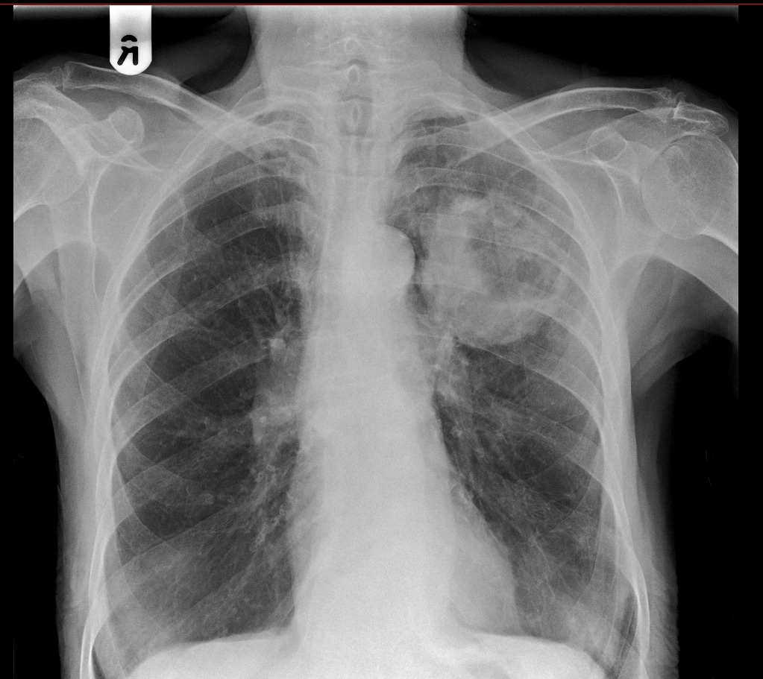
Need to make sure in a
unilateral pleural effusion
that this is not the cause –
spot the abnormality…

Slide 12
Lung Cancer
Aetiology
  Smoking
  Asbestos
  Atmospheric (pollution, chemicals, passive smoking?)

Slide 13
Presentation
Rare under 40, peaks in 70’s
Cough
Haemopytsis
SOB
Hoarse voice
Chest pain
Weight loss
Horner’s (rare)
May be found incidentally

Slide 14
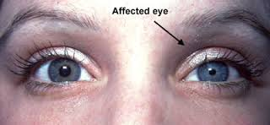
Horner’s Syndrome
Rare
Results from disruption of the sympathetic nerves supplying the eye
Partial ptosis
Miosis
Hemifacial anhidrosis

Slide 15
Total White Out / Pleural Effusion

Slide 16
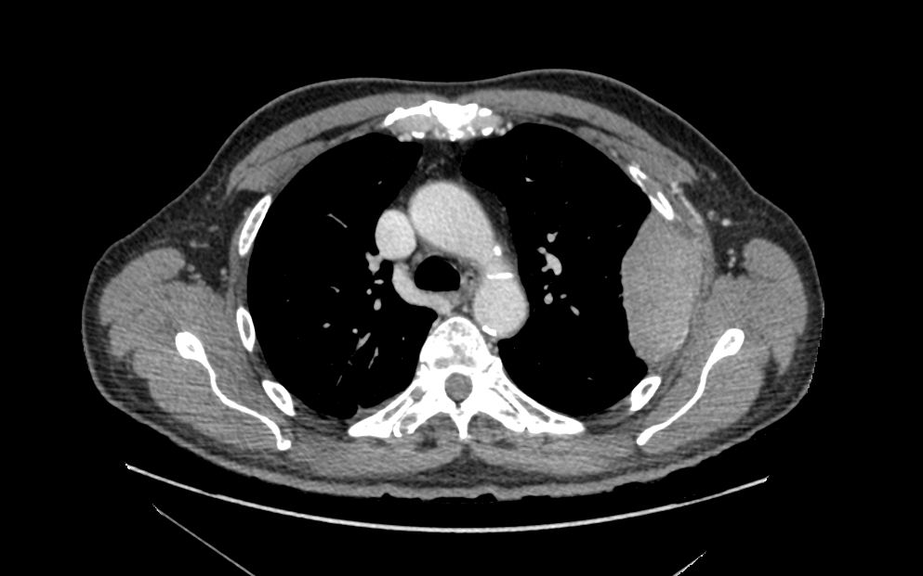

Slide 18
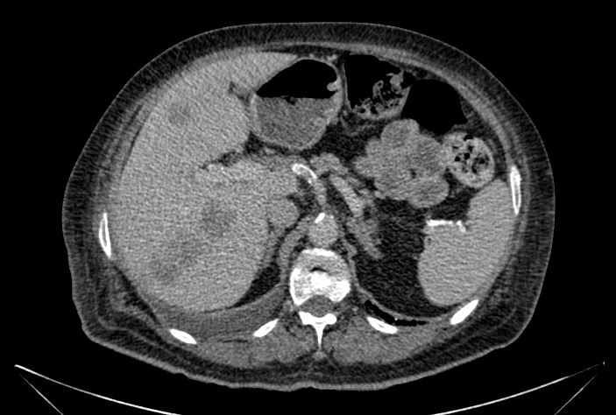

Slide 19
Liver metastases

Slide 20
Pathology
Non small cell
  Squamous cell (35%)
  Adenocarcinoma (30%)
  Undifferentiated large cell (10%)
  Bronchiolar alveolar cell carcinoma (5%)
  May be amenable to surgery
Small cell (20%)
  Arises in central airways, rapid growth, produces intrathoracic and metastatic symptoms
  Chemotherapy

Slide 21
Complications
Pleural effusion
SVCO
Recurrent laryngeal nerve palsy
Dysphagia
Phrenic nerve palsy
  Raised hemidiaphragm
SIADH
Finger clubbing

Slide 22
Management
5 year survival overall only 5 years
10-15% non-small cell operable at presentation
Chemotherapy for small cell
Radiotherapy

Slide 23
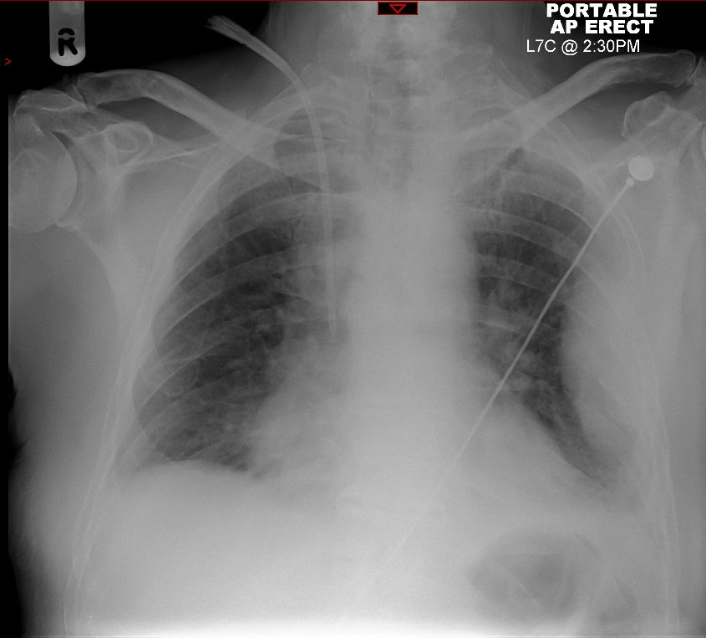
Mesothelioma

Slide 24
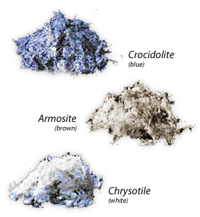
Mesothelioma
Pleural based malignancy
Asbestos exposure (occupational or WWII exposure)
Blue > brown > white causes mesothelioma
Poor prognosis

Slide 25
Get in touch!
Website
www.quackmeded.co.uk
Email
ggc.quackmeded@nhs.scot
Social Media
Twitter: @QUACK_ Med
Facebook: QUACK education

