Slide 1

Migraine
Dr Danielle Leighton
Clinical Lecturer in Neurology
Picture from www.WHO.int

Slide 2
Disclaimer*
Please note that QUACK is a regional teaching programme operating across GG&C, Lanarkshire and Ayrshire & Arran.
This presentation outlines general management, though local variances e.g. antibiotic prescription may vary slightly depending on your local trust
Remember to check your local guidelines

Slide 3
Agenda
Impact and epidemiology
Pathophysiology of migraine
Diagnosis
Acute Treatment
Prophylaxis
Special populations
Chronic migraine and onabotulinumtoxinA
CGRP

Slide 4

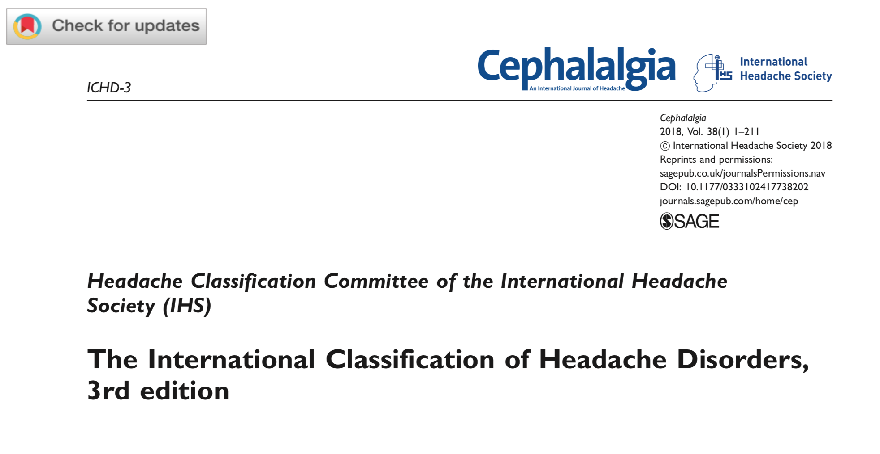
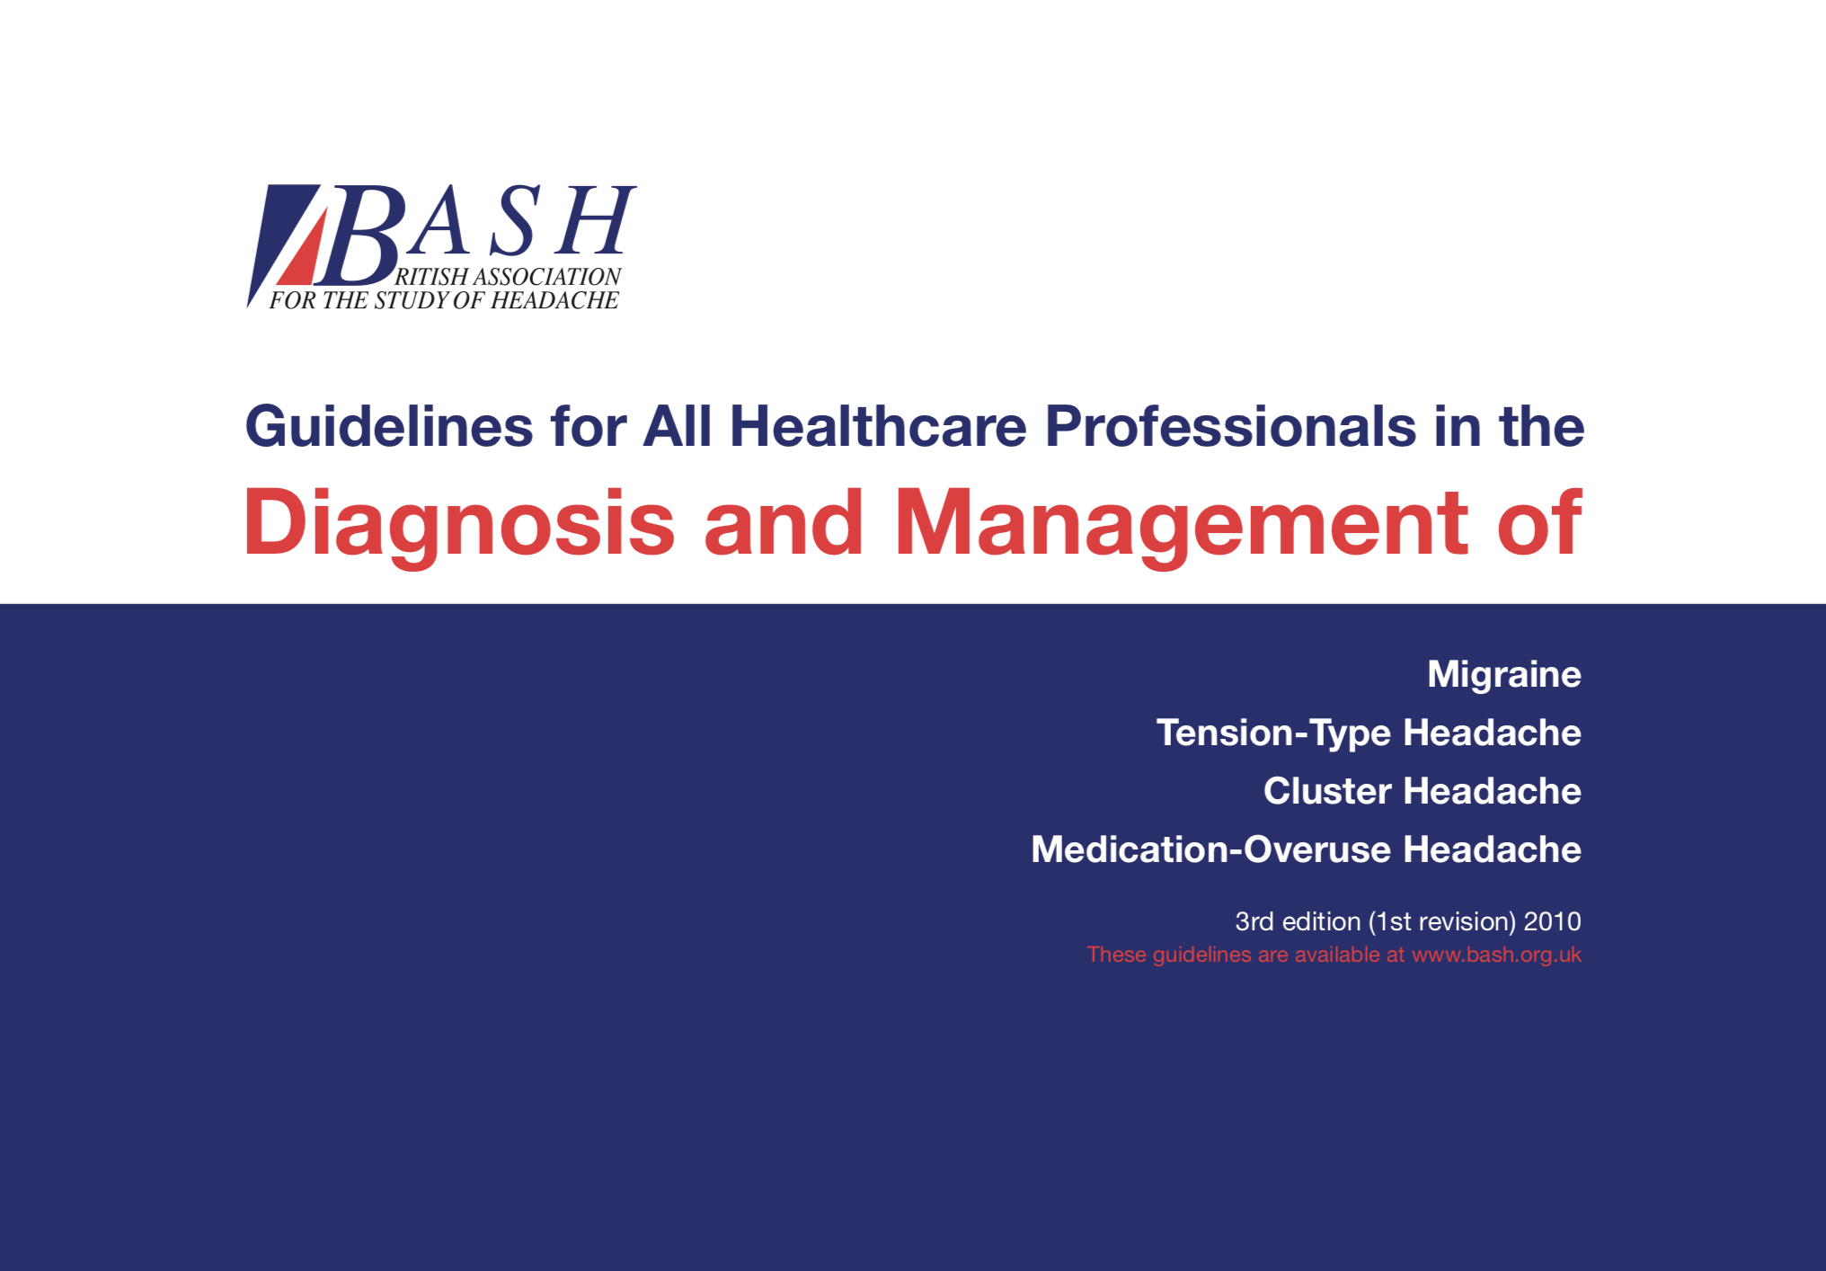
Resources
www.ichd-3.org

Slide 5
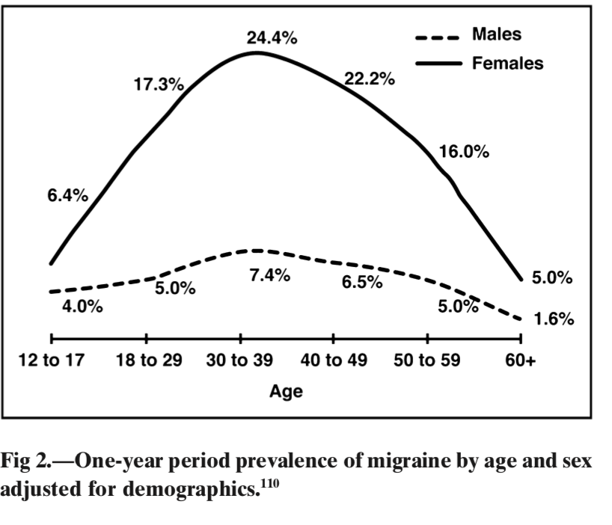
Epidemiology
Cumulative incidence (US) by 85y – 18.5% in males, 44.3% in women
Prevalence (US) - 6% men, 18% women
From Macgregor et al 2011 Headache
190 000 attacks per day in the UK
Prevalence of chronic daily headache – 4%
Notes:
Stewart et al Females – MA – peak incindece 12-13, MO 14-17
Males MA 5y, MO 10-11.

Slide 6
Impact on Individual
5 or more headache days per month
Need for bed rest
Attack related impairment
At least one day of activity restriction over 3 months
37%
53.7%
92.8%
35.1%
Notes:
Vast majority are severe and disabling

Slide 7

Impact on Society
  3% of GP consultations are with migraine
  Headache disorders are the second leading cause of years lived with disability worldwide; migraine alone is third among people aged 15 to 49 years
£150 million per year by NHS
£3.4 billion lost per year in productivity
Notes:
Money lost due to absetneesim does not include lost productivity
Money spent by NHS per year (£250M for all HA disordrs) far outweighed by lost productivity

Slide 8
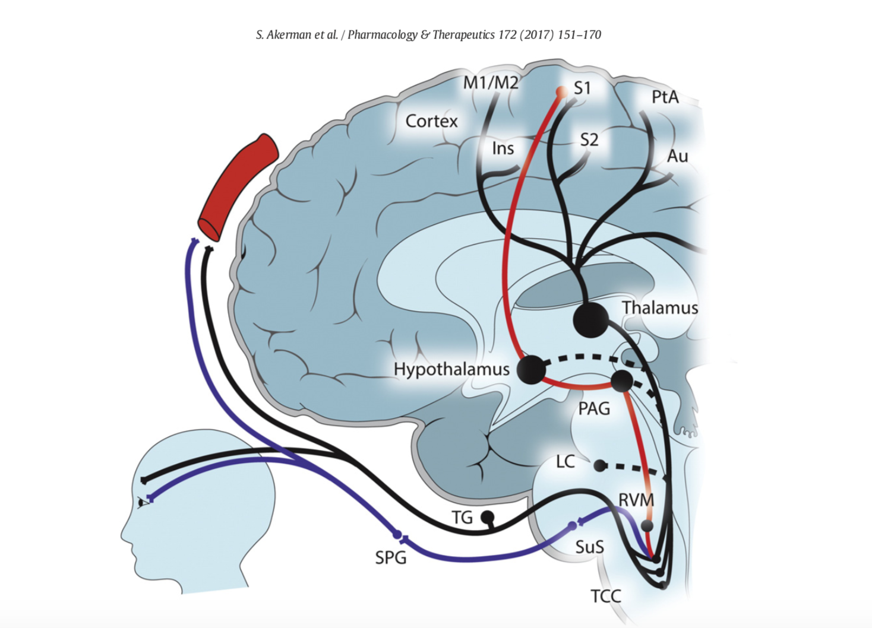
Pathophysiology

Slide 9
Pathophysiology - Activation of Trigeminovascular pathway through peripheral limb
Initial Event
cortical spreading depression mast cell degranulation, neurogenic inflam mation hydrogen ions (adenosine triphos- phate (ATP) release from intracranial endothelial blood vessels mild trauma to the head
Activation of meningeal nociceptors
TRPV1, TRPA1 and TRPM8 P2X3 receptors dopaminergic D1 and D2 receptors, serotoner- gic 5HT1b/1d receptors CGRP, (CRLR/RAMP1) (25), tumor necrosis factor (TNF)-a ASIC3
Activation of second order neurons
↓
Glutamate release
↓
Central sensitisation

Slide 10
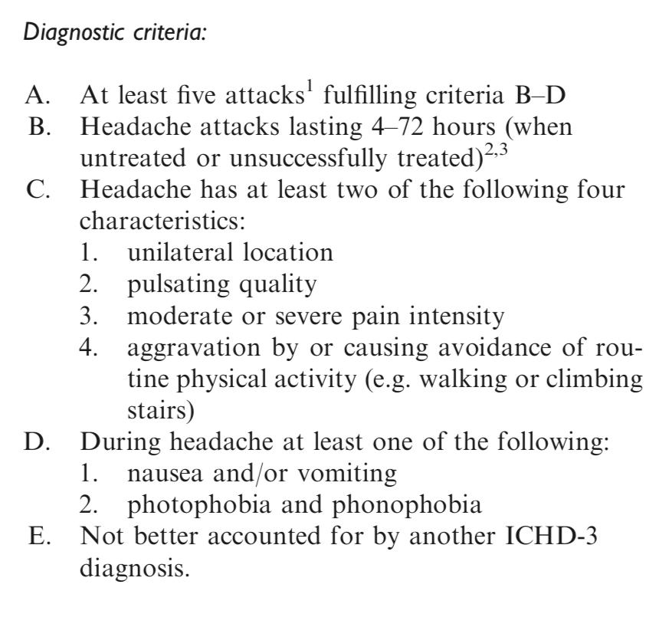
Migraine Diagnosis
ICHD-3 Criteria
Notes:
Consider migraine as a diagnosis when you have recurrent disabling headache with normal neurological examination
One or a few migraine attacks may be difficult to distinguish from symptomatic migraine-like attacks. Furthermore, the nature of a single or a few attacks may be difficult to understand.
Migraine attacks can be associated with cranial auto- nomic symptoms and symptoms of cutaneous allodynia

Slide 11
Diagnosis
Episodic
Positive Diagnosis of Migraine
With Aura
High / low frequency
Without Aura
Chronic

Slide 12
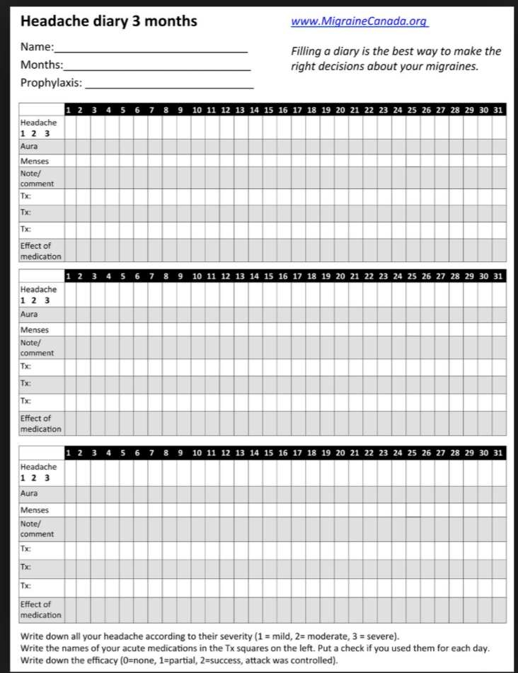
Headache Diary

Slide 13
Triggers
Emotional stress (80 percent)
Hormones in women (65 percent)
Not eating (57 percent)
Weather (53 percent)
Sleep disturbances (50 percent)
Odours (44 percent)
Neck pain (38 percent)
Lights (38 percent)
From Kelman Cephalgia 2007
●Alcohol (38 percent)
●Smoke (36 percent)
●Sleeping late (32 percent)
●Heat (30 percent)
●Food (27 percent)
●Exercise (22 percent)
●Sexual activity (5 percent)

Slide 14
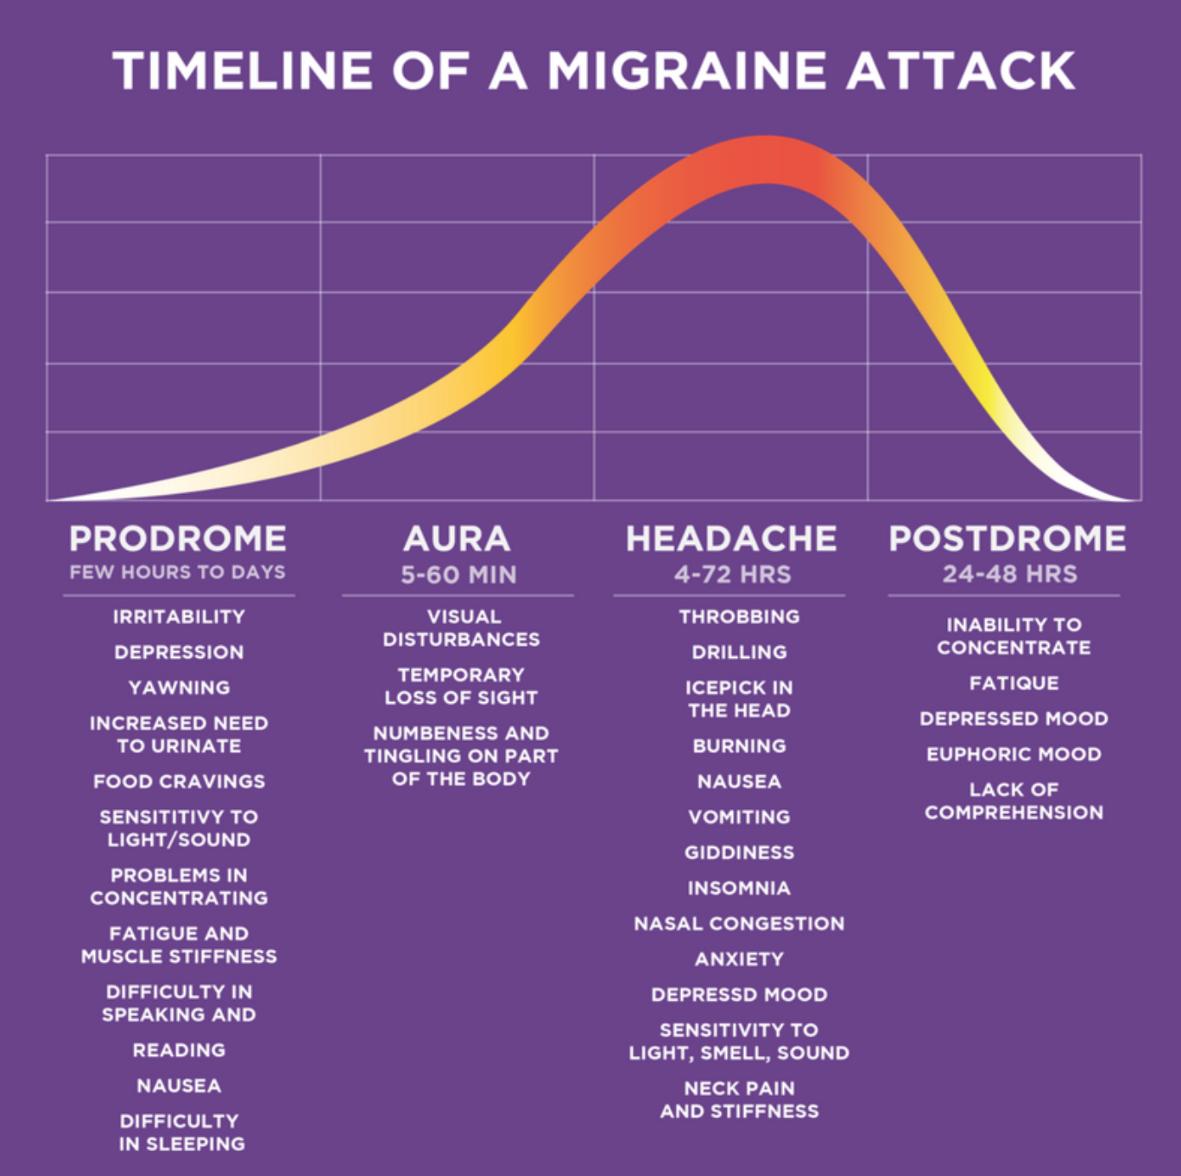
Phases of a Migraine Attack
77%
25%
73% have headache
Picture from www.americanmigrainefoundation.org
Notes:
In a Danish case study, 38 percent of patients reported having both attacks of migraine aura without headache as well as migraine aura with headache, and 4 percent had exclusively migraine aura without headache
Russell and Olesen 1996 Brain

Slide 15
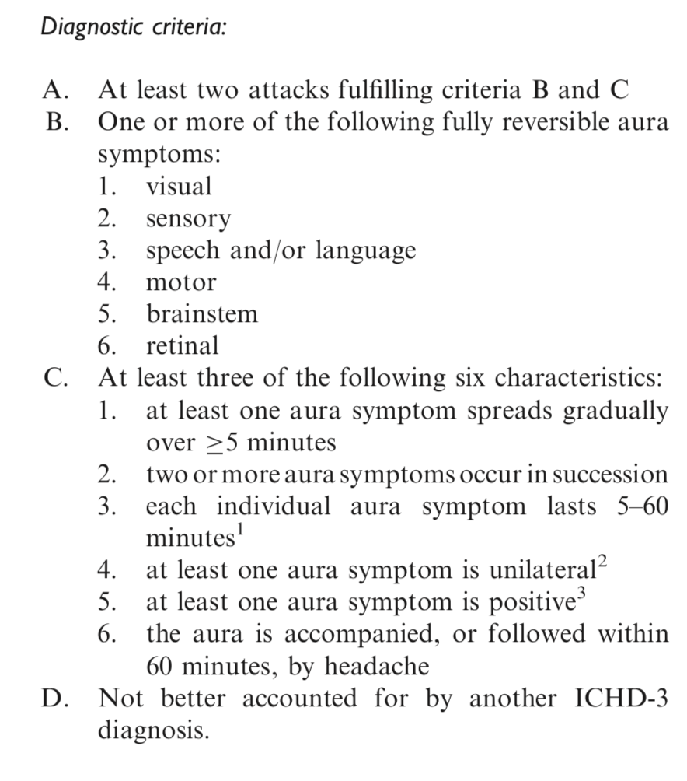
Migraine Aura
Notes:
recurrent attacks, lasting minutes, of uni- lateral fully reversible visual, sensory or other central nervous system symptoms

Slide 16
Aura
Visual (99%) > sensory (31%) > language (18%) > motor
Key elements
  Evolves
  5-60 mins
  Positive and negative elements
  Full reversible

Slide 17
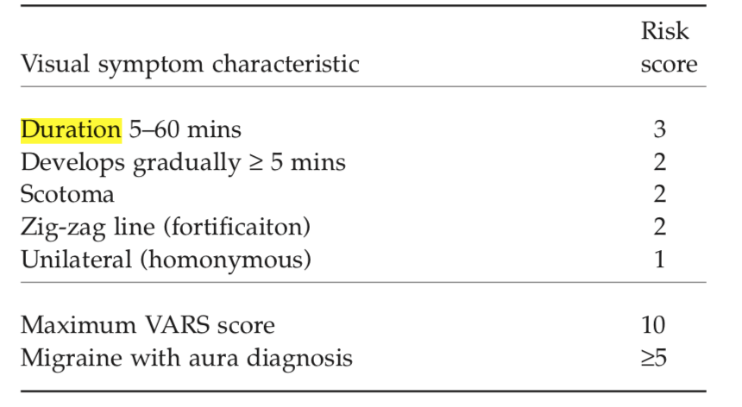
Visual Aura Ratio Scale
VARS score 5 0r more: Diagnosis MA - sensitivity 96%, specificity 98%
Eriksen et al, Cephalalgia, 2005, 25, 801–810
Notes:
92% last 5-60 mins, hardly any < 5 mins, 8% above 60 mins

Slide 18
All that glitters isn’t aura….
Possible symptoms of retinal detachment
Acute visual loss
Recent onset floaters
Sudden flashes of light
Darkening of vision
Curtain across vision
Monocular
Possible signs of Amaurosis Fugax
Abrupt onset, max. in few minutes
Most 1-15 mins
Negative symptoms
Can have positive symptoms
Monocular

Slide 19
Case
54y smoker, female
3 year history of episodes, initially every 4 months, twice per month for last year
Vertigo episodes for about 6 hours each time
NEVER any headache
On direct questioning, photophonophobia in about half of cases
Exam normal, BP normal
ECG normal, MRI brain – 4 x T2 WMHS, non specific

Slide 20
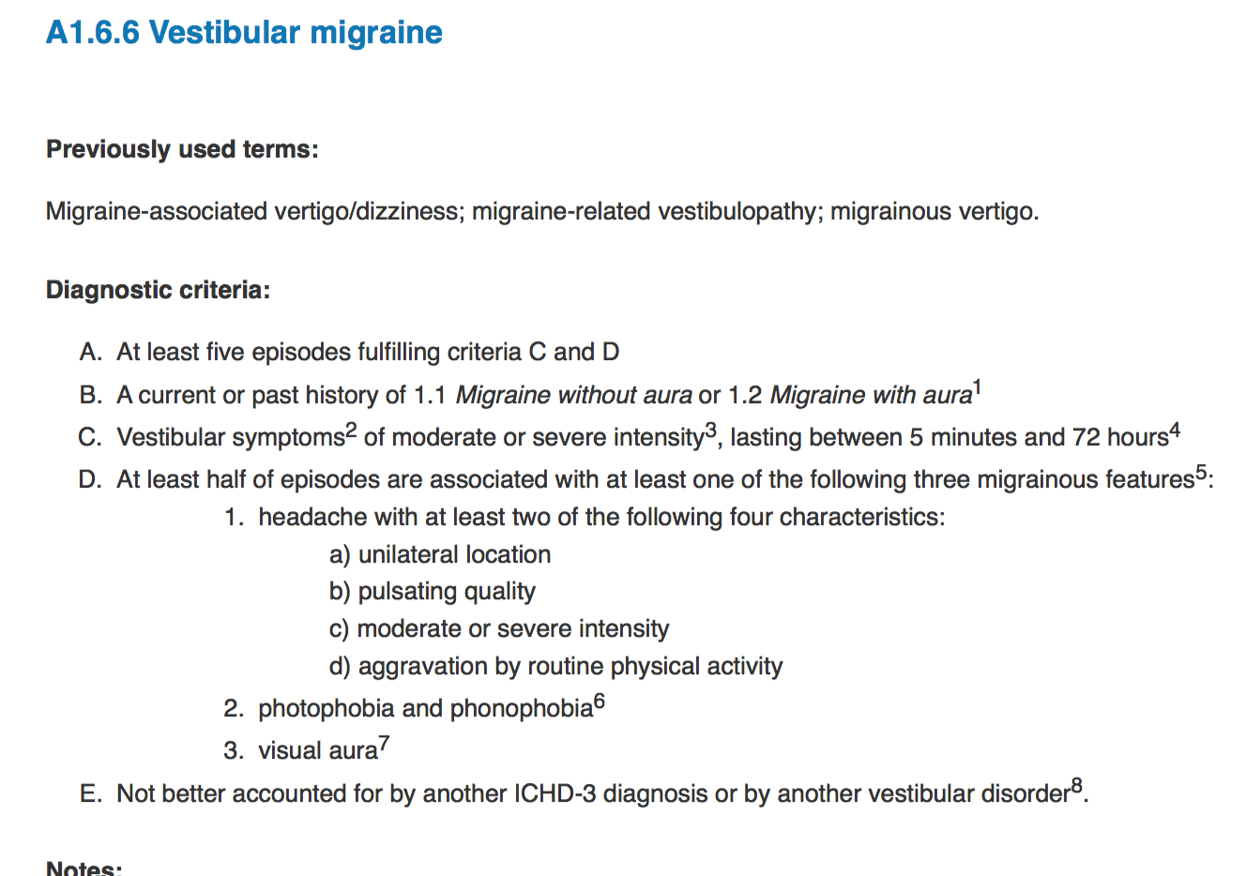
Appendix ICHD3 Criteria for Vestibular Migraine

Slide 21

Who to Image
SNOOP - SSSNOOPPP
Systemic symptoms
Secondary risk factors
Seizures
Neurological symptoms
Onset
Older
Progression (inc. change in attack frequency, nature)
Papilloedema
Precipitated by cough, exertion, sleep, valsalva
Notes:
For neuro sx include prolonged aura, first aura > 60, negative symptom aura, don’t forget amyloid spells

Slide 22
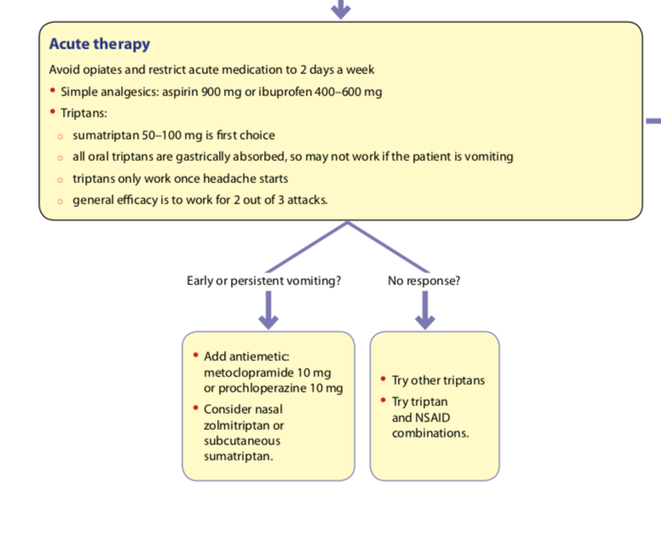
Acute Treatment of Migraine
SIGN 155
Notes:
Aspirin NNT pain free at 2h – 8.1
Aspirin not used when <16, or in pregnancy esp 3rd trimester
Discuss MI risk and NSAIDS
Probably unlike triptans NSAIDS can reverse central sensitisation s can be used deep into migraine attack
In pregnancy, ibuprofen is the anti-inflammatory agent of first choice until gestational week 28. After 28 4 weeks of gestation, repeated use of ibuprofen should be avoided.2
Metoclopramide 10 mg (oral) in combination with aspirin 900 mg had similar efficacy to 100 mg sumatriptan
in achieving the outcome of pain free at two hours

Slide 23
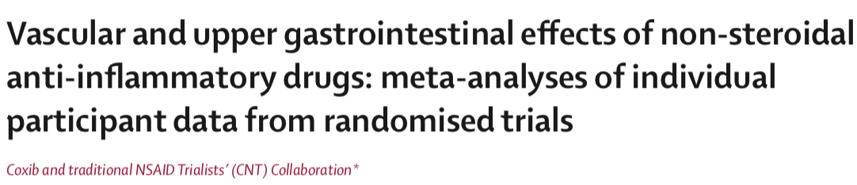
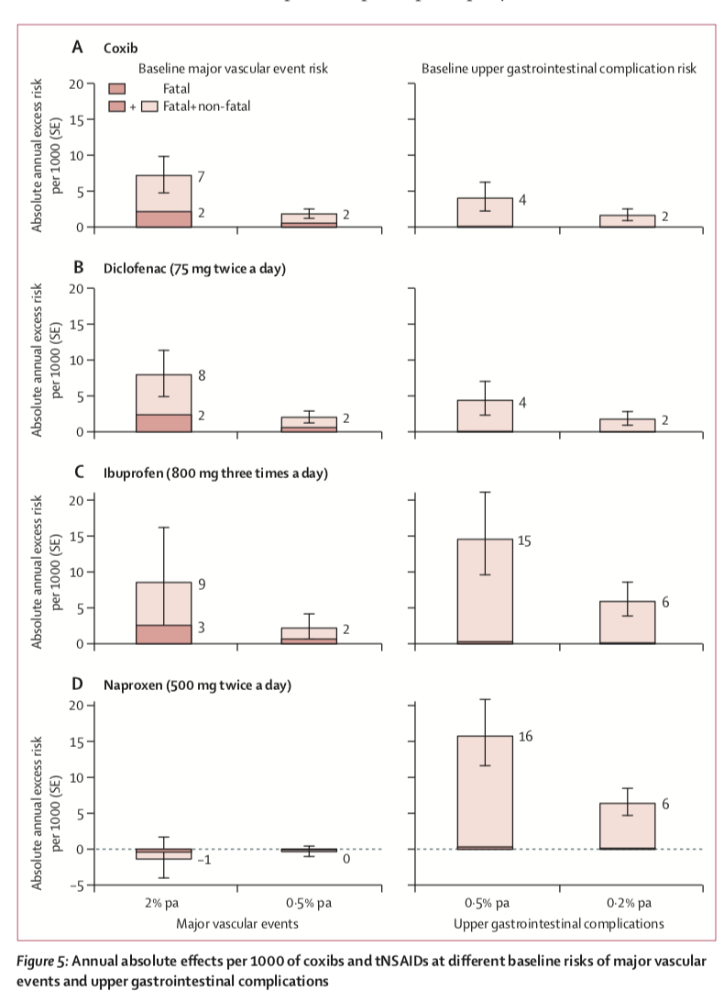
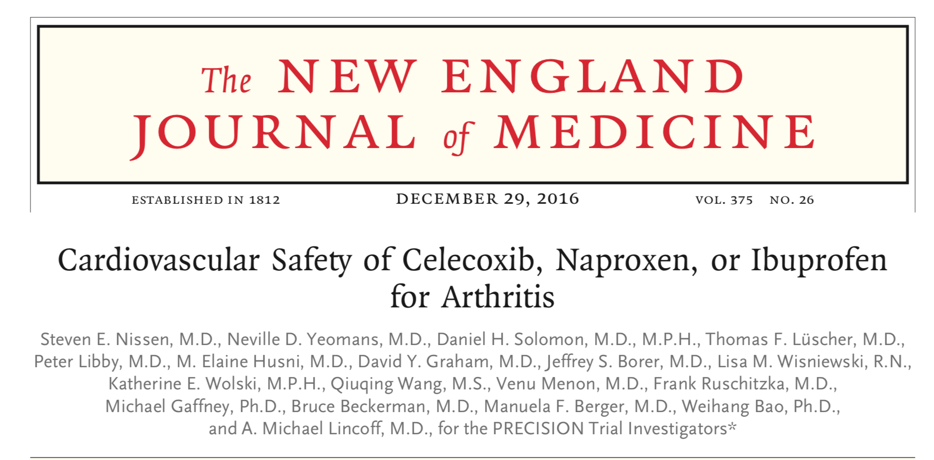
NSAIDS
Lancet 2013; 382: 769–79

Slide 24
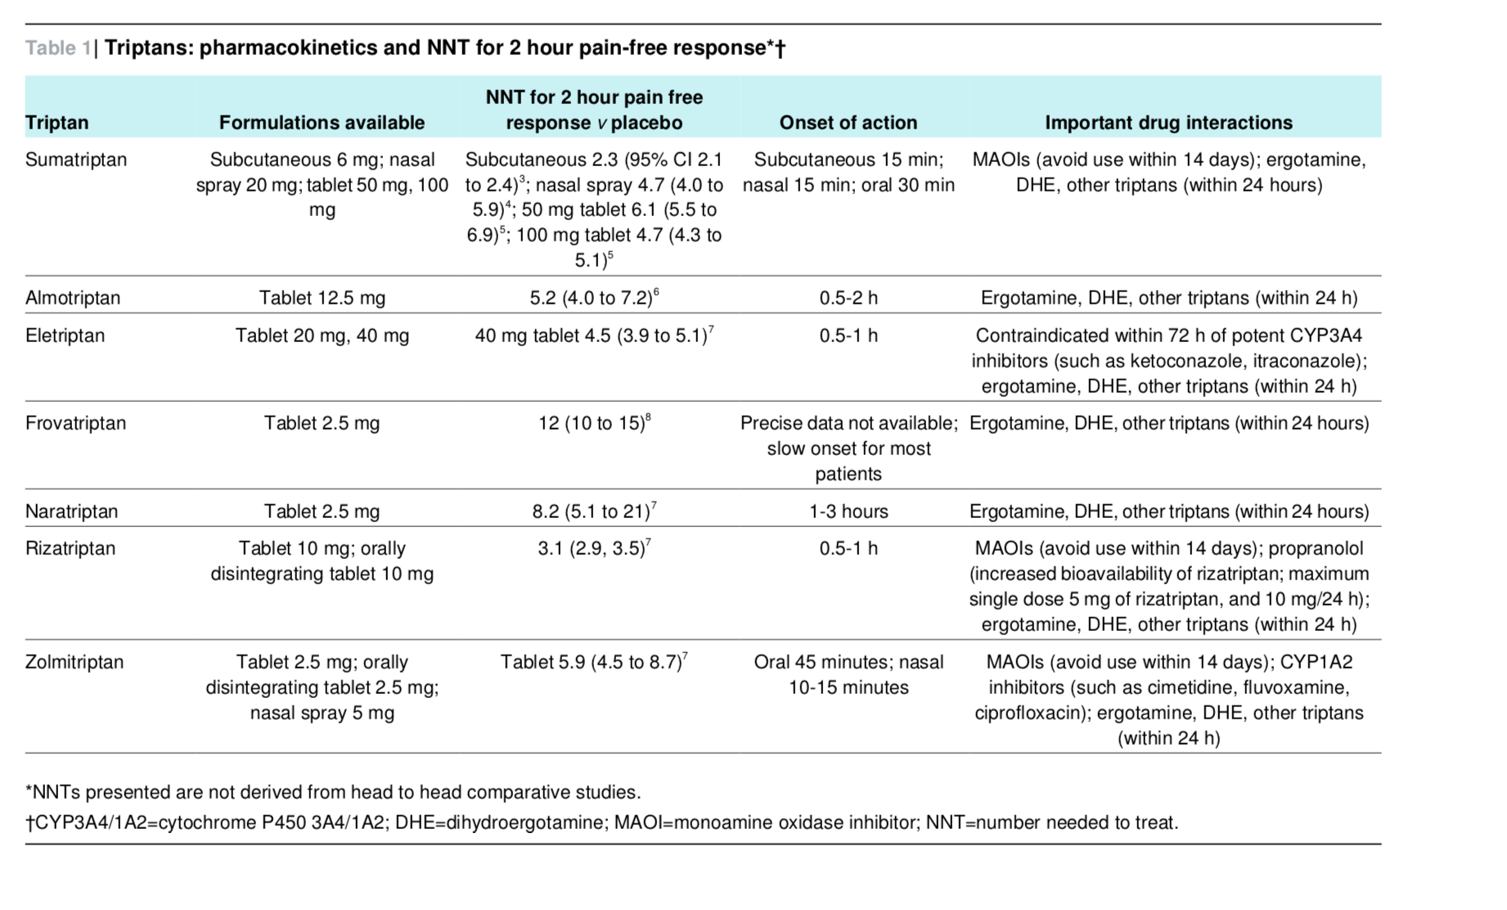
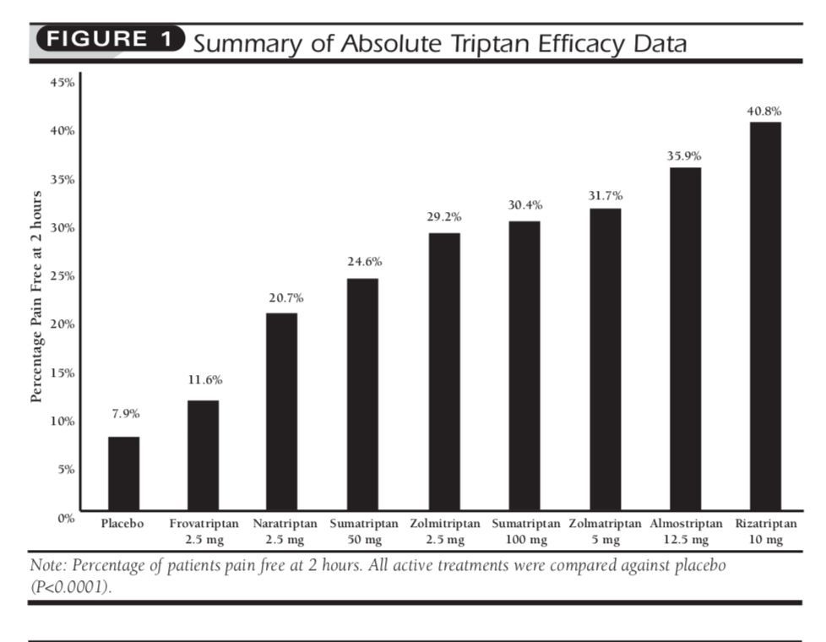
Triptans
Adelman and Belsey
Managed Care Pharm. 2003(9)1: 45-52
Pringsheim and Becker. BMJ 2014;348

Slide 25
Status Migrainosus
Treatment Options
Avoid opiates (hospitals can start MOH)
I.V. fluids (normal saline and anti emetics e.g. metoclopramide 10mg iv
S.C. sumatriptan 6mg
I.V. aspirin
I.V. magnesium 1-2g over 1 hours
_____________________________________________________
I.V. dihydroergotamine
Greater occipital nerve block
(dexamethasone or I.V. valproate – not routinely practiced in WOS)

Slide 26
Counselling and Prevention

Slide 27
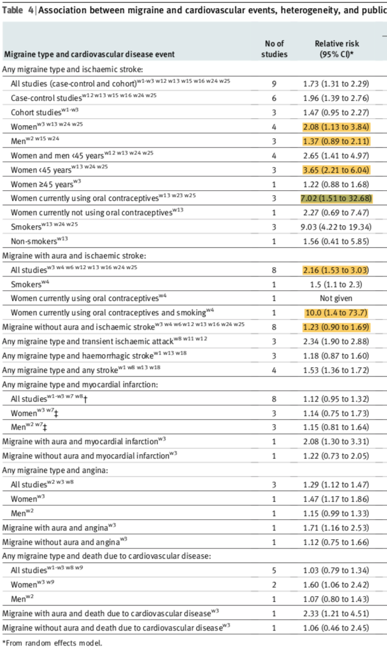
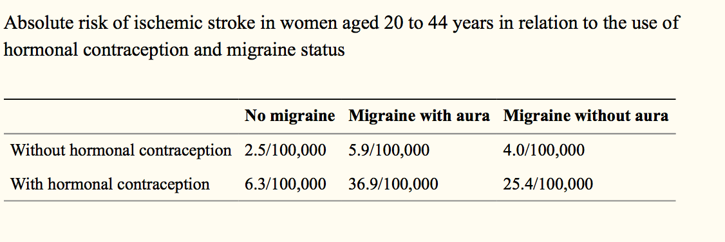
Stroke Risk
Shurks et al BMJ 2009;339:b3914
Sacco et al 2017
EHF/ESC Statement

Slide 28
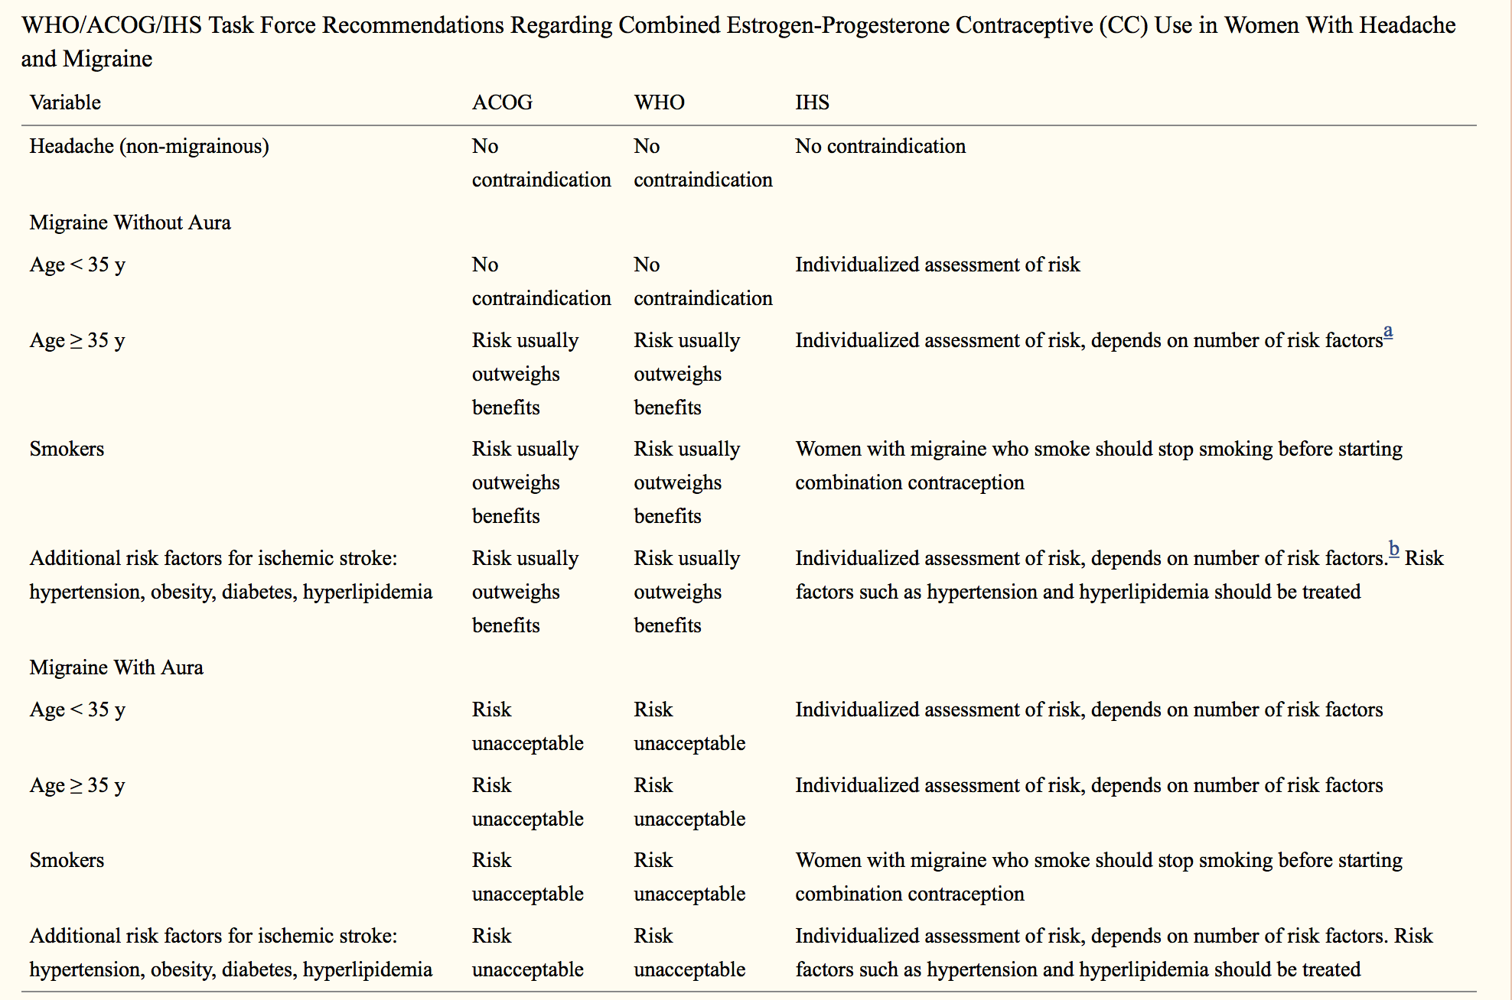
Guidelines
From
Edlow and Bartz
Rev Obstet Gynecol. 2010 Spring;3(2):55-65.

Slide 29
Prophylactic Therapy
Strategy
Lifestyle advice, triggers
Identify and treat medication overuse
Prophylaxis if >4-5 disabling headaches per month
Use headache diaries
Determine efficacy at 3 months (30-50% reduction in headache days?)
If effective, continue 6-12 months. Stop if not

Slide 30
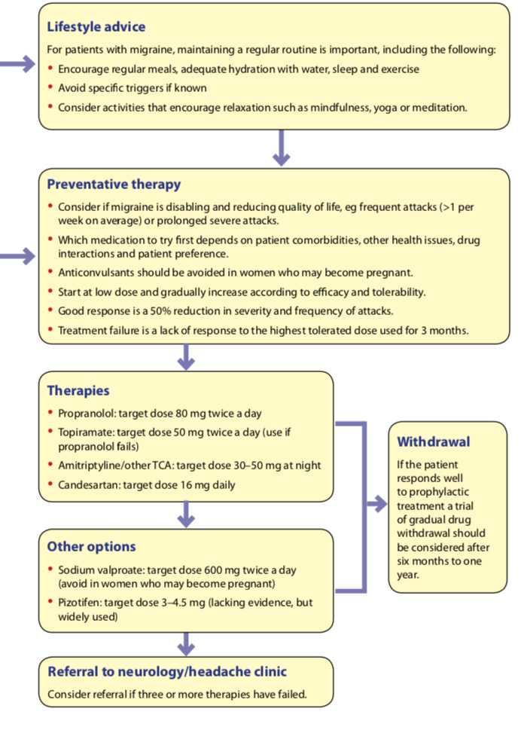
Prophylaxis
Propranolol – Start at 20mg bd, target 80mg bd. NNT 4
Topiramate –start at 15 or 25mg daily, target 50mg bd
Amitriptyline – start at 10mg, target 50mg
Candesartan – start at 4mg, target 16mg
Pizotifen –start at 1.5mg, target 3mg - 4.5mg
Flunarazine – 10mg
NOT Gabapentin
(Riboflavin 400mg)
Sodium valproate
Notes:
In general 50-75% of people will experience a > 50 reduction in headaches with these drugs
Drugs studied for episodic migraine can be used for chronic migraine
NICE
TPM
PNL
+- acupuncture 5-5 weeks
Riboflavin 400mg
SIHN
PNL – multiple triasl, NNT 4. Caution asthma
TPM – 9 trials/ Ses tingling (most) cognitive dysfunction – up to 5-13%. In CM there is some evidence too! - mean reduction in monthly migraine days of 3.5 (versus placebo -0.2) and a number- needed-to-treat of 12.5 . Up to 30% drop out during titration phase
Candesartan 16
Flunnarazine
VPA some evidence for use in CM
Others – no evidence base yet in CM

Slide 31
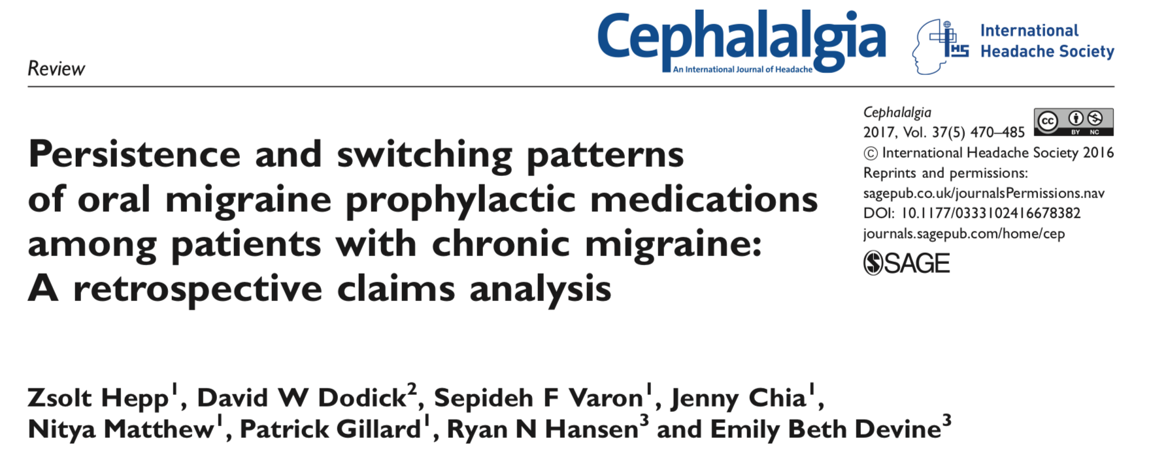
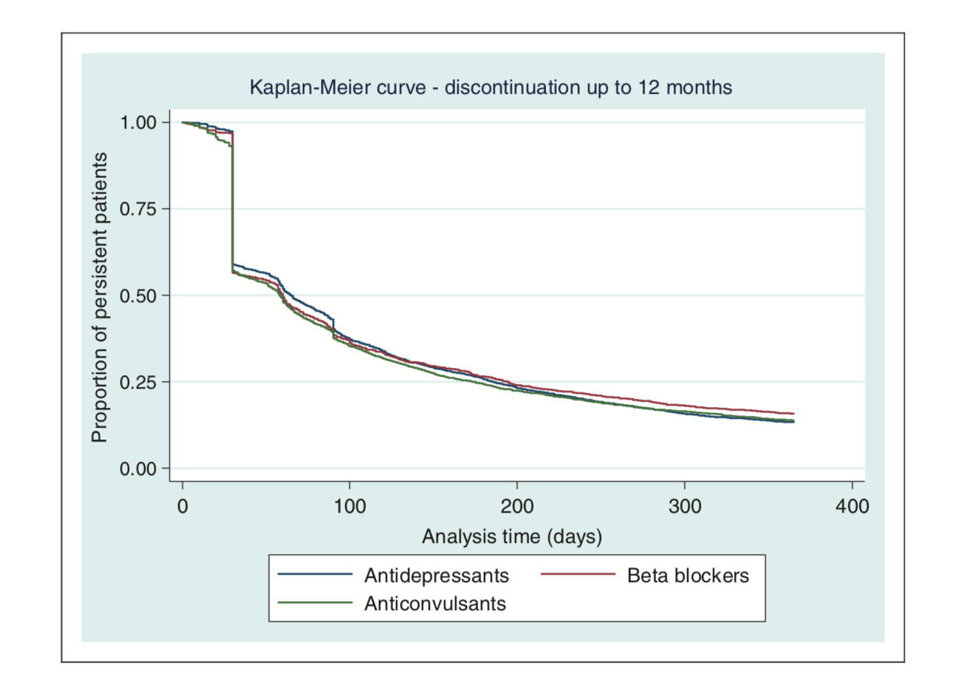
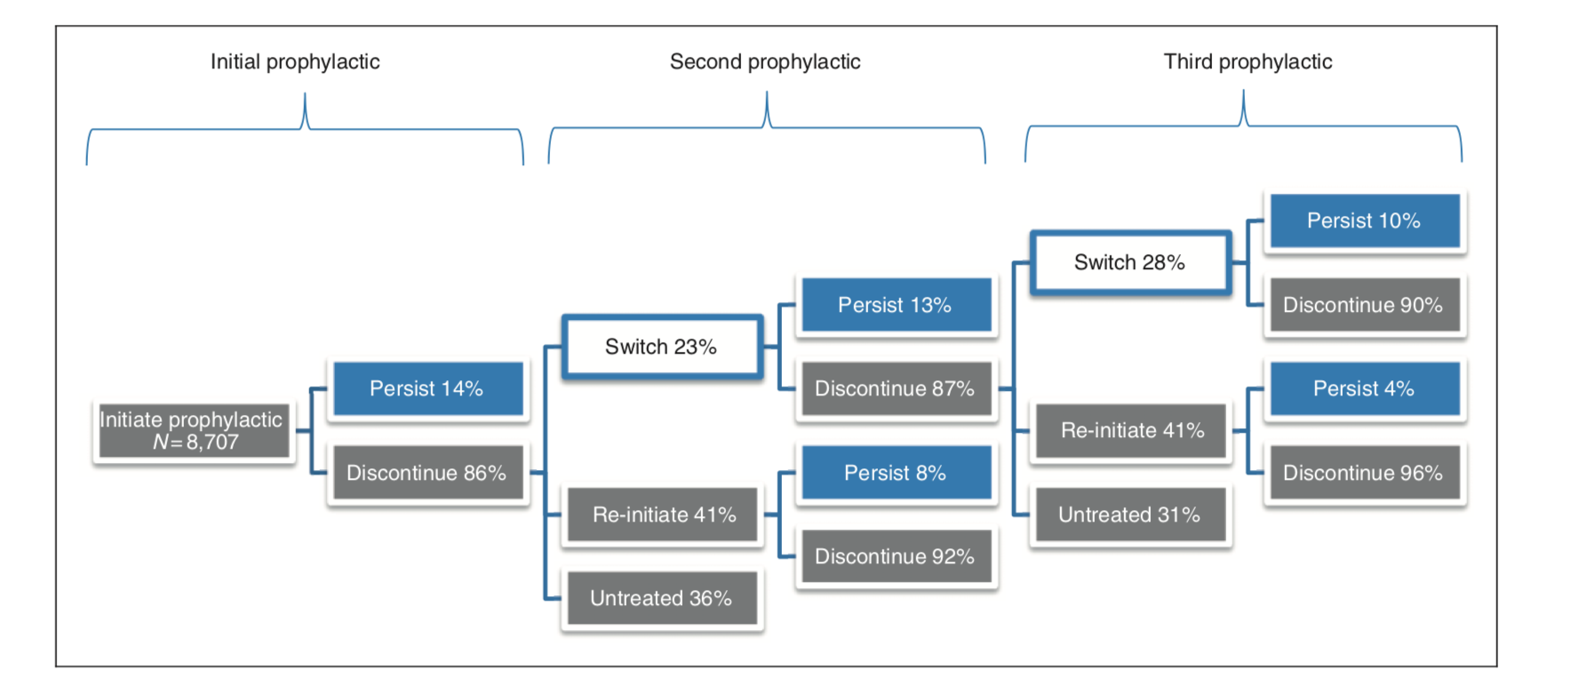
Rates of (im)persistence

Slide 32
Special Populations
Positive side effects to exploit
Hypertension - propranolol (<60y, non smokers), candesartan, flunarizine
Insomnia - amitriptyline
Epilepsy – topiramate
Obesity – topiramate
Depression – amitriptyline, venlafaxine
Raynaud’s - flunarazine

Slide 33
Special Populations
Caution with negative side effects
Renal Impairment
Hepatic Impairment
Depression
Ischaemic Heart Disease
Glaucoma
Renal Calculi
Hypertension
Asthma
Transplant
Diabetes
Pregnancy
? Use frovatriptan, less dosage change req with PNL, AMT, VPA
? Avoid all triptans when severe, eletriptan?, all prophylactics cautioned, avoid VPA, 50% dose venlafaxine
Avoid flunarizine, caution propranolol, topiramate
Avoid triptans, NSAIDS, beta blockers (if Heart block), caution AMT
Caution with pizotifen, topiramate, monitor with venlafaxine, duloxetine, amitriptyline with shallow anterior chamber
Avoid Topiramate
Monitor BP with Venlafaxine and Duloxetine
NSAIDS/aspirin, beta blockers are avoided
Caution candesartan with ciclosporin/tacrolimus (High K+), avoid VPA, TPM in liver tx, watch for interactions with all Rx
Caution with PNL and hypoglycaemic agents
Limit all drugs. Sumatriptan and PNL/AMT if required
Notes:
List not comprehensive, my own views

Slide 34
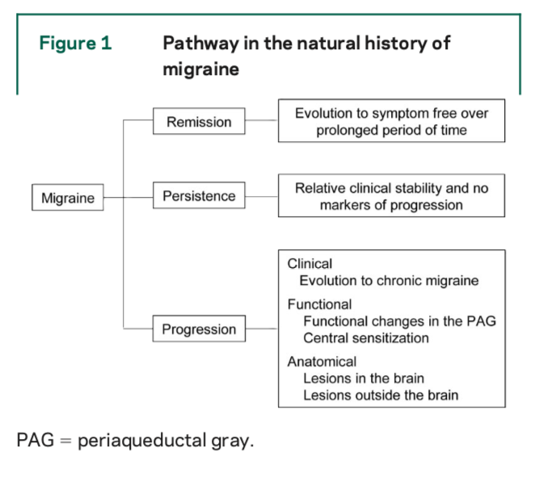
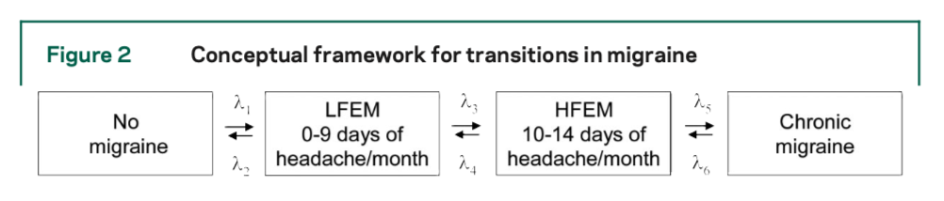
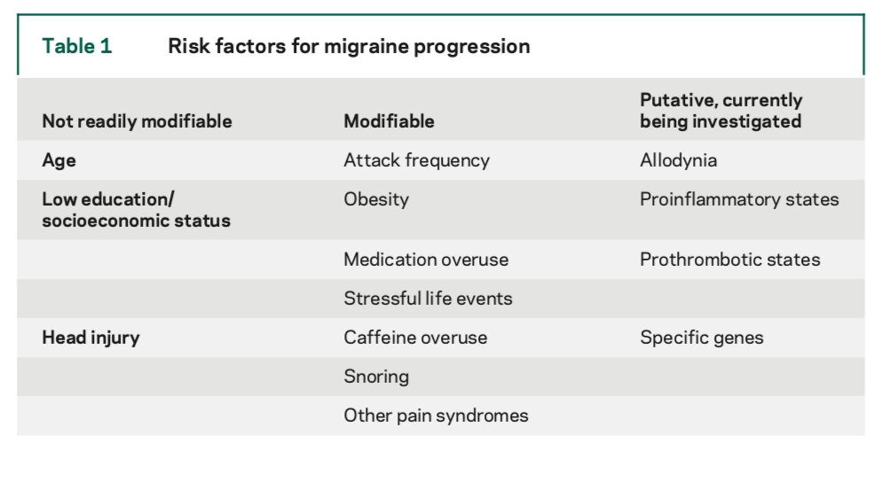
Chronic Migraine
40%
40%
20%
Bigal and Lipton Neurology 2008

Slide 35
What Next after tablets for prophylaxis
Onabotulinumtoxin A
  Chronic migraine, ≧ 15 headache days per months, 8 of which are migraine days, MOH previously addressed, failed on at least 3 prophylactics
  Approved for restricted use by SMC based on economic benefit

Slide 36
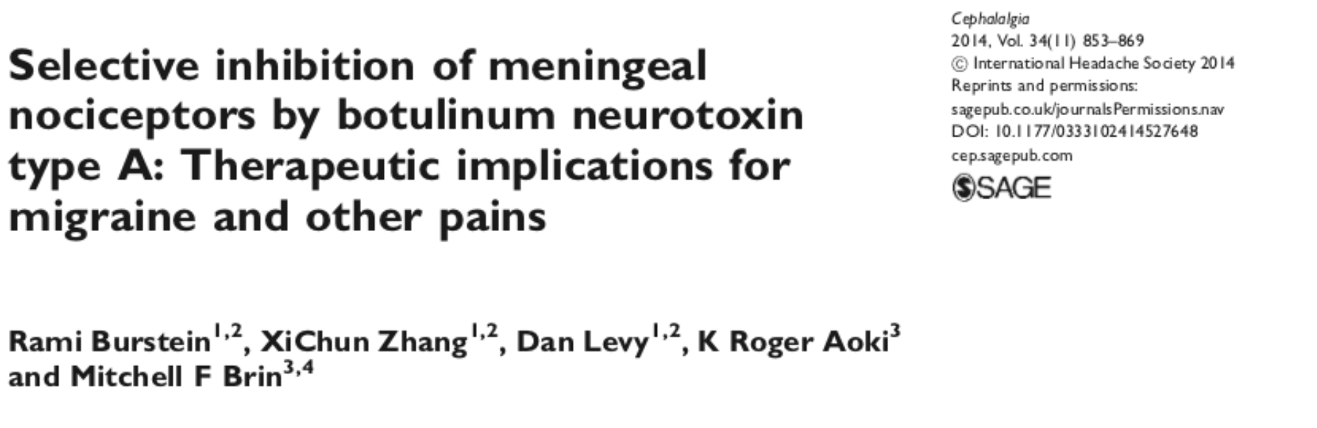
Onabotulinintoxin - Mechanisms
Botox did not have much effect on sponatenous activity
Blocked responses to mechanical pain
Did not block responses to non painful mechanical stiulation
No effect of A delta pain fibres
Effect limited to C fibres (unmyelinated pain fibres in meninges)
- reversed their sensitation
- prevented sensitization
By blocking mechanical pain
Notes:
Preclinical model
When injected extracranially inihibited completely the mechamical sensitivity of the suture branches

Slide 37
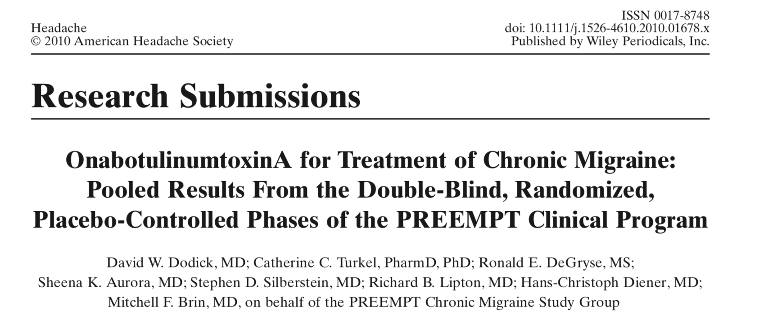
OnabotulinumtoxinA
Notes:
Two studies PREEMPT 1 and 2 rolled into one, pooled analysis performed, outcome measured was chaged after first study to reduction in headache days

Slide 38
PREEMPT Study
Inclusion
18-65y
Disabled population - duration of headaches >20y, mean 20 headache days per months
>15 headache days > 50% were migraine or probable migraine days
4 distinct headache episodes each lasting 4 hours.
Thus, patients with continuous headache were excluded
Notes:
40% had never tried a prophylactic agent, and continuosHA were excluded

Slide 39
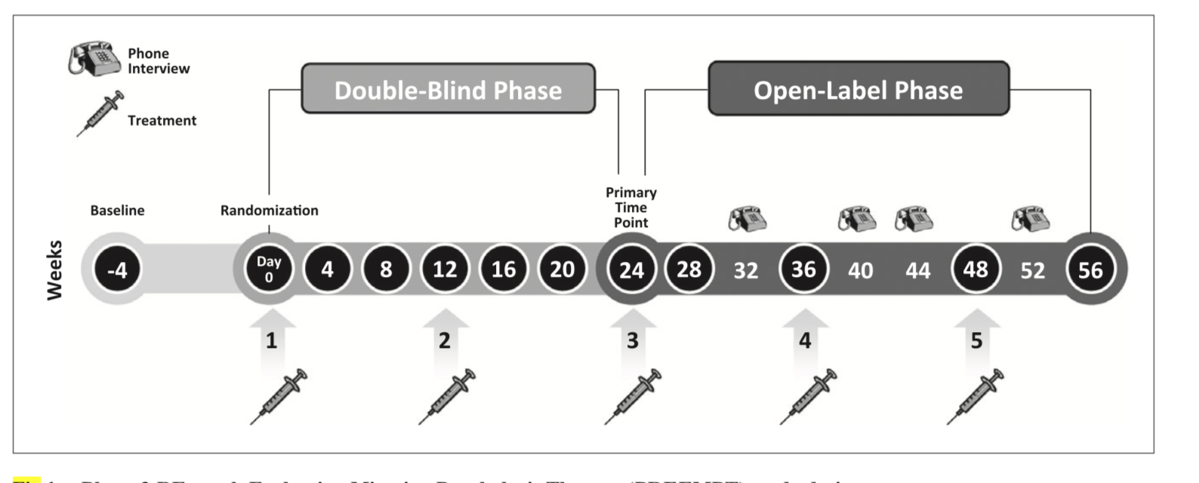
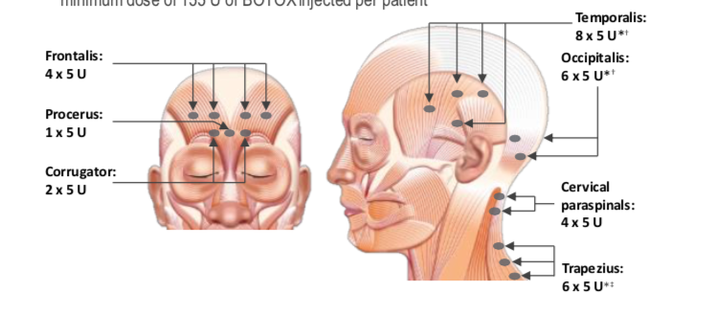
PREEMPT
Methods
Notes:
2 injection cycles, followed by a 32-week, open- label phase with 3 injection cycles

Slide 40
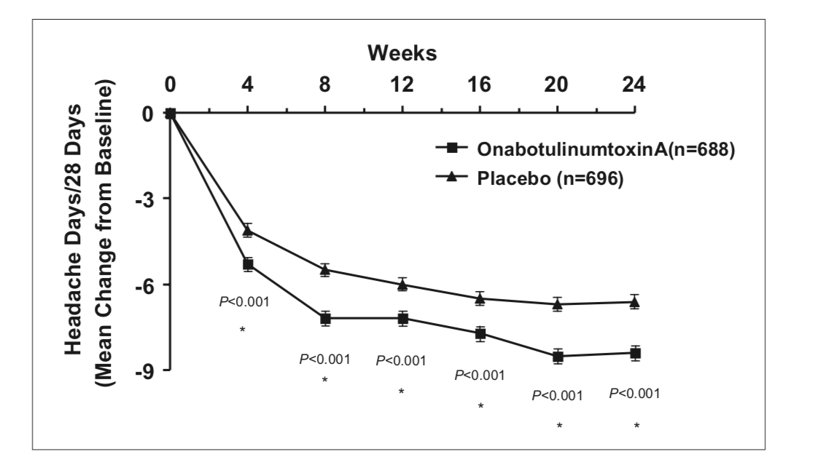
PREEMPT
1384 subjects recruited
Most patients overused acute medications, very few overused opiates
Notes:
Botox statistically more effective –8.4 vs -6.6 reduction headache days
Multiple other secondary end points were met, inc QOL meaures
Dicontinuations related to adverse events 3.8% vs 1.2%
HIGH Placebo responder rate

Slide 41
Next wave: CGRP monoclonal ab
Calcitonin gene-related peptide
Involved in modifying neurovasculature
Monoclonal antibodies (prophylaxis) vs small molecule compounds (acute)
Work either directly against CGRP or the CGRP receptor

Slide 42
CGRP Monoclonal ab
CGRP compounds | Erenumab Aimovig | Fremanezumab Ajovy | Galcanezumab Emgality | Eptinezumab
Availability in the UK | Privately – not throughout NHS (available within NHS Scotland for chronic migraine) | Approved for use within the NHS in England, Wales and Scotland for chronic migraine. Available within NHS Scotland for episodic migraine. | Privately – not on NHS | Due to be submitted for approval to be available in the UK
How it is administered | Subcutaneous injection once per month | Subcutaneous injection once per month or every three months | Subcutaneous injection once per month | Intravenous injection once every three months
https://www.migrainetrust.org/living-with-migraine/treatments/calcitonin-gene-related-peptide-pathway-monoclonal-antibodies/

Slide 43
Summary
Migraine has large disability and economic impact
Central sensitisation is a key pathophysiological event
Lifestyle advice and patient education mandatory
Acute and prophylactic therapy should take into account comorbidities and drug interactions
Significant effort should be made to prevent transformation to chronic migraine from episodic migraine
Onabotulinumtoxin A approved for restricted use for chronic migraine

Slide 44
Get in touch!
Website
www.quackmeded.co.uk
Email
ggc.quackmeded@nhs.scot
Social Media
Twitter: @QUACK_ Med
Facebook: QUACK education

