Slide 1
Clinical Presentations of Common Joint Problems
Gemma McGrory
Clinical Teaching Fellow

Slide 2
Disclaimer*
Please note that QUACK is a regional teaching programme operating across GG&C, Lanarkshire and Ayrshire & Arran.
This presentation outlines general management, though local variances e.g. antibiotic prescription may vary slightly depending on your local trust
Remember to check your local guidelines

Slide 3
Learning Outcomes
Case based approach to common medical joint problems

Slide 4
Case 1
42 year old lady
Referred to clinic by GP
2 month history of sore swollen joints in hands
Differentials?

Slide 5
Rheumatoid Arthritis
Chronic autoimmune inflammatory polyarthropathy
ACR Criteria (4 of 7)
  Morning stiffness > 1 hour for > 6 weeks
  Arthritis of 3+ joints for > 6 weeks
  Symmetrical
  Rheumatoid nodules
  Positive RhF
  Radiological changes

Slide 6
Radiological Features
Soft tissue swelling
Loss of joint space
Juxta-articular osteopenia
Marginal bone erosions
Joint deformities

Slide 7
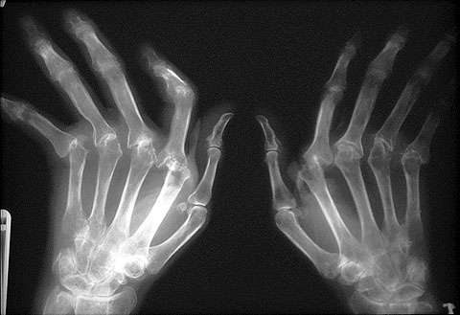
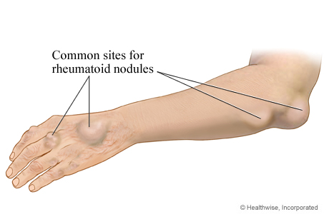

Slide 8
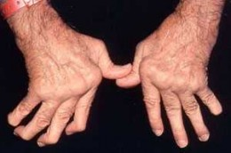
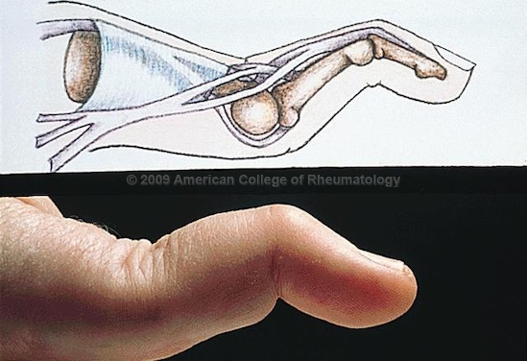
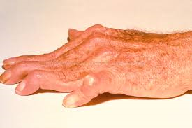
Rheumatoid Hands
Symmetrical deforming polyarthropathy affecting MCPs, PIPs and wrist joints
Spares DIPs
Active RA – hot, swollen, tender

Slide 9
Other features
Multiple extra-articular features
  Bronchietasis
  Carpall tunnel syndrome
  Amyloidosis
  Eye complications
  Myriad!

Slide 10
Treatment
Aims to start DMARD asap
  Reduce pain, swelling, stiffness
  Reduce ESR / CRP
  Correct anaemia of chronic disease
  Slow disease progression
Methotrexate DMARD of choice
Biologic agents
Steroids

Slide 11
Case 2
65 year old lady
Referred to clinic with stiff painful knees and hips over past 6 months
Here are her Xrays...
Differentials?

Slide 12
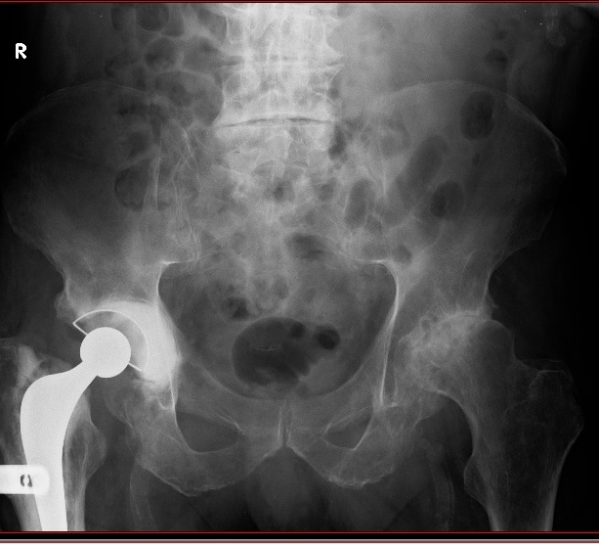
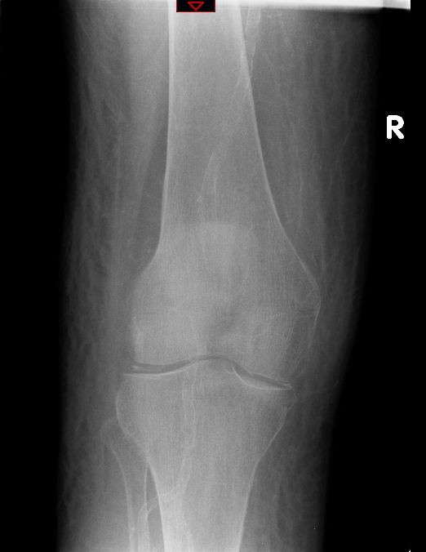

Slide 13
Osteoarthritis
Commonest joint condition
Usually >50
Pain worse towards end of day
Background pain at rest
Treat with analgesia, exercise, weight reduction +- joint replacement

Slide 14
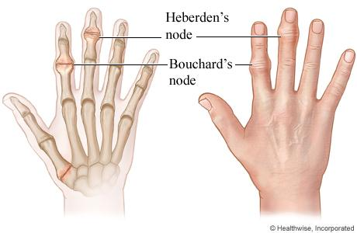
Radiological Features
Loss of joint space
Subchondral sclerosis
Subchondral cysts
Osteophytes
Heberden’s nodes

Slide 15
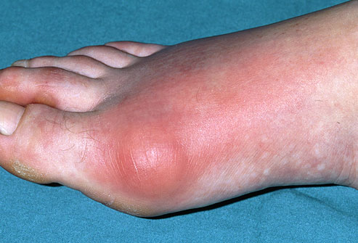
Case 3
54 year old morbidly obese gentleman
Presents to GP with acutely red, painful big toe
Known alcohol excess, hypertensive
Differentials?

Slide 16
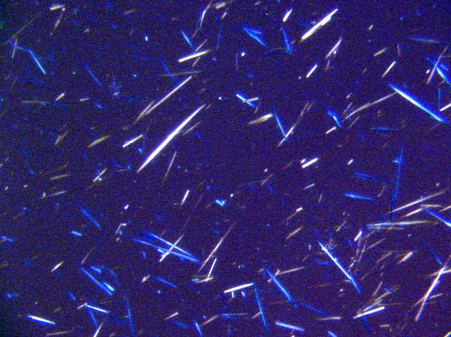
Gout
Desposition monosodium urate crystals in joint
1st MTP most common
Aspirate shows needle shaped crystals which are negatively birefringent

Slide 17
Causes
Increased urate production
  Idiopathic
  Haemotological malignancies
Decreased urate excretion
  Idiopathic
  Chronic renal failure
  Alcohol / starvation
  Ketoacidosis
Drugs
  Bendroflumethiazide
  Furosemide

Slide 18
Treatment
Acute
  NSAIDs
  Colchicine
  (steroids)
Preventative
  Allopurinol

Slide 19
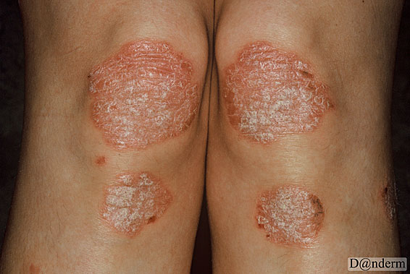
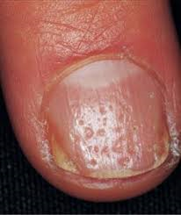
Case 4
46 year old lady present to clinic
Polyarthritis of small joints of hand
On examination...

Slide 20
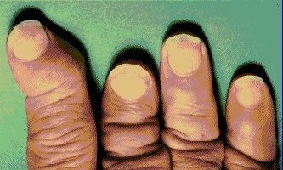
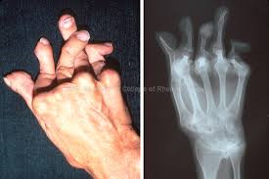
Psoriatic Arthritis
8% of those with psoriasis
Arthritis can precede rash
Multiple patterns:
  RA like polyarthritis (most common)
  DIP involvement
  Sacroillitis / spondylarthritis
  Asymmetric oligoarthritis
  Arthitis mutilans (<5%)

Slide 21
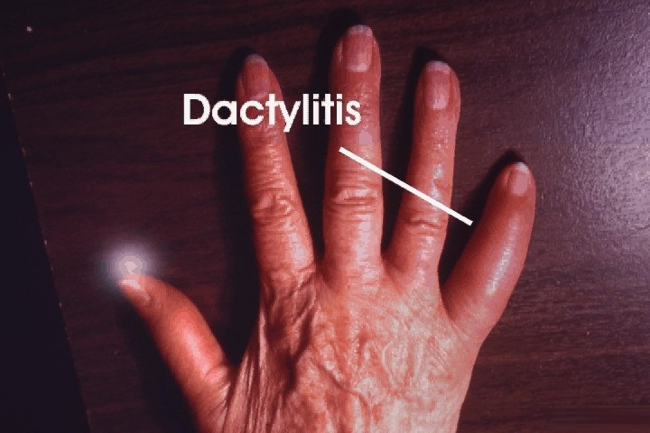
Characteristic Features
Nail pitting and onycholysis
DIP joint arthritis
Telescoping fingers
Paravertbral calcification
Dactylitis
  (sausage shaped digit)

Slide 22
Treament
Analgesia / NSAIDs
DMARDs (Sulphasalazine / methotrexate)
Anti-TNF therapy

Slide 23
Case 5
21 year old gentleman
Insidious onset of lower back pain over past 2 years
Differential?

Slide 24
Ankylosing Spondylitis
Low back pain and stiffness in young man (usually)
Less common than RA
Definitive dx:
  Radiological evidence
  Inflammatory spinal pain
  Limited spinal movement or chest expansion
Prognosis good

Slide 25
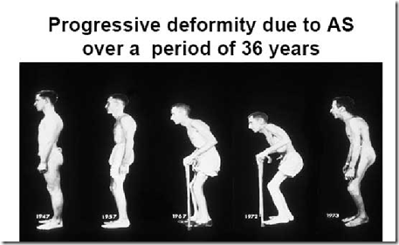

Slide 26
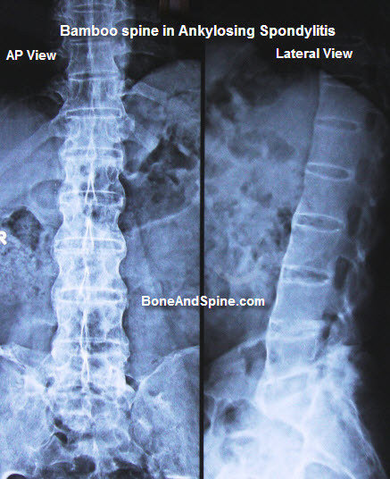
Radiological Features
Sacroillitis
Loss of lumbar lordosis
Vertebral squaring
Bamboo spine
Erosive peripheral
arthopathy

Slide 27
Anklyosing Spondylitis
Clinical features:
  Arthritis
  Anterior uveitis
  Apical pulmonary fibrosis
  Amyloidosis
  Aortic regurgitation
  Aortitis

Slide 28
Treatment
Physiotherapy
NSAIDs
Suphasalazine / methotrexate
Anti-TNF therapy
Surgery (joint replacement / spinal straightening)

Slide 29
Common Features Seronegative Spondyloarthitides
Negative RhF
Asymmetrical inflammatory peripheral arthopathy
Radiological sacroillitis
Spondylitis
Enthesitis
HLA B27 association
Anterior uveitis
Overlap clinically between diseases

Slide 30
Get in touch!
Website
www.quackmeded.co.uk
Email
ggc.quackmeded@nhs.scot
Social Media
Twitter: @QUACK_ Med
Facebook: QUACK education

