Slide 1
Thyroid Disease
Dr. Kimberley McMahon
Clinical Teaching Fellow
University Hospital Ayr

Slide 2
Disclaimer*
Please note that QUACK is a regional teaching programme operating across GG&C, Lanarkshire and Ayrshire & Arran.
This presentation outlines general management, though local variances e.g. antibiotic prescription may vary slightly depending on your local trust
Remember to check your local guidelines

Slide 3
Thyroid Hormone Regulation
Hypothalamus → Pituitary → Thyroid axis
Hypothalamus secretes TRH (Thyrotropin Releasing Hormone) → stimulates the anterior pituitary to secrete TSH (Thyroid Stimulating Hormone) → TSH acts on the thyroid gland increasing the production of T4 and T3
T3 and T4 act on a wide variety of tissues
Calcitonin is secreted by Parafollicular cells (C cells) in the thyroid gland
  Calcitonin lowers serum calcium by increasing renal calcium excretion and inhibiting osteoclast activity

Slide 4
Investigations in Thyroid Disease
TFTs
Thyroid auto-antibodies
USS Thyroid
RAIU scan
Thyroid scintigraphy (^{99m}Tc-pertechnetate)
FNA
Thyroglobulin (monitoring papillary or follicular thyroid cancer recurrence)
Calcitonin (monitoring medullary thyroid cancer recurrence)

Slide 5
TFTs
Primarily look at TSH and T4
T3 is only useful clinically in a small number of cases
TSH levels are more sensitive than T4 levels for monitoring patients with existing thyroid problems and are often used to guide treatment

Slide 6
TFT Patterns
Diagnosis | TSH | FT4
Primary Hyperthyroidism | Low | High
Subclinical Hyperthyroidism | Low | Normal
Primary Hypothyroidism | High | Low
Secondary Hypothyroidism | Low | Low
Subclinical Hypothyroidism | High | Normal
Sick Euthyroid syndrome (Non-thyroidal Illness) | Low (or Normal) | Low
Poor compliance with levothyroxine | High | Normal
Notes:
Sick Euthyroid syndrome - Common in hospital inpatients. Changes are reversible upon recovery from the systemic illness and no treatment is usually needed.
Patients who are poorly compliant with levothyroxine may only take their thyroxine in the days before a routine blood test. The thyroxine levels are therefore normal but the TSH 'lags' and reflects longer term low thyroxine levels.

Slide 7
Thyroid Disease: Auto-antibodies
Anti-thyroid peroxidase (anti-TPO) antibodies (Hasimoto’s thyroiditis, Graves’ disease)
TSH receptor antibodies (TRAbs) (Graves’ disease)
Anti-thyroglobulin antibodies (Hasimoto’s thyroiditis, can be normal)

Slide 8
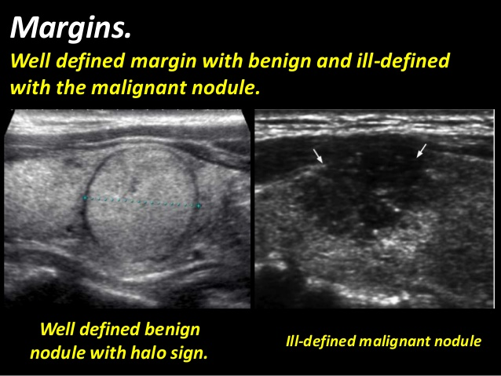
USS Thyroid
Malignant features of thyroid nodule on USS:
  Microcalcifications
  Solid and hypoechogenicity (darker)
  Irregular margins
  Absence of halo
  Intranodular vascularity (peripheral vascularity is benign)
  Solitary nodule
  Lymphadenopathy
Notes:
https://radiopaedia.org/articles/bta-ultrasound-u-classification-of-thyroid-nodules?lang=us
BTA (British Thyroid Association) developed an ultrasound ‘U’ classification of thyroid nodules. Allows nodules to be divided into benign, suspicious or malignant appearances based on USS features. Helps determine further Ix and Mx.

Slide 9
Radionuclide Thyroid Scanning
Use of I¹²³ or I¹³¹ or ^{99m}Tc-pertechnetate
Assesses thyroid gland size, shape, function
If thyroid nodule(s) present, determines if ‘hot’ nodule or ‘cold’ nodule
Detection of ectopic thyroid tissue
Post-op (total or hemi- thyroidectomy) follow-up of thyroid carcinoma (follicular/papillary)
Post-radioiodine ablation follow-up to identify thyroid remnants
Whole body scanning for distant metastases

Slide 10
Radionuclide Thyroid Scanning
Can show no difference with adjacent normal thyroid tissue, or uptake could be lower (cold nodule) or higher (hot nodule)
  Cold nodule (85%) ~5% are malignant
  Hot nodule (5%) – malignancy very rare
  Graves’ disease: homogenous diffuse uptake
  Multinodular goitre: heterogenous uptake
  Toxic adenoma: single intense area of uptake with suppression elsewhere

Slide 11
Radioiodine Ablation I¹³¹
Contraindicated in pregnancy (pregnancy should be avoided for 6 months following treatment) and age < 16 years
Relatively contraindicated in Graves’ Ophthalmopathy – can worsen it
The proportion of patients who become hypothyroid depends on the dose given, but the majority of patients will often require thyroxine supplementation after 5 years

Slide 12
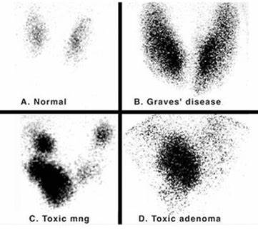
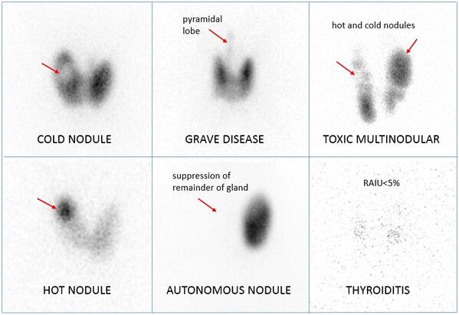
Radionuclide Thyroid Scanning

Slide 13
Hyperthyroidism

Slide 14
Hyperthyroidism: Clinical Features
General: heat intolerance, hyperactivity, anxiety, disturbed sleep, fatigue, fine tremor, +/- goitre +/- thyroid bruit
Cardio: tachycardia, palpitations, AF
GI: unintentional weight loss despite increased appetite, increased frequency of bowel movements
Gynae: oligomenorrhoea, amenorrhoea
Neuro: brisk tendon reflexes, proximal muscle weakness
Bone: osteopenia, osteoporosis
Skin: increased sweating, thyroid acropachy, pretibial myxoedema, scalp hair thinning, pruritis, onycholysis
Eyes: lid retraction, lid lag, conjunctival injection (chemosis)
Graves’ disease: pretibial myxoedema, exophthalmos, ophthalmoplegia, thyroid acropachy
Notes:
Pretibial myxoedema: erythematous, oedematous lesions on the shins
Thyroid acropachy: clubbing, periosteal new bone formation, soft tissue swelling of the hands and feet

Slide 15
Thyrotoxicosis: Causes
Primary hyperthyroidism:
  Graves’ disease (most common)
  Toxic multinodular goitre
  Toxic adenoma
  Acute phase of subacute (de quervain's) thyroiditis
  Acute phase of post-partum thyroiditis
  Acute phase of hashimoto's thyroiditis
  Drug-induced thyrotoxicosis (e.g. Amiodarone)
Secondary hyperthyroidism (rare <1% of cases)
Congenital thyrotoxicosis (rare)

Slide 16
Graves’ Disease
Most common cause of thyrotoxicosis
Typically seen in women aged 30-50 years
Autoantibodies: TSH receptor stimulating abs, anti-thyroid peroxidase abs
Risk factors:
  Smoking
  FHx thyroid disease
  Personal hx of other autoimmune conditions

Slide 17
Graves’ Disease: Management
Radioiodine ablation (first line definitive treatment)
Anti-thyroid drugs (12-18 month course):
  Titration of anti-thyroid medication regimen or
  ‘Block and replace’ regimen
Adjunct medication: Propranolol for symptomatic management
Surgery
Notes:
Offer radioactive iodine as first-line definitive treatment for adults with Graves' disease, unless antithyroid drugs are likely to achieve remission (e.g.
mild and uncomplicated Graves' disease), or it is unsuitable (for example, there are concerns about compression, malignancy is suspected, they are pregnant or trying to become pregnant or father a child within the next 4 to 6 months, or they have active thyroid eye disease).
Offer carbimazole as a 12–18 month course using either a block and replace regimen (combination of fixed high-dose carbimazole with levothyroxine), or a titration regimen (dose based on thyroid function tests).
If patients have persistent or relapsed hyperthyroidism despite antithyroid drug treatment, consider radioactive iodine or surgery.

Slide 18
Anti-thyroid Drugs
Check FBC and LFTs before starting anti-thyroid drugs
Titration Regimen:
  Carbimazole 15-40mg (first-line) commenced until patient becomes euthyroid, then gradually reduced to 5-15mg. Dose is titrated to response of TFTs
  Less side effects with a titration regimen compared to a block-and-replace regimen
Block & Replace Regimen:
  High dose carbimazole (first-line) is commenced at 40-60mg
  Levothyroxine is added when the patient is euthyroid
Consider propylthiouracil for adults who:
  Are intolerant to carbimazole (adverse reactions)
  Are pregnant or trying to conceive within the next 6 months (carbimazole a/w congenital abnormalities)
  Have a history of pancreatitis
Notes:
Measure TFTs every 6 weeks until TSH is within the reference range, then measure TSH every 3 months.

Slide 19
Anti-thyroid Drugs
Warn patient to tell doctor immediately if sore throat, bruising, fever, malaise, or non-specific illness develops
Carbimazole
  Blocks thyroid peroxidase from coupling and iodinating the tyrosine residues on thyroglobulin → reducing production of T3 & T4
  Agranulocytosis (can occur at any stage during treatment and without warning), acute pancreatitis (discontinue permanently), nausea/vomiting, rash, pruritus, cholestasis
Propylthiouracil
  Inhibits the TPO enzyme. Also acts peripherally to inhibit the enzyme 5'-deiodinase, which converts T4 → T3
  Agranulocytosis, hepatitis, rash, pruritus, urticaria, nausea/vomiting, myalgia

Slide 20
Graves’ Ophthalmopathy
May be eu-, hypo- or hyperthyroid at the time of presentation
Affects 25-50% of patients with Graves' disease
Autoimmune response against an autoantigen, possibly the TSH receptor causing retro-orbital inflammation
Glycosaminoglycan and collagen deposition in the extra-ocular muscles
Smoking is a modifiable risk factor
Radioiodine treatment may worsen eye disease in Graves’ disease
Prednisolone may help

Slide 21
Graves’ Ophthalmopathy
Management
  Smoking cessation
  Topical lubricants
  Steroids
  Radiotherapy
  Surgical decompression
Urgent ophthalmology review if:
  Cornea still visible when the eyelids are closed
  Unexplained deterioration in vision
  Awareness of change in intensity or quality of colour vision in one or both eyes
  Obvious corneal opacity
  Optic disc swelling
  History of eye suddenly 'popping out' (globe subluxation)

Slide 22
Hyperthyroidism: Toxic Multinodular Goitre
Numerous autonomously functioning thyroid nodules resulting in hyperthyroidism
First line treatment is radioiodine therapy
If radioiodine therapy is unsuitable offer:
  Total thyroidectomy or
  Life-long anti-thyroid medication

Slide 23
Thyroid Storm / Thyrotoxic Crisis
A rare but life-threatening complication of thyrotoxicosis. Medical Emergency.
Precipitating events:
  Surgery (thyroid or non-thyroidal)
  Trauma
  Infection
  Acute iodine load e.g. CT contrast media
Clinical features:
  Fever > 38.5ºc
  Tachycardia or tachyarrhythmia
  Hypertension
  Nausea, vomiting & diarrhoea
  Confusion and agitation, coma
  Heart failure/shock
  Hepatic failure with jaundice

Slide 24
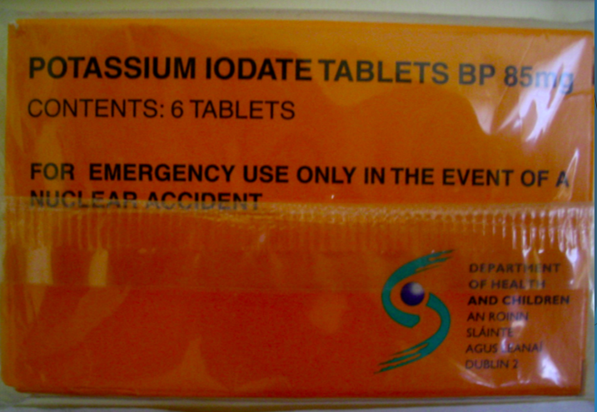
Thyroid Storm: Management
Treat the underlying precipitating event
Beta-blockers: IV propranolol
Paracetamol for pyrexia
IV fluids
Anti-thyroid drugs: High doses of propylthiouracil (Inhibits the TPO enzyme & inhibits peripheral conversion of T4 → T3)
Lugol's iodine (iodide acutely inhibits the release of thyroid hormone: Wolff–Chaikoff effect)
Dexamethasone (blocks the conversion of T4 to T3 & lowers body temperature)
Other supportive measures/symptomatic management: e.g. BP support

Slide 25
Hypothyroidism

Slide 26
Hypothyroidism: Clinical Features
General
    Goitre
  Lethargy
  Cold intolerance
  Hoarse voice
  Slowed mentally & physically
Gastrointestinal
  Constipation
  Weight gain
Gynaecological
  Menorrhagia
  Amenorrhea
Cardio
  Bradycardia
  Hypotension
  Worsening CHF, angina
  Increased cholesterol
Neurological
  Decreased deep tendon reflexes
  Carpal tunnel syndrome
  Paraesthesia
  Slow speech
  Muscle cramps
Skin
  Puffiness of face, periorbital oedema
  loss of lateral 1/3rd of eyebrows
  Dry, coarse scalp hair
  Cool & pale or yellowish skin (carotenemia)
  Dry & rough skin, pruritus
  Eczema
  Xanthomata
Notes:
Carotenaemia can be due to:
Hyperlipidaemia; lipids bind the carotenoids preventing their excretion
Liver disease, hypothyroidism and diabetes mellitus, which impair the conversion of carotenoids to retinol
Nephrotic syndrome, which prevents excretion of carotenoids in the urine

Slide 27
Hypothyroidism: Causes
More common females > males
Associated with Coeliac disease, Down syndrome, Turner syndrome
Primary hypothyroidism
  Dietary iodine deficiency (most common cause in developing world)
  Hasimoto’s thyroiditis (most common cause in developed countries)
  Hypothyroid phase of subacute thyroiditis
  Reidel’s fibrosing thyroiditis
  Iatrogenic (meds (carbimazole, lithium, amiodarone), post-thyroidectomy or radioiodine I¹³¹ treatment)
  Burnt-out Graves’ disease
  Neoplasia
  Congenital (thyroid dysgenesis or thyroid dyshormonogenesis)
Secondary hypothyroidism (rare)
Tertiary hypothyroidism (very rare)

Slide 28
Hypothyroidism: Hashimoto's thyroiditis
Hashimoto's thyroiditis is an autoimmune disorder of the thyroid gland involving lymphocytic infiltration, fibrosis, and thyroid follicular cell hyperplasia
Clinical features of hypothyroidism +/- goitre
Anti-thyroid peroxidase (TPO) and anti-thyroglobulin antibodies present
There may be a transient thyrotoxicosis in the acute phase
Associated with other autoimmune conditions (coeliac disease, T1DM, vitiligo, Addison’s disease, pernicious anaemia)
Associated with the development of MALT lymphoma

Slide 29
Hypothyroidism: Subacute Thyroiditis
Acute inflammatory disorder of the thyroid gland characterized by an initial thyrotoxic state followed by hypothyroidism eventually followed by euthyroidism in most cases
Two types: (1) painful (2) painless
Painful = viral (usually preceded by URTI), De Quervain’s (granulomatous thyroiditis)
Painless = postpartum, auto-immune
Beta-blockers if symptomatic of hyperthyroidism. If symptomatically hypothyroid, could treat short-term with levothyroxine
Permanent hypothyroidism in ~10% cases of painless thyroiditis
Postpartum: thyrotoxicosis 2-3 mo postpartum, then hypothyroid phase at 4-8 months postpartum. May recur in subsequent pregnancies

Slide 30
Hypothyroidism: De Quervain’s Thyroiditis
A.K.A. subacute granulomatous thyroiditis
Postulated to occur following viral infection and typically presents with hyperthyroidism
There are typically 4 phases
  Phase 1 (lasts 3-6 weeks): hyperthyroidism, painful goitre, raised ESR
  Phase 2 (1-3 weeks): euthyroid
  Phase 3 (weeks - months): hypothyroidism
  Phase 4: thyroid structure and function goes back to normal
Management
  Usually self-limiting. Most patients do not require treatment
  Thyroid pain may respond to aspirin or other NSAIDs
  Propranolol if symptomatic during hyperthyroid phase

Slide 31
Hypothyroidism: Reidel’s (Fibrosing) Thyroiditis
Dense fibrous tissue replacing the normal thyroid tissue
O/E: A hard, fixed, painless goitre
Usually seen in middle-aged women
Associated with retroperitoneal fibrosis

Slide 32
Hypothyroidism: Management
Therapeutic goal is normalisation of the TSH level
Starting dose of 50-100 micrograms levothyroxine OD (Dosage of 1.6 micrograms per kilogram of body weight per day, rounded to the nearest 25 micrograms)
Start lower doses (25-50 micrograms OD) and up-titrate cautiously in patients:
  >65 years
  Cardiovascular hx
  Severe hypothyroidism
After a change of levothyroxine dose, check TFTs in 8-12 weeks
Once stabilised, check TFTs annually

Slide 33
Myxoedema Coma
Medical Emergency
Severe hypothyroidism complicated by trauma, sepsis, cold exposure, MI, other stressful events
Rare, high level of mortality when it occurs (up to 60%, despite therapy)
Features:
  Decreased mental status
  Hypothermia
  Bradycardia
  Hypoventilation
  Generalized oedema
  Hypotension
  Hyponatremia
  Hypoglycemia

Slide 34
Sick Euthyroid Syndrome
Also known as ‘non-thyroidal illness’
Common in hospitalised patients
Usually everything is low (i.e. TSH, T4, T3 all low). However, TSH can be normal (inappropriately normal, given T3/T4 are low)
Reversible condition upon recovery from systemic illness
No treatment is required
Self-limiting condition

Slide 35
Thyroid Cancer

Slide 36
Thyroid Cancer
Rarely secrete thyroid hormones, hence hyperthyroidism is rarely seen
Five main types, in order of prevalence:
  Papillary
  Follicular
  Medullary
  Anaplastic
  MALT Lymphoma
Management of papillary and follicular cancer:
  Total thyroidectomy followed by radioiodine (I-131) to kill residual cells
  Thyroglobulin levels to detect early recurrent disease (papillary, follicular)

Slide 37
Thyroid Cancer
Cancer | Percentage | Notes
Papillary Carcinoma | 70% | Young females, excellent prognosis, lymphatic metastasis predominate. Thyroidectomy +/- post-op ablation.
Follicular Carcinoma | 20% | Microscopic capsular invasion is seen, haematogenous spread predominates, good prognosis. Thyroidectomy +/- post-op ablation.
Medullary Carcinoma | 5% | Cancer of parafollicular C cells (neural crest), secrete calcitonin, MEN IIa or IIb, both lymphatic and haematogenous metastasis, poor prognosis with lymph node disease. Thyroidectomy.
Anaplastic Carcinoma | 1% | Elderly females, poor prognosis, pressure symptoms, local invasion. Surgery where possible. Palliation through isthmusectomy and radiotherapy. Chemotherapy is ineffective.
Lymphoma | Rare | Rapidly enlarging thyroid mass, associated with Hasimoto’s thyroiditis, Non-Hodgkins Lymphoma, ‘B’ symptoms, chemo/radiation.

Slide 38
References
https://www.nice.org.uk/guidance/NG145
https://passmedicine.com/ MRCP Part 1
Essential Med Notes 2015, 31st Edition, Toronto Notes for Medical Students, Inc.
Oxford Handbook of Clinical Medicine, 10th Edition, Wilkinson et al, 13th July 2017.
‘Basics of Nuclear Medicine’ Google Play app
‘European Nuclear Medicine Guide’ Google Play app
https://www.govtmedicalcollegekozhikode.ac.in/nuclearMedicine
http://www.imaginglily.com/blog-what-to-expect-from-technetium-thyroid-scan.html
https://image.slidesharecdn.com/presentation1-171024110557/95/presentation1pptx-radiological-imaging-of-the-thyroid-gland-diseases-57-638.jpg?cb=1508843359

Slide 39
Thank you
Please fill out the feedback form for your certificate of learning

Slide 40
Get in touch!
Website
www.quackmeded.co.uk
Email
gg-uhb.quackmeded@nhs.net
Social Media
Twitter: @QUACK_ Med
Facebook: QUACK education

