Slide 1
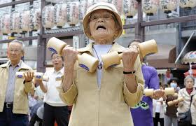
Physiology and Special Considerations in Older People
Emily Wright
ST6 DME
January 2020

Slide 2
Disclaimer*
Please note that QUACK is a regional teaching programme operating across GG&C, Lanarkshire and Ayrshire & Arran.
This presentation outlines general management, though local variances e.g. antibiotic prescription may vary slightly depending on your local trust
Remember to check your local guidelines

Slide 3
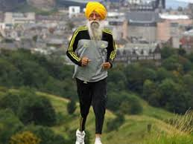
Overview
Normal ageing as a process
Physiological changes of ageing
Special points in assessing acutely unwell older patients
The importance of functional history

Slide 4
Ageing as a process
What is ageing?
  Fundamentally it occurs due to accumulation of damage at a cellular level which causes decline in structure and function until a critical point is reached
  For example we develop grey hair when the pigmented cells gradually lose the capacity to produce pigment
  The exact processes causing ageing are complex and not understood but suggestions include telomere length decreases and free radical damage accumulating

Slide 5
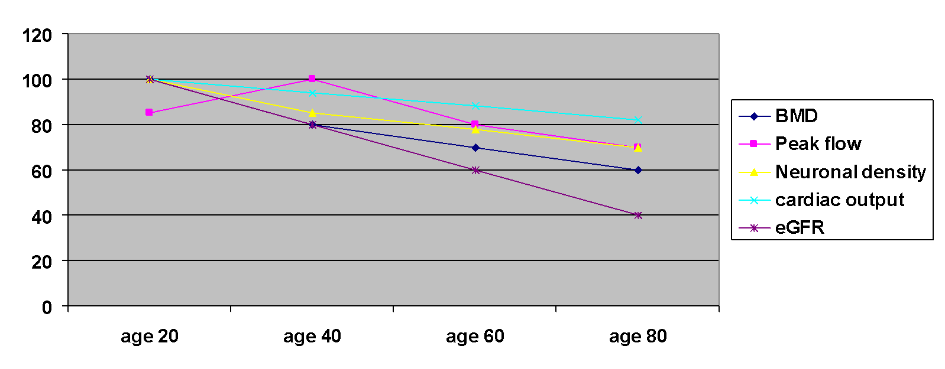
Past your peak?

Slide 6
Physiology of ageing by system
CVS
  Elastin production decreases and calcium deposition increases
  Large and medium vessels become less compliant due to reduced elasticity, increasing systemic vascular resistance and BP
  Cardiac conduction cells degenerate meaning heart block, ectopics and AF are more common – the presence of AF decreases CO by 30%
  Response to vasoactive substances is blunted

Slide 7
Physiology of ageing by system II
GI tract:
  Gut motility decreases, gastric pH increases, hepatic mass and blood flow decrease. Individual metabolic pathways in the liver remain intact
Respiratory system
  Lung and chest wall compliance decrease
  Residual volume increases due to reduced elastic support of airways and increased alveolar collapse
  Oropharynx loses elastic tissue increasing OSA

Slide 8
Physiology of ageing by system III
Metabolic system
  25% of people over 85 have diabetes
  Basal metabolic rate falls with age and reduced muscle mass can impair thermoregulatory control; there is also blunted ability to vasoconstrict/dilate to regulate temperature
  Most hormones eg testosterone, GH decrease with age
Renal tract
  Progressive loss of cortical glomeruli by 1% per year after age 20
  Increased atheroma reduces renal perfusion – renal blood flow decreases by approx. 10% every decade after 4th decade
  Creatinine can also be misleading in older people with reduced muscle mass (age is part of the Cockcroft-Gault formula)

Slide 9
Physiology of ageing by system IV
Other physiological changes
  T cell numbers are maintained but function decreases
  Epidermis thins, although the number of cells is unchanged
  Brain mass and neuronal density decrease; white matter and dopiminergic neurone loss slows metabolism in brain regions responsible for cognition
  Lean muscle mass decreases, adipose tissue proportion increases, affecting volume of distribution of drugs and making patients vulnerable to accumulation of drugs with narrow therapeutic window eg digoxin. Most clinical trials also exclude older patients

Slide 10
Special considerations in acutely unwell older patients
Aside from physiological change, what else might affect reaching a diagnosis for elderly patients?
  Communication difficulties – hearing loss, visual impairment, dysphasia post stroke
  Cognitive impairment- delirium or dementia
  Pre-existing health conditions eg heart failure with chronic dyspnoea
  Difficulties interpreting imaging eg kyphosis and CXR; central obesity and AUSS

Slide 11
Special considerations in acutely unwell older patients
There is variation in an older population as there is variation amongst all populations – an otherwise well older person may present with an acute single organ pathology and it is hard to justify use of age alone as a criterion to determine the treatment options used
  Does anyone have an example to share of where a patient has perhaps been discriminated against on the grounds of age?

Slide 12
Acutely unwell older patients II
20-30% of older patients with an infection do not mount a pyrexial response
In ACS, 89% of patients under 65 will have chest pain as a presenting complaint, but only 56% of over 65s will complain of chest pain
Rates of many cancers, eg breast and prostate, increase with age. So have a lower threshold to investigate for bone mets in older patients with back pain for example

Slide 13
Acutely unwell older patients III
Older patients are more likely to be catheterised and asymptomatic bacteruria rates approach 100% in those with longterm catheters
A patient with cognitive impairment is less likely to complain of urinary symptoms
E.coli and enterobacter (klebsiella, proteus) are the most common causative organisms, as in younger patients, but gram positives such as MRSA and enterococcus are more likely in patients with catheters. Candida and enterococcus do not produce nitrites – dipstick is not particularly helpful in isolation, particularly for patients with longterm catheters
Patients with longterm catheters are more vulnerable to infection with ESBL producing organisms

Slide 14
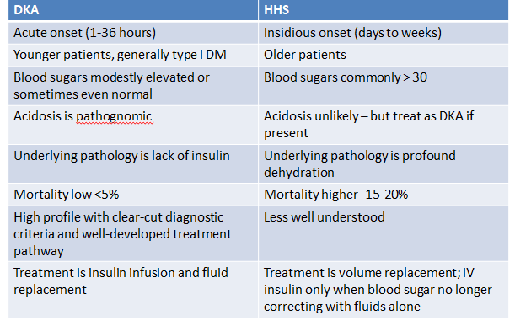
DKA and HHS compared

Slide 15
Functional assessment
This is a vital component of assessing an elderly patient
  Some ways to elicit a genuine insight are to ask about activities of daily life. Do you wash and dress yourself? Can you go to the toilet yourself? Do you get out on your own? Who does the shopping?
  There’s going to be a spectrum of responses; we should document some idea for all older patients, even if it’s just to say they are fully independent and still driving.
  Knowing what’s normal for the patient can both alert us to acute changes and prevent admissions to hospital for some patients. It’s also vital in determining escalation status

Slide 16
Key points
As with all patients we should aim to individualise care for older people, taking into account that ‘classic’ single organ pathologies may be less likely
Ageing is an inevitable natural process and understanding physiologic changes can underpin better diagnosis and management for older people
Functional status should form part of all history-taking in older patients

Slide 17
References
Being Mortal Gawande A London 2014
Anatomy and physiology of ageing article available on Anaesthesia UK website
Essential Geriatrics 2nd Edition Woodford H Oxford 2010
Fit for Frailty consensus best practice guidance British Geriatrics Society available at http://www.bgs.org.uk/campaigns/fff/fff_full.pdf
The management of the hyperosmolar hyperglycaemic state (HHS) in adults with diabetes Joint British Diabetes Societies Inpatient Care Group 2012 available at https://diabetes-resources-production.s3-eu-west-1.amazonaws.com/diabetes-storage/migration/pdf/JBDS-IP-HHS-A
ESBLs: treatment, prevention, surveillance Public Health England 2013 available at www.gov.uk/government/publications/ESBLs

Slide 18
Thank you
Please fill out the feedback form for your certificate of learning

Slide 19
Get in touch!
Website
www.quackmeded.co.uk
Email
gg-uhb.quackmeded@nhs.net
Social Media
Twitter: @QUACK_ Med
Facebook: QUACK education

