Slide 1
ROLE OF THE ELDERLY CARE ASSESSMENT NURSE
(ECAN)
Wendy Glasgow
Team Lead
Elderly Care Assessment Nurse

Slide 2
Disclaimer*
Please note that QUACK is a regional teaching programme operating across GG&C, Lanarkshire and Ayrshire & Arran.
This presentation outlines general management, though local variances e.g. antibiotic prescription may vary slightly depending on your local trust
Remember to check your local guidelines

Slide 3
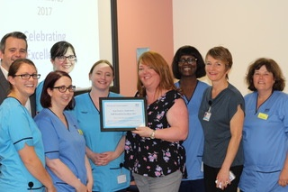
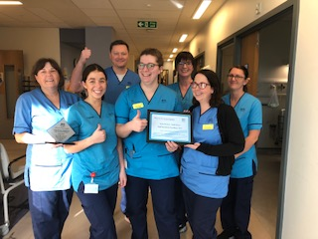
Our Frailty team

Slide 4
WHY THINK FRAILTY
AGEING POPULATION
UNPLANNED ADMISSIONS + FRAILTY=
  INCREASED RISK OF
    INFECTION
    DELIRIUM
    READMISSION
    LONGER LOS
    MORTALITY
    FALLS
CGA IMPROVES OUTCOMES
Notes:
`BY 2035 OVER 65’S WILL ACOUNT FOR 30% POPULATION
OVER 90’S WILL TREBLE
CGA FOCUS ON MEDICAL/PSYCHOLOGICAL AND FUNCTIONAL CAPABILITIES DEVELOPING A COORDINATED APPROACH TO CARE AND IMPROVING OUTCOMES.
EVIDENCE TO SHOW THAT PTS IN DME BED DO BETTER AT HOME THAN PT D/C FRM MED BED WITHOUT SPECIALITY INPUT.

Slide 5
The ecan role
Early identification of frailty patients
Facilitate early discharge
Facilitate transfers to appropriate DME ward
Frailty Huddle –liaise with hospital and community colleagues
Assess frailty using HIS Frailty tool
Comprehensive Geriatric Assessment
Detailed collateral history
Early multidisciplinary assessment
Notes:
Initially our role was to help support earlier discharges in the assessment areas. The role has developed with support from our clinical lead, lead nurse and the geriatric services to incorporate the following:

Slide 6
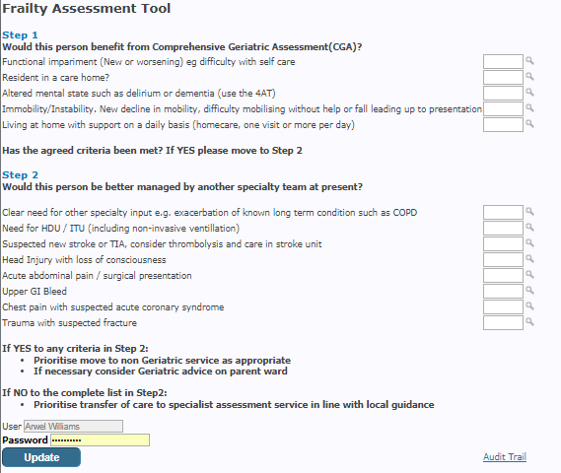
Frailty assessment tool
Notes:
We use the Health Improvement Scotland Frailty Tool. The sensitivity and specifity of the tool has been audited in work lead by Helath Improvement Scotland and with input from 5 healthboards in Scotland which looked at 1700 patients data. HIS findings are about to be finalised but it has shown that the tool is valid to measure frailty ( it was compared against the Rockwood tool ) : Its feasable to use: its valid to measure outcomes – LOS and death rates

Slide 7
Benefits of a frailty team
Reduced time to CGA
Increased number of patients receiving CGA
Improve communication
Reduce length of stay
Increase discharges
Improve capacity and flow
Reduce readmission rates
Reduce liaison burden – allow service to be more proactive
Notes:
All patients audited received CGA within 24 hours of admission to hospital

Slide 8
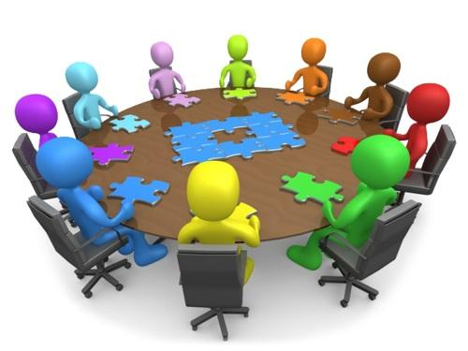
WORKING TOGETHER
Tests of change planned and executed
Ideas cultivated
Monthly frailty meetings where:
Pathways developed
Relationships built
Notes:
We have a local frailty group and with HIS where workstreams, improvement work , PDSA cycles in areas such as: IAU audit : frailty icon: ED audit : frailty huddles: patient information leaflet : Red Bag : improvement work for our short stay ward have been developed

Slide 9
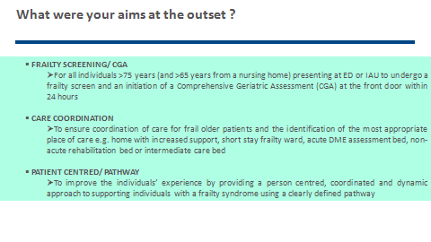

Slide 10
What have we achieved?
100% of patients screened frailty positive have a GCA commenced within 24hours
18% of frailty positive patients who receive CGA are discharged directly home from ground floor <24hours
29% of frailty positive patients who receive CGA are discharged <48hours
Notes:
Audit carried out in downstream wards looking at the length of time to CGA . Initially this was at 70% within 24 hours now at 100% consistently
Initially there was no input from the ECANs /geriatricians within the immediate assessment area or other assessment areas. PDSA cycles were undertaken and data analysed which supported the benefit of ECAN input within the assessment areas.
Data is kept on all frailty positive patients that the ECANs and Frailty team assess – 18% patients are discharged home form the assessment areas within 24hours of admission

Slide 11
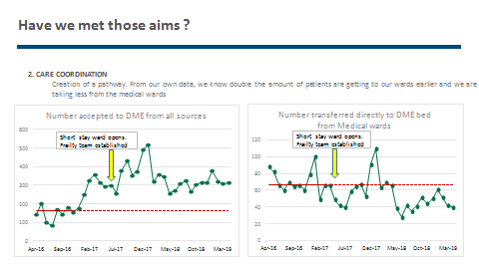

Slide 12
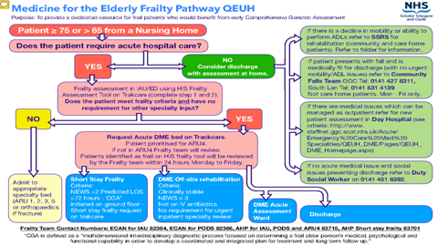

Slide 13

What were the challenges
Developing the service within assessment areas
Developing the frailty team – improved working
Hospital bed pressures – affects flow and increase on liaison referrals
Limited service at weekends
No AHP service at weekends
Notes:
There are always challenges when developing a new service - staff can be resistant to change : unclear of the benefit to their area or their patients : Being present in the assessment areas on a daily basis, staff slowly understood the benefits to them and their patients
Working more closely with PT/OT – linking in each morning, sharing information, joined up working to reduce duplication of work : Frailty huddle to share and support each other ( PT/OT, SSRS, Discharge team, social work, short stay ward staff and geriatrician allowed us to develop into a frailty team
Hospital bed pressures can affect getting our patients to the right area and when this happens we can see an increase in the number of referrals to our liaison service – however we are working more closely with bed management to try to address this
We have a limited weekend service which impacts on time to CGA in the assessment areas – again pilot studies have shown that increasing the number of ECANs on duty at a weekend improves patient assessment/ journey
Presently we have no AHP service at the weekend which does impact on discharges (Laura has further information on this )

Slide 14

Qualities of an ECAN
Professional
Ability to
Prioritise
Enabler
Communication
Skills
Educator
Team Player
Co-ordinator
Clinical Skills
Establish
Relationships
Notes:
There are many qualities of an ECAN – one of the most important ones is establishing relationships at the earliest opportunity – this allows patients and families to build up trust with you, discuss concerns which then can be explored and ensure a supportive hospital journey and discharge. Another quality is to encourage and enable the patient – focus on the positives : what the patient can do rather than what they cant do

Slide 15

Education
ALL TEAM MEMBERS BRING DIFFERENT SKILLS
ALL SKILLS SHOULD BE NURTURED
EDUCATION
at local universities
clinical assessment course
dementia champion
certificate in gerontology
hospital tutorials
ongoing supervision/training from geriatricians
EVERY TEAM MEMBER IS VALUED
Notes:
Always remember that every team members brings different strengths to the team and these strengths should be nurtured and valued.
Training that the ECANs have completed include clinical assessment course which allowed us to have a greater depth of knowledge when assessing patients and implementing plans
Certificate in gerontology including modules in frailty, dementia, compassionate care and marginalised groups – this is an other area where we may need to do more work in the future – homelessness/ addictions where this group often develop frailty syndromes 10 – 15 years earlier than the general population ( may not meet the criteria for HIS Frailty tool but would benefit from a geriatrician and CGA )

Slide 16
Ongoing work
Multi-agency assessment
Day centres
Voluntary services
GP
Community rehabilitation team
Carers support services
Working more closely with our community colleagues - prevent hospital admissions and supporting care at home
Home care
Befriending service
District nursing services
Housing
Day hospital
Social work services
Community falls prevention team
Community pharmacy
Community mental health team
Rapid access to specialists supporting chronic disease management
Notes:
This can be challenging as our hospital covers 5 council areas : each area has different services and different levels of support within these services.
Thinking in our assessment : could the patient be supported at home and what services would I need to do this?
We are building up links with community partners at our daily huddles. Other pieces of work include frailty mapping group within GGC looking at the patients journey from ED to
Discharge – what information would be beneficial to have on admission ( EMIS, KIS, DN, Homecare, SSRS , Social work ) what barriers are there to a discharge ( differences in services ) and how these can be addressed

Slide 17

Future Work
Chair Assessment Areas
Input in ED – ongoing audit
Mapping Patients journey
Feedback from our colleagues
Closer work with community colleagues
Notes:
Would there be a benefit of pulling ED frailty positive patients to a DME chair assessment area to allow for assessment by the frailty team at an earlier time in the patients journey ?
ED audit – is there a benefit of having ECAN in ED? Audit has shown that majority of ED patients that are in hospital for less than 24 hours are admitted after 5pm. – no frailty team service at this time – could we extend the hours of our service ?
We are looking at patient feedback questionaires looking at each stage of their journey : information they received : how they felt : other information they would have wanted
Feedback from our colleagues – is our info and assessment useful ? Is there any other information that you would want to see : would a shared document be beneficial ?

Slide 18
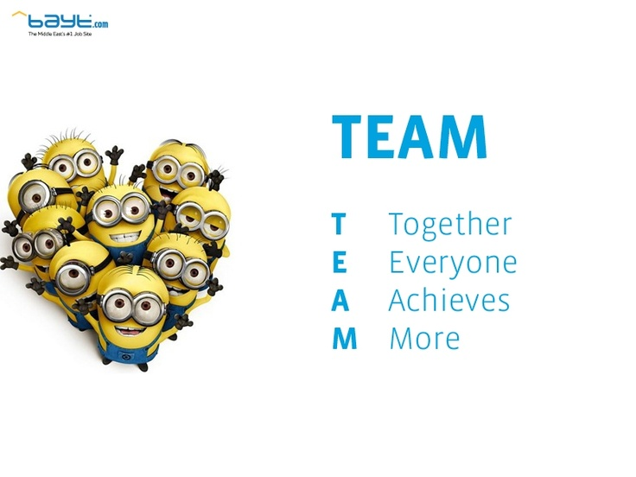
Notes:
Keep learning from other areas – we have visited frailty teams in other areas accross Scotland to share best practice
HELP EACH OTHER, NETWORK, WORK TOGETHER

Slide 19

Get in touch!
Website
www.quackmeded.co.uk
Email
gg-uhb.quackmeded@nhs.net
Social Media
Twitter: @QUACK_ Med
Facebook: QUACK education

