Slide 1
Pulmonary embolism
Gemma McGrory
ST5 AIM

Slide 2
Disclaimer*
Please note that QUACK is a regional teaching programme operating across GG&C, Lanarkshire and Ayrshire & Arran.
This presentation outlines general management, though local variances e.g. antibiotic prescription may vary slightly depending on your local trust
Remember to check your local guidelines

Slide 3
Aims
Delivered from an acute medicine perspective!
Presentation and risk factors for PE
Scoring systems in use to guide decision making
Treatment of low risk PTE
Massive VTE
Longer term management developments

Slide 4
PTE
1-2 per 1000 adults per year symptomatic VTE
1/3 of these PTE
3rd most common vascular cause of death after MI /CVA
~10% rapidly fatal
5% die after starting treatment
30% left with some residual symptoms
2% develop thromboembolic pulmonary hypertension

Slide 5
Risk Factors
Major
Minor
Previous venous thromboembolism
Age >70 years
Malignancy
Cancer chemotherapy
Paralysis
Major or lower limb trauma
Lower limb orthopaedic surgery
General anaesthesia for >30 minutes
Heparin induced thrombocytopenia
Antiphospholipid antibodies
Inherited hypercoagulable state
Obesity
Pregnancy or puerperium
Oestrogen therapy
Prolonged immobility

Slide 6
Presentation
Asymptomatic / Incidental
SOB (73%)
Chest pain (44%)
Cough (34%)
Haemoptysis
ECG changes
Tachycardia
Signs of right heart failure
Signs of DVT (~40%)

Slide 7
Scoring Systems
To inform investigation
  Well’s
  Modified Geneva
Mortality risk
  PESI
  (inpatient versus
  outpatient management)

Slide 8
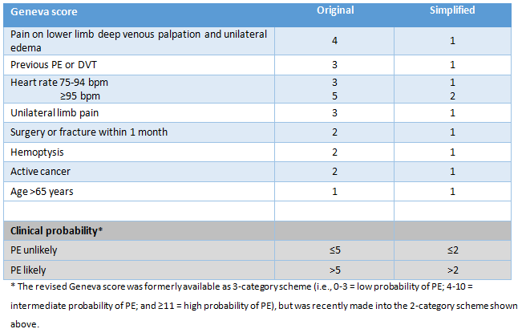

Slide 9
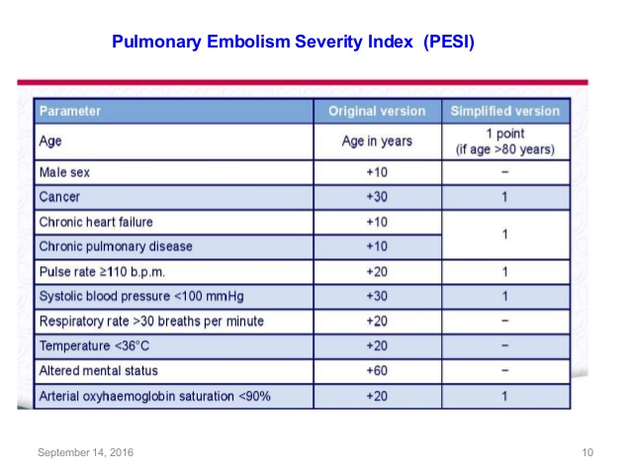

Slide 10
Ambulatory Pathway
30 day mortality low risk
PESI less than 65
LMWH then next day OP CTPA with medical review
Followed up in clinic for consideration of provoking factors and whether for long term anticoagulation
Pregnant patients usually seen by Obstetrics
  VQ versus CTPA
  Use local policy

Slide 11
Massive PTE
5% of patients
PE associated with:
  SBP <90mmHg (or drop >40mmHg)
  Evidence of right heart strain on CT or Echo
    (Guided by Troponin if haemodynamically stable)
  ?Persistent hypoxia (case by case basis)
Thrombolysis with Alteplase 10mg bolus then 90mg infusion over 2 hours
  Bleeding risk significant
  Followed by IV heparin infusion before LMWH / DOAC
If not suitable for thrombolysis, mechanical thrombectomy
  Speak to Respiratory / GJNH

Slide 12
Long Term Management
DOACs preferred over warfarin
  No monitoring required
  Easy for patients and more convenient
  3 months if first PE/DVT, life-long if second
  Can use DASH score if unsure should continue after first episode
Special circumstances
  IVDUs (some hospitals use clexane, some DOAC)
  Pregnancy (clexane bd, speak to obstetrics / refer to local policy)
  Cancer (technically life-long, but if curable cancer may be able to stop after treatment, speak to Oncology/Respiratory)
  Obesity (if >120kg then need clexane 120mg bd and warfarin induction)

Slide 13
Follow-up
PTE follow-up clinics depending on where you work
  Some places Respiratory, others Acute Medicine
Haematology can follow-up if thrombophilia suspected

Slide 14
Get in touch!
Website
www.quackmeded.co.uk
Email
ggc.quackmeded@nhs.scot
Social Media
Twitter: @QUACK_ Med
Facebook: QUACK education

