Slide 1
Lower GI Bleeding
Gemma McGrory
Clinical Teaching Fellow

Slide 2
Disclaimer*
Please note that QUACK is a regional teaching programme operating across GG&C, Lanarkshire and Ayrshire & Arran.
This presentation outlines general management, though local variances e.g. antibiotic prescription may vary slightly depending on your local trust
Remember to check your local guidelines

Slide 3
Objectives
Discuss presentations of PR bleeding
Case based

Slide 4
Case 1
56 year old male
Smoker, constipated
Presents to clinic because PR bleeding
Bright red blood on wiping and in pan
Differential diagnosis?

Slide 5
Haemorrhoids
Very common
Engorgement of anal cushions
Men > women
Precipitated by
  Pregnancy
  Constipation → straining
  Diarrhoea
Notes:
Affect almost half of population at some point. Anal cushions important for fine control of continence.
Men > Women
Thought probably initiaited by straining to pass small hard stools. Straining raises intrabdominal pressure and this obstructs venous return causing the venous plexes to become engorged. The bulging mucosa is then dragged distally by the hard stool. Furthermore, persistent straining at stool causes the pelvic floor to sag downwards, extruding the anal mucosa and causing a small degree of prolapse. Can bleed, prolapse, cause slight leakage of mucus or stool, particularly when passing flatus. Bleeding from the arterial component of the anal cushion results in chracteristic bright red bleeding. The venous component causes a problem only if it becomes thrombosed to form a throbosed external venous saccule. Haemorrhoids are usually located in the 3 / 7 /12 o’clock position when patient in supine lithotomy position.

Slide 6
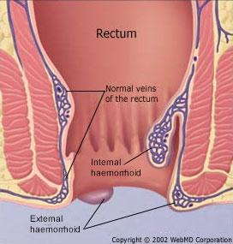

Slide 7
Grades
Grade I
  Never prolapse
Grade II
  Prolapse during defaecation but return spontaneously
Grade III
  Remain outside the anal margin

Slide 8
Presentation
Pruritus ani
PR Bleeding
  Fresh red, on the paper or separate from the stool
Mucus leakage
Haemorrhoidal prolapse
Anal pain
  If thrombosed or strangulated

Slide 9
Investigation
PR
  Note haemorrhoids usually not palpable as the contained blood empties with pressure form the examining finger
Proctoscopy
Sigmoidoscopy if >40

Slide 10
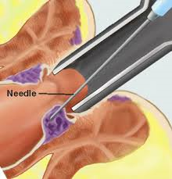
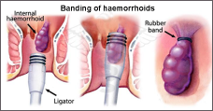
Management
Avoid constipation
Topical creams
Sclerosant injections
  Grade II or above
  Promotes an obliterative fibrotic reaction
Banding
Haemorrhoidectomy

Slide 11
Case 2
75 year old man referred for urgent colonoscopy
Anaemia picked up on routine testing
Admitted to:
  3 month history of altered bowel habit
  Dark blood mixed in with stools
Differential diagnosis?

Slide 12
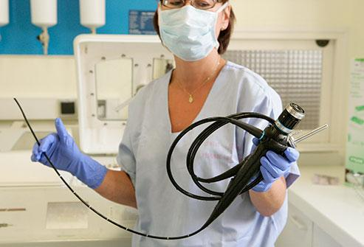
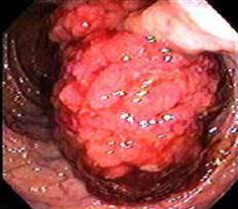

Slide 13
Risk Factors
Increasing age
Male
Low fibre, high in red meat diet
Alcohol / smoking
Ulcerative colitis
Strong family history
  Familial polyposis coli
  Hereditary non-polyposis colon cancer
  Peutz Jeghers

Slide 14
Presentation
Weight loss
Altered bowel habit
Abdominal pain
Abdominal mass
Right sided
  Caecum / proximal colon
  Iron deficiency anaemia
Left sided
  PR bleeding
  Altered bowel habit
  Obstruction
  Tenesmus

Slide 15
Investigations
PR
Bloods - anaemia
Colonoscopy
Biopsy
CT C/A/P for staging

Slide 16
Dukes’ Staging
Stage | 5 year survival
A: Confined to muscosa and submucosa | 80%+
B: Extends through muscularis propia | 60-70%
C: Regional lymph nodes involved | 30-40%
D: Distant spread | <10%
95% CRC is adenocarcinoma

Slide 17
Management
Surgical resection
Radiotherapy
Adjuvant chemotherapy
CEA / serial scopes can be used to monitor for recurrence

Slide 18
Case 3
19 year old girl
4 week history of:
  Diarrhoea up to 20 x per day
  Weight loss
  Bloody stools
Differential diagnosis?

Slide 19
Inflammatory Bowel Disease
Ulcerative colitis
  Large bowel only
Crohn’s disease
  Any part of GI tract
Indeterminate colitis

Slide 20
Pathology
Ulcerative Colitis
Crohn’s Disease
Recurrent acute inflammation
Continuous involvement of colon
Mucosal only
Superficial ulceration
No granuloma
Minimal wall fibrosis
Chronic relapsing inflammation
Skip lesions in any part of GI tract
Transmural
Fissured ulceration (cobblestone)
Granuloma
Marked wall fibrosis

Slide 21
Clinical Features
Ulcerative Colitis
Crohn’s Disease
Non smoker
Anal features less common
Less likely systemic features but... toxic megacolon
Smoker
Fistulae / Strictures / Anal lesions more common
Systemic features
  Uveitis
  Arthritis
  Erythema nodosum
  Pyoderma gangrenosum

Slide 22
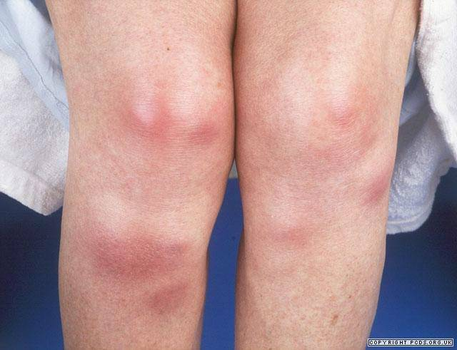
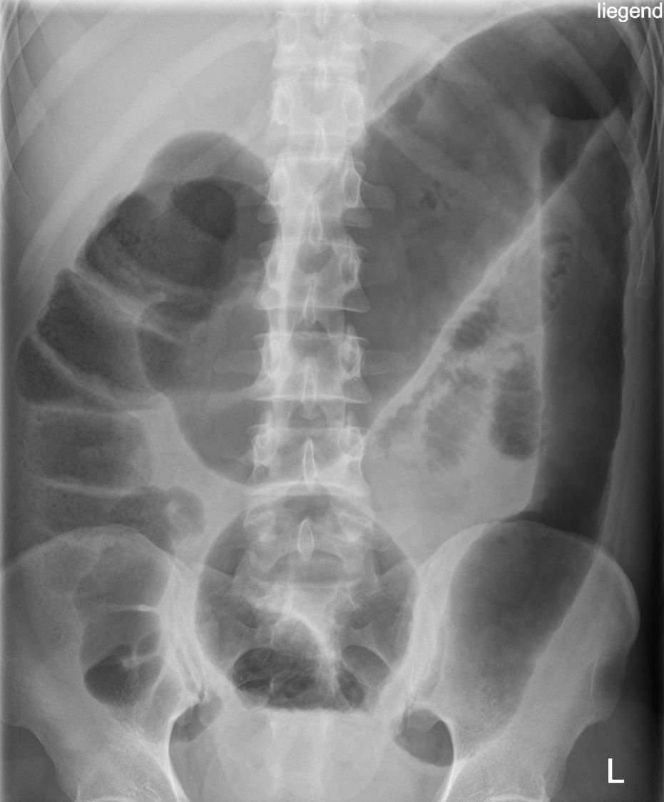
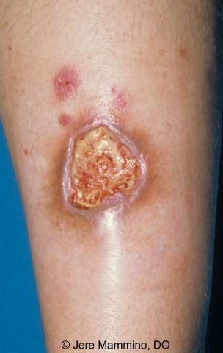
Erythema Nodosum
Toxic Megacolon
Pyoderma Gangrenosum

Slide 23
Treatment
5-ASA
  Mesalazine
  Aminosalicylate
  Anti inflammatory
Steroids (local / systemic)
Biological agents
Surgery

Slide 24
Case 4
85 year old gentleman
Hypertensive, smoker, diabetic, PVD
Presents to Surgical Receiving with:
  Acute abdominal pain
  Dark red PR bleeding
  Hypotensive, tachycardic
Differential Diagnosis?

Slide 25
Ischaemic Colitis
Occlusion of superior mesenteric artery
  Blood supply to jejunum, ileum and right colon occluded
Causes massive infarction of right colon and most of small bowel
High mortality rate
Emergency laparotomy

Slide 26
Summary
Discuss presentations of PR bleeding
  Haemorrhoids
  Colorectal cancer
  Inflammatory bowel disease
  Ischaemic Colitis
Case based

Slide 27
Get in touch!
Website
www.quackmeded.co.uk
Email
ggc.quackmeded@nhs.scot
Social Media
Twitter: @QUACK_ Med
Facebook: QUACK education

