Slide 1
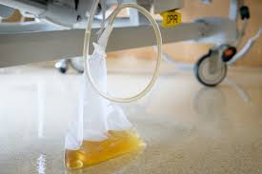
Catheter-Associated UTI
Emily Wright
DME

Slide 2
Disclaimer*
Please note that QUACK is a regional teaching programme operating across GG&C, Lanarkshire and Ayrshire & Arran.
This presentation outlines general management, though local variances e.g. antibiotic prescription may vary slightly depending on your local trust
Remember to check your local guidelines

Slide 3
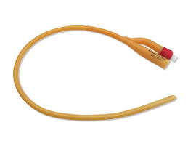
Overview
Relevance to older patients
Reasons for longterm catheterisation
Colonisation versus infection
CAUTI diagnosis and management
ESBLs

Slide 4
Relevance to Older patients
In essence, most reasons for patients to be catheterised are commoner in older patients
Prevalence of urinary catheters in in-patients in England 12-26%, varying by setting
Longterm (>28 days) catheterisation is more prevalent in older patients in the community

Slide 5
Reasons for catheterisation
Acute
  Fluid balance monitoring
  Obtaining urine sample
  Urodynamic testing
  Acute urine retention
  Hydronephrosis secondary to incomplete bladder emptying
  Intermittent self-catheterisation e.g. atonic bladder in MS
Longterm
  Chronic urine retention
    Often due to structural urinary tract problems, especially prostatic pathology – rates increase in older males

Slide 6
Colonisation versus infection
Asymptomatic bacteriuria rates increase with age for both sexes – 17% of females and 7% of males over 75 (whole population)
Of patients with bacteriuria, 10-25% will develop UTI at some point
Bacteriuria develops at a rate of 3-10% per day catheter is present – so by one month bacteriuria is pretty much universal in catheterised patients

Slide 7
Colonisation versus infection II
Presence of a catheter encourages formation of a bacterial biofilm; bacterial growth can also be encouraged by urinary stasis
Other risk factors for developing CAUTI include female sex, older age groups, Diabetes mellitus and suboptimal catheter care
So not having a catheter at all is the preferred situation, but if catheter is indicated, intermittent self-catheterisation carries lesser risk of infection – but many older patients cannot have this treatment

Slide 8
CAUTI
Common causative organisms are E.coli (around ¼), enterobacteraciae, pseudomonas, enterococci, staphylococci and klebsiella
Also common that catheters are colonised with candida, but very rare that this causes systemic candidaemia
There is a lack of evidence base for diagnostic criteria for CAUTI

Slide 9
CAUTI II
Pragmatically, CAUTI could be diagnosed in a patient who has a catheter and signs and symptoms consistent with infection, not better explained by an alternative infective source. Remember delirium may be presenting complaint
A patient with a catheter might also have a chest or soft tissue infection – rule these out before diagnosing CAUTI
Due to widespread bacteriuria, dipstick and even microscopy are not diagnostic, although culture of a urinary pathogen is supportive
Pyuria and malodorous urine is common in catheterised patients and does not correlate with presence of active infection

Slide 10
CAUTI III
Around 20% of cases of bacteraemia originate in the urinary tract
Bacteraemia carries a 10% mortality
UTI is also the commonest hospital acquired infection, often in association with a catheter
Removal of the catheter in addition to antibiotics is the mainstay of treatment; patients with indications for longterm catheter should have the catheter replaced with antibiotic cover

Slide 11
CAUTI IV
Local guidelines based on resistance patterns, other patient factors such as renal function or allergy, previous sensitivities and presence of systemic upset will guide antibiotic treatment – catheter change with gentamicin is standard
Antibiotics for routine catheter change are not indicated; there is also little to support antibiotic prophylaxis in patients at risk of CAUTI

Slide 12
ESBLs
Extended spectrum beta lactamase is an enzyme produced exclusively in gram negative bacteria which confers resistance to most beta lactam antibiotics – penicillins, cephalosporins, aztreonam
Klebsiella, E.coli, proteus, enterobacter and pseudomonas are some examples
ESBL producers are now encountered worldwide in community and hospital settings

Slide 13
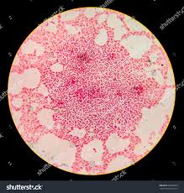
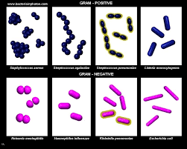
Gram negative bacteria

Slide 14
ESBLs II
Rates vary – 5-16% of gram negative isolates in the US are ESBL producers; 60% of klebsiella species in Mexico
Transmission rates from person to person are uncertain – 1.5-8.3%, hence the need for barrier nursing. Transmission has also been described in household contacts. ESBLs have been found in city rivers, sewage, sinks, livestock and pets.
Mainstay of treatment in systemic ESBL infection is Meropenem, which has been found to improve survival compared to Tazocin

Slide 15
Overview
Relevance to older patients
Reasons for longterm catheterisation
Colonisation versus infection
CAUTI diagnosis and management
ESBLs

Slide 16
References
Up to Date articles: Catheter Associated Urinary Tract Infections in Adults; Extended spectrum Beta Lactamases – referred to Jan 2019
SIGN 88 Management of suspected bacterial UTI in adults 2012
NICE guideline on antimicrobial prescribing in UTI 2018
Shackley DC, Whytock C, Parry G, et al Variation in the prevalence of urinary catheters: a profile of National Health Service patients in England BMJ Open 2017; 7:e013842

Slide 17
Thank you
Please fill out the feedback form for your certificate of learning

Slide 18
Get in touch!
Website
www.quackmeded.co.uk
Email
gg-uhb.quackmeded@nhs.net
Social Media
Twitter: @QUACK_ Med
Facebook: QUACK education

