Slide 1
Respiratory Nurse Specialist Service
Queen Elizabeth University Hospital
Gareth Shaw Andy Kerr

Slide 2
Disclaimer*
Please note that QUACK is a regional teaching programme operating across GG&C, Lanarkshire and Ayrshire & Arran.
This presentation outlines general management, though local variances e.g. antibiotic prescription may vary slightly depending on your local trust
Remember to check your local guidelines

Slide 3
Service overview: inpatients
Respiratory Nurse Specialists QEUH
COPD Early Supported Discharge (ESD)
Acute asthma review
Severe chronic COPD review
New LTOT (COPD, ILD)
  End of life --> Hospital Palliative Care Team
  Lung cancer --> Lung Cancer CNS Team
Nebuliser assessment, education & provision
Specialist nebulised treatments

Slide 4
Service overview: outpatients
Respiratory Nurse Specialists QEUH
Nurse-led biologic therapy clinics for severe asthma: omalizumab, mepolizumab
MDT-based difficult asthma clinics (GGH, Vic)
Home visits:
  COPD Early Supported Discharge (ESD)
  New & routine LTOT (COPD / ILD)
  Supportive / palliative (COPD / ILD)
  Respiratory consultant initiated
  GP initiated

Slide 5
Early Supported Discharge
Respiratory Nurse Specialists QEUH
Uncomplicated exacerbation of COPD
Clinically manage COPD patients at home
Refer via TrakCare
We review and accept for ESD if suitable
We visit at home the next day
+/- follow up visits or phone calls
We may refer to and liaise with other services
Discharge from service following resolution of exacerbation

Slide 6
ESD criteria
Respiratory Nurse Specialists QEUH
Confirmed COPD diagnosis
Infective or non-infective exacerbation
Day 5 or less of admission
Safe to manage patient at home
Exclusion criteria:
  Acute respiratory acidosis; significantly abnormal vital signs; acute confusion; focal abnormality on CXR/pneumonia; complicating co-morbidity e.g. cardiac disease; IV meds required; hypoxaemia
  Patient refuses; ESD not required; not coping at home; lone worker safety issues

Slide 7
Acute asthma reviews
Respiratory Nurse Specialists QEUH
All patients admitted past A+E with exacerbation of asthma
Treatment recommendations
Inhaler technique, compliance and optimisation
Patient education
Personal Asthma Action Plan
If required we will refer to asthma clinic
Off nebulisers for 24 hours
  never discharge with nebs!

Slide 8
Severe chronic COPD reviews
Respiratory Nurse Specialists QEUH
Severe: MRC dyspnoea scale 4-5
Frequent admissions: 3+ in 12 months
Treatment optimisation
  inhalers, nebs, LTOT
Palliation of symptoms
Review home/social circumstances
Referral to community/HPCT, DNs, Community Respiratory Team (PT/OT/dietician/pharmacist)
We may provide supportive/palliative home visit

Slide 9
Referring to our service
Respiratory Nurse Specialists QEUH
Monday - Friday 8:00 - 16:00
All referrals via TrakCare:
  New Request
  Other (Adult) tab
  Adult Respiratory Nurse Specialist Referral
General advice:
  0141 451 6073 / 6074
  86073 / 86074

Slide 10
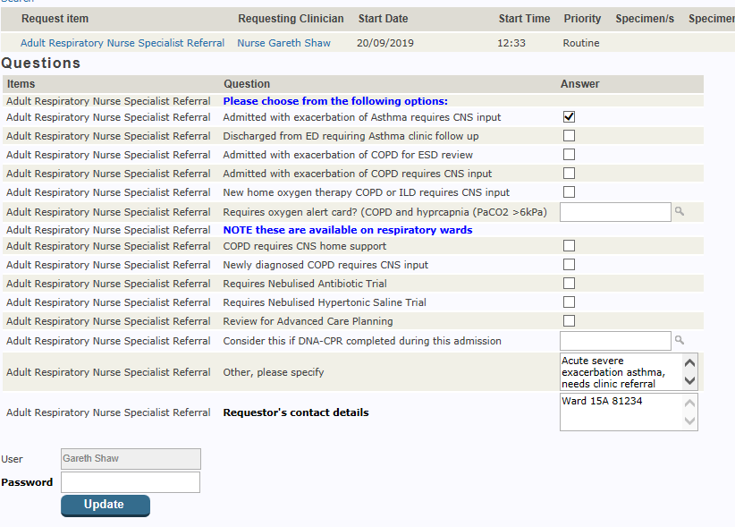

Slide 11
Summary
Respiratory Nurse Specialists QEUH
Mon – Fri 8am – 4pm, refer via Trak
Early Supported Discharge
  Uncomplicated exacerbation of COPD
  Same day discharge, home visit the following day, further support as required
Acute asthma reviews
  All exacerbations of asthma
Severe COPD reviews
  MRC 4-5, frequent admissions
  Requires complex assessment / support / optimisation

Slide 12
Get in touch!
Website
www.quackmeded.co.uk
Email
ggc.quackmeded@nhs.scot
Social Media
Twitter: @QUACK_ Med
Facebook: QUACK education

