Slide 1
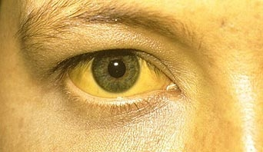
The lesser spotted jaundiced patient in medicine
Gemma McGrory
Acute Medicine Registrar

Slide 2
Disclaimer*
Please note that QUACK is a regional teaching programme operating across GG&C, Lanarkshire and Ayrshire & Arran.
This presentation outlines general management, though local variances e.g. antibiotic prescription may vary slightly depending on your local trust
Remember to check your local guidelines

Slide 3
Learning Outcomes
Case based approach
Discuss surgical causes versus medical causes of jaundice

Slide 4
Jaundice - Medical
Pre-hepatic
Hepatic
Haemolysis
Gilbert’s
Alcohol
Viral
NASH
Autoimmune
Inherited
Other infections

Slide 5
Jaundice - Surgical
Obstructive
  Gallstones
  Ascending cholangitis
  Chronic pancreatitis
  Biliary stricture
  Pancreatic carcinoma
  Cholangiocarcinoma
Other
  Hepatocellular Carcinoma
Notes:
Chronic pancreatitis causes jaundice through bile duct scarring

Slide 6
History Taking
Colour of urine / stools
Drug history
Risk for viral hepatitis
Symptoms associated with malignancy
  Anorexia
  Weight loss

Slide 7
Examination
Jaundice
Signs of chronic liver disease
Abdominal examination
  Abdominal mass, palpable liver / spleen
Couvoisier’s law
  Obstructive jaundice in presence of palpable gallbladder not due to stones

Slide 8
Investigation
Liver screen
USS
CT
ERCP / MRCP
Liver biopsy

Slide 9
Cases...

Slide 10
Case 1
45 year old morbidly obese lady
6 weeks post cholecystectomy
Presents with
  RUQ pain
  Vomiting
  Tachycardia
  Jaundice
Differential diagnosis?

Slide 11
Ascending Cholangitis
Infection of bile duct
Usually associated with a stone
  Stones can form in gallbladder or in ducts themselves

Slide 12
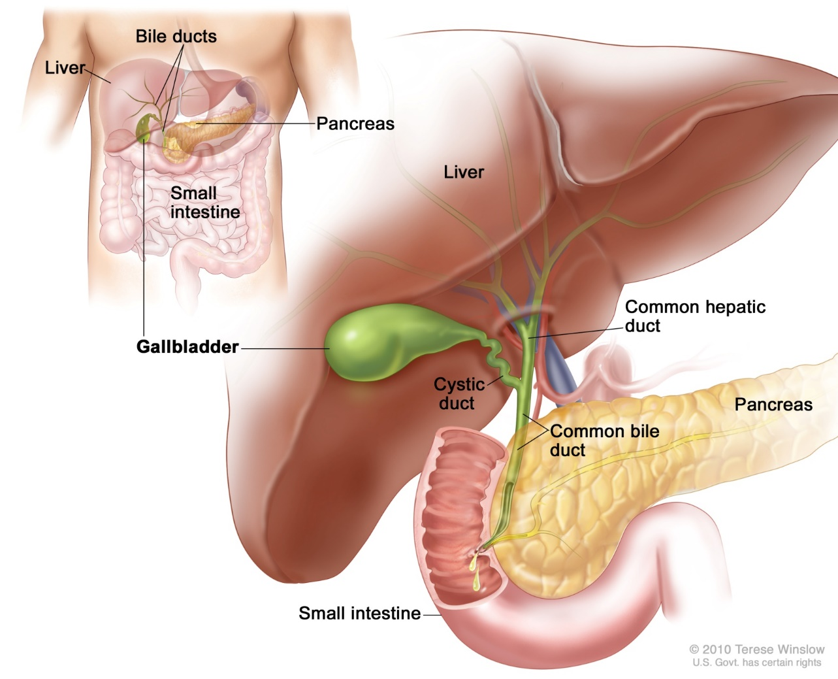

Slide 13
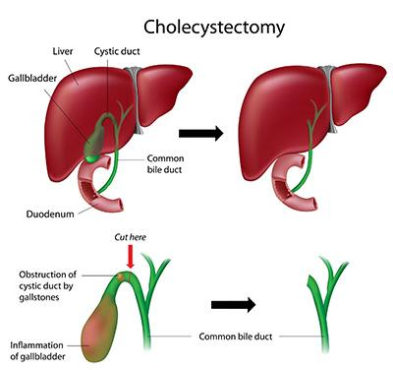

Slide 14
CBD Stones
Common bile duct is narrowest at its lower end
  Stones that are too large to pass become impacted
  More susceptible to infection
  Can occur after cholecystectomy

Slide 15
Management
IV Antibiotics
  IV Amoxicillin, Metronidazole and Gentamicin (or as per protocol)
IV fluids
USS...
  Stone in common bile duct, evidence previous cholecystecomy
ERCP...

Slide 16
ERCP
Endoscopic Retrograde Cholangiopancreatography
Direct visualisation of bile ducts
Can treat at same time

Slide 17
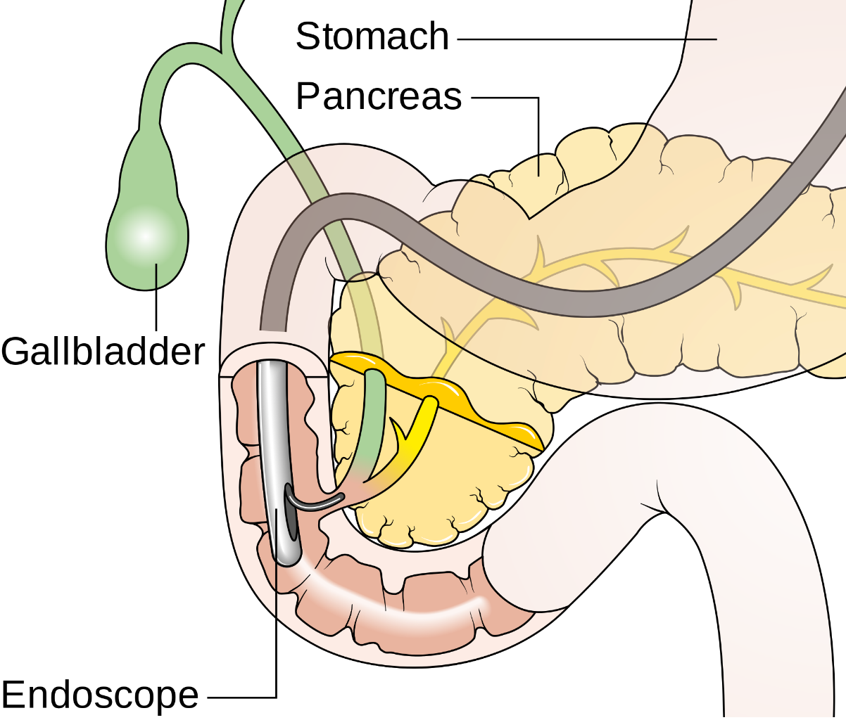

Slide 18
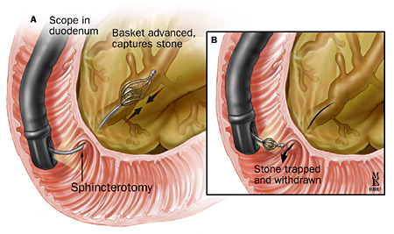

Slide 19
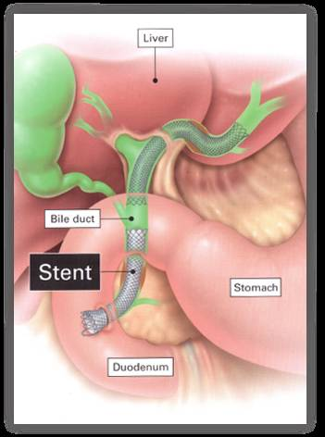

Slide 20
Case 2
68 year old presents with 1 week history of:
  Jaundice
  Recent weight loss
  Some nausea

Slide 21
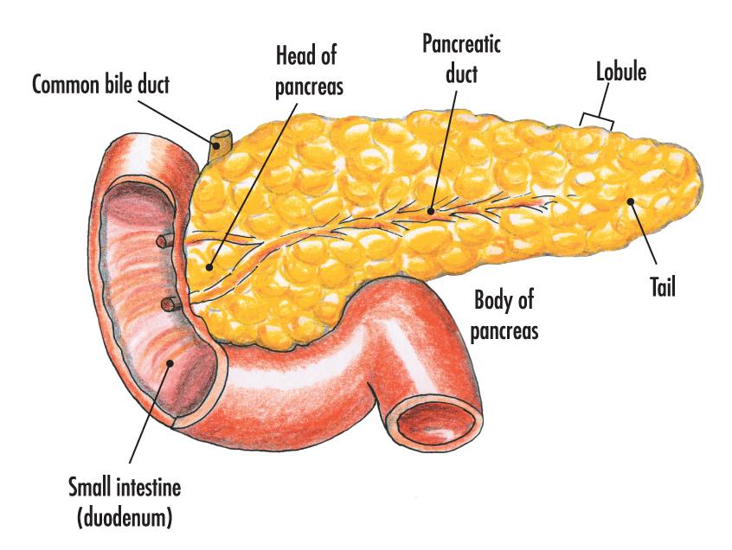
Pancreatic Cancer
90% adenocarcinomas
70% head of pancreas
Poor prognosis
  12% at 1 year
  2% at 5 years

Slide 22
Presentation
Early
Late
Painless jaundice
Nausea
Abdominal pain
  Deep, gnawing
Marked weight loss
Anorexia
Nausea
Vomiting

Slide 23
Investigations
USS
CT scanning
CT guided biopsy
MDT meeting

Slide 24
Management
Whipple’s procedure
  Pancreatico-duodenectomy
  Only 15% at presentation suitable for resection of head of pancreas
  Post-op adjuvant chemo
ERCP for symptoms
  Stenting
Palliative chemotherapy

Slide 25
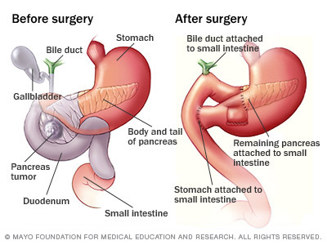

Slide 26
Case 3
39 year old presents with new jaundice, associated with vomiting
Recent travel to South Korea
Differentials?

Slide 27
Differentials of jaundice in returned traveller
Hepatitis A
Leptospirosis (Weil’s disease)
Yellow fever
Malaria
https://www.medicinejournal.co.uk/article/S1357-3039(09)00285-0/pdf

Slide 28
Differentials of jaundice in returned traveller
Hepatitis A
  Previous outbreaks in South Korea
Leptospirosis (Weil’s disease)
  More common if animal contact / sewers / watersports
Yellow fever
  Not a problem in South Korea, think South America
Malaria
  South Korea low risk area

Slide 29
Summary
Case based approach
Discuss surgical causes versus medical causes of jaundice
Ascending cholangitis
CBD obstruction post operatively
Pancreatic cancer
Jaundice in the returning traveller

Slide 30
Questions?

Slide 31
Get in touch!
Website
www.quackmeded.co.uk
Email
ggc.quackmeded@nhs.scot
Social Media
Twitter: @QUACK_ Med
Facebook: QUACK education

