Slide 1
Anaphylaxis
Gemma McGrory
Acute Medicine Registrar

Slide 2
Disclaimer*
Please note that QUACK is a regional teaching programme operating across GG&C, Lanarkshire and Ayrshire & Arran.
This presentation outlines general management, though local variances e.g. antibiotic prescription may vary slightly depending on your local trust
Remember to check your local guidelines

Slide 3
Anaphylaxis
Severe life threatening generalised or systemic hypersensitivity reaction
Sudden onset and rapid progression
Life threatening airway/breathing problems

Slide 4
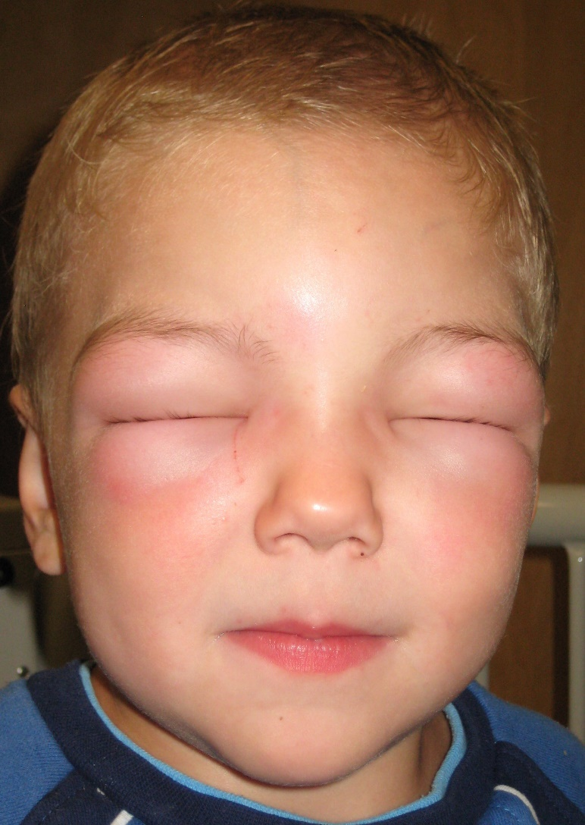
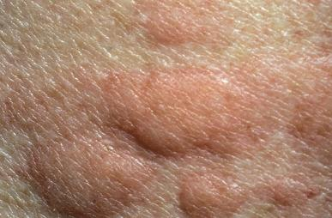
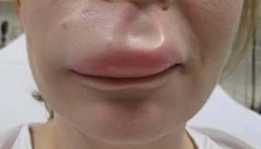

Slide 5
Presentation
Often history of previous sensitisation
Generalised itching
Urticaria
Erythema
Angio-oedema
Airway involvement (stridor / wheeze)
Haemodynamic instability
Sense of impending doom
Collapse / LOC

Slide 6
Triggers
Food
  Peanuts
  Pulses
  Tree nuts
  Fish/shellfish
  Eggs
  Milk
  Sesame
Venom
  Bee stings
  Wasp stings
Drugs
  Antibiotics
  Opioids
  NSAIDs
  IV contrast media
  Muscle relaxants
  Other anaesthetic drugs

Slide 7
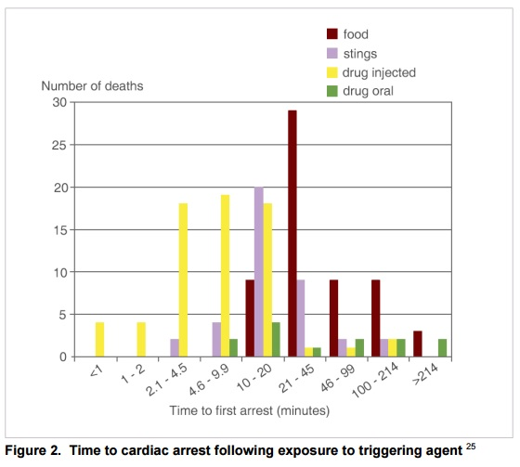
Resus Council (UK)

Slide 8
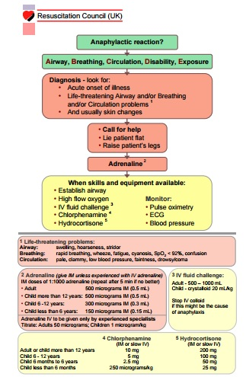
Resus Council (UK)

Slide 9
ABCDE
Assess patient using ABCDE
Any signs of life threatening airway / breathing / circulation problems in context of allergic insult usually with a rash
  IM Adrenaline 0.5mg 1 in 1000
  Do not give IV

Slide 10
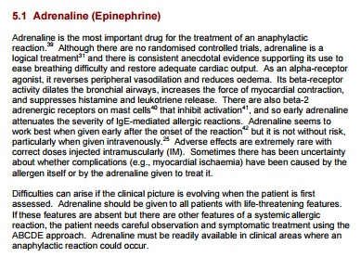
Resus Council (UK)

Slide 11
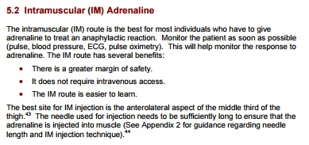
Resus Council (UK)

Slide 12
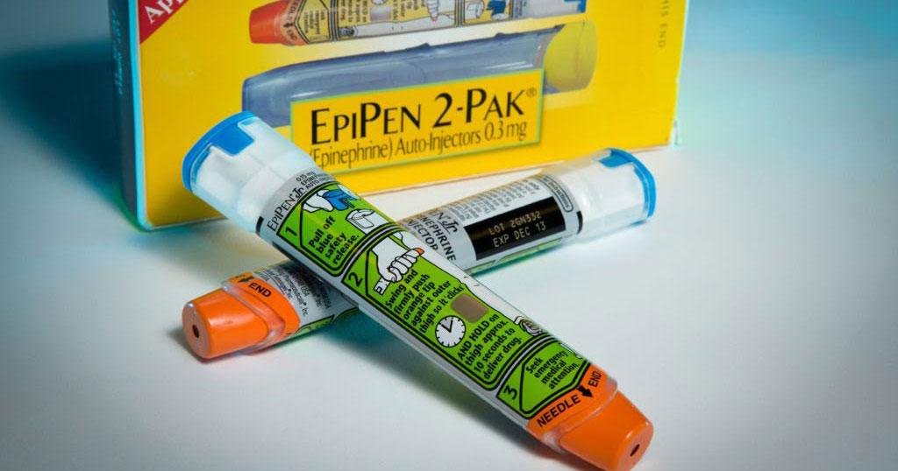

Slide 13
Investigations
Should come after immediate treatment
Mast cell tryptase
Routine bloods

Slide 14
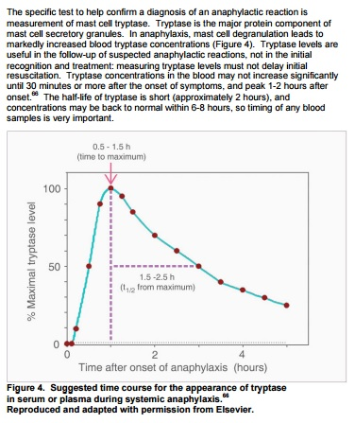
Resus Council (UK)

Slide 15
Discharge
Discharge 6 hours after if well, 12 hours if used epipen
Risk of recurrence highest in first 24 hours
Follow up with Allergy clinic
  Dr Malcolm and Dr Kewin @ West Ambulatory Care Hospital (GGC, check locally)
  Patch testing for allergies
Consider antihistamines and oral steroids for 3 days
Epipen x 2

Slide 16
Get in touch!
Website
www.quackmeded.co.uk
Email
ggc.quackmeded@nhs.scot
Social Media
Twitter: @QUACK_ Med
Facebook: QUACK education

