Slide 1
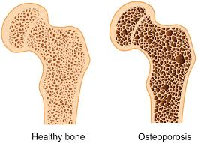
Orthogeriatrics and Bone Health
Emily Wright
QEUH

Slide 2
Disclaimer*
Please note that QUACK is a regional teaching programme operating across GG&C, Lanarkshire and Ayrshire & Arran.
This presentation outlines general management, though local variances e.g. antibiotic prescription may vary slightly depending on your local trust
Remember to check your local guidelines

Slide 3
Orthogeriatrics and Bone Health
Fragility fractures
Fractured neck of femur
Quick guide to Osteoporosis
Bone health

Slide 4
Fragility Fractures
Fracture occurring with minimal trauma
The WHO definition considers a fall from less than or equal to standing height as ‘low level trauma’
Fragility fracture sites:
  Distal radius
  Vertebral body
  Neck of femur
  Consider also humeral neck, pelvis and rib

Slide 5
Fractured neck of femur
Approximately 6000 per year in Scotland, 75,000 in the UK
Treating this injury accounts for 1% of the total UK NHS budget
Average age of patients is 77; 3x commoner in females
The majority are a result of osteoporosis/osteopenia; pathological fracture and high energy mechanism of injury are outwith our scope here

Slide 6
Fractured neck of femur II
Suspect post fall if hip pain and reduced mobility
7% of hip # are not visible on plain XR; gold standard is MRI but CT more accessible
Main diagnostic subtypes:
  Intracapsular
  Extracapsular
    In relation to the intertrochanteric line
    An intracapsular fracture proximal fragment is highly likely to lose its blood supply, hence the different management strategies

Slide 7
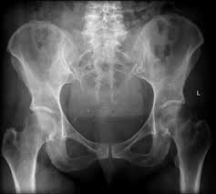
Intracapsular fracture
Radiopaedia.org

Slide 8
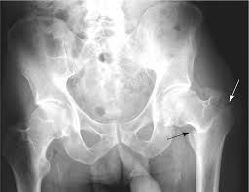
Extracapsular fracture
AAFP.org

Slide 9
Fractured neck of femur III
Intracapsular fracture fixation will typically be with a cemented hemiarthroplasty – only a fraction of patients, essentially the fittest and most mobile pre-injury, will receive total hip replacement
Extracapsular fracture fixation will typically be with a dynamic hip screw (DHS) or intramedullary nail depending on #
The majority of surgery is carried out under spinal anaesthesia

Slide 10
Fractured neck of femur IV
The Scottish Hip fracture audit was re-introduced in 2012 and measures care against 11 standards
  From provision of analgesia and screening for delirium in the ED, avoiding repeated pre-op fasting and providing CGA to remobilising on day 1 post op
85% of patients in Scotland now receive specialist orthogeriatric input; length of stay in hospital has reduced from 22 days to 17 on average
Coinciding with the spread of orthogeriatrics has been 30 day mortality decrease from 10.9% in 2007 to 6.7% in 2016

Slide 11
Osteoporosis
A reduction in bone mass and deterioration in bone microarchitecture
Diagnosed where bone mineral density is ≥2.5 standard deviations below that of mean peak mass at the femoral neck (T-score)
  Unusually, the evidence base is largely from females
A fracture with minimal trauma is more likely in those with osteoporosis – but remember it’s trauma that cause fractures. Would we be better trying to reduce falls?

Slide 12
Osteoporosis Risk Factors
  Advancing age -2% of women aged 50; 25% of women aged 80
  Previous fragility fracture
  Post-menopausal women
  Prolonged steroid use
  Low BMI
  Family history
  Smoking
  Excess alcohol
  Diabetes, Rheumatoid arthritis, IBD

Slide 13
Bone Health
NOGG advocates empirical treatment for patients with fragility fracture
SIGN 142 advocates DEXA for those with fragility fracture and use of an evaluation tool to quantify risk in those with risk factors
The fracture liaison service advises management for NHS GGC
Qfracture is an online risk assessment tool which was developed from UK population data and incorporates major risk factors; it includes patients aged 30-99 and gives risk at 1 and 10 years; ≥10% risk suggests DEXA indicated

Slide 14
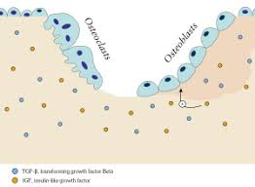
Bone remodelling
Wikipedia.org

Slide 15
Bone Health II
Both NICE and SIGN guidelines recommend DEXA for patients with fragility fracture unless impractical, although empirical management can be commenced before the DEXA and IV Zolendronate can be given without DEXA
First line Bisphosphonate oral or IV; secondary treatment options include Teriparatide (synthetic PTH)and Denosumab (monoclonal antibody inhibiting osteoclasts)

Slide 16
Bone Health III
All patients starting bisphosphonates should be advised to have a dental check-up
Alendronic acid is not suitable in those with eGFR <35
Bisphosphonate prescriptions should be re-evaluated every 5 years to see if benefit>risk
Rare association of atypical femoral fracture
Supplementation of calcium and vitamin D is of value in those with limited dietary intake or sunlight exposure

Slide 17
Bibliography
National osteoporosis guideline group (NOGG) 2017 available at https://www.sheffield.ac.uk/NOGG/NOGG%20Guideline%202017.pdf
SIGN guideline 142 management of osteoporosis and prevention of fragility fracture available at https://www.sign.ac.uk/assets/qrg142.pdf
Scottish Hip Fracture Audit data available at https://www.shfa.scot.nhs.uk/Reports/index.html
National Hip Fracture Database available at https://www.nhfd.co.uk/
NICE guideline 124 2017 management of hip fracture available at https://www.nice.org.uk/guidance/cg124

Slide 18
Thank you
Please fill out the feedback form for your certificate of learning

Slide 19
Get in touch!
Website
www.quackmeded.co.uk
Email
gg-uhb.quackmeded@nhs.net
Social Media
Twitter: @QUACK_ Med
Facebook: QUACK education

