Slide 1
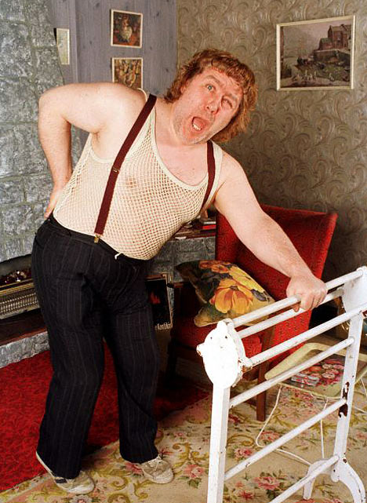

An approach to back pain
Jamie Robertson
Specialty Registrar / Clinical Lecturer
Rheumatology / GIM

Slide 2
Disclaimer*
Please note that QUACK is a regional teaching programme operating across GG&C, Lanarkshire and Ayrshire & Arran.
This presentation outlines general management, though local variances e.g. antibiotic prescription may vary slightly depending on your local trust
Remember to check your local guidelines

Slide 3
Outline
What it is and what it’s not
Differential diagnosis
Red flags
Yellow flags
Investigations

Slide 4
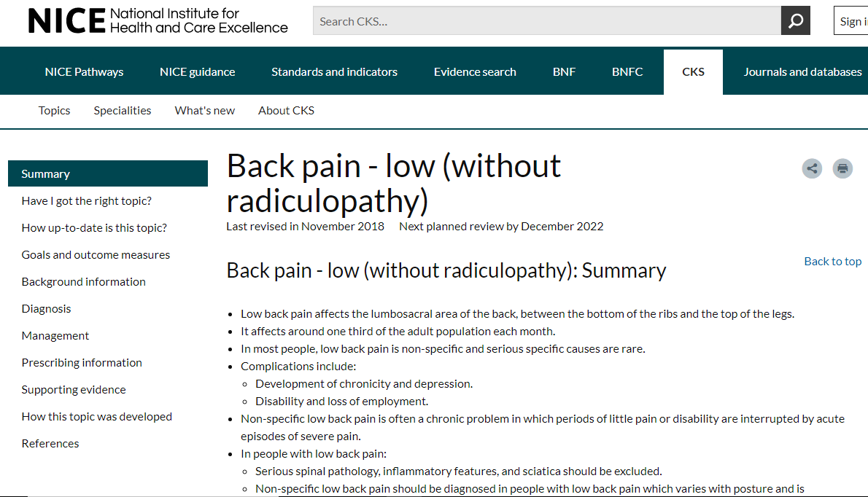
Remit
Acute back pain
(< 12 weeks)
NOT
  Chronic pain
  Sciatica
  Radiculopathy
https://cks.nice.org.uk/back-pain-low-without-radiculopathy#!topicSummary

Slide 5
Differentials
Mechanical (“Non-specific”)

Slide 6
Non-specific back pain
Relapsing / remitting course
Usually varies with posture / exacerbated by movement
Exclude red flags
Investigations usually not merited
Rx – analgesia, ??benzos, education
  Referral for CBT / group physio in high risk individuals

Slide 7
Differentials
Inflammatory
Mechanical (“Non-specific”

Slide 8
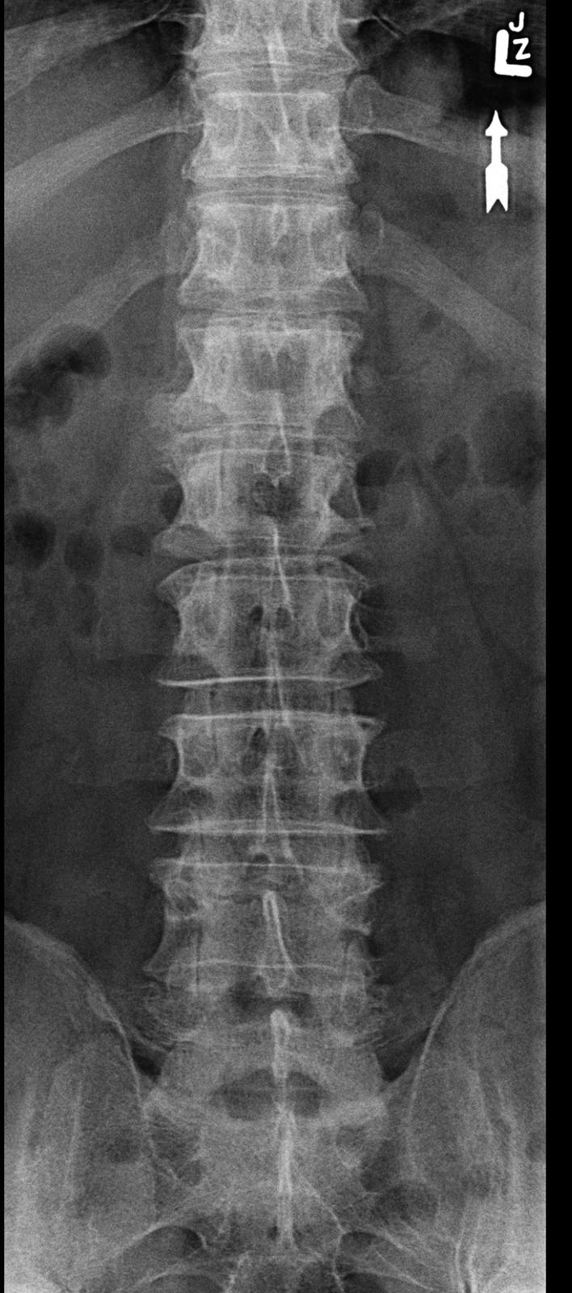
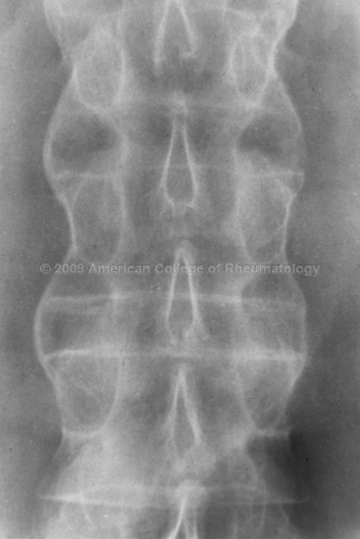
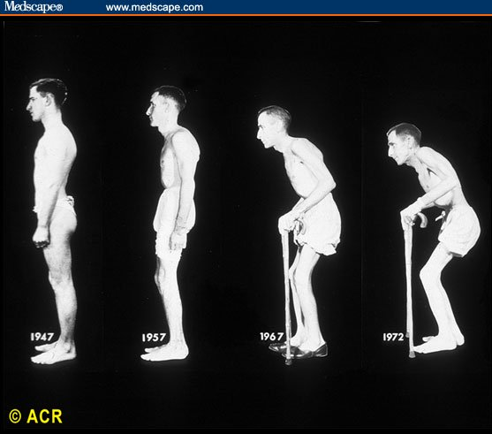
Axial Spondyloarthritis

Slide 9
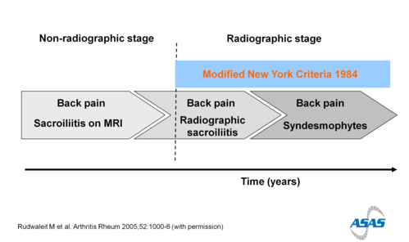
Axial Spondyloarthritis

Slide 10
Axial Spondyloarthritis
Early morning stiffness
Inactivity gelling
Low back / buttock
Wakened from sleep

Slide 11
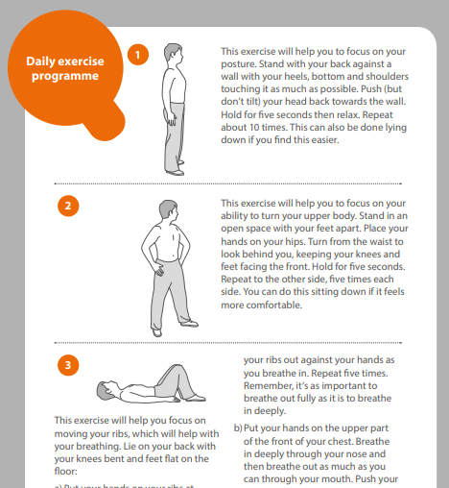
Axial Spondyloarthritis
Investigations
  Xrays, including SIJ
  MRI whole spine & SIJ (AXSPA PROTOCOL – NEED TO SPECIFY THIS)
Management
  NSAIDS
  Physiotherapy / OT
  Biologics

Slide 12
Differentials
Inflammatory
Mechanical (“Non-specific”
Infection

Slide 13
Discitis
History
  Fever (in 50%)
  Constant, non-positional pain
  Weight loss
Risk factors
  IVDU
  Diabetes / immunosuppression
  Foreign travel
Examination
  Fever & malaise
  Focal tenderness
Aetiology
  Staph (destructive)
  TB (? Disseminated)

Slide 14
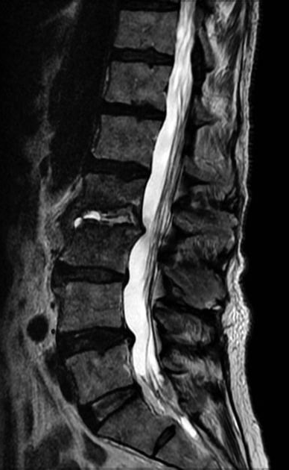
Discitis
Investigation
  Bloods
  Blood cultures
  MRI
Treatment
  Staph
  Strep
  TB

Slide 15
Differentials
Inflammatory
Mechanical (“Non-specific”
Infection
Cancer

Slide 16
Malignancy
Previous history usually
Often >50
Pain at night / rest
? Neuro features
Constitutional upset & hypercalcaemia
Investigations
  Plain film
  CT first line
  MRI later / neuro involvement

Slide 17
Differentials
Inflammatory
Mechanical (“Non-specific”
Infection
Cancer
Compression fracture

Slide 18
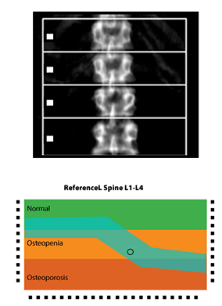
Compression fracture
Acute, severe pain at night / rest Neuro features rare
May or may not have clear history of trauma
Might be tender
Plain film gives you the diagnosis
  MRI / bone scan for chronicity

Slide 19
Differentials
Inflammatory
Mechanical (“Non-specific”
Infection
Cord compression
Cancer
Compression fracture

Slide 20
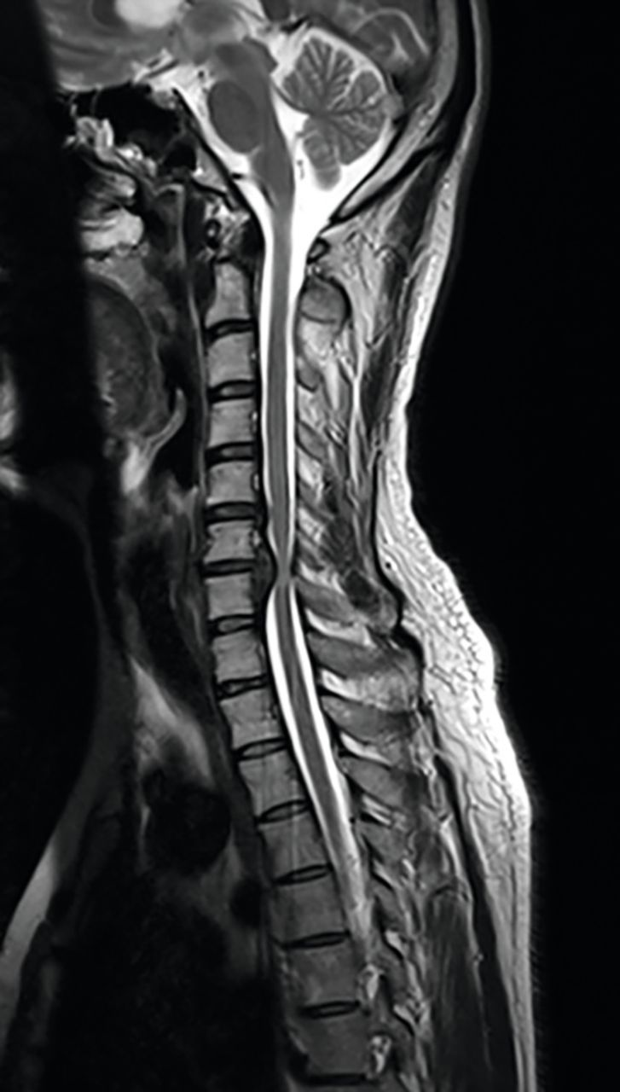
SCC / Cauda equina
Several aetiologies; often thoracic
Upper and lower motor neurone signs
Lower spine
  Bowel / bladder (LATE in SCC), saddle anaesthesia
  Limb weakness / paraesthesia / numbness – asymmetrical in cauda equina
Cervical
  Hand “clumsiness”
Treatment – MRI; dexamethasone 8mg bd, XRT, analgesia

Slide 21
Red flags
Yellow flags
Thoracic pain
Fever / weight loss
Bladder / bowel dysfunction
Hx of cancer
New / progressive neurology
  Inc saddle anaesthesia / gait disturbance
Age <20 or >55
Negative attitude that back pain is damaging / disabling
Avoidance behaviour / reduced activity levels
Belief in passive rather than active management
Low mood / social isolation
Social / financial problems

Slide 22
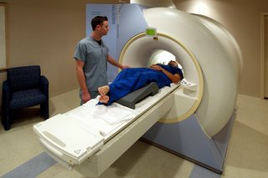
Investigations
Following history and examination ☺
Routine bloods; cultures if infection suspected
XR often doesn’t show much
  CT / MRI
  Same day if SCC suspected

Slide 23
Thank you
Please fill out the feedback form for your certificate of learning

Slide 24
Get in touch!
Website
www.quackmeded.co.uk
Email
ggc.quackmeded@nhs.scot
Social Media
Twitter: @QUACK_ Med
Facebook: QUACK education

