Slide 1
Parkinson’s Disease
Gemma McGrory
Acute Medicine Registrar

Slide 2
Disclaimer*
Please note that QUACK is a regional teaching programme operating across GG&C, Lanarkshire and Ayrshire & Arran.
This presentation outlines general management, though local variances e.g. antibiotic prescription may vary slightly depending on your local trust
Remember to check your local guidelines

Slide 3
Learning Outcomes
What Parkinson’s Disease is
Diagnosis
Symptoms
Management Strategies
DAT scans

Slide 4
Definition
Parkinsons disease is an age related slowly progressive neuro degenerative disorder with an average age of onset at 60 years

Slide 5
Incidence and prevalence
Incidence
  around 11 per 100,000
Prevalence
  around 100-200 per 100,000

Slide 6
A typical district health authority serving a population of 500,000 has around 800 patients with PD
GP list of 2500 will have approximately 4 patients with PD

Slide 7
Diagnosis of PD
Diagnosis remains clinical
Diagnostic error reported at PM (24%)
In the community: error rate of 50%
Problem mainly occurs in distinguishing different causes and also from non-parkinsonian syndrome

Slide 8
Early symptoms
Often nonspecific:
  mood or personality changes
Depression
Vague limb pain
Constipation
Fatigue

Slide 9
UK PDS Brain Bank Criteria
Step 1
  Diagnosis of Parkinsonian Syndrome
Step 2
  Exclusion criteria
Step 3
  Supportive criteria

Slide 10
#1: Parkinsonian Syndrome
Bradykinesia + at > 1 of the following:
  Muscular rigidity
  Resting tremor
  Postural instability

Slide 11
Brady/Hypokinesia
Bradykinesia
  slowness of movement
  progressive early fatigue and reduction in amplitude of repeated movement
Hypokinesia
  poverty of movement
  loss of facial expression, armswing, gesture

Slide 12
Rigidity
Resistance to passive movement
Lead pipe and cogwheel
  (c/f clasp knife of spasticity)

Slide 13
Tremor
Involuntary rhythmic oscillating movement
  4-6 HZ , ‘ Pill rolling’
  begins unilaterally - upper limb
  first symptom in 75% cases
  20% cases never develop
  postural tremor can occur

Slide 14
Postural instability
Last cardinal feature to appear
Limited diagnostic specificity in elderly
Stooping posture, shuffling festinant gait, poor arm swing with propensity to run forward

Slide 15
#2: Exclusion criteria
History of repeated strokes
History of repeated head injury
History of definite encephalitis
Cerebellar signs
Early severe autonomic involvement
Supranuclear gaze palsy
Neuroleptic drug,sustained remission, oculogyric crisis

Slide 16
#3: Positive supportive criteria
More than three of the following:
  Unilateral onset
  Resting tremor present
  Progressive disorder
  Persistent asymmetry
  Excellent levodopa response
  Severe levodopa induced chorea
  Levo dopa response = 5 years
  Clinical course = ten years

Slide 17
Investigations
Neuroimaging techniques useful in PD patients with atypical features but routine use is not recommended
  CT brain: rule out structural/vascular defect
  MRI: more sensitive for cerebellar lesion
  PET: can differentiate from normal subject
  DAT: differentiate essential tremor from PD

Slide 18
Challenge test
Oral levodopa/ subcutaneous apomorphine
  false positives and false negatives
  lowest specificity and sensitivity in early disease
  not recommended routinely

Slide 19
Differential diagnosis
Essential tremor
Vascular parkinsonism
Progressive supranuclear palsy
Multi system atrophy
Lewy body dementia

Slide 20
Who should be imaged?
Routine imaging in parkinsonism is not recommended
Parkinsons Disease Society feels that 5-25% of suspected parkinsonism cases may require FP-CIT imaging

Slide 21
Who should be imaged?
Atypical tremor (mixed postural and rest )
Equivocal bradykinesia ( ↓ arm swing alone)
Equivocal response to trial of treatment
Co-morbidity: arthritis, ↓ cognition, CVD
Unexpected severe Parkinsonian features
Functional impairment with ambiguous signs
Patient anxiety of uncertain diagnosis

Slide 22
Functional imaging
Positron emission tomography
(PET)
Commonly used tracer F-dopa
Research purpose
Expensive pet scanner
Needs to manufacture isotopes before inj using cyclotron

Slide 23
Functional imaging
Single photon emission tomography (SPECT)
Commonly used tracer is 123 I-FP-CIT (DaT scan)
More readily produced & less expensive
Uses gamma camera
3-6 hrs post injection

Slide 24
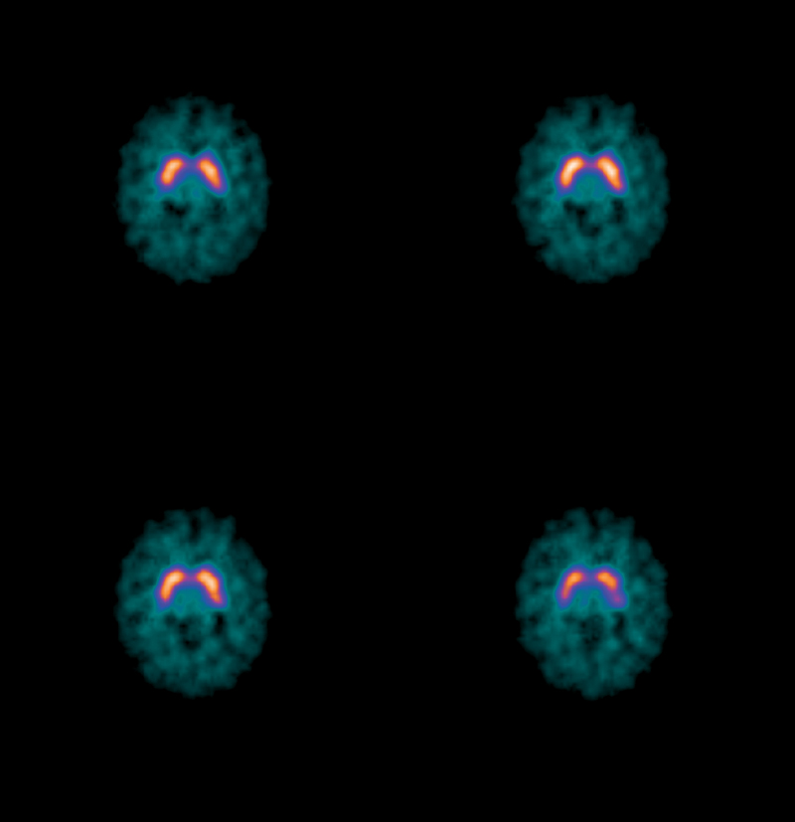

Slide 25
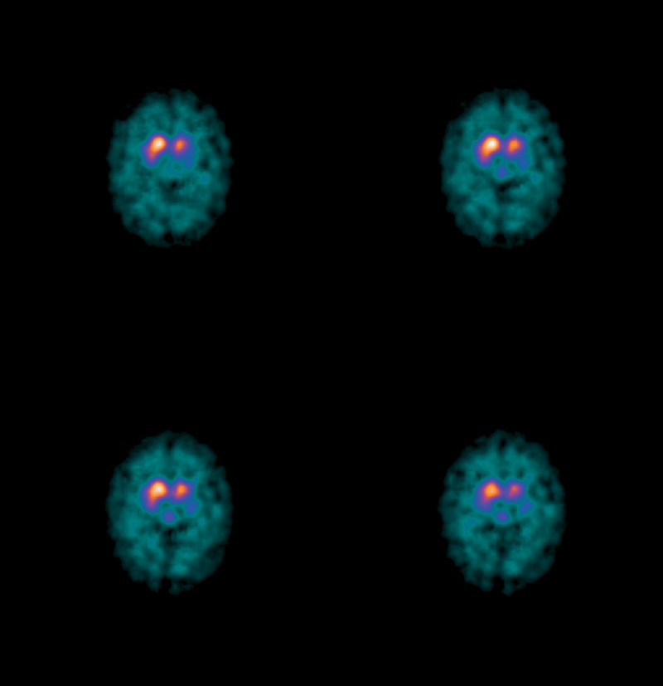

Slide 26
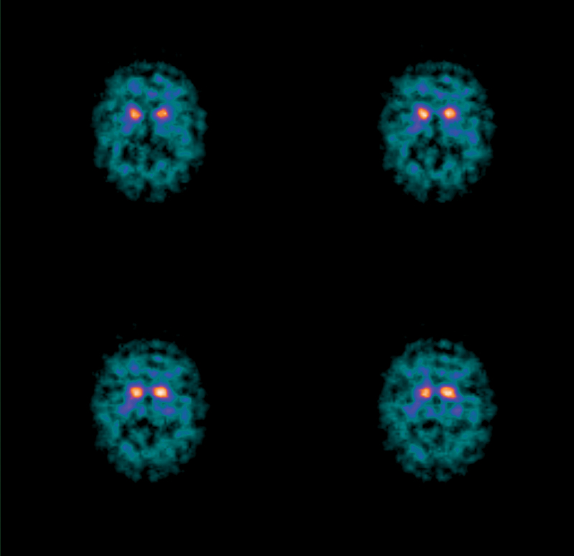

Slide 27
Essential tremor
Bilateral / postural tremor
Vocal / head tremor
Family history

Slide 28
Vascular Parkinsonism
Elderly, hypertensive, cognitively impaired
Parkinsonian symptoms predominantly affect lower body
Wide based gait, postural instability but no hand tremor

Slide 29
Multiple system atrophy
Extrapyramidal - parkinsonism
Cerebellar signs –ataxia , intention tremor and nystagmus
Corticospinal tract- UMN sign in limbs
Autonomic function- impotence, bladder disturbance and postural hypotension
No dementia
Median survival= 9 years

Slide 30
Progressive supranuclear palsy
Dementia
Ophthalmoparesis: Down gaze, up gaze then horizontal gaze palsy
Extrapyramidal- parkinsonism, early falls
Corticospinal tract – UMN signs in limbs and bulbar palsy

Slide 31
Dementia with lewy body
Fluctuating
Hallucinations
Mild parkinsonism
Neuroleptic sensitivity
Tremor less common
More symmetrical
Myoclonus common
More rigid less bradykinetic

Slide 32
Drug induced parkinsonism
Clinical
  history
  symmetry
  atypical tremor
  tardive dyskinesia
Course
  onset: 10 to 30 days
  recovery: 4 to 8 weeks (can be longer)

Slide 33
Drug induced parkinsonism
Dopamine depleting drugs
  Reserpine
  Tetrabenazine
Dopamine receptor blocking drugs
  Neuroleptics
Others
  Calcium channel blockers

Slide 34
Treatment
When to start therapy
Most clinicians will delay the treatment until functional impairment occurs to reduce or delay
  risk of long term motor complications
  acceleration of disease progression secondary to oxidative radicals derived from levodopa metabolism

Slide 35
Factors: functional impairment
Affecting ability to work
Dominant hand effected
Whether more disabling features present
Views of patient and physician

Slide 36
Minor drugs
Anticholinergic
  when resting tremor present
  adverse effects common
  seldom used in the elderly

Slide 37
Minor drug
Amantadine
  rapid tolerance
  adverse effects common
    confusion
    hallucination
    Insomnia
  used now mainly for dyskinesia

Slide 38
Minor drug
Catechol-o-Methyl transferase inhibitor
(COMT)
  adjunct to levodopa therapy
  adverse effects
    nausea
    vomiting
    neuropsychiatry
  entacapone not associated with hepatotoxicity of tolcapone

Slide 39
Minor drug
Selegiline
  MAO-B inhibitor(enzyme responsible for catabolism of dopamine)
  delays the progression of motor signs
  adjuvant to levodopa therapy
  controversial: ? increases mortality
  orthostatic hypotension may be severe

Slide 40
Levodopa
Gold standard
Improves morbity and mortality
Benefits akinesia , tremor and rigidity
Less effect on postural instability,freezing

Slide 41
Levodopa
Precursor of dopamine
Taken up by dopaminergic neurone
Decarboxylation to form dopamine
Exogenous dopamine replaces endogenous neurotransmitter lost

Slide 42
Problems of levodopa
Neurotoxicity
  neuronal degeneration due to free radicals
Motor complications
  50 to 90% patients after 5-10 years
  fluctuating motor response
  peak dose dyskinesia
  common in young but less likely in onset after 70 years

Slide 43
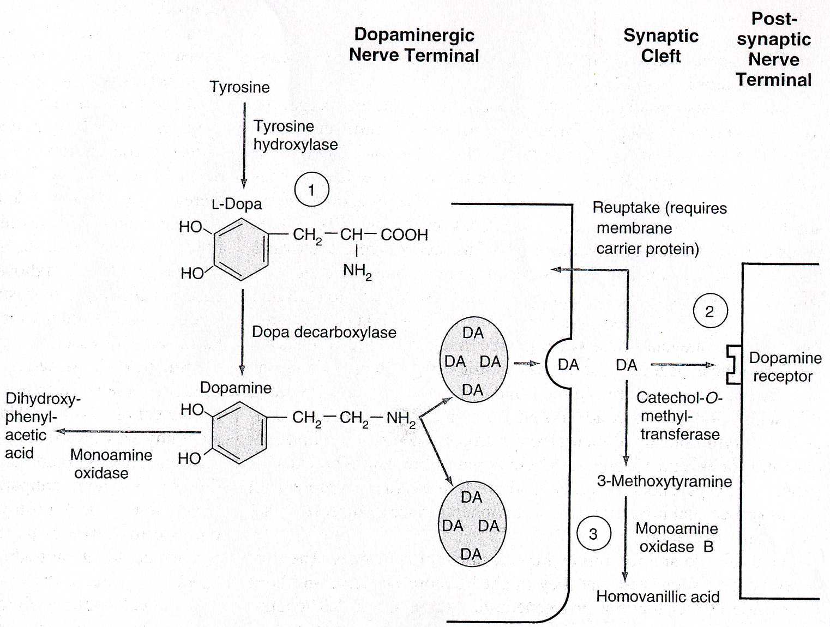

Slide 44
Levodopa
Combination with decarboxylase inhibitor
Minimum carbidopa dose: 75mg
Controlled release preparations helpful
Domperidone for nausea/vomiting
Empty stomach
  dietary aminoacid can compete its absorption from GI tract

Slide 45
Dopamine agonist
Ergot derivatives
  Bromcriptine(D2)
  Pergolide(D1and D2)
  Cabergoline
Non ergot derivatives
  Ropinirole(D2)
  Apomorphine(D1,D2)
  Pramipexole

Slide 46
Dopamine agonist
Direct stimulation of receptors
Avoid oxidative metabolites of levodopa
May have neuroprotective effect
Long half life
  ropinirole:6 hrs
  cabergoline: 65 hrs
  (c.f levodopa: 60-90min)

Slide 47
Dopamine agonist
First line of therapy in young adults
Useful adjuvant therapy to levodopa in adv PD who have motor complications
Side effects:
  nausea and vomiting
  reduced appetite
  post hypotension
  confusion, somnolence and hallucination

Slide 48
Summary
PD remains a clinical diagnosis
If atypical features develop and/ or response to treatment is less than optimal, diagnosis should be reconsidered
Imaging not recommended for routine use in diagnosis but useful in those presenting with atypical features

Slide 49
Summary
Delay initiation of treatment until patient experiences functional impairment
Levodopa is the most effective treatment
Dopamine agonists are effective in early disease and levodopa sparing
Management of PD should have a multidisciplinary approach

Slide 50
Get in touch!
Website
www.quackmeded.co.uk
Email
ggc.quackmeded@nhs.scot
Social Media
Twitter: @QUACK_ Med
Facebook: QUACK education

