Slide 1
Upper Gastrointestinal
Symptoms
Gemma McGrory
Clinical Teaching Fellow

Slide 2
Disclaimer*
Please note that QUACK is a regional teaching programme operating across GG&C, Lanarkshire and Ayrshire & Arran.
This presentation outlines general management, though local variances e.g. antibiotic prescription may vary slightly depending on your local trust
Remember to check your local guidelines

Slide 3
Learning Outcomes
Case based approach...
Upper GI symptoms

Slide 4
Upper GI Symptoms
Dysphagia
Odynophagia (painful swallowing)
Abdominal pain
Vomiting
  Coffee ground
  Frank Blood
Melaena

Slide 5
Associated History
What PMHx / SHx is relevant when someone presents with upper GI bleeding or symptoms?

Slide 6
Associated history
Weight loss
Drugs
Alcohol
Smoking
Past medical history
  PUD
  H pylori
  CLD

Slide 7
Examination
ABCDE approach
Evidence of hypovolaemia
→assess & treat
Stigmata of chronic liver disease
Abdominal examination
PR

Slide 8
Differential Diagnosis
Mallory Weiss Tear
GORD / reflux
Peptic ulcer
  NSAIDS, H Pylori
Gastric cancer
Oesophageal Cancer
Bleeding oesophageal varices

Slide 9
Investigations
FBC
  Hb/Plts
U&E
  Urea/Creatinine
LFTs
  May be normal
Coagulation screen
G&S / XMatch
ECG
Erect CXR – why?
Endoscopy

Slide 10
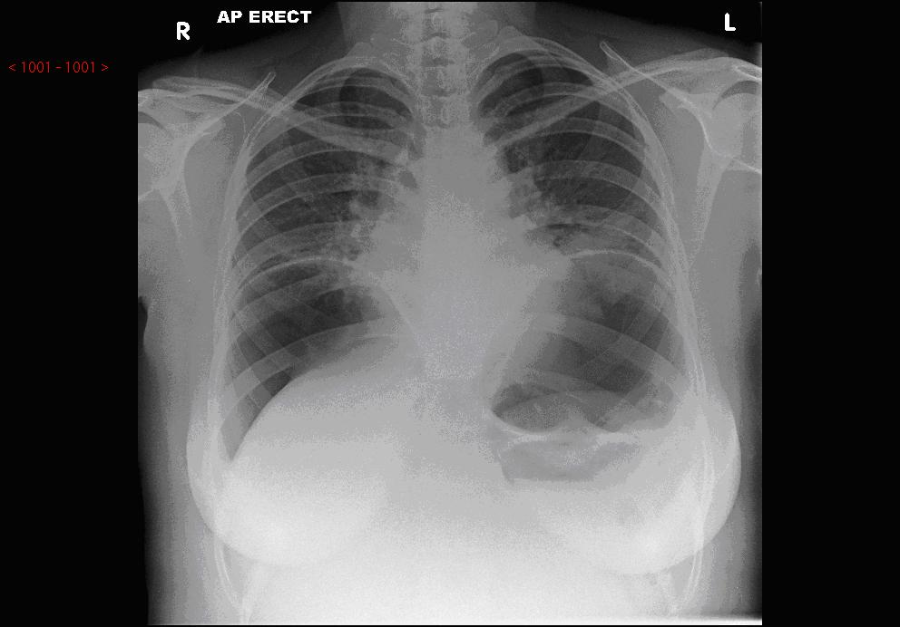
Erect CXR to exclude perforation…

Slide 11
Case 1
65 year old gentleman
Epigastric pain for 1 month
Worse after eating and at night time
1 episode of coffee ground vomit
PMHx: Gout, COPD
Social: Smoker 15/day for 20 years. Drinks 2 cans lager/day

Slide 12
Investigations?

Slide 13
What investigations would you do?
Bloods- anaemia and raised urea
H.Pylori serology/stool sample
Abdominal USS
Upper GI endoscopy- when?
  Age >55 and iron deficiency anaemia
  Unexplained persistent vomiting
  Haematemesis
  Weight loss
  Dysphagia
  Odynophagia

Slide 14
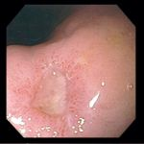

Slide 15
Dyspepsia
Non ulcer dyspepsia- 40%
GORD- 40%
Peptic Ulcer disease-13%
Gastric cancer-3%
(Oesophageal cancer)
Common symptom!

Slide 16
Peptic ulcer disease
Gastric and duodenal ulcers
DU more common than GU
GU- biopsy and repeat endoscopy to ensure healed as may be malignant

Slide 17
Aetiology
H. pylori
NSAIDs
Smoking
Alcohol
Steroids
Stress

Slide 18
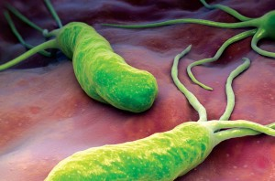
H.Pylori
95% duodenal ulcers
80% gastric ulcers
Treatment
  Triple therapy (Amox / Clarith / PPI) 7 days
  Check local guidelines

Slide 19
Complications
Bleeding
Perforation
Pyloric stenosis

Slide 20
Non ulcer dyspepsia
Also called ‘functional’ dyspepsia- no organic cause
Lifestyle advice
  Stop smoking
  Lose weight
  Reduce alcohol intake
  Avoid triggering foods
  Raise head of bed at night

Slide 21
Case 2
45 year old
Known alcohol excess
Presents as an emergency
Jaundiced, vomiting copious amounts of fresh red blood
Ascites clinically on examination
BP 60/40, HR 120, unwell

Slide 22
Bleeding Oesophageal Varices
Portal hypertension
Back pressure results in varices
Often in context of cirrhosis / liver failure
Often have abnormal coagulation
Can be life threatening
Need stabilisation before emergency OGD

Slide 23
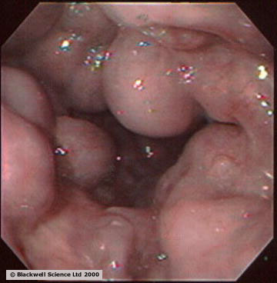
Oesophageal Varices

Slide 24
Severity of GI Bleeds
More to it than just how much blood
Glasgow Blatchford score useful to predict those at high risk of dying
    Therefore who needs emergency versus elective scope
Rockall score for post endoscopy risk of rebleeding

Slide 25
Glasgow-Blatchford
Urea
Admission value | Score
≥6.5 <8.0 | 2
≥8.0 <10.0 | 3
≥10.0 <25.0 | 4
≥25.0 | 6

Slide 26
Haemoglobin g/L
Admission value | Score MEN
≥ 12.0 <13.0 | 1
≥ 10.0 <12.0 | 3
<10.0 | 6
Admission value | Score WOMEN
≥ 10.0 <12.0 | 1
<10.0 | 6

Slide 27
Systolic Blood Pressure mmHg
Admission value | Score
100-109 | 1
90-99 | 2
<90 | 3

Slide 28
Other Markers
Admission value | Score
Pulse ≥ 100 bpm | 1
Presentation with melaena | 1
Presentation with syncope | 2
Hepatic disease | 2
Cardiac failure | 2

Slide 29
Glasgow-Blatchford
Scores ≥ 6 are associated with 50% risk of needing intervention
Score of 0 can be safely discharged home with OP scope

Slide 30
Case 3
22 year old student
Out drinking last night, vomited since came home
Initially yellow vomit, now blood
Otherwise well
Haemodynamically stable

Slide 31
Mallory Weiss Tear
Tear in mucosa at gastro-oesophageal junction
Follows retching / vomiting
Particularly common after large volumes of alcohol
Normal vomit initially then becomes red
Usually spontaneously stops
Severe need surgery

Slide 32
Case 4
75 year old ex smoker
4 month history of feeling food sticking in gullet
Past 2 months finding it more difficult to swallow solid foods
Weigh loss of 1 stone

Slide 33
Oesophageal Cancer
Relatively rare in West
Smoking / alcohol association
Adenocarcinoma: squamous cell carcinoma 2:1
Barrett’s oesophagus = risk for adenocarcinoma
  Metaplastic changes in oesophageal mucosa from squamous to columnar epithelium secondary to reflux

Slide 34
Symptoms
Retrosternal discomfort
Belching
Dyspepsia
Weight loss
Progressive dysphagia
  First to solids
  Then liquids
  Total (inability to swallow saliva)

Slide 35
Investigations
Barium swallow
Endoscopy
Biopsy
CT C/A/P

Slide 36
Management
Surgical resection
  Need to be premorbidly fit
  Locally removable cancer
  No detectable metastatic disease
  Can be open or endoscopic
  +- neoadjuvant chemo / radiotherapy
Argon bean laser destruction of tumour
Oesophageal stenting

Slide 37
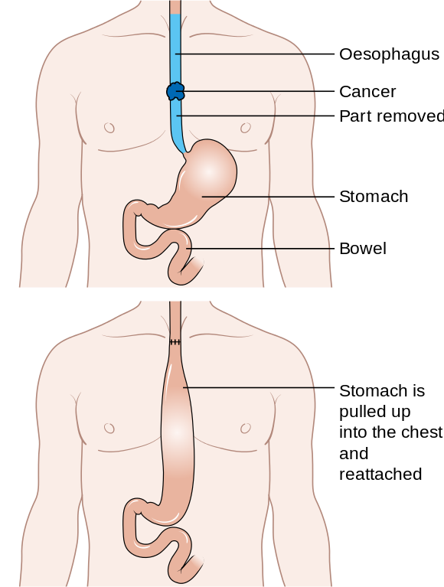
Oesophagectomy

Slide 38
Summary
Case based approach...
Upper GI symptoms
Differential diagnoses of GI bleeding
  Peptic ulcer disease
  H pylori
  Bleeding oesophageal varices
  Mallory Weiss tear

Slide 39
Get in touch!
Website
www.quackmeded.co.uk
Email
ggc.quackmeded@nhs.scot
Social Media
Twitter: @QUACK_ Med
Facebook: QUACK education

