Slide 1
Anaemia
Samantha Drummond
Clinical Teaching Fellow in Haematology

Slide 2
Disclaimer*
Please note that QUACK is a regional teaching programme operating across GG&C, Lanarkshire and Ayrshire & Arran.
This presentation outlines general management, though local variances e.g. antibiotic prescription may vary slightly depending on your local trust
Remember to check your local guidelines

Slide 3
Learning outcomes
By the end of this lecture you should be able to:
Define anaemia
Describe the presentation of anaemia
Describe the pathophysiology of anaemia
Outline the morphological approach to assessment of anaemia
Suggest appropriate further investigation of anaemia
Outline appropriate initial management of anaemia

Slide 4
Overview
Brief overview
Red cell production
Clinical presentation of anaemia
Anaemia
  How to classify anaemia
  Investigations
  Management

Slide 5
Back to basics
What are the components of blood?
  Red blood cells
  White blood cells
  Platelets
  Plasma

Slide 6
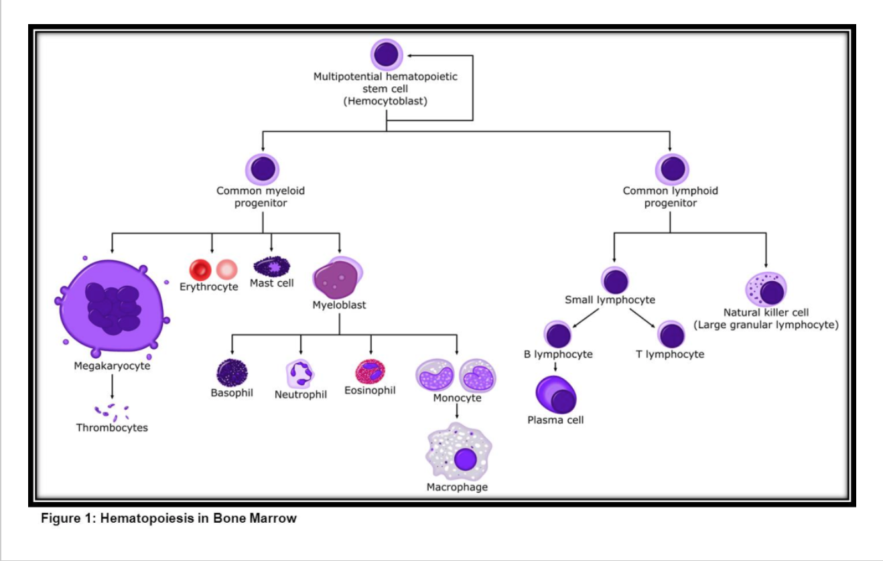
Notes:
Haemopoesis is the process by which blood cells are made
In infants all haemopoesis can occur in all bones but with age there is progressive fatty replacement of bone marrow. In adults this is restricted to the central skeleton and proximal ends of long bones
Properties of stem cells:
Able to self renew
Ables to proliferate and differentiate into progenitor cells which are committed to one specific cell line
Process is regulated by growth factors

Slide 7
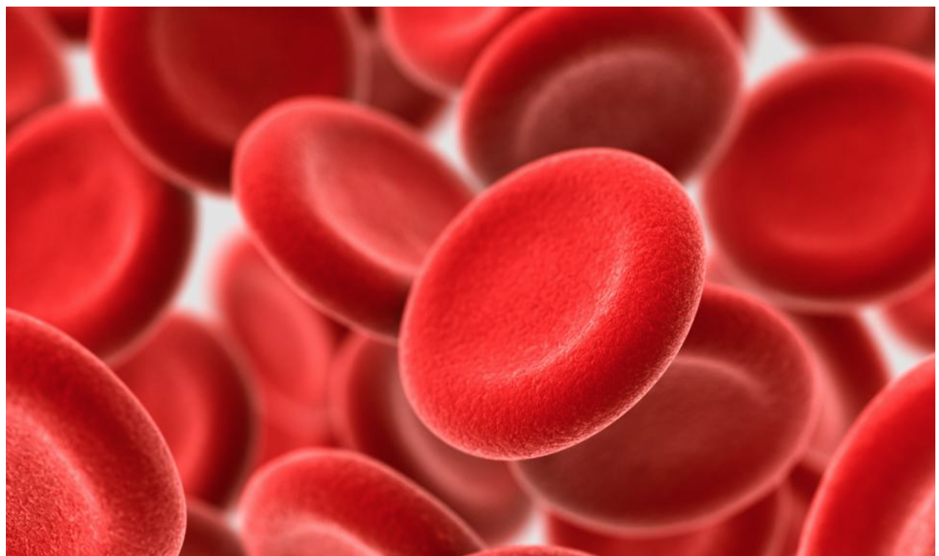
Red blood cell journey
Develop in bone marrow
Non-nucleated, biconcave disc
Erythropoeitin regulates erythropoiesis
Cells are broken down in the reticuloendothelial system
Life span is 120 days
Notes:
Whilst in the bone marrow red cells are nucleated, as the red cells develop the nucleus condenses and is extruded before release in the circulation
Reticulocytes are immature red blood cells which retain RNA and these can be used as a measure of RBC production
Erythropoeitin is mainly produced is the peritubular cells of the kidney (90%) and 10% produced in liver and elsewhere
RBC are removed by macrophages in liver, spleen and marrow
Relevant when considering HbA1c

Slide 8
The normal full blood count
Hb 122-165 g/l (Female)
133-176g/l (Male)
Hct 0.360-0.480 (Female)
0.390-0.500 (Male)
MCV 82-98 fl
MCH 27.3-32.6 ρg
WCC 3.9-11.1 x10⁹/l
Neutrophils 1.8-7.4 x10⁹/l
Lymphocytes 1.3-3.5 x10⁹/l
Eosinophils 0.02-0.7 x10⁹/l
Monocytes 0.2-0.9 x10⁹/l
Basophil 0-0.1 x10⁹/l
Platelets 150-400 x10⁹/l
Notes:
How is anaemia defined?
Below normal haemoglobin for age and sex
WHO defines anaemia as: haemoglobin <130 g/L (13 g/dL) in men aged ≥15 years; <120 g/L (12 g/dL) in non-pregnant women aged ≥15 years; and <110 g/L (11 g/dL) in pregnant women
Red cell indices
Mean corpuscular volume (MCV)
Mean corpuscular l haemoglobin (MCH)
Helps to guide further investigations

Slide 9
Clinical considerations in anaemia
-History
Symptoms
  Breathlessness
  Fatigue
  Dizziness
  Chest pain
Questions to consider
  Duration of symptoms
  Evidence of blood loss
  Family history
  Drug history
  Diet
  Increased requirements (e.g. pregnancy)
Notes:
The tissues complaining due to a lack of oxygen
No absolute number whether symptoms will occur- varies, also depends on speed of onset
Rate at which anaemia develops can be important as a rapid change can overwhelm the body’s compensatory mechanisms (BMJ BestPractice Assessment of Anaemia)

Slide 10
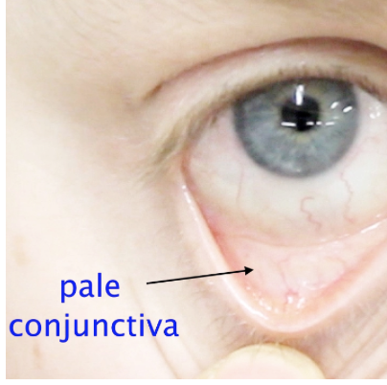
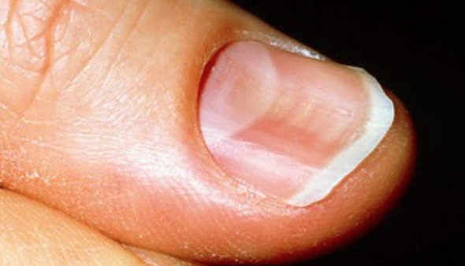
Clinical considerations in anaemia
-Examination
Signs
  Pallor
  Koilonychia
  Glossitis
  Angular stomatitis
  Hepato-splenomegaly
  Jaundice
Notes:
Signs may point to specific causes

Slide 11
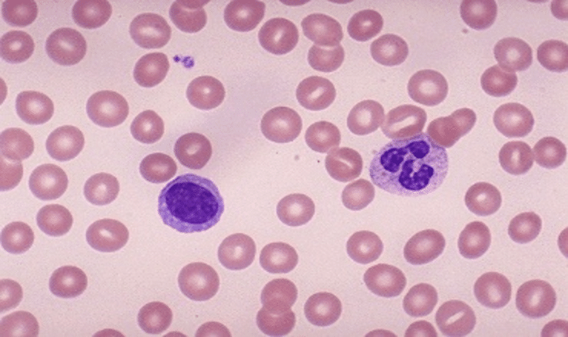
How to classify anaemia
How do we classify anaemia?
  Problem with production
  Problem with product
  Due to destruction or loss
Morphological description
  Hypochromic microcytic
  Normochromic normocytic
  Macrocytic
Notes:
Can think of anaemia as being a problem with:
-Production of RBC eg problem with the bone marrow (cellularity, stroma, nutrients)
Problem with the product itself (eg membrane, enzymes or haemoglobin)
Due to destruction or loss eg blood loss, haemolysis, hypersplenism
Importantly anaemia is not a diagnosis- need to identify underlying cause

Slide 12
Approach to anaemia
Red cell indices
Microcytic
Normocytic
Macrocytic
Notes:
Can also think about the appearance on the blood film- hypochromic/normochromic

Slide 13
Approach to anaemia
Red cell indices
Microcytic
Normocytic
Macrocytic
Notes:
Need to think about the next investigation in patients presenting with anaemia

Slide 14
Microcytic anaemia
Serum ferritin
Normal or increased
Low
Iron deficiency
Thalassaemia
Anaemia of chronic disease
Notes:
Serum ferritin however is an acute phase reactant

Slide 15
Microcytic anaemia
Serum ferritin
Normal or increased
Low
Iron deficiency
Thalassaemia
Anaemia of chronic disease
Notes:
Other laboratory findings include low serum iron, increased TIBC and low transferrin saturation

Slide 16
Iron metabolism
Iron is required for the formation of haemoglobin, myoglobin and haem enzymes
Dietary iron is absorbed from the duodenum and upper jejunum
Transported across cell membrane be ferroportin 1
Regulated by hepcidin
Transported in plasma bound to transferrin and stored as ferritin
Iron lost through urine, faeces and skin desquamation
Notes:
Iron is therefore essential for red blood cell production and cellular processes
Total iron body store is about 4g- two thirds of the body’s iron store is in haemoglobin
Dietary iron is absorbed mostly in the duodenum and jejunum- about 5-10% of dietary iron is absorbed
Hepcidin is produced in the liver and regulates iron absorbtion by regulating the activity of ferroportin
Iron is transported by transferrin and stored in either ferritin or haemosiderin forms
There is no regulatory pathway for iron excretion- is lost through menstruation, skin desquamation and through faeces/urine
Once the body’s stores are full it is deposited in tissues

Slide 17
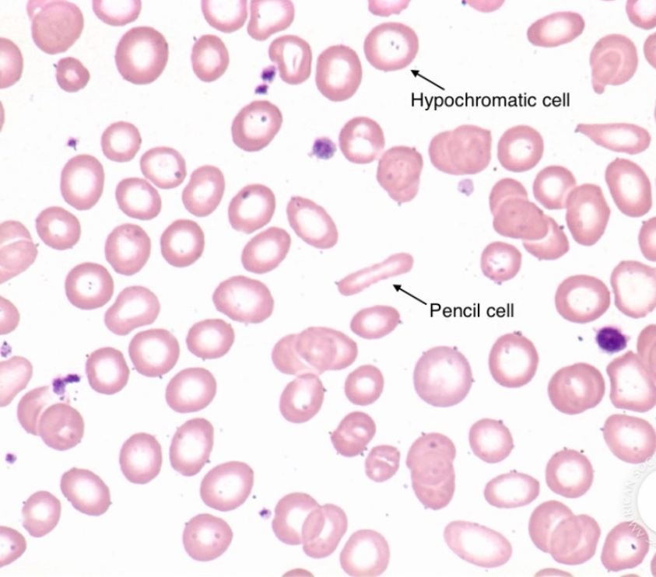
Iron deficiency anaemia
Commonest cause of anaemia worldwide
Aetiology
  Dietary
  Malabsoprtion (e.g. gastrectomy, coeliac)
  Blood loss (e.g. GI tract, menstruation)
  Increased requirements (e.g. pregnancy)
Notes:
Iron deficiency anaemia is common in women of reproductive age due to menstrual blood loss
Common causes of anaemia (blood loss- GI tract/menorrhagia, malabsorption eg coeliac disease, gastrectomy, physiological (growth spurts, pregnancy), dietary, frequent venesection.)
Commonly will present with pallor, specific signs include koilonychia, angular chelitis
May see pencil cells and target cells on blood film

Slide 18
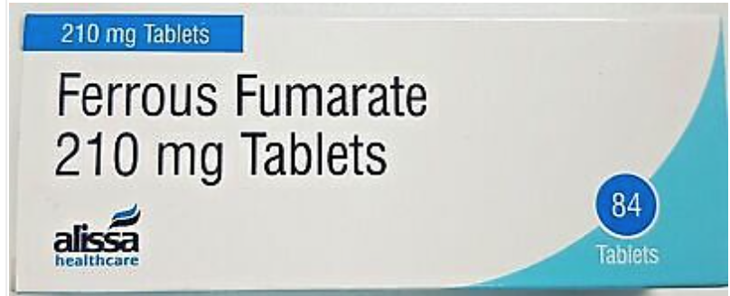
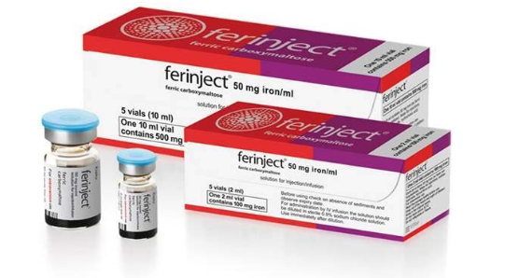
Iron deficiency anaemia
Need to consider appropriate investigations
  Upper GI endoscopy, colonoscopy
  Coeliac serology
  ?no further investigations
Management
  Iron replacement
    Oral
    IV
  Transfusion
Notes:
haemoglobin should show improvement at 3 to 4 weeks (by 20 g/L [2 g/dL]) with normalisation of haemoglobin after 2 to 4 months and replacement of iron stores after 6 months.[4]
Oral iron can cause GI side effects and some patients cannot tolerate this- can give IV iron, this can be given as a day case

Slide 19
Microcytic anaemia
Serum ferritin
Normal or increased
Low
Iron deficiency
Thalassaemia
Anaemia of chronic disease
Notes:
Anaemia of chronic disease can be hypochromic microcytic but is more commonly normocytic so we will come back to that
Going to have a think about thalassaemia

Slide 20
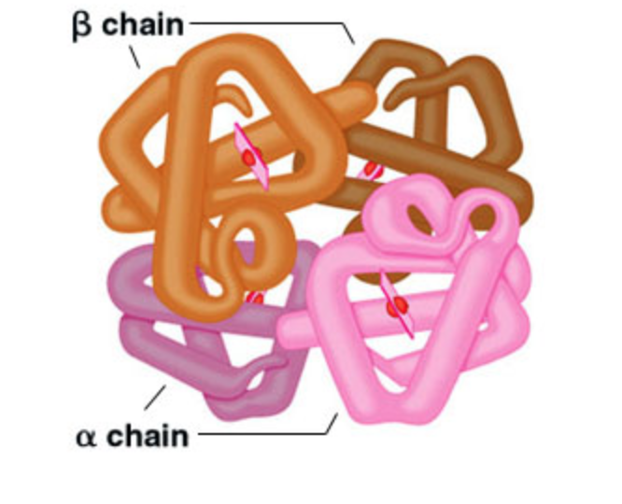
Haemaglobinopathies
Haemoglobin
  4 protein subunits (2α and 2β)
  Each subunit linked to a haem group
Adult haemoglobin predominantly HbA (α₂β₂)
Disorders are related to:
  Structural abnormalities of Hb
  Imbalanced globin chain production
Notes:
All globins related to alpha are located on chromosome 11, all globins related to beta are located on chromosome 16
Haemoglobin production alters throughout development

Slide 21
Thalassaemia
Reduced or absent globin chain production
Results in:
  Premature haemolysis of red blood cells in peripheral circulation
  Destruction of erythroid precursors in bone marrow and extramedullary sites
Named after affected gene
Severity varies depending on type of mutation or deletion
Notes:
Occur most frequently in Africa, Mediterranean, middle east and Asia
Autosomal recessive
Destruction is ineffective erythropoesis
Can screen for antenatally
There are at least 4 different and distinct alpha-thalassaemias: silent carrier (1 affected alpha-globin gene), alpha-thalassaemia trait (2 affected alpha-globin genes), Hb H disease (typically 3 affected alpha-globin genes), and Hb Bart hydrops fetalis syndrome (typically deletion of all 4 alpha-globin genes). There are 2 major varieties of alpha-thalassaemia: alpha(0) thalassaemia (--/), in which both alpha-globin genes on the same chromosome are deleted, and alpha(+) thalassaemia (-alpha/), in which 1 of the 2 alpha- globin genes on the same chromosome is deleted or mutated.
Haemoglobin Bart hydrops fetalis syndrome
• Haemoglobin Bart hydrops fetalis syndrome is typically caused when all 4 alpha-globin genes are deleted.
• It is also known as alpha-thalassaemia major or homozygous alpha(0) thalassaemia.

Slide 22
β Thalassaemia
Most commonly due to point mutations
Reduced or absent β globin synthesis
β thalassaemia trait
  Carrier state
  Treatment not usually required
β thalassaemia intermedia
  Variable presentation, moderate anaemia
  Usually not transfusion dependent
Notes:
Beta thalassaemia intermedia presentation is variable and can be anything in between trait and major

Slide 23
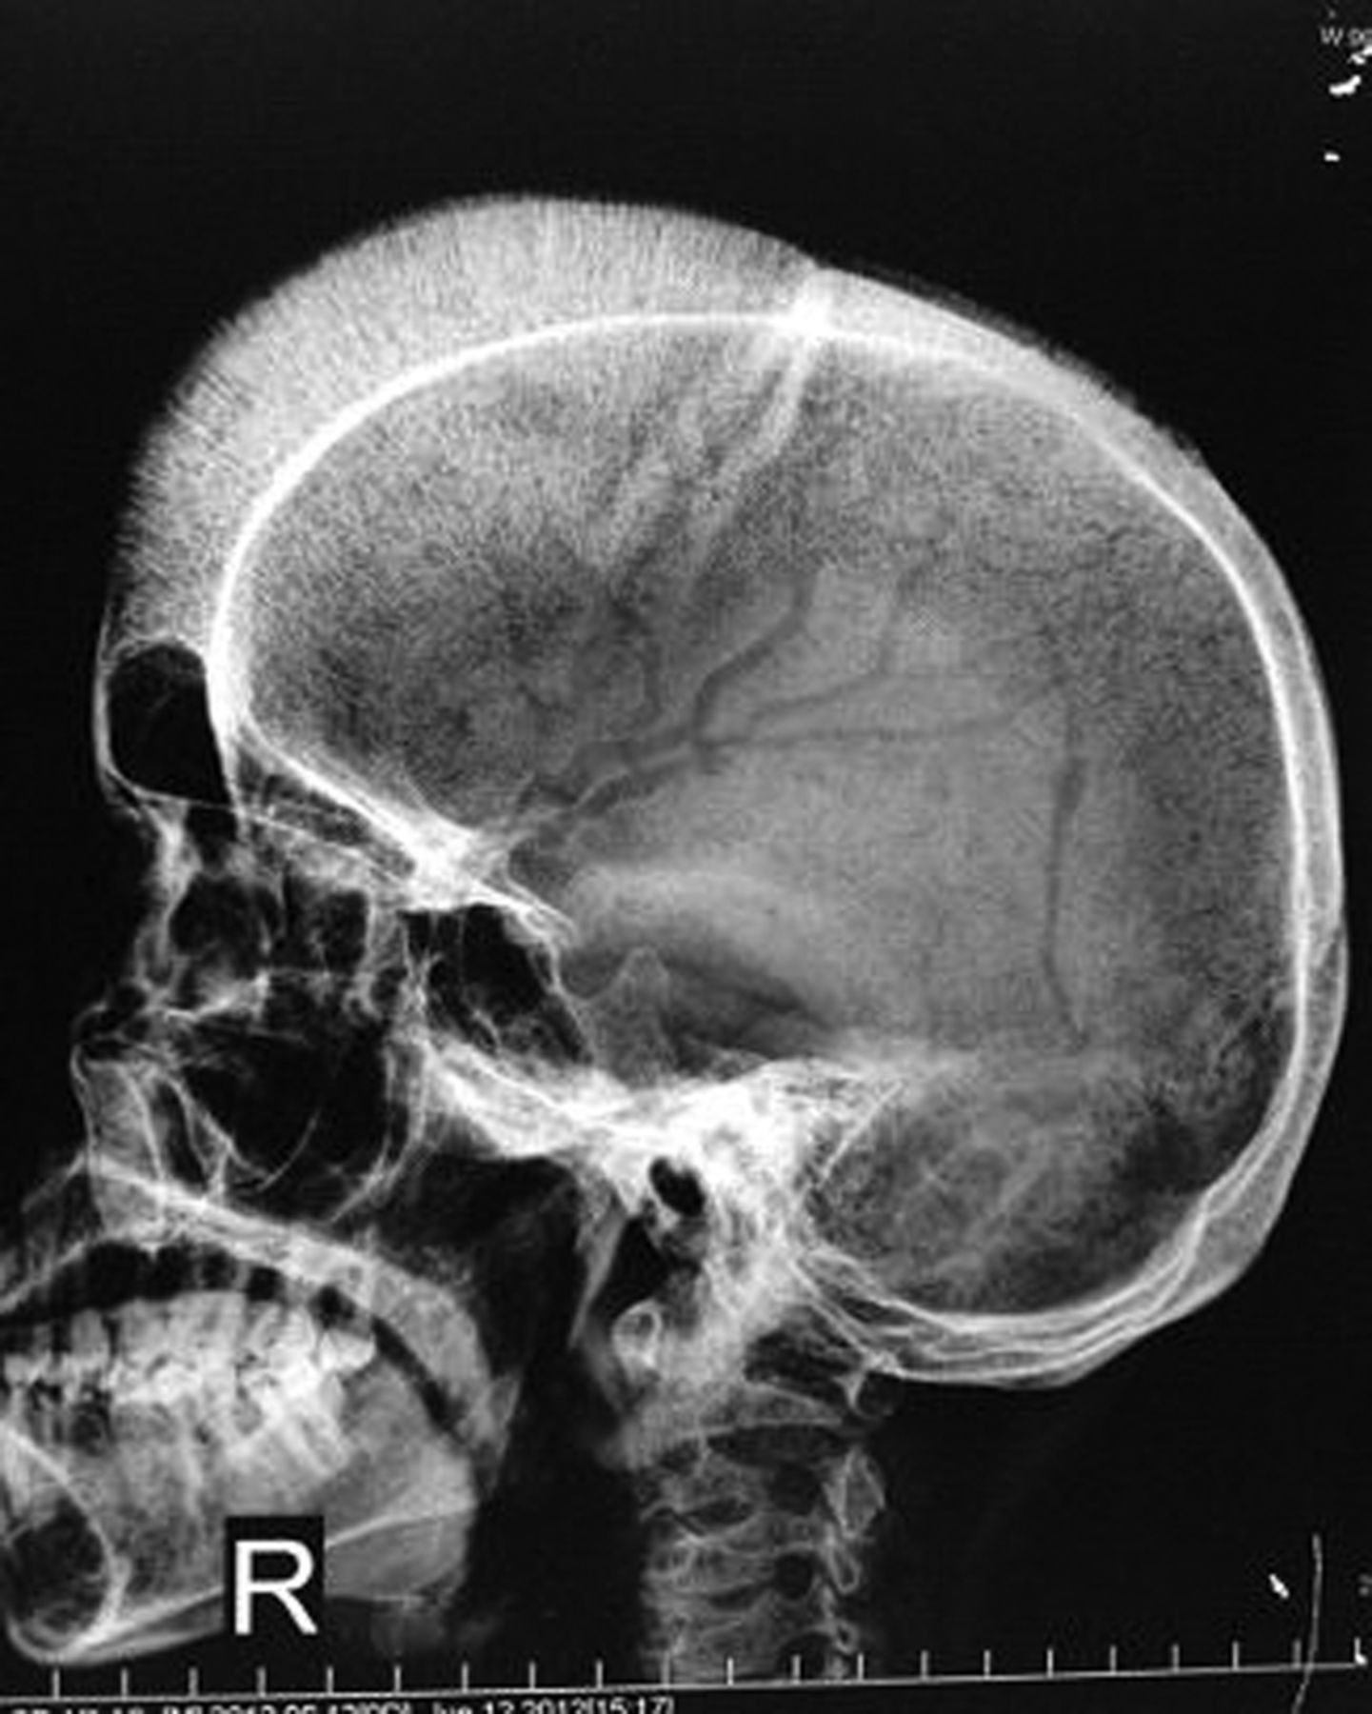
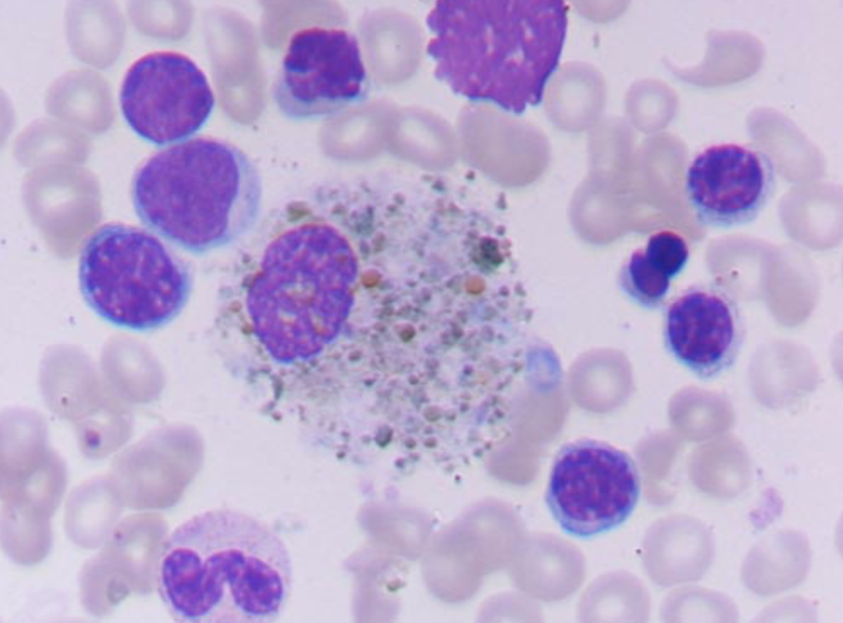
β Thalassaemia
β thalassaemia major
  Abnormalities of both β globin genes
  Moderate to severe anaemia
  Failure to thrive
  Hepatosplenomegaly
  Jaundice
  Skeletal abnormalities
  Regular lifelong blood transfusion
  Iron overload- requires chelation
  Stem cell transplantation
Notes:
Usually presents in infancy
Frontal and parietal bossing
Hair on end appearance due to increased marrow activity
May require splenectomy due to hypersplenism and splenomegaly
Stem cell transplantation is the only curative treatment- this should be considered early before significant iron overload
Also need to consider genetic counselling

Slide 24
Approach to anaemia
Red cell indices
Microcytic
Normocytic
Macrocytic
Notes:
One of the other things you may see is a dilutional anaemia this is usually iatrogenic secondary to IV fluids

Slide 25
Normocytic anaemia
Reticulocyte count
Infiltration
Anaemia of chronic disease
Increased
Acute blood loss
Haemolysis
Normal or low
Notes:
Reticulocytes
In acute blood loss the cells themselves are normal there are simply not enough of them- there has not been sufficient time to develop IDA or to mount a reticulocyte response on acute blood loss
If reticulocytes are low or normal this is inappropriate and suggests the bone marrow is not working

Slide 26
Normocytic anaemia
Reticulocyte count
Infiltration
Anaemia of chronic disease
Increased
Acute blood loss
Haemolysis
Normal or low

Slide 27
Haemolytic anaemia
Haemolytic anaemia is characterized by a reduction in red cell lifespan
Can either be extravascular or intravascular
Confirm haemolysis is occurring
  FBC
  Peripheral blood film- polychromasia, spherocytosis, fragmentation
  Increased reticulocytes
  Increased serum bilirubin (unconjugated)
  Low/absent haptoglobin (bind free Hb)
  High LDH
Notes:
Rate of production does not keep up with the rate of loss
Extravascular haemolysis is accelerated RBC destruction by the reticuloendothelial system
Intravascular haemolysis results from red cell destruction within the vasculature, due to complement-mediated lysis or direct red cell trauma from a prosthetic heart valve or microangiopathic process.

Slide 28
Haemolysis
Congenital
Acquired

Slide 29
Haemolysis
Congenital
Acquired

Slide 30
Acquired haemolytic anaemia
Can be immune or non-immune mediated
Differentiate via the direct antiglobulin test (DAGT)
DAGT
  Detects antibody or complement on red cells
  Reagent contains either
    Anti-human IgG
    Anti complement
  Reagent binds to antibody (or complement) on red cell surface and causes agglutination in vitro
  Implies immune basis for haemolysis
Notes:
Previously known as the Coombs test

Slide 31
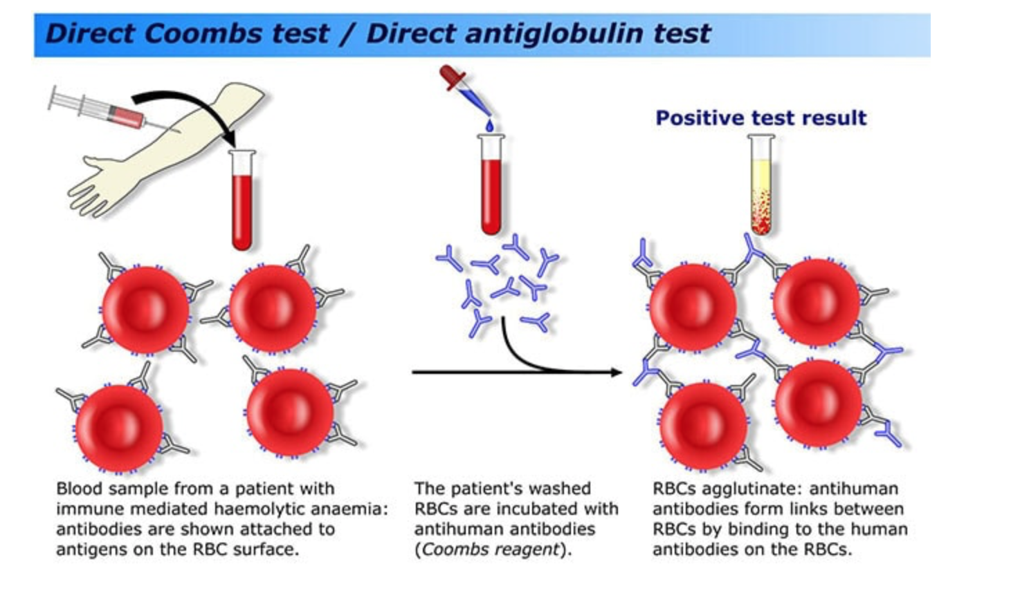

Slide 32
DAGT
Non-immune mediated
Positive
Immune mediated
Negative

Slide 33
DAGT
Non-immune mediated
Positive
Immune mediated
Negative

Slide 34
Immune-mediated haemolytic anemia
Immune mediated haemolysis
Warm auto-antibody
Cold auto-antibody
Alloantibody
Auto-immune
Drugs
CLL
CHAD
Infections
Lymphoma
Transfusion reaction
Notes:
Warm autoantibody is the commonest form
Autoimmune diseases such as SLE
Drugs eg cephalsporins, ibuprofen
Autoimmune can be treated with steroids
Cold auto-antibody is a problem mostly in the peripheral circulation
CHAD= cold haemagglutinating disease
Infections such as mycoplasma pneumoniae and infectious mononucleosis
Transfusion reaction in the chronically transfused- usually due to ABO incompatibility

Slide 35
DAGT
Non-immune mediated
Positive
Immune mediated
Negative

Slide 36
Non-immune mediated haemolysis
Infection
  Malaria
  Viral
Mechanical
  Valve replacement
  Microangiopathic haemolytic anaemia (MAHA)
  March haemoglobinuria
Chemical and physical
  Methaemaglobinaemia
  Lead poisoning
  Burns
Notes:
In lead poisoning- lead competed with zinc which is an important co-factor in haem synthesis
We will discuss non-immune mediated haemolysis in another lecture as these are also associated with bleeding disorders- MAHA

Slide 37
Management of haemolytic anaemia
Support bone marrow function
  Folic acid
Correct underlying cause
  Immunosuppression
  Stop causative drug
Remove site of RBC destruction
  Splenectomy
Consider transfusion

Slide 38
Haemolysis
Congenital
Acquired

Slide 39
Congenital haemolytic anaemia
Where is the problem?
  Red cell membrane
  Enzymes/metabolic pathways
  Haemoglobin
Notes:
Many of the congenital anaemias reduce the red cell survival and result in haemolysis

Slide 40
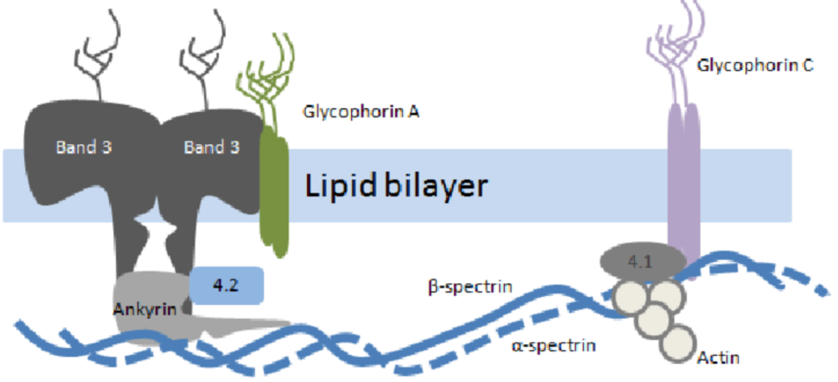
Red cell membrane defects
Hereditary spherocytosis
  Most commonly autosomal dominant
  Many different mutations which result in same defect
  Abnormal RBC cytoskeleton
  Loss of membrane deformability
  Cells are recognized as defective and destroyed prematurely
  Cells appear spherical
Notes:
Affects approximately 1:5000 Northern Europeans
Defects can occur in any of the five proteins: Alpha-spectrin • Beta-spectrin • Ankyrin, Band 3 protein • Protein 4.2.
Loss of lipid from RBC membrane leads to spherical cells with reduced surface area
Cells are destroyed in the spleen
Cells use more glucose than normal cells to try and maintain red cell shape
Red cell membrane is a bipolar lipid layer
Other rarer membrane disorders include hereditary elliptocytosis

Slide 41
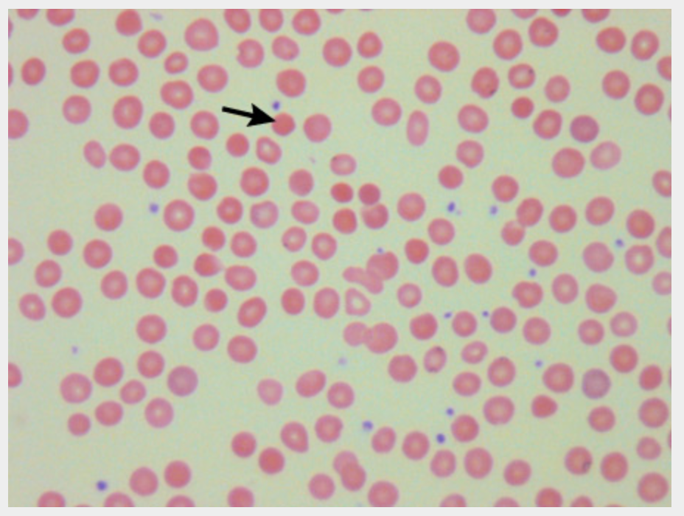
Hereditary spherocytosis
Clinical presentation
  Anaemia
  Jaundice
  Splenomegaly
  Pigment gallstones
Management
  Folic acid
  Splenectomy ± cholecystectomy
  Transfusion
Notes:
Osmotic frailty test
Usually few symptoms
Can have aplastic crisis eg due to parvovarius infection
Haemolysis is increased during intercurrent infection
Can be diagnosed by confirming reticucytosis and typical blood film appearance, with negative DAGT

Slide 42
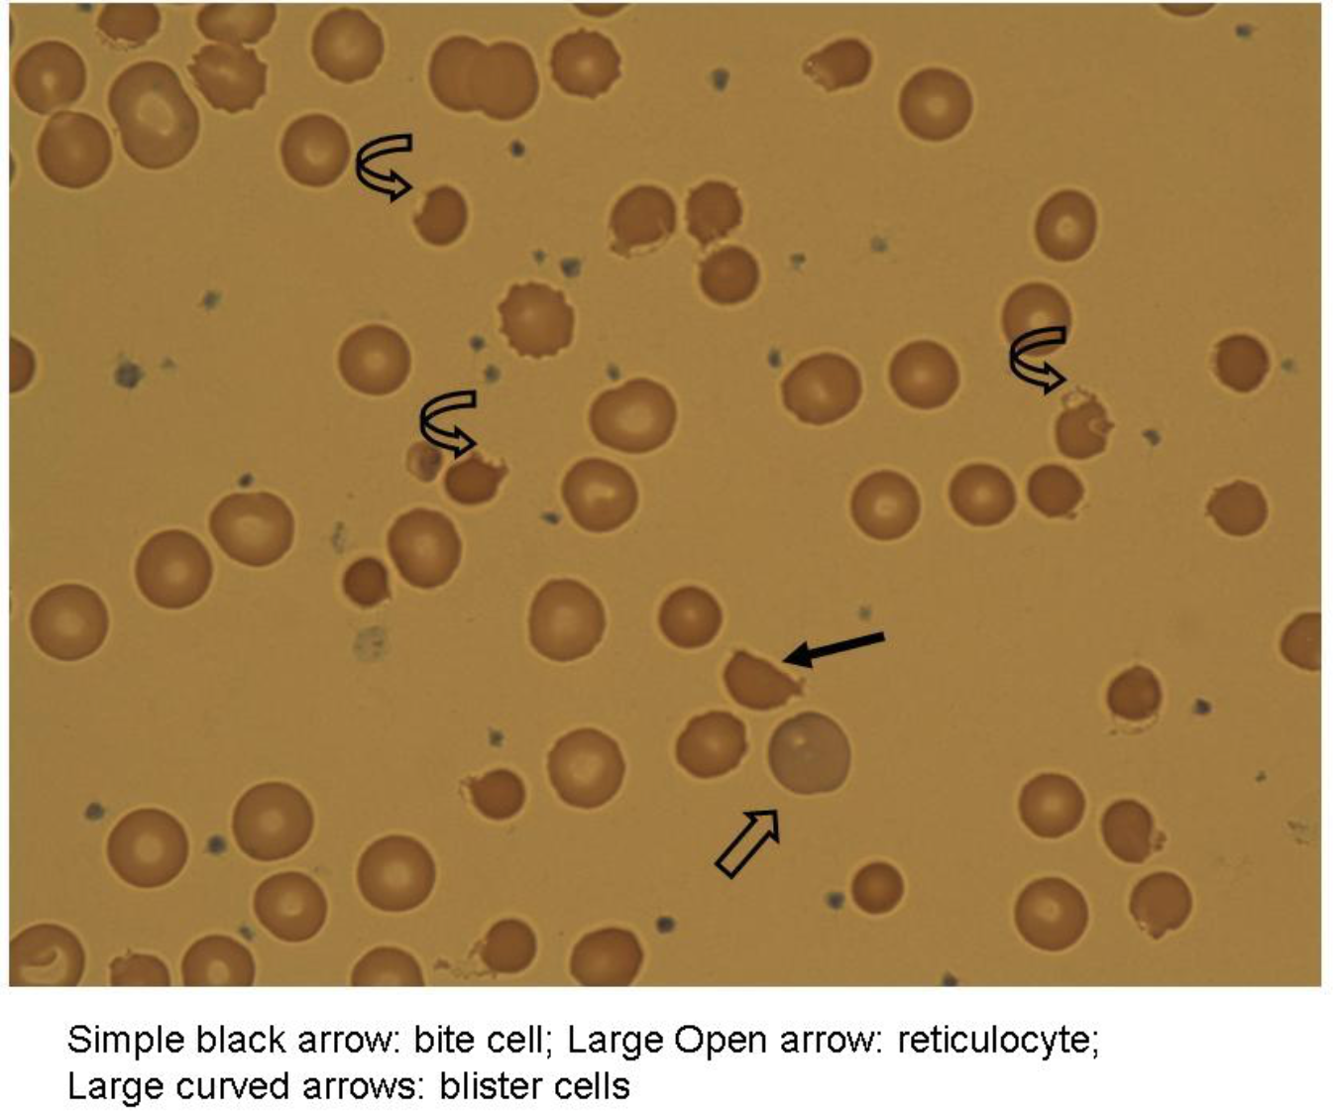
Red cell metabolism disorders
Glucose-6-phosphate dehydrogenase (G6PD) deficiency
  G6PD protects red cell proteins from oxidative damage
  Most commonly X linked
  Variable clinical presentation
    Most patients asymptomatic
    Symptoms can include anaemia, neonatal jaundice, splenomegaly and pigment gallstones
  Cells appear as bite or blister cells
Notes:
Glucose- 6- phosphate dehydrogenase
Involved in the phosphate pentose shunt pathway- generates NADP, NADPH and glutathione for maintenance of Hb and RBC membrane integrity and reverse oxidative damage to RBC membrane and RBC component
Confers protection against malaria in carrier state
Others include pyruvate kinase deficiency

Slide 43
G6PD deficiency
Haemolysis triggers
  Infection
  Broad beans
  Drugs (e.g. anti-malarials, nitrofurantoin, dapsone, sulfonamides)
Treatment of acute haemolysis
  Folic acid supplementation
  Supportive care
  Transfusion if severe symptomatic anaemia
Notes:
Drug induced anaemia begins 1-3 days after drug ingestion, anaemia most severe 7-10 days after ingestion
Urine becomes dark (intravascular haemolysis)
Red cells develop Heinz body inclusions (fragments of denatured haemoglobin)
Acute haemolytic events are usually self limiting

Slide 44
Haemaglobinopathies
Haemoglobin
  4 protein subunits (2α and 2β)
  Each subunit linked to a haem group
Adult haemoglobin predominantly HbA (α₂β₂)
Disorders are related to:
  Structural abnormalities of Hb
  Imbalanced globin chain production
Notes:
All globins related to alpha are located on chromosome 11, all globins related to beta are located on chromosome 16
Haemoglobin production alters throughout development

Slide 45
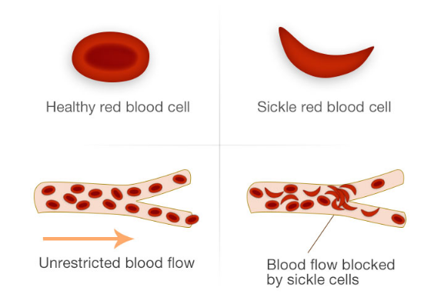
Sickle cell disease
Autosomal recessive
Sickle haemoglobin
  2 alpha chains
  2 beta (sickle) chains- point mutation
HbS deform under conditions of reduced oxygenation
Forms characteristic sickle cells resulting in reduced flow
This results in vascular occlusion and sickle cell crises
Notes:
Sickle cell disease is an inherited haemaglobinopathy in which Hb polymerises at low oxygen tension altering the shape of RBC
Protection against malaria for heterozygotes
In sickle cell anaemia, valine replaces glutamic acid at the sixth amino acid of the beta globin chain, as a result of a recessive single gene mutation
Sickle cells do not flow well through small vessels and are more adherent to the normal vascular endothelium
Results in chronic haemolysis
Diagnosis confirmed with Hb electrophoresis or high performance liquid chromatography
Screening in place so most are picked up in the neonatal period

Slide 46
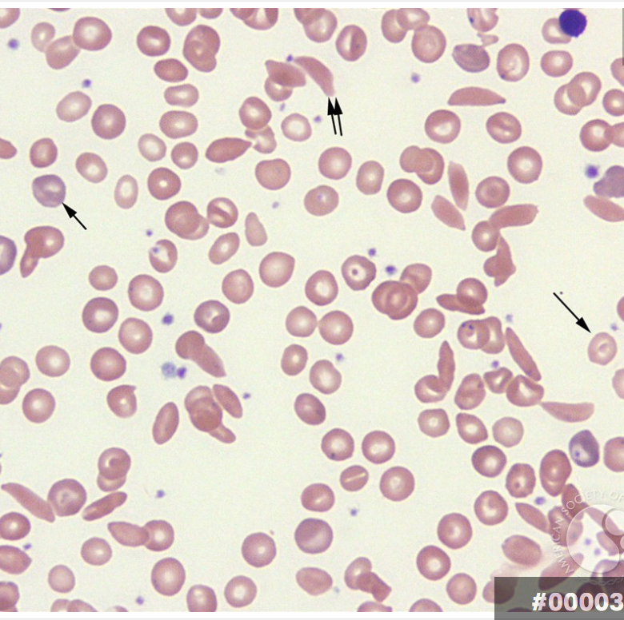
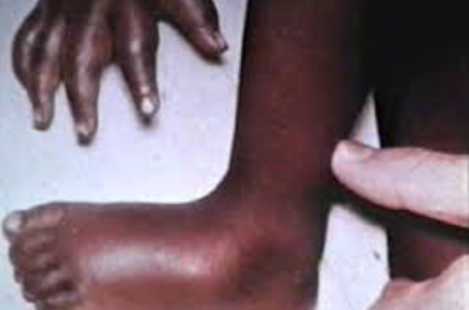
Clinical features
Anaemia
Infection
Jaundice
Vaso-occlusive crisis
Chest crisis
Sequestration crisis
Gallstones
Stroke
Leg ulceration
Notes:
The clinical features are variable
Chronic haemolytic anaemia- generally well adapted
Triggers for vaso-occlusive crisis include infection, dehydration, menstruation, hypoxia and temperature changes
Functional hyposplenism
Chest crises- chest pain, fever, dyspnoea, tachypnoea, hypoxaemia, and a new pulmonary infiltrate on chest x-ray
Polychromatophilic RBCs (reticulocytes) are present (small single arrow). Target cell (large single arrow) and sickle cell (double arrow) can be seen in this view.

Slide 47
Management of sickle cell disease
Prophylactic treatment
  Vaccination, antibiotics, folic acid
Acute events
  Management of precipitating factors e.g. dehydration, infection
  Pain control
Transfusion
Disease modifying drugs
  Hydroxyurea
Transplant
  Bone marrow transplantation
Notes:
Hydroxyurea increases HbF – decreases the concentration of Hb S and inhibits polymerisation
Transcranial doppler US for stroke prevention
Newer gene therapies are still experimental

Slide 48
Normocytic anaemia
Reticulocyte count
Infiltration
Anaemia of chronic disease
Increased
Acute blood loss
Haemolysis
Normal or low

Slide 49
Anaemia of chronic disease
Mostly normochromic normocytic (80%)
  A smaller proportion is hypochromic microcytic
Cytokine driven suppression of red cell production
Treatment is usually of the underlying condition
Can treat with transfusion or EPO (if particularly symptomatic)
Notes:
Proinflammatory cytokines trigger a cascade of events, mediated via upregulation of hepcidin, that decrease RBC production (by lowering serum iron and erythropoietin levels) and
increase RBC destruction (by stimulating erythrophagocytosis and oxygen free radical formation)
Pro-inflammatory cytokines cause the liver to increase hepcidin production. Hepcidin decreases the number of ferroportin molecules on cell membranes preventing iron store release
The ACD syndrome is defined by the following constellation of laboratory test results:
• Mild to moderate anaemia that is either normocytic normochromic or microcytic hypochromic • Otherwise normal red blood cell (RBC) morphology
• Normal or elevated serum ferritin
• Transferrin saturation <15%.

Slide 50
Anaemia of chronic disease
Causes
  Autoimmune disorders e.g. SLE, RA, IBD
  Chronic infection e.g TB
  Acute infection
  Malignancy
  Chronic diseases e.g. CKD, heart failure

Slide 51
Approach to anaemia
Red cell indices
Microcytic
Normocytic
Macrocytic

Slide 52
Macrocytic anaemia
B12/folate assay
Bone marrow
Dyserythropoeisis
Megaloblastic
B12 deficiency
Folate deficiency
Non-megaloblastic
Notes:
B12 and folate are both required for DNA synthesis
Bone marrow problem
Megaloblastic: deficiency of DNA production or maturation resulting in the appearance of large immature RBCs (megaloblasts) and hypersegmented neutrophils in the circulation.

Slide 53
Macrocytic anaemia
B12/folate assay
Bone marrow
Dyserythropoeisis
Megaloblastic
B12 deficiency
Folate deficiency
Non-megaloblastic
Notes:
B12 and folate are both required for DNA synthesis
Bone marrow problem
Megaloblastic is an abnormal appearance of the bone marrow which is characterized by delayed nuclear maturation relative to the cytoplasm. Affects all three cell lines. It results from deficient nucleic acid synthesis

Slide 54
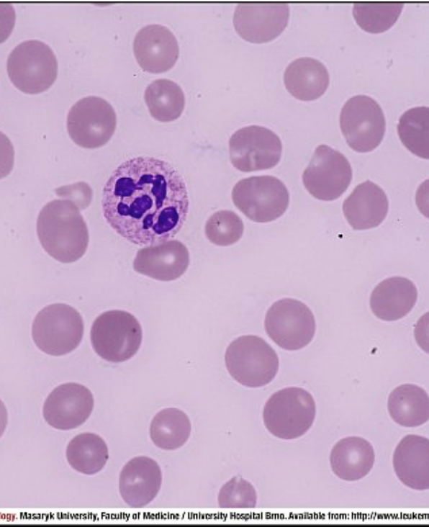
Vitamin B₁₂
Vitamin B₁₂ is required for DNA synthesis and for normal neurological function
Absorbed in the terminal ileum
Binds to intrinsic factor
B₁₂ found in meat, fish, eggs and dairy produce
Causes of B₁₂ deficiency
  Pernicious anaemia
  Following total gastrectomy
  Ileal disease eg Crohns
  Malabsoprtion eg Coeliac disease
  Bacterial overgrowth
  Dietary deficiency
Notes:
Pernicious anaemia is an autoimmune condition- gastric parietal cell or intrinsic factor antibodies which result in low B12 uptake
Hypersegmented neutrophils on films
B12 stores can last for years
Leucopenia and thrombocytopenia are common

Slide 55
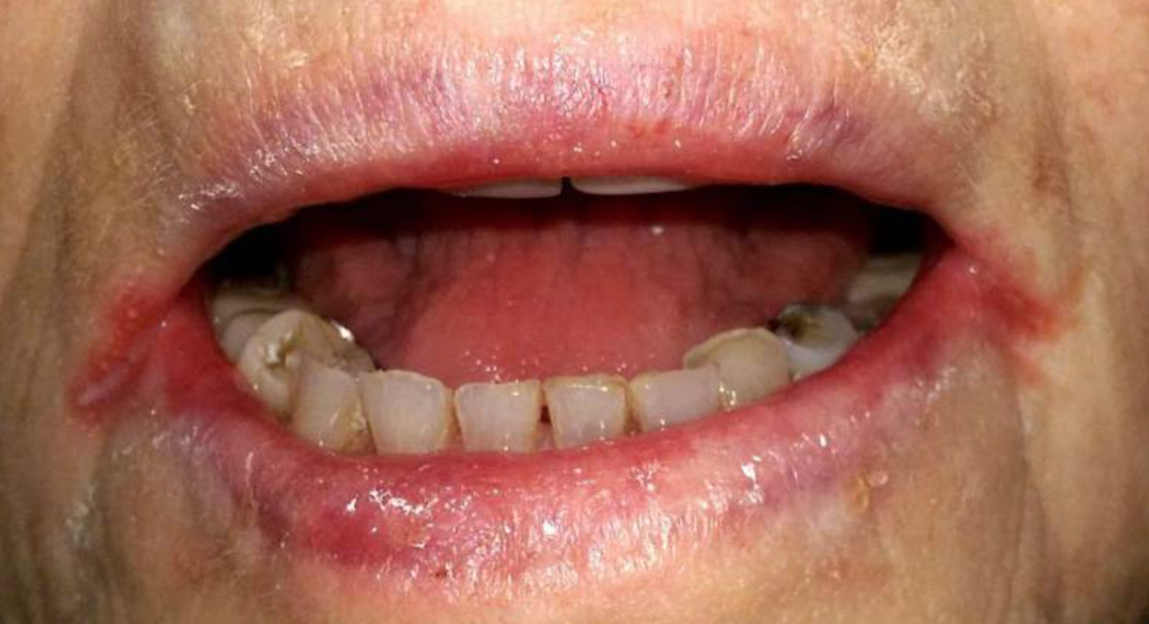
B12 deficiency
Presentation
  Jaundice
  Glossitis
  Angular stomatitis
  Neurological- peripheral neuropathy, subacute combined degeneration of the cord
  Cognitive impairment
Treatment
  Oral replacement may be sufficient in mild deficiency of dietary cause
  Otherwise IM replacement
Notes:
Sub-acute combined spinal degeneration is progressive neurological degeneration of the posterior and lateral columns of the spinal cord. Patients present with ataxia, decreased vibration sense, muscle weakness, and hyporeflexia.

Slide 56
Macrocytic anaemia
B12/folate assay
Bone marrow
Dyserythropoeisis
Megaloblastic
B12 deficiency
Folate deficiency
Non-megaloblastic
Notes:
B12 and folate are both required for DNA synthesis
Bone marrow problem

Slide 57
Folate deficiency
Folic acid is an essential co-factor in DNA synthesis
Main site of absorption is the proximal jejunum
Dietary sources are liver, green vegetables, nuts and yeasts
Causes of folate deficiency
  Dietary
  Increased requirements e.g. pregnancy, haemolysis
  Drugs e.g. phenytoin, valproate, methotrexate, trimethoprim
  Alcohol
  Malabsorption e.g. Coeliac disease, Crohns
Treatment is with oral folate replacement
Notes:
Signs include angular stomatitis
Folate deficiency in pregnancy can lead to neural tube defects
Blood film and marrow appearances are identical in b12 and folate deficiencies
Stores last for 4 months
Megaloblastic anaemia should never be treated with folic acid alone. If they lack B12 then folic acid can precipitate subacute combined degeneration of the cord

Slide 58
Causes of macrocytosis
Disordered liver function
Hypothyroidism
Alcohol excess
Drugs (methotrexate, anti-malarials, hydroxycarbamide)
Myelodysplasia
Aplastic anaemia
Notes:
Alcohol has a direct suppressive effect on erythropoiesis which results in an increased MCV- toxic and reversible effect

Slide 59
Approach to anaemia
Red cell indices
Microcytic
Normocytic
Macrocytic
Serum ferritin
Reticulocyte count
B12/folate
Bone marrow

Slide 60
Questions ?
Email: s.drummond1@nhs.net

Slide 61
Thank you
Please fill out the feedback form for your certificate of learning

Slide 62
Get in touch!
Website
www.quackmeded.co.uk
Email
ggc.quackmeded@nhs.scot
Social Media
Twitter: @QUACK_ Med
Facebook: QUACK education

