Slide 1
A Case of Endocarditis…
Gareth Ingram
Acute Medicine Clinical Fellow

Slide 2
Disclaimer*
Please note that QUACK is a regional teaching programme operating across GG&C, Lanarkshire and Ayrshire & Arran.
This presentation outlines general management, though local variances e.g. antibiotic prescription may vary slightly depending on your local trust
Remember to check your local guidelines

Slide 3
Admission
46 year old male
A&E
Presented @ 19:15
Reason for attendance “Vomiting blood”, BIBA
Triage category 1
Straight to resus

Slide 4
Observations
RR 18
Sats 100% on air
Temperature 39.6
Heart rate 122
BP 128/82

Slide 5
A&E Assessment
24 hour history of vomiting
?Coffee ground component
Lethargic
“Near falls”
Reduced oral intake for 24 hours
Felt feverish
Further vomit in department – no blood

Slide 6
Past Medical History
IVDU – last injected 3/12 ago
Hep C - treated
IE 2016
  Aortic valve replacement (bioprosthetic)
  Pericardectomy
CVA 2016
Necrotising fasciitis 2006
Prev DVT and chronic leg ulceration
Severe Psoriasis

Slide 7
Focused Examination
Alert and orientated
Patent airway though poor air entry globally
No murmurs
Soft abdomen
Warm legs bilaterally, mild erythema, no necrosis

Slide 8
Provisional Differential and Plan
Nec Fasc
Osteomyelitis
Cellulitis
X-rays
Access, bloods and cultures. IV Abx and fluids
Anti-emetic
Ulcer swabs
Refer Ortho ?Nec Fasc

Slide 9
1st few hours
Unable to get access
Central line inserted RIJ
D/W Ortho – commenced on Nec Fasc Protocol
5x Abx microbial therapy
Legs marked
BP dropped to 85 systolic
  Ortho still not been to review
  Refer medics as “severe cellulitis” ?Med HDU
  Catheterised

Slide 10
Nec Fasc score
The LRINEC Score, Laboratory Risk Indicator for Necrotizing Fasciitis
  CRP >150, 4 points (505)
  Na <135, 2 points (128)
  Creatinine <141, 0 points (116)
  Glucose <10, 0 points (6.6)
  Hb <110, 2 points (1.5)
  WCC <15, 0 points (8.6)
    Score = 8, high positive predictor value
Lactate 2.8, LFTs 100ish, Platelets 94, Neuts 7.9

Slide 11
Medical HDU
Peri-arrest bleeder upstairs
I went on behalf 2.30AM
Recently febrile, lethargic, mild cough, generalised abdo pain
Generally unwell and reduced oral intake
District nurses for chronic leg ulceration dressings
Non-drinker, Smokes 20/day

Slide 12
Medication
Aspirin 75mg daily
Bisoprolol 1.25mg daily
Cetirizine 10mg OD
Enalapril 2.5mg OD
Furosemide 60mg OD
Gabapentin 300mg TDS
Omeprazole 20mg OD
Methadone 90ml daily

Slide 13
Initial Assessment
3 litres in
100ml out in last 45 mins
BP 100/85, pulse 80
Pyrexial at 40
Urine dip – no leukocytes, nitrates. Positive for RCC
  A, Patent
  B, Few bibasal creps
  C, Peripherally warm, I + II + soft diastolic murmur, intravascularly deplete
  D, Suprapubic tenderness
  E, Alert, bilateral calf pain, no crepitus, chronic ulceration, active trauma, mild erythema, not spread since marking

Slide 14
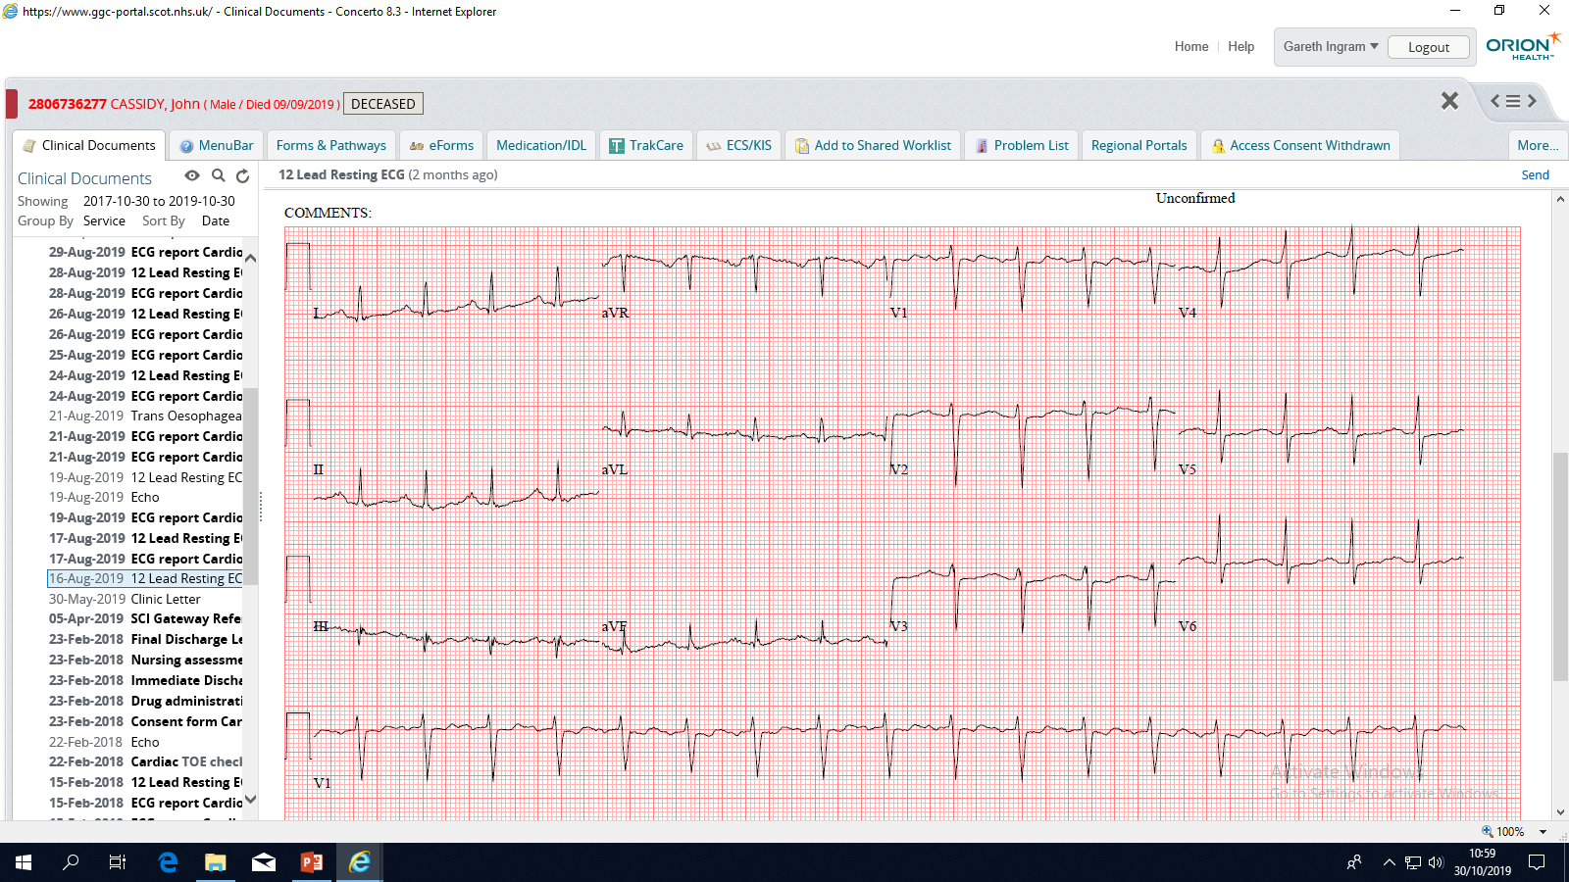
ECG

Slide 15
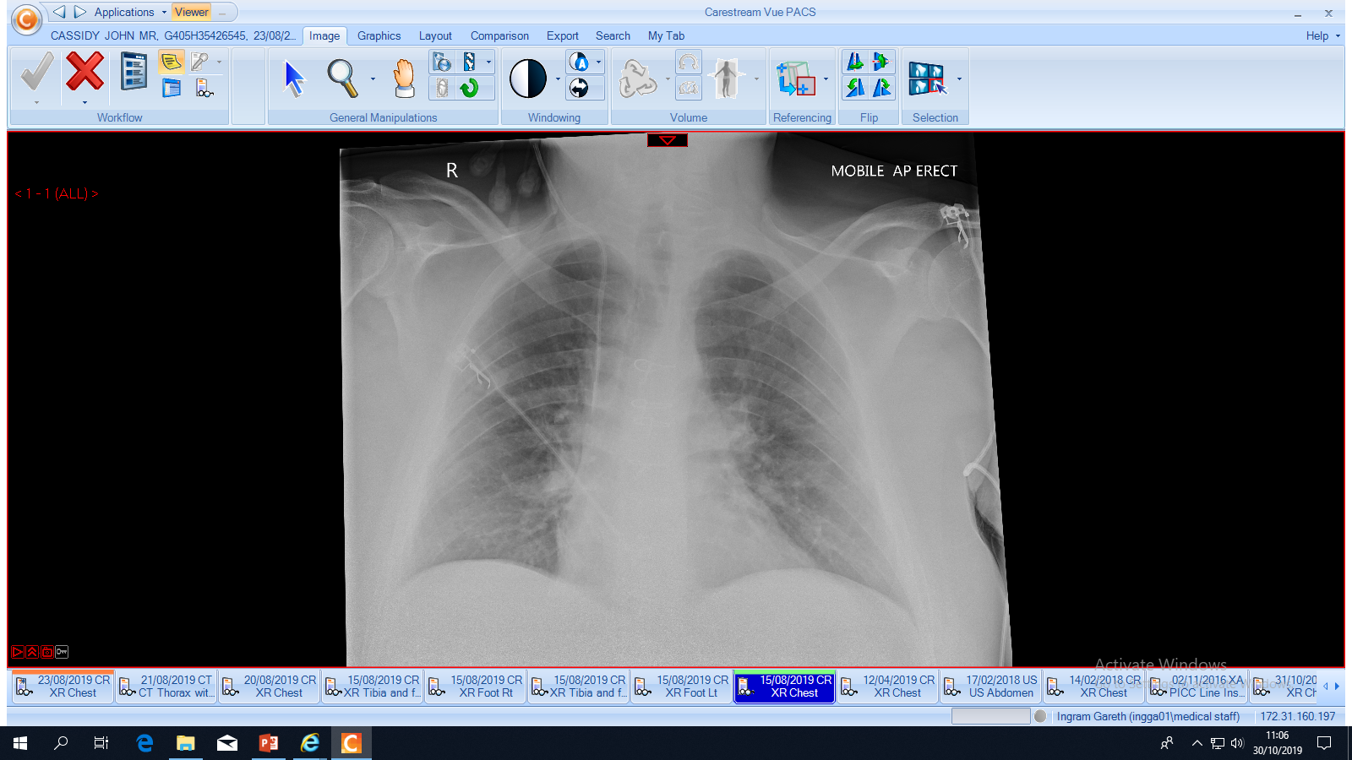
CXR

Slide 16
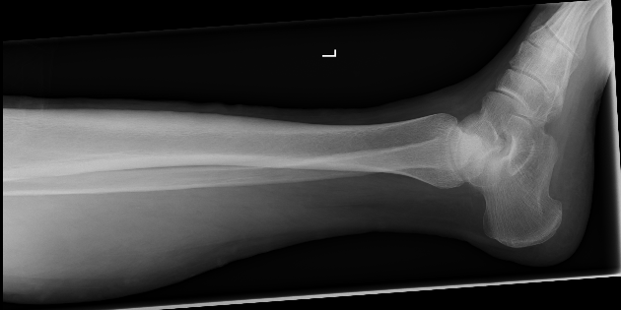
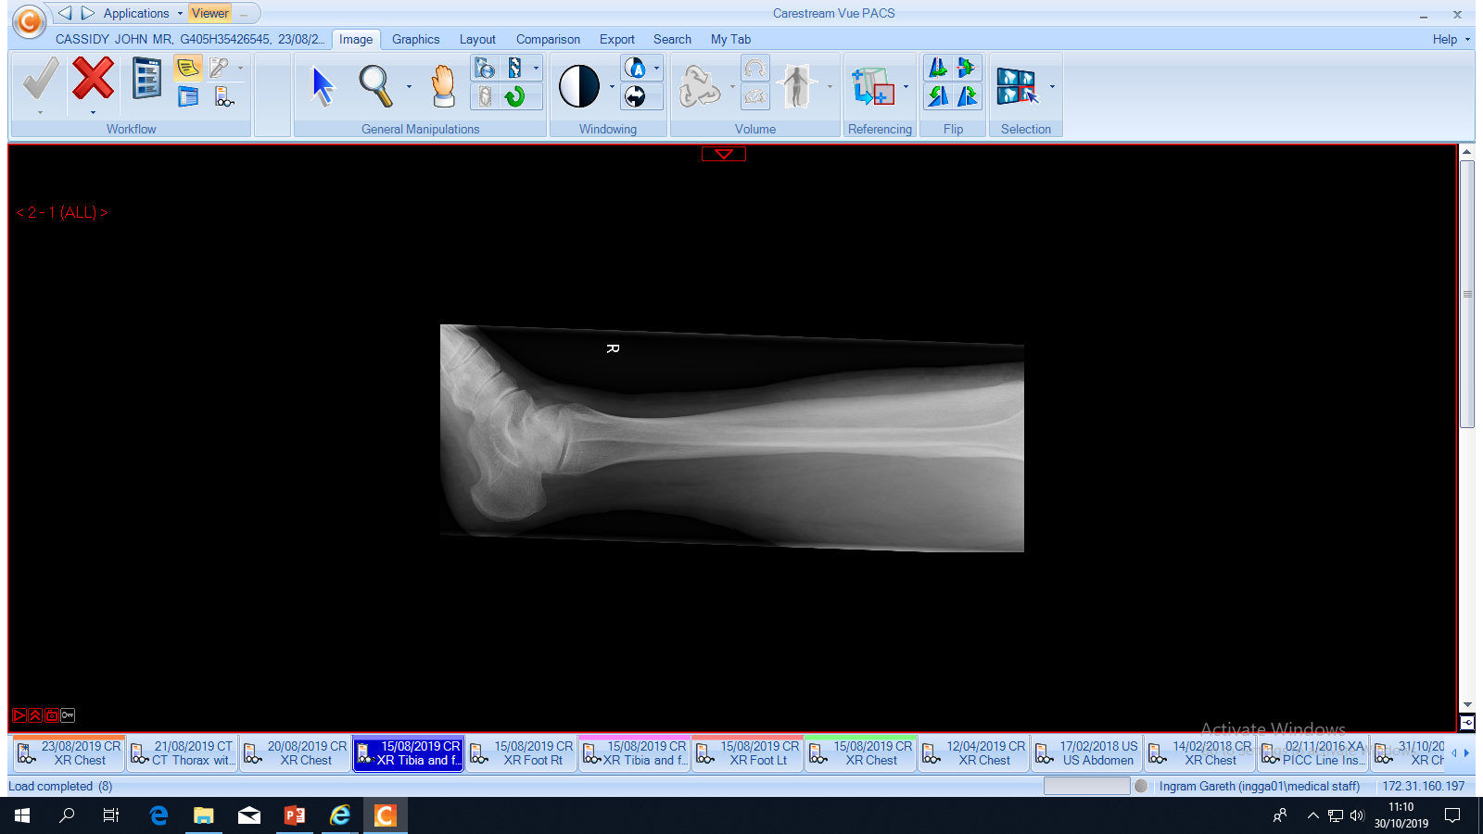
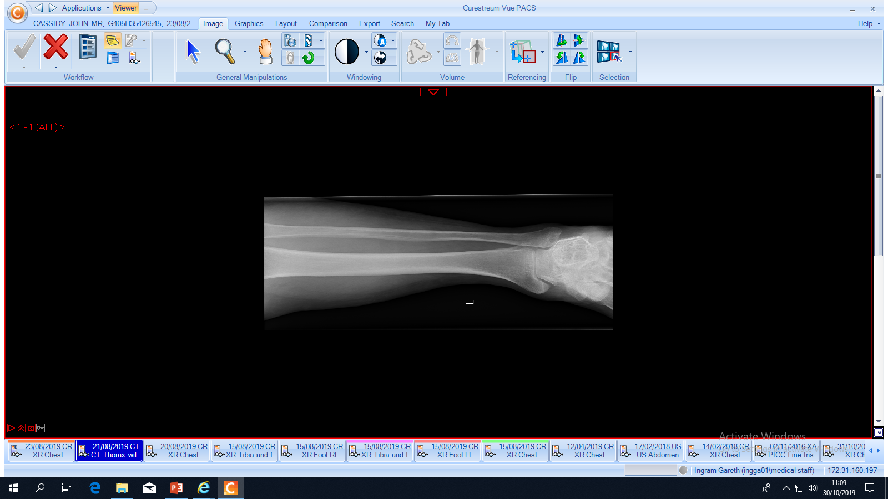
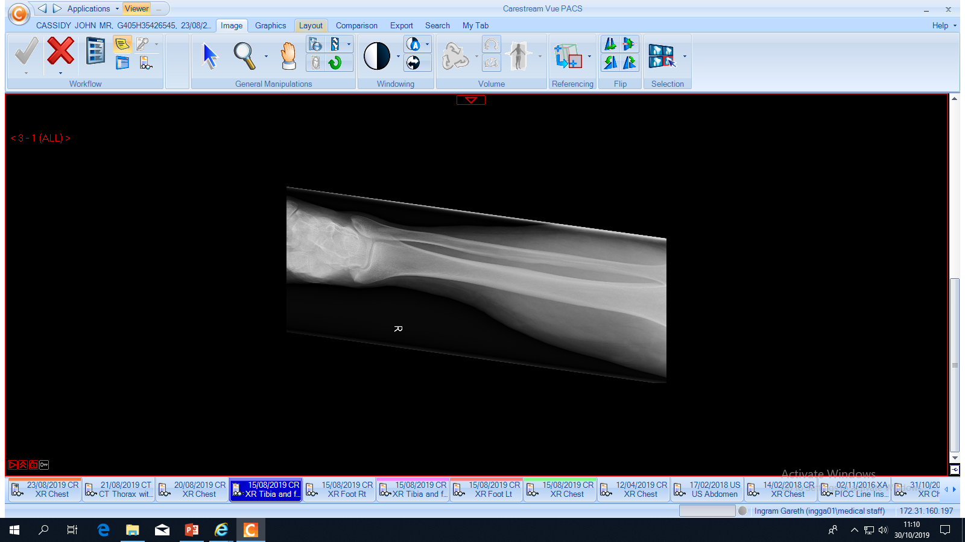
Leg Xrays

Slide 17
Differential and Plan
Infective endocarditis with evidence of sepsis
Hyponatraemia
  No clinical evidence of nec fasc
  Secondary to infection/unwell/vomiting. Dry
Further cultures, leg swabs
Urine culture, casts
Hyponatraemia screen, fluid balance + hourly volumes
Echo
Rationalised to fluclox and gent, continue IV fluids
ID/Cardio AM

Slide 18
Following Events
Ortho reviewed
Not nec fasc
  Medics +/- vascular if concerns re ulcers
AM ward round – treat as severe bilateral cellulitis
Chase cultures + Update U&Es
Addictions – methadone clarified

Slide 19
Medical Ward
Transferred to downstream medical ward
Seen by CT2 24 hours after admission
Swinging pyrexia. BP 118/62
E3 M6 V5
Diastolic murmur
“Leg’s never been that bad” from patient
Consideration for Level 2 care if hypotensive refractory to IV fluids

Slide 20
Day 2
Splinter haemorrhages
Prolonged PR interval
Positive blood cultures for staph aureus
Urine drip ++++ blood
Abx changed to Vanc and synergistic gent
CRP 455
Seen by cardiology
V scan – mild MR, no Aortic concerns
Transferred to CCU

Slide 21
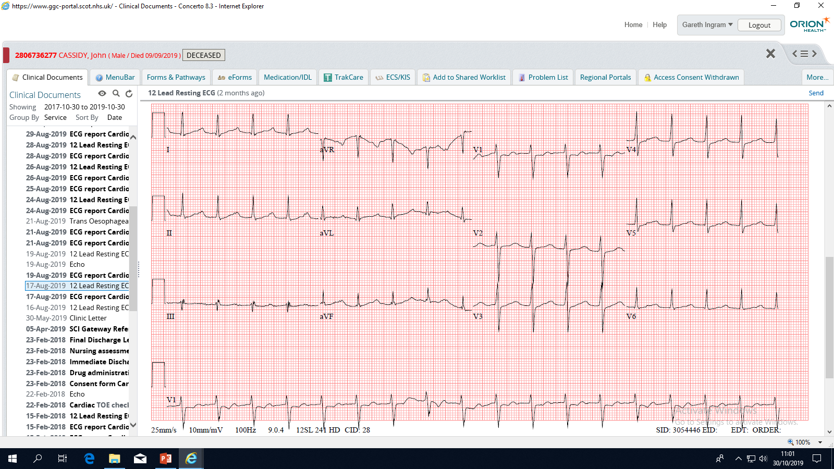
ECG

Slide 22
Echo Day 5
Small LV, mild concentric LVH, function normal
RV not dilated, mildly impaired function
RA mildly dilated
No significant valvular abnormality
No obvious vegetations
Bioprosthetic valve well seated
Suboptimal imaging
Cannot exclude IE on TTE

Slide 23
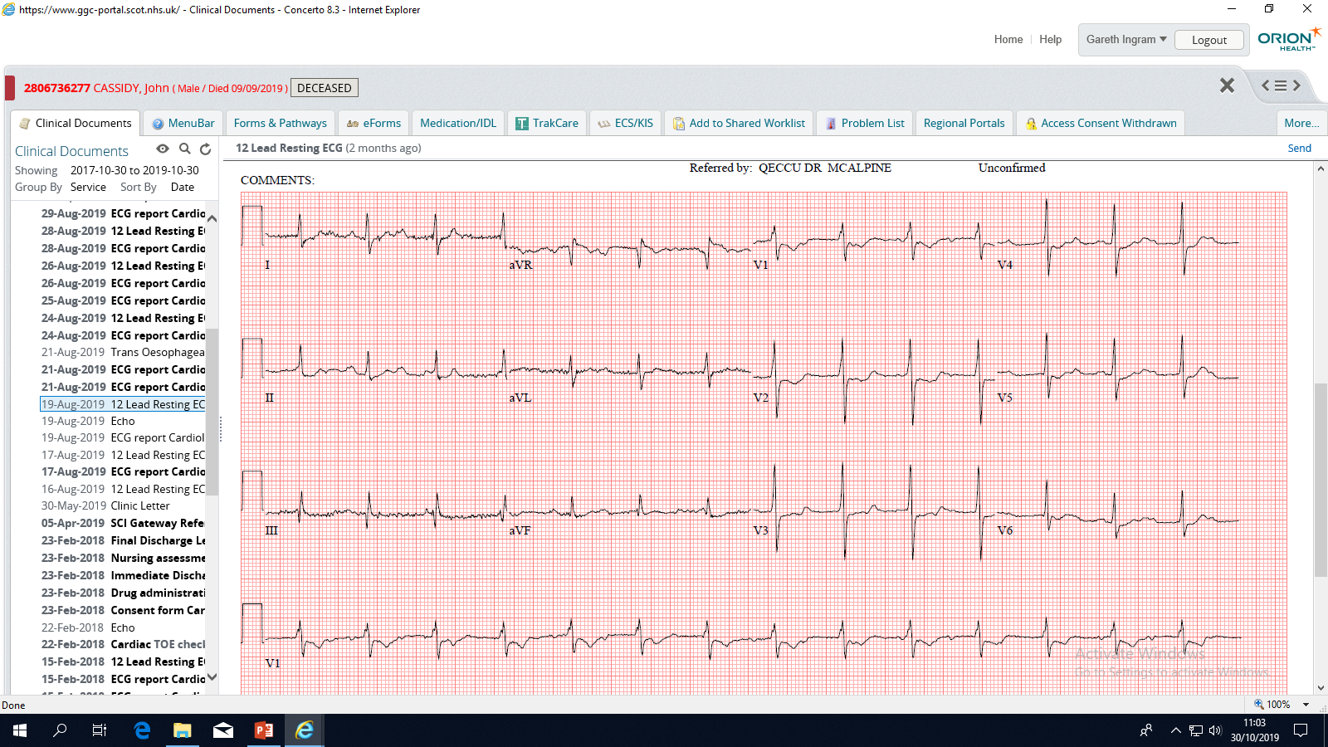
More ECGs!

Slide 24
MDT approach
Cardio
  TOE 7 days post admission aortic abscess cavity
ID/Micro
  Switch back to Fluclox – (six times daily)
  Guideline is rifampicin – interactions with methadone
  Given Rifabutin to reduce opiate metabolism
Pharmacy
GJNH
Dermatology – phone advice re emollients
Addictions re methadone

Slide 25
GJNH
CT Scan – nil focal. ? Splenic infarction
Discussed at valve MDT
Complex
Not suitable for re-do surgery
Not for escalation of care
Supportive care only
IV abx ceiling of care and family updates
Palliative Care

Slide 26
Culture Results
15th August
  Fully sensitive staph aureus – pre abx
No other positive urine/blood cultures
Ongoing ID support, consistently pyrexial and CRP >150 throughout

Slide 27
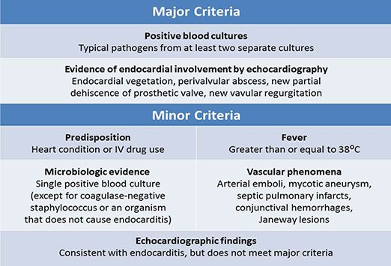
2 Major Criteria
1 Major + 3 Minor
5 Minor
Positive findings from surgery or autopsy

Slide 28
Interesting points
Patient cohort – frequently present, systemic diseases
Complex PMH – previous endocarditis AND Nec Fasc
MDT approach
? Early cardio input
Echo on ground floor
Blood cultures!

Slide 29
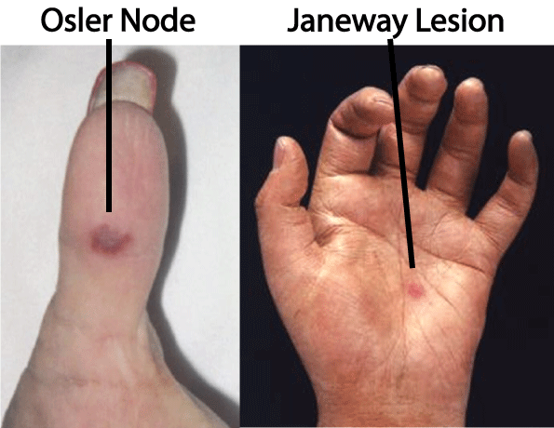
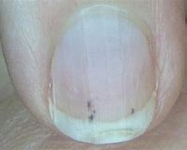
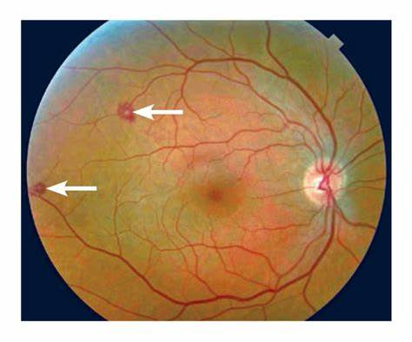
Splinter Haemorrhages
Roth Spots

Slide 30
Organisms
Viridans Group Streptococci
Staph Aureus
HACEK (late culture)
Streptococcus bovis – link with bowel Ca

Slide 31
Get in touch!
Website
www.quackmeded.co.uk
Email
ggc.quackmeded@nhs.scot
Social Media
Twitter: @QUACK_ Med
Facebook: QUACK education

