Slide 1
CVA Basics
Gemma McGrory
Acute Medicine Registrar

Slide 2
Disclaimer*
Please note that QUACK is a regional teaching programme operating across GG&C, Lanarkshire and Ayrshire & Arran.
This presentation outlines general management, though local variances e.g. antibiotic prescription may vary slightly depending on your local trust
Remember to check your local guidelines

Slide 3
Learning Outcomes
Types of stroke and definitions
Management of acute stroke
Thrombolysis
CT findings

Slide 4
Stroke – Oxford Classification
TACS
PACS
POCS
LACS

Slide 5
TACS
Highest total mortality (60% by one year) Very poor chance of making recovery to independent living (<5%)
Three features- all three are present:
  1) Contralateral hemiparesis (usually severe or “dense)
  2) Contralateral homonymous hemianopia
  3) Higher cortical dysfunction (dysphasia or dyspraxia or inattention)

Slide 6
PACS
Two out of the three features of TACS usually
  1) Higher cortical dysfunction plus
  2) Contralateral weakness or sensory loss
Deficit is often incomplete e.g. monoparesis
Significant risk of early recurrence

Slide 7
POCS
Higher risk of late recurrence than other strokes (20% within a year)
Any of the three main possibilities:
  1) Contralateral homonymnous hemianopia OR
  2) Cerebellar signs OR
  3) Brainstem signs (e.g. Horner’s / conjugate gaze palsy / ipsilateral cranial nerve lesion with contralateral hemiparesis)

Slide 8
LACS
Four features are absent:
  No higher cortical dysfunction as cortex not affected
  No homonymous hemianopia as lesion away from optic radiation
  No drowsiness
  No brainstem signs
Several lacunar syndromes:
  1) Pure motor stroke (posterior limb of internal capsule)
  2) Pure sensory stroke (posterior thalamus)
  3) Sensorimotor stroke (internal capsule)
  4) Dysarthria-clumsy hand syndrome (middle of internal capsule)
  5) Contralateral hemiballismus (rare- subthalamic nucleus infarct)

Slide 9
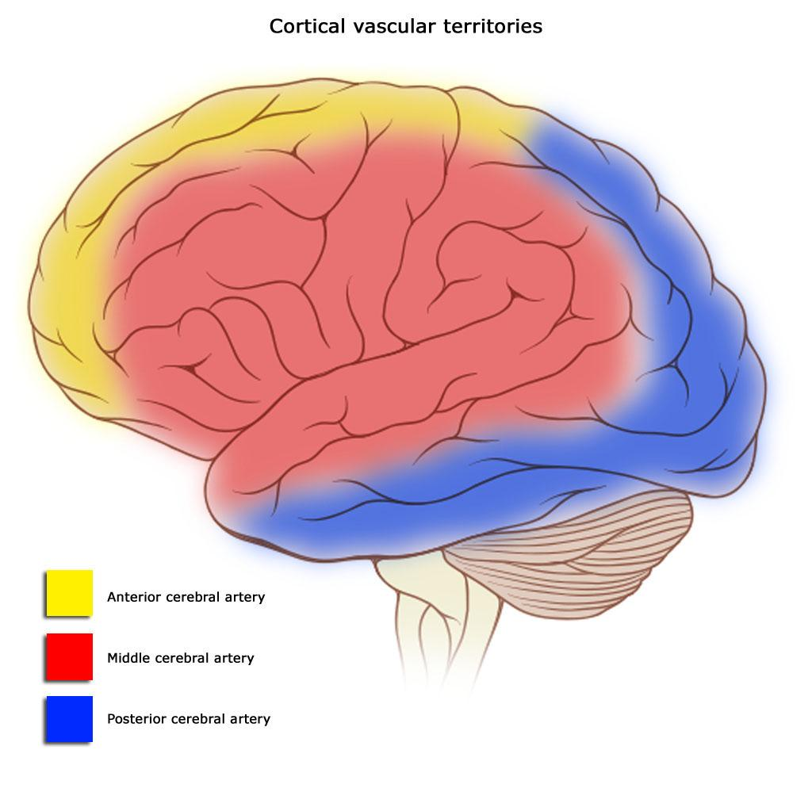
Cerebral Circulation
https://en.wikipedia.org/wiki/Cerebral_circulation

Slide 10
Different affected arteries result in different types of CVA
The anterior cerebral circulation is the blood supply to the anterior portion of the brain including the eyes. It is supplied by the following arteries:
Internal carotid arteries: These large arteries are the medial branches of the common carotid arteries which enter the skull, as opposed to the external carotid branches which supply the facial tissues; the internal carotid artery branches into the anterior cerebral artery and continues to form the middle cerebral artery.
Posterior cerebral circulation
The anterior and posterior circulations meet at the Circle of Willis, which rests at the top of the brainstem
The posterior cerebral circulation is the blood supply to the posterior portion of the brain, including the occipital lobes, cerebellum and brainstem. It is supplied by the following arteries:
Vertebral arteries: These smaller arteries branch from the subclavian arteries which primarily supply the shoulders, lateral chest and arms. Within the cranium the two vertebral arteries fuse into the basilar artery.
Posterior inferior cerebellar artery (PICA)
Basilar artery: Supplies the midbrain, cerebellum, and usually branches into the posterior cerebral artery
Posterior cerebral artery (PCA)
Posterior communicating artery
https://en.wikipedia.org/wiki/Cerebral_circulation

Slide 11
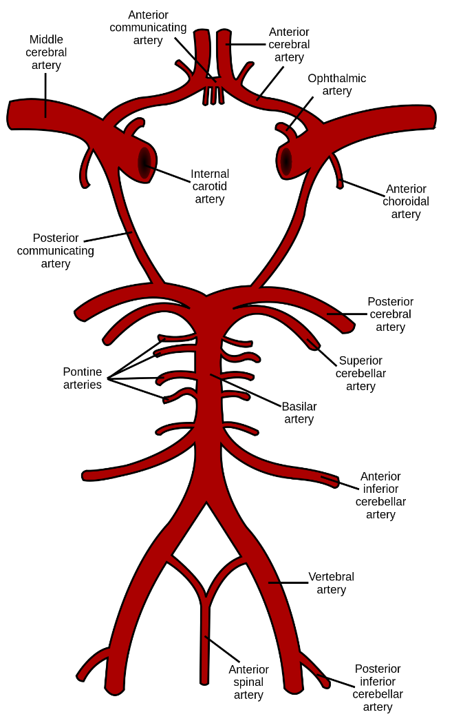
Circle of Willis
https://en.wikipedia.org/wiki/Cerebral_circulation

Slide 12
Management of acute stroke

Slide 13
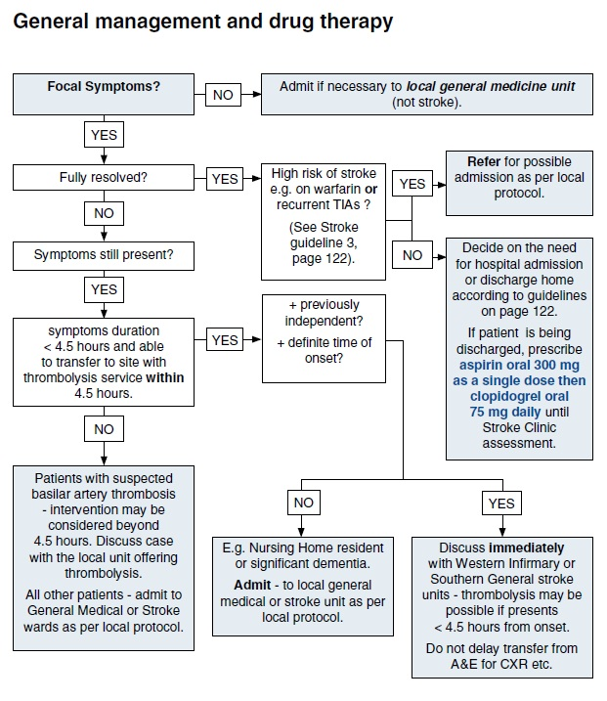

Slide 14
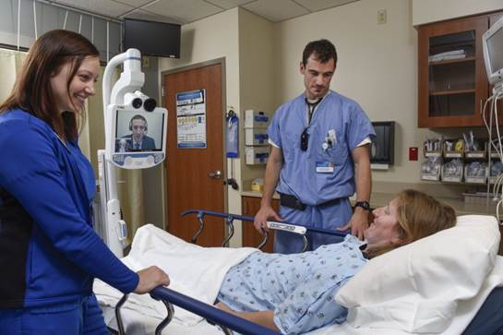
Thrombolysis
ROSIER / NIHSS scores
No contraindications
Within 4.5 hours of onset of symptoms
Alteplase bolus then infusion
*Always under advice of stroke team*
Often via telemedicine in DGHs

Slide 15
Contraindications
Absolute Contraindications to Thrombolysis
Any previous history of hemorrhagic stroke
History of stroke, dementia, or central nervous system damage within 1 year
Head trauma or brain surgery within 6 months
Known intracranial neoplasm
Suspected aortic dissection
Internal bleeding within 6 weeks
Active bleeding or known bleeding disorder
Major surgery, trauma, or bleeding within 3 weeks
Traumatic cardiopulmonary resuscitation within 3 weeks
Relative Contraindications to Thrombolysis[
Oral anticoagulant therapy
Acute pancreatitis
Pregnancy or within 1 week postpartum
Active peptic ulceration
Transient ischemic attack within 6 months
Dementia
Infective endocarditis
Active cavitating pulmonary tuberculosis
Advanced liver disease
Intracardiac thrombi
Uncontrolled hypertension (systolic blood pressure >180 mm Hg, diastolic blood pressure >110 mm Hg)
Puncture of noncompressible blood vessel within 2 weeks
Previous streptokinase therapy

Slide 16
Investigations
What investigations do we need to do in the first 24 hours post CVA and why?

Slide 17
The First 24 hours
ECG +- 24 hour tape
Bloods inc cholesterol and glucose
Swallow assessment
Monitor BP
CT brain
  If no haemorrhage, aspirin 300mg
Admission to Stroke Unit

Slide 18
Basic Management of Confirmed CVA
Aspirin 300mg od for 14 days
Then Clopidogrel 75mg od
Risk reduction for future events
  Statin, ACE-I, manage hypertension, smoking cessation, etc.
PT / OT / Rehabilitation

Slide 19
Emergency CT
When and why would you do an emergency CT?

Slide 20
Emergency CT...
Deteriorating consciousness level or coma.
On anticoagulants
Brain stem symptoms plus bilateral limb signs or progression of signs or ‘locked in’
Cerebellar stroke with headache or features of raised ICP
Severe headache
‘Stuttering’ onset
Immunocompromised patients
Clinical signs of raised intracranial pressure

Slide 21
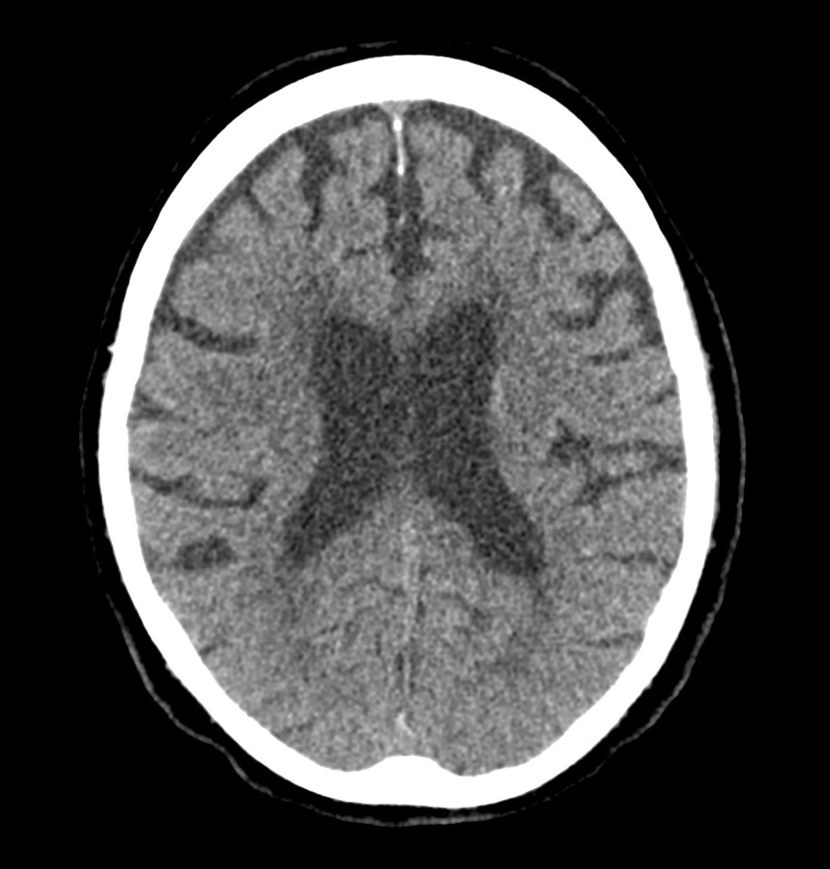
CT normal

Slide 22
CT normal
Normal CT

Slide 23
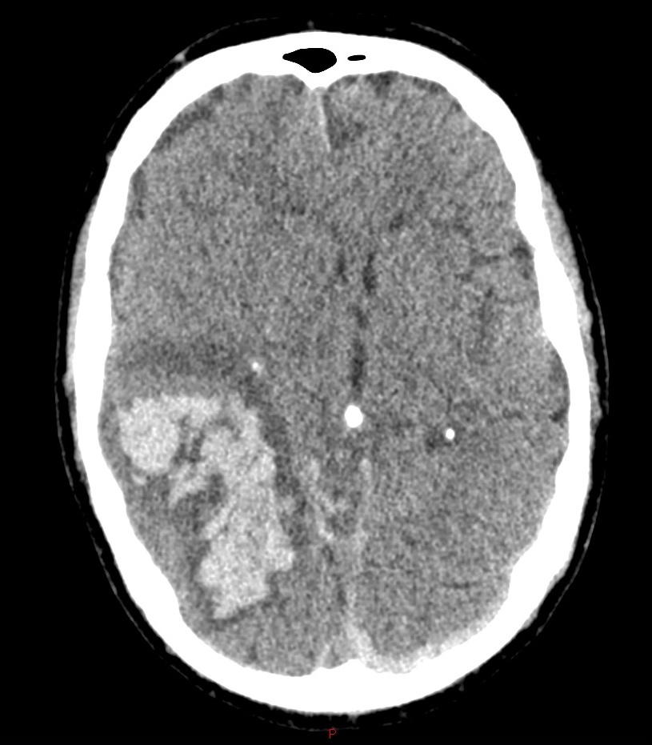
Intracerebral
Haemorrhage

Slide 24
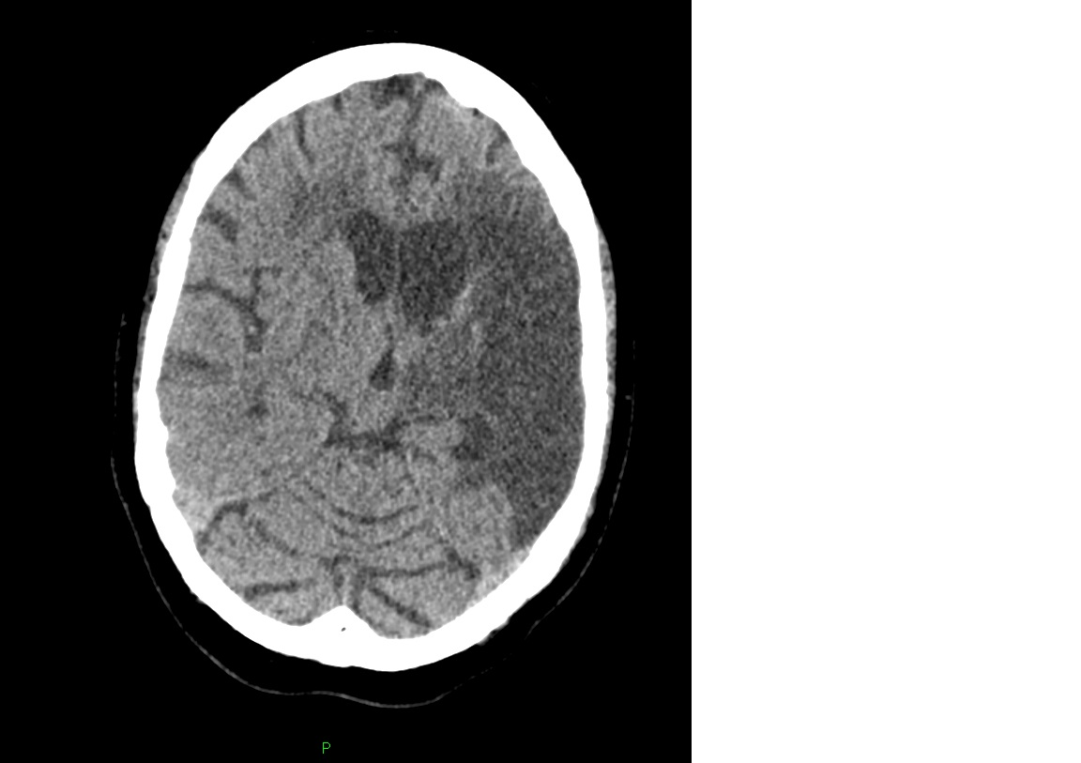
CT established CVA
Established
infarct

Slide 25
Question?
How do you tell the difference between a facial nerve palsy (LMN lesion) and a stroke (UMN lesion)?

Slide 26
Bell’s Palsy vs CVA
The nerve fibres that control the lower face travel from the cortex down to the brainstem where they cross over to the contralateral facial nerve
The nerve fibres that control the upper face take a slightly different path. After travelling down to the brainstem, half cross over to the contralateral facial nerve, and half remain on the same side and contribute to the ipsilateral facial nerve
Therefore, the forehead receive innervation from both hemispheres, while the lower face only receives innervation from the contralateral hemisphere
That’s why you get forehead sparing with a CVA...

Slide 27
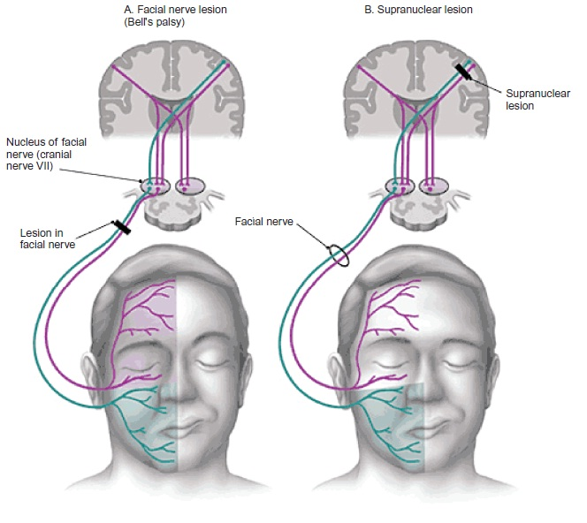

Slide 28
Get in touch!
Website
www.quackmeded.co.uk
Email
ggc.quackmeded@nhs.scot
Social Media
Twitter: @QUACK_ Med
Facebook: QUACK education

