Slide 1
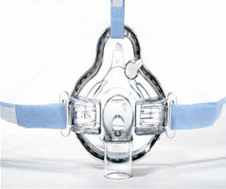
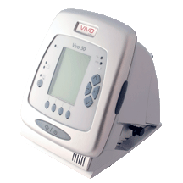
NON-INVASIVE VENTILATION (NIV)
Dr Manish Patel
Consultant Respiratory Physician
University Hospital Wishaw

Slide 2
Disclaimer*
Please note that QUACK is a regional teaching programme operating across GG&C, Lanarkshire and Ayrshire & Arran.
This presentation outlines general management, though local variances e.g. antibiotic prescription may vary slightly depending on your local trust
Remember to check your local guidelines

Slide 3
Learning Outcomes
Principles of non invasive ventilation
Definition of Respiratory Failure
Review of BIPAP therapy
NIV Protocol

Slide 4
WHAT IS NIV?
“The application of positive airway pressure to the upper respiratory tract for the purpose of augmenting alveolar ventilation”(BTS, 2002)
First used for treatment of hypoventilation at night in patients with neuromuscular disease
Many trials have shown NIV as a valuable treatment for acute hypercapnic respiratory failure (type II respiratory failure)
NIV (BIPAP) not to be confused with CPAP

Slide 5
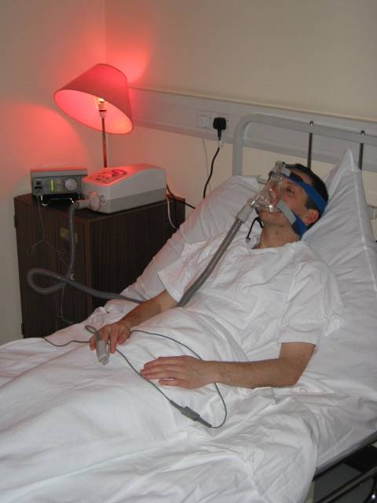
Principles of Non Invasive Ventilation
Provision of ventilatory support through the patients upper airway
Achieved via special face mask connected to a ventilator
No use of tracheal tube, laryngeal mask or tracheostomy

Slide 6
Respiratory Failure Defined
“Failure to maintain adequate gas exchange”
■ Type I failure
PaO₂ <8 kPa with normal or low PaCO₂
Lung Failure (gas exchange) manifested by hypoxaemia
■ Type II failure
PaO₂ <8 kPa and PaCO₂ >6 kPa
Pump failure (ventilatory) manifested by Hypercapnoea
Respiratory failure can be acute, acute-on-chronic or chronic

Slide 7
MODES OF VENTILATION
-CPAP
-NIV (Bi-level, Bipap)

Slide 8
What is CPAP?
■ Continuous PEEP/EPAP - pressure
■ Positive at one level delivered
■ Airway continuously through
■ Pressure the breathing cycle

Slide 9
CPAP continuous positive airway pressure
What is it?
Pressure
Inspiration
Expiration
10cmH₂O
Time

Slide 10
CPAP-WHAT DOES IT DO?
Provides continuous flow of gas throughout the whole respiratory cycle
Splints the airways open
Increases functional residual capacity (FRC)
Reduces work of breathing
Improves oxygenation
Increases intrathoracic pressure (monitor BP)
Reverse or prevent atelectasis (collapse of part or all of a lung)

Slide 11
CPAP - INDICATIONS
■ Acute hypoxaemic respiratory failure
■ Pulmonary oedema
■ Weaning from mechanical ventilation
■ Decrease incidence of post operative pulmonary complications
■ Obstructive sleep apnoea
- (not for acute use – patients use CPAP every night whilst asleep to prevent upper airway collapse and sleep disturbance)

Slide 12
Benefits of CPAP
Increases functional residual capacity – increases the volume of gas remaining in lungs at end-expiration
Distends alveoli preventing collapse on expiration
Greater surface area improves gas exchange
Increases oxygen uptake into the blood
Reduces work of breathing

Slide 13
Contraindications
■ Untreated Pneumothorax
■ Uncontrolled Vomiting
■ Unstable facial fractures
■ Burns
■ Inability to protect upper airway

Slide 14
Possible Complications
■ Gastric Distension
■ Aspiration
■ Hypoventilation
■ Facial sores/abrasions
■ CO₂ retention

Slide 15
What is BiPAP?
■ Bi level Two levels of pressure
■ Positive IPAP – Inspiratory Positive
■ Airway Airway Pressure
■ Pressure EPAP – Expiratory Positive
Airway Pressure

Slide 16
NIV/BiPAP non-invasive ventilation/bilevel positive airway pressure
What is it?
Pressure
Inspiration
Expiration
12cmH₂O
4cmH₂O
Time

Slide 17
BIPAP – WHAT DOES IT DO?
Two levels of respiratory support:
IPAP during inspiration
*supports/augments inspiratory effort, reducing work of breathing
*Increases tidal volume
*Improves CO₂ removal
*Recruits under ventilated lung space caused by hypoventilation

Slide 18
BIPAP Cont.
EPAP during expiration
*Helps to splint open the airways
*Helps to overcome intrinsic PEEP (PEEPi)
- Intrinsic PEEP (positive end expiratory pressure) is the concept that in patients with severe COPD, the lung does not fully empty due to the obstruction in the airway resulting in a positive pressure in the airways at end expiration. Therefore to breathe in, the patient must first overcome this positive airway pressure before he/she can generate a negative pressure to inhale more air.

Slide 19
NIV/BiPAP non-invasive ventilation/bilevel positive airway pressure
What is it?
Pressure
Inspiration
Expiration
12cmH₂O
4cmH₂O
Time

Slide 20
Intrinsic PEEP in COPD
What is it?
Pressure
COPD
10cmH₂O
Set EPAP
0 cmH₂O

Slide 21
EPAP during expiration cont.
*Increases FRC (functional residual capacity)
*Improves alveolar gas exchange
*Improves oxygenation
*Reduces respiratory muscle effort
*Assists in eliminating exhaled gas through the exhaust port

Slide 22
Modes Available On BiPAP Machines
PSV mode (Pressure Support Ventilation) or Spontaneous / Timed (S/T) – the device will augment any breath initiated by the patient, but will also deliver additional breaths in the event of apnoea or should the respiratory rate fall below the clinician set “backup” breath rate.
PCV mode (Pressure Control Ventilation) The ventilation is controlled by the ventilator. This is done by the pressure, rate, inspiration time and rise time settings.
CPAP mode (Continuous Positive Airway Pressure) The device will deliver a continuous positive airway pressure during operation.

Slide 23
ADVANTAGES OF NIV
Avoidance of complications associated with invasive ventilation
ICU facilities may not be required
Reduced hospital stay
Allows breaks for eating & drinking
Ease of application/removal
Easier weaning
Offers hope for the “not for intubation” patient

Slide 24
NIV for COPD in the real world – on the medical wards
13 centres (n=236) in acute exacerbation of COPD where:
Respiratory rate > 23
PaCO₂ > 6
pH between 7.25 and 7.35 ONCE ARRIVED ON WARD
Randomised to conventional therapy or NIV
Standardised mask use and pressure settings for NIV
All therapy applied by normal ward staff
(Plant (2000), The Lancet)

Slide 25
NIV for COPD in the real world
Plant Lancet 2000
Primary Outcome Measure:
  “Need for intubation”
Need for Intubation defined as
    pH<7.2
    pH 7.2-7.25 on 2 occasions 1 hour apart
    GCS<8 and PaCO₂>8
    PaO₂<6 despite maximum F_{I}O₂
    cardiorespiratory arrest

Slide 26
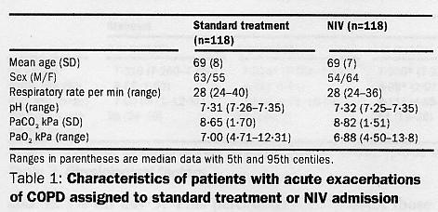
NIV for COPD in the real world

Slide 27
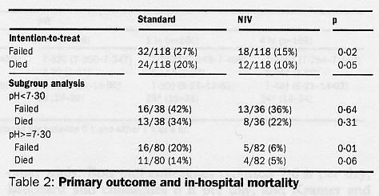
NIV for COPD in the real world

Slide 28
Benefits of NIV in Acute COPD
Mortality:
  NIV group 20%; Conventional group 10%
Decrease in rate of intubation by 30-60%
Poorer outcome in those with initial pH<7.30
Perhaps general ward not appropriate for sickest patients

Slide 29
NIV for COPD in the real world
NIV use
  Day 1 8 hours
  Day 2 7 hours
  Day 3 5 hours
Nursing workload
  26 minute increase in nursing workload in first 8 hours after admission
  No difference after 8 hours
Training
  7.6 hours in first 3 months; 0.9 hours/month thereafter

Slide 30
Benefits of NIV in Acute COPD
Extrapolating from study:
  Number of patients treated with NIV to prevent one death = 15
  Number of patients treated with NIV to prevent one intubation = 8

Slide 31
Success Predictors
Younger Age
Lower acuity of illness
Patient able to co-operate
Moderate hypercapnia, PCO₂ >6KPa but <12KPa
Improvement in gas exchange/heart rate/ respiratory rate within first 2 hours

Slide 32
The Patient
Must be conscious and breathing spontaneously
Must have an adequate cough and gag reflex

Slide 33
Early Principles
Patient should remain on NIV for as long as possible over the first 24 hours
Patient requires careful monitoring and regular ABG’s
Where necessary, can be discontinued briefly for meals, physio, nebulisers
As patient stabilises, may only be necessary to use NIV overnight

Slide 34
Protocol Step 1
Selecting The Appropriate Patient
STEP 1.
History
Examination
CXR
ABG
IS THE PATIENT A CANDIDATE FOR NIV?
Does the patient have a diagnosis of COPD
Does the patient have an acidotic exacerbation of COPD
If no to above then refer to senior medical staff

Slide 35
Protocol Step 1
Selecting The Appropriate Patient
Physiological criteria:
  Decompensated (pH <7.35 (H⁺>45))
  Type 2 resp failure (pCO₂ > 6)
* On maximum medical therapy (and has been on max med therapy for 1 hour), (nebulised Salbutamol prn, prednisolone, antibiotics if appropriate, controlled FiO₂ and reversal of respiratory depressants)

Slide 36
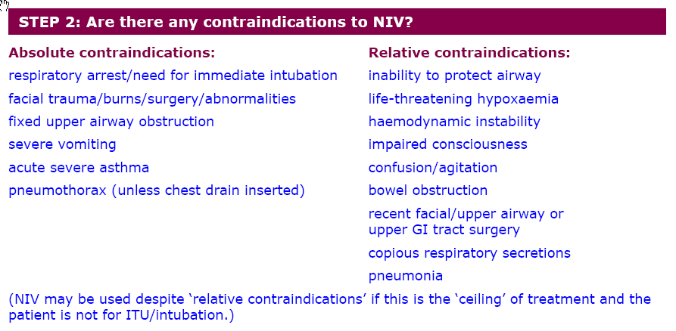
STEP 2 - CONTRAINDICATIONS

Slide 37
STEP 3 – INVOLVING ICU
STEP 3: Should the patient be considered for ICU/intubation?
YES NO
∕ \ ↓
Immediate referral Trial of NIV Trial of NIV
↓ ↓ or consider
Can commence NIV Refer to respiratory palliation
In interim prior to Consultant i.e. end stage
review ↓ disease
Respiratory Consultant to
liaise with ICU Consultant

Slide 38
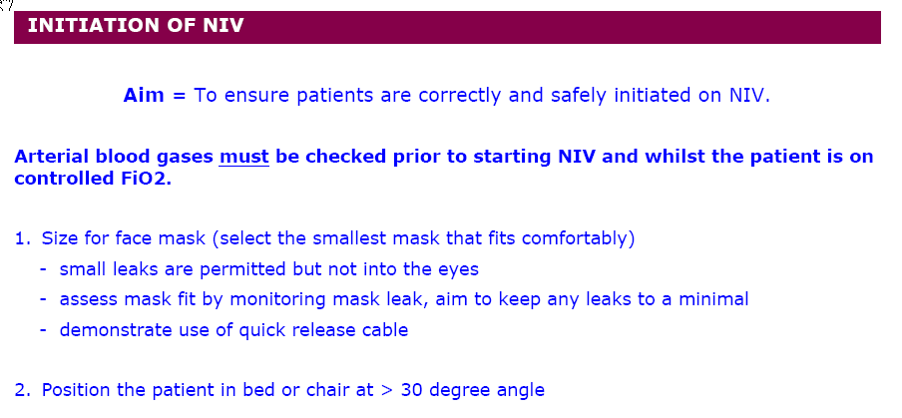
STEP 4 – INITIATION OF NIV

Slide 39
STEP 4 Cont.
3. Set ventilator settings:
- IPAP = 10cmH₂O
- EPAP = 4cmH₂O
- RATE = 12 bpm (becomes active should patient stop breathing or have periods of apnoea)
- EXPIRATORY TRIGGER = 1
- INSPIRATORY TRIGGER = 1
- RISE TIME = 5
- OXYGEN = if supplementary oxygen required, set at 4ltr/min and titrate as necessary to maintain SpO₂ 88-92%
4. Increase IPAP in increments of 2cmH₂O to the maximum that the patient will tolerate

Slide 40
STEP 5 – MONITORING THE PATIENT ON NIV
Record observations on NIV Obs Chart every 15mins for the first hour, evaluate thereafter.
Spo₂ – Continuous monitoring with pulse oximeter
ABG’s – 1 hour post commencement of NIV, thereafter evaluate as per patients condition. (if ABG’s worsening after 4-6 hours then this is a poor prognostic factor for NIV)
Respiratory Rate
Heart Rate
Evaluate accessory muscle use
Mental State
Chest wall movement (to ensure adequate ventilation)
Synchrony with ventilator and air leaks

Slide 41
STEP 6 – TREATMENT FAILURE
Indication of failure include:
■ No improvement in acidosis
■ No improvement in CO₂
■ No reduction in respiratory rate
■ Patient not tolerating
■ Patients refusal
If ceiling of treatment and NIV fails refer to local palliative care guidelines. Ensure documentation of patient and family views

Slide 42
Step 7 – Weaning Criteria
Is the Patient ready to wean?
  Clinically stable for > 6 hours
  Respiratory Rate <24 bpm
  Heart Rate <110 bpm
  H⁺ <45
  SpO₂ 88% or above on <4 litres O₂ whilst on NIV
  If ‘no’ to the above:
  Continuous NIV (monitor as before)
  If ‘yes’ to the above:
  Allow breaks
  Consider nocturnal ventilation only
  Controlled O₂ therapy
  If worsening respiratory distress, reassess patient, review therapy and consider recommencing NIV

Slide 43
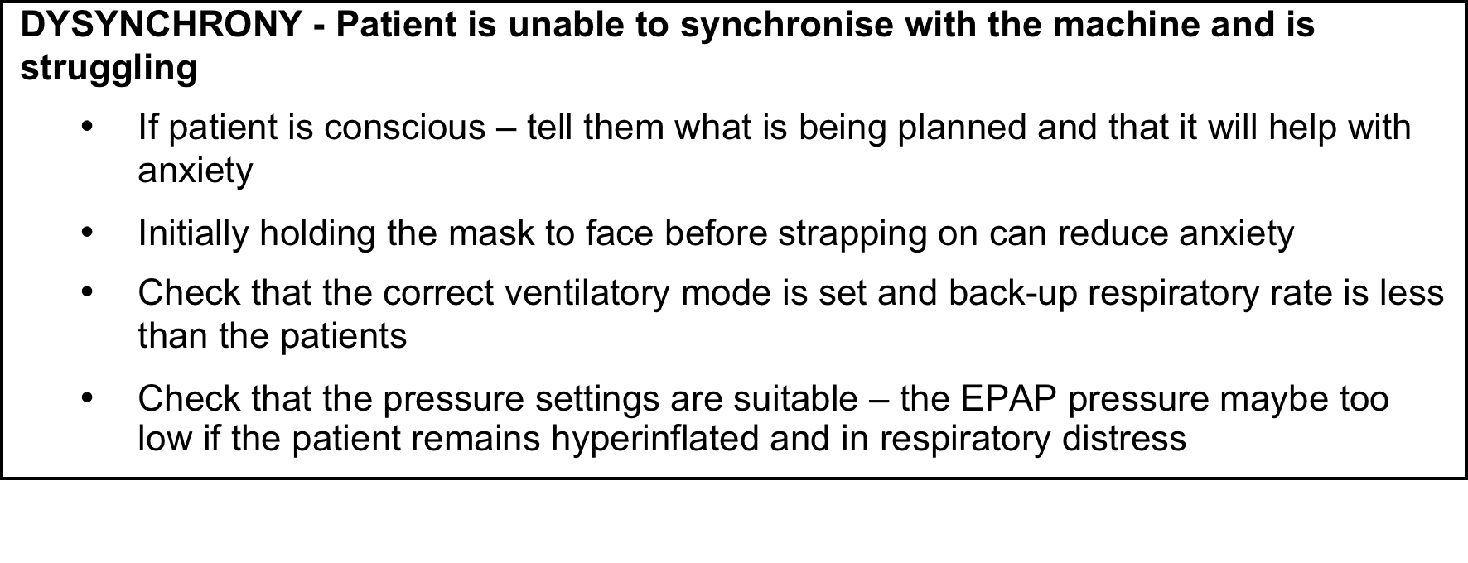
Common Problems:
Dysynchrony

Slide 44
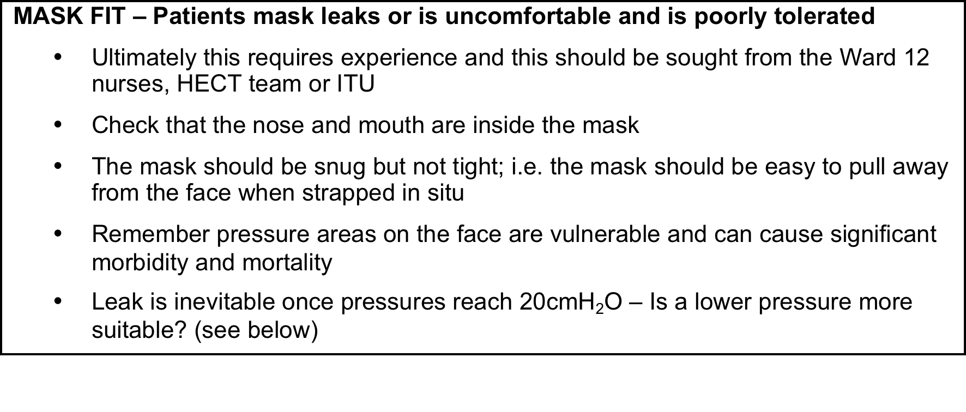
Common Problems:
Mask Fit

Slide 45
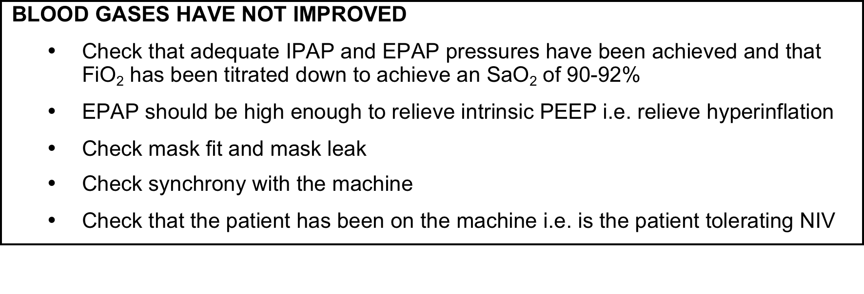
Common Problems –
ABGs not improved

Slide 46
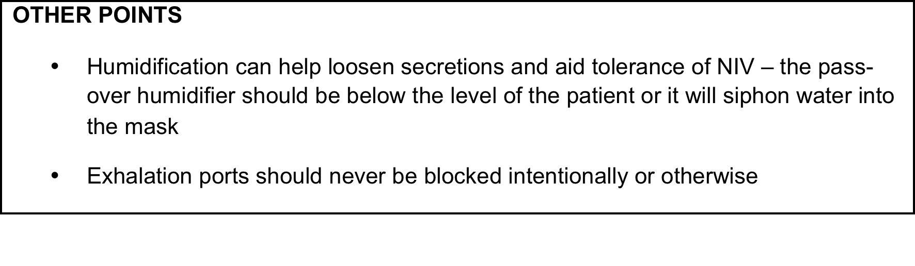
Other Common Problems

Slide 47
Thank you
Please fill out the online survey to obtain a certificate

Slide 48
Get in touch!
Website
www.quackmeded.co.uk
Email
ggc.quackmeded@nhs.scot
Social Media
Twitter: @QUACK_ Med
Facebook: QUACK education

